Slide 1
Firearm Injury Death and Morbidity in North Carolina, 2022
Division of Public Health
Injury and Violence Prevention Branch

Slide 2
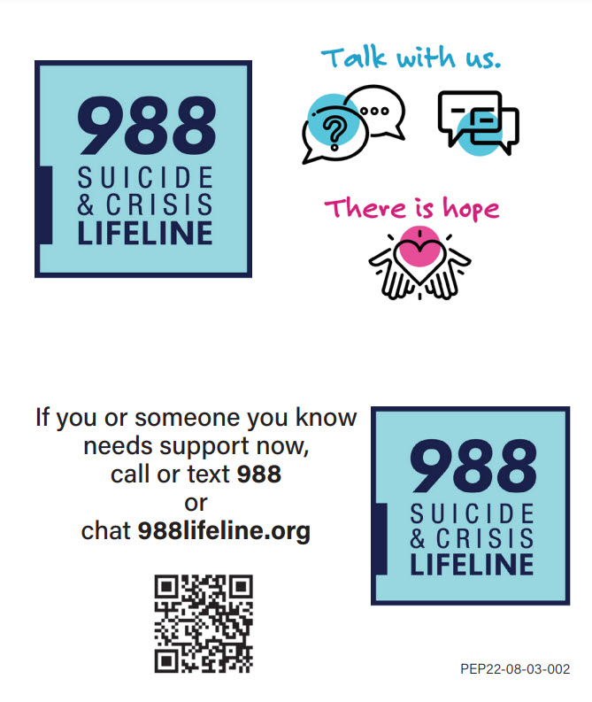
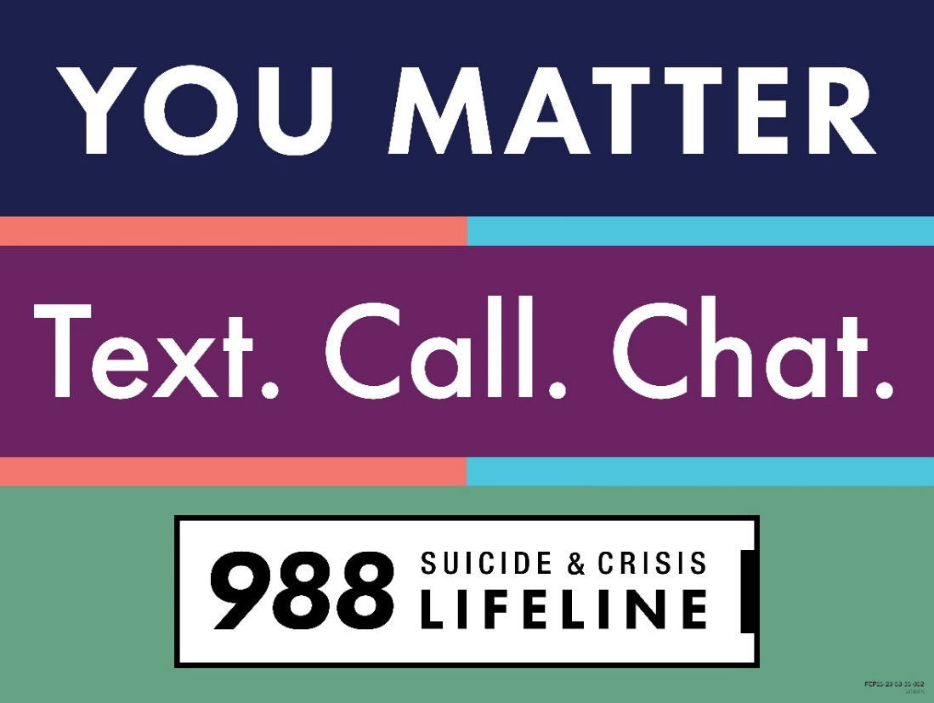
If you or someone you know needs support now, call or text 988 or chat 988lifeline.org
2

Slide 3
Firearm Injury Death and Morbidity Technical Notes
The fatality data provided here are part of the Vital Registry System of the State Center for Health Statistics (SCHS) and have been used to historically track and monitor the firearm injury burden in NC using ICD-10 codes. The definitive data on deaths come from the NC Office of the Chief Medical Examiner (OCME).
2022 NC SCHS data are final as of December 2023.
There was a transition in Hospital and Emergency Department coding structure in October 2015. Due to the transition, there are different definitions for injury. Data after October 2015 are not comparable to data from before the transition.
ICD-10 firearm injury codes listed as cause of death: W32-W34, X72-X74, X93-X95, Y22-Y24, Y35.0, U01.4
ICD-10-CM firearm injury codes: See the CDC Firearm Injury V2 for a comprehensive list of codes.
Firearm suicide data is limited to NC residents ages 10 and older.
Notes:
For more detailed technical notes on any of the data shared in this slide set, please contact us at InjuryData@dhhs.nc.gov.

Slide 4
Overview
Firearm-related Death
Firearm-related Injury
Resources
Firearm-related Deaths and Injury data are available at https://injuryfreenc.dph.ncdhhs.gov/safestorage/index.htm
For custom data requests see https://injuryfreenc.dph.ncdhhs.gov/DataSurveillance/DataRequestPolicy.htm
Notes:
This presentation is not intended to cover all data related to firearm-related injury and death. Rather it gives an overview of some of the key trends in North Carolina. It includes information on statewide firearm-related deaths, firearm injury hospitalizations and emergency department visits, and resources. Please note that when the COVID-19 pandemic began in 2020, there were many implications, including major changes to the numbers and rates within the firearm-related injury data in this slide deck. The Injury and Violence Prevention Branch is still assessing how each aspect of the data were impacted.
If this slide deck does not contain the information you need, please see our custom data request policy and contact us at InjuryData@dhhs.nc.gov.

Slide 5
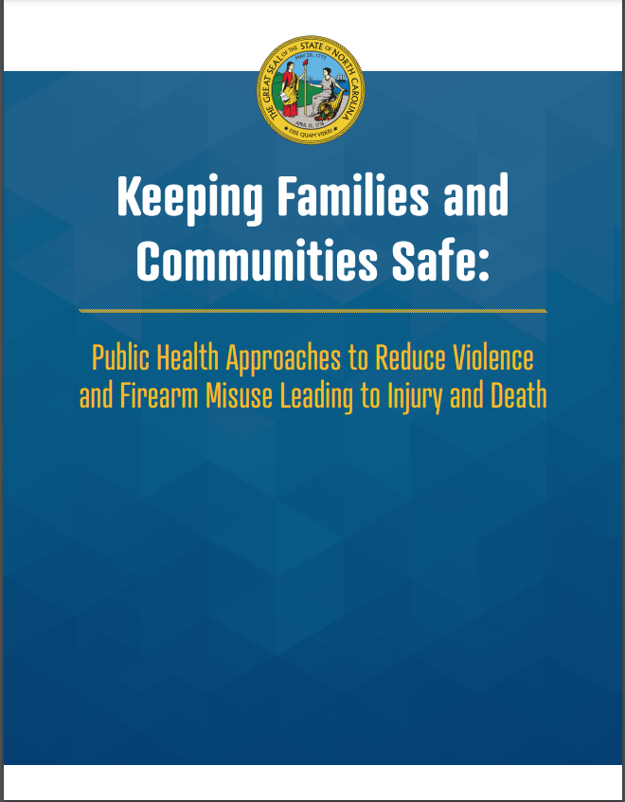
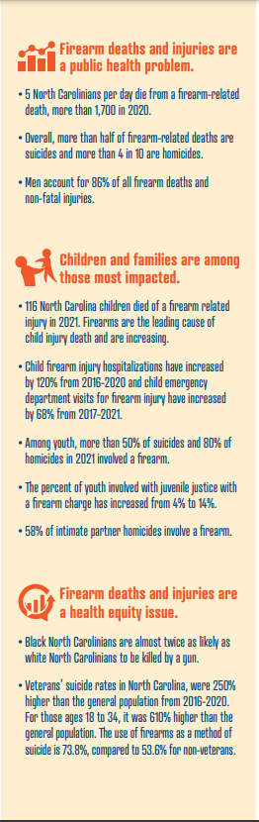
November 2022
NCDHHS white paper describing strategies to reduce firearm violence and misuse, addresses:
    Self-Injury & Suicide
    Intentional interpersonal injury & Homicide
    Unintentional Injury & Death
https://www.ncdhhs.gov/media/18351/open
Notes:
In November 2022, Governor Roy Cooper and the North Carolina Department of Health and Human Services (NCDHHS) convened a roundtable of health, education and law enforcement professionals to discuss promising efforts already underway related to reducing violence and firearm misuse in North Carolina. The result of that convening is this report which addresses public health strategies to increase community and family safety from firearm violence and misuse in a new plan focused on implementing public health actions to reduce firearm injury and death.
It can be found at: https://injuryfreenc.dph.ncdhhs.gov/safestorage/docs/DHHS_Firearm_whitepaper_web.pdf.

Slide 6

4
Notes:
The firearm-related death data presented in these slides comes from the North Carolina Violent Death Reporting System (NC-VDRS). The NC-VDRS is a public health, population-based surveillance system that contains detailed information on deaths that result from violence.

Slide 7
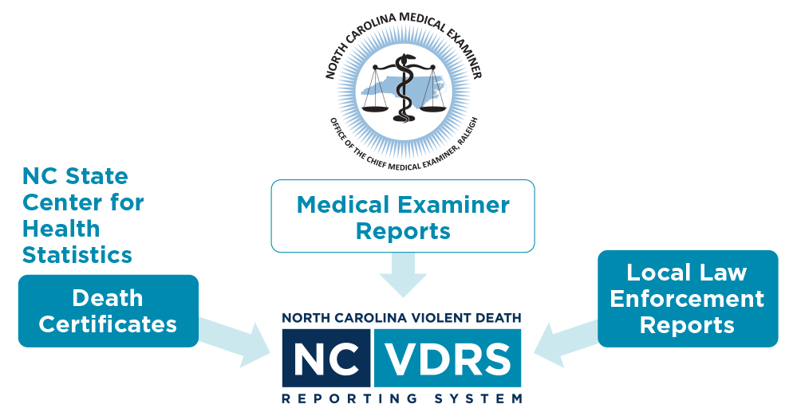
NC-VDRS
North Carolina-Violent Death Reporting System
CDC-funded statewide surveillance system collecting data on deaths resulting from violence such as homicide, suicide, legal intervention
Funded in 2003
  Data collection began in 2004
  ~35,000 incidents reported to date
Multi-sourced incident-based system
5
Notes:
The NC-VDRS provides timely information on the victims, suspects, relationships, circumstances, and weapons that are associated with every violent incident that results in a fatality in North Carolina. It is an incident-based, relational database that combines information from multiple sources, such as death certificates, medical examiner reports, and incident reports from law enforcement agencies on violent deaths to not only understand the “who, when, where, and how” but also “why” these deaths occurred. The NC-VDRS began collecting data in January 2004.

Slide 8

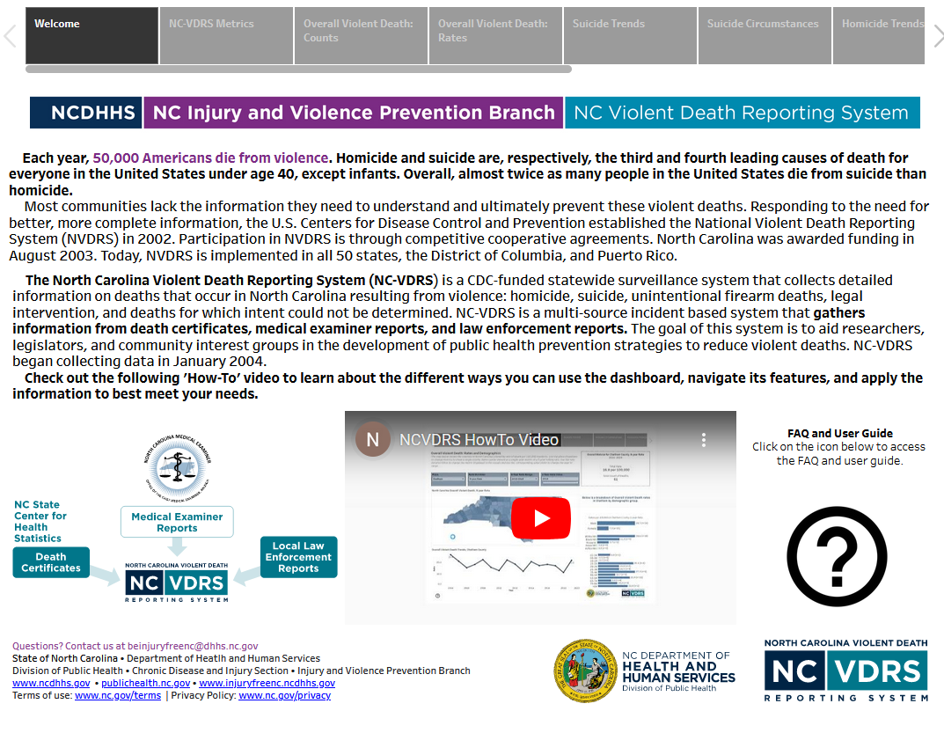
QR code- use your phone
Access more data on the NC-VDRS dashboard
6
Notes:
Additional data for North Carolina violent deaths can be found by accessing the NC-VDRS data dashboard on the Violent Death Data page on our branch website, Injuryfreenc.dph.dhhs.gov. The data dashboard has a firearm deaths tab specific to firearm-related violent deaths.

Slide 9
Firearms are the most common weapon used in violent deaths in NC
64% of violent deaths in the last 10 years (2013-2022) were firearm-related.
7
Notes:
Over the last 10 years (2013-2022), 64.2% of all violent deaths in the state of North Carolina involved a firearm. Firearm lethality far exceeds that of other weapons and methods of self harm and injury.

Slide 10
5 people a day die from firearm injury in NC
The number of firearm deaths in North Carolina has increased by 48% over the last 10 years, with a 29% increase from the start of the pandemic (2019).
8
Notes:
In 2022, an average of five North Carolinians died each day from firearm-related injury.
Firearm deaths continue to rise in the state of North Carolina. In 2022, 1,782 North Carolinians died from firearm injury, a 48% increase over the past 10 years (2013-2022). A small decrease was observed before the start of the pandemic, with a 29% increase from 2019.

Slide 11
Firearms were used in 78% of homicides and 59% of suicides among NC residents
Total Violent Deaths = 22,354
Total Firearm Deaths = 14,352
9
Notes:
s
11
Over the last 10 years (2013-2022), the majority of violent deaths were firearm related (64.2%). Breaking down by manner of death, firearms were used in 78% of homicides and 59% of suicides among NC residents.

Slide 12
Most firearm deaths in NC are suicides (58%) followed by homicides (39%)
Firearm suicides have increased by 26% over the past 10 years (2013-2022).
Homicides have increased by 96% since 2013 and by 37% since the start of the pandemic.
10
Notes:
This graph shows the total count of firearm suicide, firearm homicide and other firearm deaths in North Carolina in the past 10 years (2013-2022).
In 2022, there were 967 firearm suicide deaths among NC residents, a 26% increase from 2013. There were 746 NC firearm homicide deaths in 2022, a decrease from 2021. However, the number of firearm homicide deaths among North Carolinians has increased by 96% over the last 10 years (2013-2022), with a 37% increase from 2019. Other NC firearm deaths remained stable over the last 10 years (2013-2022).

Slide 13
Males, NH American Indian and NH Black residents, and young adults (19-24) experienced the highest rates of firearm death in NC
11
Notes:
The highest rates of firearm deaths occurred amongst male NC residents (24.1 per 100,000), non-Hispanic American Indians (23.0 per 100,000) and non-Hispanic Blacks (21.3 per 100,000) and young adults ages 19-24 (24.1 per 100,000).
These rates are calculated over a 10-year time period (2013-2022).

Slide 14
Firearm homicide rates are highest among NH Black and NH American Indian residents. Firearm suicide rates are highest among NH White residents.
12
Notes:
s
14
This graph looks at firearm homicides and firearm suicides specifically.
The highest rates of firearm homicide occurred amongst male NC residents (9.2 per 100,000), non-Hispanic Black (16.8 per 100,000) and non-Hispanic American Indian NC residents (15.2 per 100,000). Firearm suicide rates were highest among male NC residents (16.0 per 100,000) and non-Hispanic White NC residents (12.1 per 100,000).
These rates are calculated over a 10-year time period (2013-2022).

Slide 15
Firearm homicide rates are highest among 20–24-year-olds
Firearm suicide rates increase with age.
13
Notes:
s
15
This graph shows NC firearm death rates by age over a 10-year time period (2013-2022).
Firearm homicide and firearm suicide follow different patterns with respect to age. Firearm homicide rates are highest among 20-24-year-olds (14.6 per 100,000) whereas firearm suicide rates increase with age. The highest rate of firearm suicide is among NC residents 85 years and older (16.4 per 100,000).
Technical note: CSTE guidance does not include decedents younger than 10 years old which is why data for firearm suicide rates start at ages 10-14.

Slide 16
There were 185 unintentional firearm deaths (1.3%) over the past 10 years
Unintentional firearm deaths increased by 78.6% from 2013-2022 and by 66.7% since the start of the pandemic.
14
Notes:
Unintentional firearm deaths make up 1.3% of all firearm deaths in the state of NC in the last 10 years (2013-2022). The number of unintentional firearm deaths has increased by 78.6% since 2013. A decrease was observed before the start of the pandemic, with an 66.7% overall increase since 2019. Another decrease was observed in 2022.

Slide 17
Most unintentional firearm victims shot themselves
Unintentional firearm deaths were highest among males and among ages 18-24 followed by ages 10-17 and <10.
15
Notes:
This graph shows the context surrounding unintentional firearm deaths and demographic characteristics of the victims. Over half (51.4%) of all unintentional firearm deaths in the past 10 years (2013-2022) were self-inflicted. 80% of these unintentional deaths were among male NC residents and 23.8% were among those 18-24 years of age.

Slide 18
Circumstances of
Firearm Suicide
16

Slide 19
More than 1/4 of firearm suicide victims told someone or disclosed their suicidal intent
More females experienced a current mental health problem than males and females were more likely to have a history of suicidal behavior.
17
Notes:
s
19
More than one-fourth of firearm suicide victims told someone their suicidal intent. More females experienced a current mental health problem, were currently undergoing mental health treatment, or had ever been treated for mental health than males. There was also a higher proportion of females than males that had a history of suicidal thoughts, left a suicide note, or had previously attempted suicide.

Slide 20
Circumstances of
Firearm Homicide
18

Slide 21
Almost half of firearm homicides among females involved intimate partner violence
19
Notes:
s
21
Female homicide deaths were four times more likely to involve intimate partner violence than male homicide deaths. More male homicide deaths were precipitated by an argument or conflict, a crime, drugs or gang involvement than females.

Slide 22
Circumstances of Unintentional Firearm Deaths
20

Slide 23
Circumstances of Unintentional Firearm Deaths in North Carolina, 2013-2022
Limited to NC resident deaths with reported circumstance information (95.1%); 7 males and 2 females were missing circumstance information Source: NC-VDRS, 2013-2022 Analysis by the DPH Injury Epidemiology, Surveillance, and Informatics Unit
21
Notes:
s
23
Most unintentional firearm deaths occurred while victim was playing with the gun (37.5%) or from unintentionally pulling the trigger (33.5%).

Slide 24
Firearm deaths are just the tip of the iceberg
In 2022, there were:
Despite NC’s excellent reporting systems, the
total burden of
firearm-related
outcomes in
the state is
unknown.
1,782
Deaths
1,476
Firearm-Related Hospitalizations
3,792
Firearm-Related ED Visits
Roughly 1 million
Adults store their firearm(s) loaded and unlocked
About 4.4 million
NC adults have a firearm in or around the home
INJURY PYRAMID
Limited to NC residents Source: NC-VDRS, 2022; NC State Center for Health Statistics, Hospital Data (2022); NC DETECT ED Visit Data (2022); NC BRFSS Firearm Safety Module (2021) Analysis by the DPH Injury Epidemiology, Surveillance, and Informatics Unit
22
Notes:
Firearm deaths are just the tip of the iceberg. Firearm-related injury hospitalizations and emergency department visits also contribute to the overall burden of firearm violence on the state of North Carolina. Of the 4.4 million NC adults that have a firearm in or around the home, roughly 1 million report storing their firearms loaded and unlocked.

Slide 25

Firearm Injury Hospitalizations

Slide 26
Firearm injury hospitalizations increased by 38% from 2019 to 2020 and remained high in 2023
23
Notes:
Firearm injury hospitalizations among NC residents increased by 38% between 2019 and 2020. The number of hospitalizations remain high with a 3.1% increase was observed between 2022 and 2023.

Slide 27
Rates of firearm injury hospitalization were highest among males, NH Black residents, and young adults ages 19-24
24
Notes:
The highest rates for firearm injury hospitalizations occurred amongst male NC residents (12.6 per 100,000), NH Black (21.3 per 100,000) and NH American Indian residents (13.1 per 100,000), and young adults ages 19-24 (20.2 per 100,000).
These rates are calculated over a 5-year time period (2018-2022).

Slide 28

Firearm Injury Emergency Department Visits

Slide 29
Firearm injury ED visits increased by 28% from 2019 to 2020 and remained high in 2023
25
Notes:
Firearm injury ED visits among NC residents increased by 28% between 2019 and 2020. The number of ED visits remain high with a 5.7% increase was observed between 2022 and 2023.

Slide 30
Rates of firearm injury ED visits were highest among males, Black residents, and young adults ages 19-24
26
Notes:
The highest rates for firearm ED visits occurred amongst male NC residents (32.1 per 100,000), Black residents (115.6 per 100,000) and young adults ages 19-24 (53.0 per 100,000).
These rates are calculated over a 5-year time period (2019-2023).

Slide 31
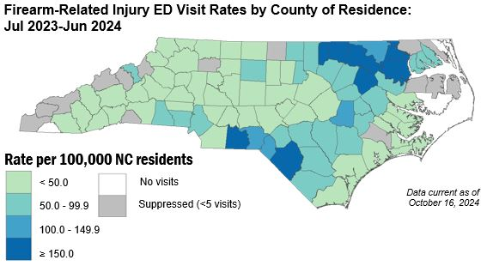
Rates of firearm injury ED visits were highest in Anson, Warren, and Edgecombe counties
Limited to NC Residents
Source: NC DETECT, Emergency Department (ED) Visit Data, 2023-2024; US Census non-bridged population estimates, 2022
Analysis by the DPH Injury Epidemiology, Surveillance and Informatics Unit
Notes:
In 2024, rates of firearm injury ED visits were highest in Anson, Warren, and Edgecombe counties.

Slide 32

NC-FASTER
Firearm Injury Surveillance Through Emergency Rooms
NC is one of 10 states funded for enhanced surveillance of non-fatal firearm injuries
3-year award, started September 1, 2020
STRATEGY 1
Increase the timeliness of ED visits for firearm injuries reporting.
STRATEGY 2
Disseminate surveillance findings to key stakeholders.
Increase availability of rapid, reliable, and geographically-specific surveillance data on ED visits for nonfatal firearm injuries.
Improve firearm injury syndromic surveillance methodology.
27
Notes:
NC-FASTER began in September 2020 as a CDC-funded award for enhanced surveillance of nonfatal firearm injuries through syndromic surveillance on emergency department visits. Data are collected through the North Carolina Disease Event Tracking and Epidemiologic Collection Tool (NC DETECT), the state’s syndromic surveillance system.

Slide 33
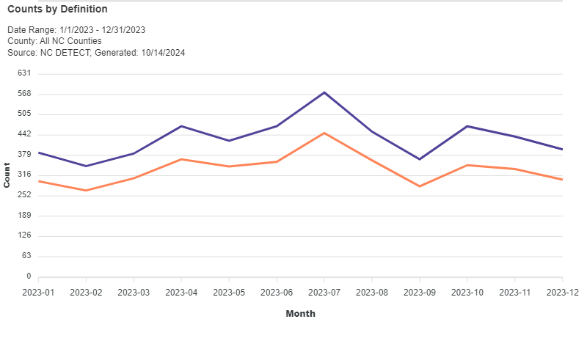
NC-FASTER Definition Compared to the Current Code-Based Definition for Firearm Injury ED Visits
Limited to NC Residents
Source: NC DETECT, ED Visit Data, 2023, NC-FASTER Firearm Injury - All Intents CDC V2 Syndrome & ICD-10-CM code based defintion
28
Notes:
This line graph compares the count of cases captured by month by the NC-FASTER definition of nonfatal firearm injury compared to the ICD-10-CM code-based definition in the past year (2023). The NC-FASTER definition is more sensitive at capturing nonfatal firearm injury cases than the code-based definition because it includes both ICD-10-CM codes and keywords from triage notes and chief complaint narratives found in the ED record. This enhanced surveillance provides valuable insights to healthcare providers, researchers and community partners in describing the burden of firearm injury in the state.

Slide 34

Intent coding in the ED visit data is inaccurate and in need of improvement for firearm injury tracking
Most firearm-related injury ED visits (66%) from January-March 2024 were coded as unintentional injuries.
There is an overcount of unintentional firearm injuries and an undercount of intentional injuries, such as assaults and self-harm.
ICD-10-CM coding guidance currently defaults to unintentional injury if intent is not directly documented in the medical record and should be revised.
Source: NC DETECT, ED Visit Data, NC-FASTER Firearm Injury - All Intents CDC V2 Syndrome
29
Notes:
An important aspect of our work with NC-FASTER is examining the intent of firearm injuries treated in the ED.
As you can see from this diagram of firearm related ED visits, the majority are reported to be unintentional injury with far fewer coded as assaults and even fewer as self-harm. You’ll note that there are many for which intent is not indicated at all and others which are coded with more than one intent, which is contradictory. This pattern of intent for non-fatal firearm injury is very different than the pattern for fatal firearm injury, which is not necessarily surprising given the lethality of firearms. However, we do suspect that there is miscoding of intent in these data and we are working to determine to what extent that may be occurring.
Most of our work for NC-FASTER is using the ED visit data in NC DETECT but we are also now beginning to also work with the EMS encounter data in NC DETECT. Our work is exploring firearm injury by demographics and geography and we try to find clear but innovative ways to visually present the information. Eventually, we want to add a public facing dashboard to make firearm injury data available to anyone interested.

Slide 35
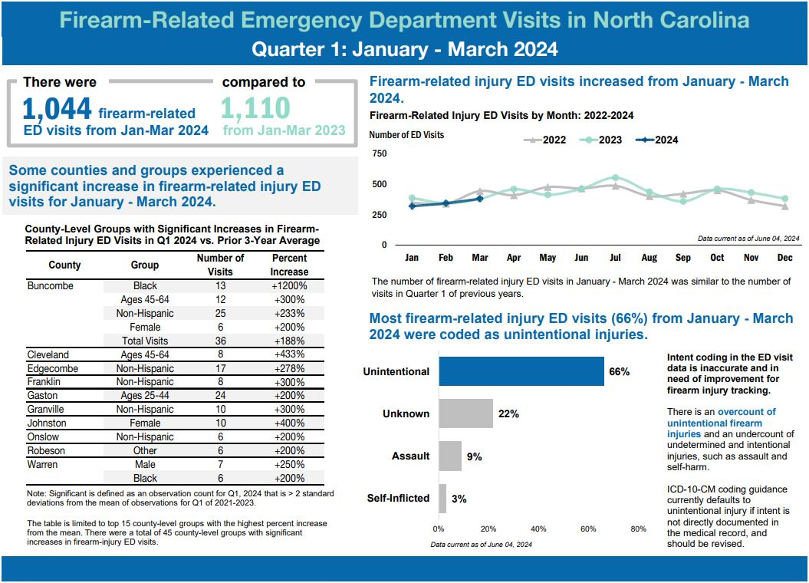
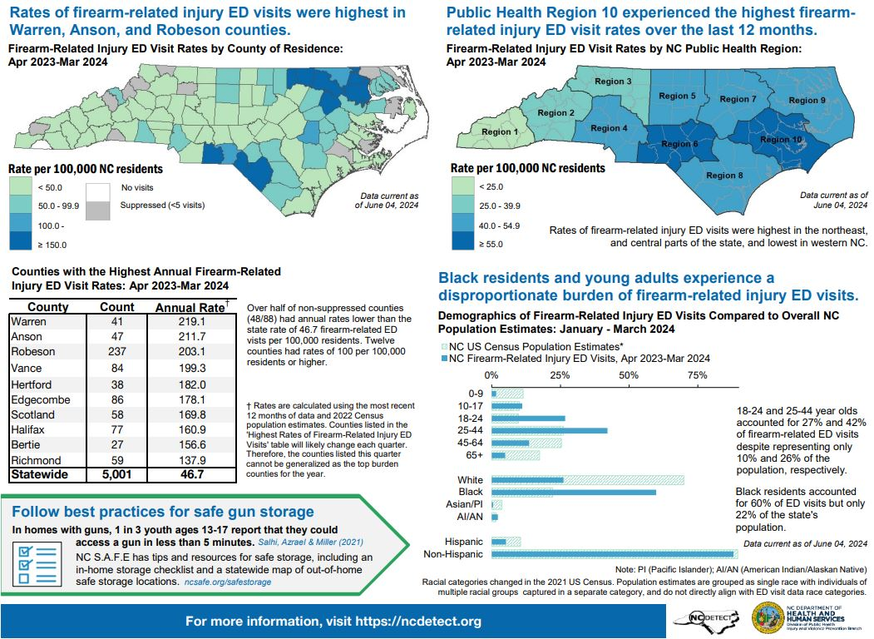
NC-FASTER
Data Products
Quarterly & Annual Reports
https://ncdetect.org/nc-faster-firearm-quarterly-reports/
30
Notes:
NC-FASTER quarterly reports provide a snapshot into nonfatal firearm injuries throughout the state and include ED visit data by demographic group, county/region, and intent. These quarterly reports are available on the NC DETECT website.

Slide 36
More than 2/5 of NC adults have a firearm in or around the home.¹ Over half of firearms that are stored loaded are also unlocked.¹
42%
45%
53%
of NC adults surveyed
of those with firearms kept
at home
of those with loaded firearms at home
¹ NC BRFSS Firearm Safety Module, 2021 https://schs.dph.ncdhhs.gov/data/brfss/2021/nc/all/topics.htm#fr
31
Notes:
The Behavioral Risk Factor Surveillance System (BRFSS), developed by the Centers for Disease Control and Prevention (CDC), is a random telephone survey of state residents aged 18 years and older and administered in all 50 states, the District of Columbia and U.S. territories. The purpose is to obtain estimates of the prevalence of personal health behaviors that contribute to morbidity and mortality.
The Firearm Safety Module was included in the 2021 NC BRFSS and found that more than two-fifths of NC adults have a firearm in or around the home. Over half (53%) of firearms that are stored loaded are also unlocked.

Slide 37
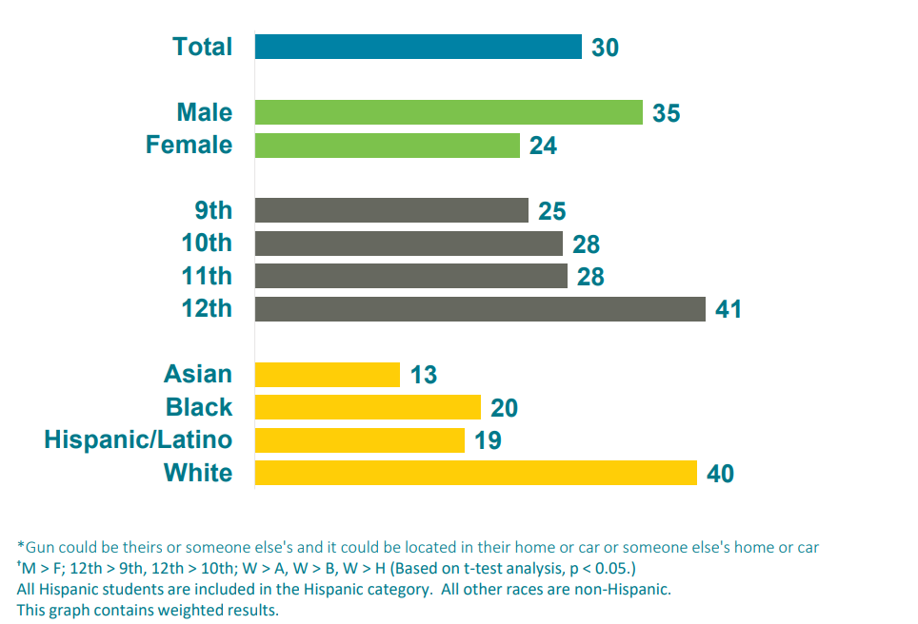
30% of high school students say they could be ready to fire a loaded gun in less than an hour without a parent or other adult’s permission
Percentage
Source: North Carolina Department of Public Instruction, Youth Risk Behavior Survey, 2021
32
Notes:
The Youth Risk Behavior Survey (YRBS), developed by the CDC, is a school-based survey conducted in both middle and high schools during odd-numbered years. The purpose is to obtain prevalence estimates of youth risk behaviors that could lead to the development of adverse health conditions later in life.
In 2021, 30% of NC high school students reported that it would take them less than an hour to get and be ready to fire a loaded gun without a parent or other adult’s permission; for white high school students it was 40%.

Slide 38
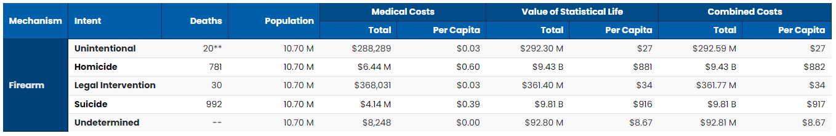
The financial toll of firearm injury and violence on society is costly
Firearm deaths alone in NC resulted in a combined cost of nearly $20 Billion in 2022
  $1,869 per capita
Source: CDC WISQARS, 2022
33
Notes:
The economic impact of firearm injury and violence in North Carolina is significant, resulting in nearly $20 billion in 2022 due to the combined cost of firearm deaths alone, about $1,869 per capita.
Data retrieved from the CDC Web-based Injury Statistics Query and Reporting System (WISQARS). Fatal injury data come from the CDC’s National Center for Health Statistics (NCHS) mortality data.

Slide 39
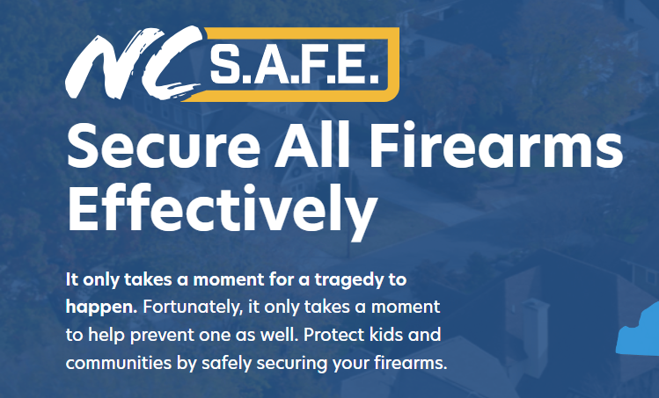
https://www.ncsafe.org/
34
Notes:
NC S.A.F.E. (Secure All Firearms Effectively) is North Carolina’s statewide initiative designed to raise awareness of the importance of safe firearm storage. Established in 2023, the initiative provides resources and best practices for firearm storage and safety. NC S.A.F.E. is not associated with any advocacy-based initiatives related to gun laws or regulations. The initiative is run by the North Carolina Department of Public Safety and funded in part through the 2023 Byrne-State Crisis Intervention Program.

Slide 40
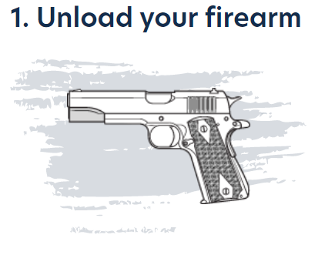
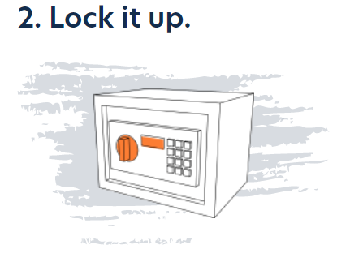
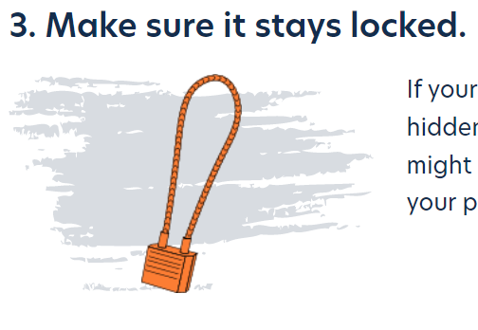
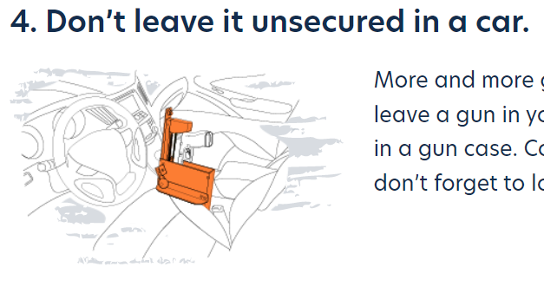

Protect your children and your community by safely securing your firearm
https://www.ncsafe.org/safestorage/
35

Slide 41
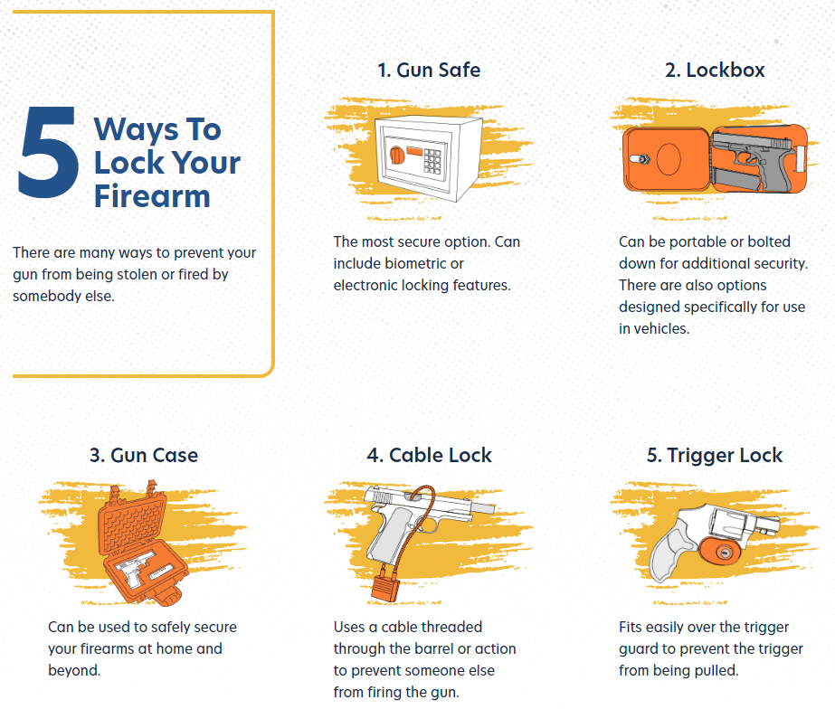

Ways To Lock Your Firearm
5
There are many ways to prevent your gun from being stolen or fired by somebody else.
https://www.ncsafe.org/safestorage/
36

Slide 42
Where to find more data on firearm injury?
NC Injury and Violence Prevention Branch Firearm Data Page
  NC-VDRS Annual Report
  NC-VDRS Fact Sheets
  NC-VDRS Data Dashboard
  NC DETECT quarterly NC-FASTER reports
State Center for Health Statistics (SCHS) Death Certificate Data
  NC Health Data Query System
CDC WISQARS – Fatal Injury and Violence Data
CDC NVDRS - CDC NVDRS
37

Slide 43

North Carolina Medical Journal
Special Issue on Firearm Injury and Violence Prevention https://ncmedicaljournal.com/issue/7874
Notes:
A special issue in the North Carolina Medical Journal (NCMJ) on firearm injury and violence prevention was published in July/August 2023. Featured articles include current efforts across the state, evidence-based prevention strategies, and proposed solutions for at-risk groups such as veterans, adolescents and young adults.
The special issue can be found here:
https://ncmedicaljournal.com/issue/7874

Slide 44
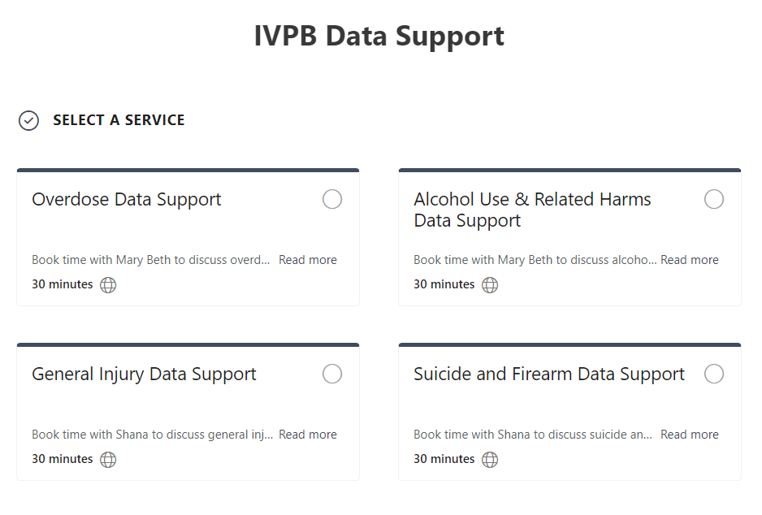

IVPB Data Support now available!
Book time with an IVPB epidemiologist to discuss available data products, to talk through custom data requests, or for general data questions.
IVPB Data Request Policy
IVPB Data Support Bookings
39

Slide 45
Questions?
InjuryData@dhhs.nc.gov
Injury and Violence Prevention Branch
Division of Public Health
https://injuryfreenc.dph.ncdhhs.gov/

