Slide 1
Alcohol and Cancer
Division of Public Health
Injury and Violence Prevention Branch
Data through 2024
Notes:
Speaker’s notes: This slide set was created to provide basic data trends and public health surveillance around alcohol and cancer in North Carolina. This presentation is not intended to cover all data related to alcohol-attributable cancer harms. It includes information on statewide alcohol-attributable cancer deaths and key prevention strategies for alcohol use and alcohol-attributable cancer harms.
Feel free to incorporate these slides into your own presentations, grant proposals, reports, or any other way they may be useful. If this slide deck does not contain the information you need, please see our custom data request policy (https://injuryfreenc.dph.ncdhhs.gov/DataSurveillance/DataRequestPolicy.htm) and contact us at SubstanceUseData@dhhs.nc.gov.
Please read both the speaking and technical notes to ensure the data are presented in a consistent manner.

Slide 2
Technical Notes
The fatality data provided here are part of the Vital Registry System of the North Carolina Department of Health and Human Services (NCDHHS), State Center for Health Statistics (SCHS) and are analyzed using the Alcohol-Related Disease Impact (ARDI) methodology provided by the Centers for Disease Control and Prevention. This methodology was updated in 2024 to reflect most recent literature, which affected alcohol-attributable fractions and conditions. Estimates are calculated for nine cancer causes of death using alcohol-attributable fractions. Alcohol-attributable fractions for cancer causes are based on any alcohol use due to evidence that shows cancer is linked even to low levels of alcohol use.
2024 NCDHHS, SCHS data are final as of January 2026.
U.S. Census non-bridged single-race population categories do not directly align with death certificate race categories.
Speaking and technical notes should be read prior to using.
Notes:
Speaker’s notes: For more detailed technical notes on any of the data shared in this slide set, please contact us at SubstanceUseData@dhhs.nc.gov.

Slide 3
Funding
This presentation is partially supported by the Centers for Disease Control and Prevention of the U.S. Department of Health and Human Services (HHS) as part of a financial assistance award totaling $166,667. The contents are those of the author(s) and do not necessarily represent the official views of, nor an endorsement, by CDC/HHS, or the U.S. Government.
Notes:
Speaker’s notes: This presentation is partially supported by the Centers for Disease Control and Prevention of the U.S. Department of Health and Human Services (HHS) as part of a financial assistance award totaling $166,667. The contents are those of the author(s) and do not necessarily represent the official views of, nor an endorsement, by CDC/HHS, or the U.S. Government.

Slide 4




What is considered a “drink”?
Examples: gin, rum, vodka, whiskey
CRAFT
12 ounces
5% ABV beer*
4-12 ounces
5-15% ABV craft beer*
8 ounces
7% ABV malt liquor*
5 ounces
12% ABV wine*
1.5 ounces
40% ABV (80 proof) distilled spirits*
*The alcohol content of different types of beer, wine, and liquor may vary. To see how many standard drinks are within a container, please use NIAAA’s Drink Size Calculator.
Definitions: ABV – Alcohol by Volume
Source: National Institute on Alcohol Abuse and Alcoholism (NIAAA)
Notes:
Speaker’s notes: One standard drink is 14 grams or 0.6 fluid ounces of pure alcohol. The alcohol content of different types of beer, wine, and liquor may vary. For example, 12 ounces of a beer at 5% alcohol by volume (ABV) is one standard drink, while 5 ounces of wine at 12% ABV is also one standard drink.
It’s important to understand how much alcohol is in a drink so that you can make informed decisions if you do choose to drink.
Technical notes: To see how many standard drinks are within a container, please use the National Institute of Alcohol Abuse and Alcoholism’s Drink Size Calculator - https://rethinkingdrinking.niaaa.nih.gov/tools/calculators/drink-size-calculator .

Slide 5
Levels of Alcohol Use
No amount of alcohol is safe for your health. Each drink increases the risk of harm.
Men
Heavy Drinking:
Consuming 15 or more drinks per week
Binge Drinking:
Consuming 5 or more drinks in one occasion
Women
Heavy Drinking:
Consuming 8 or
more drinks per week
Binge Drinking:
Consuming 4 or more drinks in one occasion
Excessive alcohol use is heavy drinking, binge drinking, or any alcohol consumed while pregnant or under the age of 21.
Source: US Alcohol Policy Alliance’s (USAPA) Alcohol Consumption Guidelines for the American People
Notes:
Speaker’s notes: No amount of alcohol is safe for your health. Each drink increases the risk of harm. Alcohol use can increase the risk of injuries (e.g., overdose and falls), violence (e.g., homicide and suicide), chronic conditions (e.g., cancer and heart disease), and social and wellness issues (e.g., mental health and relationship issues).
To reduce the risk of alcohol-related harms, the US Alcohol Policy Alliance (USAPA) recommends:
If you do not drink alcohol, do not start. Alcohol use offers no health benefits and carries risk.
Cut back if you do drink alcohol. Each drink increases the risk of harm, including cancer, heart disease, and early death.
Avoid alcohol if you:
Are pregnant,
Are under 21 years old,
Are in recovery,
Have certain health conditions,
Have a family history of alcohol-related cancers, or
Use any medication or drugs that interact with alcohol.
For adults 21 and older who choose to drink, drinking less alcohol is always better.
Due to biological differences in body structure and chemistry, the levels of alcohol use differ between men and women. After drinking the same amount of alcohol, most women tend to have higher blood alcohol levels and the immediate effects of alcohol usually occur more quickly and last longer in women than in men.
Many of the harms that come from alcohol use are due to excessive alcohol use. Excessive alcohol use is defined as heavy drinking (8+ drinks in one week for women, 15+ for men), binge drinking (4+ drinks in one sitting for women, 5+ for men), or any alcohol consumed while pregnant or under the age of 21.
However, some alcohol-related harms are due to any alcohol use, such as alcohol-related cancers.
Technical Note: The USAPA is a nonprofit, nonpartisan organization that translates alcohol policy research into public health practice. USAPA is committed to ensuring that local and statewide organizations have access to the science, resources, and technical assistance required to engage in informed decisions and actions in translating alcohol policy research into public health practice. To read USAPA’s clear, science-based alcohol recommendations please visit https://drive.google.com/file/d/1Dy0NSyvhDyrB0zMU5tZB3ReouSUi4ulH/view

Slide 6
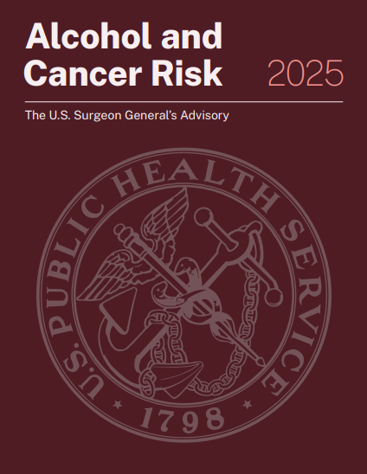

U.S. Surgeon General’s Advisory on Alcohol and Cancer Risk 2025
Notes:
Speaker’s notes: In 2025, the U.S. Surgeon General released an advisory on alcohol and cancer risk. The advisory describes the scientific evidence for the link between alcohol use and increased risk for several different types of cancer, including breast (in women), colorectum, esophagus, voice box, liver, mouth, and throat. It also helps to better inform the public of this information and offers key recommendations to reduce alcohol-related cancers. The QR code on the slide leads to the report (https://www.hhs.gov/sites/default/files/oash-alcohol-cancer-risk.pdf).

Slide 7
Alcohol is a group 1 carcinogen, the highest category of cancer-causing substances, like tobacco, asbestos, and radiation.
Notes:
Speaker’s notes: Alcohol is also included with tobacco, asbestos, and radiation as a group 1 carcinogen, which is the highest group of cancer-causing agents.

Slide 8
All types of alcohol, in any amount, including red and white wine, beer, and liquor, can cause cancer. Drinking less alcohol or choosing not to drink at all will lower cancer risk.
Notes:
Speaker’s notes: All alcoholic beverages, in any amount, including red and white wine, beer, and liquor, can cause cancer. Drinking less alcohol or choosing not to drink at all will lower cancer risk.

Slide 9
Alcohol increases the risk for cancer in at least 4 ways:
Alcohol can damage your DNA. The body breaks alcohol down into a chemical, known as acetaldehyde, that can damage your DNA. Damaged DNA can cause a cell to grow out of control and become cancer.
Alcohol increases oxidative stress that increases inflammation. Oxidative stress can also damage DNA, proteins, and cells.
Source: The U.S. Surgeon General’s Advisory on Alcohol and Cancer Risk 2025
Notes:
Speaker’s notes: When alcohol is consumed, it increases the risk of cancer in several ways.
1. Alcohol can damage your DNA. The body breaks alcohol down into a chemical, known as acetaldehyde, that can damage your DNA. Damaged DNA can cause a cell to grow out of control and become cancer.
2. Alcohol increases oxidative stress that increases inflammation. Oxidative stress can also damage DNA, proteins, and cells.

Slide 10
Alcohol increases the risk for cancer in at least 4 ways:
Alcohol increases hormone levels (e.g., estrogen). Increased hormone levels can increase the risk of certain cancers, such as breast cancer.
Alcohol makes it easier for cells to absorb other cancer-causing chemicals. For example, alcohol increases the absorption of carcinogens from tobacco if you use both substances.
Source: The U.S. Surgeon General’s Advisory on Alcohol and Cancer Risk 2025
Notes:
Speaker’s notes: When alcohol is consumed, it increases the risk of cancer in several ways.
3. Alcohol increases hormone levels (e.g., estrogen). Increased hormone levels can increase the risk of certain cancers, such as breast cancer.
4. Alcohol makes it easier for cells to absorb other cancer-causing chemicals. For example, alcohol increases the absorption of carcinogens from tobacco if you use both substances.

Slide 11
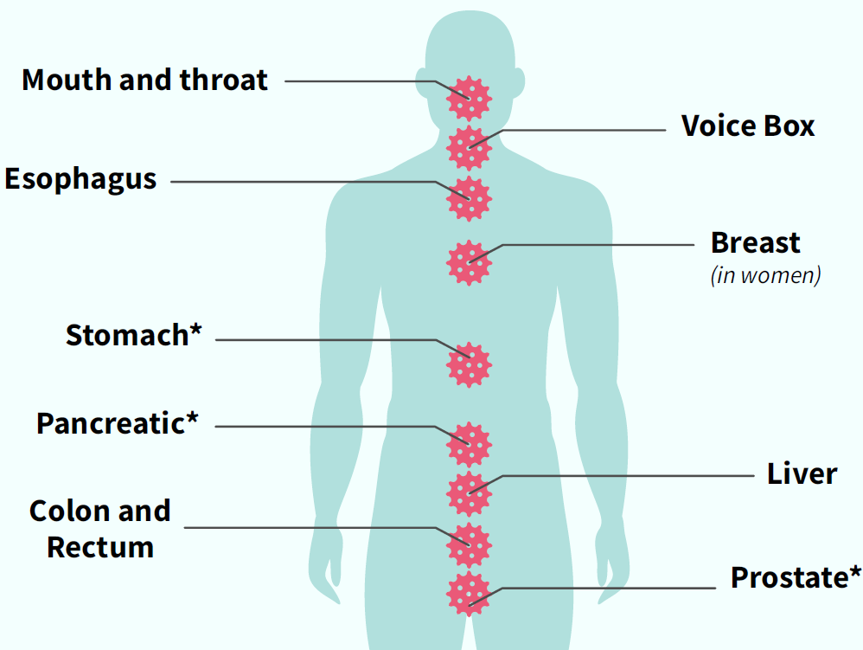
Drinking any type of alcohol raises the risk of several types of cancer, including:
Breast
Colon and rectum
Liver
Mouth and throat
Voice box
Esophagus
Stomach*
Pancreatic*
Prostate*
*Studies show that some cancers are dependent on high levels of alcohol use (i.e., three or more alcoholic beverages in a day).
Notes:
Speaker’s notes: Alcohol use increases the risk of developing several types of cancer, including breast and colon cancers. Some research shows that a few cancers are dependent on high levels of alcohol use (i.e., stomach, pancreatic, prostate).

Slide 12
In 2024, more than 840 North Carolinians died from an alcohol-attributable cancer. Most of these deaths could have been prevented if all adults followed the 2020-2025 Dietary Guidelines for Americans* for alcohol use. Even more deaths could have been prevented by not drinking alcohol at all.
*The 2020-2025 Dietary Guidelines for Americans recommends that adults of legal age can choose not to drink, or to drink in moderation by limiting intake to 2 drinks or less in a day for men and 1 drink or less in a day for women. For more information, please see 2020-2025 Dietary Guidelines for Americans.
Technical Note: Alcohol-attributable cancer deaths include deaths from breast (female only), colorectal, esophageal, laryngeal, liver, pancreatic, prostate (male only), stomach, and oral cavity and pharyngeal cancers. Estimates calculated for cancer causes of death are due to any alcohol use. The Alcohol-Related Disease Impact (ARDI) methodology is used to calculate estimates over a specified period. The methodology is not set up to examine trends over time due to year-to-year variations in these estimates that may not be due to alcohol consumption. All estimates are currently based on alcohol consumption patterns of 2020-2021.
Source: NC State Center for Health Statistics , 2024; CDC ARDI Estimates for alcohol-attributable death by all causes of death - for more information on ARDI see https://nccd.cdc.gov/DPH_ARDI/default/default.aspx; Esser MB, Sherk A, Liu Y, Henley SJ, Naimi TS. Reducing Alcohol Use to Prevent Cancer Deaths: Estimated Effects Among U.S. Adults. Am J Prev Med. 2024 Apr;66(4):725-729. doi: 10.1016/j.amepre.2023.12.003. PMID: 38514233; PMCID: PMC10963036.
Analysis by Injury Epidemiology, Surveillance, and Informatics Unit
Notes:
Speaker’s notes: In 2024, more than 840 North Carolinians died from an alcohol-attributable cancer. Most of these deaths could have been prevented if all adults followed the 2020-2025 Dietary Guidelines for Americans for alcohol use. The 2020-2025 Dietary Guidelines for Americans recommended that adults of legal age can choose not to drink, or to limit intake to 2 drinks or less in a day for men and 1 drink or less in a day for women. Even more deaths could have been prevented by not drinking alcohol at all.
Technical Notes: Alcohol-attributable cancer deaths include deaths from breast (female only), colorectal, esophageal, laryngeal, liver, pancreatic, prostate (male only), stomach, and oral cavity and pharyngeal cancers. Alcohol-attributable deaths due to cancer are based on any alcohol use due to evidence that shows cancer is linked even to low levels of alcohol use.
Alcohol-attributable deaths include deaths from 58 acute and chronic causes of death due to excessive use of alcohol. However, estimates calculated for cancer causes of death are based on any alcohol use. The Alcohol-Related Disease Impact (ARDI) methodology is used to calculate estimates over a specified period. The methodology is not set up to examine trends over time due to year-to-year variations in these estimates that may not be due to alcohol use. All estimates are currently based on alcohol use patterns of 2020-2021. All death estimates are directly related to alcohol, but estimates are calculated with either direct or indirect alcohol-attributable fractions (AAFs). AAFs are used to express the extent to which alcohol use contributes to a health outcome. Direct AAFs are based on scientific studies that have directly measured the relationship between excessive alcohol use and a given health outcome. Indirect AAFs use pooled risk estimates obtained from meta-analyses on the relationship between alcohol and various causes as well as data on the prevalence of alcohol use at specific levels. All AAFs, except the AAF for motor vehicle crashes, are national, not state specific. For more information on the ARDI methodology, please visit https://nccd.cdc.gov/DPH_ARDI/default/default.aspx.
The NC Division of Public Health Alcohol Data Dashboard (https://www.dph.ncdhhs.gov/programs/chronic-disease-and-injury/injury-and-violence-prevention-branch/north-carolina-alcohol-use-and-related-harms-prevention/data) and Prevention Webpage (https://www.dph.ncdhhs.gov/programs/chronic-disease-and-injury/injury-and-violence-prevention-branch/north-carolina-alcohol-use-and-related-harms-prevention) share state and county level estimates of acute, chronic, and total alcohol-attributable deaths as well as strategies to reduce excessive alcohol use and its related harms.
Esser et. al. estimated that most alcohol-attributable cancer deaths could have been prevented if adults who drank in excess of the Dietary Guidelines had instead followed the guidelines. For more information, please visit https://pubmed.ncbi.nlm.nih.gov/38514233/ .

Slide 13
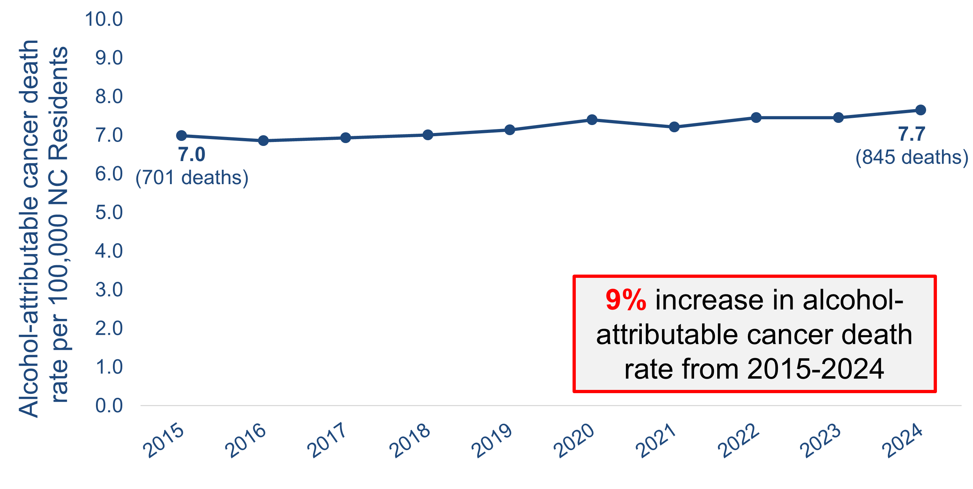
Alcohol-attributable cancer death rates increased slightly from 2015 to 2024
9% increase in alcohol-attributable cancer death rate from 2015-2024
Source: Death – NC State Center for Health Statistics (SCHS), Vital Statistics-Deaths, 2015-2024, and CDC’s Alcohol-Related Disease Impact (ARDI). Population – U.S Census, 2015-2024.
Analysis by Injury Epidemiology, Surveillance, and Informatics Unit
Notes:
Speaker’s notes: Using CDC’s Alcohol-Related Disease Impact (ARDI) methodology, the alcohol-attributable cancer death rate was 7.7 deaths per 100,000 population in 2024, an estimated 845 deaths. Alcohol-attributable death rates have increased slightly, with a 9% increase since the 2015 death rate of 7.0 deaths per 100,000 population, an estimated 701 deaths.
Technical Notes: Alcohol-attributable cancer deaths include deaths from breast (female only), colorectal, esophageal, laryngeal, liver, pancreatic, prostate (male only), stomach, and oral cavity and pharyngeal cancers. Alcohol-attributable deaths due to cancer are based on any alcohol use due to evidence that shows cancer is linked even to low levels of alcohol use.
Alcohol-attributable deaths include deaths from 58 acute and chronic causes of death due to excessive use of alcohol. However, estimates calculated for cancer causes of death are based on any alcohol use. The Alcohol-Related Disease Impact (ARDI) methodology is used to calculate estimates over a specified period. The methodology is not set up to examine trends over time due to year-to-year variations in these estimates that may not be due to alcohol use. All estimates are currently based on alcohol use patterns of 2020-2021. All death estimates are directly related to alcohol, but estimates are calculated with either direct or indirect alcohol-attributable fractions (AAFs). AAFs are used to express the extent to which alcohol use contributes to a health outcome. Direct AAFs are based on scientific studies that have directly measured the relationship between excessive alcohol use and a given health outcome. Indirect AAFs use pooled risk estimates obtained from meta-analyses on the relationship between alcohol and various causes as well as data on the prevalence of alcohol use at specific levels. All AAFs, except the AAF for motor vehicle crashes, are national, not state specific. For more information on the ARDI methodology, please visit https://nccd.cdc.gov/DPH_ARDI/default/default.aspx.
The NC Division of Public Health Alcohol Data Dashboard (https://www.dph.ncdhhs.gov/programs/chronic-disease-and-injury/injury-and-violence-prevention-branch/north-carolina-alcohol-use-and-related-harms-prevention/data) and Prevention Webpage (https://www.dph.ncdhhs.gov/programs/chronic-disease-and-injury/injury-and-violence-prevention-branch/north-carolina-alcohol-use-and-related-harms-prevention) share state and county level estimates of acute, chronic, and total alcohol-attributable deaths as well as strategies to reduce excessive alcohol use and its related harms.

Slide 14
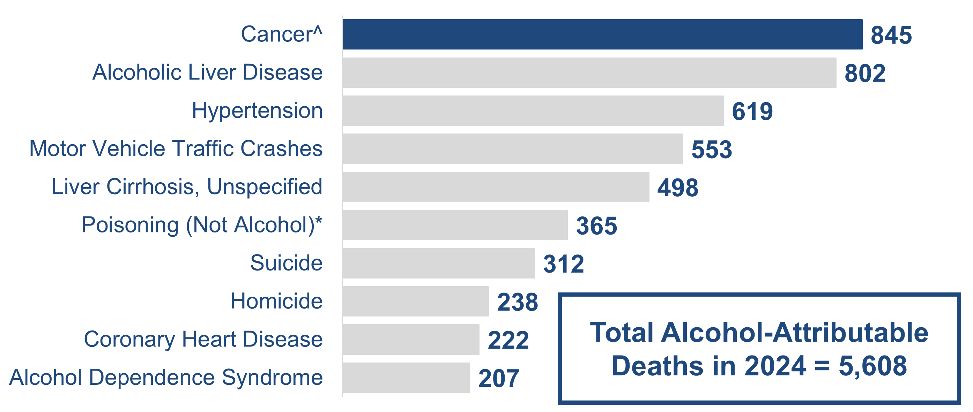
Cancer is the leading cause of alcohol-attributable death among NC residents in 2024
Total Alcohol-Attributable Deaths in 2024 = 5,608
^Alcohol-attributable cancer deaths include deaths from breast (female only), colorectal, esophageal, laryngeal, liver, pancreatic, prostate (male only), stomach, and oral cavity and pharyngeal cancers.
*Poisoning (Not Alcohol) deaths are deaths that involve another substance in addition to a high blood alcohol concentration (e.g., an opioid overdose with alcohol involvement).
Example Interpretation: The leading cause of alcohol-attributable deaths was cancer^ with 845 deaths. Deaths due to cancer were 15% of all alcohol-attributable deaths in 2024.
Note: Leading causes of death bar chart only includes top 10 causes of alcohol-attributable deaths, estimates will not add up to total alcohol-attributable deaths.
Source: NC State Center for Health Statistics 2024, Vital Statistics, CDC Alcohol-Related Disease Impact (ARDI) estimates for alcohol-attributable death.
Analysis by Injury Epidemiology, Surveillance, and Informatics Unit
Notes:
Speaker’s notes: Cancer is the leading cause of alcohol-attributable death among NC residents in 2024. Alcohol-attributable cancer deaths include deaths from breast (female only), colorectal, esophageal, laryngeal, liver, pancreatic, prostate (male only), stomach, oral cavity, and pharyngeal cancers.
845 alcohol-attributable deaths in 2024 were due to cancers. Deaths due to alcohol-attributable cancers were 15% of all alcohol-attributable deaths in 2024.
Technical Notes: Alcohol-attributable cancer deaths include deaths from breast (female only), colorectal, esophageal, laryngeal, liver, pancreatic, prostate (male only), stomach, and oral cavity and pharyngeal cancers. Alcohol-attributable deaths due to cancer are based on any alcohol use due to evidence that shows cancer is linked even to low levels of alcohol use.
Alcohol-attributable deaths include deaths from 58 acute and chronic causes of death due to excessive use of alcohol. However, estimates calculated for cancer causes of death are based on any alcohol use. The Alcohol-Related Disease Impact (ARDI) methodology is used to calculate estimates over a specified period. The methodology is not set up to examine trends over time due to year-to-year variations in these estimates that may not be due to alcohol use. All estimates are currently based on alcohol use patterns of 2020-2021. All death estimates are directly related to alcohol, but estimates are calculated with either direct or indirect alcohol-attributable fractions (AAFs). AAFs are used to express the extent to which alcohol use contributes to a health outcome. Direct AAFs are based on scientific studies that have directly measured the relationship between excessive alcohol use and a given health outcome. Indirect AAFs use pooled risk estimates obtained from meta-analyses on the relationship between alcohol and various causes as well as data on the prevalence of alcohol use at specific levels. All AAFs, except the AAF for motor vehicle crashes, are national, not state specific. For more information on the ARDI methodology, please visit https://nccd.cdc.gov/DPH_ARDI/default/default.aspx.
The NC Division of Public Health Alcohol Data Dashboard (https://www.dph.ncdhhs.gov/programs/chronic-disease-and-injury/injury-and-violence-prevention-branch/north-carolina-alcohol-use-and-related-harms-prevention/data) and Prevention Webpage (https://www.dph.ncdhhs.gov/programs/chronic-disease-and-injury/injury-and-violence-prevention-branch/north-carolina-alcohol-use-and-related-harms-prevention) share state and county level estimates of acute, chronic, and total alcohol-attributable deaths as well as strategies to reduce excessive alcohol use and its related harms.

Slide 15
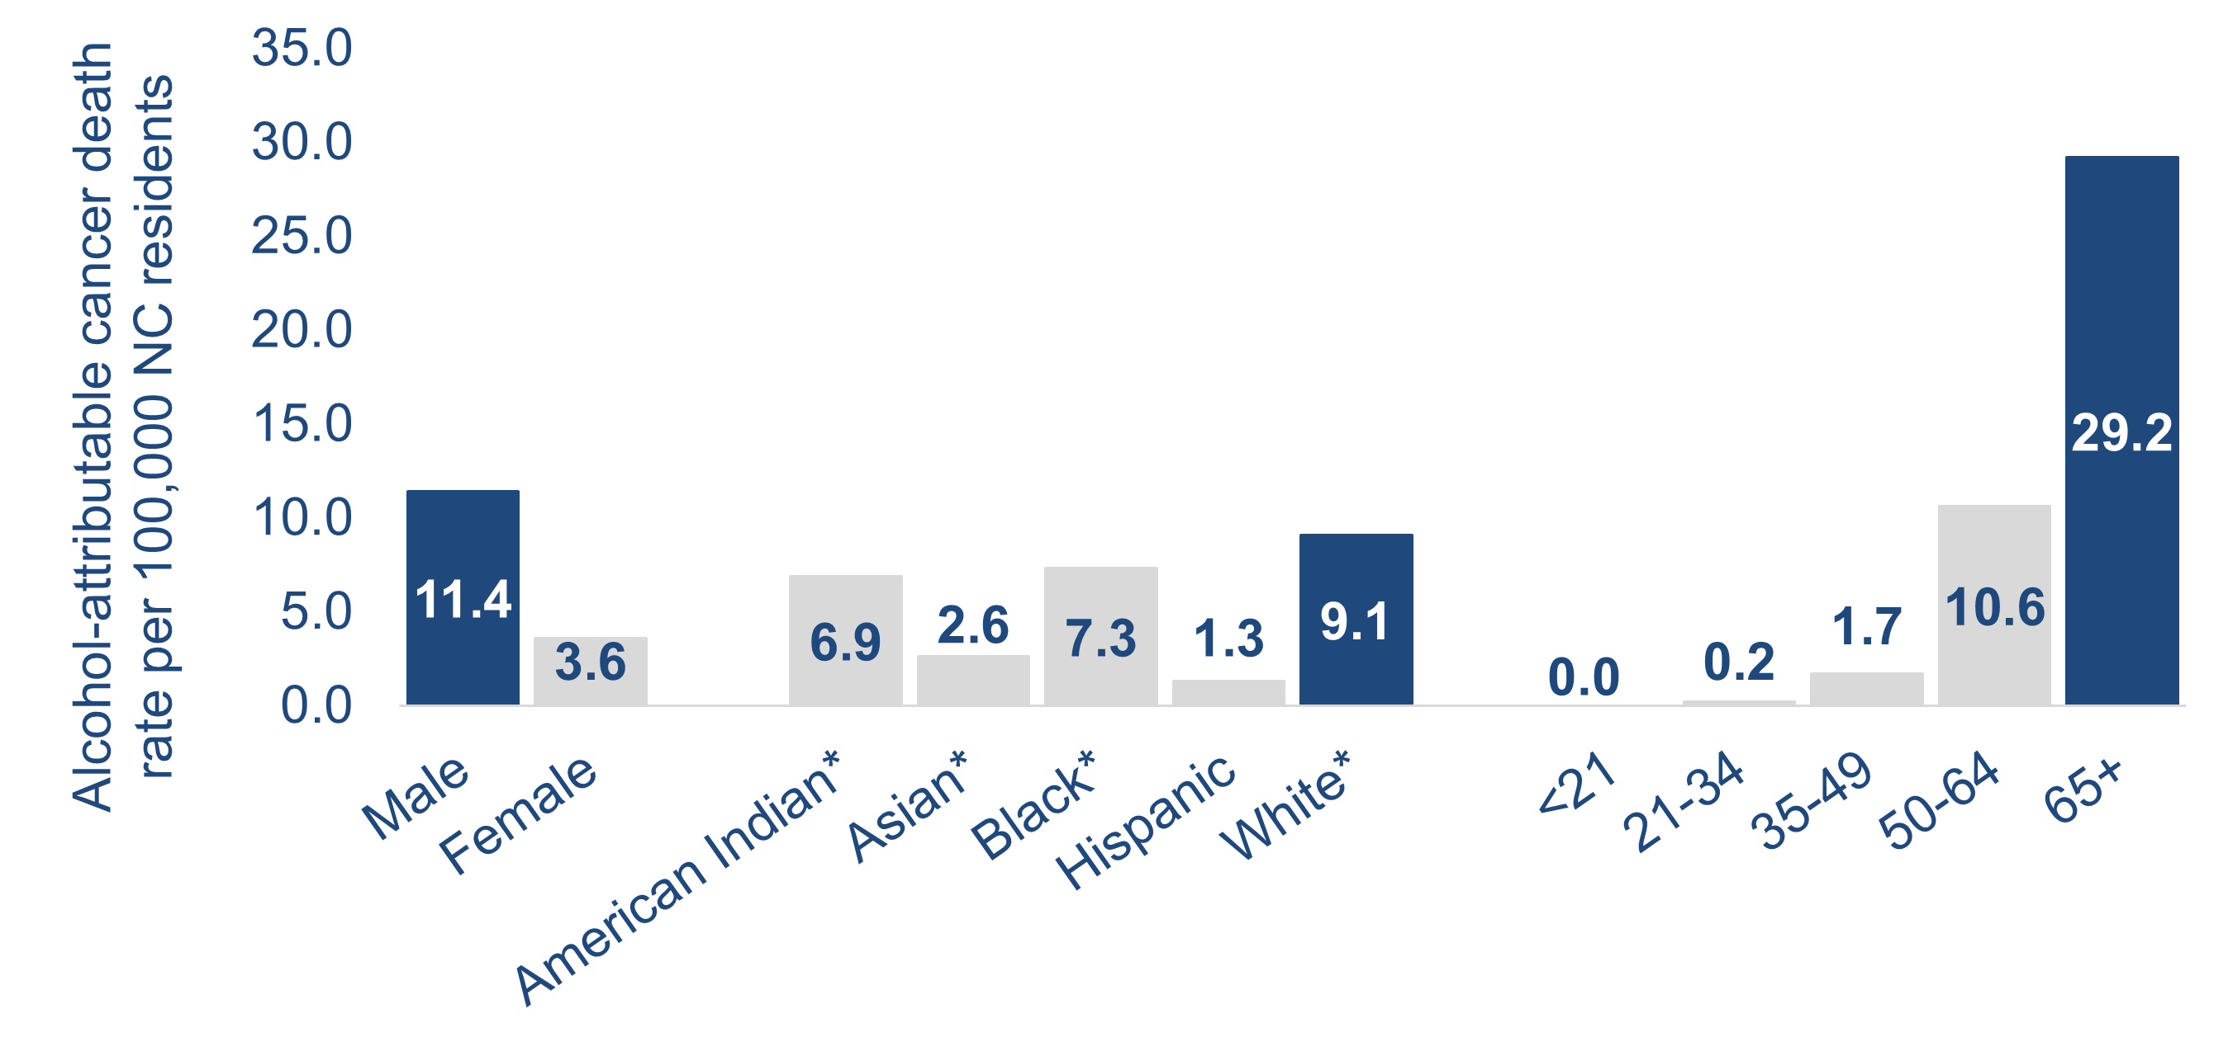
From 2020 to 2024, alcohol-attributable cancer death rates were highest among individuals who are male, white*, or aged 65 years and older
0.0
*NH = Non-Hispanic
Example Interpretation: From 2020-2024, the alcohol-attributable cancer death rate for North Carolina males was 11.4 alcohol-attributable cancer deaths per 100,000 population.
Technical Note: Rates by race and ethnicity are calculated using the Alcohol-Related Disease Impact (ARDI) methodology to estimate alcohol-attributable deaths. ARDI does not provide stratification by race/ethnicity, only by age and sex. Alcohol-attributable deaths for race/ethnicity may be high among one race/ethnicity group due to a broader disparity in one of the 58 alcohol-attributable causes of death and not necessarily due to a difference in alcohol involvement.
Source: Death – NC State Center for Health Statistics (SCHS), 2020-2024; CDC ARDI Estimates for alcohol-attributable death. Population – U.S. Census, 2020-2024
Analysis by Injury Epidemiology, Surveillance, and Informatics Unit
Notes:
Speaker’s notes: Looking at the most recent five years of available data (2020-2024), we can analyze descriptive trends within these alcohol-attributable cancer deaths. Males have a higher rate of alcohol-attributable cancer deaths, at 11.4 per 100,000 population, compared with females at a little under a third of that. Rates of alcohol-attributable cancer death increased by age group. Even though the percent of older adults who report drinking is low, the rates of alcohol-related cancer death are high among this group. This is because the Alcohol-Related Disease Impact (ARDI) methodology considers both chronic and acute causes of death that are attributable to alcohol. All cancer types are considered chronic causes of death that are attributable to alcohol use. White non-Hispanic (NH) residents have a higher rate of alcohol attributable death, at 9.1 per 100,000 population, with the next highest group being Black NH residents at 7.3 per 100,000 population.
Technical Notes: Alcohol-attributable cancer deaths include deaths from breast (female only), colorectal, esophageal, laryngeal, liver, pancreatic, prostate (male only), stomach, and oral cavity and pharyngeal cancers. Alcohol-attributable deaths due to cancer are based on any alcohol use due to evidence that shows cancer is linked even to low levels of alcohol use.
Alcohol-attributable deaths include deaths from 58 acute and chronic causes of death due to excessive use of alcohol. However, estimates calculated for cancer causes of death are based on any alcohol use. The Alcohol-Related Disease Impact (ARDI) methodology is used to calculate estimates over a specified period. The methodology is not set up to examine trends over time due to year-to-year variations in these estimates that may not be due to alcohol use. All estimates are currently based on alcohol use patterns of 2020-2021. All death estimates are directly related to alcohol, but estimates are calculated with either direct or indirect alcohol-attributable fractions (AAFs). AAFs are used to express the extent to which alcohol use contributes to a health outcome. Direct AAFs are based on scientific studies that have directly measured the relationship between excessive alcohol use and a given health outcome. Indirect AAFs use pooled risk estimates obtained from meta-analyses on the relationship between alcohol and various causes as well as data on the prevalence of alcohol use at specific levels. All AAFs, except the AAF for motor vehicle crashes, are national, not state specific.
Rates were calculated for 2020 to 2024 by sex, age, and race/ethnicity using the ARDI methodology to estimate alcohol-attributable deaths. ARDI methodology only includes sex- and age-specific AAFs, which aid in the calculation of alcohol-attributable deaths. Due to AAFs not being available by race/ethnicity, alcohol-attributable deaths may be higher amongst one race/ethnicity due to a broader disparity in one of the 58 alcohol-attributable causes of death, and not necessarily attributable to alcohol's involvement. For example, one race/ethnicity may have a higher rate of colorectal cancer, which would lead to a higher cancer and overall alcohol-attributable death rate estimate. In addition, with race/ethnicity data, demographic misclassifications could have occurred during the death certification process. For more information on the ARDI methodology, please visit https://nccd.cdc.gov/DPH_ARDI/default/default.aspx.
The NC Division of Public Health Alcohol Data Dashboard (https://www.dph.ncdhhs.gov/programs/chronic-disease-and-injury/injury-and-violence-prevention-branch/north-carolina-alcohol-use-and-related-harms-prevention/data) and Prevention Webpage (https://www.dph.ncdhhs.gov/programs/chronic-disease-and-injury/injury-and-violence-prevention-branch/north-carolina-alcohol-use-and-related-harms-prevention) share state and county level estimates of acute, chronic, and total alcohol-attributable deaths as well as strategies to reduce excessive alcohol use and its related harms.

Slide 16
Alcohol and Cancer Prevention Strategies
Alcohol-attributable cancers can be reduced through evidence-based policies that reduce alcohol availability and affordability, such as:
  Government control of alcohol sales
  Alcohol taxes to increase the price of alcohol
  Regulating the number of businesses that sell alcohol
  Limits on days and hours of alcohol sales
To learn more about the strategies that protect the health of North Carolinians, please see the Reducing Excessive Alcohol Use to Build Healthier North Carolina Communities factsheet.
Source: CDC’s Preventing Excessive Alcohol Use with Proven Strategies
Notes:
Speaker’s notes: Alcohol-attributable cancers can be reduced through evidence-based policies that reduce alcohol availability and affordability. When alcohol is less available and costs more, people tend to drink less leading to reduced alcohol-related harms, such as cancer. Policies can include:
- Government control of alcohol sales: In North Carolina (NC), the sale of liquor is limited to ABC stores where price is controlled by the Alcoholic Beverage Control (ABC) Commission and advertising/promotion is limited. Government control of alcohol sales limits excessive availability and exposure to alcohol, which in turn reduces excessive alcohol use and related injury, illness, and death.
- Alcohol taxes to increase the price of alcohol: An excise tax is levied on alcoholic beverages sold in and/or shipped into NC. Tax increases raise the price of alcohol, which decreases excessive alcohol use and related harms – and increases state revenue too.
- Regulating the number of businesses that sell alcohol: Regulating the number of places selling alcohol and the distance between them limits excessive access to alcohol. This lowers excessive alcohol use, improves health, and increases quality of life. NC allows the ABC Commission to approve or deny permits to sell alcohol, weighing impact on zoning laws, the number of places already holding ABC permits within the neighborhood, types of businesses already in the neighborhood, and whether the establishment is located near a church or school.
-Limits on days and hours of alcohol sales: Maintaining existing hours and days of alcohol sales helps limits excessive availability of alcohol, leading to reduced alcohol-related harms. NC limits the sale of alcohol to particular hours and days of the week and prohibits sales on certain holidays.
To learn more about the strategies that protect the health of North Carolinians, please see the Reducing Excessive Alcohol Use to Build Healthier North Carolina Communities factsheet (https://www.dph.ncdhhs.gov/reducing-excessive-alcohol-use-build-healthier-north-carolina-communities/open).

Slide 17
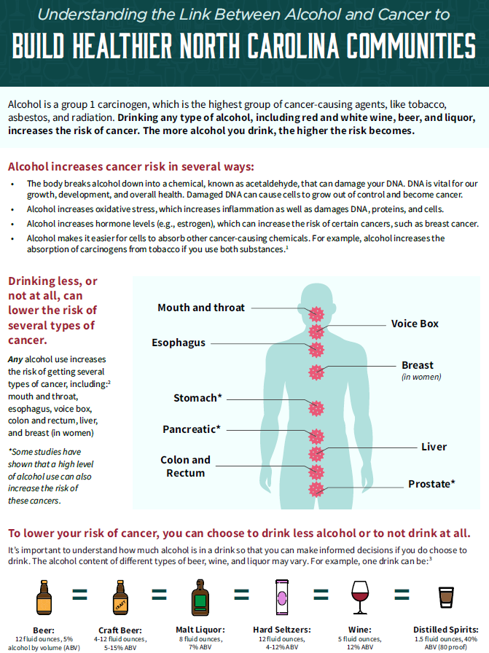
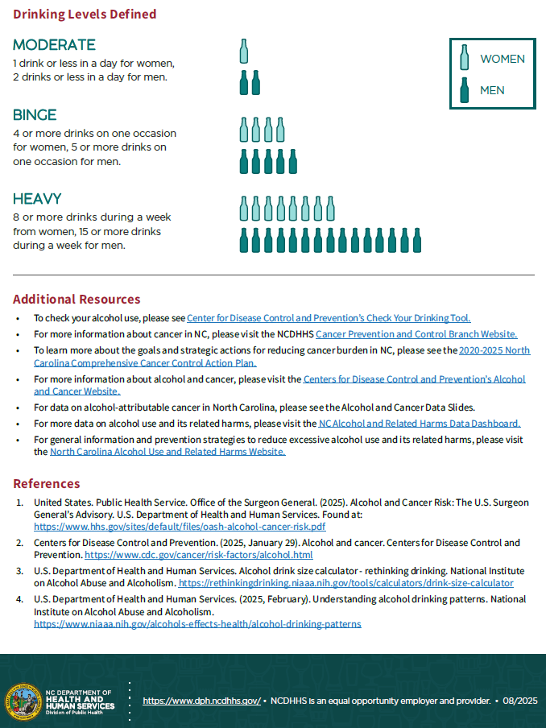
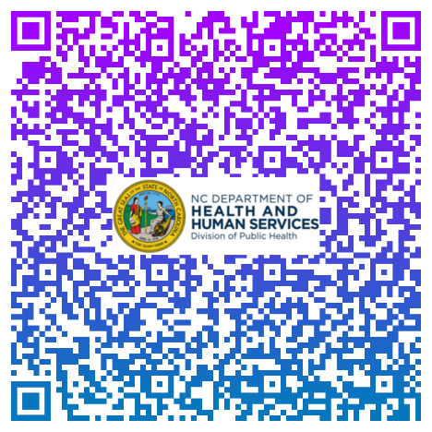
Understanding the Link Between Alcohol and Cancer to Build Healthier North Carolina Communities factsheet
Notes:
Speaker’s notes: The Understanding the Link Between Alcohol and Cancer to Build Healthier NC Communities factsheet (https://www.dph.ncdhhs.gov/chronic-disease-and-injury/injury-and-violence-prevention/understanding-link-between-alcohol-and-cancer-build-healthier-north-carolina-communities/open) provides an overview of alcohol’s link to cancer as well as the cancer types associated with alcohol use.

Slide 18
Additional Alcohol and Cancer Resources
For more information about cancer in NC, please visit the NCDHHS Cancer Prevention and Control Branch website.
To learn more about the goals and strategic actions for reducing cancer burden in NC, please see the 2025-2030 North Carolina Comprehensive Cancer Control Action Plan.
For more information about alcohol and cancer, please visit the Centers for Disease Control and Prevention’s Alcohol and Cancer website.
Notes:
Speaker’s notes: The NC Cancer Prevention and Control Branch website (https://www.dph.ncdhhs.gov/programs/chronic-disease-and-injury/cancer-prevention-and-control-branch) provides additional information on cancer. The branch also provides resources and data on cancer burden in NC. To learn more about the goals and strategic actions for reducing cancer burden in North Carolina, please see the 2025-2030 North Carolina Comprehensive Cancer Control Action Plan (https://www.dph.ncdhhs.gov/chronic-disease-and-injury/cancer-prevention-and-control/nc-cancer-plan-2025-2030/open). For more information about alcohol and cancer, please visit the Centers for Disease Control and Prevention’s Alcohol and Cancer website (https://www.cdc.gov/cancer/risk-factors/alcohol.html).

Slide 19
Additional Alcohol Use and it’s Related Harms Resources
For more data about alcohol use in NC, please visit the NC Injury and Violence Prevention Branch (IVPB) Alcohol and Related Harms Data Dashboard.
For general information and prevention strategies to reduce excessive alcohol use and its related harms, please visit the North Carolina Alcohol Use and Related Harms Website.
For questions related to alcohol data requests, please email SubstanceUseData@dhhs.nc.gov.
If you have questions regarding a custom data request or available data products, please use the IVPB Data Support Bookings Application to reserve time to chat with one of our epidemiologists.
Notes:
Speaker’s notes: The NC Injury and Violence Prevention Branch (IVPB) Alcohol and Related Harms Data Dashboard (https://www.dph.ncdhhs.gov/programs/chronic-disease-and-injury/injury-and-violence-prevention-branch/north-carolina-alcohol-use-and-related-harms-prevention/data) provides additional data on alcohol use. The NC IVPB Alcohol Use and Related Harms Website (https://www.dph.ncdhhs.gov/programs/chronic-disease-and-injury/injury-and-violence-prevention-branch/north-carolina-alcohol-use-and-related-harms-prevention) includes additional information and prevention strategies to reduce excessive alcohol use and its related harms in NC. IVPB also provides data and technical support for alcohol use and its related harms. For data requests, please email SubstanceUseData@dhhs.nc.gov. If you have additional questions regarding alcohol-related custom data requests or data resources, please use the IVPB data support bookings application (https://outlook.office365.com/owa/calendar/IVPBDataSupport@ncconnect.onmicrosoft.com/bookings/) to reserve time to chat with one of our epidemiologists.

Slide 20
Questions?
SubstanceUseData@dhhs.nc.gov
Injury and Violence Prevention Branch Division of Public Health
North Carolina Alcohol and Related Harms Data
Notes:
Speaker’s notes: Please reach out if you have any further questions, suggestions for improvement, or data requests.

