Slide 1
Alcohol-Related
Harms Surveillance
Division of Public Health
Injury and Violence Prevention Branch
Data through 2024
This presentation is partially supported by the Centers for Disease Control and Prevention of the U.S. Department of Health and Human Services (HHS) as part of a financial assistance award totaling $166,667. The contents are those of the author(s) and do not necessarily represent the official views of, nor an endorsement, by CDC/HHS, or the U.S. Government.
Notes:
Speaker’s notes: This slide set was created to provide basic data trends and public health surveillance around alcohol-related harms in North Carolina. This presentation is not intended to cover all data related to alcohol-related harms. It includes information on statewide alcohol use, alcohol-related mortality, and key prevention strategies for excessive alcohol use and its related harms.
Feel free to incorporate these slides into your own presentations, grant proposals, reports, or any other way they may be useful. If this slide deck does not contain the information you need, please see our custom data request policy (https://injuryfreenc.dph.ncdhhs.gov/DataSurveillance/DataRequestPolicy.htm) and contact us at SubstanceUseData@dhhs.nc.gov.
Please read both the speaking and technical notes to ensure the data are presented in a consistent manner.

Slide 2
Technical Notes
The fatality data provided here are part of the Vital Registry System of the State Center for Health Statistics (SCHS) and are analyzed using the Alcohol-Related Disease Impact (ARDI) methodology provided by the Centers for Disease Control and Prevention. This methodology was updated in 2024 to reflect most recent literature, which affected alcohol-attributable fractions and conditions. Therefore, this version is not comparable to estimates of alcohol-attributable deaths previously released by the state of North Carolina. Estimates are calculated for 58 acute and chronic causes of death using alcohol-attributable fractions.
2024 NC SCHS data are final as of February 2026.
U.S. Census non-bridged single race population categories do not directly align with death certificate race categories.
Speaking and technical notes should be read prior to using.
Notes:
Speaker’s notes: For more detailed technical notes on any of the data shared in this slide set, please contact us at SubstanceUseData@dhhs.nc.gov.

Slide 3
Levels of Alcohol Use
No amount of alcohol is safe for your health. Each drink increases the risk of harm.
Men
Heavy Drinking:
Consuming 15 or more drinks per week
Binge Drinking:
Consuming 5 or more drinks in one occasion
Women
Heavy Drinking:
Consuming 8 or
more drinks per week
Binge Drinking:
Consuming 4 or more drinks in one occasion
Excessive alcohol use is heavy drinking, binge drinking, or any alcohol consumed while pregnant or under the age of 21.
Source: US Alcohol Policy Alliance’s (USAPA) Alcohol Consumption Guidelines for the American People
Notes:
Speaker’s notes: No amount of alcohol is safe for your health. Each drink increases the risk of harm. Alcohol use can increase the risk of injuries (e.g., overdose and falls), violence (e.g., homicide and suicide), chronic conditions (e.g., cancer and heart disease), and social and wellness issues (e.g., mental health and relationship issues).
To reduce the risk of alcohol-related harms, the US Alcohol Policy Alliance (USAPA) recommends:
If you do not drink alcohol, do not start. Alcohol use offers no health benefits and carries risk.
Cut back if you do drink alcohol. Each drink increases the risk of harm, including cancer, heart disease, and early death.
Avoid alcohol if you:
Are pregnant,
Are under 21 years old,
Are in recovery,
Have certain health conditions,
Have a family history of alcohol-related cancers, or
Use any medication or drugs that interact with alcohol.
For adults 21 and older who choose to drink, drinking less alcohol is always better.
Due to biological differences in body structure and chemistry, the levels of alcohol use differ between men and women. After drinking the same amount of alcohol, most women tend to have higher blood alcohol levels and the immediate effects of alcohol usually occur more quickly and last longer in women than in men.
Many of the harms that come from alcohol use are due to excessive alcohol use. Excessive alcohol use is defined as heavy drinking (8+ drinks in one week for women, 15+ for men), binge drinking (4+ drinks in one sitting for women, 5+ for men), or any alcohol consumed while pregnant or under the age of 21.
However, some alcohol-related harms are due to any alcohol use, such as alcohol-related cancers.
Technical note: The USAPA is a nonprofit, nonpartisan organization that translates alcohol policy research into public health practice. USAPA is committed to ensuring that local and statewide organizations have access to the science, resources, and technical assistance required to engage in informed decisions and actions in translating alcohol policy research into public health practice. To read USAPA’s clear, science-based alcohol recommendations please visit https://drive.google.com/file/d/1Dy0NSyvhDyrB0zMU5tZB3ReouSUi4ulH/view

Slide 4




What is considered a “drink”?
Examples: gin, rum, vodka, whiskey
CRAFT
12 ounces
5% ABV beer*
4-12 ounces
5-15% ABV craft beer*
8 ounces
7% ABV malt liquor*
5 ounces
12% ABV wine*
1.5 ounces
40% ABV (80 proof) distilled spirits*
*The alcohol content of different types of beer, wine, and liquor may vary. To see how many standard drinks are within a container, please use NIAAA’s Drink Size Calculator.
Definitions: ABV – Alcohol by Volume
Source: National Institute on Alcohol Abuse and Alcoholism
Notes:
Speaker’s notes: One standard drink is 14 grams or 0.6 fl. oz. of pure alcohol. The alcohol content of different types of beer, wine, and liquor may vary. For example, 12 ounces of a beer at 5% ABV is one standard drink, while 5 ounces of wine at 12% ABV is also one standard drink.
It’s important to understand how much alcohol is in a drink so that you can make informed decisions if you do choose to drink.
Technical notes: To see how many standard drinks are within a container, please use the National Institute of Alcohol Abuse and Alcoholism’s Drink Size Calculator - https://rethinkingdrinking.niaaa.nih.gov/tools/calculators/drink-size-calculator .

Slide 5
Alcohol Use in North Carolina
Is a leading preventable cause of death,
Contributes to acute and chronic health outcomes,
Increases the risk of getting several types of cancer,
Resulted in over 5,600 deaths in 2024, and
Cost over $14 billion in 2024.
Source: NC Alcohol Data Dashboard
Notes:
Speaker’s notes: Alcohol use is a leading preventable cause of death in North Carolina.
Alcohol use contributes to both acute health outcomes, like poisonings, motor vehicle traffic crashes, or other injuries, and chronic health outcomes, such as liver disease and pancreatitis.
Any alcohol use increases the risk of several types of cancer, including breast (female only), colorectal, esophageal, laryngeal, liver, pancreatic, prostate (male only), stomach, and oral cavity and pharyngeal cancers.
In 2024, there were over 5,600 alcohol attributable deaths among NC residents. Alcohol use costs the state over $14 billion.

Slide 6
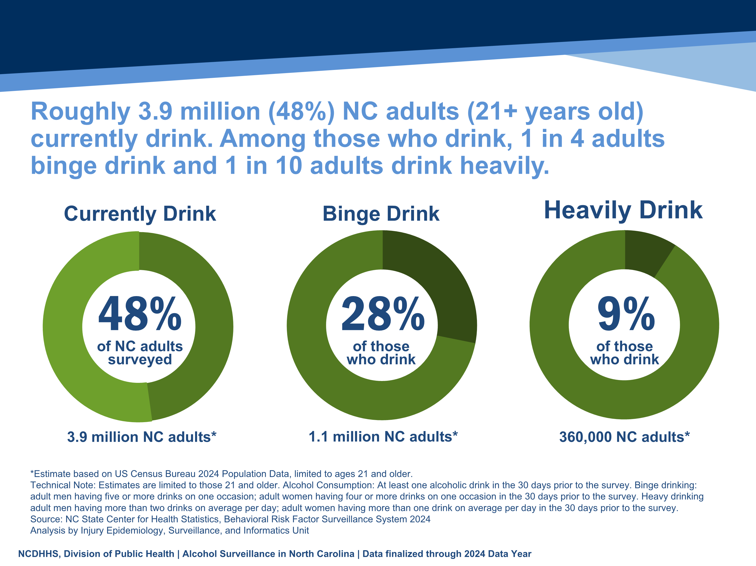
Roughly 3.9 million (48%) NC adults (21+ years old) currently drink. Among those who drink, 1 in 4 adults binge drink and 1 in 10 adults drink heavily.
48%
28%
9%
of NC adults surveyed
of those
who drink
of those
who drink
3.9 million NC adults*
1.1 million NC adults*
360,000 NC adults*
*Estimate based on US Census Bureau 2024 Population Data, limited to ages 21 and older.
Technical Note: Estimates are limited to those 21 and older. Alcohol Consumption: At least one alcoholic drink in the 30 days prior to the survey. Binge drinking: adult men having five or more drinks on one occasion; adult women having four or more drinks on one occasion in the 30 days prior to the survey. Heavy drinking adult men having more than two drinks on average per day; adult women having more than one drink on average per day in the 30 days prior to the survey.
Source: NC State Center for Health Statistics, Behavioral Risk Factor Surveillance System 2024
Analysis by Injury Epidemiology, Surveillance, and Informatics Unit
Notes:
Speaker’s notes: Adult alcohol use is an important public health concern. Alcohol use can reduce individual lifespan and at the community level, impact adult productivity and unemployment, impacting community health overall. In 2024, 48% of adults (21+) in NC currently drink, which is an estimated 3.9 million adults in North Carolina.
Of those adults who drink, 28% said that they binge drink (4+ drinks in one occasion for women, 5+ for men) at least one time per month, an estimated 1.1 million NC adults, and 9% said that they have drank heavily (8+ drinks in one week for women, 15+ for men), an estimated 360,000 NC adults.
Technical notes: Data are limited to those 21 years and older.
These data come from the Behavioral Risk Factor Surveillance System Survey (BRFSS). This is a yearly, random telephone survey of NC adults 18+ years old. Information is collected in a routine, standardized manner on a variety of health behaviors and preventive health practices, such as cardiovascular disease, cancer, diabetes, and injuries. BRFSS interviews are conducted year-round, and data are analyzed annually; a variety of yearly analyses are available at: https://schs.dph.ncdhhs.gov/data/brfss/survey.htm .

Slide 7
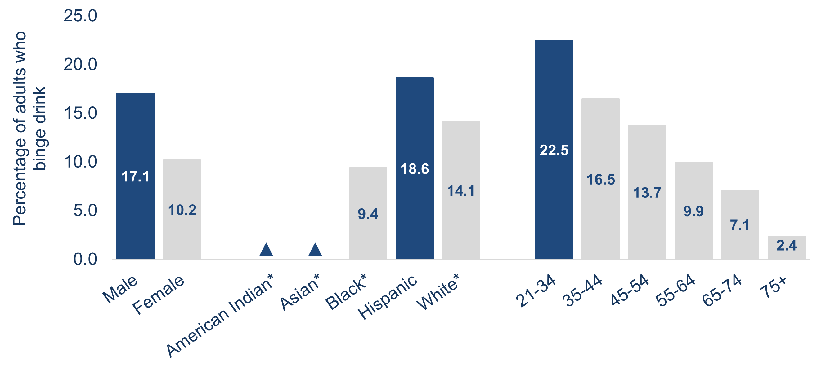
There is a higher percentage of binge drinking among adults who are male, Hispanic, or aged 21–34 years.
▲
▲
*Non-Hispanic ▲ Estimate suppressed because it did not meet minimum statistical reliability requirements
Example Interpretation: In 2024, 17.1% of male adults reported binge drinking at least once in the 30 days before the survey.
Technical Note: Estimates are limited to those 21 and older. Binge drinking: adult men having five or more drinks on one occasion; adult women having four or more drinks on one occasion in the 30 days prior to the survey.
Source: NC State Center for Health Statistics, Behavioral Risk Factor Surveillance System 2024
Analysis by Injury Epidemiology, Surveillance, and Informatics Unit
Notes:
Speaker’s notes: A higher percentage of adults who are male, Hispanic, or aged 21–34 years reported binge drinking.
Technical notes: Data are limited to those 21 years and older.
The percentages of adults who are American Indian non-Hispanic (NH) or Asian NH were suppressed due to estimates not meeting minimum statistical reliability requirements . Due to suppression, differences in binge drinking prevalence by race/ethnicity is not fully understood in NC. Binge drinking is the most common and costly pattern of excessive alcohol use. This does not give the full magnitude of adult binge drinking prevalence and subsequent related health outcome disparities among various demographic groups.
Socioeconomic conditions and historical trauma have led to persistent racial and ethnic disparities. These inequities, along with other factors, have contributed to the observed health disparity in binge drinking.
These data come from the Behavioral Risk Factor Surveillance System Survey (BRFSS). This is a yearly, random telephone survey of NC adults 18+ years old. Information is collected in a routine, standardized manner on a variety of health behaviors and preventive health practices, such as cardiovascular disease, cancer, diabetes, and injuries. BRFSS interviews are conducted year-round, and data are analyzed annually; a variety of yearly analyses are available at: https://schs.dph.ncdhhs.gov/data/brfss/survey.htm .
BRFSS methodology weights the sample by age, sex, race and ethnicity. Weighting improves the degree and extent to which the BRFSS sample is representative of the state’s adult population.

Slide 8
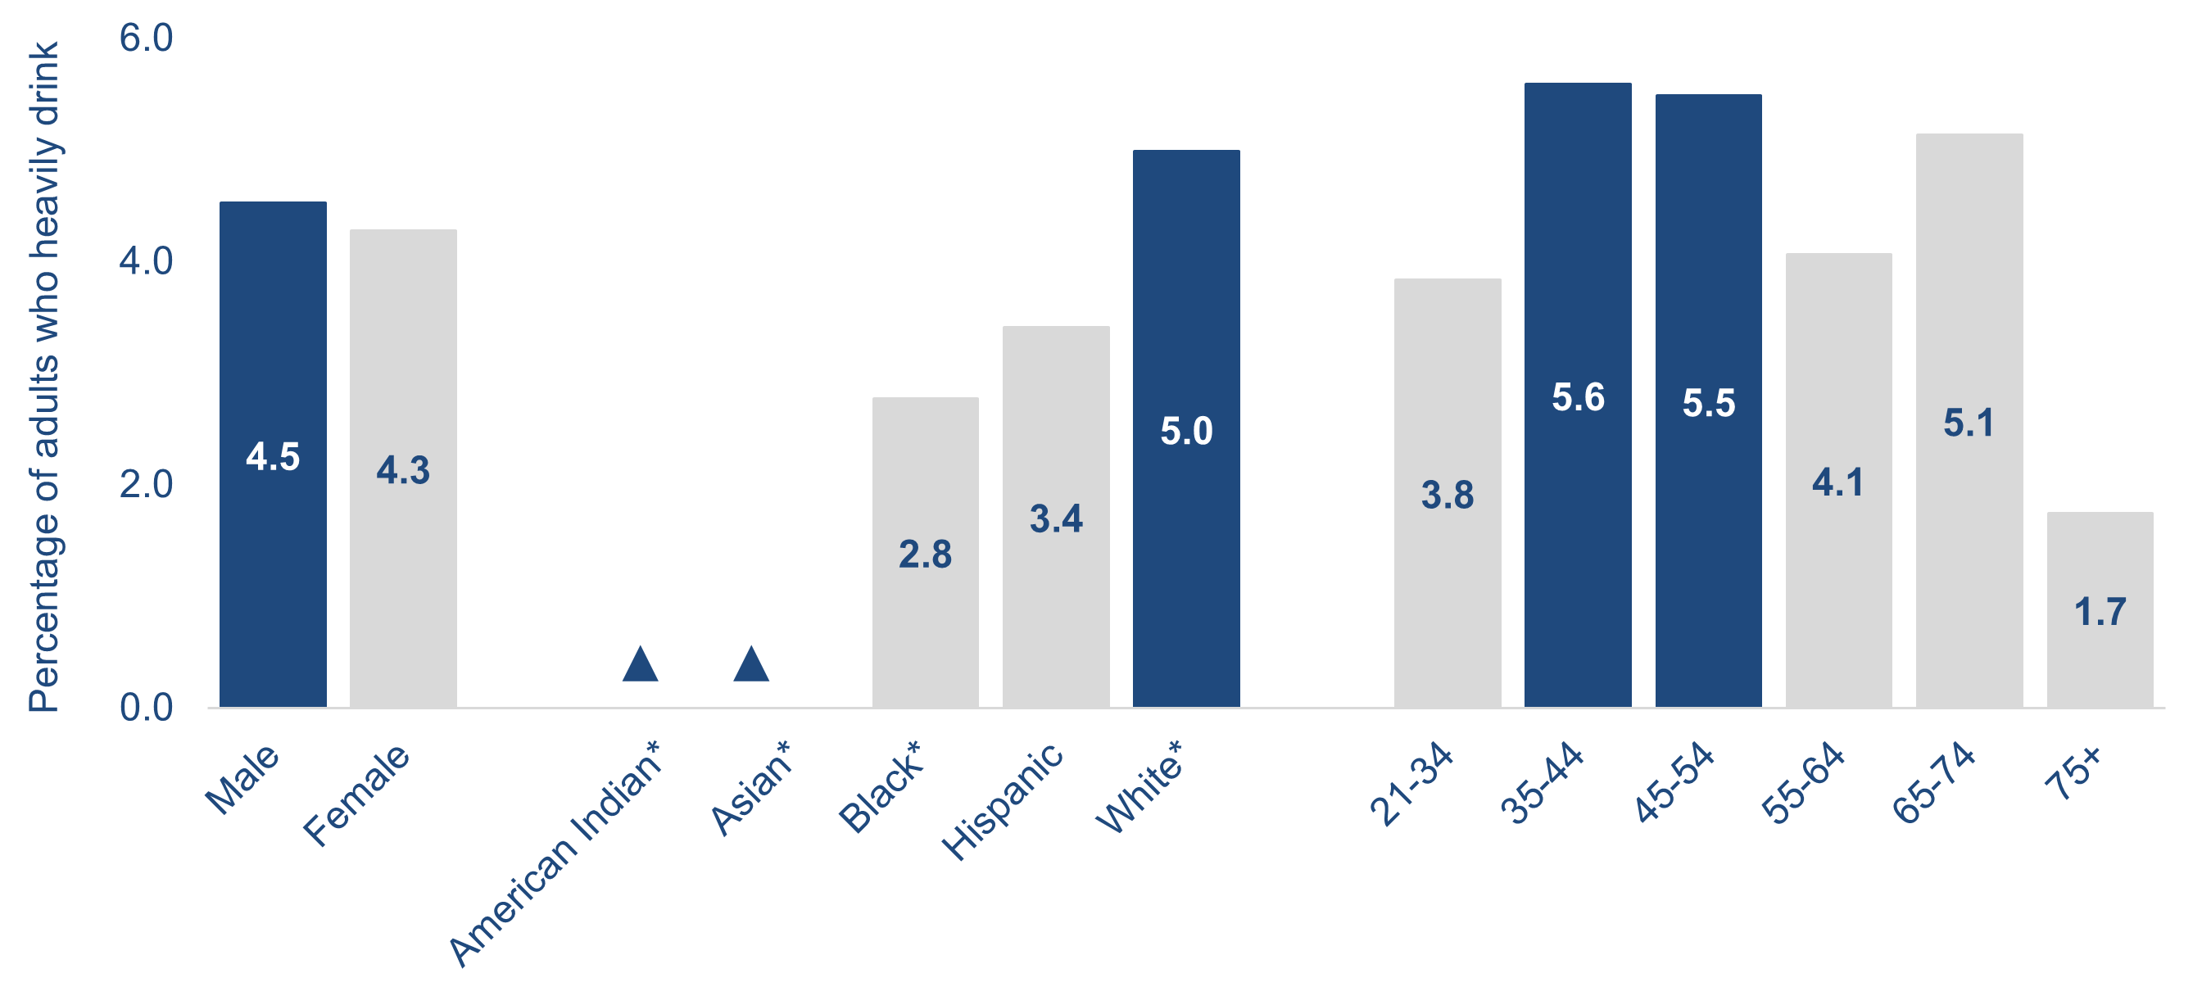
There is a higher percentage of heavy drinking among adults who are male, white*, or aged 35–54 years.
▲
▲
*Non-Hispanic ▲ Estimate suppressed because it did not meet minimum statistical reliability requirements
Example interpretation: In 2024, 4.5% of male adults reported drinking heavily in the past 30 days before the survey.
Technical note: Estimates are limited to those 21 and older. Heavy drinking: adult men having more than two drinks on average per day; adult women having more than drink on average per day in the 30 days prior to the survey.
Source: NC State Center for Health Statistics, Behavioral Risk Factor Surveillance System 2024
Analysis by Injury Epidemiology, Surveillance, and Informatics Unit
Notes:
Speaker’s notes: A higher percentage of adults who are male, white non-Hispanic (NH), or aged 35–54 years reported drinking heavily.
Technical notes: Data are limited to those 21 years and older.
The percentages of adults who are American Indian NH or Asian NH were suppressed due to estimates not meeting minimum statistical reliability requirements . Due to suppression, differences in heavy drinking prevalence between race/ethnicity is not fully understood in NC. This does not give the full magnitude of adult heavy drinking prevalence and subsequent related health outcome disparities among various demographic groups.
Socioeconomic conditions and historical trauma have led to persistent racial and ethnic disparities. These inequities, along with other factors, have contributed to the observed health disparity in heavy drinking.
These data come from the Behavioral Risk Factor Surveillance System Survey (BRFSS). This is a yearly, random telephone survey of NC adults 18+ years old. Information is collected in a routine, standardized manner on a variety of health behaviors and preventive health practices, such as cardiovascular disease, cancer, diabetes, and injuries. BRFSS interviews are conducted year-round, and data are analyzed annually; a variety of yearly analyses are available at: https://schs.dph.ncdhhs.gov/data/brfss/survey.htm .
BRFSS methodology weights the sample by age, sex, race and ethnicity. Weighting improves the degree and extent to which the BRFSS sample is representative of the state’s adult population.

Slide 9
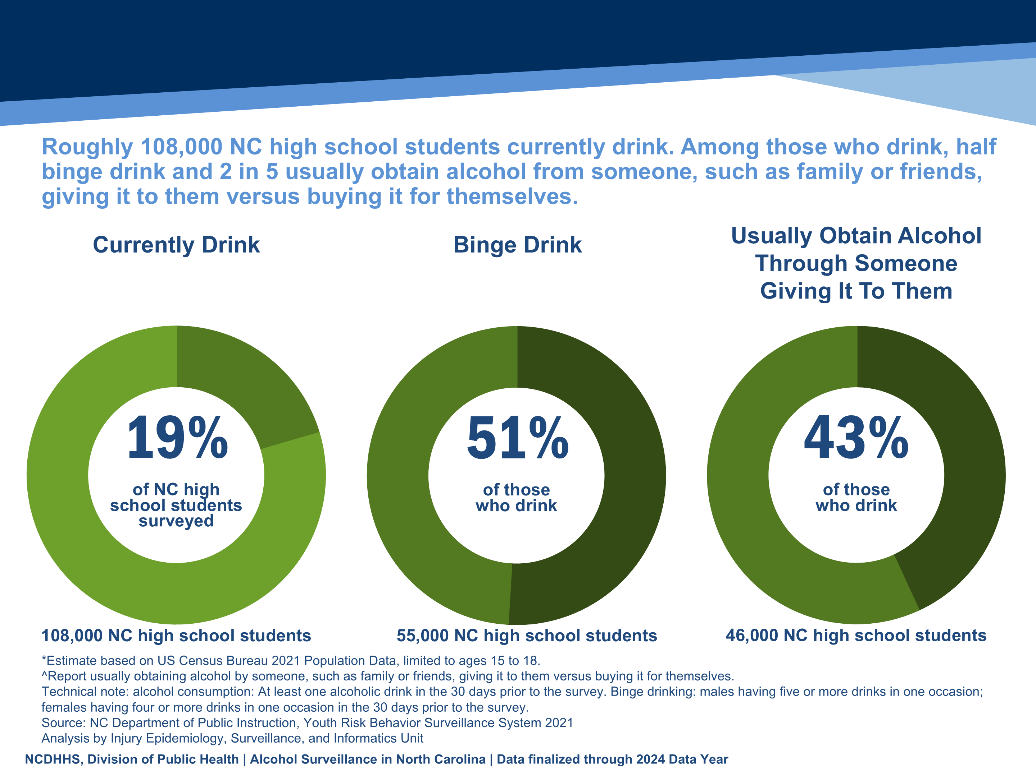
Roughly 108,000 NC high school students currently drink. Among those who drink, half binge drink and 2 in 5 usually obtain alcohol from someone, such as family or friends, giving it to them versus buying it for themselves.
Currently Drink
Binge Drink
Usually Obtain Alcohol Through Someone
Giving It To Them
19%
51%
43%
of NC high school students surveyed
of those
who drink
of those
who drink
108,000 NC high school students
55,000 NC high school students
46,000 NC high school students
*Estimate based on US Census Bureau 2021 Population Data, limited to ages 15 to 18.
^Report usually obtaining alcohol by someone, such as family or friends, giving it to them versus buying it for themselves.
Technical note: alcohol consumption: At least one alcoholic drink in the 30 days prior to the survey. Binge drinking: males having five or more drinks in one occasion; females having four or more drinks in one occasion in the 30 days prior to the survey.
Source: NC Department of Public Instruction, Youth Risk Behavior Surveillance System 2021
Analysis by Injury Epidemiology, Surveillance, and Informatics Unit
Notes:
Speaker’s notes: Underage alcohol use puts youth at a higher risk of injury, including motor vehicle crashes, suicide, sexual assault, and unprotected sex and other sexual risk behaviors. Understanding current alcohol use among people under 21 who drink helps develop appropriate public health interventions. In 2021, 19% of high school students in NC said they are currently drinking alcohol. Of those high school students who drink, 51% binge drink, and 43% usually obtained alcohol by someone, such as family or friends, giving it to them versus buying it for themselves.
Technical notes: These data come from the Youth Risk Behavior Surveillance System (YRBSS), which is conducted every other year. It asks middle and high school students questions about their behaviors that impact their health now and in the future. Topics include violence, personal safety, physical activity, nutrition, mental health, tobacco, drugs and alcohol, protective factors and sexual behavior questions. A variety of biannual analyses available: https://sites.google.com/dpi.nc.gov/nchealthyschools/nc-healthy-schools-data/yrbs . The most recent available YRBSS data is from 2023. 2021 YRBSS data was used due to questions on binge drinking behaviors not being available.

Slide 10
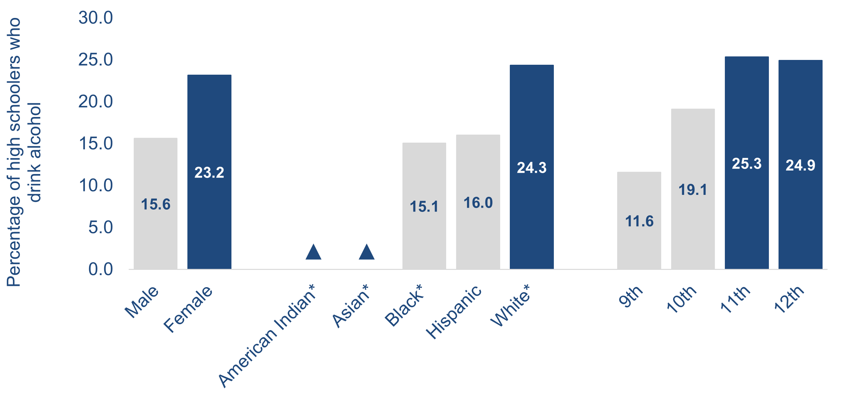
There is a higher percentage of alcohol use among high school students who are female, white*, or in 11th or 12th grade.
▲
▲
*Non-Hispanic ▲ Estimate not available due to a small number of students sampled.
Example interpretation: In 2021, 15.6% of male high school students reported drinking alcohol at least once in the 30 days before the survey.
Technical note: alcohol consumption: Percent of students who currently drank alcohol (at least one drink of alcohol on at least 1 day during the 30 days before the survey).
Source: NC Department of Public Instruction, Youth Risk Behavior Surveillance System 2021
Analysis by Injury Epidemiology, Surveillance, and Informatics Unit
Notes:
Speaker’s notes: A higher percentage of high school students who are female, white non-Hispanic (NH), or in 11th or 12th grade reported consuming alcohol.
Technical notes: The percentages of high school students who are American Indian NH or Asian NH were not available due to a small number of students sampled. Due to the small sample, race/ethnicity differences in youth alcohol use prevalence is not fully understood in NC. Youth who drink alcohol are more likely to experience school problems, social problems, disruption of development, violence, and many other alcohol-related outcomes. This does not give the full magnitude of youth alcohol use prevalence and subsequent related health outcome race/ethnicity disparities.
Socioeconomic conditions and historical trauma have led to persistent racial and ethnic disparities. These inequities, along with other factors, have contributed to the observed health disparity in alcohol use.
These data come from the Youth Risk Behavior Surveillance System (YRBSS), which is conducted every other year. It asks middle and high school students questions about their behaviors that impact their health now and in the future. Topics include violence, personal safety, physical activity, nutrition , mental health, tobacco, drugs and alcohol, protective factors and sexual behavior questions. A variety of biannual analyses available: https://sites.google.com/dpi.nc.gov/nchealthyschools/nc-healthy-schools-data/yrbs . The most recent available YRBSS data is from 2023. 2021 YRBSS data was used due to questions on binge drinking behaviors not being available.
YRBSS methodology weights the sample by sex, grade, race and ethnicity. Weighting improves the degree and extent to which the YRBSS sample is representative of the student population.

Slide 11
Alcohol-Attributable Mortality
Alcohol-attributable mortality refers to deaths that are fully or partially attributable to excessive alcohol use.
Notes:
Speaker’s notes: NC State Center for Health Statistics death certificate data are also leveraged for alcohol surveillance by applying CDC’s Alcohol-Related Disease Impact (ARDI) methodology. Alcohol-related mortality refers to deaths that are fully or partially attributable to alcohol use. Fully alcohol-attributable deaths are deaths that would not occur in the absence of alcohol, such as alcoholic liver disease or alcohol poisoning. Partially alcohol-attributable deaths are deaths where alcohol is a contributing factor in a proportion of the deaths from those conditions, such as certain types of cancer and heart disease.
Technical notes: For more information on the ARDI methodology, please visit https://nccd.cdc.gov/DPH_ARDI/default/default.aspx.

Slide 12
In 2024, an average of 15 North Carolinians died every day due to alcohol use.
Technical note: Alcohol-attributable deaths include deaths from both acute and chronic causes of death due to excessive use of alcohol. However, estimates calculated for cancer causes of death are due to any alcohol use. The Alcohol-Related Disease Impact (ARDI) methodology is used to calculate estimates over a specified period. The methodology is not set up to examine trends over time due to year-to-year variations in these estimates that may not be due to alcohol consumption. All estimates are currently based on alcohol consumption patterns of 2020-2021.
Source: NC State Center for Health Statistics, 2024; CDC ARDI Estimates for alcohol-attributable death by all causes of death - for more information on ARDI see https://nccd.cdc.gov/DPH_ARDI/default/default.aspx
Analysis by Injury Epidemiology, Surveillance, and Informatics Unit
Notes:
Speaker’s notes: In 2024, there were over 5,600 alcohol-attributable deaths in North Carolina. That is an average of 15 North Carolinians dying every day due to alcohol use.
Technical notes: Alcohol-attributable deaths include deaths from 58 acute and chronic causes of death due to excessive use of alcohol. However, estimates calculated for cancer causes of death are due to any alcohol use based on evidence that shows cancer is linked even to low levels of alcohol use. The Alcohol-Related Disease Impact (ARDI) methodology is used to calculate estimates over a specified period. The methodology is not set up to examine trends over time due to year-to-year variations in these estimates that may not be due to alcohol use. All estimates are currently based on alcohol use patterns of 2020-2021. All death estimates are directly related to alcohol, but estimates are calculated with either direct or indirect alcohol-attributable fractions (AAFs). AAFs are used to express the extent to which alcohol use contributes to a health outcome. Direct AAFs are based on scientific studies that have directly measured the relationship between excessive alcohol use and a given health outcome. Indirect AAFs use pooled risk estimates obtained from meta-analyses on the relationship between alcohol and various causes as well as data on the prevalence of alcohol use at specific levels. All AAFs, except the AAF for motor vehicle crashes, are national, not state-specific. For more information on the ARDI methodology, please visit https://nccd.cdc.gov/DPH_ARDI/default/default.aspx.
The Division of Public Health Alcohol Data Dashboard (https://www.dph.ncdhhs.gov/programs/chronic-disease-and-injury/injury-and-violence-prevention-branch/north-carolina-alcohol-use-and-related-harms-prevention/data) and Prevention Webpage (https://www.dph.ncdhhs.gov/programs/chronic-disease-and-injury/injury-and-violence-prevention-branch/north-carolina-alcohol-use-and-related-harms-prevention) share state and county-level estimates of acute, chronic, and total alcohol-attributable deaths as well as strategies to reduce excessive alcohol use and related harms.

Slide 13
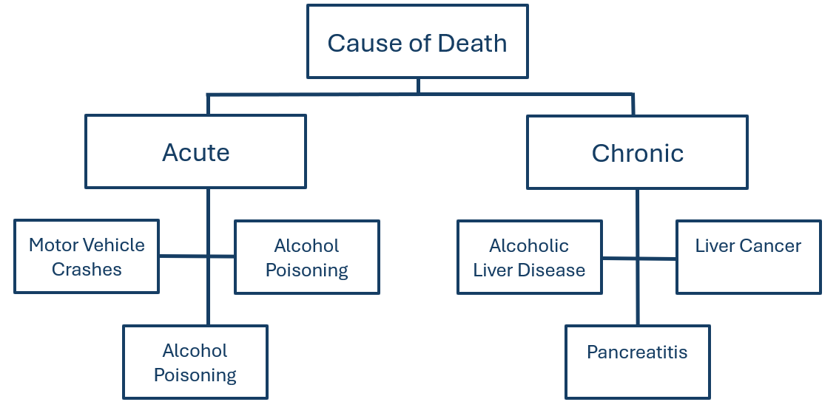
Examples of Alcohol-Attributable Deaths
Source: Selected Examples of Alcohol-Attributable Deaths. CDC Alcohol-Related Disease Impact: https://nccd.cdc.gov/DPH_ARDI/Info/ICDCodes.aspx
Notes:
Speaker’s notes: Of the alcohol-attributable deaths, some causes of death are acute, like falls, motor vehicle crashes, or alcohol poisoning. However, the majority of the alcohol-attributable deaths are due to chronic conditions. Some, like alcohol abuse or alcohol-induced pancreatitis, are 100% attributable to alcohol use, while others, like liver disease, certain cancers, and strokes, are partially attributable to alcohol use.
Technical notes: Alcohol-attributable deaths include deaths from 58 acute and chronic causes of death due to excessive use of alcohol. However, estimates calculated for cancer causes of death are due to any alcohol use based on evidence that shows cancer is linked even to low levels of alcohol use. The Alcohol-Related Disease Impact (ARDI) methodology is used to calculate estimates over a specified period. The methodology is not set up to examine trends over time due to year-to-year variations in these estimates that may not be due to alcohol use. All estimates are currently based on alcohol use patterns of 2020-2021. All death estimates are directly related to alcohol, but estimates are calculated with either direct or indirect alcohol-attributable fractions (AAFs). AAFs are used to express the extent to which alcohol use contributes to a health outcome. Direct AAFs are based on scientific studies that have directly measured the relationship between excessive alcohol use and a given health outcome. Indirect AAFs use pooled risk estimates obtained from meta-analyses on the relationship between alcohol and various causes as well as data on the prevalence of alcohol use at specific levels. All AAFs, except the AAF for motor vehicle crashes, are national, not state-specific. For more information on the ARDI methodology, please visit https://nccd.cdc.gov/DPH_ARDI/default/default.aspx.
The Division of Public Health Alcohol Data Dashboard (https://www.dph.ncdhhs.gov/programs/chronic-disease-and-injury/injury-and-violence-prevention-branch/north-carolina-alcohol-use-and-related-harms-prevention/data) and Prevention Webpage (https://www.dph.ncdhhs.gov/programs/chronic-disease-and-injury/injury-and-violence-prevention-branch/north-carolina-alcohol-use-and-related-harms-prevention) share state and county-level estimates of acute, chronic, and total alcohol-attributable deaths as well as strategies to reduce excessive alcohol use and related harms.

Slide 14
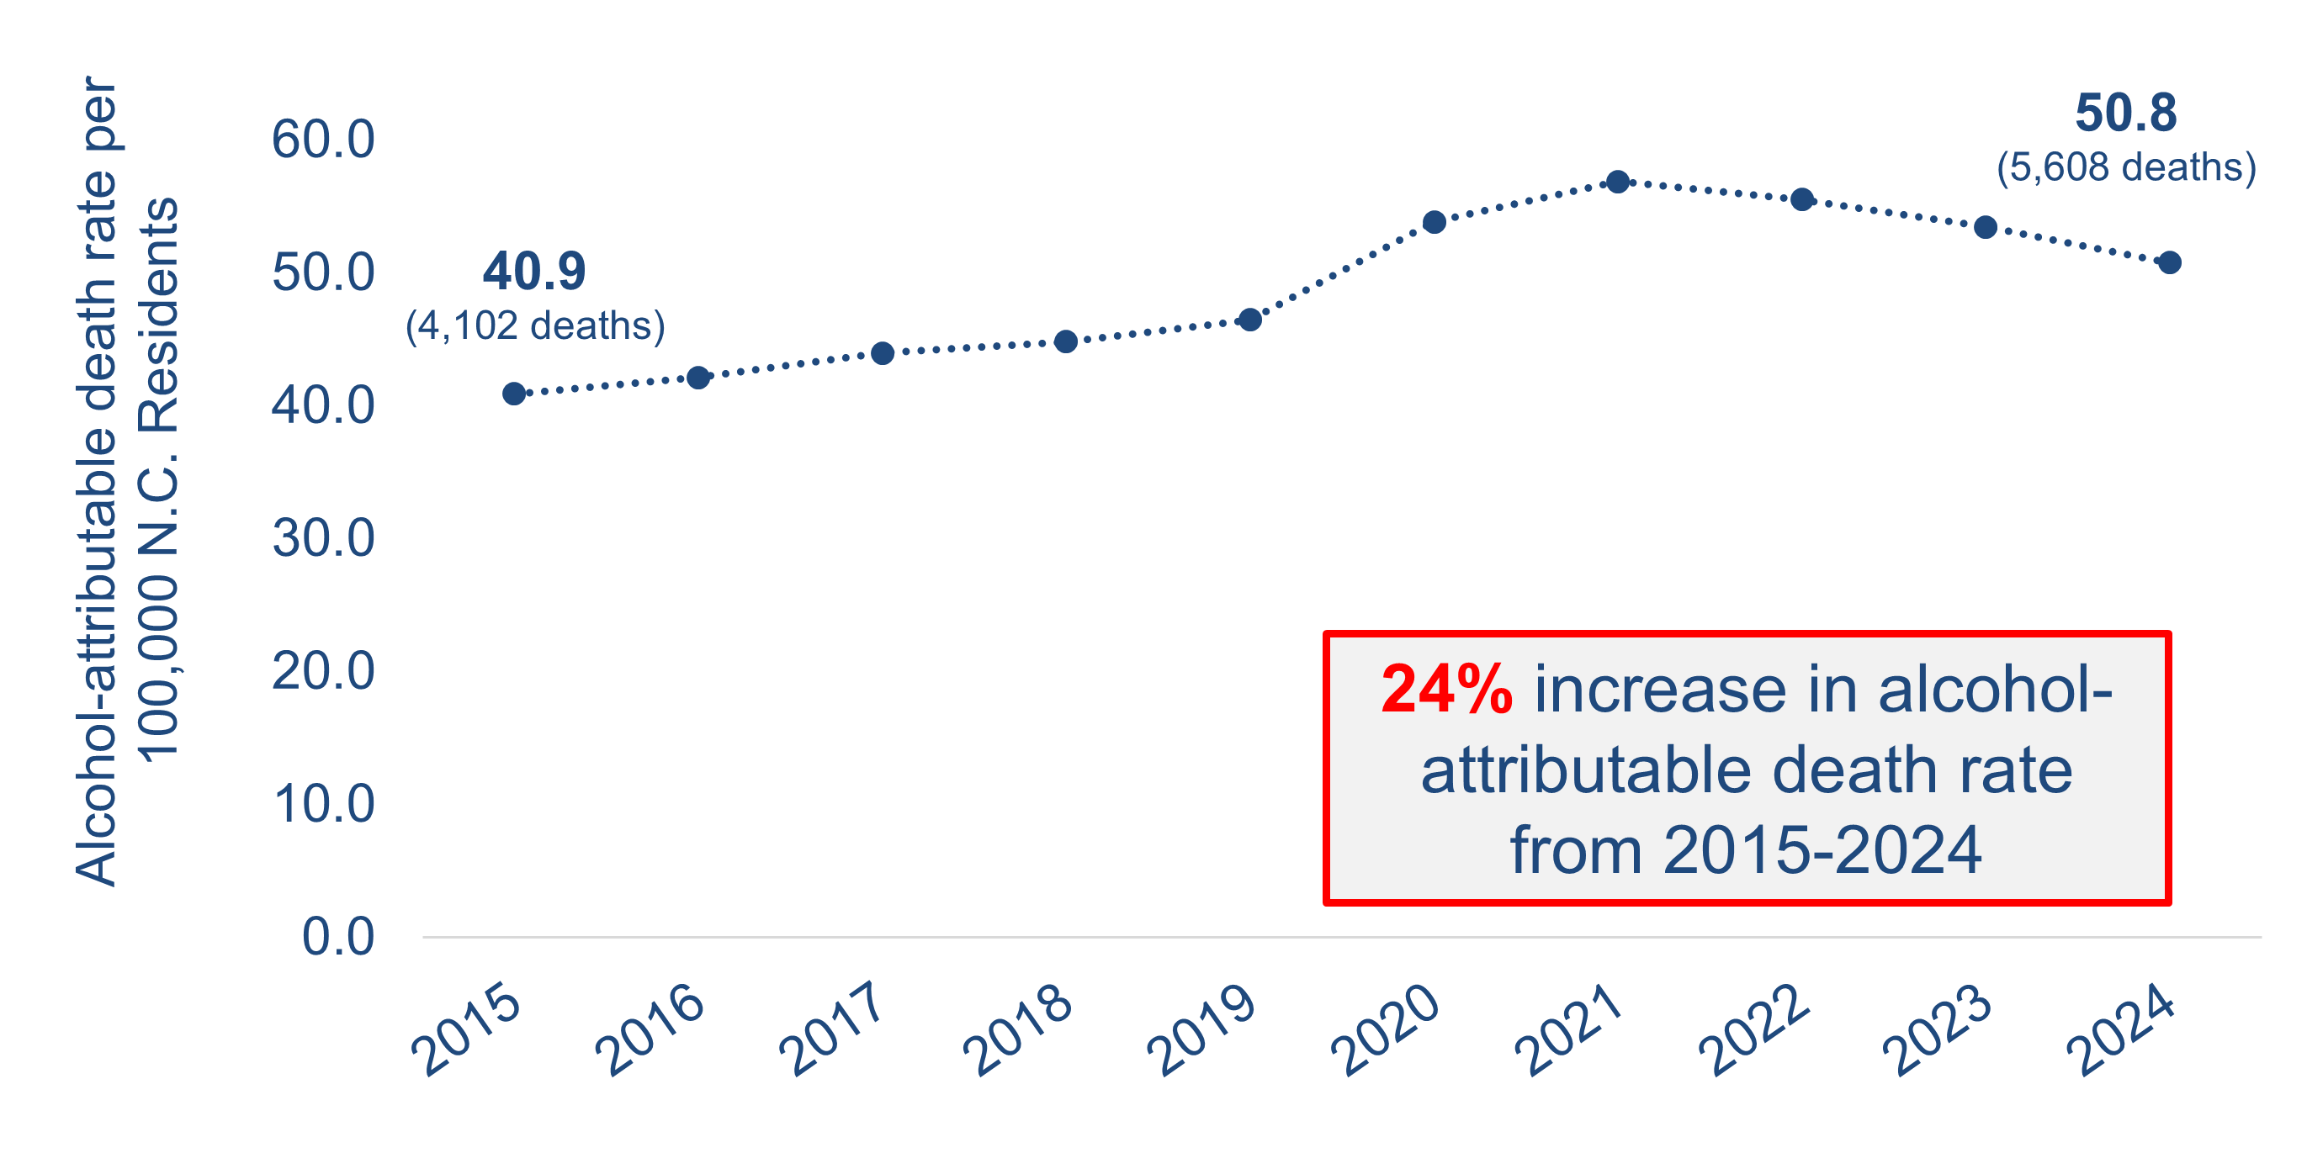
Alcohol-attributable death rates decreased slightly from 2021 to 2024, but rates are higher compared to 2015
24% increase in alcohol-attributable death rate from 2015-2024
Source: Death – NC State Center for Health Statistics (SCHS), Vital Statistics-Deaths, 2015-2024, and CDC’s Alcohol-Related Disease Impact (ARDI). Population – U.S Census, 2015-2024.
Analysis by Injury Epidemiology, Surveillance, and Informatics Unit
Notes:
Speaker’s notes: Using CDC’s Alcohol-Related Disease Impact (ARDI) methodology, the alcohol-attributable death rate was 50.8 deaths per 100,000 population in 2024, an estimated 5,608 deaths. Alcohol-attributable death rates have increased 24% since the 2015 death rate of 40.9 deaths per 100,000 population, an estimated 4,102 deaths.
Technical notes: Alcohol-attributable deaths include deaths from 58 acute and chronic causes of death due to excessive use of alcohol. However, estimates calculated for cancer causes of death are due to any alcohol use based on evidence that shows cancer is linked even to low levels of alcohol use. The Alcohol-Related Disease Impact (ARDI) methodology is used to calculate estimates over a specified period. The methodology is not set up to examine trends over time due to year-to-year variations in these estimates that may not be due to alcohol use. All estimates are currently based on alcohol use patterns of 2020-2021. All death estimates are directly related to alcohol, but estimates are calculated with either direct or indirect alcohol-attributable fractions (AAFs). AAFs are used to express the extent to which alcohol use contributes to a health outcome. Direct AAFs are based on scientific studies that have directly measured the relationship between excessive alcohol use and a given health outcome. Indirect AAFs use pooled risk estimates obtained from meta-analyses on the relationship between alcohol and various causes as well as data on the prevalence of alcohol use at specific levels. All AAFs, except the AAF for motor vehicle crashes, are national, not state-specific. For more information on the ARDI methodology, please visit https://nccd.cdc.gov/DPH_ARDI/default/default.aspx.
The Division of Public Health Alcohol Data Dashboard (https://www.dph.ncdhhs.gov/programs/chronic-disease-and-injury/injury-and-violence-prevention-branch/north-carolina-alcohol-use-and-related-harms-prevention/data) and Prevention Webpage (https://www.dph.ncdhhs.gov/programs/chronic-disease-and-injury/injury-and-violence-prevention-branch/north-carolina-alcohol-use-and-related-harms-prevention) share state and county-level estimates of acute, chronic, and total alcohol-attributable deaths as well as strategies to reduce excessive alcohol use and related harms.

Slide 15
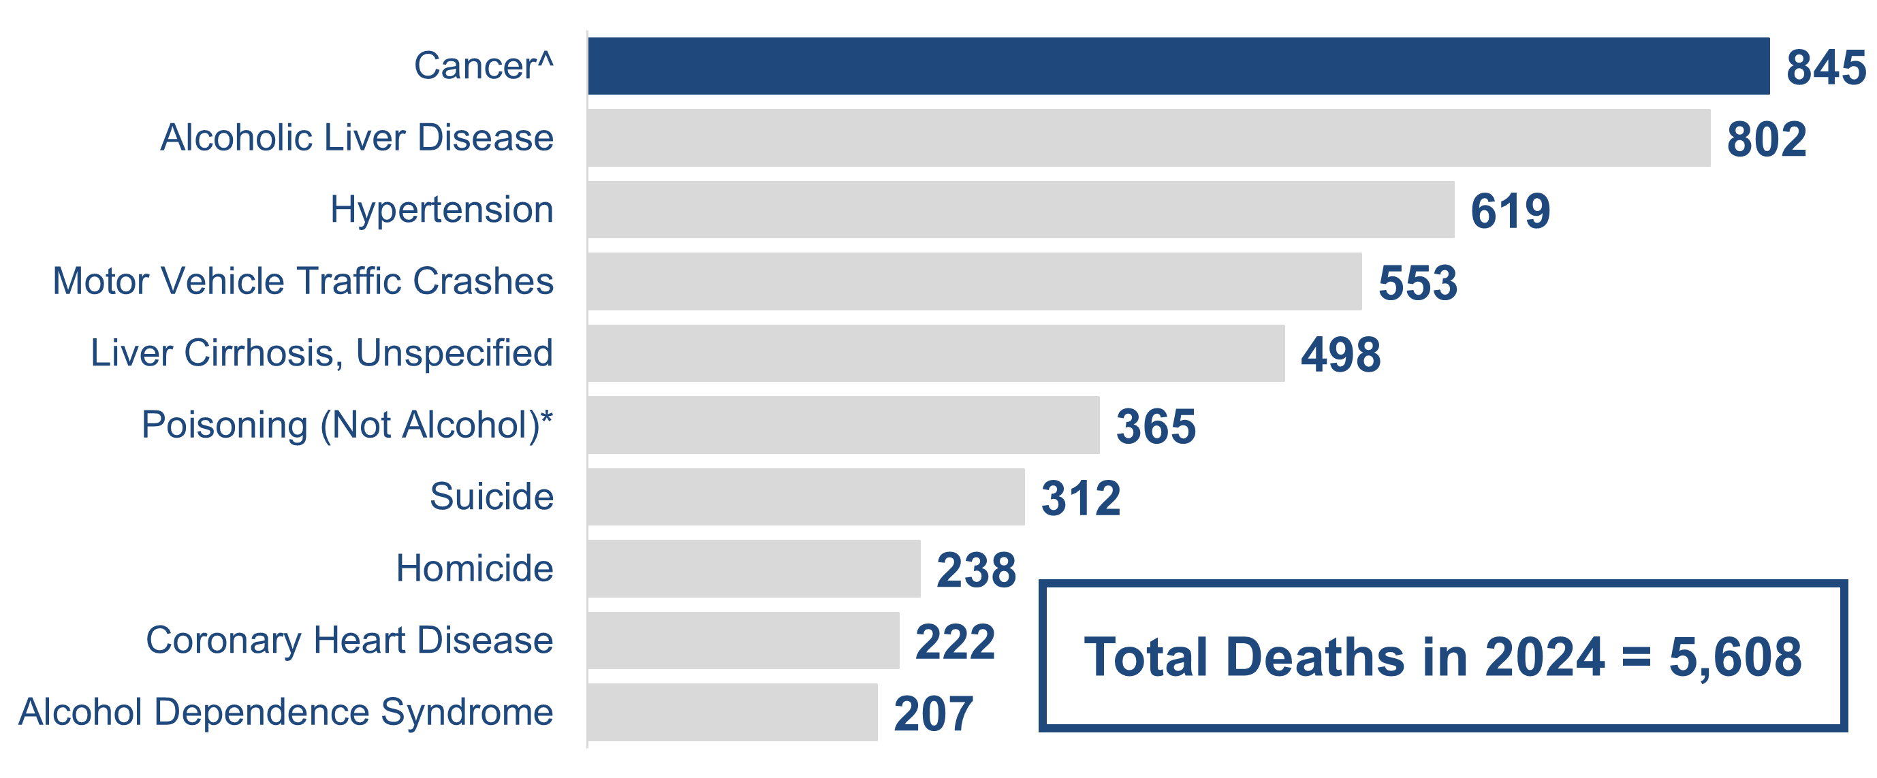
The leading cause of alcohol-attributable death in NC was due to cancer^
Total Deaths in 2024 = 5,608
^Alcohol-attributable cancer deaths include deaths from breast (female only), colorectal, esophageal, laryngeal, liver, pancreatic, prostate (male only), stomach, and oral cavity and pharyngeal cancers.
*Poisoning (Not Alcohol) deaths are deaths that involve another substance in addition to a high blood alcohol concentration (e.g., an opioid overdose with alcohol involvement).
Example interpretation: The leading cause of alcohol-attributable deaths was cancer^ with 845 deaths. Deaths due to cancer^ were 15% of all alcohol-attributable deaths in 2024.
Source: NC State Center for Health Statistics 2024, Vital Statistics, CDC Alcohol-Related Disease Impact (ARDI) estimates for alcohol-attributable death.
Analysis by Injury Epidemiology, Surveillance, and Informatics Unit
Notes:
Speaker’s notes: The leading cause of alcohol-attributable death in NC was due to cancer^.
845 alcohol-attributable deaths in 2024 were due to cancer^. Deaths due to cancer^ were 15% of all alcohol-attributable deaths in 2024.
Technical notes: Alcohol-attributable deaths include deaths from 58 acute and chronic causes of death due to excessive use of alcohol. However, estimates calculated for cancer causes of death are due to any alcohol use based on evidence that shows cancer is linked even to low levels of alcohol use. The Alcohol-Related Disease Impact (ARDI) methodology is used to calculate estimates over a specified period. The methodology is not set up to examine trends over time due to year-to-year variations in these estimates that may not be due to alcohol use. All estimates are currently based on alcohol use patterns of 2020-2021. All death estimates are directly related to alcohol, but estimates are calculated with either direct or indirect alcohol-attributable fractions (AAFs). AAFs are used to express the extent to which alcohol use contributes to a health outcome. Direct AAFs are based on scientific studies that have directly measured the relationship between excessive alcohol use and a given health outcome. Indirect AAFs use pooled risk estimates obtained from meta-analyses on the relationship between alcohol and various causes as well as data on the prevalence of alcohol use at specific levels. All AAFs, except the AAF for motor vehicle crashes, are national, not state-specific. For more information on the ARDI methodology, please visit https://nccd.cdc.gov/DPH_ARDI/default/default.aspx.
The Division of Public Health Alcohol Data Dashboard (https://www.dph.ncdhhs.gov/programs/chronic-disease-and-injury/injury-and-violence-prevention-branch/north-carolina-alcohol-use-and-related-harms-prevention/data) and Prevention Webpage (https://www.dph.ncdhhs.gov/programs/chronic-disease-and-injury/injury-and-violence-prevention-branch/north-carolina-alcohol-use-and-related-harms-prevention) share state and county-level estimates of acute, chronic, and total alcohol-attributable deaths as well as strategies to reduce excessive alcohol use and related harms.

Slide 16
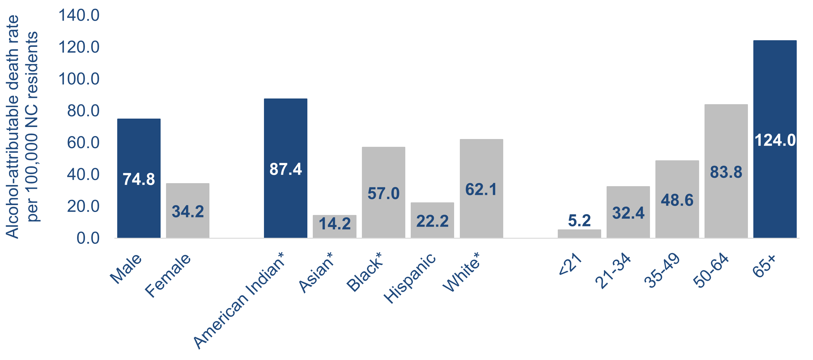
From 2020-2024, alcohol-attributable death rates were highest among individuals who are male, American Indian*, or aged 65 years and older.
*NH = Non-Hispanic
Example interpretation: From 2020-2024, the alcohol-attributable death rate for North Carolina males was 74.8 alcohol-attributable deaths per 100,000 population.
Technical note: Rates by race and ethnicity are calculated using the Alcohol-Related Disease Impact (ARDI) methodology to estimate alcohol-attributable deaths. ARDI does not provide stratification by race/ethnicity, only by age and sex. Alcohol-attributable deaths for race/ethnicity may be high among one race/ethnicity group due to a broader disparity in one of the 58 alcohol-attributable causes of death, and not necessarily due to a difference in alcohol involvement.
Source: Death – NC State Center for Health Statistics (SCHS), 2020-2024; CDC ARDI Estimates for alcohol-attributable death. Population – U.S. Census, 2020-2024
Analysis by Injury Epidemiology, Surveillance, and Informatics Unit
Notes:
Speaker’s notes: Looking at the most recent five years of available data (2020-2024), we can analyze descriptive trends within these alcohol-attributable deaths. Males have a higher rate of alcohol attributable deaths, at 74.8 per 100,000 population, compared with females at a little under half of that.
American Indian non-Hispanic (NH) residents have a higher rate of alcohol attributable death, at 87.4 per 100,000 population, with the next highest group being White NH residents at 62.1 per 100,000 population. Socioeconomic conditions and historical trauma have led to persistent racial and ethnic disparities. These inequities, along with other factors, have contributed to the observed health disparity in alcohol-attributable death rates.
Rates of alcohol-attributable death increased by age group. Even though the percent of older adults who report excessive drinking is low, the rates of alcohol-related death are high among this group. This is because the Alcohol-Related Disease Impact (ARDI) methodology considers both chronic and acute causes of death that are attributable to alcohol.
Technical notes: Alcohol-attributable deaths include deaths from 58 acute and chronic causes of death due to excessive use of alcohol. However, estimates calculated for cancer causes of death are due to any alcohol use based on evidence that shows cancer is linked even to low levels of alcohol use. The Alcohol-Related Disease Impact (ARDI) methodology is used to calculate estimates over a specified period. The methodology is not set up to examine trends over time due to year-to-year variations in these estimates that may not be due to alcohol use. All estimates are currently based on alcohol use patterns of 2020-2021. All death estimates are directly related to alcohol, but estimates are calculated with either direct or indirect alcohol-attributable fractions (AAFs). AAFs are used to express the extent to which alcohol use contributes to a health outcome. Direct AAFs are based on scientific studies that have directly measured the relationship between excessive alcohol use and a given health outcome. Indirect AAFs use pooled risk estimates obtained from meta-analyses on the relationship between alcohol and various causes as well as data on the prevalence of alcohol use at specific levels. All AAFs, except the AAF for motor vehicle crashes, are national, not state specific. For more information on the ARDI methodology, please visit https://nccd.cdc.gov/DPH_ARDI/default/default.aspx.
Rates were calculated for 2020 to 2024 by sex, age, and race/ethnicity using the ARDI methodology to estimate alcohol-attributable deaths. ARDI methodology only includes sex- and age-specific AAFs, which aid in the calculation of alcohol-attributable deaths. Due to AAFs not being available by race/ethnicity, alcohol-attributable deaths may be higher amongst one race/ethnicity due to a broader disparity in one of the 58 alcohol-attributable causes of death, and not necessarily attributable to alcohol's involvement. For example, one race/ethnicity may have a higher rate of drowning (acute cause of death), which would lead to a higher total and acute alcohol-attributable rate estimate. In addition, with race/ethnicity data, demographic misclassifications could have occurred during the death certification process. For more information on the ARDI methodology, please visit https://nccd.cdc.gov/DPH_ARDI/default/default.aspx.
The Division of Public Health Alcohol Data Dashboard (https://www.dph.ncdhhs.gov/programs/chronic-disease-and-injury/injury-and-violence-prevention-branch/north-carolina-alcohol-use-and-related-harms-prevention/data) and Prevention Webpage (https://www.dph.ncdhhs.gov/programs/chronic-disease-and-injury/injury-and-violence-prevention-branch/north-carolina-alcohol-use-and-related-harms-prevention) share state and county-level estimates of acute, chronic, and total alcohol-attributable deaths as well as strategies to reduce excessive alcohol use and related harms.

Slide 17
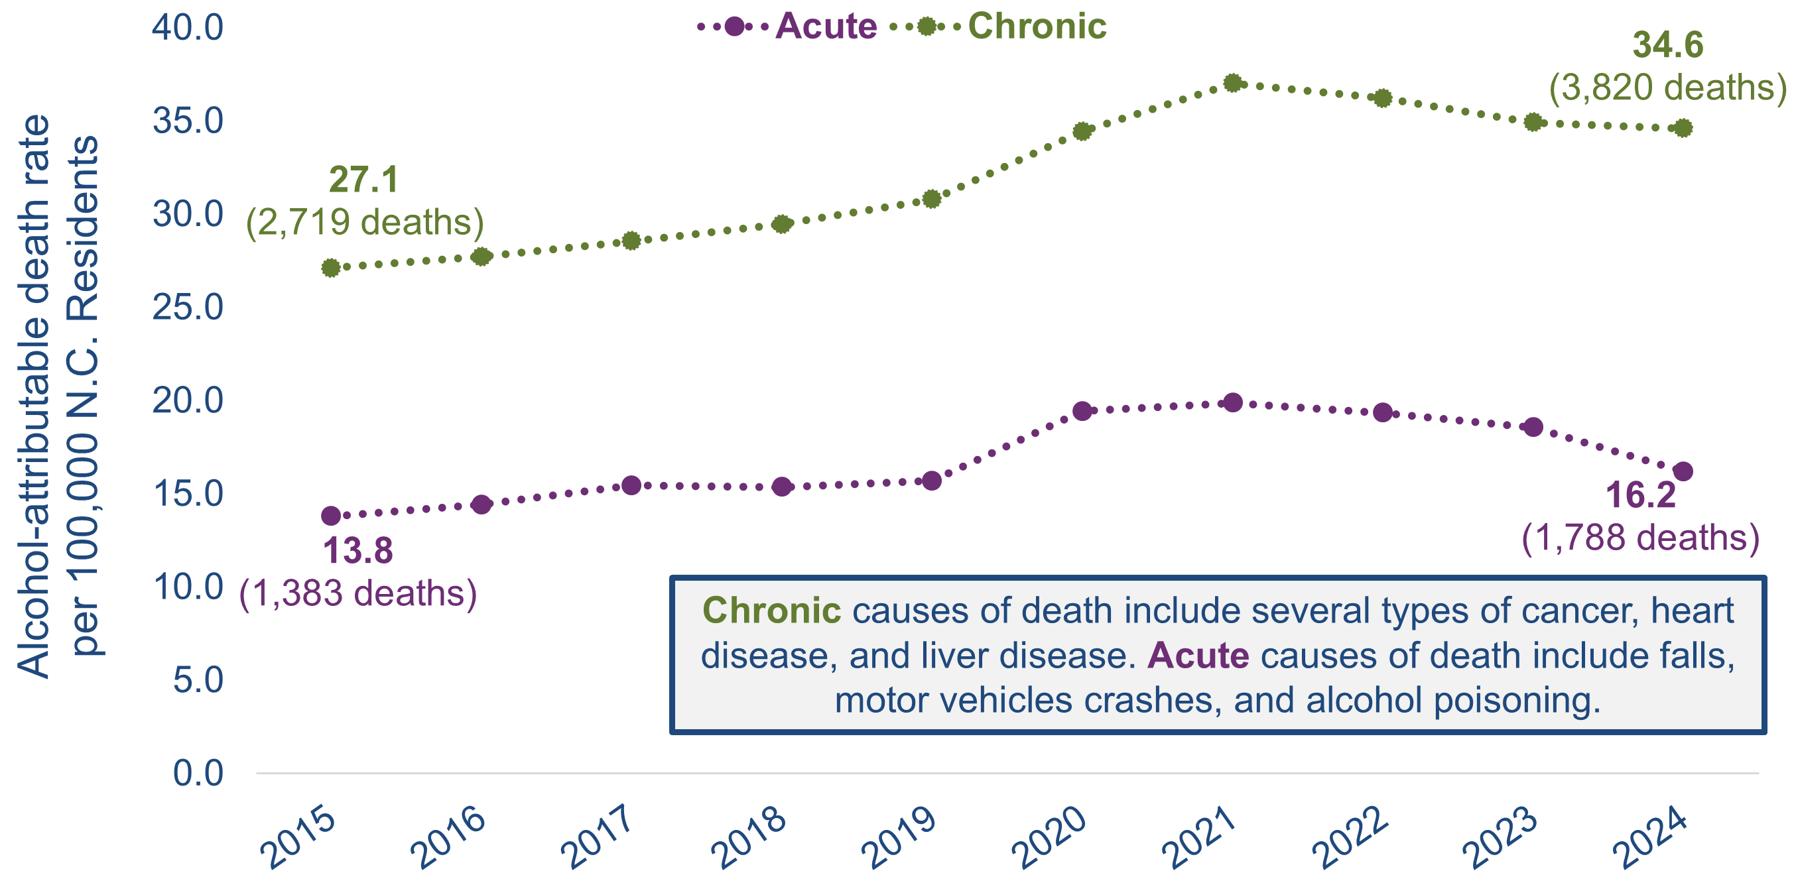
Alcohol-attributable death rates were highest for chronic causes of death.
Chronic causes of death include several types of cancer, heart disease, and liver disease. Acute causes of death include falls, motor vehicles crashes, and alcohol poisoning.
Source: NC State Center for Health Statistics (SCHS), Vital Statistics-Deaths, 2015-2024, and CDC’s Alcohol-Related Disease Impact (ARDI). Population – U.S. Census, 2015-2024
Analysis by Injury Epidemiology, Surveillance, and Informatics Unit
Notes:
Speaker’s notes: From 2015 to 2024, alcohol-attributable death rates were highest for chronic causes of death. However, rates increased for both chronic and acute causes of alcohol-attributable death, a 24% increase for chronic causes and a 17% increase for acute causes. For chronic causes, the rate increased from 27.1, an estimated 2,719 deaths, to 34.6, an estimated 3,820 deaths, per 100,000 population. For acute causes, the rate increased from 13.8, an estimated 1,383 deaths, to 16.2, an estimated 1,788 deaths, per 100,000 population.
Technical notes: Alcohol-attributable deaths include deaths from 58 acute and chronic causes of death due to excessive use of alcohol. However, estimates calculated for cancer causes of death are due to any alcohol use based on evidence that shows cancer is linked even to low levels of alcohol use. The Alcohol-Related Disease Impact (ARDI) methodology is used to calculate estimates over a specified period. The methodology is not set up to examine trends over time due to year-to-year variations in these estimates that may not be due to alcohol use. All estimates are currently based on alcohol use patterns of 2020-2021. All death estimates are directly related to alcohol, but estimates are calculated with either direct or indirect alcohol-attributable fractions (AAFs). AAFs are used to express the extent to which alcohol use contributes to a health outcome. Direct AAFs are based on scientific studies that have directly measured the relationship between excessive alcohol use and a given health outcome. Indirect AAFs use pooled risk estimates obtained from meta-analyses on the relationship between alcohol and various causes as well as data on the prevalence of alcohol use at specific levels. All AAFs, except the AAF for motor vehicle crashes, are national, not state-specific. For more information on the ARDI methodology, please visit https://nccd.cdc.gov/DPH_ARDI/default/default.aspx.
The Division of Public Health Alcohol Data Dashboard (https://www.dph.ncdhhs.gov/programs/chronic-disease-and-injury/injury-and-violence-prevention-branch/north-carolina-alcohol-use-and-related-harms-prevention/data) and Prevention Webpage (https://www.dph.ncdhhs.gov/programs/chronic-disease-and-injury/injury-and-violence-prevention-branch/north-carolina-alcohol-use-and-related-harms-prevention) share state and county-level estimates of acute, chronic, and total alcohol-attributable deaths as well as strategies to reduce excessive alcohol use and related harms. Chronic alcohol-attributable deaths often result from long-term, excessive use of alcohol. However, estimates calculated for cancer causes of death, which are chronic causes of death, are due to any alcohol use based on evidence that shows cancer is linked to low levels of alcohol use. Acute alcohol-attributable deaths often result from short-term, excessive use of alcohol.

Slide 18
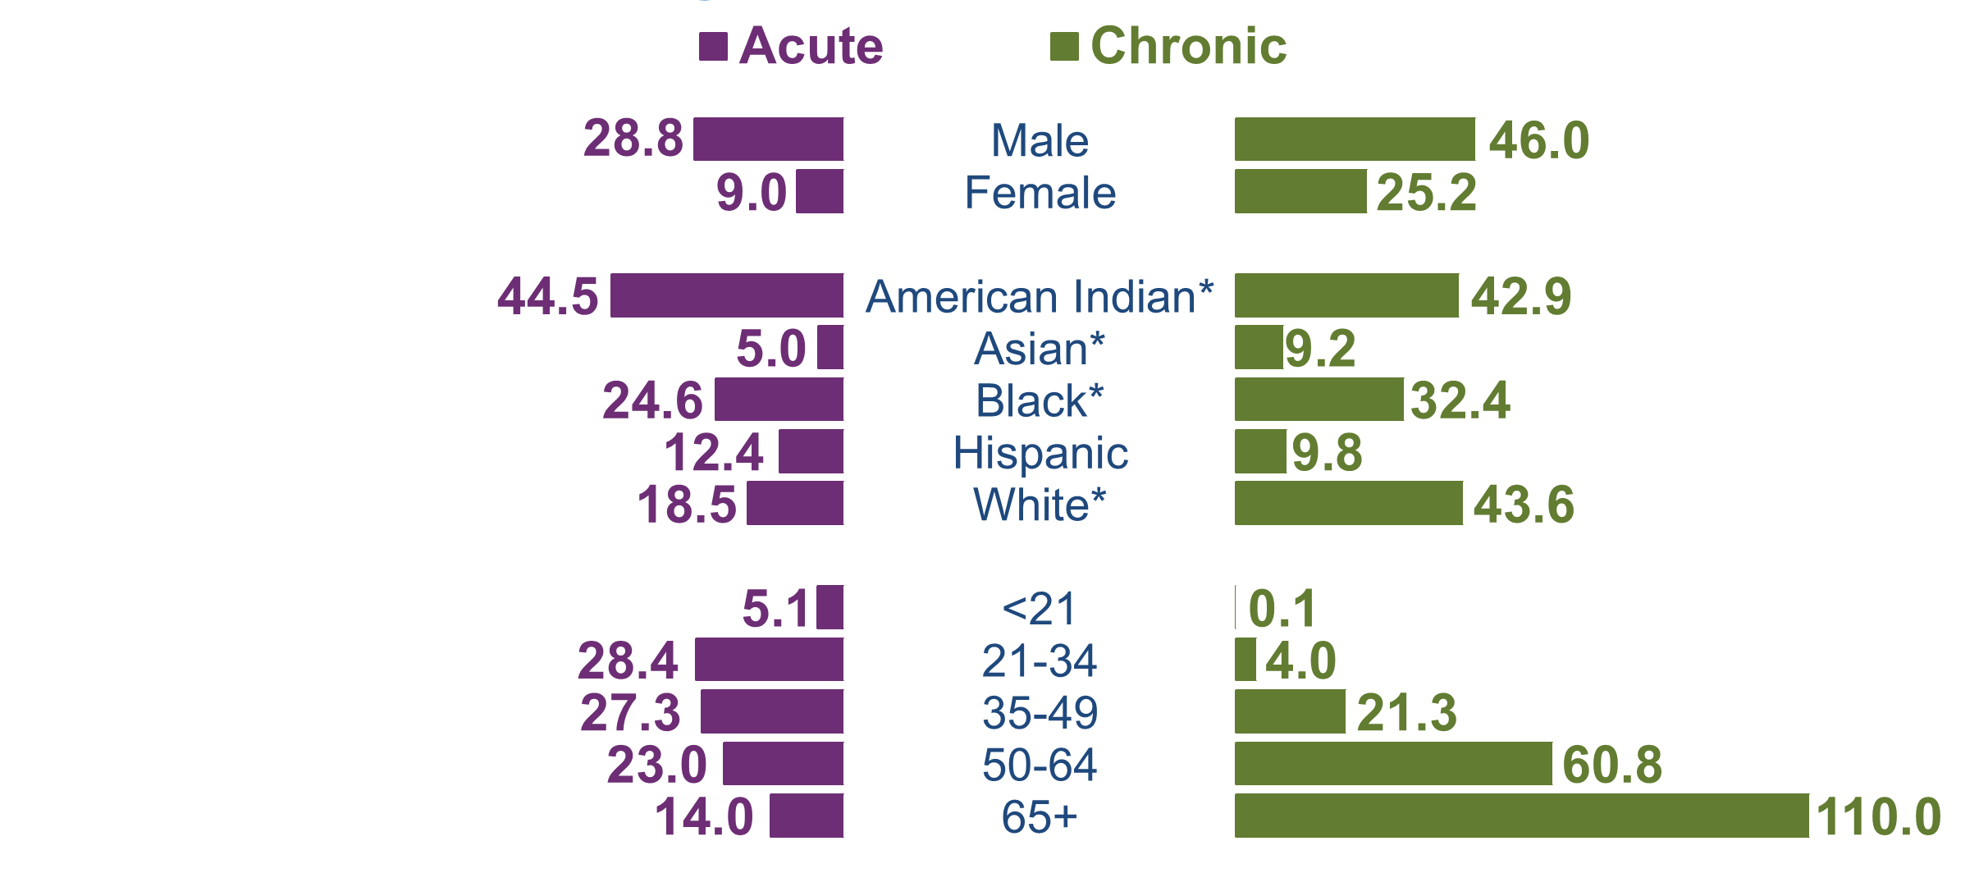
The rates of acute and chronic alcohol-attributable deaths are consistent across sex and race. However, as age increases, the rate of chronic alcohol attributable deaths is higher than acute deaths.
*Non-Hispanic
Example interpretation: From 2020-2024, the acute alcohol-attributable death rate for North Carolina males was 28.8 deaths per 100,000 population. The chronic alcohol-attributable death rate for North Carolina males was 46.0 deaths per 100,000 population.
Technical note: Rates by race and ethnicity are calculated using the Alcohol-Related Disease Impact (ARDI) methodology to estimate alcohol-attributable deaths. ARDI does not provide stratification by race/ethnicity, only by age and sex. Alcohol-attributable deaths for race/ethnicity may be high among one race/ethnicity group due to a broader disparity in one of the 58 alcohol-attributable causes of death, and not necessarily attributable to alcohol's involvement.
Source: NC State Center for Health Statistics (SCHS), 2020-2024; CDC ARDI Estimates for acute and chronic alcohol-attributable death. Population – U.S. Census, 2020-2024
Analysis by Injury Epidemiology, Surveillance, and Informatics Unit
Notes:
Speaker’s notes: Looking at the most recent five years of available data (2020-2024), we can analyze descriptive trends within acute and chronic alcohol-attributable deaths. Acute and chronic alcohol-attributable death rates were similar by sex, with male residents having higher rates than female residents.
Acute alcohol-attributable death rates were highest among individuals who are American Indian non-Hispanic (NH) or Black NH. Chronic alcohol-attributable death rates were highest among individuals who are American Indian NH or white NH. Socioeconomic conditions and historical trauma have led to persistent racial and ethnic disparities. These inequities, along with other factors, have contributed to the observed health disparity in both acute and chronic alcohol-attributable death rates.
Acute alcohol-attributable death rates were highest among those aged 21 to 34, with a death rate of 28.4 per 100,000 population. Among chronic alcohol-attributable deaths, the death rates increase with age, with a death rate of 110.0 per 100,000 population for people aged 65 and older.
Technical notes: Alcohol-attributable deaths include deaths from 58 acute and chronic causes of death due to excessive use of alcohol. However, estimates calculated for cancer causes of death are due to any alcohol use based on evidence that shows cancer is linked even to low levels of alcohol use. The Alcohol-Related Disease Impact (ARDI) methodology is used to calculate estimates over a specified period. The methodology is not set up to examine trends over time due to year-to-year variations in these estimates that may not be due to alcohol use. All estimates are currently based on alcohol use patterns of 2020-2021. All death estimates are directly related to alcohol, but estimates are calculated with either direct or indirect alcohol-attributable fractions (AAFs). AAFs are used to express the extent to which alcohol use contributes to a health outcome. Direct AAFs are based on scientific studies that have directly measured the relationship between excessive alcohol use and a given health outcome. Indirect AAFs use pooled risk estimates obtained from meta-analyses on the relationship between alcohol and various causes as well as data on the prevalence of alcohol use at specific levels. All AAFs, except the AAF for motor vehicle crashes, are national, not state-specific. For more information on the ARDI methodology, please visit https://nccd.cdc.gov/DPH_ARDI/default/default.aspx.
Rates were calculated for 2020 to 2024 by sex, age, and race/ethnicity using the ARDI methodology to estimate alcohol-attributable deaths. ARDI methodology only includes sex- and age-specific AAFs, which aid in the calculation of alcohol-attributable deaths. Due to AAFs not being available by race/ethnicity, alcohol-attributable deaths may be higher amongst one race/ethnicity due to a broader disparity in one of the 58 alcohol-attributable causes of death and not necessarily attributable to alcohol's involvement. For example, one race/ethnicity may have a higher rate of drowning (acute cause of death), which would lead to a higher total and acute alcohol-attributable rate estimate. In addition, with race/ethnicity data, demographic misclassifications could have occurred during the death certification process. For more information on the ARDI methodology, please visit https://nccd.cdc.gov/DPH_ARDI/default/default.aspx.
The Division of Public Health Alcohol Data Dashboard (https://www.dph.ncdhhs.gov/programs/chronic-disease-and-injury/injury-and-violence-prevention-branch/north-carolina-alcohol-use-and-related-harms-prevention/data) and Prevention Webpage (https://www.dph.ncdhhs.gov/programs/chronic-disease-and-injury/injury-and-violence-prevention-branch/north-carolina-alcohol-use-and-related-harms-prevention) share state and county-level estimates of acute, chronic, and total alcohol-attributable deaths as well as strategies to reduce excessive alcohol use and related harms. Chronic alcohol-attributable deaths often result from long-term, excessive use of alcohol. However, estimates calculated for cancer causes of death, which are chronic causes of death, are due to any alcohol use based on evidence that shows cancer is linked to low levels of alcohol use. Acute alcohol-attributable deaths often result from short-term, excessive use of alcohol.

Slide 19
Alcohol-Related Cost
Notes:
Speaker’s notes: Excessive alcohol use can also impact the economy of North Carolina.

Slide 20
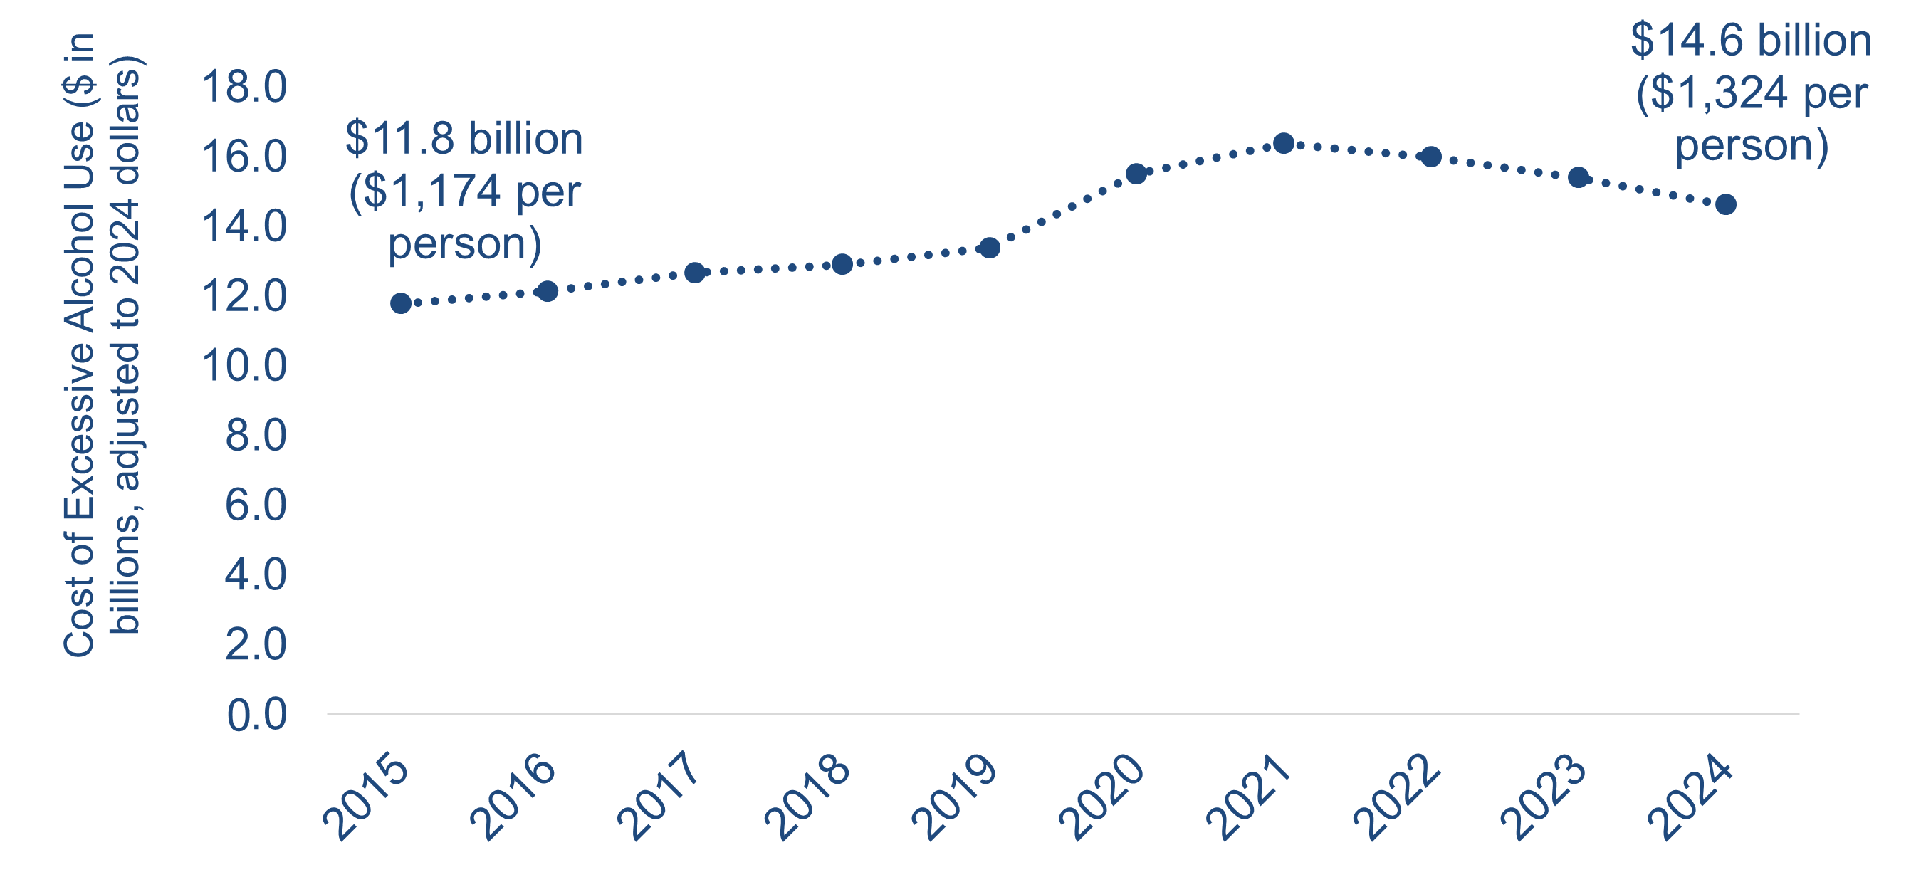
In 2024, NC lost an estimated $14.6 billion* due to alcohol use^
0
*All costs have been adjusted to 2024 dollars
^Costs due to alcohol use include losses in productivity, healthcare costs, criminal justice expenses, and motor vehicle crashes
Source: Following the methods of Gora Combs, K., Fliss, M. D., Knuth, K. B., Cox, M. E., &amp; Trangenstein, P. J. (2022). The societal cost of excessive drinking in North Carolina, 2017. North Carolina Medical Journal, 83(3), 214–220. https://doi.org/10.18043/ncm.83.3.214
Notes:
Speaker’s notes: The economic cost of excessive alcohol use includes losses in productivity, healthcare costs, criminal justice expenses, and motor vehicle crashes for one year. In 2024, NC lost an estimated $14.6 billion due to excessive alcohol use, roughly $1,324 per person.
Technical notes: The numbers generated in this slide were estimated using the methods by Combs et. al, 2017 study, “The Societal Cost of Excessive Drinking in North Carolina, 2017” (https://pubmed.ncbi.nlm.nih.gov/35504714/), and adjusted to changes in inflation and alcohol-attributable death rates.

Slide 21
Preventing Excessive Alcohol Use and Related Harms
Notes:
Speaker’s notes: In light of these trends, there are numerous opportunities for prevention and reduction of excessive alcohol use and its related harms.

Slide 22
Evidence-based strategies to reduce excessive alcohol use and its related harms in NC
Government Control of Alcohol Sales – Government control of alcohol sales limits excessive availability and exposure to alcohol, reducing excessive alcohol use and related injury, illness, and death.
Alcohol Taxes – Tax increases raise the price of alcohol, which decreases excessive alcohol use and related harms – and increases state revenue too.
Limits on Days and Hours of Alcohol Sales – Maintaining existing hours and days of alcohol sales helps control excessive alcohol use and related health outcomes.
Regulate Number of Places Selling Alcohol and Distance Between Them – Regulating the number of places selling alcohol and the distance between them limits excessive access to alcohol.
Commercial Host Liability Laws – Maintain laws that permit retail establishments to be held liable for injuries or harms caused by illegal service to intoxicated or underage customers.
Electronic Screening and Brief Intervention – Increase electronic screening of excessive drinking in adults and provide a brief intervention with those who screen positive.
Source: CPSTF Findings for Excessive Alcohol Use
Notes:
Speaker’s notes: The Community Preventive Services Task Force issued several evidence-based recommendations for reducing excessive drinking. When alcohol is less available, less accessible, and more expensive, people tend to drink less. The following proven strategies work to prevent excessive alcohol use to create communities that promote health and well-being:
Government Control of Alcohol Sales – In NC, the sale of liquor is limited to ABC stores where price is controlled by the Alcoholic Beverage Control (ABC) Commission. Government control of alcohol sales limits excessive availability and exposure to alcohol, which in turn reduces excessive alcohol use and related injury, illness, and death. Laws that privatize alcohol sales by removing government control increase the number of places that sell alcohol, which increases excessive alcohol use and alcohol-related harms, such as child maltreatment and neglect, domestic violence, and motor vehicle crashes.
Alcohol Taxes – An excise tax is levied on alcoholic beverages sold in and/or shipped into NC. Tax increases raise the price of alcohol, which decreases excessive alcohol use and related harms – and increases revenue too. Laws that decrease alcohol excise taxes lead to increases in motor vehicle crash deaths, violence, and lower state revenue.
Limit the days and hours of alcohol sales – NC limits the sale of alcohol to particular hours and days of the week and prohibits sales on certain holidays. Maintaining existing hours and days of alcohol sales helps control excessive alcohol use and negative health outcomes. Increases to hours and days of sale lead to increases in motor vehicle injuries, as well as alcohol-related assaults and other injuries.
Regulate Number of Places Selling Alcohol and Distance Between Them – Regulating the number of places selling alcohol and the distance between them limits excessive access to alcohol. Having more places that sell alcohol leads to increases in disorderly conduct, property damage, crime, and other community disruptions.
Commercial host liability laws – These laws permit retail establishments to be held liable for injuries or harms caused by illegal service to intoxicated or underage customers.
Electronic alcohol screening and brief intervention (e-SBI) – Increase electronic screening of excessive drinking in adults and provide a brief intervention with those who screen positive.
Technical notes: The Community Preventive Services Task Force (CPSTF) is an independent, non-federal, volunteer body of public health and prevention experts. CPSTF provides recommendations and findings on programs, services, and other interventions to protect and improve population health. The recommendations and findings are based on systematic reviews of evidence on the effectiveness and economic impact. For more information on CPSTF and excessive alcohol use prevention strategies, please visit https://www.thecommunityguide.org/topics/excessive-alcohol-consumption.html
.

Slide 23
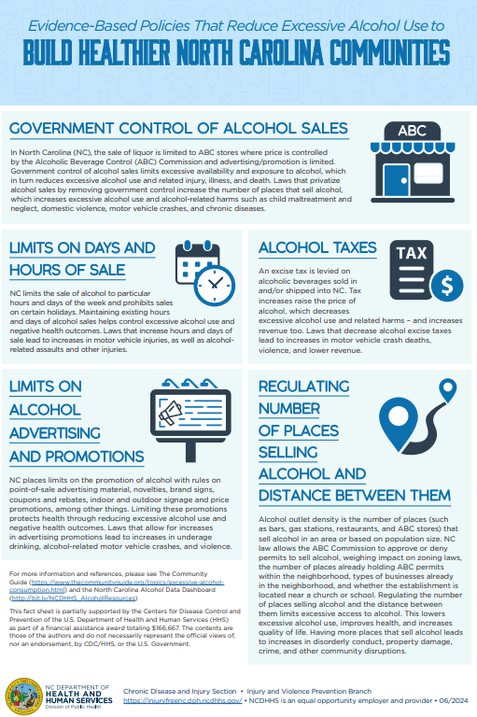
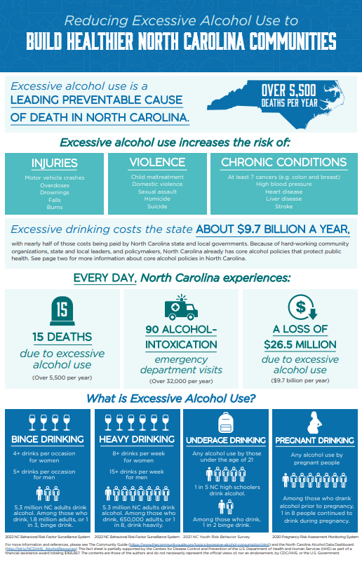
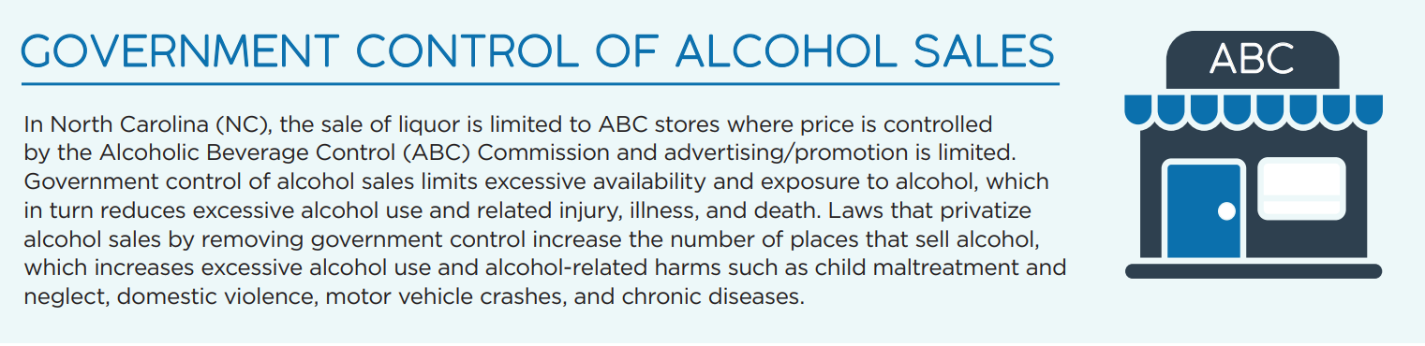
Reducing Excessive Alcohol Use to Build Healthier North Carolina Communities Fact Sheet
Notes:
Speaker’s notes: The Reducing Excessive Alcohol Use to Build Healthier North Carolina Communities fact sheet provides an overview of excessive alcohol use, the evidence-based policies to reduce excessive alcohol use, and the status of those policies in NC.
North Carolina has many existing core alcohol policies that protect public health due to the hard-work of many community advocates and policymakers. These policies focus on reducing the availability and accessibility of alcohol. The fact sheet focuses on the five following policies: government control of alcohol sales; limits on days and hours of sale; alcohol taxes; limits on promotions; and regulation of alcohol outlet density.
The fact sheet can be found at https://www.dph.ncdhhs.gov/reducing-excessive-alcohol-use-build-healthier-north-carolina-communities/open.

Slide 24
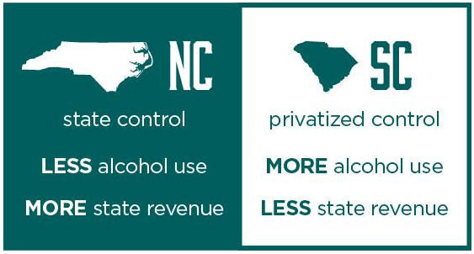
NC consumes less alcohol, but receives more revenue from alcohol sales than SC
Source: Kerr, WC, Patterson, D, Williams, E (2024). Alcoholic Beverage Revenues and Taxes: 2022 Report, National Alcohol Beverage Association (NABCA), Arlington, VA..
Notes:
Speaker’s notes: North Carolina is one of 17 states with government-controlled alcohol sales, while South Carolina has a privatized system. Government control of alcohol sales means that government agencies control the sale of distilled spirits, and in some cases, wine and beer at the wholesale level. Privatized control of sales means that government control of alcohol sales have been repealed, allowing commercial agencies to sell alcoholic beverages.
North Carolinians consume less alcohol than South Carolinians, and North Carolina receives more revenue from alcohol sales than South Carolina. North Carolina ranks 42nd per capita in gallons consumed and 3rd in revenue per gallon, while South Carolina, ranks 31st in consumption and 23rd in revenue.
Technical notes: The Alcoholic Beverage Revenues and Taxes: 2022 Report aims to provide comparable information regarding alcoholic beverage taxation and revenues for both control states and license states in the U.S..

Slide 25
U.S. Alcohol Policy Alliance’s (USAPA) Alcohol Consumption Guidelines for the American People
There is no safe level of alcohol use.
USAPA recommends:
  If you do not drink alcohol, do not start. Alcohol use offers no health benefits and carries risk.
  Cut back if you do drink alcohol. Each drink increases the risk of harm, including cancer, heart disease, and early death.
  Avoid alcohol if you:
    Are pregnant,
    Are under 21 years old,
    Are in recovery,
    Have certain health conditions,
    Have a family history of alcohol-related cancers, or
    Use any medications or drugs that interact with alcohol.
For adults 21 and older who choose to drink, drinking less alcohol is always better.
Source: U.S. Alcohol Policy Alliance Alcohol Consumption Guidelines for the American People
Notes:
Speaker’s notes: There is no safe level of alcohol use.
The U.S. Alcohol Policy Alliance’s Alcohol Consumption Guidelines for the American People recommends:
If you do not drink alcohol, do not start. Alcohol use offers no health benefits and carries risk.
Cut back if you do drink alcohol. Each drink increases the risk of harm, including cancer, heart disease, and early death.
Avoid alcohol if you:
Are pregnant,
Are under 21 years old,
Are in recovery,
Have certain health conditions,
Have a family history of alcohol-related cancers, or
Use any medications or drugs that interact with alcohol.
For adults 21 and older who choose to drink, drinking less alcohol is always better.
Technical note: The U.S. Alcohol Policy Alliance (USAPA) is a nonprofit, nonpartisan organization that works to translate alcohol policy research into public health practice. To learn more about USAPA’s Alcohol Consumption Guidelines for the American People, visit https://drive.google.com/file/d/1Dy0NSyvhDyrB0zMU5tZB3ReouSUi4ulH/view

Slide 26
Alcohol Data Resources
Notes:
Speaker’s notes: Division of Public Health maintains several resources to help understand the burden of excessive alcohol use in our state.

Slide 27
Evidence-based strategies lower alcohol use and reduce negative impacts of alcohol use in North Carolina
Limit the
number of places that sell alcohol
Lower overall
Alcohol Use
Reduce negative
Health Outcomes & Economic Costs
Alcohol Control
Strategies
promote healthier use
Notes:
Speaker’s notes: There are evidence-based strategies we can implement to reduce the harms of excessive alcohol use, and surveillance efforts help us understand the overall impact of these strategies. Alcohol control strategies, like the government control of alcohol sales that we currently have in NC and limiting the number of places that sell alcohol result in lower overall alcohol use, which reduces negative health outcomes and economic costs. Surveillance efforts inform each of these pieces.

Slide 28
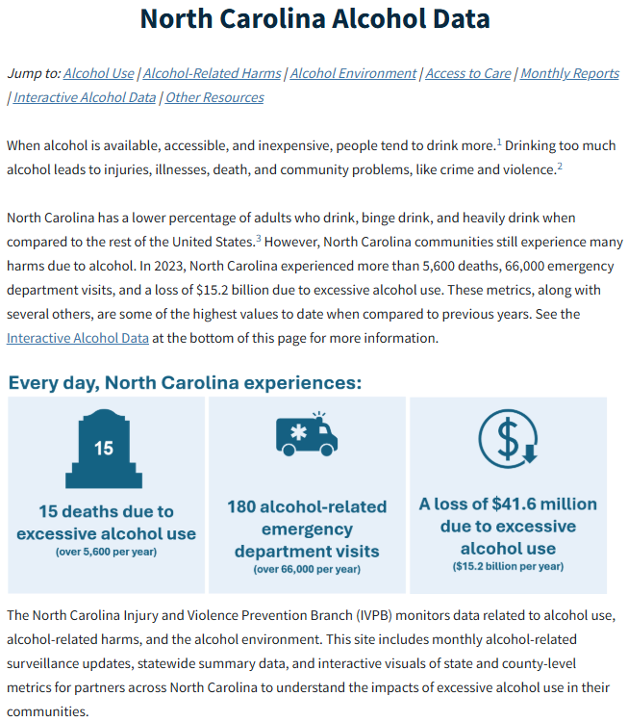
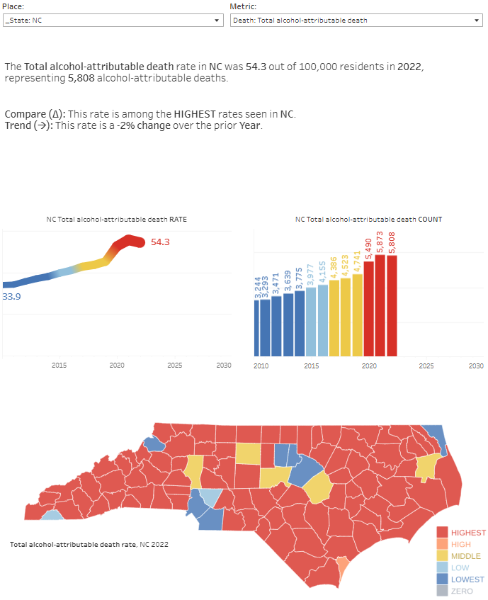
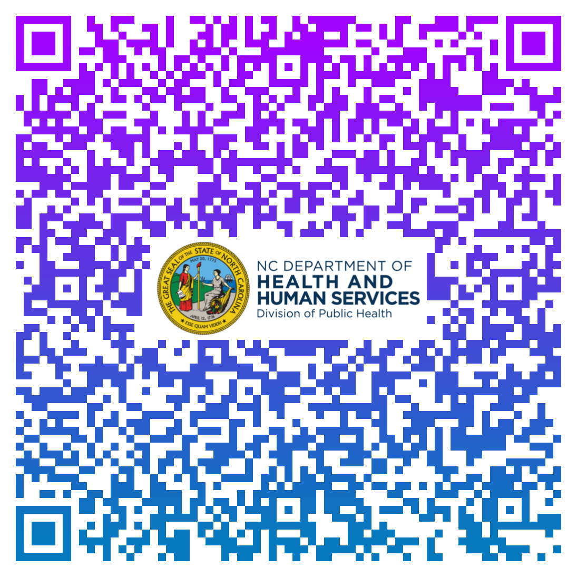
The NC Alcohol Data Dashboard presents state and county-level data summaries
Notes:
Speaker’s notes: The North Carolina Alcohol Data Dashboard walks through the public health narrative of the acute and chronic impacts of excessive alcohol use. We use many different data sets to tell this story. The Behavioral Risk Factor Surveillance System and Youth Risk Behavior Surveillance System give us survey data on consumption, emergency department visits illustrate the impacts on the healthcare system, and death data provide estimates of those who died due to excessive alcohol use. We pull this all together and present both state- and county-level information. These can be very helpful when pulling together presentations and grant applications. The QR code will take you to the Alcohol data dashboard, also found at: https://www.dph.ncdhhs.gov/programs/chronic-disease-and-injury/injury-and-violence-prevention-branch/north-carolina-alcohol-use-and-related-harms-prevention/data

Slide 29
North Carolina State Excessive Alcohol Advisory Committee (NC SEAAC)
NC SEAAC was established to develop and implement a statewide action plan to address excessive alcohol use and its related harms in North Carolina.
Meetings focus on excessive alcohol use prevention priorities presented by subject matter experts.
Participants have the opportunity to meet and network with other partners across the state.
If you are interested in participating in NC SEAAC, please email SubstanceUseData@dhhs.nc.gov.
Notes:
Speaker’s notes: Engaging partners allows the Division of Public Health to better understand and address excessive alcohol use at both the local and state level. The North Carolina State Excessive Alcohol Advisory Committee (NC SEAAC) was established to engage partners working in preventing excessive alcohol use and its related harms across the state. The committee hopes to develop and implement a statewide plan to address excessive alcohol use and its related harms in the state. In addition, the committee meets twice a year to network and hear presentations on excessive alcohol use prevention strategies by subject matter experts. If you are interested in participating in NC SEAAC, please email SubstanceUseData@dhhs.nc.gov.

Slide 30
Additional excessive alcohol use and its related harms resources
For more data about excessive alcohol use in NC, please visit the NC Injury and Violence Prevention Branch (IVPB) Alcohol and Related Harms Data Dashboard.
For general information and prevention strategies to reduce excessive alcohol use and its related harms, please visit the North Carolina Alcohol Use and Related Harms Website.
For questions related to alcohol data requests, please email SubstanceUseData@dhhs.nc.gov.
If you have questions regarding a custom data request or available data products, please use the IVPB Data Support Bookings Application to reserve time to chat with one of our epidemiologists.
Notes:
Speaker’s notes: The NC Injury and Violence Prevention Branch (IVPB) Alcohol and Related Harms Data Dashboard (https://www.dph.ncdhhs.gov/programs/chronic-disease-and-injury/injury-and-violence-prevention-branch/north-carolina-alcohol-use-and-related-harms-prevention/data) provides additional data on alcohol use. The NC IVPB Alcohol Use and Related Harms Website (https://www.dph.ncdhhs.gov/programs/chronic-disease-and-injury/injury-and-violence-prevention-branch/north-carolina-alcohol-use-and-related-harms-prevention) includes additional information and prevention strategies to reduce excessive alcohol use and its related harms in NC. IVPB also provides data and technical support for alcohol use and its related harms. For data requests, please email SubstanceUseData@dhhs.nc.gov. If you have additional questions regarding alcohol-related custom data requests or data resources, please use the IVPB data support bookings application (https://outlook.office365.com/owa/calendar/IVPBDataSupport@ncconnect.onmicrosoft.com/bookings/) to reserve time to chat with one of our epidemiologists.

Slide 31
Questions?
SubstanceUseData@dhhs.nc.gov
Injury and Violence Prevention Branch NCDHHS, Division of Public Health
https://www.dph.ncdhhs.gov/programs/chronic-disease-and-injury/injury-and-violence-prevention-branch/north-carolina-alcohol-use-and-related-harms-prevention/data
Notes:
Speaker’s notes: Please reach out if you have any further questions, suggestions for improvement, or data requests.

