Slide 1
Child Firearm Injury Death and Morbidity in North Carolina, 2023
Division of Public Health
Injury and Violence Prevention Branch

Slide 2
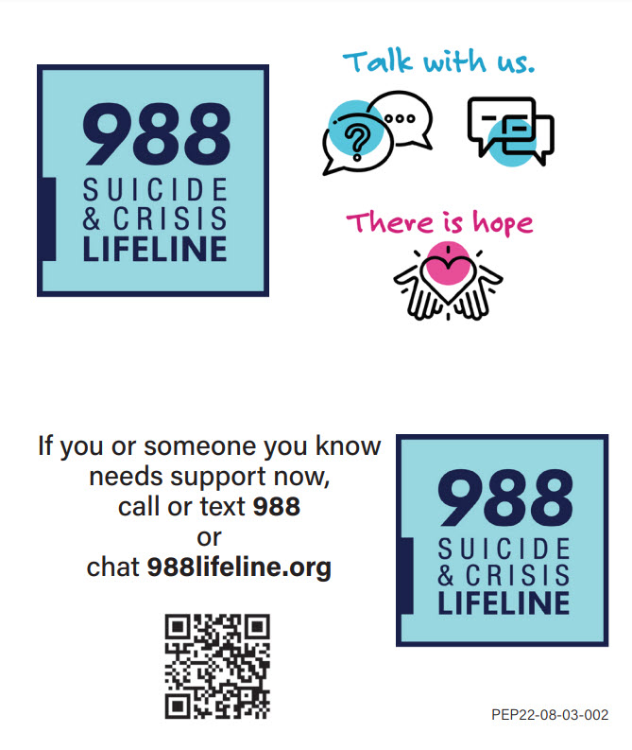
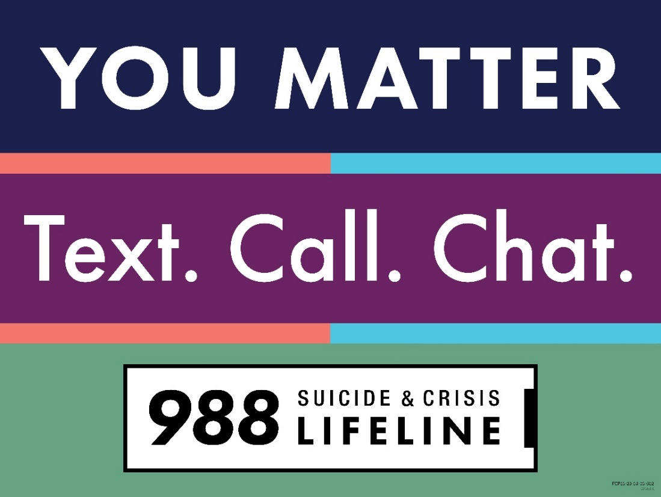
If you or someone you know needs support now, call or text 988 or chat 988lifeline.org
2

Slide 3
Child Firearm Injury Death and Morbidity Technical Notes
The fatality data provided here are part of the North Carolina Violent Death Reporting System (NC-VDRS), a state-wide surveillance system funded by CDC that collects detailed information on deaths that occur in NC resulting from homicide, suicide, unintentional firearm-related injuries, legal intervention, and deaths for which the intent could not be determined. NC-VDRS combines information from death certificates, medical examiner reports, and incident reports from law enforcement agencies.
2023 NC-VDRS data are final as of June 2025.
There was a transition in Hospital and Emergency Department coding structure in October 2015. Due to the transition, there are different definitions for injury. Data after October 2015 are not comparable to data from before the transition.
ICD-10 firearm injury codes listed as cause of death: W32-W34, X72-X74, X93-X95, Y22-Y24, Y35.0, U01.4
ICD-10-CM firearm injury codes: See the CDC Firearm Injury V2 for a comprehensive list of codes.
Data provided are limited to NC children ages 0-17.
Firearm suicide data is limited to NC children ages 10 and older.
3
Notes:
For more detailed technical notes on any of the data shared in this slide set, please contact us at InjuryData@dhhs.nc.gov.

Slide 4
Overview
Firearm-related Death
Firearm-related Injury
Resources
Firearm-related Deaths and Injury data are available at https://injuryfreenc.dph.ncdhhs.gov/safestorage/index.htm
For custom data requests see https://injuryfreenc.dph.ncdhhs.gov/DataSurveillance/DataRequestPolicy.htm
4
Notes:
This presentation is not intended to cover all data related to firearm-related injury and death. Rather it gives an overview of some of the key trends in North Carolina. It includes information on statewide firearm-related deaths, firearm injury hospitalizations and emergency department visits, and resources. Please note that when the COVID-19 pandemic began in 2020, there were many implications, including major changes to the numbers and rates within the firearm-related injury data in this slide deck.
If this slide deck does not contain the information you need, please see our custom data request policy and contact us at InjuryData@dhhs.nc.gov.

Slide 5

6
Notes:
The firearm-related death data presented in these slides comes from the North Carolina Violent Death Reporting System (NC-VDRS). The NC-VDRS is a public health, population-based surveillance system that contains detailed information on deaths that result from violence.

Slide 6
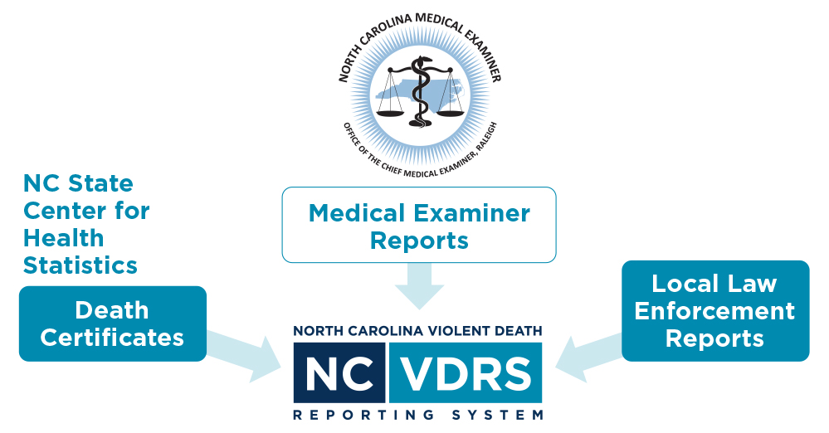
NC-VDRS
North Carolina-Violent Death Reporting System
CDC-funded statewide surveillance system collecting data on deaths resulting from violence such as homicide, suicide, and legal intervention
Funded in 2003
  Data collection began in 2004
  ~43,000 incidents reported to date
Multi-sourced incident-based system
7
Notes:
The NC-VDRS provides timely information on the victims, suspects, relationships, circumstances, and weapons that are associated with every violent incident that results in a fatality in North Carolina. It is an incident-based, relational database that combines information from multiple sources, such as death certificates, medical examiner reports, and incident reports from law enforcement agencies on violent deaths to not only understand the “who, when, where, and how” but also “why” these deaths occurred. The NC-VDRS began collecting data in January 2004.

Slide 7

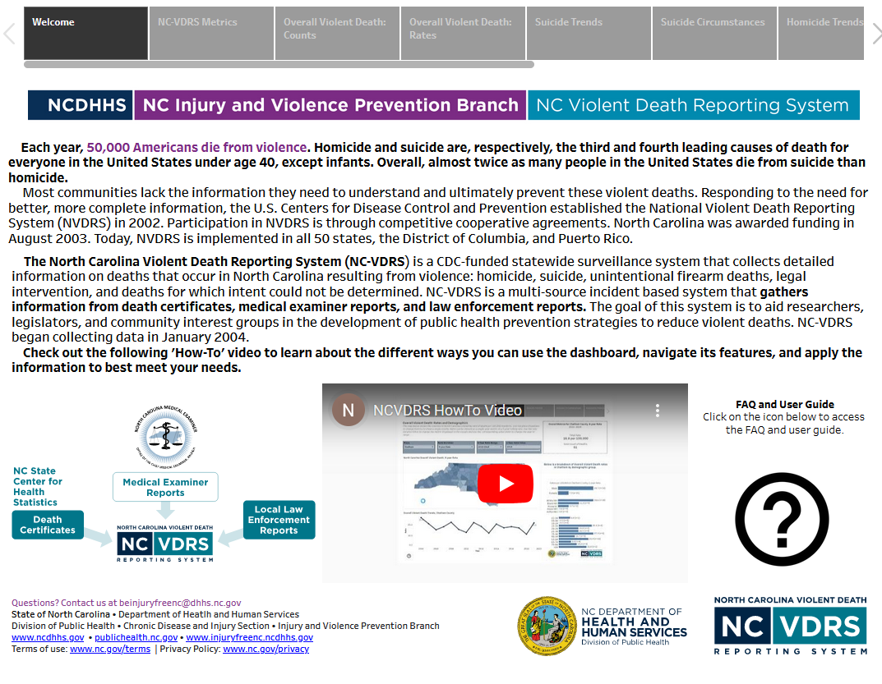
QR code- use your phone
Access more data on the NC-VDRS dashboard
8
Notes:
Additional data for North Carolina violent deaths can be found by accessing the NC-VDRS data dashboard on the Violent Death Data page on our branch website, Injuryfreenc.dph.dhhs.gov. The data dashboard has a firearm deaths tab specific to firearm-related violent deaths.

Slide 8
Firearms are the most common weapon used in child violent deaths in NC
57% of child violent deaths in the last 10 years (2014-2023) were firearm-related.
9
Notes:
Over the last 10 years (2014-2023), 56.7%% of all violent deaths in the state of North Carolina among children ages 0-17 involved a firearm. Firearm lethality far exceeds that of other weapons and methods of self harm and injury.

Slide 9
2 children a week die from firearm injury in NC
The number of child firearm deaths in North Carolina has increased by 110% over the past 10 years, with an 87% increase from 2019.
10
Notes:
In 2023, an average of two North Carolinian children died each week from firearm-related injury.
Firearm deaths continue to rise in the state of North Carolina. In 2023, 101 North Carolinian children ages 0-17 died from firearm injury, a 110% increase over the past 10 years (2014-2023). A small decrease was observed before 2019, with a 87% increase since then.

Slide 10
Firearms were used in 62% of homicides and 49% of suicides among NC children
Total Violent Deaths = 1,279
Total Firearm Deaths = 725
11
Notes:
s
10
Over the last 10 years (2014-2023), the majority of child violent deaths were firearm related (56.7%). Breaking down by manner of death, firearms were used in 62% of homicides and 49% of suicides among NC children ages 0-17.

Slide 11
Most child firearm deaths in NC are homicides (57%) followed by suicides (32%)
Child firearm suicides have increased by 9% over the past 10 years (2014-2023).
Child firearm homicides have increased by 215% since 2014 and by 70% since 2019.
12
Notes:
This graph shows the total count of child firearm suicide, child firearm homicide and other child firearm deaths in North Carolina in the past 10 years (2014-2023).
In 2023, there were 25 firearm suicide deaths among NC children, a 9% increase from 2014. There were 63 NC firearm homicide deaths among NC children in 2023, a decrease from 2022. However, the number of firearm homicide deaths among North Carolinian children has increased by 215% over the last 10 years (2014-2023), with a 70% increase from 2019. Other NC child firearm deaths have slightly increased over the last 10 years (2014-2023).

Slide 12
Males, NH Black and NH American Indian children, and teens ages 15-17 experienced the highest rates of child firearm death in NC
13
Notes:
The highest rates of child firearm death occurred amongst male NC children (5.1 per 100,000), non-Hispanic Black (7.2 per 100,000) and non-Hispanic American Indian (4.5 per 100,000) children and teens ages 15-17 (12.1 per 100,000).
These rates are calculated over a 10-year time period (2014-2023).

Slide 13
Firearm homicide rates are highest among NH Black, NH American Indian, and male children. Firearm suicide rates are highest among male and NH White children.
14
Notes:
s
13
This graph looks at child firearm homicides and child firearm suicides specifically.
The highest rates of firearm homicide occurred amongst male NC children (2.9 per 100,000), non-Hispanic Black (5.6 per 100,000) and non-Hispanic American Indian NC children (2.4 per 100,000). Firearm suicide rates were highest among male NC children (3.6 per 100,000) and non-Hispanic White NC children (2.8 per 100,000). Counts were too low to calculate rates for non-Hispanic Asian homicide, non-Hispanic Asian suicide, and non-Hispanic American Indian suicide.
These rates are calculated over a 10-year time period (2014-2023).

Slide 14
Child firearm homicide and child firearm suicide rates are highest among 15- to 17-year-olds.
15
Notes:
s
14
This graph shows NC child firearm death rates by age over a 10-year time period (2014-2023).
Child firearm homicide and child firearm suicide rates are highest among teens ages 15-17 (7.3 per 100,000 and 4.0 per 100,000).
Technical note: CSTE guidance does not include suicide decedents younger than 10 years old which is why data for firearm suicide rates start at ages 10-14.

Slide 15
There were 68 child unintentional firearm deaths (9.4% of total) over the past 10 years.
Child unintentional firearm deaths increased by 120% from 2014-2023 and by 450% since 2019.
16
Notes:
Unintentional firearm deaths made up 9.4% of all child firearm deaths in the state of NC in the last 10 years (2014-2023). The number of child unintentional firearm deaths has increased by 120% since 2014. A decrease was observed 2019, with a 450% overall increase since 2019.

Slide 16
Most child unintentional firearm victims were shot by someone else.
Child unintentional firearm deaths were highest among males and among ages 15-17 followed by ages 1-4.
17
Notes:
This graph shows the context surrounding child unintentional firearm deaths and demographic characteristics of the victims. Over half (52.9%) of all child unintentional firearm deaths in the past 10 years (2014-2023) were inflicted by another person. 75% of these unintentional deaths were among male NC children and 33.8% were among those 15-17 years of age.

Slide 17
Circumstances of
Child Firearm Suicide
18

Slide 18
Nearly half of children who died by suicide experienced a recent crisis.
More females experienced a current mental health problem than males and females were more likely to have a history of suicidal behavior.
19
Notes:
s
18
Nearly half (43%) of children who died by suicide experienced a recent crisis. More females experienced a current mental health problem, were currently undergoing mental health treatment, or had ever been treated for mental health than males. There was also a higher proportion of females than males that had a history of suicidal thoughts, left a suicide note, or had previously attempted suicide.

Slide 19
Circumstances of
Child Firearm Homicide
20

Slide 20
Female child firearm homicides are five times more likely to involve intimate partner violence than males.
21
Notes:
s
20
Female child homicide deaths were nearly five times more likely to involve intimate partner violence than male child homicide deaths. More male child homicide deaths were precipitated by an argument or conflict, a crime, drugs or gang involvement than females.

Slide 21
Nearly 85% of firearm homicides of children 4 years old or younger were committed by a caregiver of the victim.
Notes:
Firearm homicides of children ages 4 years and younger are primarily perpetrated by the victim’s caregiver (83.8%). The term “caregiver” refers to anyone serving in a caregiving role and who is responsible for the care and rearing of children or who is temporarily supervising or helping to supervise the child victim (e.g., parent, mother’s boyfriend, babysitter, older sibling, or cousin acting as babysitter/helper).

Slide 22
Younger children were more commonly killed by a parent or a parent’s romantic partner.
Half of all children killed by a parent were less than one year old and nearly one-third (30.5%) were ages 1-4.
Notes:
Younger children were more commonly killed by a parent or a parent’s romantic partner (e.g., boyfriend/girlfriend/spouse). Nearly half of all children killed by their parent (48.9%) were infants less than one year old and nearly one-third (30.5%) were toddlers ages 1-4.

Slide 23
Most child homicides perpetrated by non-relatives and by strangers were among older adolescents.
Three-fourths (75%) of all child homicides committed by another person known to the victim (such as a friend or acquaintance) were 15 to 17 years old.
Notes:
Older children were more commonly killed by a non-relative who was known to them or by a stranger. Three-fourths (74.5%) of child homicides committed by another person known to the victim (such as a friend or acquaintance) were teens ages 15-17.

Slide 24
Circumstances of Child Unintentional Firearm Deaths
22

Slide 25
Most child unintentional firearm deaths occurred while playing with a gun or from unintentionally pulling the trigger.
Circumstances of Child Unintentional Firearm Deaths in North Carolina, 2014-2023
Limited to NC resident deaths ages 0-17 with reported circumstance information (98.5%); 1 male and 0 females were missing circumstance information Source: NC-VDRS, 2014-2023 Analysis by the DPH Injury Epidemiology, Surveillance, and Informatics Unit
23
Notes:
s
25
Most unintentional firearm deaths among children occurred while victim was playing with the gun (65.7%) or from unintentionally pulling the trigger (28.4%).

Slide 26
Firearm deaths are just the tip of the iceberg
In 2023, there were:
Despite NC’s excellent reporting systems, the
total burden of
firearm-related
outcomes in
the state is
unknown.
101
Deaths
215
Firearm-Related Hospitalizations
528
Firearm-Related ED Visits
Roughly 1 million
Adults store their firearm(s) loaded and unlocked
About 4.4 million
NC adults have a firearm in or around the home
INJURY PYRAMID
Limited to NC residents Source: NC-VDRS, 2014-2023; NC State Center for Health Statistics, Hospital Discharge Data (2023); NC DETECT ED Visit Data (2023); NC BRFSS Firearm Safety Module (2023) Analysis by the DPH Injury Epidemiology, Surveillance, and Informatics Unit
24
Notes:
Firearm deaths are just the tip of the iceberg. Firearm-related injury hospitalizations and emergency department visits also contribute to the overall burden of firearm violence on North Carolina children. Of the 4.4 million NC adults that have a firearm in or around the home, roughly 1 million report storing their firearms loaded and unlocked.

Slide 27

Child Firearm Injury Hospitalizations
25

Slide 28
Child firearm injury hospitalizations increased by 144% over the past 10 years.
26
Notes:
Firearm injury hospitalizations among NC children increased by 144.3% between 2014 and 2023. The number of child hospitalizations decreased by 25.6% between 2023 and 2024.

Slide 29
Rates of child firearm injury hospitalization were highest among males, NH Black children, and young teens ages 15-17.
27
Notes:
The highest rates for child firearm injury hospitalizations occurred amongst male NC children (12.4 per 100,000), NH Black (24.3 per 100,000) and NH American Indian children (10.6 per 100,000), and teens ages 15-17 (28.5 per 100,000).
These rates are calculated over a 5-year time period (2020-2024).

Slide 30

Child Firearm Injury Emergency Department Visits
28

Slide 31
Child firearm injury ED visits increased by 100% over the past 10 years.
29
Notes:
Firearm injury ED visits among NC children increased by 100% between 2014 and 2023. The number of child ED visits decreased by 20.8% from 2023 and 2024.

Slide 32
Rates of child firearm injury ED visits were highest among males, Black children, and teens ages 15-17.
30
Notes:
The highest rates for child firearm ED visits occurred amongst male NC children (35.2 per 100,000), Black children (65.9 per 100,000), and teens ages 15-17 (69.9 per 100,000).
These rates are calculated over a 5-year time period (2020-2024).

Slide 33

NC-FASTER
Firearm Injury Surveillance Through Emergency Rooms
NC was one of 10 states funded for enhanced surveillance of non-fatal firearm injuries
3-year award, started September 1, 2020
STRATEGY 1
Increase the timeliness of ED visits for firearm injuries reporting.
STRATEGY 2
Disseminate surveillance findings to key stakeholders.
Increase availability of rapid, reliable, and geographically-specific surveillance data on ED visits for nonfatal firearm injuries.
Improve firearm injury syndromic surveillance methodology.
32
Notes:
NC-FASTER began in September 2020 as a three-year CDC-funded award for enhanced surveillance of nonfatal firearm injuries through syndromic surveillance on emergency department visits. This enhanced surveillance increases the timeliness of firearm injury reporting and increases the availability of rapid, reliable, and geographically-specific data. Data are collected through the North Carolina Disease Event Tracking and Epidemiologic Collection Tool (NC DETECT), the state’s syndromic surveillance system, and disseminated to key partners across the state.

Slide 34
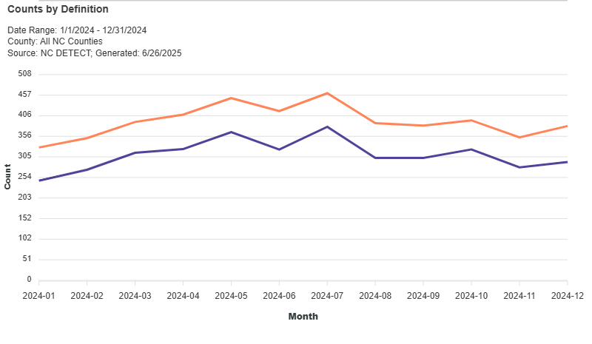
NC-FASTER Definition Compared to the Current Code-Based Definition for Firearm Injury ED Visits
*2024 Emergency Department (ED) Visit Data are provisional and subject to change; Limited to NC Residents
Source: NC DETECT, ED Visit Data, 2024, NC-FASTER Firearm Injury - All Intents CDC V2 Syndrome & ICD-10-CM code based defintions
33
Notes:
This line graph compares the count of cases captured by month by the NC-FASTER definition of nonfatal firearm injury compared to the ICD-10-CM code-based definition in the past year (2024). The NC-FASTER definition is more sensitive at capturing nonfatal firearm injury cases than the code-based definition because it includes both ICD-10-CM codes and keywords from triage notes and chief complaint narratives found in the ED record. This enhanced surveillance provides valuable insights to healthcare providers, researchers and community partners in describing the burden of firearm injury in the state.

Slide 35

Intent coding in the ED visit data is inaccurate and in need of improvement for firearm injury tracking
Most firearm-related injury ED visits (67%) from January-March 2025 were coded as unintentional injuries.
There is an overcount of unintentional firearm injuries and an undercount of intentional injuries, such as assaults and self-harm.
ICD-10-CM coding guidance currently defaults to unintentional injury if intent is not directly documented in the medical record and should be revised.
Source: NC DETECT, ED Visit Data, NC-FASTER Firearm Injury - All Intents CDC V2 Syndrome
34
Notes:
An important aspect of our work with NC-FASTER is examining the intent of firearm injuries treated in the ED.
As you can see from this diagram of all firearm related ED visits, the majority are reported to be unintentional injury with far fewer coded as assaults and even fewer as self-harm. You’ll note that there are many for which intent is not indicated at all and others which are coded with more than one intent, which is contradictory. This pattern of intent for non-fatal firearm injury is very different than the pattern for fatal firearm injury, which is not necessarily surprising given the lethality of firearms. However, we do suspect that there is miscoding of intent in these data and we are working to determine to what extent that may be occurring.
Most of our work for NC-FASTER uses the ED visit data in NC DETECT but we are also now beginning to also work with the EMS encounter data in NC DETECT. Our work is exploring firearm injury by demographics and geography and we try to find clear but innovative ways to visually present the information. Eventually, we want to add a public facing dashboard to make firearm injury data available to anyone interested.

Slide 36
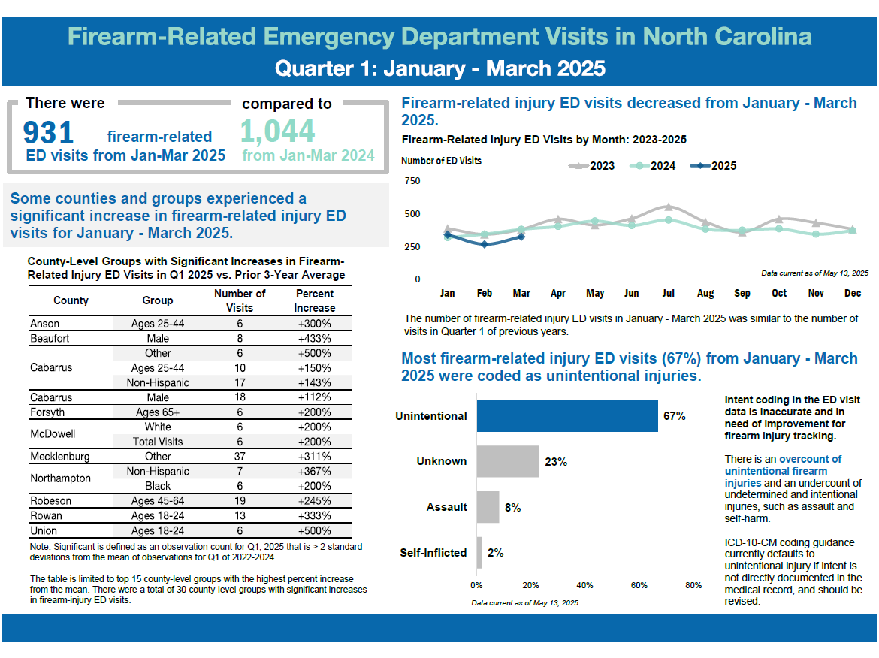
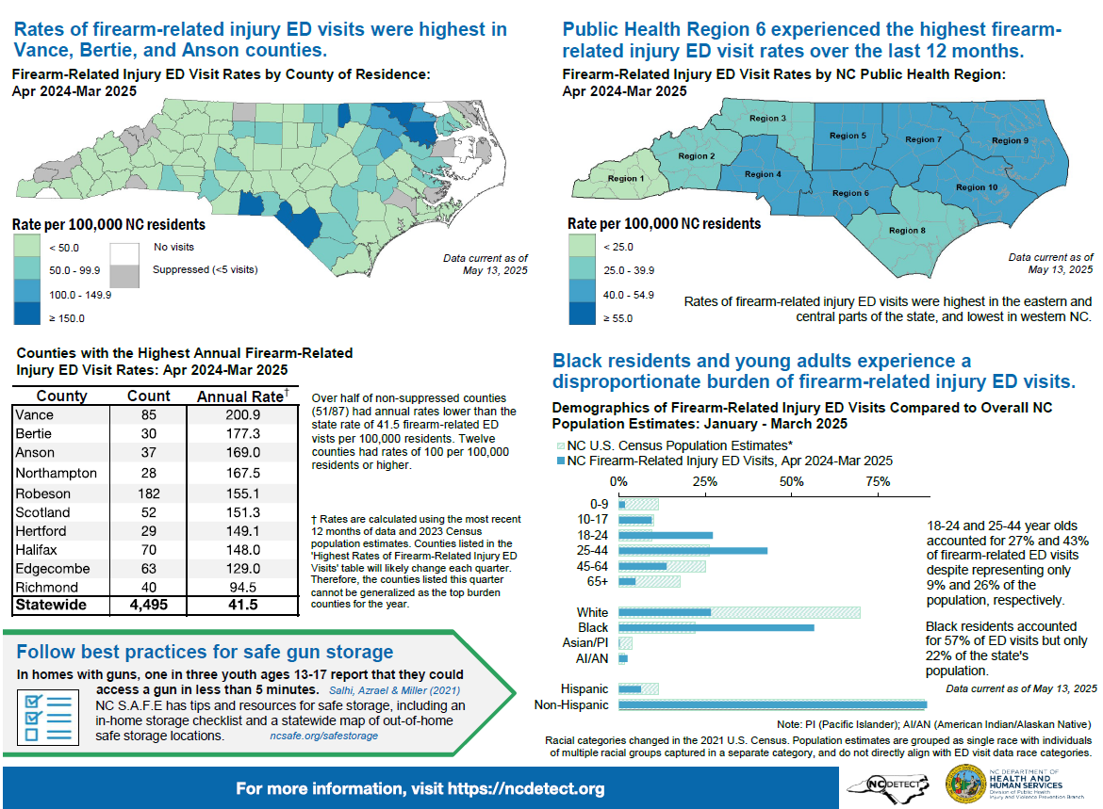
NC-FASTER
Data Products
Quarterly & Annual Reports
https://ncdetect.org/nc-faster-firearm-quarterly-reports/
35
Notes:
NC-FASTER quarterly reports provide a snapshot into nonfatal firearm injuries throughout the state and include ED visit data by demographic group, county/region, and intent. These quarterly reports are available on the NC DETECT website.

Slide 37
More than 2/5 of NC adults have a firearm in or around the home.¹ Over half of firearms that are stored loaded are also unlocked.¹
42%
45%
53%
of NC adults surveyed
of those with firearms kept
at home
of those with loaded firearms at home
¹ NC BRFSS Firearm Safety Module, 2021 https://schs.dph.ncdhhs.gov/data/brfss/2021/nc/all/topics.htm#fr
36
Notes:
The Behavioral Risk Factor Surveillance System (BRFSS), developed by the Centers for Disease Control and Prevention (CDC), is a random telephone survey of state residents aged 18 years and older and administered in all 50 states, the District of Columbia and U.S. territories. The purpose is to obtain estimates of the prevalence of personal health behaviors that contribute to morbidity and mortality.
The Firearm Safety Module was included in the 2021 NC BRFSS and found that more than two-fifths of NC adults have a firearm in or around the home. Over half (53%) of firearms that are stored loaded are also unlocked.

Slide 38
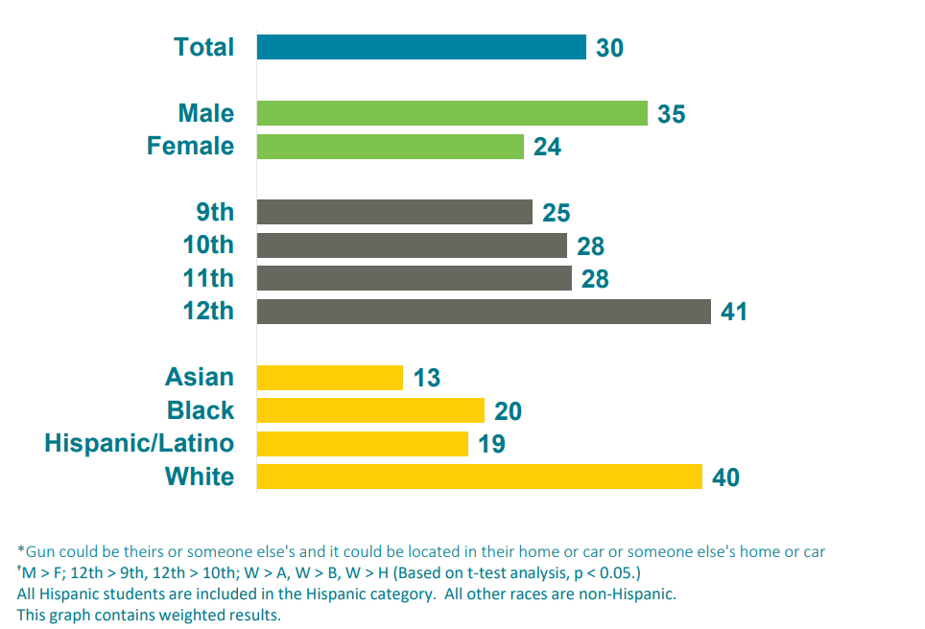
30% of high school students say they could be ready to fire a loaded gun in less than an hour without a parent’s or other adult’s permission
Percentage
Source: North Carolina Department of Public Instruction, Youth Risk Behavior Survey, 2021
37
Notes:
The Youth Risk Behavior Survey (YRBS), developed by the CDC, is a school-based survey conducted in both middle and high schools during odd-numbered years. The purpose is to obtain prevalence estimates of youth risk behaviors that could lead to the development of adverse health conditions later in life.
In 2021, 30% of NC high school students reported that it would take them less than an hour to get and be ready to fire a loaded gun without a parent or other adult’s permission; for white high school students it was 40%.

Slide 39
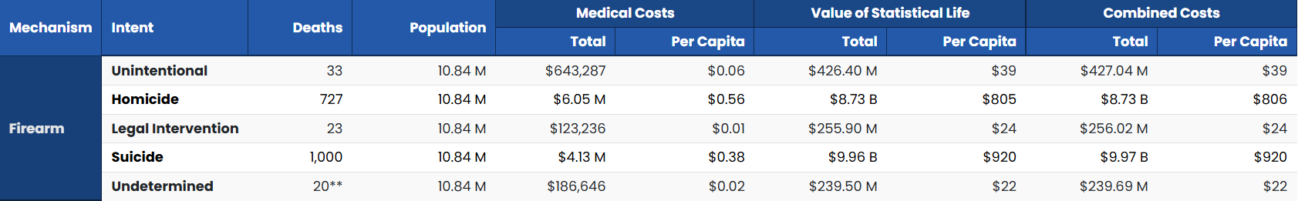
The financial toll of firearm injury and violence on society is costly
Child firearm deaths alone in NC resulted in a combined cost of nearly $1.9 billion in 2023
  $800 per capita
Source: CDC WISQARS, 2023
38
Notes:
The economic impact of firearm injury and violence in North Carolina is significant. The combined cost of child firearm deaths alone resulted in nearly $1.9 billion in 2023, about $800 per capita among North Carolinians ages 0-17.
Data retrieved from the CDC Web-based Injury Statistics Query and Reporting System (WISQARS). Fatal injury data come from the CDC’s National Center for Health Statistics (NCHS) mortality data.

Slide 40
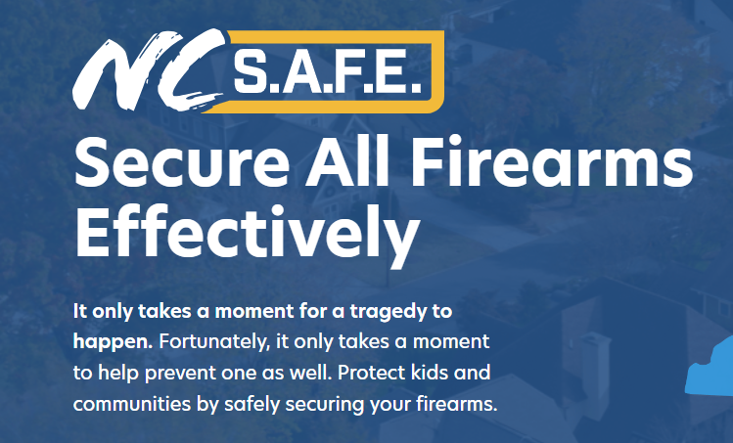
https://www.ncsafe.org/
39
Notes:
NC S.A.F.E. (Secure All Firearms Effectively) is North Carolina’s statewide initiative designed to raise awareness of the importance of safe firearm storage. Established in 2023, the initiative provides resources and best practices for firearm storage and safety. NC S.A.F.E. is not associated with any advocacy-based initiatives related to gun laws or regulations. The initiative is run by the North Carolina Department of Public Safety and funded in part through the 2023 Byrne-State Crisis Intervention Program.

Slide 41
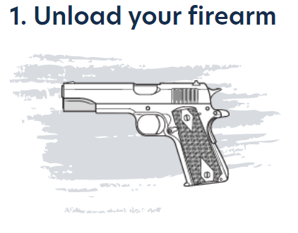
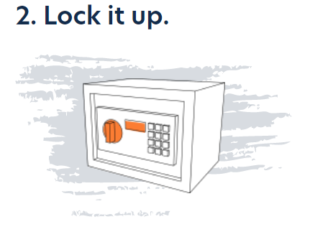
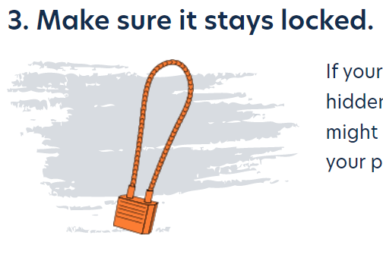
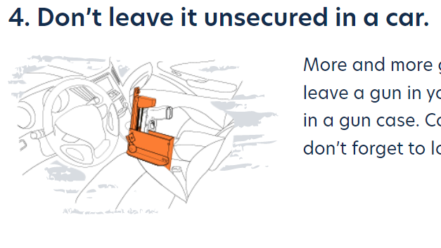

Protect your children and your community by safely securing your firearm
https://www.ncsafe.org/safestorage/
40

Slide 42
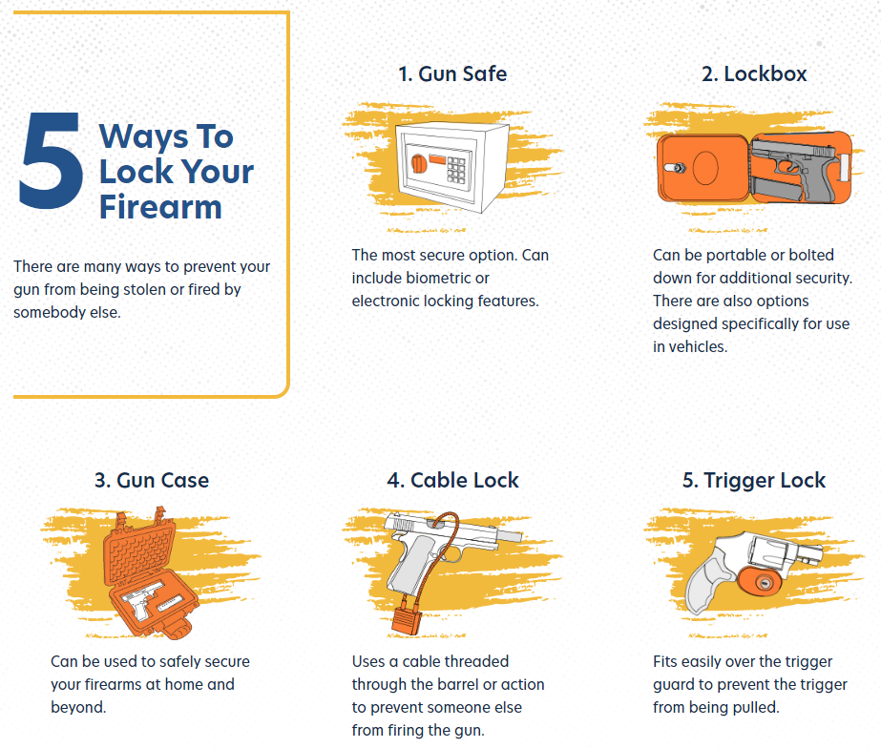

Ways To Lock Your Firearm
5
There are many ways to prevent your gun from being stolen or fired by somebody else.
https://www.ncsafe.org/safestorage/
41

Slide 43
Where to find more data on firearm injury?
NC Injury and Violence Prevention Branch Firearm Data Page
  NC-VDRS Annual Report
  NC-VDRS Fact Sheets
  NC-VDRS Data Dashboard
  NC DETECT quarterly NC-FASTER reports
State Center for Health Statistics (SCHS) Death Certificate Data
  NC Health Data Query System
CDC WISQARS – Fatal Injury and Violence Data
CDC NVDRS – CDC NVDRS
42

Slide 44

North Carolina Medical Journal
Special Issue on Firearm Injury and Violence Prevention https://ncmedicaljournal.com/issue/7874
43
Notes:
A special issue in the North Carolina Medical Journal (NCMJ) on firearm injury and violence prevention was published in July/August 2023. Featured articles include current efforts across the state, evidence-based prevention strategies, and proposed solutions for at-risk groups such as veterans, adolescents and young adults.
The special issue can be found here:
https://ncmedicaljournal.com/issue/7874

Slide 45
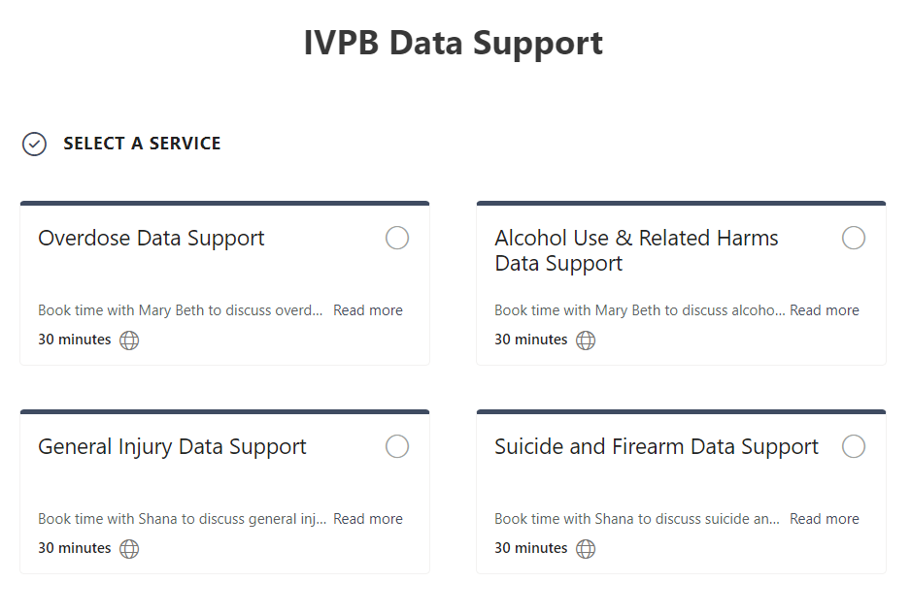

IVPB Data Support now available!
Book time with an IVPB epidemiologist to discuss available data products, to talk through custom data requests, or for general data questions.
IVPB Data Request Policy
IVPB Data Support Bookings
44

Slide 46
Questions?
InjuryData@dhhs.nc.gov
Injury and Violence Prevention Branch
Division of Public Health
https://injuryfreenc.dph.ncdhhs.gov/

