Slide 1
NC Overdose Data: Trends and Surveillance
Division of Public Health
Injury and Violence Prevention Branch
Data through 2024
This slide deck was supported by the Centers for Disease Control and Prevention (CDC) of the U.S. Department of Health and Human Services (HHS) as part of the Overdose Data to Action in States (CDC-RFA-CE-23-0002) cooperative agreement award totaling $4,950,273 annually with 100% funded by CDC/HHS. The contents are those of the author(s) and do not necessarily represent the official views of, nor an endorsement by, CDC/HHS or the U.S. Government.
Notes:
This slide set was created to provide basic data trends and public health surveillance around the drug overdose epidemic. They are meant to offer a state-level background on drug overdose. If you’d like a copy of the slides, please visit the Overdose Data page on our branch website, https://www.dph.ncdhhs.gov/programs/chronic-disease-and-injury/injury-and-violence-prevention-branch. The direct link is also shared at the end of this presentation.
Feel free to incorporate these slides into your own presentations, grant proposals, reports, or any other way they may be useful.
Please read both the speaking and technical notes to ensure that data are presented in a consistent manner.

Slide 2
Technical Notes
The fatality data provided here are part of the Vital Registry System of the State Center for Health Statistics (SCHS) and have been used to historically track and monitor the drug overdose burden in NC using ICD-10 codes. The definitive data on deaths come from the NC Office of the Chief Medical Examiner (OCME).
2024 NC SCHS data are final as of January 2026.
Due to national changes in population data reporting U.S. Census non-bridged single race population categories do not directly align with ED Visit data race categories (population estimates exclude 1.8% multi-race residents).
There was a transition in Hospital and Emergency Department coding structure in October 2015. Due to the transition, there are different definitions for injury. Data after October 2015 are not comparable to data from before the transition.
Speaking and technical notes should be read prior to using.
Notes:
For more detailed technical notes on any of the data shared in this slide set, please contact us at SubstanceUseData@dhhs.nc.gov

Slide 3
Overview
This slide deck covers the who, what, where, when, and why of the overdose epidemic in North Carolina.
These slides are not intended to cover all data related to substance use and its related impacts. Rather, they give a high-level overview of some of the key trends in North Carolina.
For additional resources, visit the North Carolina Overdose Epidemic Data page.
Notes:
This presentation is not intended to cover all data related to the overdose epidemic. Rather it gives an overview of some of the key trends in North Carolina. It includes information on statewide medication and drug overdoses, opioid-related overdoses, and our state’s response coordination. Please note that when the COVID-19 pandemic began in 2020, there were many implications, including major changes to the numbers and rates within the overdose data in this slide deck.
If this slide deck does not contain the information you need, please see our custom data request policy and contact us at SubstanceUseData@dhhs.nc.gov.

Slide 4
Who are the people most impacted by the overdose epidemic?
Who?

Slide 5
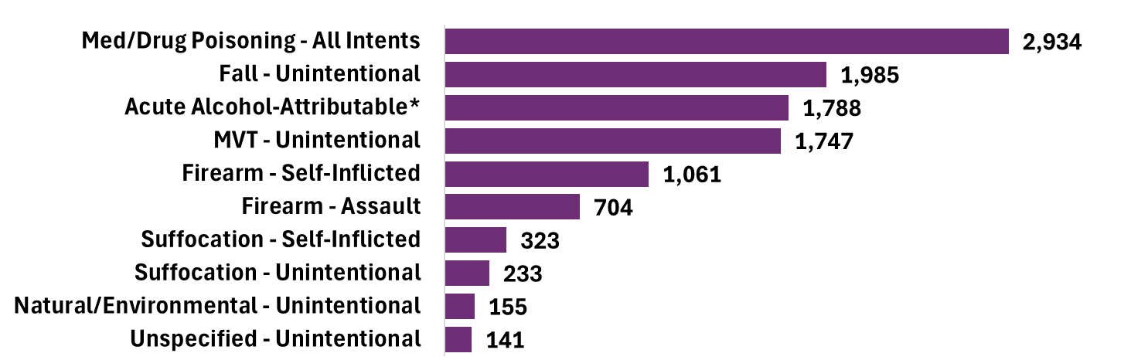
Overdose is the leading cause of injury death among North Carolina residents, 2024
*Acute causes of alcohol-attributable death result from short-term, excessive use of alcohol. Estimates are calculated using the Alcohol-Related Disease Impact (ARDI) methodology from the CDC, which provides estimates of alcohol-related harms. Acute causes of alcohol-attributable death include 18 injuries (e.g., poisonings, falls, homicide) and therefore, this category includes a proportion of deaths from the other injuries listed here. Excessive alcohol use also contributes to 40 chronic causes of alcohol-attributable death (e.g., liver cirrhosis, hypertension, several types of cancer). In 2024, there were 3,820 alcohol-attributable deaths due to chronic causes, contributing to a total of 5,608 alcohol-attributable deaths. For more information, please visit https://nccd.cdc.gov/DPH_ARDI/default/default.aspx
^MVT = Motor Vehicle Traffic
Source: NC State Center for Health Statistics, Vital Statistics Deaths (2024) ; data limited to NC residents.
Analysis by Injury Epidemiology and Surveillance Unit
Notes:
In 2024, the leading cause of injury death was all intents medication or drug poisoning (2,934), followed by unintentional falls (1,985), acute alcohol attributable (1,788; short-term excessive use of alcohol), and unintentional motor vehicle traffic-related injury (1,747).

Slide 6
In 2024, an average of 8 North Carolinians died each day from an overdose.
Technical Notes: Medication and drug overdose: X40-X44, X60-X64, Y10-Y14, X85; Limited to NC residents
Source: Deaths-NC State Center for Health Statistics, Vital Statistics, 2024
Analysis by Injury Epidemiology and Surveillance Unit
Notes:
In 2024, an average of 8 North Carolinians died each day from an overdose. Though largely driven by fentanyl, this number includes overdose deaths from other medications and drugs (cocaine, benzodiazepines, etc). This number includes all medication and/or drug overdoses, including unintentional, self-inflicted, undetermined, and assault.

Slide 7
On average, every day in North Carolina, there are…
8
Overdose Deaths
30
34
Overdose Emergency Department (ED) Visits
Overdose Hospitalizations
9
45
Emergency Medical Services (EMS) Encounters for suspected overdose
Overdose reversals^ by a community member administering naloxone
Technical Notes: Medication and drug overdose: X40-X44, X60-X64, Y10-Y14, X85; Limited to NC residents; ED Visits are based on initial encounter, unintentional and undetermined intent cases, for ICD10CM overdose codes of drugs and medications with dependency potential within T40, T42, T43, T50.7, and T50.9, NC residents, ages 15-65 years. ^This number is likely an underestimate of the total overdose reversals done by SSP participants, as many are not reported.
Source: Deaths-NC State Center for Health Statistics, Vital Statistics, 2024; Hospitalizations- North Carolina Healthcare Association, 2024; ED Visits-NC DETECT, 2024; EMS encounters-NC DETECT, 2024; Community naloxone reversals-NC Division of Public Health, Safer Syringe Initiative Annual Report, July 2023-June 2024; Analysis by Injury Epidemiology and Surveillance Unit
Notes:
An overdose is an injury with a range of outcomes and impacts.
In North Carolina, there are on average, 8 overdose deaths, 30 overdose hospitalizations, 34 overdose-related emergency department visits, 9 emergency medical services (EMS) encounters for suspected overdoses, and 45 naloxone reversals by community members each day. Addressing this issue requires a collaborative effort between communities, healthcare providers, and public health organizations to reduce the impacts on both individuals and the healthcare system.

Slide 8
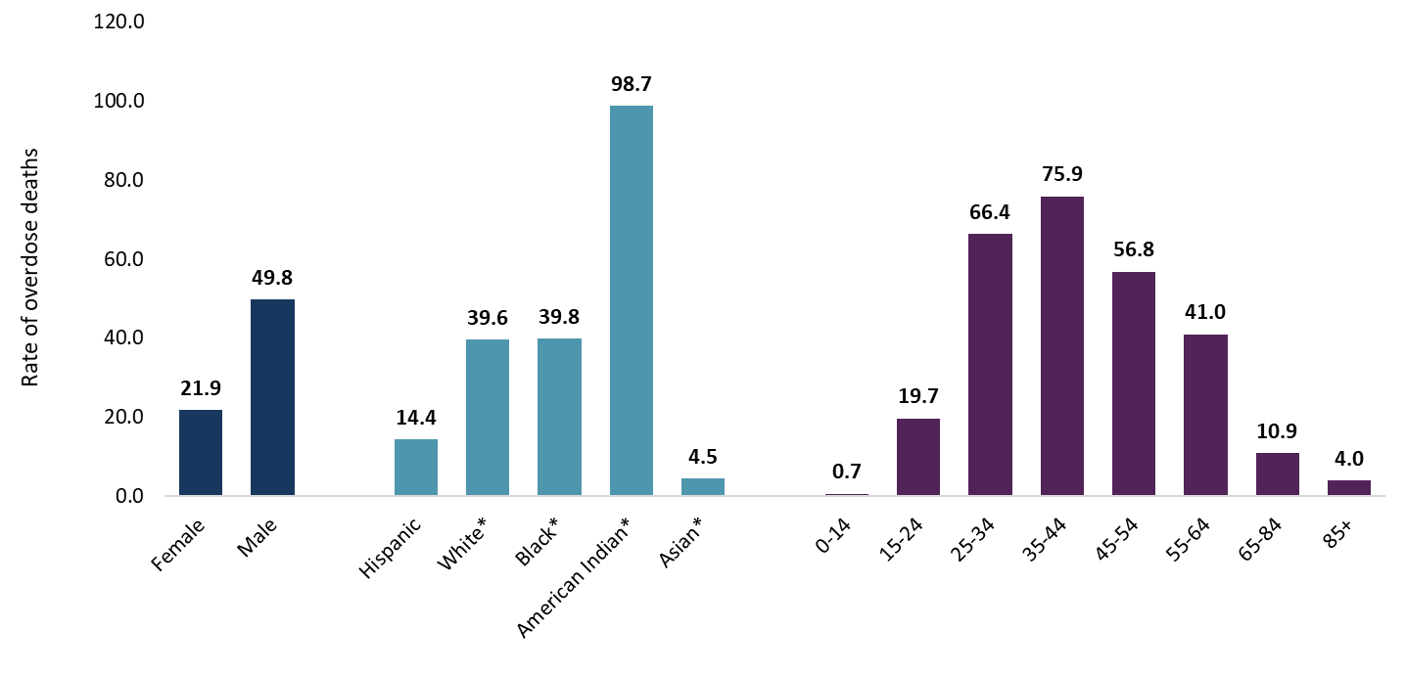
Overdose death rates are highest among males, American Indians, and those 25-54 years old (2020-2024)
*NH = Non-Hispanic
Technical Notes: Rates are per 100,000 NC residents; All intent medication and drug overdose: X40-X44, X60-X64, Y10-Y14, X85
Source: Deaths- NC State Center for Health Statistics, Vital Statistics, 2020-2024; Population-NCHS, 2020-2024
Analysis by Injury Epidemiology and Surveillance Unit
Notes:
The highest rates of med/drug overdose deaths occurred among NC residents ages 35-44 (75.9 per 100,000) and 25-34 (66.4 per 100,000), males (49.8 per 100,000), Non-Hispanic American Indians (98.7 per 100,000). These rates are calculated over a five-year time period (2020-2024).

Slide 9
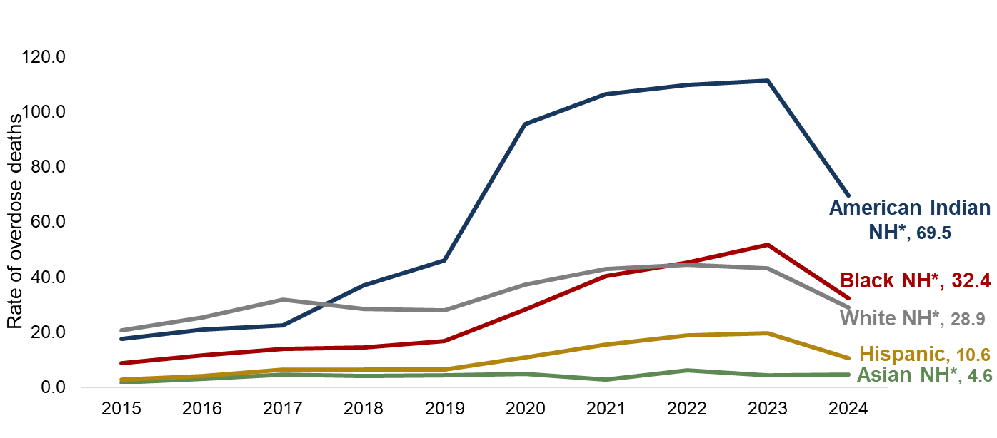
In 2024, nearly all populations experienced a decrease in overdose deaths
Rate change | 2019 to 2023 | 2023 to 2024
Black* | +210% | -37%
Hispanic | +200% | -46%
American Indian* | +141% | -38%
White* | +55% | -33%
Asian* | +2% | +7%
*NH = Non-Hispanic
Technical Notes: Rates are per 100,000 NC residents; All intent medication and drug overdose: X40-X44, X60-X64, Y10-Y14, X85
Source: Deaths-NC State Center for Health Statistics, Vital Statistics, 2015-2024; Population-NCHS, 2015-2024
Analysis by Injury Epidemiology and Surveillance Unit
Notes:
After reaching its peak overdose death rate in 2023, North Carolina experienced a decrease in 2024. However, the decrease seen statewide is not evenly dispersed amongst historically marginalized populations.
The percentage by which overdose death rates changed from 2023 to 2024 was highest among Hispanic people with a 45.6% decrease in their overdose death rate (19.5 to 10.6 per 100,000). American Indian/Indigenous communities had the highest overdose death rate in 2024, a 37.6% decrease from 2023 to 2024 (111.3 to 69.5 per 100,000). White NH people saw a 33.1% decrease in overdose death rates from 2023 to 2024 (43.2 to 28.9 per 100,000). Black NH people had the second highest rate in 2024, a 37.5% decrease from 2023 to 2024 (51.8 to 32.4 per 100,000). Asian NH people saw a 7.0% increase in overdose death rates from 2023 to 2024 (4.3 to 4.6 per 100,000).

Slide 10
Despite the decrease in 2024, fatal overdose rates for many populations remain higher than rates were prior to the start of the COVID-19 pandemic
Rate per 100,000 residents | 2019 rate | 2024 rate | Increase
Black* | 16.7 | 32.4 | 94%
Hispanic | 6.5 | 10.6 | 62%
American Indian* | 46.1 | 69.5 | 51%
White* | 27.9 | 28.9 | 4%
Asian* | 4.2 | 4.6 | 8%
*Non-Hispanic
Technical Notes: Rates are per 100,000 NC residents; All intent medication and drug overdose: X40-X44, X60-X64, Y10-Y14, X85
Source: Deaths-NC State Center for Health Statistics, Vital Statistics, 2019-2024; Population-NCHS, 2019-2024
Analysis by Injury Epidemiology and Surveillance Unit
Notes:
Despite the decrease from 2023 to 2024, rates of overdose deaths are still higher than they were pre-pandemic. This table shows the overdose death rates in North Carolina (per 100,000 residents) by year and race and shows the increase from pre-pandemic (2019) to 2024.
The overall number of overdose deaths is still highest among non-Hispanic white people; however, when measured as a portion of population, American Indian/Indigenous people have the highest overdose death rate.
The percentage by which overdose death rates increased from pre-COVID-19 rates in 2019 to 2024 rates was highest for Black/African American people and Hispanic people with their rates increasing 94% and 62%, respectively. Before the COVID-19 pandemic, the overdose death rate for Black residents in North Carolina remained lower than that of white residents. However, since 2020, the rate among Black residents has climbed at a faster pace, and in 2023 the overdose death rate among Black residents surpassed the rate among white residents. American Indian/Indigenous populations also experienced a 51% increase in overdose death rates from 2019 to 2024.

Slide 11
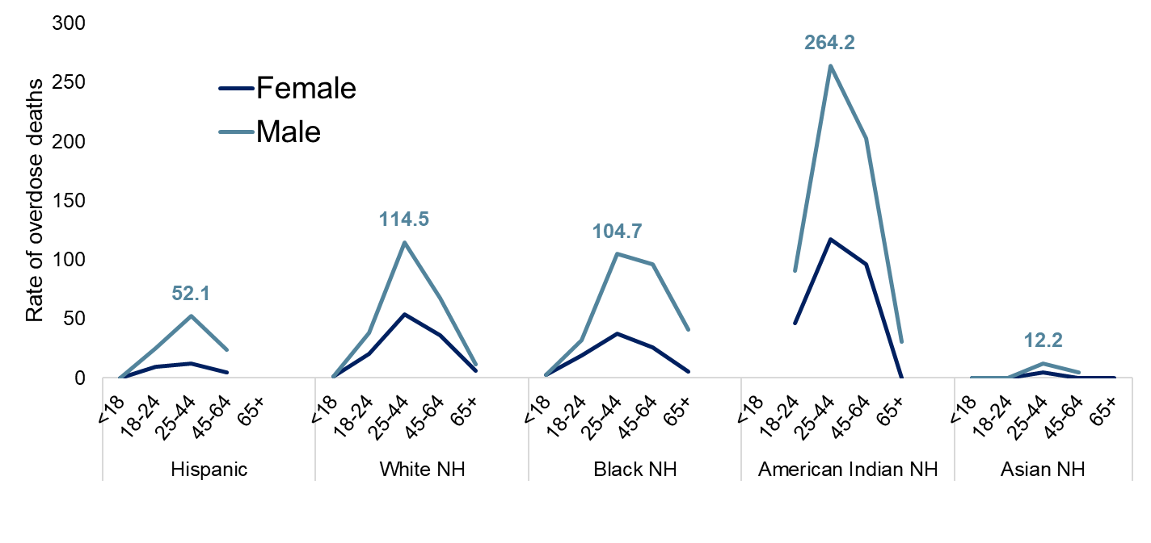
Fatal overdose trends vary within populations, but rates are highest for males ages 25-44, regardless of race/ethnicity
*
*
*
*
*
NH=Non-Hispanic *Rates not calculated for low counts 1-4
Technical Notes: Rates are per 100,000 NC residents; All intent medication and drug overdose: X40-X44, X60-X64, Y10-Y14, X85
Source: Deaths-NC State Center for Health Statistics, Vital Statistics, 2020-2024; Population-NCHS, 2020-2024
Analysis by Injury Epidemiology and Surveillance Unit
Notes:
Overdose death rate trends vary within populations. This graph shows the breakdown of rates (2020-2024) by race/ethnicity. And, within each race/ethnicity category the overdose death rate by sex and age group.
Ages 25 to 44 have the highest overdose death rate among all race/ethnicity groups for both males and females.
Within each race there are differences between sex of those ages 25 to 44:
Hispanic males (52.1 per 100,000), Hispanic females (12.1 per 100,000)
White males (114.5 per 100,000), White females (53.6 per 100,000)
Black males (104.7 per 100,000), Black females (37.5 per 100,000)
American Indians had the highest rates for both males (264.2 per 100,000) and females (117.2 per 100,000)
Asians had the lowest rates for both males (12.2 per 100,000) and females (4.6 per 100,000)

Slide 12
How are overdose events defined and what substances are involved?
What?

Slide 13
96% of poisoning deaths in NC are medication/drug overdoses.
Any Opioid
Rx Opioids
Illicit Opioids
Other Rx Opioids
Methadone
Heroin
Fentanyl (Other Synthetic Narcotics)
Any Stimulant
Other
Antiepileptics
(Gabapentin)
Cocaine
Psychostimulant (Meth, Ecstasy, Rx stimulants)
Benzodiazepines
Poisoning
Medication/Drug Overdose
Non-drug
Chemicals
Biological Substances
Gases
Technical Notes: Any poisoning: X40-X49, X60-X69, X85-X90, Y10-Y19; Medication and drug overdose: X40-X44, X60-X64, Y10-Y14, X85; Limited to NC residents
Source: Deaths-NC State Center for Health Statistics, Vital Statistics, 2024
Analysis by Injury Epidemiology and Surveillance Unit
Notes:
In 2024, there were 3,050 poisoning deaths among North Carolina residents.
Poisonings can involve medications and/or drugs (referred to as an overdose) or be a non-drug poisoning.
2,934 of these were medication and/or drug overdoses. Ultimately, 96.2% of all poisoning deaths were due to medication and/or drug overdose.

Slide 14
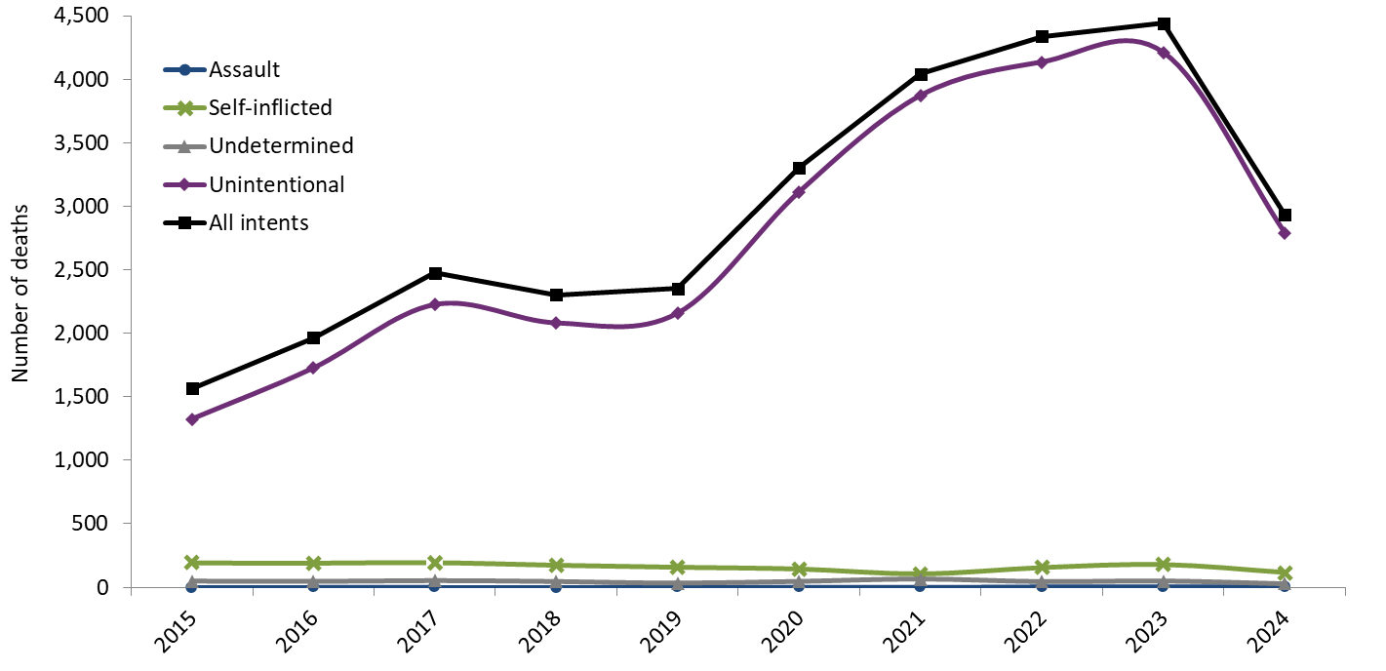
In 2024, 95% of all overdoses were unintentional
87% increase in all medication and drug overdose deaths over the last 10 years
Technical Notes: Medication and drug overdose: X40-X44, X60-X64, Y10-Y14, X85; Limited to NC residents
Source: Deaths-NC State Center for Health Statistics, Vital Statistics, 2015-2024
Analysis by Injury Epidemiology and Surveillance Unit
Notes:
Overdose deaths can be unintentional, self-inflicted, an assault, or the intent may be undetermined.
In North Carolina, and in the United States as whole, deaths due to an overdose have been steadily increasing since 1999, and in 2024 the vast majority (94.9%) of these are unintentional.
The number of overdose deaths in NC has increased 87.4%, over the last 10 years (2015-2024).

Slide 15
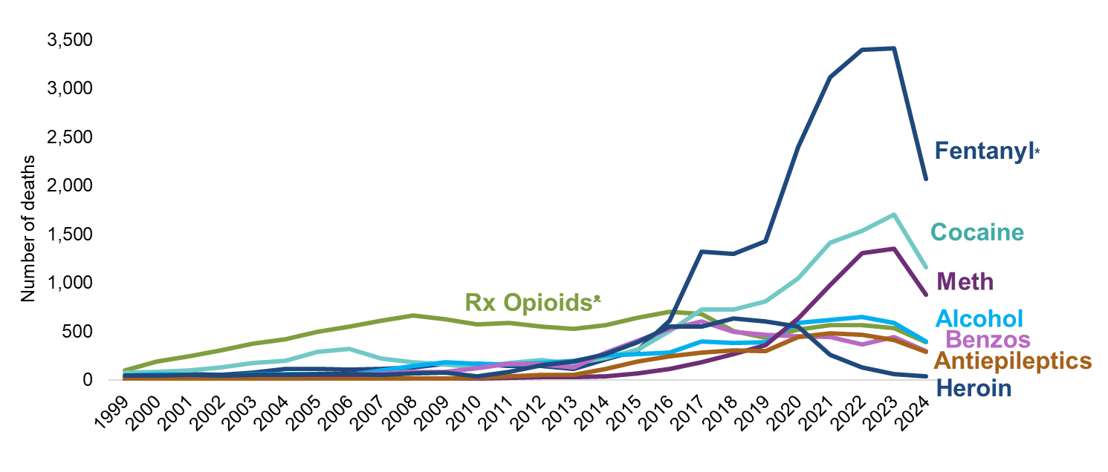
Illicitly manufactured fentanyl* remains the main contributor to overdose deaths
A growing number of deaths involve multiple substances in combination (i.e., polysubstance use)
*Fentanyl surveillance based on Other Synthetic Narcotics (T40.4), which consists of mainly illicitly manufactured fentanyl and fentanyl analogues ᵜCommonly Prescribed Opioid Medications
Technical Notes: These counts are not mutually exclusive; If the death involved multiple substances, it can be counted on multiple lines; Toxicology data is unable to distinguish whether the presence of multiple substances indicate intentional polysubstance use or if one substance was tainted with other drugs (e.g. cocaine laced with fentanyl); All intent medication, drug, alcohol poisoning: X40-X45, X60-64, Y10-Y14, X85 with any mention of specific T-codes by drug type; limited to NC residents
Source: Deaths-NC State Center for Health Statistics, Vital Statistics, 1999-2024
Analysis by Injury Epidemiology and Surveillance Unit
Notes:
The overdose epidemic is mostly driven by fentanyl.
Historically, prescription opioids (drugs like hydrocodone, oxycodone, morphine) contributed to an increasing number of medication/drug overdose deaths. In more recent years, synthetic narcotics such as fentanyl, and fentanyl analogues* have resulted in increased deaths. The number of deaths involving stimulants like cocaine and psychostimulants (which includes methamphetamine) also continue to rise.
These counts are not mutually exclusive. If a death involved multiple substances, it can be counted on multiple lines. A growing number deaths involve multiple substances in combination. Toxicology data is unable to distinguish whether the presence of multiple substances indicate intentional polysubstance use or if one substance was tainted with other drugs (e.g. cocaine laced with fentanyl).
*Fentanyl analogues are drugs that are similar to fentanyl but have been chemically modified in order to bypass current drug laws.

Slide 16
Fentanyl*, a synthetic opioid, is 50 times stronger than heroin and 100 times stronger than morphine.
Fentanyl* was involved in 70% of overdose deaths among North Carolinians in 2024.
*Fentanyl surveillance based on Other Synthetic Narcotics (T40.4), which consists of mainly illicitly manufactured fentanyl and fentanyl analogues
Technical Notes: All intent medication/drug poisoning: X40-X44, X60-64, Y10-Y14, X85 with any mention of T40.4; limited to NC residents
Source: Deaths-NC State Center for Health Statistics, Vital Statistics, 2024
Analysis by Injury Epidemiology and Surveillance Unit

Slide 17
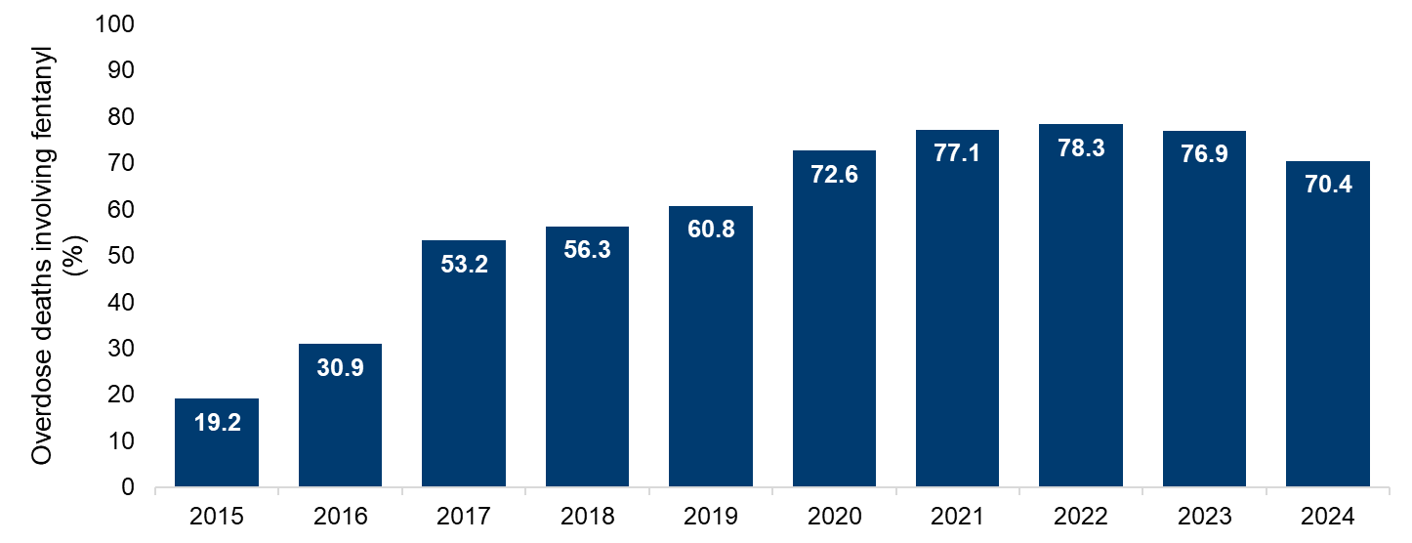
Since 2020, fentanyl has been involved in 70% or more of overdose deaths in North Carolina
Technical Notes: All intent medication/drug poisoning: X40-X44, X60-64, Y10-Y14, X85 with any mention of T40.4; limited to NC residents
Source: Deaths-NC State Center for Health Statistics, Vital Statistics, 2015-2024
Analysis by Injury Epidemiology and Surveillance Unit
Notes:
This graph depicts the increase in the percentage of overdose deaths among North Carolina that involved fentanyl.
The percent of fentanyl involved overdose deaths has decreased from 3,417 deaths in 2023 (76.9%) to 2,066 deaths in 2024 (70.4%).
Note:
*There is no individual code for fentanyl involvement on a death certificate; instead, the code T40.4 - an overdose involving another synthetic narcotic is used as a proxy for fentanyl-involvement.
Fentanyl gets coded using the other synthetic narcotic code, but there may be other drugs included in this category; however, we know from toxicology data that the majority of deaths receiving this code involved fentanyl.

Slide 18
What death data can’t tell us:
Most overdose deaths involve polysubstance use (multiple substances in combination). We can’t know from death data whether someone was intentionally using multiple substances or if their polysubstance use was unintended (e.g., it was unknown to the individual that their stimulant also contained fentanyl).
Overdose deaths have a longer lag time than many other causes of death. The lag time is the time between when the death occurred and when the data are available for analysis. This means that relying entirely on death data can put us behind the actual changing landscape of drug use. Drug checking programs like The Street Drug Analysis Lab at UNC Chapel Hill can provide more timely insights.

Slide 19
Where do overdoses occur in North Carolina?
Where?

Slide 20
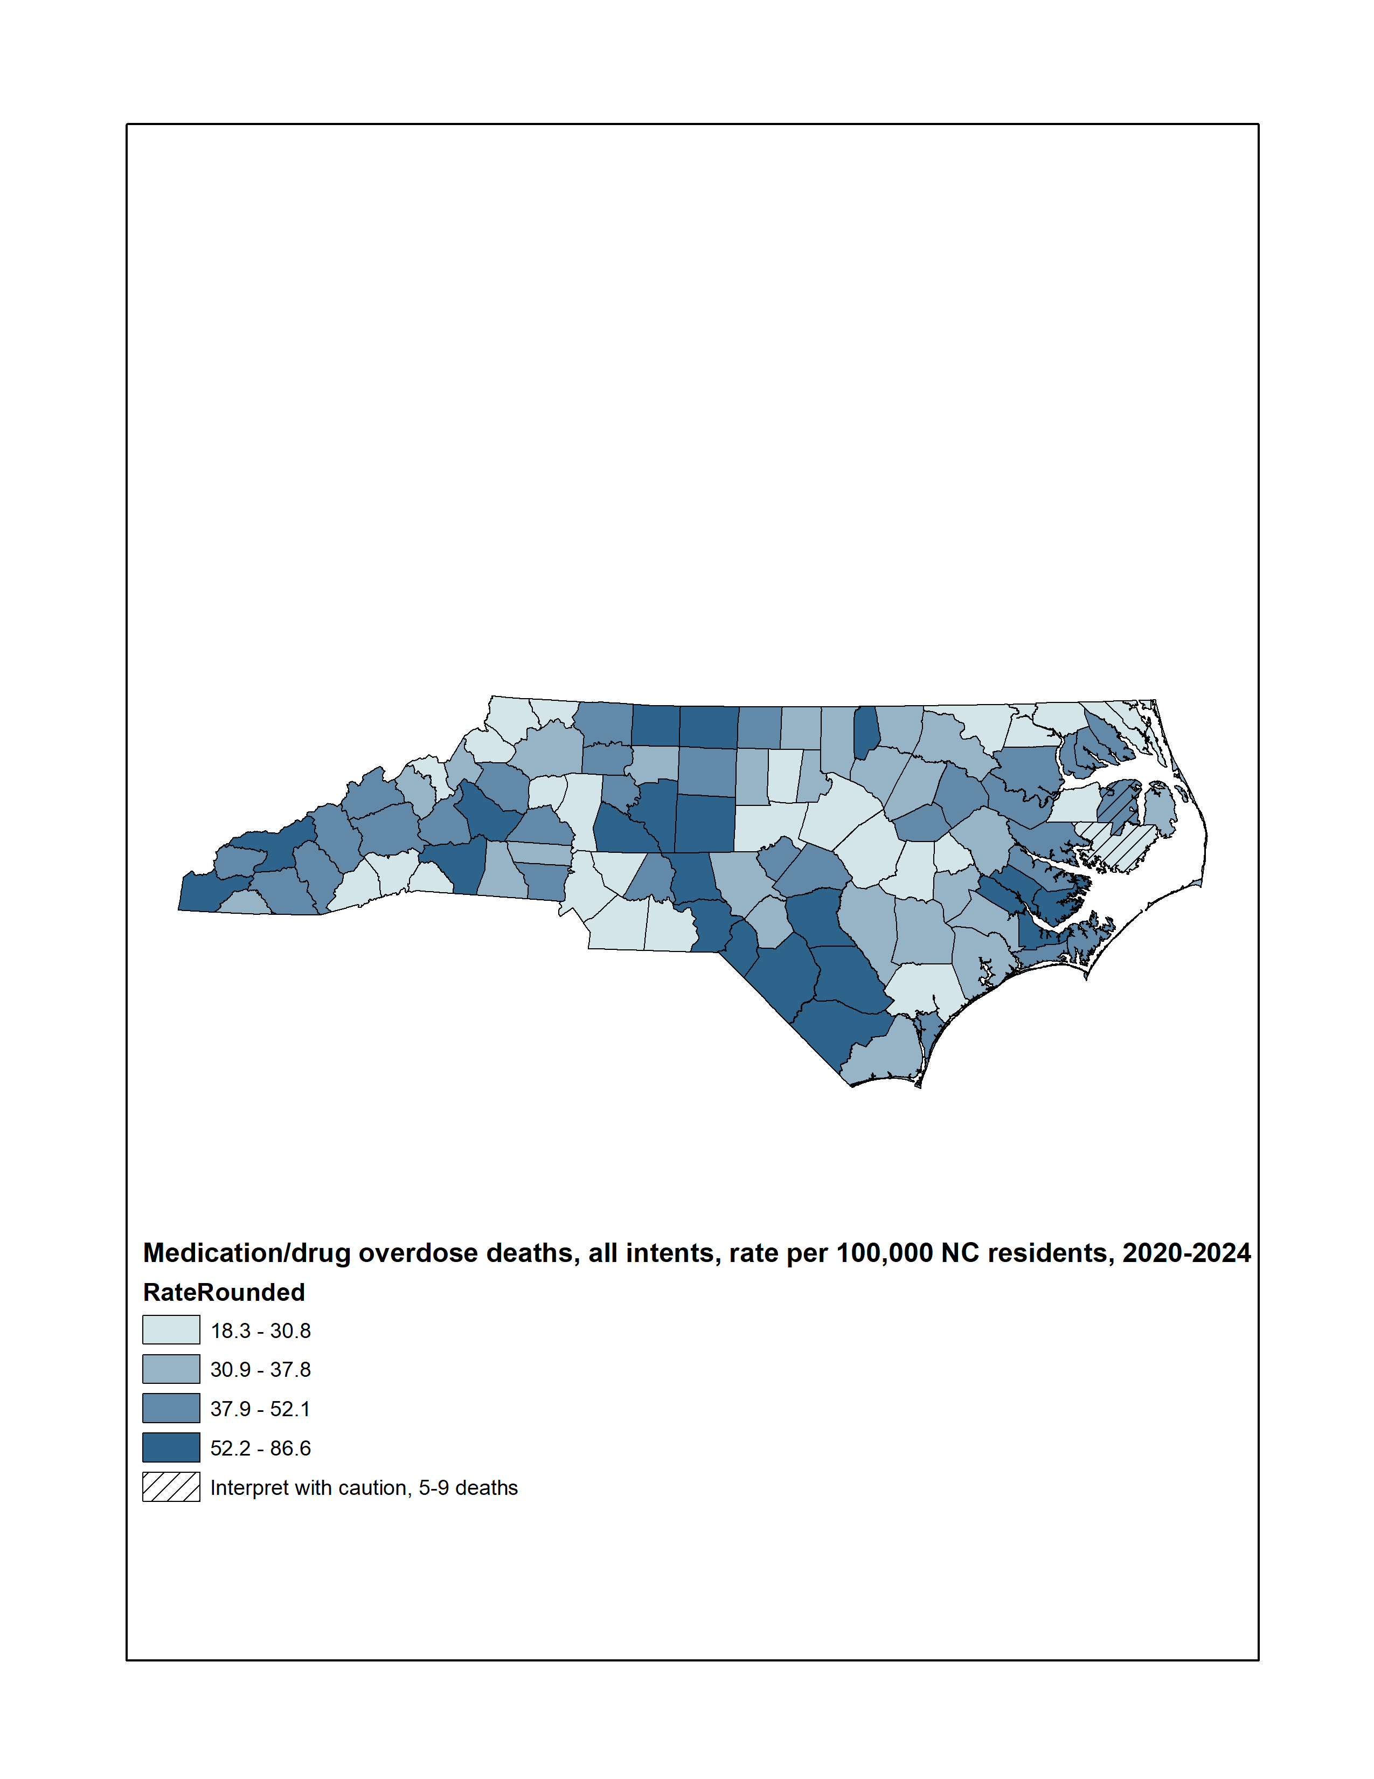
Statewide, the overdose death rate from 2020-2024 was 35.5 deaths per 100,000 residents
Medication/drug overdose deaths, all intents, rate per 100,000
Technical Notes: Rates are per 100,000 NC residents; All intent medication and drug overdose: X40-X44, X60-X64, Y10-Y14, X85
Source: Deaths-NC State Center for Health Statistics, Vital Statistics, 2020-2024; Population-NCHS, 2020-2024
Analysis by Injury Epidemiology and Surveillance Unit
Notes:
This map shades the counties of NC based on their respective overdose death rate. The statewide rate was 35.5 per 100,000 residents from 2020-2024. This five-year period was used in order to provide greater reliability in county-level rate estimates.
All counties had more than four deaths, so all rates were calculated. Interpret rates with caution in counties with fewer than 10 deaths.

Slide 21
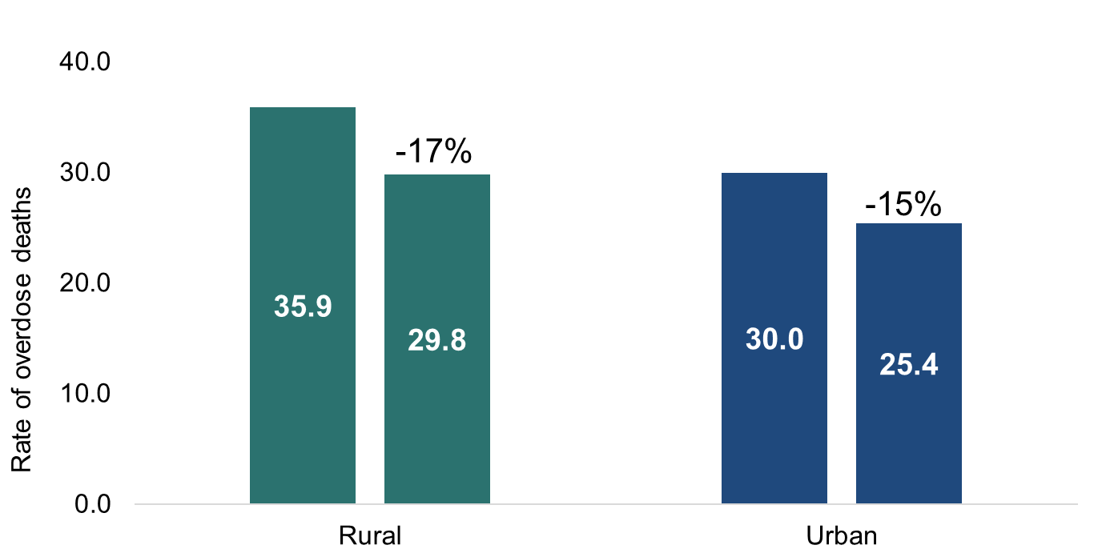
Overdose death rates are highest in rural counties
2020 2024
2020 2024
Technical Notes: Rates are per 100,000 NC residents; All intent medication and drug overdose: X40-X44, X60-X64, Y10-Y14, X85 Source: Deaths-NC State Center for Health Statistics, Vital Statistics, 2020-2024; Population-NCHS, 2020-2024 Analysis by Injury Epidemiology and Surveillance Unit
Notes:
Overdose death rates are highest in rural counties.
Rural counties experienced an 17% rate decrease from 2020 (35.9 per 100,000) to 2024 (29.8 per 100,000).
Urban counties experienced an 15% rate decrease from 2020 (30.0 per 100,000) to 2024 (25.4 per 100,000).

Slide 22
What are the overdose trends over time in North Carolina?
When?

Slide 23
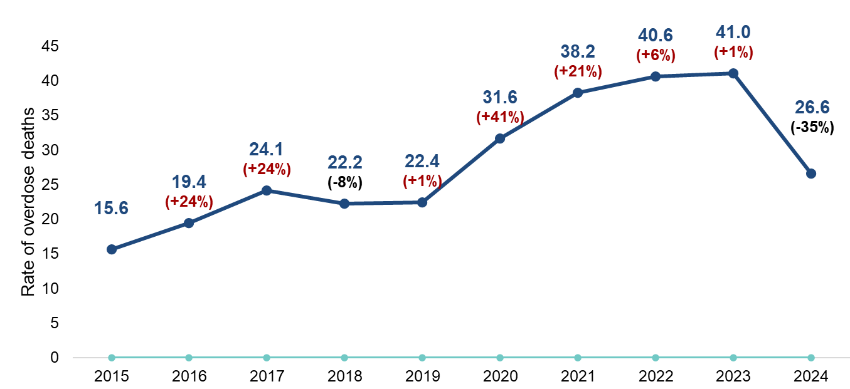
Overdose death rates in North Carolina decreased in 2024
n=2,934
n=1,566
From 2015 to 2024, the fatal overdose rate increased 71%.
Technical Notes: All intent medication and drug overdose: X40-X44, X60-X64, Y10-Y14, X85; Limited to NC residents
Source: Deaths-NC State Center for Health Statistics, Vital Statistics, 2015-2024
Analysis by Injury Epidemiology and Surveillance Unit
Notes:
Disruption to public health, healthcare, and social services from COVID-19 all contributed to the 41% increase in 2020 and the continued increases in our state.
This slide looks at the rate of med/drug overdose deaths among NC residents. From 2023, with a death rate of 41.0 per 100,000, to 2024, with a death rate of 26.6 per 100,000, North Carolina saw a 35% decrease in the rate of overdose deaths.
The number of overdose deaths increased from 1,566 in 2015 to 2,934 in 2024, a 87.4% increase. Similarly, the rate of overdose deaths increased from 15.6 in 2015 to 26.6 in 2024, a 70.5% increase.

Slide 24
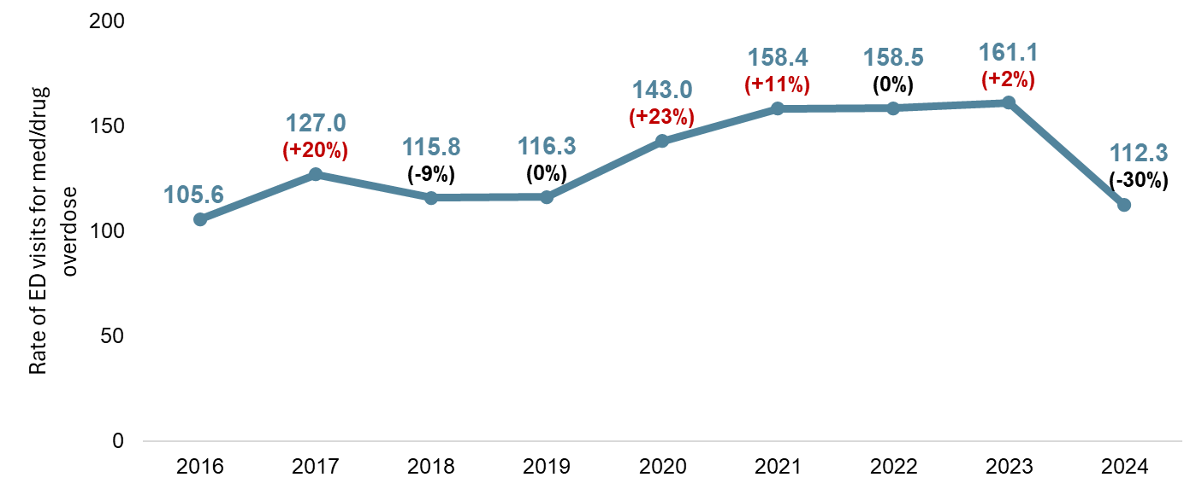
ED overdose visit rates in North Carolina decreased in 2024
n=10,726
n=12,405
From 2016 to 2024, the rate of ED visits for overdose^ increased 6%.
Technical Notes: Unintentional/Undetermined Medication or Drug Overdose (ages 15-65): This syndrome is used to track overdose Emergency Department (ED) visits for medications or drugs with dependency potential. It is limited to ED visits by NC residents ages 15-65.
Data Sources: Emergency Department-North Carolina Disease Event Tracking and Epidemiologic Tool (NCDETECT), 2016-2024;
Analysis by Injury Epidemiology and Surveillance Unit
Notes:
ED visits for overdoses involving medications/drugs with dependency potential decreased in 2024. In 2023 there were 161.1 ED visits per 100,000 population and in 2024 there were 112.3 ED visits per 100,000 population, a 30% decrease.
The number of overdose ED visits decreased from 14,938 in 2020 to 12,405 in 2024, a 17% decrease. Similarly, the rate of overdose ED visits decreased from 143.0 in 2020 to 112.3 in 2024, a 21.4% decrease.
This slide shows rates of unintentional and undetermined overdoses with the potential for misuse among those ages 15 to 65 visits to the Emergency Department. See details of the case definition at https://ncdetect.org/case-definitions/
***NC DETECT is a statewide public health syndromic surveillance system, funded by the NC Division of Public Health (NC DPH) Federal Public Health Emergency Preparedness Grant and managed through collaboration between NC DPH and the UNC-CH Department of Emergency Medicine’s Carolina Center for Health Informatics. The NC DETECT Data Oversight Committee is not responsible for the scientific validity or accuracy of methodology, results, statistical analyses, or conclusions presented.

Slide 25
What are factors that may have led to a person’s overdose?
Why?

Slide 26
The “why?” behind an overdose can be both individual and systemic.
Communities of color have been systematically marginalized through decades of a criminalized response to addiction. This has taken root in critical systems, including education, employment, housing, child welfare, immigration, and public benefits and causes health disparities. Health disparities are differences in health outcomes among groups of people.
Often times, data on these drivers of health are not collected alongside health outcome data, like overdoses. Special research studies linking datasets and systems like the North Carolina State Unintentional Drug Overdose Reporting System (NC-SUDORS) can offer insights.

Slide 27
People are 50 times more likely to die of an opioid overdose in the two weeks post-incarceration than the general population.
AM J Public Health: Opioid Overdose Deaths Among Formerly Incarcerated Persons and the General Population: North Carolina, 2000-2018

Slide 28
Preliminary findings linking housing shelter data to death records show that overdose was the most frequent cause of death among people with a history of experiencing homelessness.
Learn more here:
Injuries among people experiencing homelessness in North Carolina fact sheet
NCMJ: People Experiencing Homelessness in NC have Increased Mortality, Including High Overdose, Violence, Injury, and Chronic Disease Death Rates

Slide 29

There are many things the data may not be able to tell us, but NC-SUDORS offers additional insights into the circumstances leading to an overdose death.
Death Certificates
-Demographics
-Decedent resident information
-Cause of death information
Medical Examiner Reports
-Scene evidence of drug use
-Timing and context of overdose
-Medical and social history/circumstances
Toxicology Results
-All substances detected
-Substances that caused death
North Carolina State Unintentional Drug Overdose Reporting System (NC-SUDORS)
Circumstance data are gathered during the initial death investigation, often during interviews with the decedent’s family and friends. These data are not always known or relayed.
Notes:
The North Carolina State Unintentional Drug Overdose Reporting System (NC-SUDORS) is made up of multiple sources of data including death certificates, medical examiner/coroner reports, and toxicology results. The incorporation of different sources of data provide a unique opportunity to analyze circumstance data for these unintentional or undetermined overdose deaths.
SUDORS, a program developed by the Centers for Disease Control and Prevention (CDC) enables states to collect detailed overdose death information. SUDORS provides rich circumstance data and highlights opportunities where intervention could save lives. Circumstance data is gathered during the initial death investigation oftentimes during interviews with the decedent’s family and friends. All circumstance data are not always known or relayed during the investigation.

Slide 30
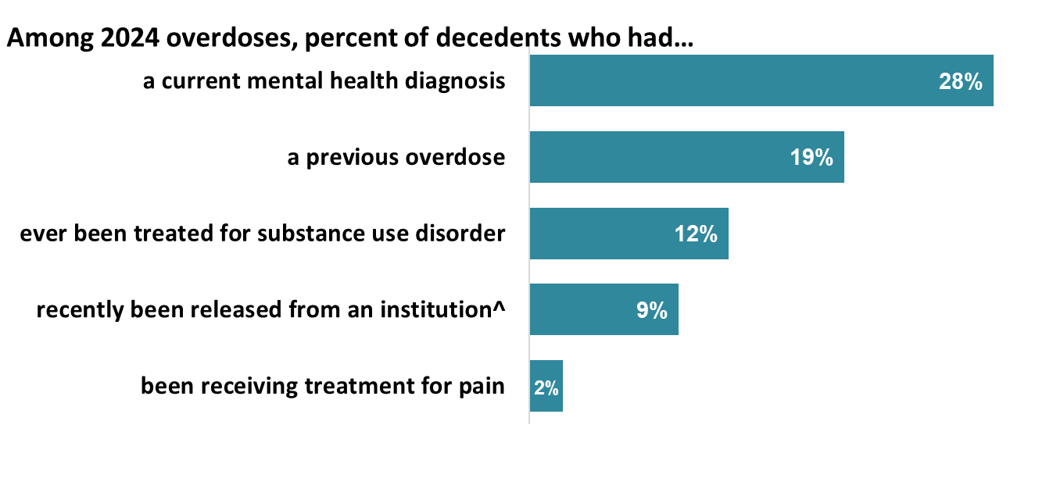
In 2024, 50% of overdose decedents had at least one documented interaction with a health care provider
^Deaths that occurred within a month of the decedent being released from or admitted to an institutional setting (includes jail, prison, detention facility, hospital, psychiatric hospital, etc.)
Technical Notes: Limited to unintentional and undetermined intent overdose deaths that occurred in NC; Denominators are all NC-SUDORS decedents. Circumstance data are gathered during the initial death investigation oftentimes during interviews with the decedent’s family and friends. These data are not always known or relayed. If additional details are discovered, they may be included in future updates of the NC-SUDORS dataset.
Source: NC-State Unintentional Drug Overdose Reporting System (NC-SUDORS), 2024.
Analysis by Injury Epidemiology and Surveillance Unit
Notes:
In 2024 50% of unintentional or undetermined intent overdose deaths that occurred in North Carolina had at least one document interaction with a health care provider.
Opportunities for intervention exist every time a patient interacts with a medical provider in the healthcare system.
These data come from the State Unintentional Drug Overdose Reporting System (SUDORS), a program developed by the Centers for Disease Control and Prevention (CDC) as a response to the opioid overdose epidemic to enable states to collect detailed overdose death information. SUDORS provides rich circumstance data and highlights opportunities where intervention could save lives. Circumstance data is gathered during the initial death investigation oftentimes during interviews with the decedent’s family and friends. All circumstance data are not always known or relayed during the investigation. Stigma associated with mental health conditions contributes to underreporting of MH burden among this population-counts are likely higher than reported. If additional details are discovered, they may be included in future updates of the NC-SUDORS dataset.

Slide 31
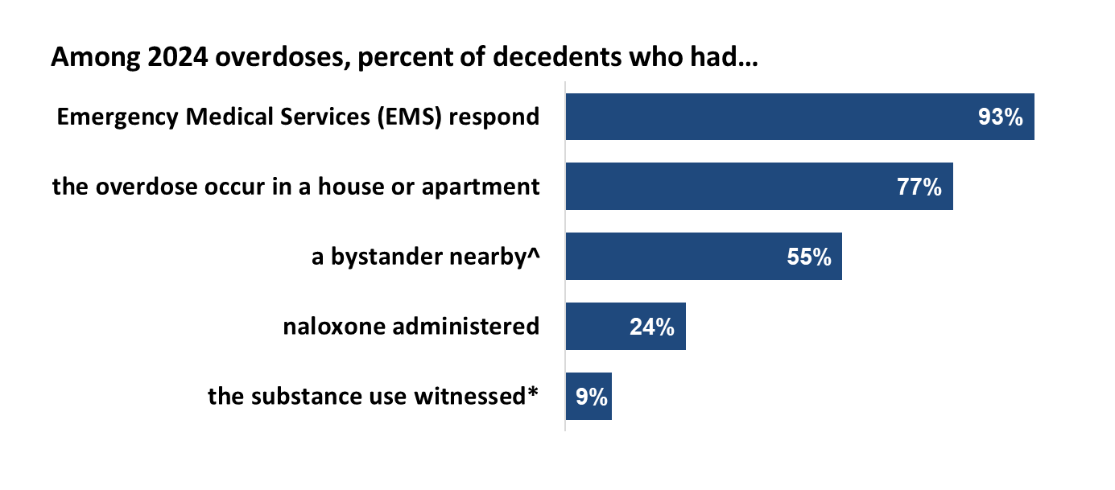
Although a bystander was known to be nearby for 55% of fatal overdoses, naloxone was only administered 24% of the time
^A bystander is an individual who was physically nearby, either during or shortly preceding a drug overdose, who potentially had an opportunity to intervene and respond to the overdose. *A witness is an individual, aged 11 years or older, who witnessed the decedent use the substance(s) that resulted in his/her overdose.
Technical Notes: Limited to unintentional and undetermined intent overdose deaths that occurred in NC; Denominators are all NC-SUDORS decedents. Circumstance data are gathered during the initial death investigation oftentimes during interviews with the decedent’s family and friends. These data are not always known or relayed. If additional details are discovered, they may be included in future updates of the NC-SUDORS dataset.
Source: NC-State Unintentional Drug Overdose Reporting System (NC-SUDORS), 2024.
Analysis by Injury Epidemiology and Surveillance Unit
Notes:
The response of bystanders and/or EMS personnel are important factors that can be used to inform and guide overdose prevention efforts in North Carolina. Naloxone should be provided to any individual at risk for overdose, their family and friends with directions for use. In 2024, at least one bystander was known to be present at 55% of fatal overdoses, naloxone was only administered 24% of the time.
These data come from the State Unintentional Drug Overdose Reporting System (SUDORS), a program developed by the Centers for Disease Control and Prevention (CDC) as a response to the opioid overdose epidemic to enable states to collect detailed overdose death information. SUDORS provides rich circumstance data and highlights opportunities where intervention could save lives. Circumstance data is gathered during the initial death investigation oftentimes during interviews with the decedent’s family and friends. All circumstance data are not always known or relayed during the investigation. Stigma associated with mental health conditions contributes to underreporting of MH burden among this population-counts are likely higher than reported.

Slide 32
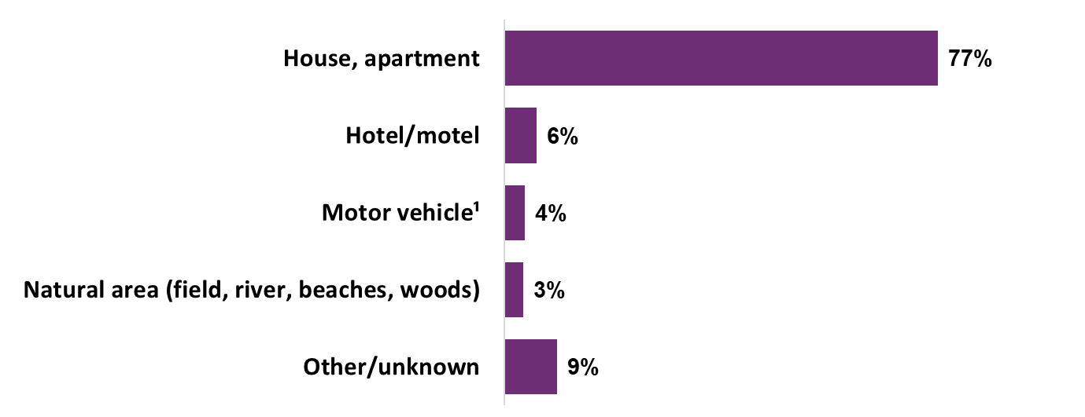
Three of four overdose deaths occurred at home
Among 2024 overdoses, percent of decedents who overdosed at…
¹Excludes school bus and public transportation or station
Technical Notes: Limited to unintentional and undetermined intent overdose deaths that occurred in NC; Denominators are all NC-SUDORS decedents. Circumstance data are gathered during the initial death investigation oftentimes during interviews with the decedent’s family and friends. These data are not always known or relayed. If additional details are discovered, they may be included in future updates of the NC-SUDORS dataset.
Source: NC-State Unintentional Drug Overdose Reporting System (NC-SUDORS), 2024.
Analysis by Injury Epidemiology and Surveillance Unit
Notes:
In 2024, 77% of unintentional and undetermined overdose deaths in North Carolina occurred in a house or apartment.
Other locations included: hotel/motel (6%), motor vehicle (4%), natural area (3%), and other/unknown (9%).
These data come from the State Unintentional Drug Overdose Reporting System (SUDORS), a program developed by the Centers for Disease Control and Prevention (CDC) as a response to the opioid overdose epidemic to enable states to collect detailed overdose death information. SUDORS provides rich circumstance data and highlights opportunities where intervention could save lives.

Slide 33
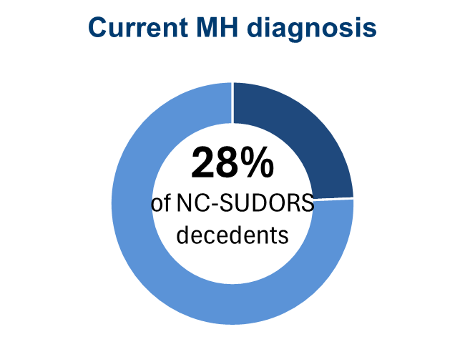
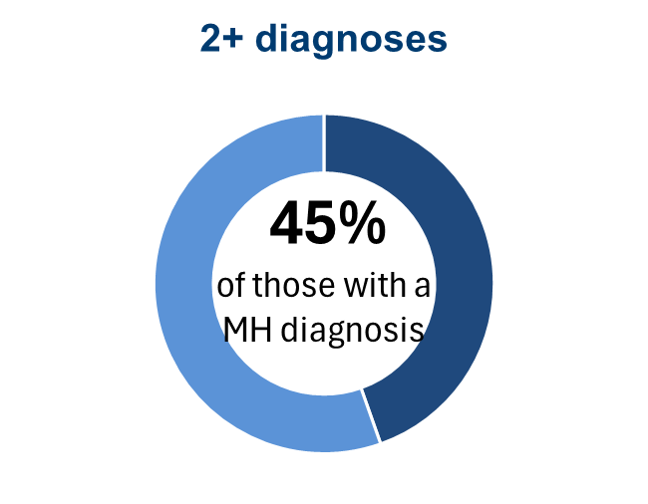
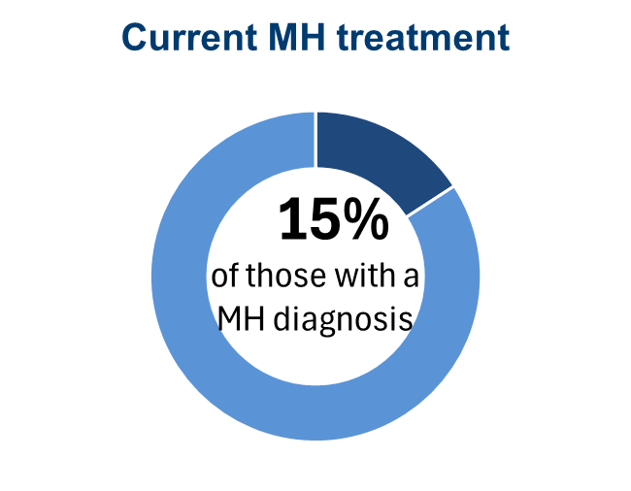
One in four overdose decedents had a non-substance-related mental health disorder in 2024
MH = Mental health
Technical notes: Limited to unintentional and undetermined intent overdose deaths that occurred in NC. Circumstance data are gathered during the initial death investigation oftentimes during interviews with the decedent’s family and friends. These data are not always known or relayed. Stigma associated with mental health conditions contributes to underreporting of MH burden among this population-counts are likely higher than reported. These data are not always known or relayed. If additional details are discovered, they may be included in future updates of the NC-SUDORS dataset.
Source: NC-State Unintentional Drug Overdose Reporting System (NC-SUDORS), 2024.
Analysis by Injury Epidemiology and Surveillance Unit
Notes:
In 2024, 28.4% of decedents had a known mental health diagnosis. Among those, 44.6% had two or more diagnoses, and only 14.6% of decedents with a mental health diagnosis were known to be in treatment when they died.
There are several important caveats to keep in mind:
When accounting for undiagnosed and/or undocumented mental health conditions, the true prevalence of at least one mental condition is likely higher than our results show.
These data come from the State Unintentional Drug Overdose Reporting System (SUDORS), a program developed by the Centers for Disease Control and Prevention (CDC) as a response to the opioid overdose epidemic to enable states to collect detailed overdose death information. SUDORS provides rich circumstance data and highlights opportunities where intervention could save lives. Circumstance data are gathered during the initial death investigation oftentimes during interviews with the decedent’s family and friends. All circumstance data are not always known or relayed during the investigation. Stigma associated with mental health conditions contributes to underreporting of MH burden among this population-counts are likely higher than reported. If additional details are discovered, they may be included in future updates of the NC-SUDORS dataset.

Slide 34
Most common non-substance-related mental health diagnoses among NC overdose decedents
Depression/ dysthymia | Anxiety disorder | Bipolar disorder
68% | 29% | 24%
Technical notes: Limited to unintentional and undetermined intent overdose deaths that occurred in NC; Denominator are those decedents with a current mental health problem. Counts are not mutually exclusive; a person could have more than one mental health (MH) diagnosis. Circumstance data are gathered during the initial death investigation oftentimes during interviews with the decedent’s family and friends. These data are not always known or relayed. Stigma associated with mental health conditions contributes to underreporting of MH burden among this population-counts are likely higher than reported. If additional details are discovered, they may be included in future updates of the NC-SUDORS dataset.
Source: NC-State Unintentional Drug Overdose Reporting System (NC-SUDORS), 2024.
Analysis by Injury Epidemiology and Surveillance Unit
Notes:
The three most common mental health diagnoses among North Carolina overdose decedents in 2024 included depression, anxiety, and bipolar disorder.
After depression (67.7%), anxiety (29.0%), and bipolar disorder (24.2%), the next two most common diagnoses for 2024 were Schizophrenia (12.0%) and PTSD (9.8%).
There are several important caveats to keep in mind:
A single decedent could—and often did—have more than one diagnosis AND
When accounting for undiagnosed and/or undocumented mental health conditions, the true prevalence of at least one mental condition is likely higher than our results show.
These data come from the State Unintentional Drug Overdose Reporting System (SUDORS), a program developed by the Centers for Disease Control and Prevention (CDC) as a response to the opioid overdose epidemic to enable states to collect detailed overdose death information. SUDORS provides rich circumstance data and highlights opportunities where intervention could save lives. Circumstance data are gathered during the initial death investigation oftentimes during interviews with the decedent’s family and friends. All circumstance data are not always known or relayed during the investigation. Stigma associated with mental health conditions contributes to underreporting of MH burden among this population-counts are likely higher than reported.

Slide 35
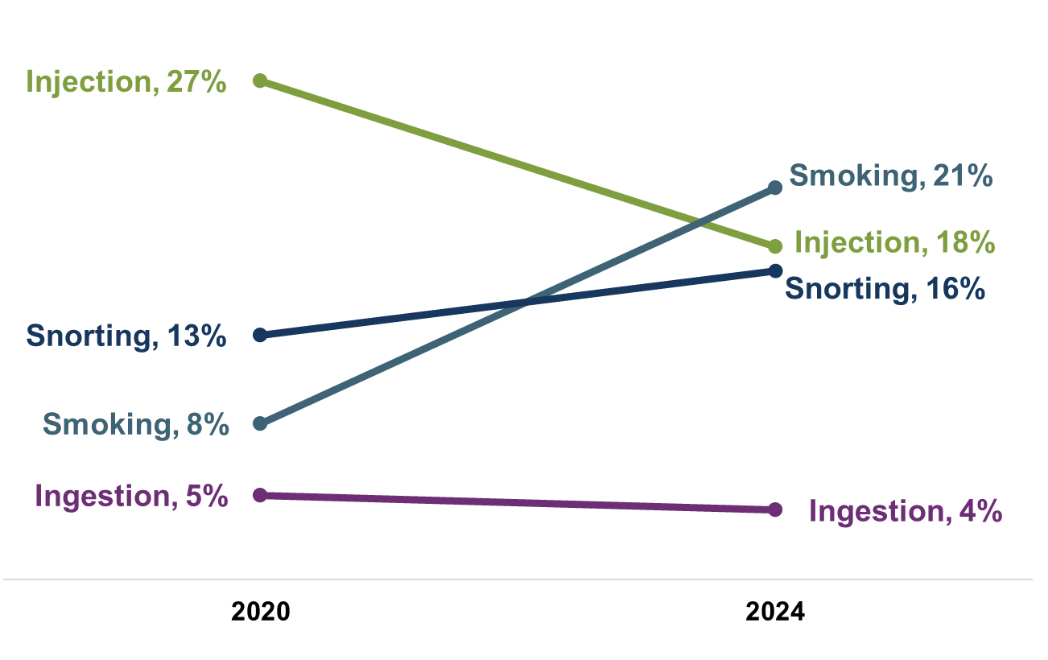
The route of drug administration changed from 2020 to 2024
Technical notes: Limited to unintentional and undetermined intent overdose deaths that occurred in NC; Denominators are all NC-SUDORS decedents. Circumstance data are gathered during the initial death investigation oftentimes during interviews with the decedent’s family and friends. These data are not always known or relayed. If additional details are discovered, they may be included in future updates of the NC-SUDORS dataset.
Source: NC-State Unintentional Drug Overdose Reporting System (NC-SUDORS), 2020 and 2024.
Analysis by Injury Epidemiology and Surveillance Unit
Notes:
From 2020 to 2024, the percentage of overdose deaths with evidence of injection decreased from 26.5% in 2020 to 17.7% in 2024.
Other routes of administration have increased:
The percentage with evidence of smoking increased from 8.3% to 20.8%
The percentage with evidence of snorting increased from 13.0% to 16.4%
The percentage with evidence of ingestion decreased from 4.5% to 3.7%
These data come from the State Unintentional Drug Overdose Reporting System (SUDORS), a program developed by the Centers for Disease Control and Prevention (CDC) as a response to the opioid overdose epidemic to enable states to collect detailed overdose death information. SUDORS provides rich circumstance data and highlights opportunities where intervention could save lives. Circumstance data are gathered during the initial death investigation oftentimes during interviews with the decedent’s family and friends. All circumstance data are not always known or relayed during the investigation.

Slide 36
What is being done across North Carolina to address the overdose epidemic?
How to stay informed

Slide 37
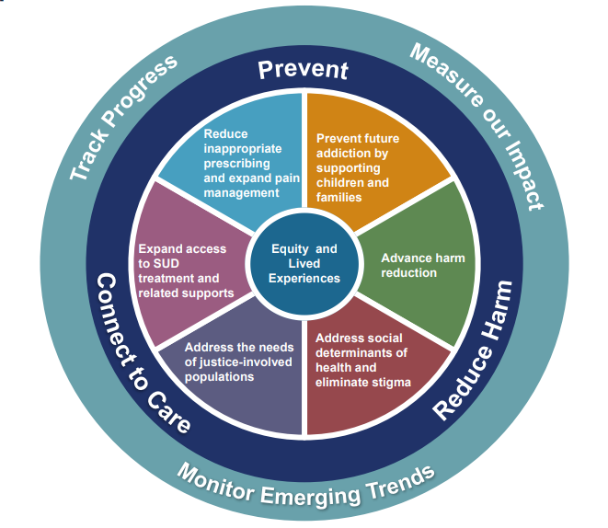
The NC Opioid and Substance Use Action Plan (NC OSUAP) has seven focus areas to address the overdose epidemic:
Opioid and Substance Use Action Plan
Notes:
To combat the opioid crisis, the North Carolina Department of Health and Human Services worked with community partners to develop the original North Carolina Opioid Action Plan (NC OAP) in June 2017. Version 2.0 launched in June 2019, and version 3.0 (now the Opioid and Substance Use Action Plan, OSUAP) launched in May 2021.
The NC OSUAP, version 3.0, includes a broadened focus on polysubstance use as well as centering equity and lived experiences to ensure that the strategies address the overdose epidemic are led by those closest to the issue.
The plan focuses on four priority areas to address the epidemic: Center Equity and Lived Experiences, Prevent Future Addiction and Address Trauma, Reduce Harm, and Connect to Care.

Slide 38
North Carolina Opioid and Prescription Drug Abuse Advisory Committee (OPDAAC)
OPDAAC was created to develop and implement a statewide strategic plan to combat the problem of prescription drug use in North Carolina. It’s evolved into a community of practice for anyone working to address the opioid epidemic from prescribers, treatment, recovery and community groups, families who have lost loved ones to overdose, health systems, pharmaceutical industry, harm reduction and law enforcement. All perspectives are welcomed and heard.
Opioid and Prescription Drug Abuse Advisory Committee

Slide 39
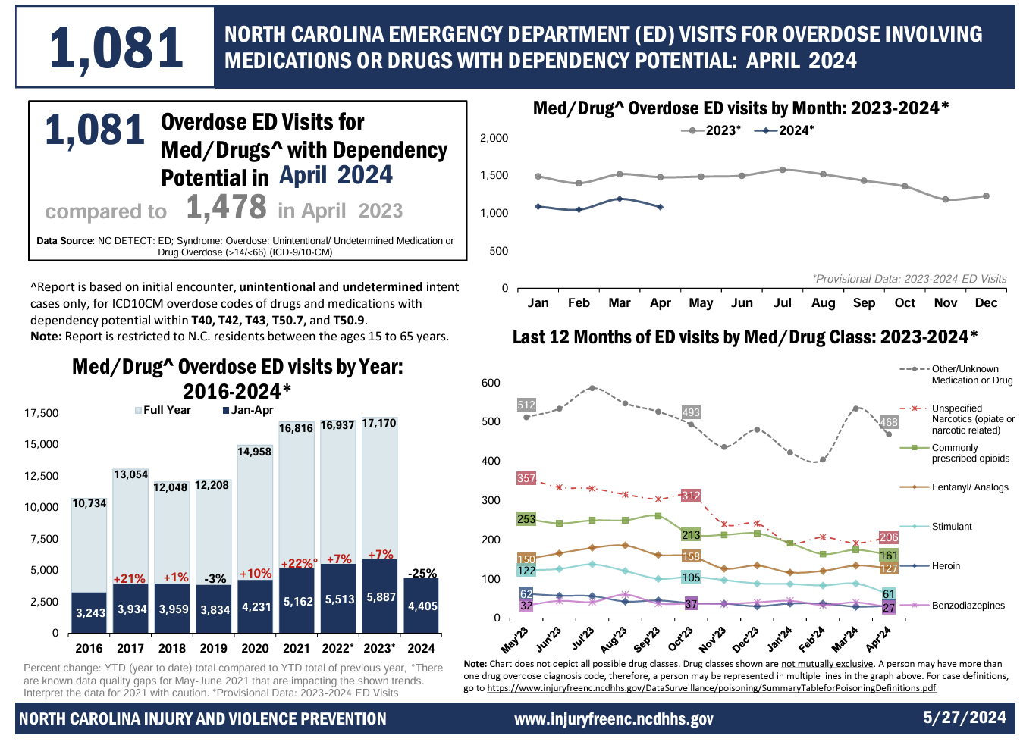
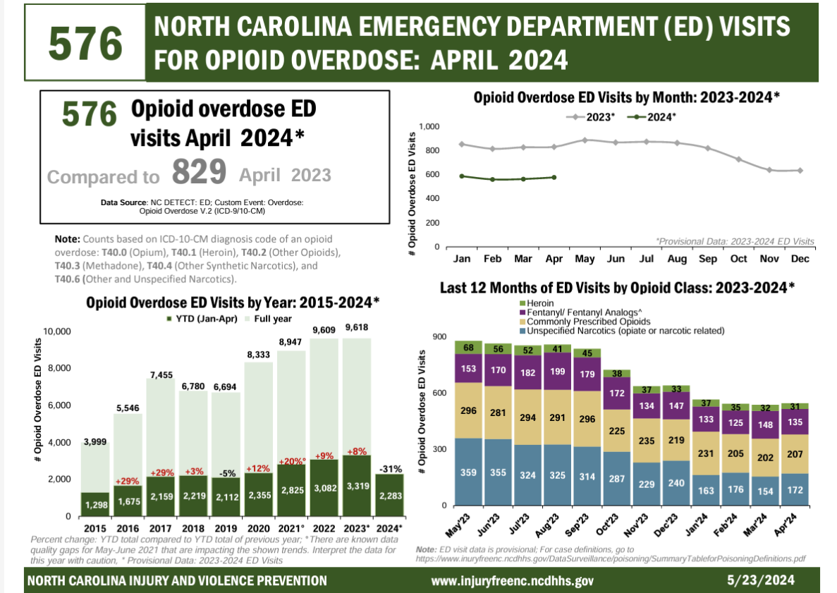
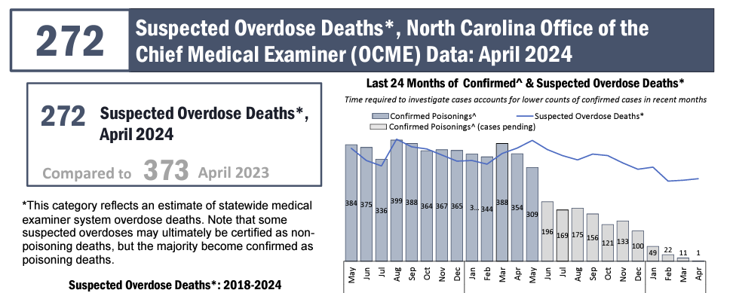
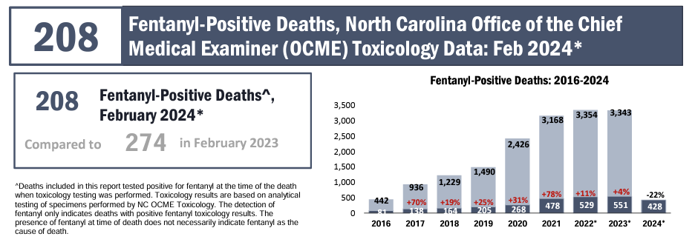
Email
SubstanceUseData
@dhhs.nc.gov
to receive monthly data updates
Notes:
Monthly overdose reports including Fentanyl-Positive Deaths, Suspected Overdose Deaths, Med/Drug Overdose ED Visits, and Opioid Overdose ED Visits are available.
Email SubstanceUseData@dhhs.nc.gov to receive monthly updates.
Reports are posted at https://www.dph.ncdhhs.gov/programs/chronic-disease-and-injury/injury-and-violence-prevention-branch/north-carolina-overdose-epidemic-data#monthly-reports

Slide 40
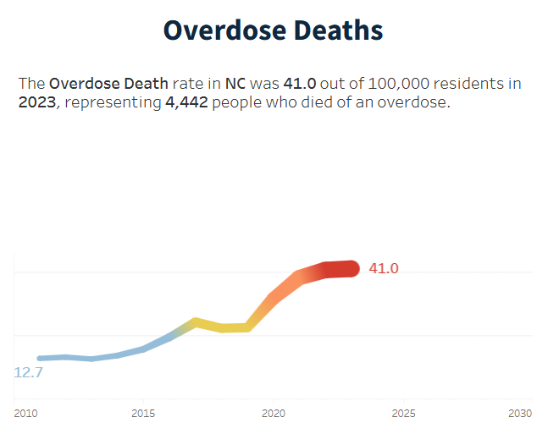
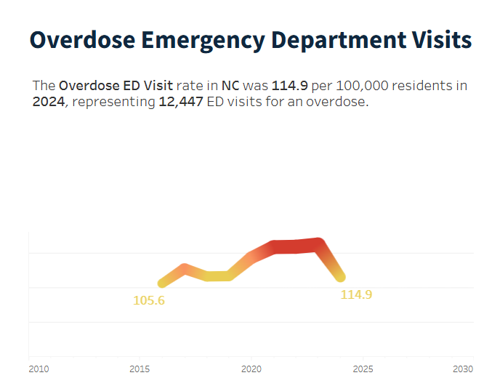
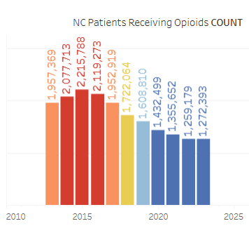
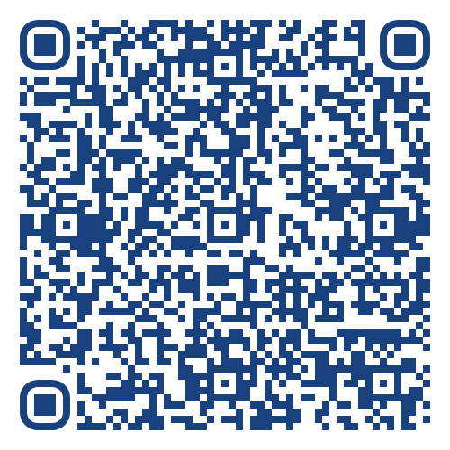
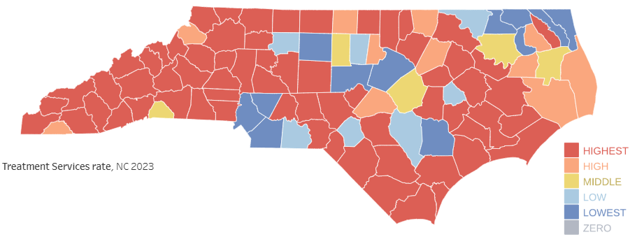
NC Overdose Epidemic Data
Notes:
The new NC Overdose Epidemic Data website launched in December 2024. The page includes monthly overdose surveillance updates, statewide summary data, and interactive visuals of state and county-level indicators. Those indicators include illicit overdose deaths, overdose ED visits, patients receiving buprenorphine or opioids, treatment services, and more.
Visit the dashboard here:
https://www.dph.ncdhhs.gov/programs/chronic-disease-and-injury/injury-and-violence-prevention-branch/north-carolina-overdose-epidemic-data

Slide 41
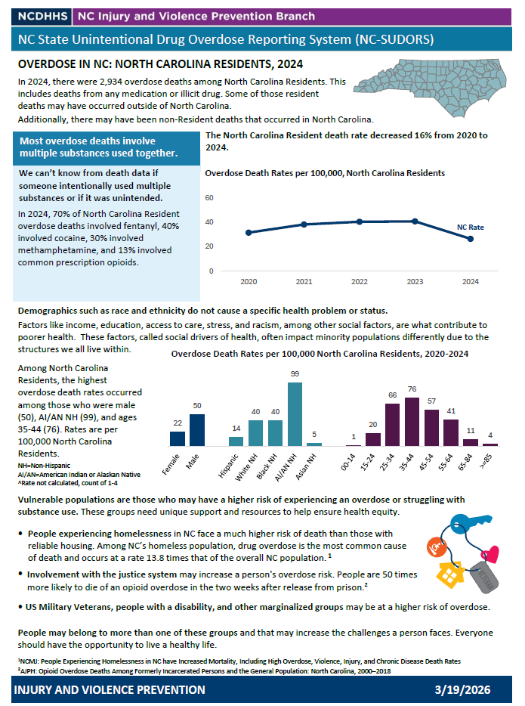
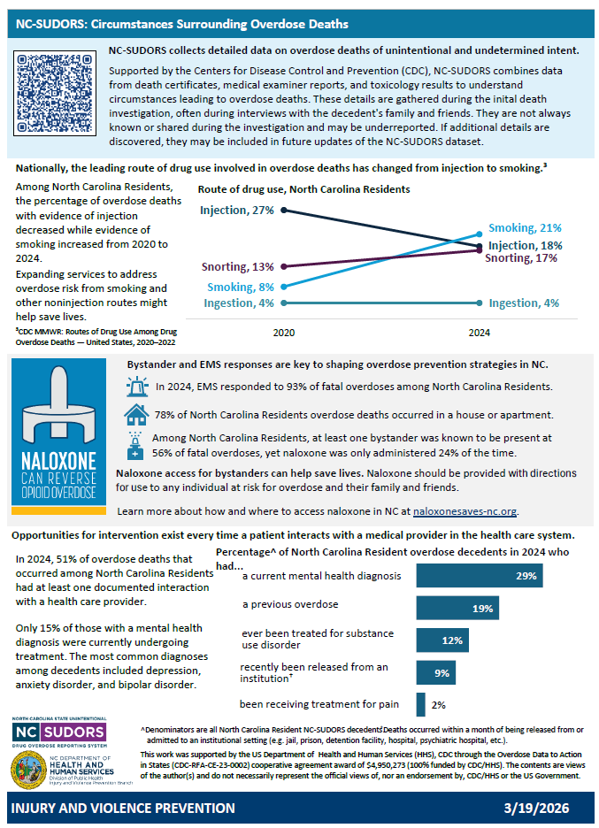
NC-SUDORS resources
Notes:
NC-SUDORS data is available to request. Researchers can request line level data to conduct their own research. Local health department’s can request their jurisdiction’s data, summarized by decedent, to aid in things such as overdose fatality reviews.
A new NC-SUDORS factsheet is available with aggregate data by county or congressional district. The two-page fact sheet gives an overview of overdose in the specified region over the past five years. It includes rates, demographics, and NC-SUDORS circumstance data such as route of drug administration, if a bystander was present, and more information surrounding the decedent’s fatal overdose. Factsheets for those counties with an average of ten or more fatal overdoses over the last five years will be available on our website. If you do not see your jurisdiction posted, please contact us and we will work with you to get the data you need.

Slide 42
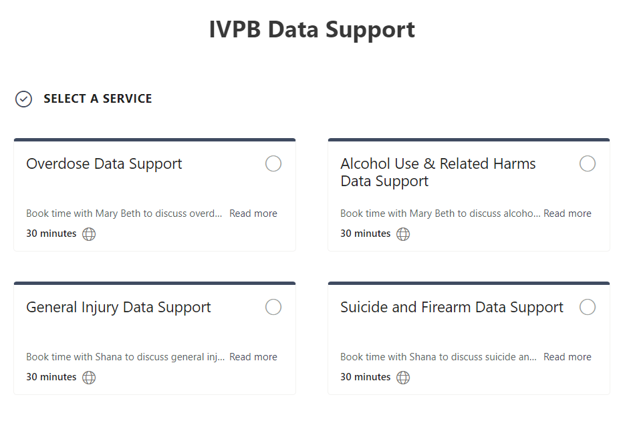

IVPB Data Support available!
Book time with an IVPB epidemiologist to discuss available data products, to talk through custom data requests, or for general data questions.
IVPB Data Request Policy
IVPB Data Support Bookings

Slide 43
Questions?
SubstanceUseData@dhhs.nc.gov
Injury and Violence Prevention Branch
NCDHHS, Division of Public Health
NC Overdose Data
Schedule Data Support

