Slide 1
Suicide and Self-inflicted Injury Death and Morbidity in North Carolina, 2023
North Carolina Division of Public Health
Injury and Violence Prevention Branch
Notes:
This slide set was created to provide basic data trends and public health surveillance around suicide mortality and morbidity. They are meant to offer a state-level background on suicide and self-inflicted injury. If you’d like a copy of the slides, please visit the Suicide and Self-Inflicted Injury Data page on our branch website, https://www.dph.ncdhhs.gov/programs/chronic-disease-and-injury/injury-and-violence-prevention-branch. The direct link is also shared at the end of this presentation.
Feel free to incorporate these slides into your own presentations, grant proposals, reports, or any other way they may be useful.
Please read both the speaking and technical notes to ensure that data are presented in a consistent manner.

Slide 2
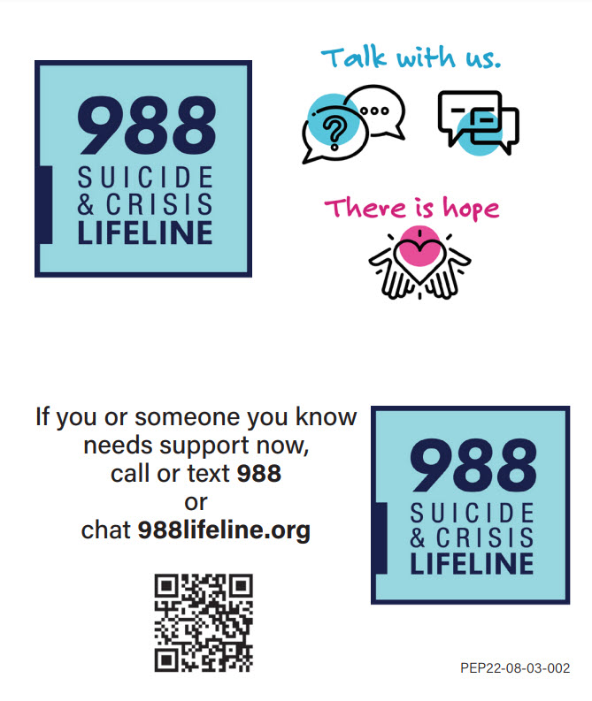
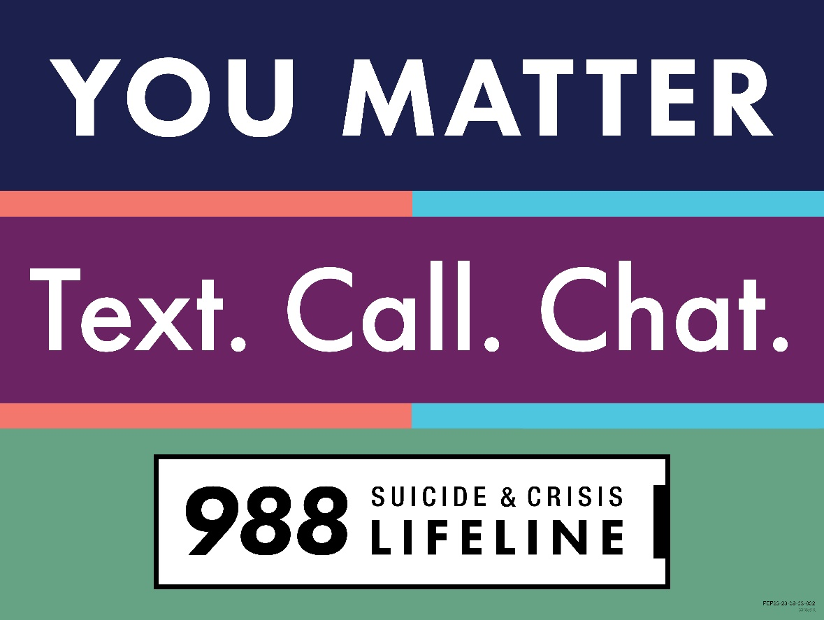
If you or someone you know needs support now, call or text 988 or chat 988lifeline.org
Notes:
If you or someone you know is feeling suicidal or is in emotional distress, please call or text the Suicide Prevention Lifeline at 988 or reach out through chat by visiting 988lifeline.org/chat.
The 988 Lifeline provides 24/7, free and confidential support for people in distress, prevention and crisis resources for you and your loved ones and best practices for professionals in the US.
Veterans can call 988 and press 1.

Slide 3
Suicide and Self-inflicted Injury Technical Notes
The fatality data provided here are part of the North Carolina Violent Death Reporting System (NC-VDRS), a state-wide surveillance system funded by CDC that collects detailed information on deaths that occur in NC resulting from homicide, suicide, unintentional firearm-related injuries, legal intervention, and deaths for which the intent could not be determined. NC-VDRS combines information from death certificates, medical examiner reports, and incident reports from law enforcement agencies.
2023 NC-VDRS data are final as of June 2025.
There was a transition in Hospital and Emergency Department coding structure in October 2015. Due to the transition, there are different definitions for injury. Data after October 2015 are not comparable to data from before the transition.
ICD-10 suicide codes listed as cause of death: *U03, X60-X84, X87.0
ICD-10-CM self-inflicted injury codes: See the CSTE Self-Harm Indicator for a comprehensive list of codes.
Data is limited to NC residents ages 10 and older.
Notes:
For more detailed technical notes on any of the data shared in this slide set, please contact us at InjuryData@dhhs.nc.gov.

Slide 4
Overview
Suicide Death
Self-Inflicted Injury/Harm
Resources
Suicide and Self-Inflicted Injury/Harm data are available at https://injuryfreenc.dph.ncdhhs.gov/DataSurveillance/SuicideData.htm
Mental Health data are available at https://ncdetect.org/mental-health-dashboard/
For custom data requests see https://injuryfreenc.dph.ncdhhs.gov/DataSurveillance/DataRequestPolicy.htm
Notes:
This presentation is not intended to cover all data related to suicide and self-inflicted injury. Rather it gives an overview of some of the key trends in North Carolina. It includes information on statewide suicide deaths, self-inflicted injury hospitalizations and emergency department visits, and resources. Please note that when the COVID-19 pandemic began in 2020, there were many implications, including major changes to the numbers and rates within the self-inflicted injury data in this slide deck.
If this slide deck does not contain the information you need, please see our custom data request policy and contact us at InjuryData@dhhs.nc.gov.

Slide 5
Suicide Death

Slide 6

Notes:
The suicide death data presented in these slides comes from the North Carolina Violent Death Reporting System (NC-VDRS). The NC-VDRS is a public health, population-based surveillance system that contains detailed information on deaths that result from violence.

Slide 7
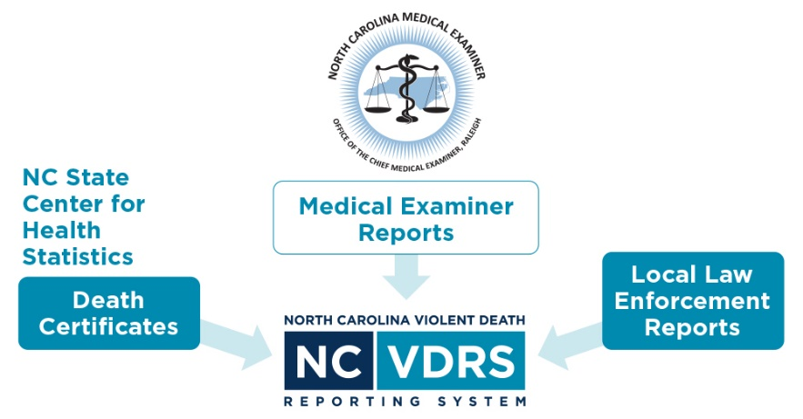
NC-VDRS
North Carolina-Violent Death Reporting System
CDC-funded statewide surveillance system collecting data on deaths resulting from violence such as homicide, suicide, and legal intervention
Funded in 2003
  Data collection began in 2004
  ~43,000 incidents reported to date
Multi-sourced incident-based system
Notes:
The NC-VDRS provides timely information on the victims, suspects, relationships, circumstances, and weapons that are associated with every violent incident that results in a fatality in North Carolina. It is an incident-based, relational database that combines information from multiple sources, such as death certificates, medical examiner reports, and incident reports from law enforcement agencies on violent deaths to not only understand the “who, when, where, and how” but also “why” these deaths occurred. The NC-VDRS began collecting data in January 2004.

Slide 8
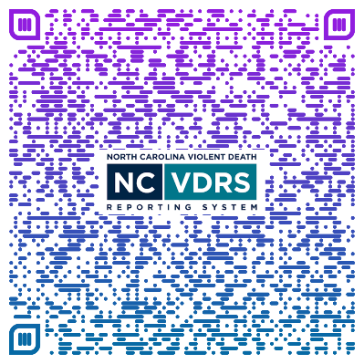
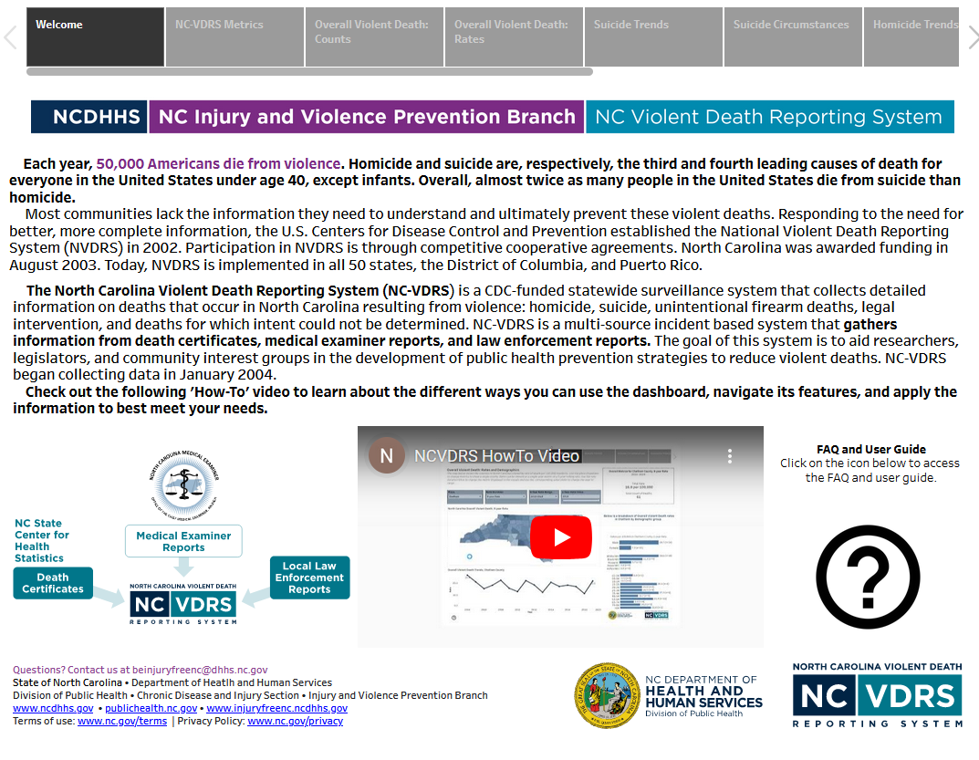
Access more data on the NC-VDRS dashboard
Notes:
Additional data for North Carolina violent deaths can be found by accessing the NC-VDRS data dashboard on the Violent Death Data page on our branch website, https://www.dph.ncdhhs.gov/programs/chronic-disease-and-injury/injury-and-violence-prevention-branch.

Slide 9
4 people a day die from suicide in NC
The number of suicide deaths in North Carolina has increased by 22% over the past 10 years, with a 17% increase from 2019.
Notes:
In 2023, an average of four North Carolinians died each day from suicide.
The number of suicide deaths among NC has increased by 22% over the last 10 years (2014-2023). A decrease was observed before 2019, with a 17% increase since.

Slide 10
Firearms are the most common weapon used in suicide deaths in NC
59% of suicide deaths in the last 10 years (2014-2023) were firearm-related
Notes:
Firearms were used in more than half of suicide deaths among NC residents (59%), followed by hanging, strangulation, suffocation (22%), and poisoning (14%).
These percentages are calculated over a 10-year time period (2014-2023).

Slide 11
Males, NH White and NH American Indian residents, and adults ages 45-64 experienced the highest rates of suicide death in NC
Notes:
The highest rates for suicide deaths occurred amongst male NC residents (25.0 per 100,000), NH Whites (20.3 per 100,000) and NH American Indians (14.8 per 100,000), and ages 45-64 (18.5 per 100,000).
These rates are calculated over a 10-year time period (2014-2023).

Slide 12
Suicide rates increase with age
Notes:
Suicide rates steadily increase with age.

Slide 13
Circumstances of Suicide

Slide 14
More than 1/4 of suicide victims told someone or disclosed their suicidal intent
More females experienced a current mental health (MH) problem than males, and females were more likely to have a history of suicidal behavior
Notes:
More than one-fourth of suicide victims told someone their suicidal intent. More females experienced a current mental health problem, were currently undergoing mental health treatment, or had ever been treated for mental health. More females left a suicide note, had a history of suicidal thoughts, or had previously attempted suicide.

Slide 15
Veteran Suicide

Slide 16
Veterans in North Carolina were 2.5 times more likely to die from suicide than non-veterans
Notes:
North Carolina veterans are two and a half times more likely to die from suicide than non-veterans. The highest rates of suicide occurred among NC veterans ages 18-34 (92.6 per 100,000), Asian (66.8 per 100,000) and White (51.0 per 100,000), and males (45.9 per 100,000).
These rates are calculated over a 10-year period (2014-2023).

Slide 17
Veteran suicides were more likely to be firearm-related than non-veteran suicides
76% of veteran suicide deaths in the last 10 years (2014-2023) were firearm-related
Notes:
Firearms were used in three-fourths of NC veteran suicides (76%) compared to a little over half of non-veteran suicides (56%). Hanging, strangulation, suffocation and poisoning were the next highest method of suicide death for both veteran and non-veteran.

Slide 18
More than 1/4 of veteran suicide victims told someone or disclosed their suicidal intent
More veterans experienced a physical health problem than non-veterans and non-veterans were more likely to have a history of suicidal behavior
Notes:
More than one-fourth of NC veterans and non-veterans told someone their suicidal intent. More veterans experienced a physical health problem, whereas more non-veterans experienced a current mental health problem, were currently undergoing mental health treatment, or had ever been treated for mental health. More non-veterans had a history of suicidal thoughts or had previously attempted suicide.

Slide 19
Rural Suicide

Slide 20
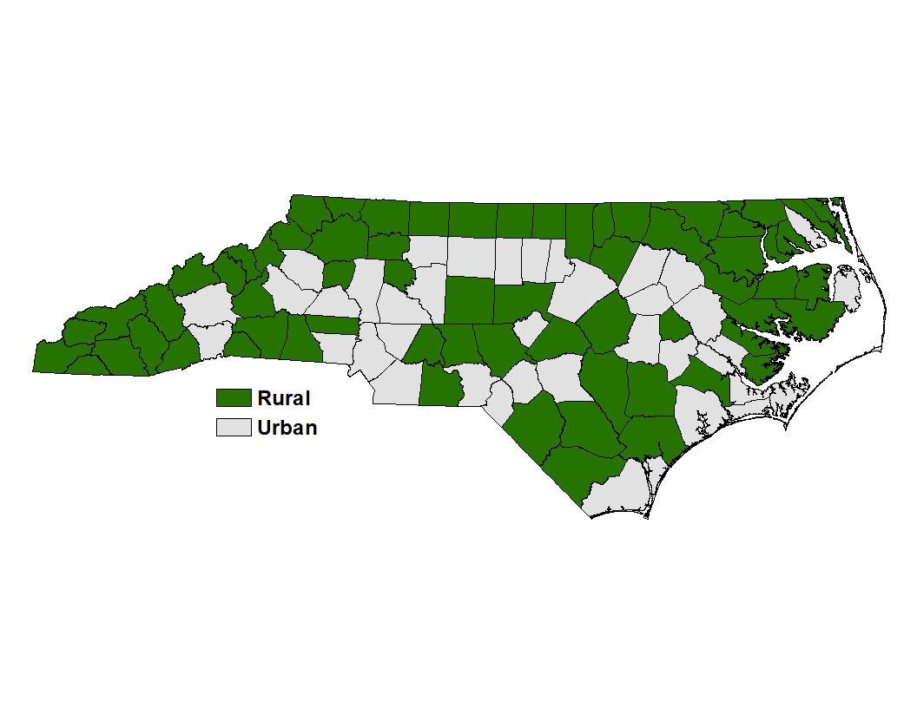
North Carolina has 64 rural counties
Notes:
Almost two-thirds of North Carolina’s counties are considered rural.

Slide 21
Males, NH White and NH American Indian residents, and adults ages 45-64 experienced the highest rates of suicide death in rural NC counties
Notes:
The highest rates of suicide of NC residents in rural counties occurred among males (29.0 per 100,000), NH Whites (22.4 per 100,000) and NH American Indians (14.4 per 100,000), and ages 45-64 (21.1 per 100,000).
These rates are calculated over a 10-year period (2014-2023).

Slide 22
Suicides among rural county residents were more likely to be firearm-related than those of residents in more urban counties
65% of rural suicide deaths in the last 10 years (2014-2023) were firearm-related
Notes:
Firearms were used in more NC rural suicides (65%) compared to urban suicides (56%). Hanging, strangulation, suffocation and poisoning were the next highest method of suicide death for both rural and urban residents.

Slide 23
More than 1/4 of rural suicide victims told someone or disclosed their suicidal intent
More rural residents experienced a physical health problem than urban residents and urban residents were more likely to have a history of suicidal behavior
Notes:
More than one-fourth of NC rural and urban residents told someone their suicidal intent. More rural residents experienced a physical health problem, whereas more urban residents experienced a current mental health problem, were currently undergoing mental health treatment, or had ever been treated for mental health. More urban residents left a suicide note, had a history of suicidal thoughts or had previously attempted suicide.

Slide 24
Self-Inflicted Injury/Harm

Slide 25
Suicide deaths are just the tip of the iceberg
In 2023, there were:
Despite NC’s rigorous reporting systems, the total burden
of suicide and self-inflicted
injury outcomes in the
state is unknown.
1,593
Deaths
3,055
Self-inflicted Injury Hospitalizations
12,720
Self-inflicted Injury ED Visits
? EMS
? Medically Unattended Injuries
Limited to NC residents ages 10 and older Source: NC-VDRS, 2014-2023; NC State Center for Health Statistics, Hospital Discharge Data (2023); NC DETECT ED Visit Data (2023) Analysis by the DPH Injury Epidemiology, Surveillance, and Informatics Unit

Slide 26
Self-Inflicted Injury Hospitalizations

Slide 27
The number of self-inflicted injury hospitalizations in North Carolina has decreased by 25% since 2016
Notes:
In 2024, an average of eight North Carolinians were hospitalized each day for self-inflicted injury. The number of self-inflicted injury hospitalizations in North Carolina has steadily decreased by 25% since 2016.

Slide 28
Rates of self-inflicted injury hospitalization were highest among females, NH white residents, and children ages 10-18
Notes:
The highest rates for self-inflicted injury hospitalizations occurred amongst female NC residents (36.5 per 100,000), NH Whites (34.1 per 100,000) and NH American Indians (29.8 per 100,000), and ages 10-18 (55.8 per 100,000).
These rates are calculated over a 5-year time period (2020-2024).

Slide 29
Most male and female self-inflicted injury hospitalizations were related to poisonings
Notes:
Nearly all female self-inflicted hospitalizations were related to poisonings (87.9%). Nearly three-fourths of male self-inflicted hospitalizations were related to poisonings (71.1%) followed by firearm injuries (6.8%) and cut/pierce injuries (6.4%).

Slide 30
Self-Inflicted Injury ED Visits

Slide 31
Self-inflicted injury ED visits decreased by 8% from 2019-2020 but have since increased 13%
Notes:
Self-inflicted injury-related ED visits decreased by 8% from 2019-2020 but have since increased by 13%.

Slide 32
Rates of self-inflicted injury ED visits were highest among females, Black residents, and children ages 10-18
Notes:
The highest rates for self-inflicted injury ED visits occurred amongst female NC residents (152.8 per 100,000), Black residents (136.6 per 100,000) and Whites (116.3 per 100,000), and ages 10-18 (294.7 per 100,000).
These rates are calculated over a 5-year time period (2020-2024).

Slide 33
Most Male and Female Self-Inflicted Harm ED Visits were related to Poisonings and Cuts/Pierces
Notes:
Most male and female self-inflicted ED visits were related to poisonings followed by cut/pierce injuries. The other mechanism category includes visits with an unspecified or other specified injury code.

Slide 34
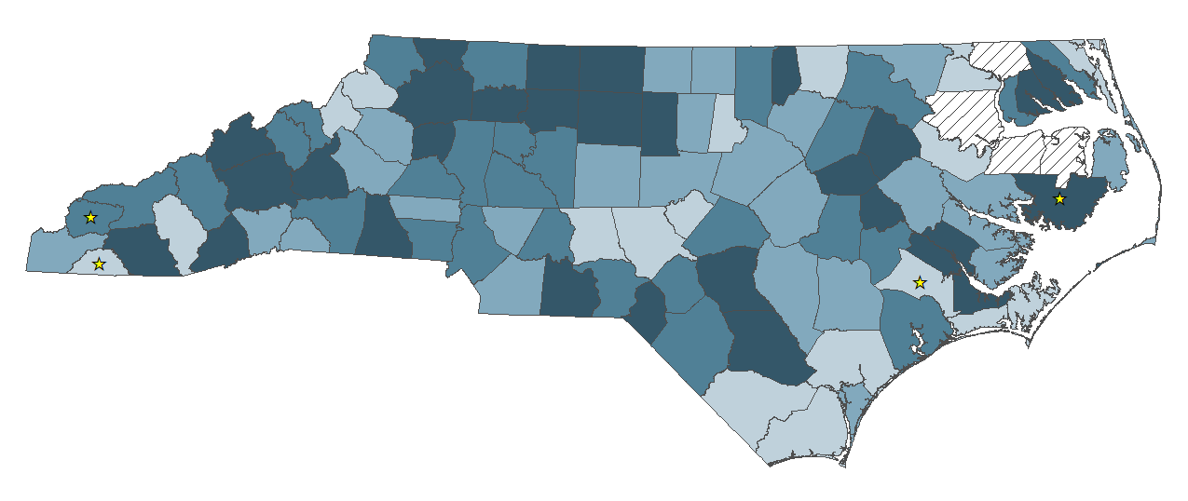
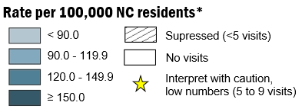
Self-inflicted injury ED visit rates were highest in Anson, McDowell, and Alexander counties
Provisional Self-Inflicted Injury ED Visit Rates by County of Residence: April 2024 – March 2025
Limited to NC Residents; NH = non-Hispanic
Source: NC DETECT, Emergency Department (ED) Visit Data, 2024-2025; US Census non-bridged population estimates, 2023
Analysis by the DPH Injury Epidemiology, Surveillance, and Informatics Unit
Notes:
In 2024, the rates of self-inflicted ED visits were highest in Anson, McDowell, and Alexander counties.

Slide 35

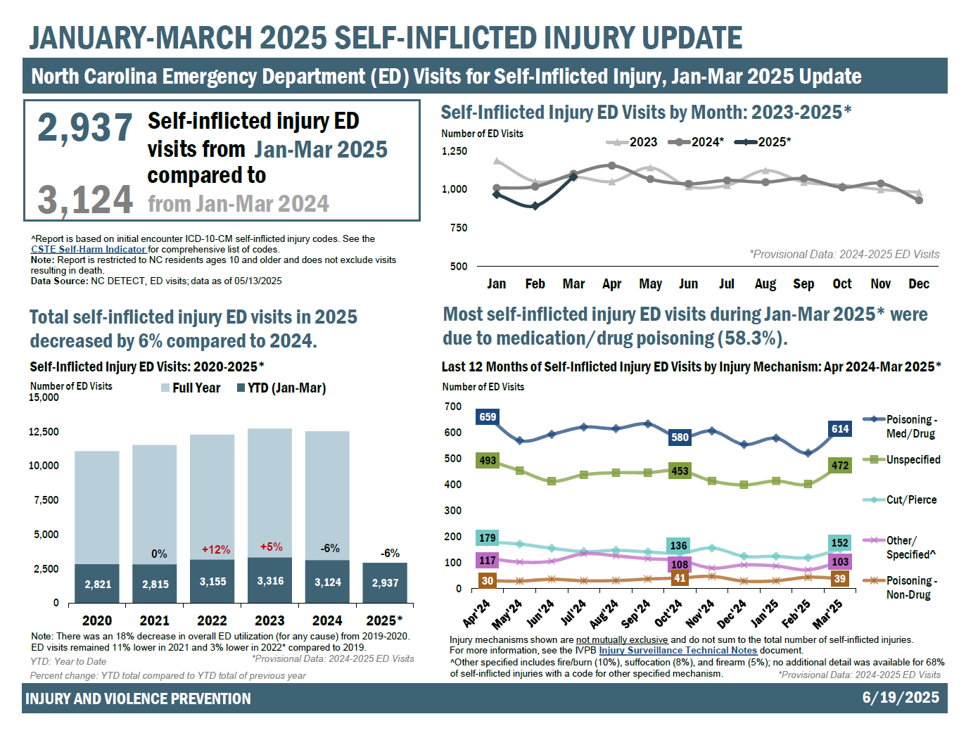
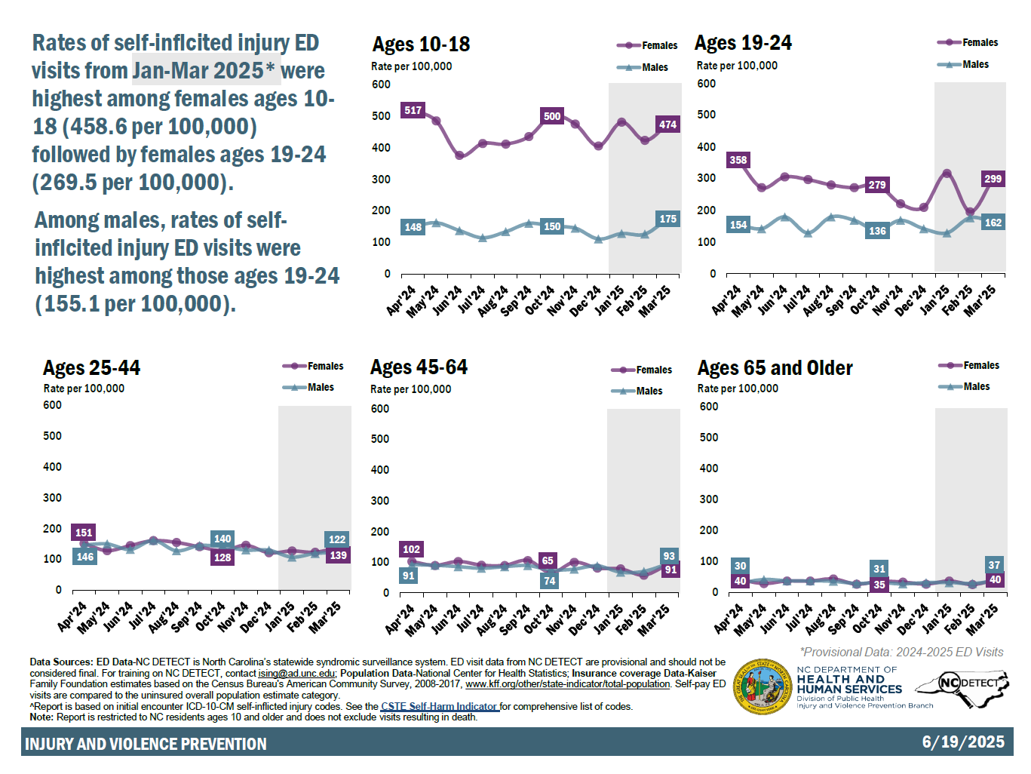
Self-Inflicted Injury Data Products
Quarterly Reports
https://injuryfreenc.dph.ncdhhs.gov/DataSurveillance/SuicideData.htm
Notes:
Self-inflicted injury reports are created quarterly. These reports offer a comprehensive analysis of self-inflicted injuries and assess temporal trends across North Carolina EDs using data provided by NC DETECT. Provisional data are analyzed to incorporate a 3-month lag to ensure data completeness. The reports provide crucial insights into emerging patterns, demographic disparities, and potential risk factors associated with suicidal behavior. The reports inform partners, healthcare providers, and community advocates and underscores the need for evidence-based interventions focusing on promoting mental health in NC.

Slide 36
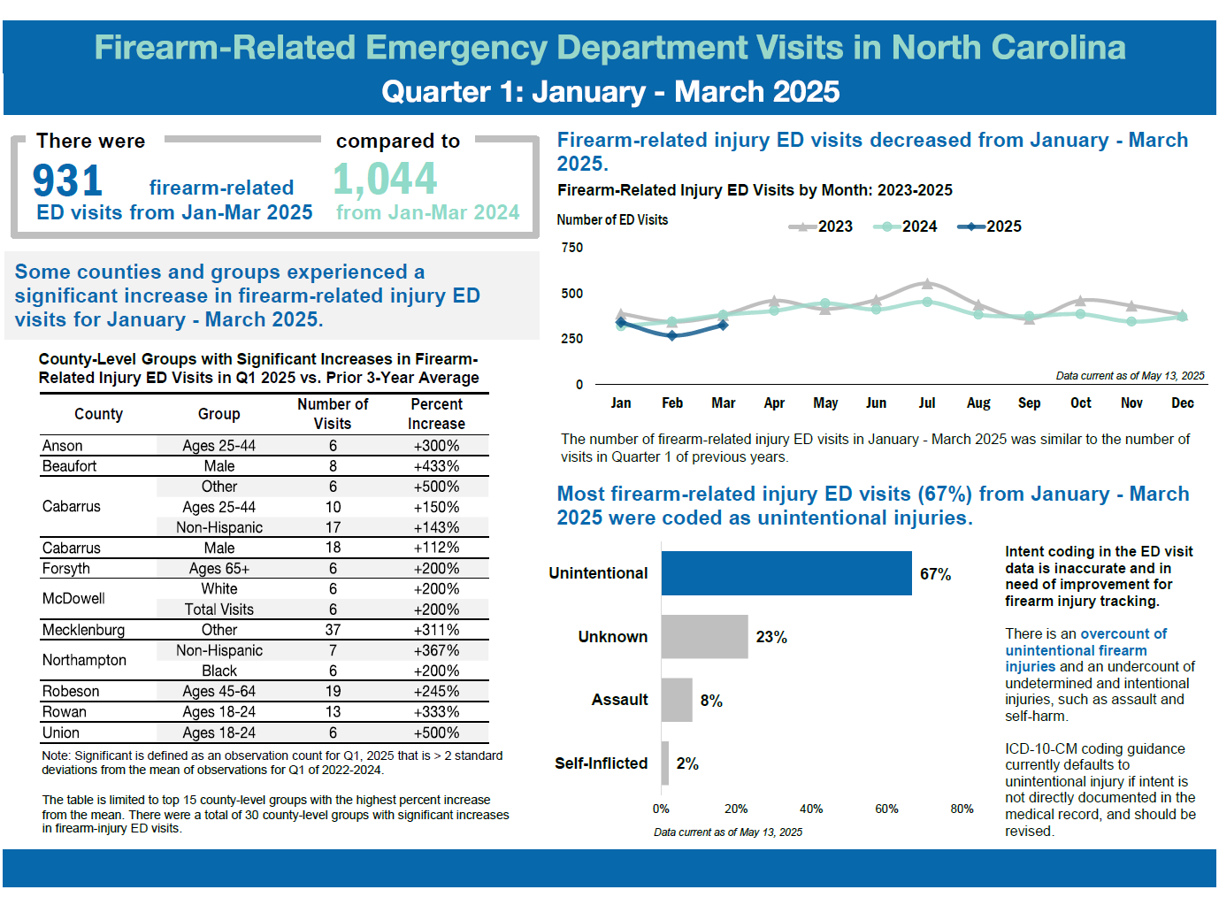
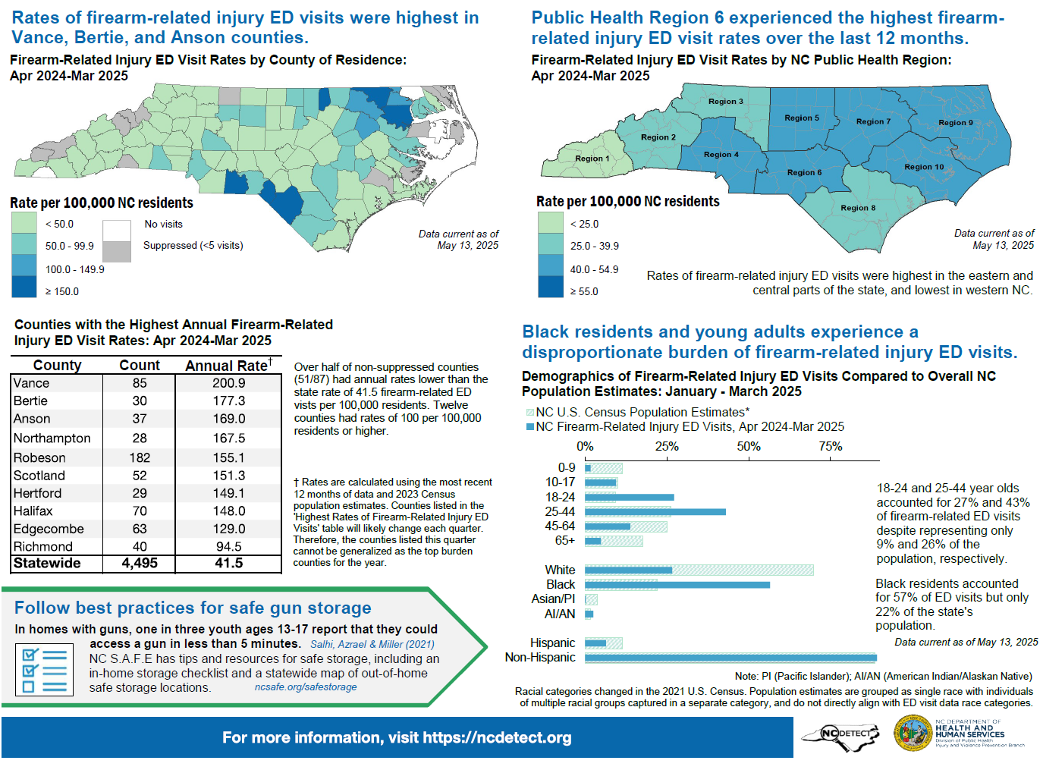
NC-FASTER Data Products
Quarterly Reports
https://ncdetect.org/nc-faster-firearm-quarterly-reports/
Notes:
The FASTER quarterly reports delve into trends of firearm-related injuries across North Carolina EDs using data provided by NC DETECT. By analyzing the incidence, demographics, and circumstances surrounding nonfatal firearm injuries, these reports provide valuable insights to partners, healthcare providers, and community advocates. These reports not only highlight the incidence of firearm-related injuries but also underscore the need for evidence-based interventions aimed at preventing such injuries and promoting safety in NC.

Slide 37
More than 1/7 of NC adults experienced frequent mental distress and 1/6 reported that poor mental or physical health kept them from doing their usual activities
15%
17%
of NC adults surveyed
of those with at least one day of poor health
* Frequent Mental Distress = 14 or more days of poor mental health in the past month
** Usual Activities = self-care, work, or recreation
Limited to NC Residents
Source: NC BRFSS Core Module, 2023 https://schs.dph.ncdhhs.gov/data/brfss/2023/nc/all/topics.htm
Analysis by the DPH Injury Epidemiology, Surveillance, and Informatics Unit
Notes:
The Behavioral Risk Factor Surveillance System, developed by the Centers for Disease Control and Prevention (CDC), is a random telephone survey of state residents aged 18 years and older. The purpose is to obtain estimates of the prevalence of personal health behaviors that contribute to morbidity and mortality. In 2023, 15% or NC adults surveyed reported experiencing frequent mental distress. Frequent mental distress is defined as experiencing 14 or more days of poor mental health in the past month. Of those who reported at least one day of poor mental or physical health, 17% said that poor health kept them from doing usual activities such as self-care, work, or recreation.

Slide 38
About three in 10 NC adults reported feeling lonely
Social isolation and loneliness can have debilitating effects on a person’s health. It is also associated with depression, anxiety, cognitive decline, and other mental, emotional, or psychological conditions.¹
8%
5%
30%
of NC adults surveyed
of NC adults surveyed
of NC adults surveyed
Limited to NC Residents
Source: NC BRFSS Social Determinants of Health and Health Equity Module, 2023 https://schs.dph.ncdhhs.gov/data/brfss/2023/nc/all/topics.htm
¹Social Bridging NC, https://socialbridgingnc.org/social-isolation
Analysis by the DPH Injury Epidemiology, Surveillance, and Informatics Unit
Notes:
In 2023, 5% of NC adults surveyed reported that they were dissatisfied with life, 8% reported that they could not get the emotional or social support they needed, and 30% reported feeling socially isolated. Studies show that social isolation and loneliness can have debilitating effects on a person’s health. It is also associated with depression, anxiety, cognitive decline, and other mental, emotional, or psychological conditions.

Slide 39
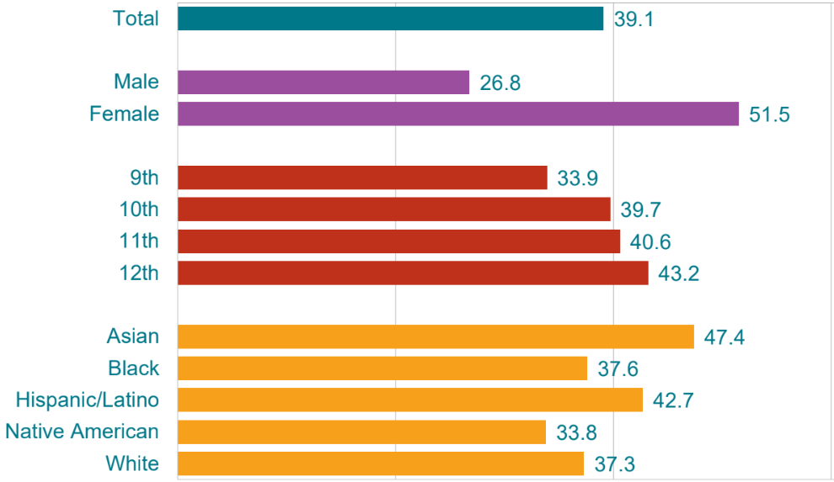
Two in Five High School Students Felt Sad or Hopeless
Source: North Carolina Department of Public Instruction, Youth Risk Behavior Survey, 2023 https://www.dpi.nc.gov/districts-schools/classroom-resources/academic-standards/programs-and-initiatives/nc-healthy-schools/nc-healthy-schools-data
Analysis by the DPH Injury Epidemiology, Surveillance, and Informatics Unit
Notes:
The Youth Risk Behavior Survey, developed by the CDC, is a school-based survey conducted in both middle and high schools during odd-numbered years. The purpose is to obtain prevalence estimates of youth risk behaviors that could lead to the development of adverse health conditions later in life. In 2023, 40% of NC high school students reported feeling sad or hopeless almost every day for at least two weeks in a row so that they stopped doing some usual activities.

Slide 40
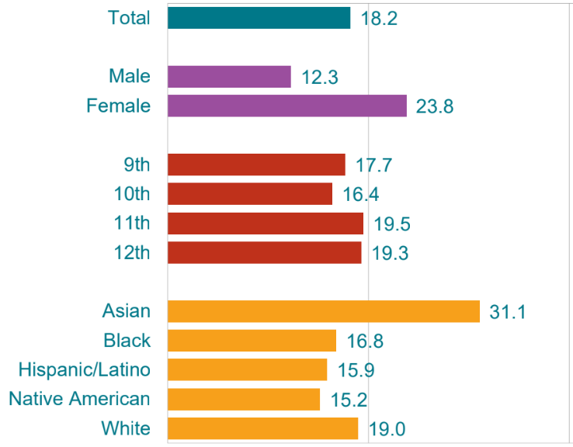
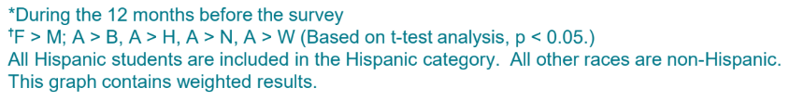
Nearly 1/5 of High School Students Seriously Considered Attempting Suicide
Source: North Carolina Department of Public Instruction, Youth Risk Behavior Survey, 2023 https://www.dpi.nc.gov/districts-schools/classroom-resources/academic-standards/programs-and-initiatives/nc-healthy-schools/nc-healthy-schools-data
Analysis by the DPH Injury Epidemiology, Surveillance, and Informatics Unit
Notes:
In 2023, 18% of NC high school students reported that they seriously considered attempting suicide in the past 12 months.

Slide 41
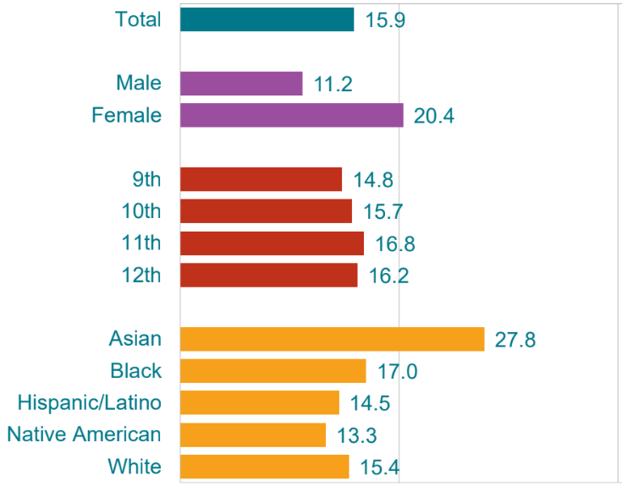
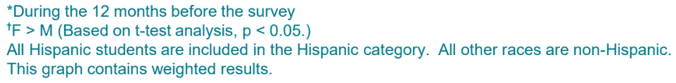
Nearly 1/6 of High School Students Made a Plan About Attempting Suicide
Source: North Carolina Department of Public Instruction, Youth Risk Behavior Survey, 2023 https://www.dpi.nc.gov/districts-schools/classroom-resources/academic-standards/programs-and-initiatives/nc-healthy-schools/nc-healthy-schools-data
Analysis by the DPH Injury Epidemiology, Surveillance, and Informatics Unit
Notes:
In 2023, 16% of NC high school students reported that they made a suicide plan in the past 12 months.

Slide 42
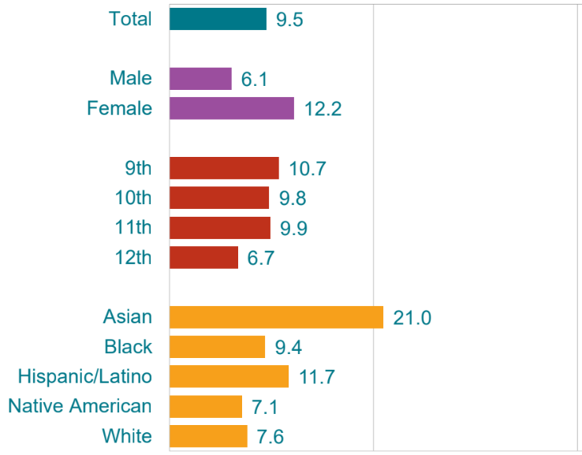
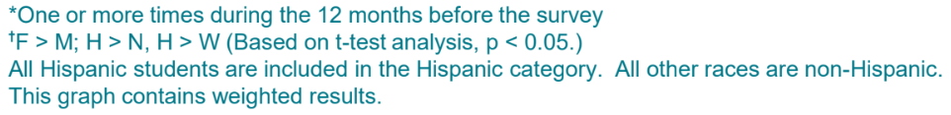
One in 10 High School Students made a Suicide Attempt
Source: North Carolina Department of Public Instruction, Youth Risk Behavior Survey, 2023 https://www.dpi.nc.gov/districts-schools/classroom-resources/academic-standards/programs-and-initiatives/nc-healthy-schools/nc-healthy-schools-data
Analysis by the DPH Injury Epidemiology, Surveillance, and Informatics Unit
Notes:
In 2023, 10% of NC high school students reported making a suicide attempt in the past 12 months.

Slide 43
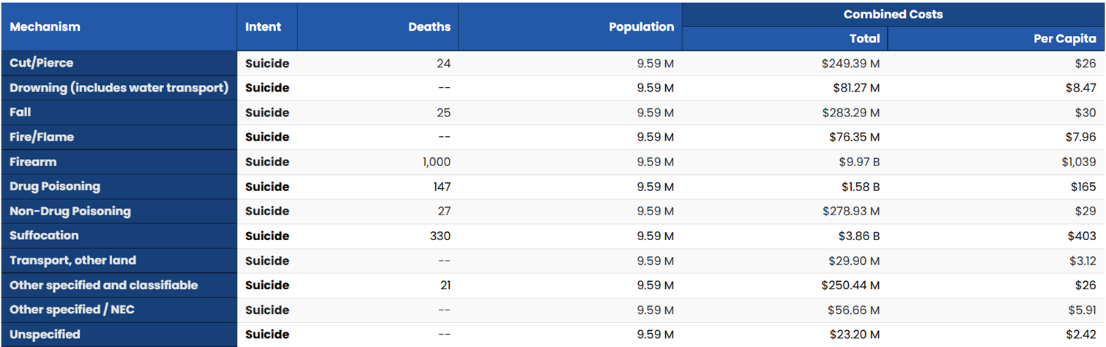
The financial toll of suicide and self-inflicted injury on society is costly
Suicide deaths alone in NC resulted in a combined cost of over $16 billion in 2023
  $1,746 per capita
Source: CDC WISQARS Cost of Injury Report https://wisqars.cdc.gov/cost/
Analysis by the DPH Injury Epidemiology, Surveillance, and Informatics Unit
Notes:
The financial toll of suicide and self-inflicted injury on NC is costly, resulting in a combined cost of over $16 billion in 2023 alone. That equates to roughly $1,746 per person.

Slide 44
Where to find resources for suicide and self-inflicted injury prevention?
NC Comprehensive Suicide Prevention Program
  Comprehensive Suicide Prevention Advisory Council (CSPAC) Quarterly Meetings
NC S.A.F.E – Store All Firearms Effectively – provides resources and information on storing firearms safely.
Injury-Free NC is a collaborative of UNC and NCDHHS DPH to keep NC safe from injury and violence.
  Comprehensive Suicide Prevention Academy
  Firearm and Lethal Means Safety
CDC Suicide Prevention Resource for Action

Slide 45
Where to find more data on suicide and self-inflicted injury?
NC Injury and Violence Prevention Branch Suicide and Self-Inflicted Injury Data Page
  NC-VDRS Annual Report
  NC-VDRS Fact Sheets
  NC-VDRS Data Dashboard
  Self-Inflicted Injury ED Visit quarterly reports
  NC DETECT Mental Health Dashboard
State Center for Health Statistics (SCHS) Death Certificate Data
  NC Health Data Query System
CDC WISQARS – Fatal Injury and Violence Data
CDC NVDRS - CDC NVDRS

Slide 46
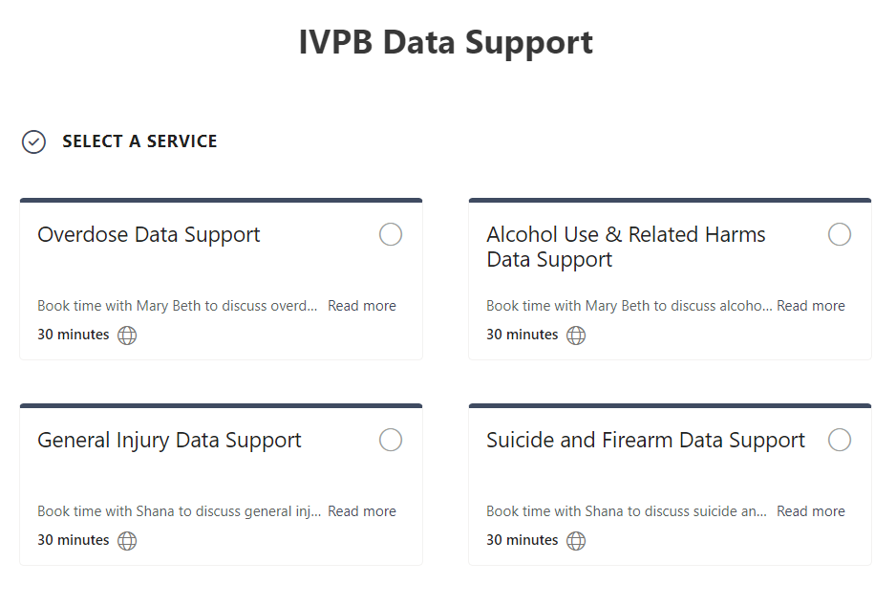

IVPB Data Support now available!
Book time with an IVPB epidemiologist to discuss available data products, to talk through custom data requests, or for general data questions.
IVPB Data Request Policy
IVPB Data Support Bookings

Slide 47
Acknowledgements
This work was supported by the Centers for Disease Control and Prevention (CDC) of the U.S. Department of Health and Human Services (HHS) as part of the Comprehensive Suicide Prevention program CDC-RFA-CE20-2001 cooperative agreement award 100% funded by CDC/HHS. The contents are those of the author(s) and do not necessarily represent the official views of, not an endorsement by, CDC/HHS or the U.S. Government.

Slide 48
Questions?
InjuryData@dhhs.nc.gov
Injury and Violence Prevention Branch
NC Division of Public Health
www.injuryfreenc.dph.ncdhhs.gov

