Slide 1
Traumatic Brain Injuries in
North Carolina, 2024
Division of Public Health
Data updated February 13, 2026
Notes:
This slide set was created to provide basic data trends and public health surveillance around mortality and morbidity of traumatic brain injuries (TBI). They are meant to offer a state-level background on TBI. If you’d like a copy of the slides, please visit the “Traumatic Brain Injury” Data page on our branch website, https://www.dph.ncdhhs.gov/programs/chronic-disease-and-injury/injury-and-violence-prevention-branch. The direct link is also shared at the end of this presentation.
Feel free to incorporate these slides into your own presentations, grant proposals, reports, or any other way they may be useful.
Please read both the speaking and technical notes to ensure that data are presented in a consistent manner.

Slide 2
Traumatic Brain Injury Technical Notes
Surveillance methods have been updated to identify any mention of an injury in our morbidity data sources. Individual records with multiple injuries listed will be included in the total for each of those injuries but only counted once for overall total injury count. Previously, only the first listed injury was counted, which has resulted in an increase in the number of specific injuries identified.
For questions or for more information see technical notes document available at https://injuryfreenc.dph.ncdhhs.gov/DataSurveillance/
Case definitions used:
Deaths – ICD-10 codes listed as cause of death: S01.0-S01.9, S02.2, S02.1, S02.3, S02.7-S02.9, S04.0, S06.0-S06.9, S07.0, S07.1, S07.8, S07.9, S09.7-S09.9, T01.0, T02.0, T04.0, T06.0, T90.2, T90.4, T90.5, T90.8, T90.9
*See technical notes document for a full list of ICD-10 codes used for TBI deaths
Notes:
For more detailed technical notes on any of the data shared in this slide set, please contact us at InjuryData@dhhs.nc.gov.

Slide 3
Technical Notes, Continued
Hospitalizations – Among records with an ICD-10-CM injury code,* any mention of the following ICD-10-CM codes (includes records resulting in death)
Emergency Department Visits – Any mention of the following ICD-10-CM codes (includes records resulting in hospitalization or death)
S02.0, S02.1 | Fracture of skull
S02.8, S02.91 | Fracture of other specified skull and facial bones; unspecified fracture
S04.02, S04.03, S04.04 | Injury of optic chiasm; injury of optic tract and pathways; injuries of visual cortex
S06 | Intracranial injury
S07.1 | Crushing injury of skull
T74.4 | Shaken infant syndrome
*7th character of A, B, or missing (reflects initial encounter, active treatment)
*See technical notes document for a full list of ICD-10-CM injury diagnosis codes
Notes:
For more detailed technical notes on any of the data shared in this slide set, please contact us at InjuryData@dhhs.nc.gov.

Slide 4
The populations most at risk of fall-related TBI are projected to have the fastest growth over the next 20 years
2024 Population
2044 Population
Percent Change 2024-2044
N=11,052,495
N=13,030,273
Overall increase of 18%
Source: North Carolina OSBM, Standard Population Estimates, Vintage 2024
Notes:
Over the next 20 years, North Carolinians ages 60 and over are projected to have the fastest population growth (34-105%), outpacing the overall 20-year population growth (18%). Twenty years from now, the population of North Carolinians ages 60 and over is expected to increase by 34%. The largest increase in population growth is expected among those ages 85 and older (105%).

Slide 5
Most older adults (ages 65+) in NC are non-Hispanic White
NH = non-Hispanic
Source: U.S. Census non-bridged population estimates, 2024; ages 65 and older
Notes:
In 2024, most North Carolinians ages 65 and older are non-Hispanic White (75%). The second largest racial/ethnic group among North Carolinians ages 65 and older are non-Hispanic Blacks (18%).

Slide 6
Demographic characteristics among older adults in North Carolina
43%
of housing units with people 65 and older are single person households
* Adults ages 65 and older
Source: American Community Survey, 2024 5-year estimates. Table S0103: Population 65 and older
Notes:
According to the 2024 American Community Survey, 43% of housing units with people 65 and older are single person households. One-third (33%) of North Carolina adults ages 65 and older have a disability. 29% of North Carolina adults ages 65 and older have a high school education/G.E.D.

Slide 7
One in five older adults in NC reports trouble walking
Disability among adults 65 and older
Source: American Community Survey, 2024 5-year estimates. Table S1810: Population 65 and older
Notes:
According to the 2024 American Community Survey, approximately 1 in 5 North Carolina adults ages 65 and over reported having trouble walking. Furthermore, North Carolina adults ages 65 and over experience hearing (14%), cognitive (8%), vision (6%), and self-care disabilities (7%). About 12% of people ages 65 and older in North Carolina also reported living alone/independently.

Slide 8
Around 83% of older adults in NC have one or more chronic diseases
Source: NC State Center of Health Statistics, 2024 Behavioral Risk Factor Surveillance System (BRFSS) Survey Results
Notes:
In North Carolina, approximately 83% of adults ages 65 and older have one or more chronic disease. Among adults ages 65-74, 52% have 2 or more chronic diseases. About 54% of North Carolina adults ages 75 and older have 2 or more chronic diseases.

Slide 9
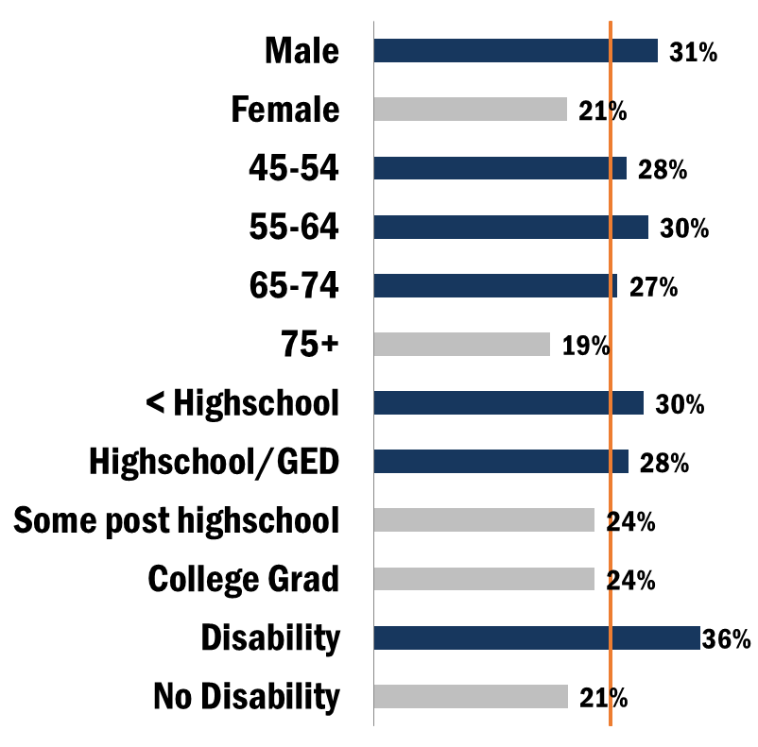
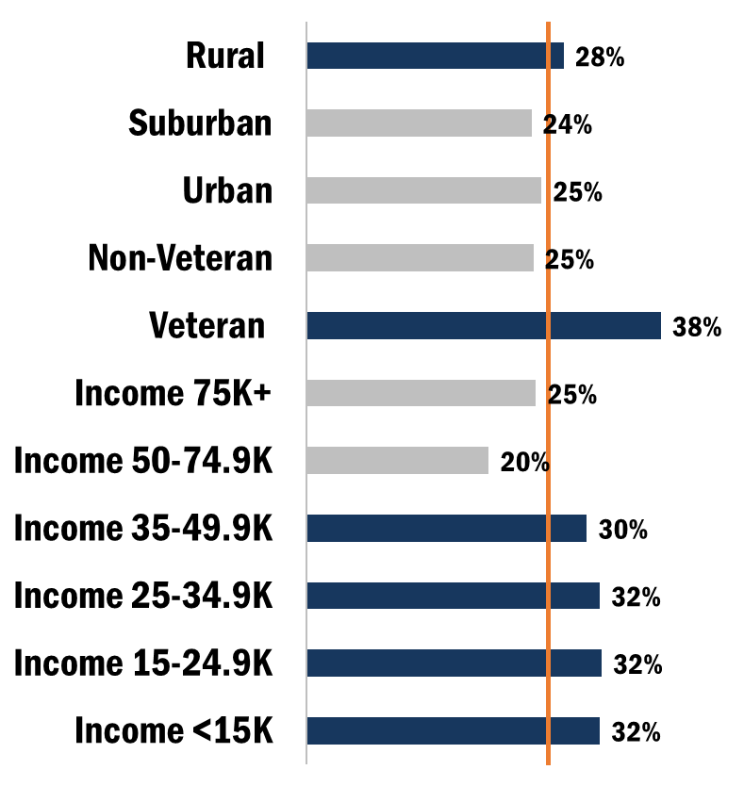
Proportion of demographic groups reporting having ever experienced loss of consciousness, 2019 BRFSS
Overall 26%
Overall 26%
Source: NC State Center of Health Statistics, 2019 Behavioral Risk Factor Surveillance System (BRFSS) Survey Results
Notes:
According to the 2020 Behavior Risk Factor Surveillance System (BRFSS) Survey, 26% of North Carolina respondents reported experiencing loss of consciousness. Individuals with a disability (36%), veterans (38%), males (31%), and individuals ages 55-64 (30%) had the highest proportions of reporting loss of consciousness.

Slide 10
TBI deaths are the tip of the iceberg
Despite NC’s excellent reporting systems, the total burden of TBI in the state
is unknown.
2,668
Deaths
8,260
Hospitalizations
32,068
ED Visits
? Outpatient Visits
? Medically Unattended Injuries
INJURY ICEBERG
Limited to NC Residents, 2024
Source: NC State Center for Health Statistics, Vital Statistics – Deaths (2024) and Hospitalization Discharge Data (2024); NC DETECT (2024)
Analysis by Injury Epidemiology and Surveillance Unit
Notes:
In 2024 there were 2,668 deaths, 8,260 hospitalizations, and 32,068 emergency department visits associated with unintentional TBI injuries in North Carolina. However, this is just the tip of the iceberg and the total burden of TBI injury in North Carolina is unknown.

Slide 11
Traumatic Brain Injury Deaths

Slide 12
TBI-related deaths increased by 27% over the last 10 years
Limited to NC Residents, 2015-2024
Source: NC State Center for Health Statistics, Vital Statistics – Deaths (2015-2024)
Analysis by Injury Epidemiology and Surveillance Unit
Notes:
The number of TBI deaths in North Carolina has increased by 27% over the last 10 years (2015-2024).

Slide 13
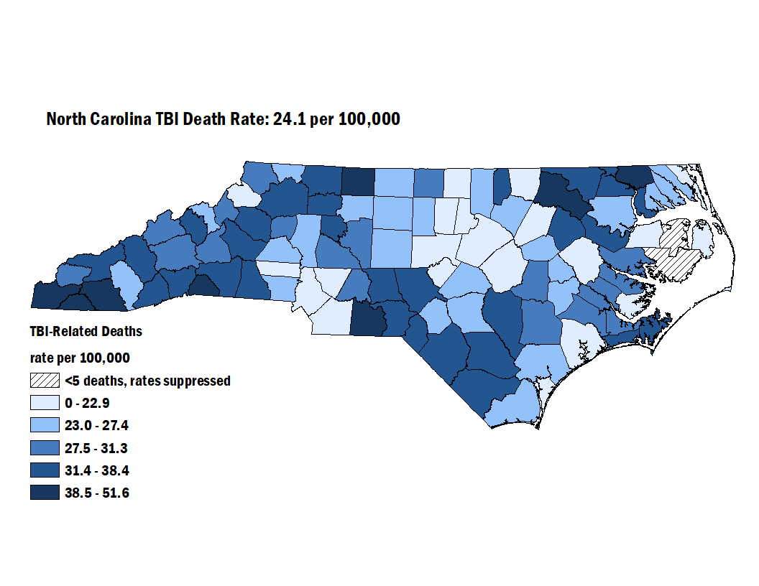
TBI-related deaths among North Carolina residents, 2022-2024
Limited to NC Residents, 2022-2024
Source: NC State Center for Health Statistics, Vital Statistics – Deaths (2022-2024)
Analysis by Injury Epidemiology and Surveillance Unit
Notes:
The overall rate of TBI deaths from 2022-2024 in North Carolina was 24.1 per 100,000. The counties with the highest rates were Clay, Anson, and Chowan counties.

Slide 14
Most TBI-related deaths occurred among men and non-Hispanic Whites
Count of Deaths by Demographic, 2024
NH - non-Hispanic; There were 8 deaths where the race/ethnicity was unknown
Limited to NC Residents, 2024, N=2,668
Source: NC State Center for Health Statistics, Vital Statistics – Deaths (2024)
Analysis by Injury Epidemiology and Surveillance Unit
Notes:
In 2024, most TBI deaths occurred amongst male North Carolina residents (n=1,949) and non-Hispanic Whites (n=1,907).

Slide 15
Rates of TBI-related deaths were highest among men and non-Hispanic Whites
Rate by Demographic, 2024
Limited to NC Residents, 2024, N=2,668
Source: NC State Center for Health Statistics, Vital Statistics – Deaths (2024)
Analysis by Injury Epidemiology and Surveillance Unit
Notes:
In 2024, the groups with the highest rate of TBI-deaths occurred amongst male North Carolina residents (36.1 per 100,000) and non-Hispanic Whites (28.8 per 100,000).

Slide 16
Self-Inflicted Firearm was the leading mechanism-intent category for all TBI deaths
52.8% Unintentional
36.1% Self-Inflicted
9.9% Assault
* Included in other specified are Other Transport – Unintentional (0%), Struck By/Against – Assault (0%), and Unspecified – Unintentional (2%), as well as other mechanism/intents.
Notes:
Self-inflicted firearm (35.5%) was the leading mechanism-intent category for TBI deaths. 52.1% of intents were unintentional, followed by self-inflicted (35.7%) and assault (9.9%).

Slide 17
44% of TBI-related deaths occurred among older adults 65+
Count of Deaths by Age Group, 2024
Limited to NC Residents, 2024, N=2,668
Source: NC State Center for Health Statistics, Vital Statistics – Deaths (2024)
Analysis by Injury Epidemiology and Surveillance Unit
Notes:
Approximately 44% of TBI-related deaths were among North Carolina adults ages 65 and over.

Slide 18
TBI death rates are highest among those 85 and older
Rate by Age Group, 2024
Rates begin increasing among ages 75+
Limited to NC Residents, 2024, N=2,668
Source: NC State Center for Health Statistics, Vital Statistics – Deaths (2024)
Analysis by Injury Epidemiology and Surveillance Unit
Notes:
TBI death rates were highest among those ages 85 and older and began increasing after age 75.

Slide 19
86% of fall-related TBI deaths occurred among older adults 65+
Count of Deaths by Age Group, 2024
Limited to NC Residents, 2024, N=2,668
Source: NC State Center for Health Statistics, Vital Statistics – Deaths (2024)
Analysis by Injury Epidemiology and Surveillance Unit
Notes:
In 2024, 86% of fall-related TBI deaths occurred among adults ages 65 and older.

Slide 20
Fall-related TBI death rates were highest among adults 85 and older
Rate by Age Group, 2024
Limited to NC Residents, 2024, N=2,668
Source: NC State Center for Health Statistics, Vital Statistics – Deaths (2024)
Analysis by Injury Epidemiology and Surveillance Unit
Notes:
Death rates for TBI-related deaths were highest among those ages 85 and older in 2024.

Slide 21
Fall-related TBI deaths were most common among men and non-Hispanic Whites
Count of Deaths Demographic, 2024
Limited to NC Residents, 2024, N=2,668
Source: NC State Center for Health Statistics, Vital Statistics – Deaths (2024)
Analysis by Injury Epidemiology and Surveillance Unit
Notes:
The highest number of fall-related TBI deaths occurred in males and non-Hispanic Whites.

Slide 22
Similarly, fall-related TBI death rates were highest among men and non-Hispanic Whites
Rate by Demographic, 2024
Limited to NC Residents, 2024, N=2,668
Source: NC State Center for Health Statistics, Vital Statistics – Deaths (2024)
Analysis by Injury Epidemiology and Surveillance Unit
Notes:
The highest rate of fall-related TBI deaths also occurred in males and non-Hispanic Whites.

Slide 23
Traumatic Brain Injury Hospitalizations

Slide 24
TBI-related hospitalizations increased by 14% over the last five years
Limited to NC Residents, 2020-2024
Source: NC State Center for Health Statistics, Hospitalization Discharge Data (2020-2024)
Analysis by Injury Epidemiology and Surveillance Unit
Notes:
The number of TBI hospitalizations in North Carolina increased by 14% over the last 5 years (2020-2024).

Slide 25
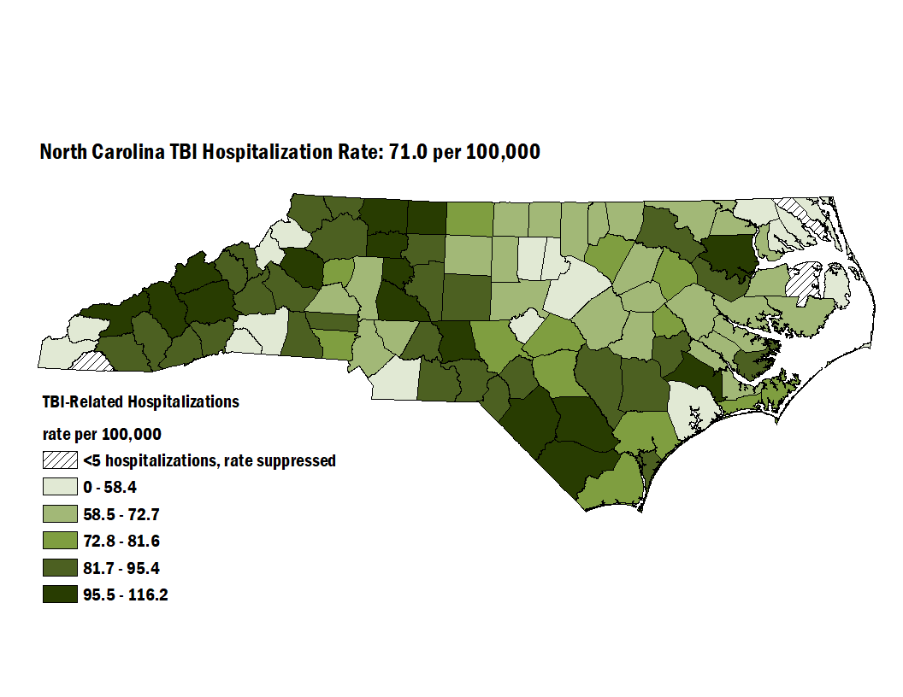
TBI-related Hospitalizations among North Carolina residents, 2022-2024
Limited to NC Residents, 2022-2024
Source: NC State Center for Health Statistics, Hospitalization Discharge Data (2022-2024)
Analysis by Injury Epidemiology and Surveillance Unit
Notes:
The overall rate of TBI hospitalizations from 2022-2024 in North Carolina was 71.0 per 100,000. The counties with the highest rates were Bertie, Bladen, and Caldwell counties.

Slide 26
Most TBI-related hospitalizations occurred among men and non-Hispanic Whites
Count by Demographic, 2024
NH – non-Hispanic
Sex was unknown for 4(<0.1%) injury hospitalizations and race/ethnicity was unknown for 210(<0.1%) injury hospitalizations
Limited to NC Residents, 2024
Source: NC State Center for Health Statistics, Hospitalization Discharge Data (2024)
Analysis by Injury Epidemiology and Surveillance Unit
Notes:
In 2024, most TBI hospitalizations occurred amongst male North Carolina residents (n=4,916) and non-Hispanic Whites (n=5,646).

Slide 27
Similarly, TBI-related hospitalization rates were highest among men and non-Hispanic Whites
Rate by Demographic, 2024
NH – non-Hispanic
Limited to NC Residents, 2024
Source: NC State Center for Health Statistics, Hospitalization Discharge Data (2024)
Analysis by Injury Epidemiology and Surveillance Unit
Notes:
In 2024, the groups with the highest rate of TBI hospitalizations occurred amongst male North Carolina residents (91.1 per 100,000) and non-Hispanic Whites (85.3 per 100,000).

Slide 28
Unintentional Falls were the leading mechanism-intent category for all TBI hospitalizations
88.9% Unintentional
5.4% Assault
1.2% Self-Inflicted
Included in other specified are Struck By/Against - Assault (2%), Unspecified - Unintentional (2%),
and Other Land Transport - Unintentional (1%), as well as other mechanism/intents.
Limited to NC Residents, 2024
Source: NC State Center for Health Statistics, Hospitalization Discharge Data (2024)
Analysis by Injury Epidemiology and Surveillance Unit
Notes:
Unintentional fall (56.4%) was the leading mechanism-intent category for TBI hospitalizations. 88.9% of intents were unintentional, followed by assault (5.4%) and self-inflicted (1.2%).

Slide 29
55% of TBI-related hospitalizations occurred among adults 65 and older
Count by Age Group, 2024
Limited to NC Residents, 2024
Source: NC State Center for Health Statistics, Hospitalization Discharge Data (2024)
Analysis by Injury Epidemiology and Surveillance Unit
Notes:
Approximately 55% of TBI-related hospitalizations were among North Carolina adults ages 65 and over.

Slide 30
Adults 85 and older have the highest rates of TBI-related hospitalizations
Rate by Age Group, 2024
Limited to NC Residents, 2024
Source: NC State Center for Health Statistics, Hospitalization Discharge Data (2024)
Analysis by Injury Epidemiology and Surveillance Unit
Notes:
TBI hospitalization rates were highest among those ages 85 and older and began increasing after age 65.

Slide 31
Traumatic Brain Injury Emergency Department Visits

Slide 32
TBI-related ED visits increased by 42% over the last five years
Limited to NC Residents, 2020-2024
Source: NC DETECT (2020-2024)
Analysis by Injury Epidemiology and Surveillance Unit
Notes:
The number of TBI emergency department (ED) visits in North Carolina increased by 42% over the last 5 years (2020-2024).

Slide 33
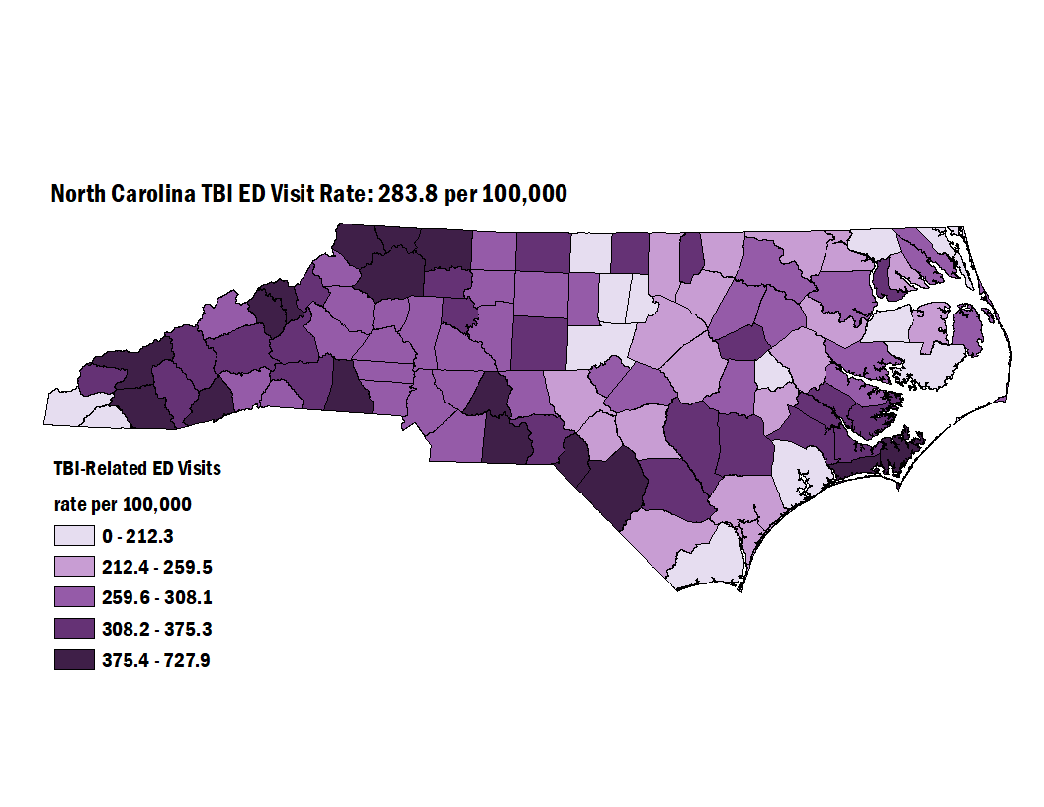
TBI-related Emergency Department visits (ED) among North Carolina residents, 2022-2024
Limited to NC Residents, 2022-2024
Source: NC DETECT (2022-2024)
Analysis by Injury Epidemiology and Surveillance Unit
Notes:
The overall rate of TBI ED visits from 2022-2024 in North Carolina was 283.8 per 100,000. The counties with the highest rates were Transylvania, Wilkes, and Scotland counties.

Slide 34
Most TBI-related ED visits occurred among men and non-Hispanic Whites
Count by Demographic, 2024
NH - non-Hispanic; sex was unknown for 208(<0.1%) injury ED visits and race/ethnicity was unknown for 829(<0.1%) injury ED visits
Limited to NC Residents, 2024
Source: NC DETECT (2024)
Analysis by Injury Epidemiology and Surveillance Unit
Notes:
In 2024, most TBI ED visits occurred amongst male North Carolina residents (n=16,510) and non-Hispanic Whites (n=20,215).

Slide 35
However, rates of TBI-related ED visits were highest among men, non-Hispanic Whites, and non-Hispanic American Indian / Alaskan Natives
Rate by Demographic, 2024
Limited to NC Residents, 2024
Source: NC DETECT (2024)
Analysis by Injury Epidemiology and Surveillance Unit
Notes:
In 2024, the groups with the highest rate of TBI ED visits occurred amongst male North Carolina residents (306.1 per 100,000), non-Hispanic Whites (305.4 per 100,000), non-Hispanic American Indians (303.8 per 100,000), and non-Hispanic Blacks (294.4 per 100,000).

Slide 36
Falls were the leading specified cause of TBI-related ED visits
61% Unintentional
7.3% Assault
0.2% Self-Inflicted
* Included in other specified are Struck By/Against - Assault (3%), Unspecified - Unintentional (2%), and Motor Vehicle-Nontraffic - Unintentional (1%), as well as other mechanism/intents.
Limited to NC Residents, 2024
Source: NC DETECT (2024)
Analysis by Injury Epidemiology and Surveillance Unit
Notes:
Unintentional fall (34.3%) was the leading mechanism-intent category for TBI ED visits. 61% of intents were unintentional, followed by assault (7.3%) and self-inflicted (0.2%).

Slide 37
TBI-related ED visits were highest among ages 25-34 and 75-84
Count by Age Group, 2024
Limited to NC Residents, 2024
Source: NC DETECT (2024)
Analysis by Injury Epidemiology and Surveillance Unit
Notes:
TBI-related ED visits were highest among those ages 25-34 and 75-84 years old.

Slide 38
Adults 85 and older have the highest rates of TBI-related ED visits
Rate by Age Group, 2024
Limited to NC Residents, 2024
Source: NC DETECT (2024)
Analysis by Injury Epidemiology and Surveillance Unit
Notes:
Adults 85 and older have the highest rate of TBI-related ED visits (1,342.7 per 100,000).

Slide 39
TBI-related ED visit rates were highest among men ages 85 and older in 2024
Limited to NC Residents, 2024
Source: NC DETECT (2024)
Analysis by Injury Epidemiology and Surveillance Unit
Notes:
By sex, males most often had higher rates of TBI-related ED visits than females. The highest rate was males aged 85 and older (1,554.7 per 100,000).

Slide 40
Summary of Traumatic Brain Injury in North Carolina
In 2024, traumatic brain injuries resulted in:
  Over 2,600 deaths
  Over 8,200 hospitalizations
  Over 32,000 emergency department visits
Most TBI-related injuries and deaths occurred among males and non-Hispanic Whites
Rates of TBI were highest in the 75-84 and 85 and older age groups
Most traumatic brain injuries were related to unintentional falls
Notes:
In 2024, TBI resulted in over 2,600 deaths, 8,200 hospitalizations, and 32,000 ED visits. Most TBI-related injuries and deaths occurred in males and non-Hispanic White individuals. Rates of TBI are highest in older adults. Unintentional falls are a large contributor to TBI-related injuries and deaths in North Carolina.

Slide 41
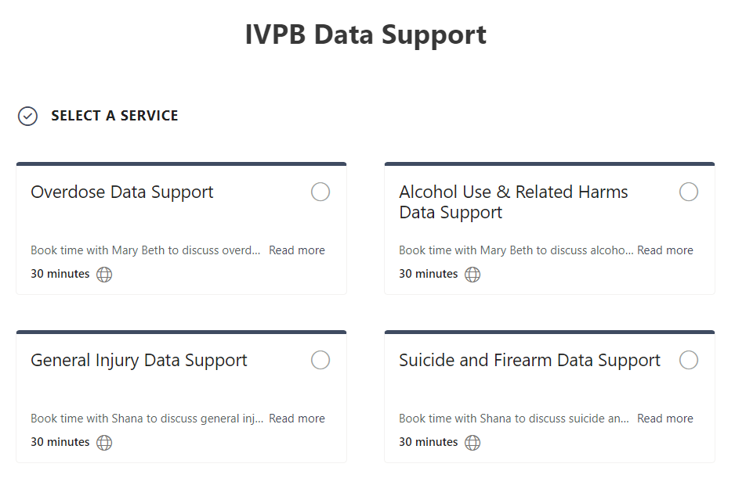

IVPB Data Support now available!
Book time with an IVPB epidemiologist to discuss available data products, to talk through custom data requests, or for general data questions.
IVPB Data Request Policy
IVPB Data Support Bookings

Slide 42
Questions?
InjuryData@dhhs.nc.gov
Injury and Violence Prevention Branch
Division of Public Health
https://www.dph.ncdhhs.gov/programs/chronic-disease-and-injury/injury-and-violence-prevention-branch

