Slide 1
Unintentional Fall Injuries in North Carolina
2024
Division of Public Health
Data updated February 16, 2026
Notes:
This slide set was created to provide basic data trends and public health surveillance around mortality and morbidity of falls. They are meant to offer a state-level background on unintentional fall injury. If you’d like a copy of the slides, please visit the “Falls” Data page on our branch website, https://www.dph.ncdhhs.gov/programs/chronic-disease-and-injury/injury-and-violence-prevention-branch. The direct link is also shared at the end of this presentation.
Feel free to incorporate these slides into your own presentations, grant proposals, reports, or any other way they may be useful.
Please read both the speaking and technical notes to ensure that data are presented in a consistent manner.

Slide 2
Unintentional Falls Technical Notes
Surveillance methods have been updated to identify any mention of an injury in our morbidity data sources. Individual records with multiple injuries listed will be included in the total for each of those injuries but only counted once for overall total injury count. Previously, only the first listed injury was counted, which has resulted in an increase in the number of specific injuries identified.
For questions or for more information, see technical notes document available at
https://www.injuryfreenc.ncdhhs.gov/DataSurveillance/
Case Definitions used:
Deaths – ICD10 code W00-W19 listed cause of death
Notes:
For more detailed technical notes on any of the data shared in this slide set, please contact us at InjuryData@dhhs.nc.gov.

Slide 3
Technical Notes, Continued
Hospitalizations – Among records with an ICD-10-CM injury code,* any mention of the ICD-10-CM codes below (includes records resulting in death)
Emergency Department Visits – Any mention of the ICD-10-CM codes below: (includes records resulting in hospitalization or death)
V00.11-V00.89 with 6th character=1 | Falls related to pedestrian conveyance
W00-W15, W17, W19 | Falls
W16 with 6th character=2 (Except 16.4 and 16.9 with 5th character=2) | Fall, jump, or diving into water
W18.1, W18.2, W18.3 | Other falls
7th character of A or missing (reflects initial encounter, active treatment)
*See technical notes document for a full list of ICD-10-CM injury diagnosis codes
Notes:
For more detailed technical notes on any of the data shared in this slide set, please contact us at InjuryData@dhhs.nc.gov.

Slide 4
Overview
Vulnerable Populations
Unintentional Fall Deaths
Unintentional Fall Morbidity
  Hospitalizations and Emergency Department Visits
Unintentional Fall Injury/Harm data are available at https://injuryfreenc.dph.ncdhhs.gov/DataSurveillance/FallsData.htm
For custom data requests, see https://injuryfreenc.dph.ncdhhs.gov/DataSurveillance/DataRequestPolicy.htm
Notes:
This presentation is not intended to cover all data related to unintentional fall-related injury. Rather it gives an overview of some of the key trends in North Carolina. It includes information on statewide vulnerable populations, unintentional fall deaths, and unintentional fall injury hospitalizations and emergency department visits. Please note that when the COVID-19 pandemic began in 2020, there were many implications, including major changes to the numbers and rates within the unintentional fall injury data in this slide deck. The Injury and Violence Prevention Branch is still assessing how each aspect of the data were impacted.
If this slide deck does not contain the information you need, please see our custom data request policy and contact us at InjuryData@dhhs.nc.gov.

Slide 5
The populations most at risk of falls are projected to have the fastest growth over the next 20 years
2024 Population
2044 Population
Percent Change 2024-2044
N=11,052,495
N=13,030,273
Overall increase of 18%
North Carolina OSBM, Standard Population Estimates, Vintage 2024
Notes:
Over the next 20 years, North Carolinians ages 60 and over are projected to have the fastest population growth (34-105%), outpacing the overall 20-year population growth (18%). Twenty years from now, the population of North Carolinians ages 60 and over is expected to increase by 34%. The largest increase in population growth is expected among those ages 85 and older (105%).

Slide 6
Most older adults (ages 65+) in NC are non-Hispanic White
NH = non-Hispanic
Source: US Census non-bridged population estimates, 2024; ages 65 and older
Notes:
In 2024, most North Carolinians ages 65 and older are non-Hispanic White (75%). The second largest racial/ethnic group among North Carolinians ages 65 and older are non-Hispanic Black (18%).

Slide 7
Demographic characteristics among older adults in North Carolina
43%
of housing units with people 65 and older are single person households
* Adults ages 65 and older
Source: American Community Survey, 2024 5-year estimates. Table S0103: Population 65 and older
Notes:
According to the 2024 American Community Survey, 43% of housing units with people 65 and older are single person households. 1/3 (33%) of North Carolina adults ages 65 and older have a disability. 29% of North Carolina adults ages 65 and older have a high school education/G.E.D.

Slide 8
One in five older adults in NC reports trouble walking
Disability among adults 65 and older
Source: American Community Survey, 2024 5-year estimates. Table S1810: Population 65 and older
Notes:
According to the 2024 American Community Survey, approximately 1 in 5 North Carolina adults ages 65 and over reported having trouble walking. Furthermore, North Carolina adults ages 65 and over experience hearing (13%), cognitive (8%), vision (6%), and self-care disabilities (7%). About 13% of people ages 65 and older in North Carolina also reported living alone/independently.

Slide 9
Around 74% of older adults in NC have one or more chronic disease
Source: NC State Center of Health Statistics, 2024 Behavioral Risk Factor Surveillance System (BRFSS) Survey Results
Notes:
In North Carolina, approximately 83% of adults ages 65 and older have one or more chronic disease. Among adults ages 65-74, 52% have 2 or more chronic diseases. About 54% of North Carolina adults ages 75 and older have 2 or more chronic diseases.

Slide 10
Proportion of demographic groups reporting two or more falls in the last 12 months, 2023 BRFSS
Overall 12%
Overall 12%
Source: NC State Center of Health Statistics, 2023 Behavioral Risk Factor Surveillance System (BRFSS) Survey Results
Notes:
In 2023, 12% of NC respondents reported two or more falls in the last 12 months. However, when broken out by demographics and socioeconomic status, more than 12% (state overall) reported two or more falls in the last 12 months. These groups included females (12.4%), those ages 55 years and older (13%, 13%, and 14%), individuals with some post high school education (13%), individuals with a disability (25%), veterans (14%), respondents living in suburban areas (16%), and those in the 3rd quartile of social vulnerability (17%). Less than 10% of college graduates (9%), respondents living in urban areas (9%), and those with no disability (5%) reported two or more falls in the last 12 months.

Slide 11
Unintentional fall-related deaths are the tip of the iceberg
Despite NC’s excellent reporting systems, the total burden of fall injury in the state
is unknown.
1,985
Deaths
29,975
Hospitalizations
284,874
ED Visits
? EMS
? Outpatient Visits
? Medically Unattended Injuries
INJURY ICEBERG
Limited to NC Residents, 2024
Source: NC State Center for Health Statistics, Vital Statistics-Deaths (2024) and Hospitalization Discharge Data (2024); NC DETECT (2024)
Analysis by Injury Epidemiology and Surveillance Unit
Notes:
In 2024 there were 1,985 deaths, 29,975 hospitalizations, and 284,874 emergency department visits associated with unintentional fall injuries in North Carolina. However, this is just the tip of the iceberg and the total burden of unintentional fall injury in NC is unknown.

Slide 12

Unintentional Fall
Deaths

Slide 13
Unintentional fall-related deaths increased by 69% over the last 10 years
69%
increase
Limited to NC Residents, 2015 – 2024
Source: NC State Center for Health Statistics, Vital Statistics-Deaths (2015 – 2024)
Analysis by Injury Epidemiology and Surveillance Unit
Notes:
The number of unintentional fall-related deaths in North Carolina has increased by 69% over the last 10 years (2015-2024).

Slide 14
Unintentional falls were the second leading cause of injury death* in 2024
*by mechanism and intent
MVT = Motor Vehicle Traffic
Limited to NC Residents, 2015 – 2024
Source: NC State Center for Health Statistics, Vital Statistics-Deaths (2024)
Analysis by Injury Epidemiology and Surveillance Unit
Notes:
In 2024, unintentional falls were the second leading cause of injury-related death in North Carolina, with 1,985 unintentional fall-related deaths among NC residents.

Slide 15
Unintentional falls were the number one cause of injury death among older adults*
90%
of fall-related deaths
*Adults ages 65 and older
Limited to NC Residents, 2024 (N = 1,985)
Source: NC State Center for Health Statistics, Vital Statistics-Deaths (2024)
Analysis by Injury Epidemiology and Surveillance Unit
Notes:
In 2024, unintentional falls were the number one cause of injury death among North Carolina residents ages 65 and older. Approximately 90% of unintentional fall-related deaths were among those ages 65 and over.

Slide 16
Unintentional fall death rates are highest among those ages 85 and older
Rates begin increasing among ages 45-54
*Rate suppressed due to count being less than 5
Limited to NC Residents, 2024 (N = 1,985)
Source: NC State Center for Health Statistics, Vital Statistics-Deaths (2024)
Analysis by Injury Epidemiology and Surveillance Unit
Notes:
In 2024, North Carolina residents ages 85 and older (489.9 per 100,000) had the highest unintentional fall-related death rates. The death rates of unintentional falls began increasing at age 45.

Slide 17
Rates of unintentional fall-related deaths were highest among men and non-Hispanic Whites
NH - non-Hispanic; There were 0 deaths where the race/ethnicity was unknown
Limited to NC Residents, 2024 (N = 1,985)
Source: NC State Center for Health Statistics, Vital Statistics-Deaths (2024)
Analysis by Injury Epidemiology and Surveillance Unit
Notes:
In 2024, the highest rates for unintentional fall-related deaths occurred amongst male (18.2 per 100,000) and non-Hispanic White (26.1 per 100,000) North Carolina residents.

Slide 18
Unintentional Fall
Hospitalizations

Slide 19
Unintentional fall-related hospitalizations increased by 20% over the last five years
20%
increase
Limited to NC Residents, 2020 - 2024
Source: NC State Center for Health Statistics, Hospitalization Discharge Data (2020 - 2024)
Analysis by Injury Epidemiology and Surveillance Unit
Notes:
In 2024, the number of unintentional fall-related hospitalizations in North Carolina has increased by 20% since 2020.

Slide 20
79% of unintentional fall-related hospitalizations occurred among adults 65 and older
Age was unknown for 0 hospitalizations
Limited to NC Residents, 2024
Source: NC State Center for Health Statistics, Hospitalization Discharge Data (2024)
Analysis by Injury Epidemiology and Surveillance Unit
Notes:
In 2024, 79% of fall-related hospitalizations were among NC residents ages 65 and over.

Slide 21
Adults 85 and older have the highest rates of unintentional fall-related hospitalizations
Age was unknown for 0 hospitalizations
Limited to NC Residents, 2024
Source: NC State Center for Health Statistics, Hospitalization Discharge Data (2024)
Analysis by Injury Epidemiology and Surveillance Unit
Notes:
In 2024, the highest rates for fall-related hospitalizations occurred amongst NC residents ages 85 and older (4,233.3 per 100,000). These hospitalization rates began increasing at age 55.

Slide 22
Unintentional fall-related hospitalization rates were highest among women and NH Whites
NH – non-Hispanic
Sex was unknown for 1 (<0.1%) injury hospitalizations and race/ethnicity was unknown for 312 (0.1%) injury hospitalizations
Limited to NC Residents, 2024
Source: NC State Center for Health Statistics, Hospitalization Discharge Data (2024)
Analysis by Injury Epidemiology and Surveillance Unit
Notes:
In 2024, the highest rates for fall-related hospitalizations occurred amongst female (326.4 per 100,000) and non-Hispanic White (370.5 per 100,000) North Carolina residents.

Slide 23
Unintentional Fall Emergency Department Visits

Slide 24
Unintentional fall-related ED visits increased by 56% over the last five years
56%
increase
Limited to NC Residents, 2024
Source: NC DETECT (2020 - 2024)
Analysis by Injury Epidemiology and Surveillance Unit
Notes:
Overall, the number of unintentional fall-related emergency department visits in North Carolina increased by 56% over the last 5 years (2020-2024). Since 2020, there has been a steady increase in ED visits for unintentional fall-related injuries.

Slide 25
54% of unintentional fall-related ED visits occurred among adults 65 and older
Age was unknown for 348 ED Visits
Limited to NC Residents, 2024
Source: NC DETECT (2024)
Analysis by Injury Epidemiology and Surveillance Unit
Notes:
In 2024, more than half (54%) of unintentional fall-related emergency department visits were among NC residents ages 65 and older.

Slide 26
Adults 85 and older have the highest rates of unintentional fall-related ED visits
Age was unknown for 348 ED Visits
Limited to NC Residents, 2024
Source: NC DETECT (2024)
Analysis by Injury Epidemiology and Surveillance Unit
Notes:
In 2024, the highest rates for unintentional fall-related emergency department visits occurred amongst North Carolina residents ages 85 and older (23,101.6 per 100,000). The rates of unintentional fall-related ED visits began increasing at age 55.

Slide 27
Rates of unintentional fall-related ED visits were highest among women and NH Whites
NH - non-Hispanic; sex was unknown for 332 (<0.1%) injury ED visits and race/ethnicity was unknown for 3,904(<0.1%) injury ED visits
Limited to NC Residents, 2024
Source: NC DETECT (2024)
Analysis by Injury Epidemiology and Surveillance Unit
Notes:
In 2024, the highest rates for unintentional fall-related ED visits occurred amongst female (2,999.8 per 100,000) and non-Hispanic White (3,024.6 per 100,000) North Carolina residents.

Slide 28
Leading diagnosis codes for unintentional fall-related ED visits
Limited to NC Residents, 2024
Source: NC DETECT (2024)
Analysis by Injury Epidemiology and Surveillance Unit
Notes:
Over two-thirds (70.1%) of unintentional fall-related ED visits are categorized as unspecified falls. Of those with a specified reason, 7.8% are falls related to slipping, tripping and stumbling.

Slide 29
Summary of unintentional fall-related injuries in North Carolina
In 2024, unintentional fall-related injuries resulted in:
  Nearly 2,000 deaths
  Nearly 30,000 hospitalizations
  Nearly 285,000 emergency department visits
Most falls occur among females and Non-Hispanic White NC residents
Rates of fall-related injuries are highest in the 75-84 and 85 and older age groups
Notes:
In 2024, unintentional fall-related injuries resulted in nearly 2,000 deaths, nearly 30,000 hospitalizations, and nearly 285,000 emergency department visits in North Carolina. The highest rates of unintentional fall-related injuries and death occurred among females, non-Hispanic Whites, and residents ages 75 years and older.

Slide 30
Where to find more data on unintentional fall-related death and injury?
NC Injury and Violence Prevention Branch Falls Injury Data
NC DETECT Unintentional Falls Dashboard
State Center for Health Statistics (SCHS) Death Certificate Data
  NC Health Data Query System
CDC WISQARS – Fatal Injury and Violence Data

Slide 31
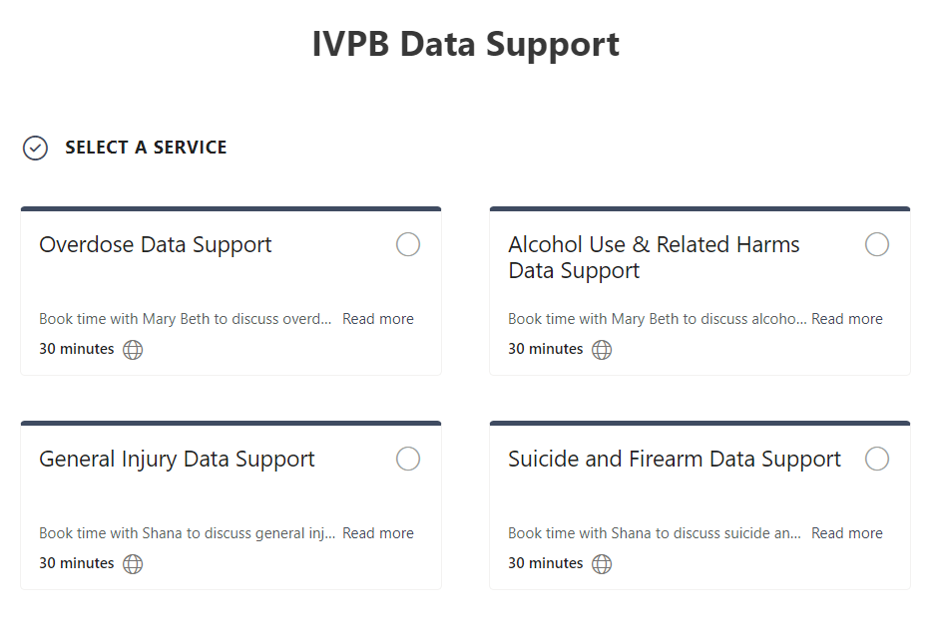

IVPB Data Support now available!
Book time with an IVPB epidemiologist to discuss available data products, to talk through custom data requests, or for general data questions.
IVPB Data Request Policy
IVPB Data Support Bookings

Slide 32
Questions?
InjuryData@dhhs.nc.gov
Injury and Violence Prevention Branch
Division of Public Health
https://www.dph.ncdhhs.gov/programs/chronic-disease-and-injury/injury-and-violence-prevention-branch

