Slide 1
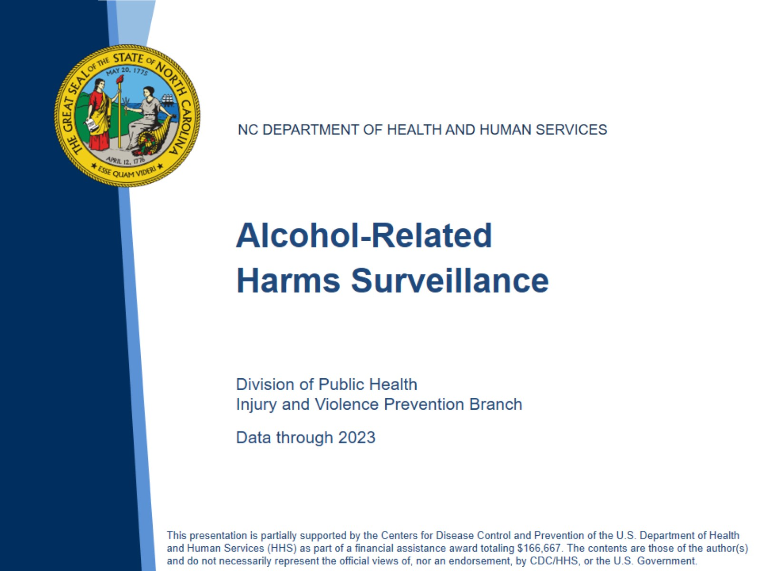
Notes:
Speaker’s notes: This slide set was created to provide basic data trends and public health surveillance around alcohol-related harms in North Carolina. This presentation is not intended to cover all data related to alcohol-related harms. It includes information on statewide alcohol use, alcohol-related mortality, and key prevention strategies for excessive alcohol use and its related harms.
Feel free to incorporate these slides into your own presentations, grant proposals, reports, or any other way they may be useful. If this slide deck does not contain the information you need, please see our custom data request policy (https://injuryfreenc.dph.ncdhhs.gov/DataSurveillance/DataRequestPolicy.htm) and contact us at SubstanceUseData@dhhs.nc.gov.
Please read both the speaking and technical notes to ensure the data are presented in a consistent manner.

Slide 2
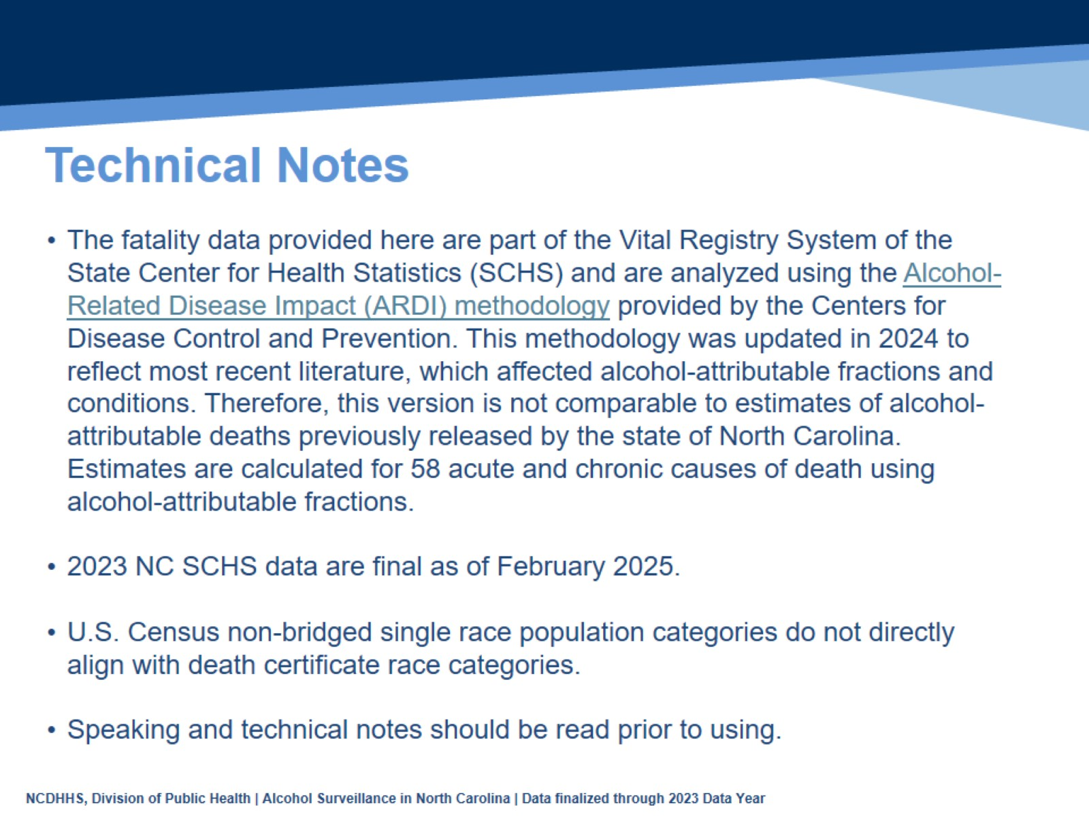
Technical Notes
Notes:
Speaker’s notes: For more detailed technical notes on any of the data shared in this slide set, please contact us at SubstanceUseData@dhhs.nc.gov.

Slide 3
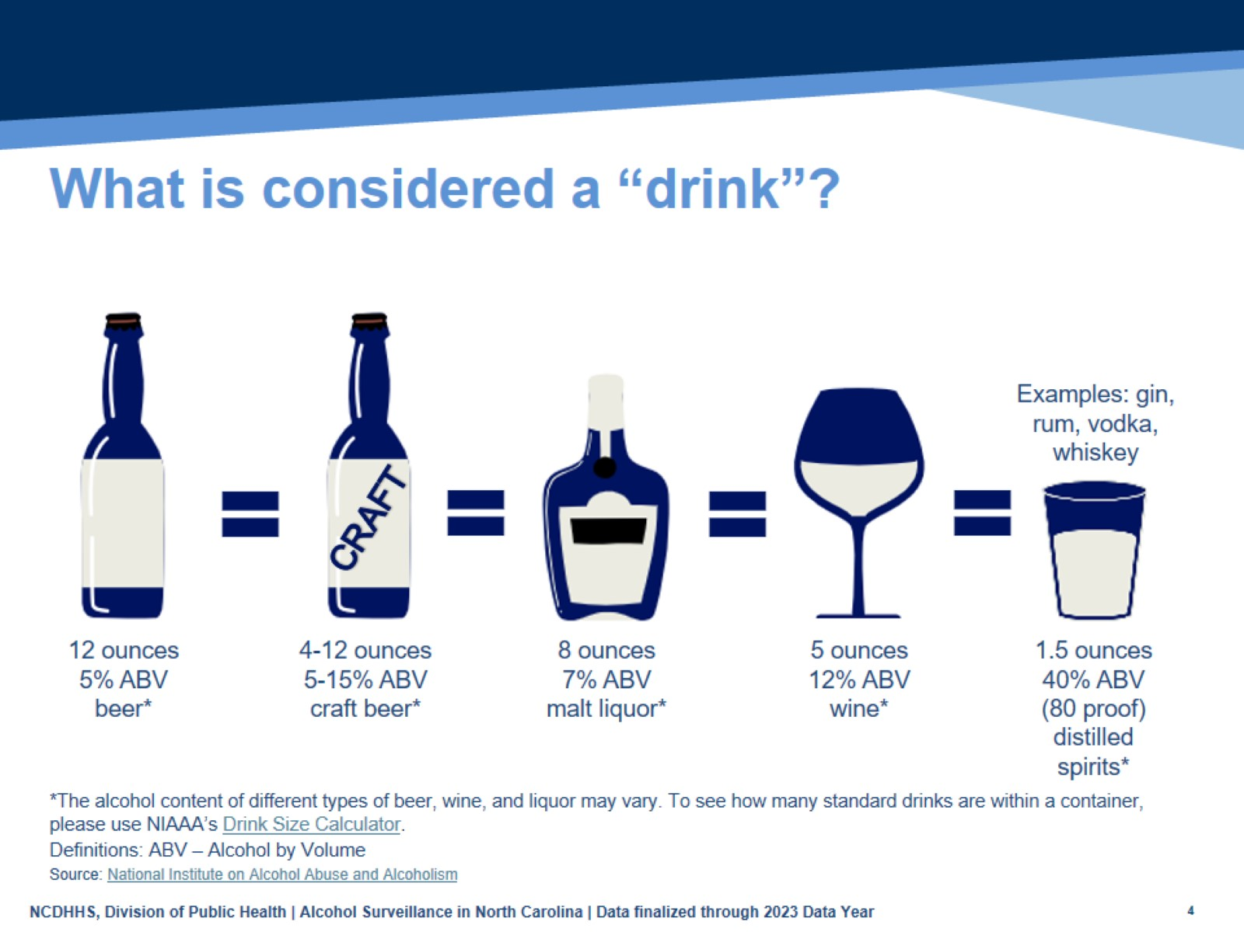
What is considered a “drink”?
Notes:
Speaker’s notes: One standard drink is 14 grams or 0.6 fl. oz. of pure alcohol. The alcohol content of different types of beer, wine, and liquor may vary. For example, 12 ounces of a beer at 5% ABV is one standard drink, while 5 ounces of wine at 12% ABV is also one standard drink.
It’s important to understand how much alcohol is in a drink so that you can make informed decisions if you do choose to drink.
Technical notes: To see how many standard drinks are within a container, please use the National Institute of Alcohol Abuse and Alcoholism’s Drink Size Calculator - https://rethinkingdrinking.niaaa.nih.gov/tools/calculators/drink-size-calculator.

Slide 4
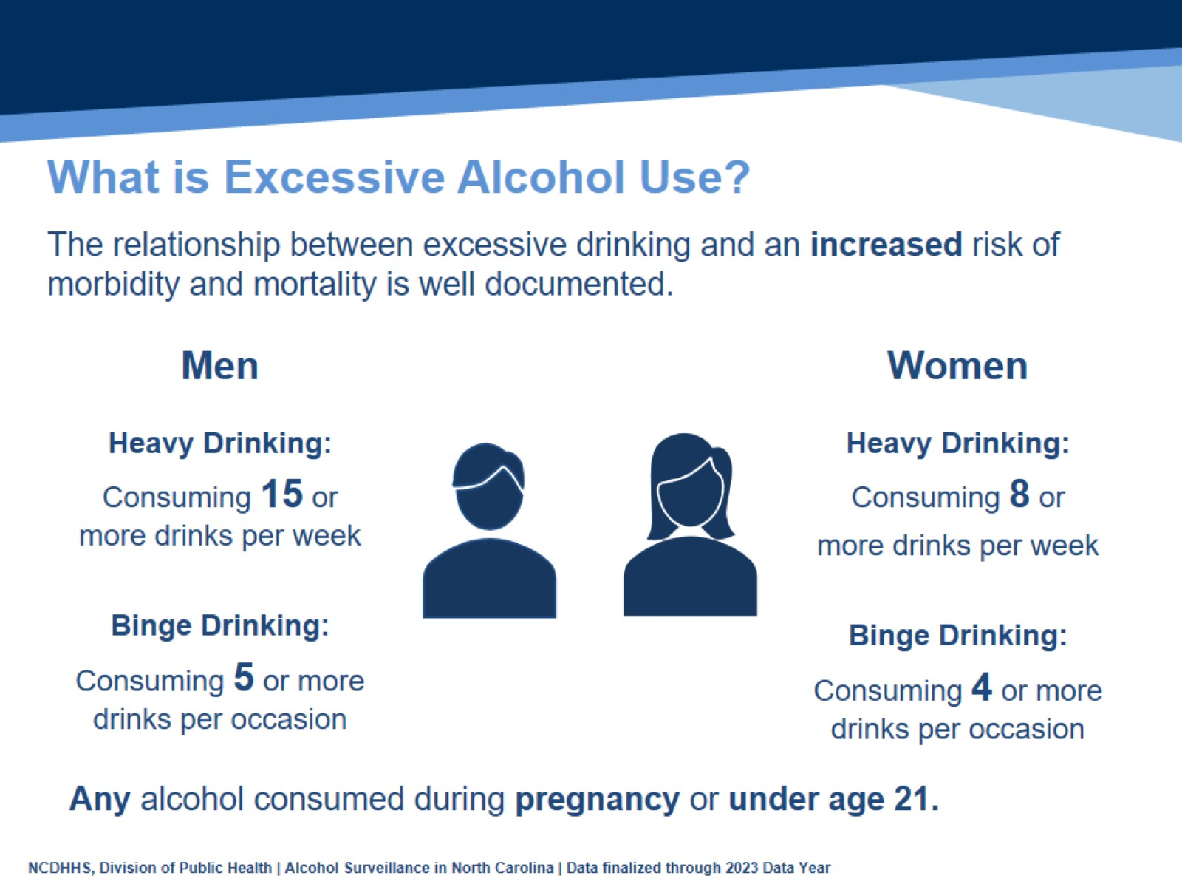
What is Excessive Alcohol Use?
Notes:
Speaker’s notes: One drink is equivalent to a 12-ounce beer, a 5-ounce glass of wine, or a drink with one shot (1.5-ounces) of liquor.
Due to biological differences in body structure and chemistry, the definition of excessive drinking differs between men and women. After drinking the same amount of alcohol, most women tend to have higher blood alcohol levels, and the immediate effects of alcohol usually occur more quickly and last longer in women than in men.
Excessive alcohol use is defined as binge drinking (4+ drinks in one sitting for women, 5+ for men), heavy drinking (8+ drinks in one week for women, 15+ for men), or any alcohol use during pregnancy or under the age of 21.

Slide 5
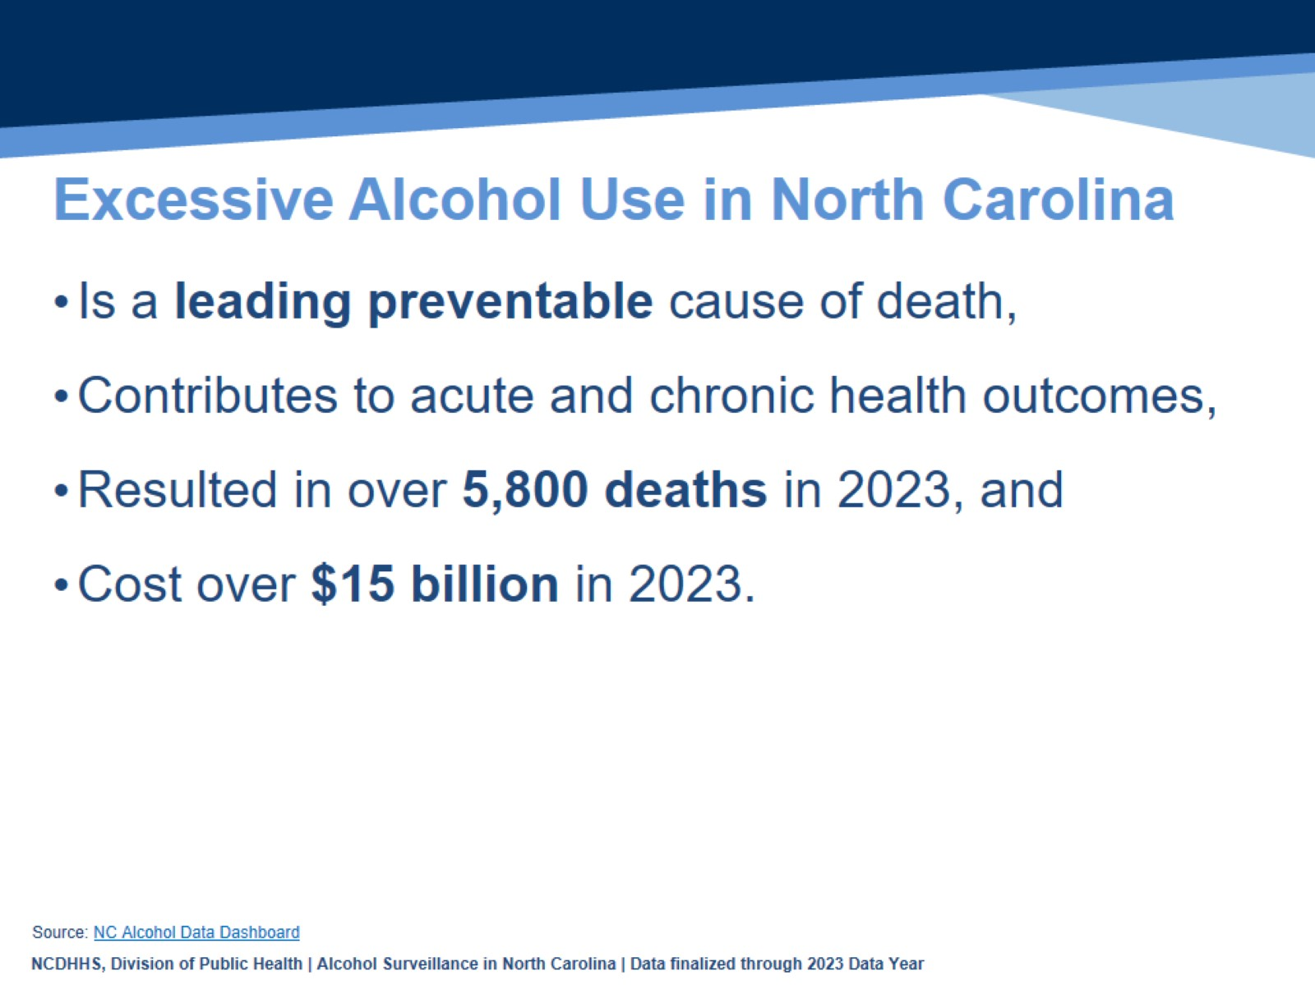
Excessive Alcohol Use in North Carolina
Notes:
Speaker’s notes: Excessive alcohol use is a leading preventable cause of death in North Carolina. Excessive alcohol use contributes to both acute health outcomes, like poisonings, motor vehicle traffic crashes, or other injuries, and chronic health outcomes, such as liver disease, pancreatitis, and certain types of cancer. In 2023, there were over 5,800 alcohol attributable deaths among NC residents. Excessive alcohol use costs the state over $15 billion.

Slide 6
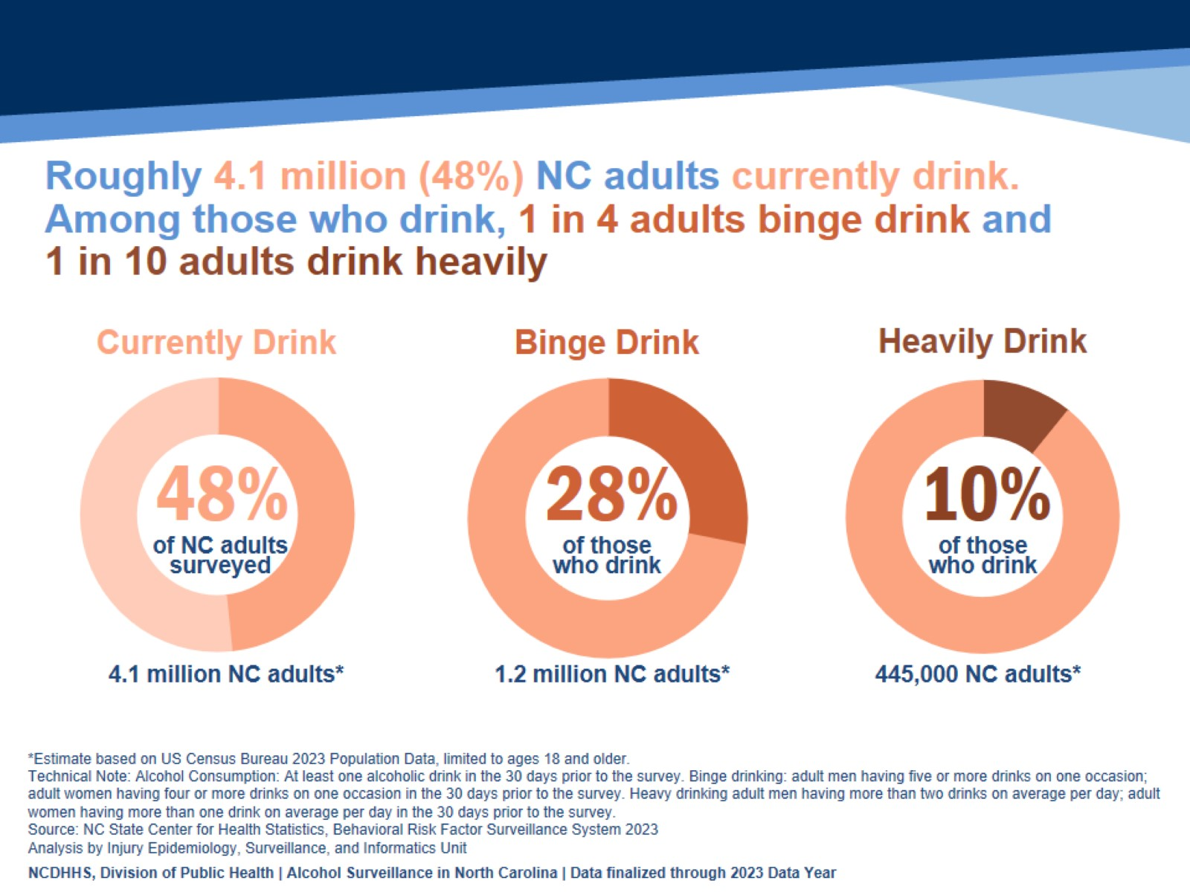
Notes:
Speaker’s Notes: Adult alcohol use is an important public health concern. Alcohol use can reduce individual lifespan and at the community level, impact adult productivity and unemployment, impacting community health overall. In 2023, 48% of adults in NC currently drink, which is an estimated 4.1 million adults in North Carolina.
Of those adults who drink, 28% said that they binge drink (4+ drinks in one occasion for women, 5+ for men) at least one time per month, an estimated 1.2 million NC adults, and 10% said that they have drank heavily (8+ drinks in one week for women, 15+ for men), an estimated 445,000 NC adults.
Technical notes: These data come from the Behavioral Risk Factor Surveillance System Survey (BRFSS). This is a yearly, random telephone survey of NC adults 18+ years old. Information is collected in a routine, standardized manner on a variety of health behaviors and preventive health practices, such as cardiovascular disease, cancer, diabetes, and injuries. BRFSS interviews are conducted year-round, and data are analyzed annually; a variety of yearly analyses are available at: https://schs.dph.ncdhhs.gov/data/brfss/survey.htm .

Slide 7
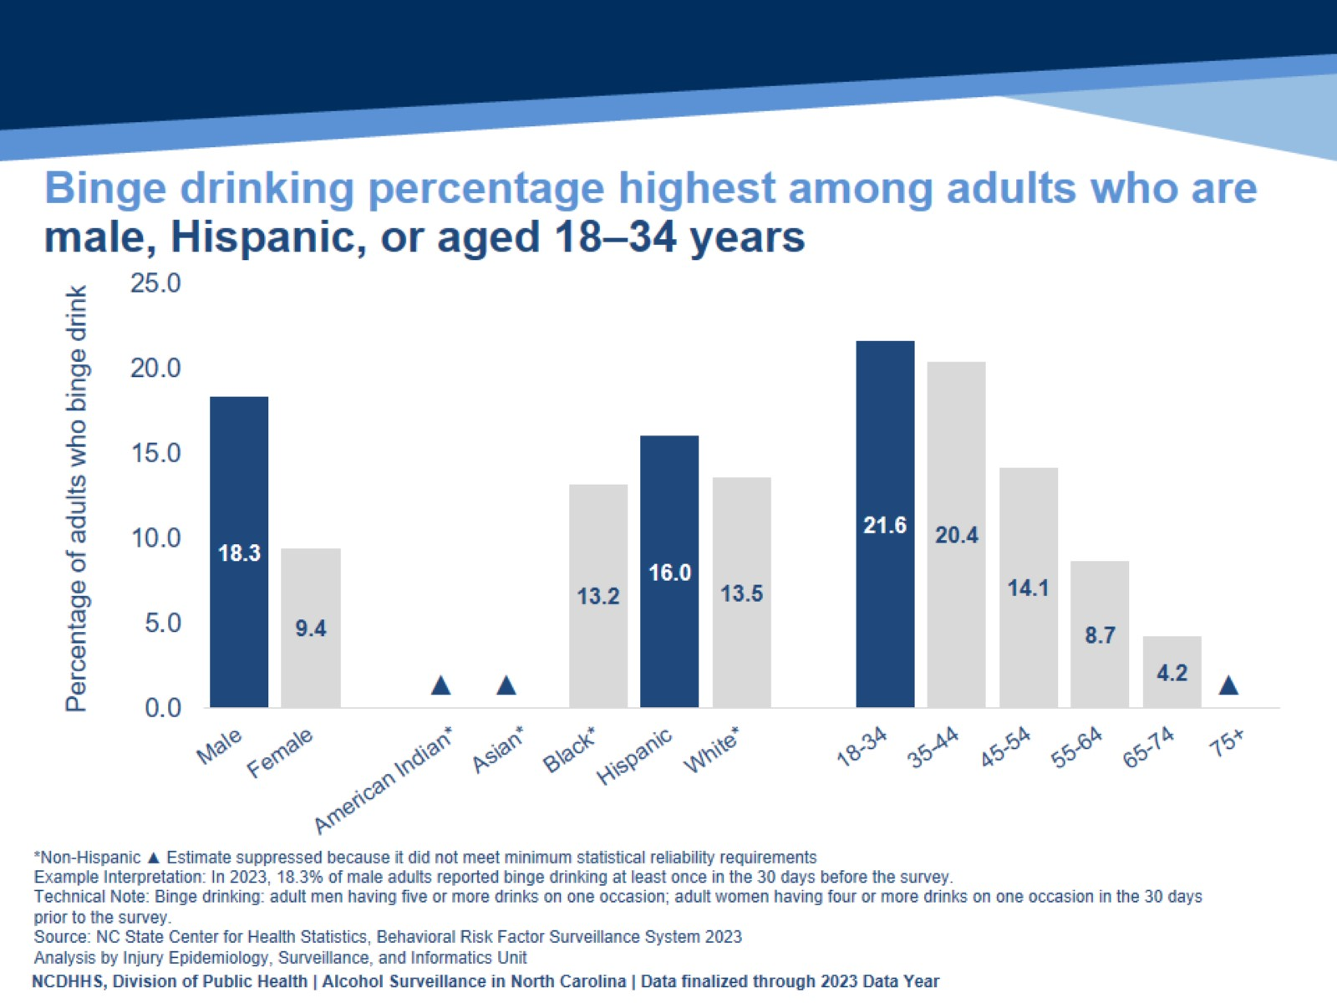
Binge drinking percentage highest among adults who are male, Hispanic, or aged 18–34 years
Notes:
Speaker’s Notes: A higher percentage of adults who are male, Hispanic, or aged 18–34 years reported binge drinking.
Technical notes: The percentages of adults who are 75 or older, American Indian non-Hispanic (NH), or Asian NH were suppressed due to estimates not meeting minimum statistical reliability requirements . Due to suppression, differences in binge drinking prevalence by age and race/ethnicity is not fully understood in NC. Binge drinking is the most common and costly pattern of excessive alcohol use. This does not give the full magnitude of adult binge drinking prevalence and subsequent related health outcome disparities among various demographic groups.
These data come from the Behavioral Risk Factor Surveillance System Survey (BRFSS). This is a yearly, random telephone survey of NC adults 18+ years old. Information is collected in a routine, standardized manner on a variety of health behaviors and preventive health practices, such as cardiovascular disease, cancer, diabetes, and injuries. BRFSS interviews are conducted year-round, and data are analyzed annually; a variety of yearly analyses are available at: https://schs.dph.ncdhhs.gov/data/brfss/survey.htm .

Slide 8
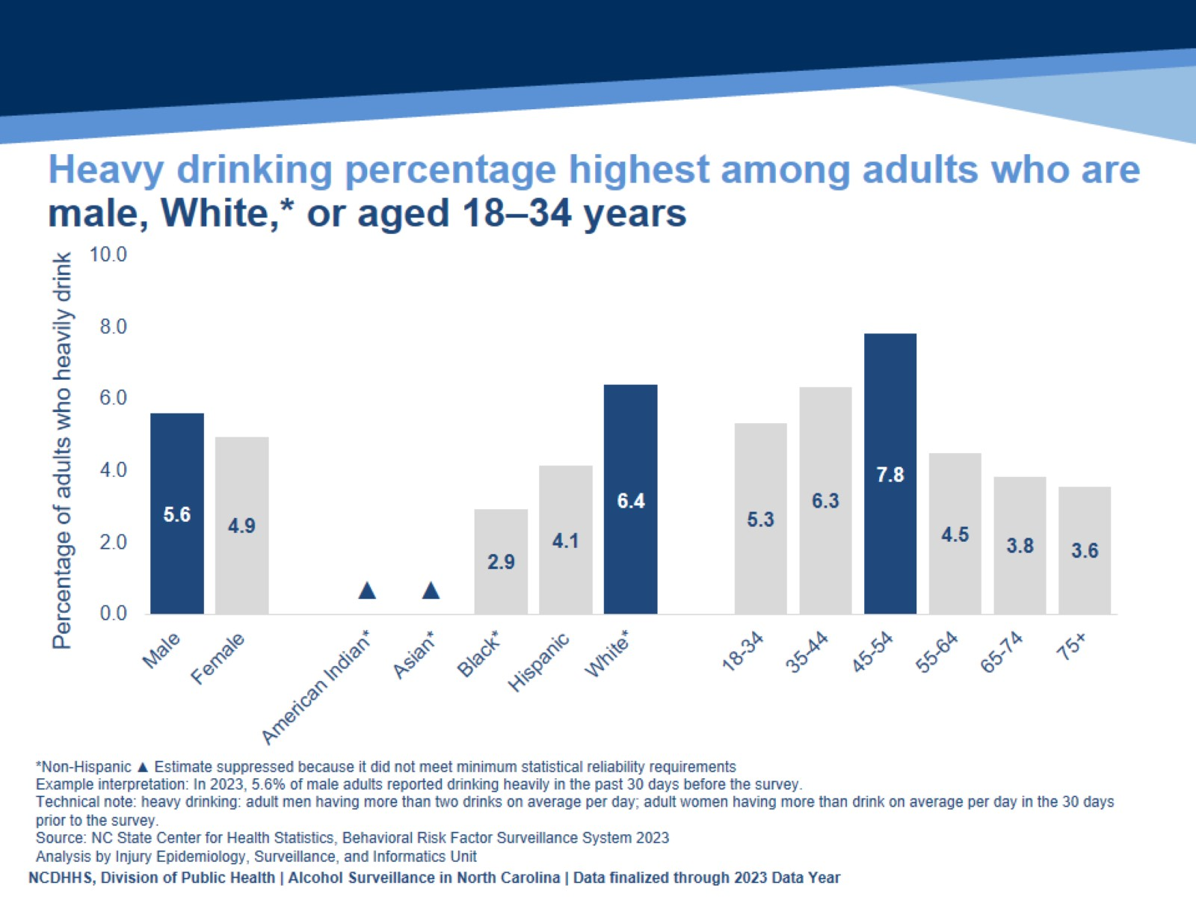
Heavy drinking percentage highest among adults who are male, White,* or aged 18–34 years
Notes:
Speaker’s notes: A higher percentage of adults who are male, White non-Hispanic (NH), or aged 18–34 years reported drinking heavily.
Technical notes: The percentages of adults who are American Indian NH or Asian NH were suppressed due to estimates not meeting minimum statistical reliability requirements . Due to suppression, differences in heavy drinking prevalence between race/ethnicity is not fully understood in NC. This does not give the full magnitude of adult heavy drinking prevalence and subsequent related health outcome disparities among various demographic groups.
These data come from the Behavioral Risk Factor Surveillance System Survey (BRFSS). This is a yearly, random telephone survey of NC adults 18+ years old. Information is collected in a routine, standardized manner on a variety of health behaviors and preventive health practices, such as cardiovascular disease, cancer, diabetes, and injuries. BRFSS interviews are conducted year-round, and data are analyzed annually; a variety of yearly analyses are available at: https://schs.dph.ncdhhs.gov/data/brfss/survey.htm .

Slide 9
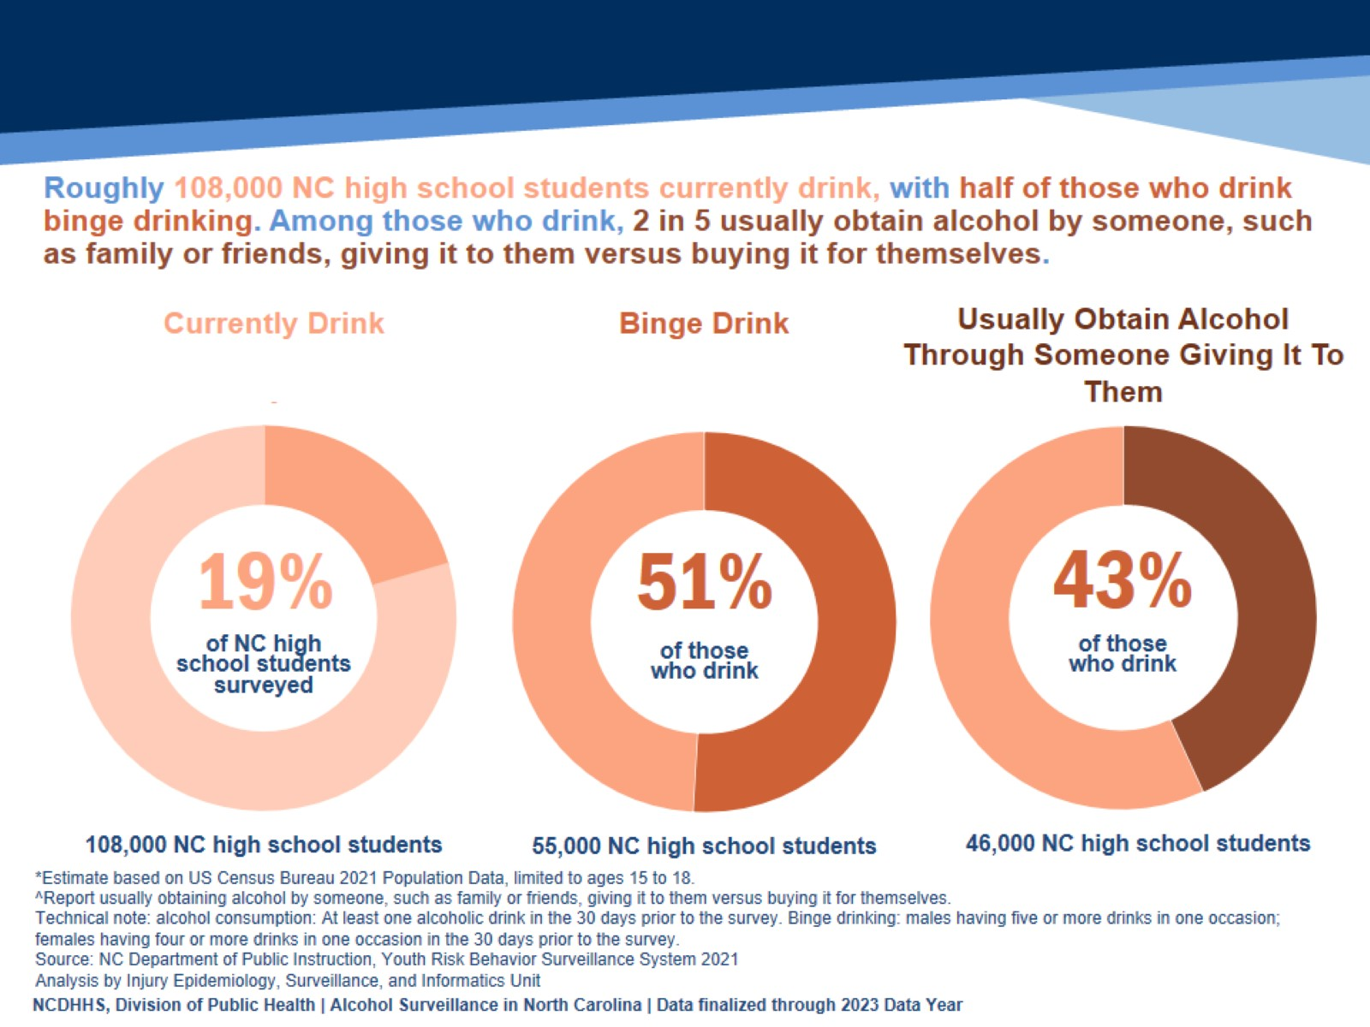
Notes:
Speaker’s notes: Underage alcohol use puts youth at a higher risk of injury, including motor vehicle crashes, suicide, sexual assault, and unprotected sex and other sexual risk behaviors. Understanding current alcohol use among people under 21 who drink helps develop appropriate public health interventions. In 2021, 19% of high school students in NC said they are currently drinking alcohol. Of those high school students who drink, 51% binge drink, and 43% usually obtained alcohol by someone, such as family or friends, giving it to them versus buying it for themselves.
Technical notes: These data come from the Youth Risk Behavior Surveillance System (YRBSS), which is conducted every other year. It asks middle and high school students questions about their behaviors that impact their health now and in the future. Topics include violence, personal safety, physical activity, nutrition, mental health, tobacco, drugs and alcohol, protective factors and sexual behavior questions. A variety of biannual analyses available: https://sites.google.com/dpi.nc.gov/nchealthyschools/nc-healthy-schools-data/yrbs . The most recent available YRBSS data is from 2023. 2021 YRBSS data was used due to questions on binge drinking behaviors not being available.

Slide 10
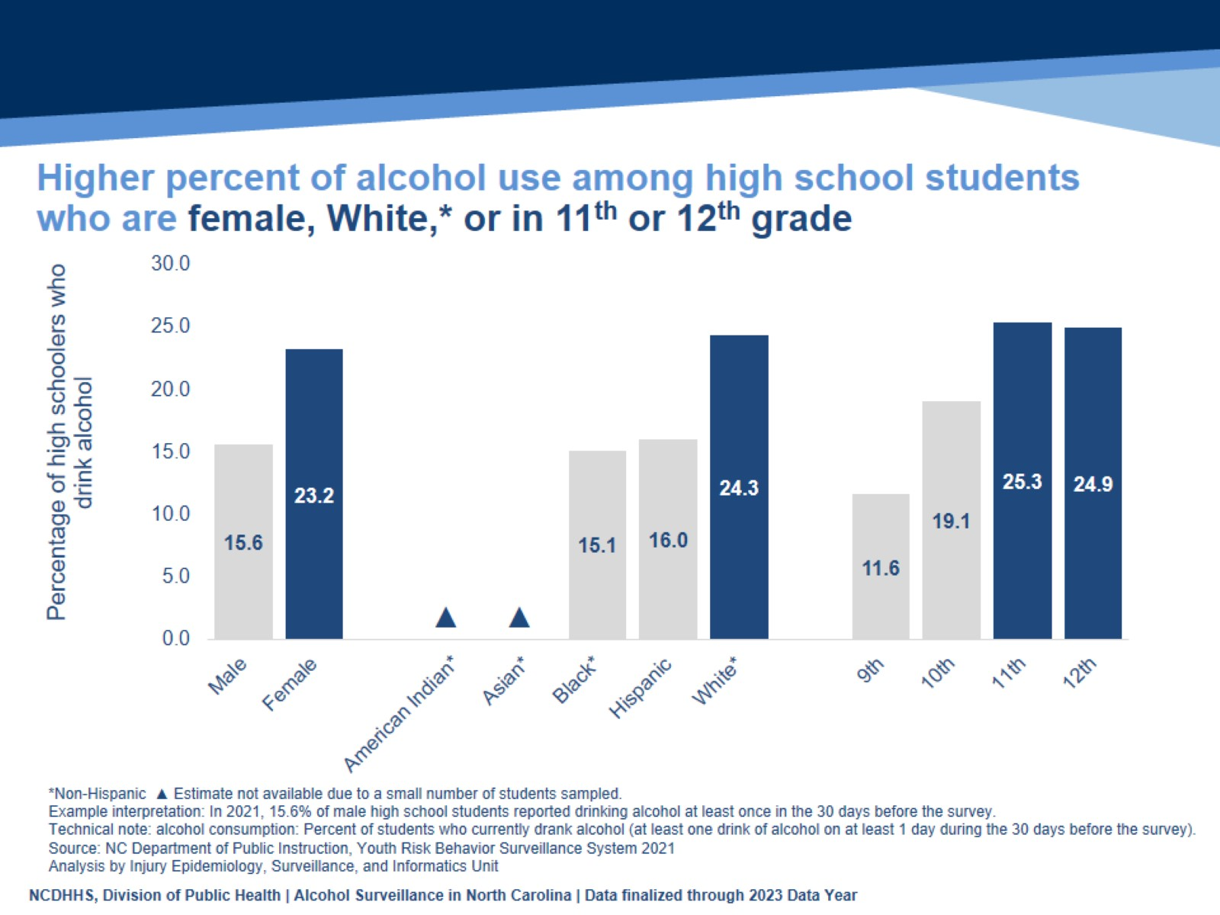
Higher percent of alcohol use among high school students who are female, White,* or in 11th or 12th grade
Notes:
Speaker’s notes: A higher percentage of high school students who are female, White non-Hispanic (NH), or in 11th or 12th grade reported consuming alcohol.
Technical notes: The percentages of high school students who are American Indian NH or Asian NH were not available due to a small number of students sampled. Due to the small sample, race/ethnicity differences in youth alcohol use prevalence is not fully understood in NC. Youth who drink alcohol are more likely to experience school problems, social problems, disruption of development, violence, and many other alcohol-related outcomes. This does not give the full magnitude of youth alcohol use prevalence and subsequent related health outcome race/ethnicity disparities.
These data come from the Youth Risk Behavior Surveillance System (YRBSS), which is conducted every other year. It asks middle and high school students questions about their behaviors that impact their health now and in the future. Topics include violence, personal safety, physical activity, nutrition , mental health, tobacco, drugs and alcohol, protective factors and sexual behavior questions. A variety of biannual analyses available: https://sites.google.com/dpi.nc.gov/nchealthyschools/nc-healthy-schools-data/yrbs . The most recent available YRBSS data is from 2023. 2021 YRBSS data was used due to questions on binge drinking behaviors not being available.

Slide 11
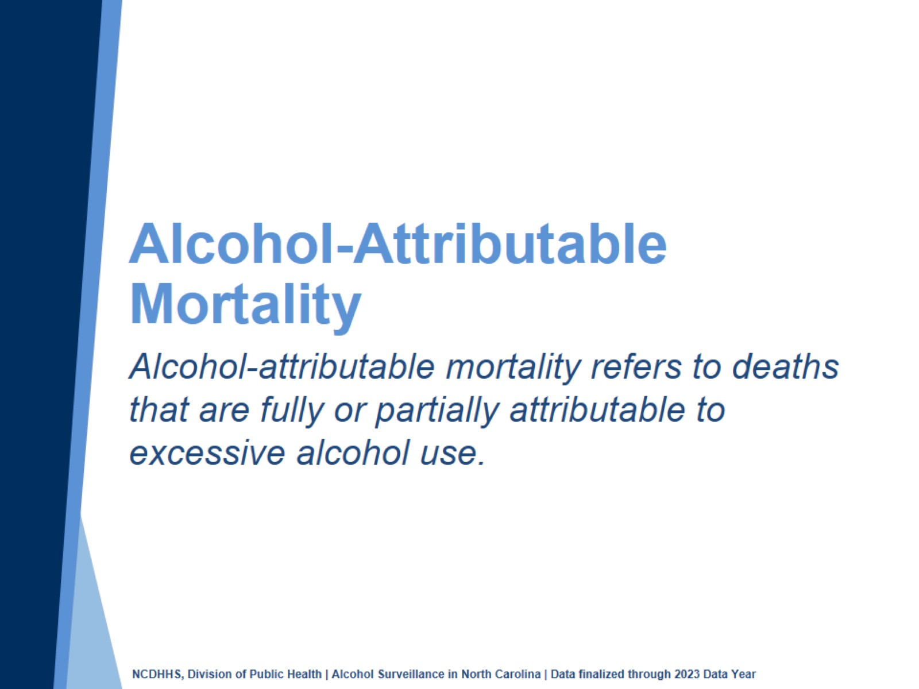
Notes:
Speaker’s notes: NC State Center for Health Statistics death certificate data are also leveraged for alcohol surveillance by applying CDC’s Alcohol-Related Disease Impact (ARDI) methodology. Alcohol-related mortality refers to deaths that are fully or partially attributable to alcohol use. Fully alcohol-attributable deaths are deaths that would not occur in the absence of alcohol, such as alcoholic liver disease or alcohol poisoning. Partially alcohol-attributable deaths are deaths where alcohol is a contributing factor in a proportion of the deaths from those conditions, such as certain types of cancer and heart disease.
Technical notes: For more information on the ARDI methodology, please visit https://nccd.cdc.gov/DPH_ARDI/default/default.aspx.

Slide 12
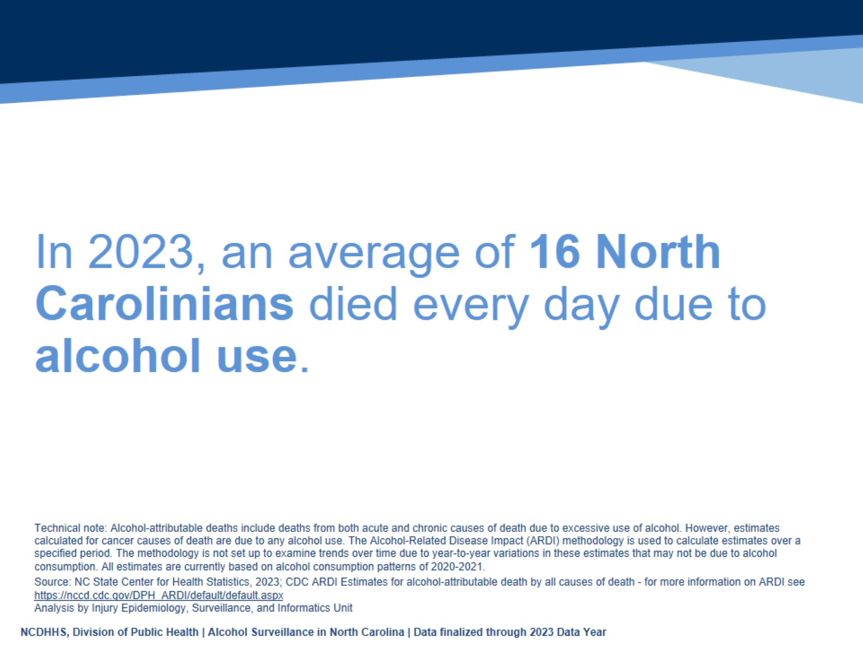
In 2023, an average of 16 North Carolinians died every day due to alcohol use.
Notes:
Speaker’s notes: In 2023, there were over 5,800 alcohol-attributable deaths in North Carolina. That is an average of 16 North Carolinians dying every day due to alcohol use.
Technical notes: Alcohol-attributable deaths include deaths from 58 acute and chronic causes of death due to excessive use of alcohol. However, estimates calculated for cancer causes of death are due to any alcohol use based on evidence that shows cancer is linked even to low levels of alcohol use. The Alcohol-Related Disease Impact (ARDI) methodology is used to calculate estimates over a specified period. The methodology is not set up to examine trends over time due to year-to-year variations in these estimates that may not be due to alcohol use. All estimates are currently based on alcohol use patterns of 2020-2021. All death estimates are directly related to alcohol, but estimates are calculated with either direct or indirect alcohol-attributable fractions (AAFs). AAFs are used to express the extent to which alcohol use contributes to a health outcome. Direct AAFs are based on scientific studies that have directly measured the relationship between excessive alcohol use and a given health outcome. Indirect AAFs use pooled risk estimates obtained from meta-analyses on the relationship between alcohol and various causes as well as data on the prevalence of alcohol use at specific levels. All AAFs, except the AAF for motor vehicle crashes, are national, not state-specific. For more information on the ARDI methodology, please visit https://nccd.cdc.gov/DPH_ARDI/default/default.aspx.
The Division of Public Health Alcohol Data Dashboard (https://www.dph.ncdhhs.gov/programs/chronic-disease-and-injury/injury-and-violence-prevention-branch/north-carolina-alcohol-and-related-harms-data) and Alcohol Use Webpage (https://injuryfreenc.dph.ncdhhs.gov/DataSurveillance/alcohol.htm) share state and county-level estimates of acute, chronic, and total alcohol-attributable deaths.

Slide 13
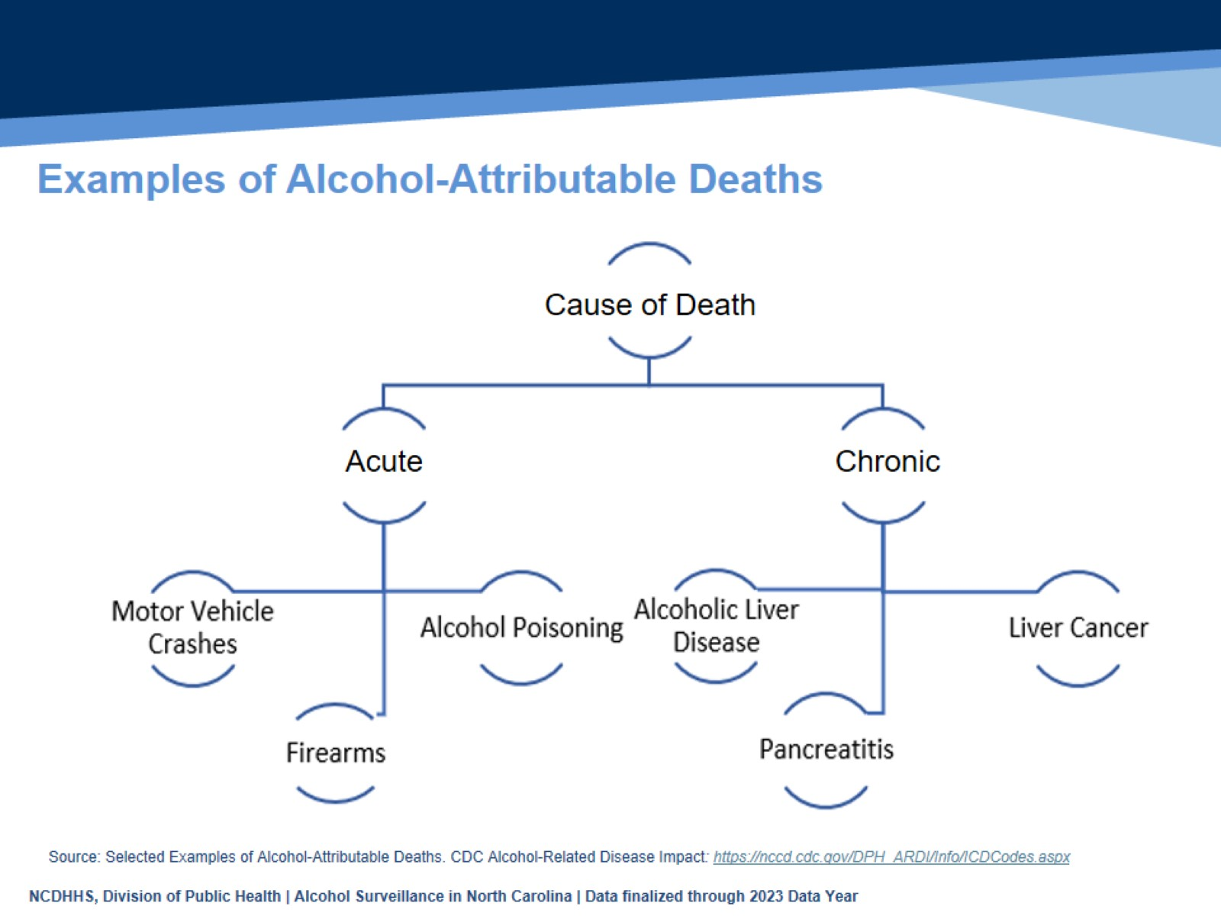
Examples of Alcohol-Attributable Deaths
Notes:
Speaker’s notes: Of the alcohol-attributable deaths, some causes of death are acute, like falls, motor vehicle crashes, or alcohol poisoning. However, the majority of the alcohol-attributable deaths are due to chronic conditions. Some, like alcohol abuse or alcohol-induced pancreatitis, are 100% attributable to alcohol use, while others, like liver disease, certain cancers, and strokes, are partially attributable to alcohol use.
Technical notes: Alcohol-attributable deaths include deaths from 58 acute and chronic causes of death due to excessive use of alcohol. However, estimates calculated for cancer causes of death are due to any alcohol use based on evidence that shows cancer is linked even to low levels of alcohol use. The Alcohol-Related Disease Impact (ARDI) methodology is used to calculate estimates over a specified period. The methodology is not set up to examine trends over time due to year-to-year variations in these estimates that may not be due to alcohol use. All estimates are currently based on alcohol use patterns of 2020-2021. All death estimates are directly related to alcohol, but estimates are calculated with either direct or indirect alcohol-attributable fractions (AAFs). AAFs are used to express the extent to which alcohol use contributes to a health outcome. Direct AAFs are based on scientific studies that have directly measured the relationship between excessive alcohol use and a given health outcome. Indirect AAFs use pooled risk estimates obtained from meta-analyses on the relationship between alcohol and various causes as well as data on the prevalence of alcohol use at specific levels. All AAFs, except the AAF for motor vehicle crashes, are national, not state-specific. For more information on the ARDI methodology, please visit https://nccd.cdc.gov/DPH_ARDI/default/default.aspx.
The Division of Public Health Alcohol Data Dashboard (https://www.dph.ncdhhs.gov/programs/chronic-disease-and-injury/injury-and-violence-prevention-branch/north-carolina-alcohol-and-related-harms-data) and Alcohol Use Webpage (https://injuryfreenc.dph.ncdhhs.gov/DataSurveillance/alcohol.htm) share state and county-level estimates of acute, chronic, and total alcohol-attributable deaths.

Slide 14
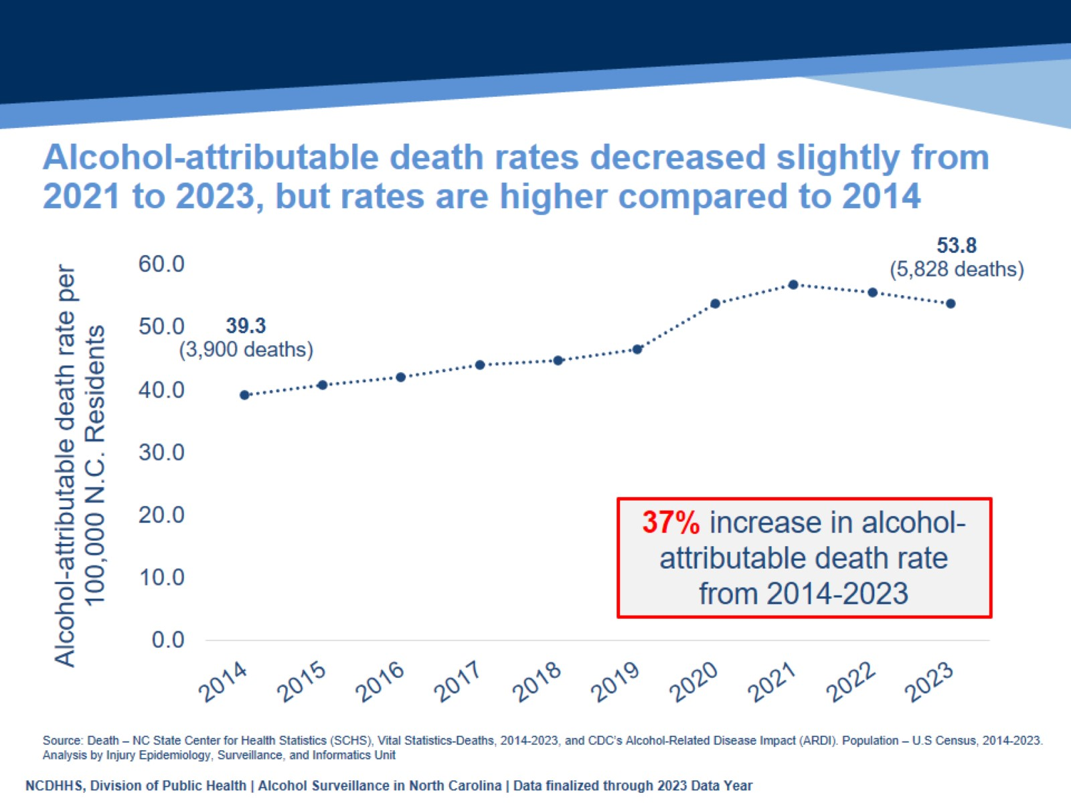
Alcohol-attributable death rates decreased slightly from 2021 to 2023, but rates are higher compared to 2014
Notes:
Speaker’s notes: Using CDC’s Alcohol-Related Disease Impact (ARDI) methodology, the alcohol-attributable death rate was 53.8 deaths per 100,000 population in 2023, an estimated 5,828 deaths. Alcohol-attributable death rates have increased 37% since the 2014 death rate of 39.3 deaths per 100,000 population, an estimated 3,900 deaths.
Technical notes: Alcohol-attributable deaths include deaths from 58 acute and chronic causes of death due to excessive use of alcohol. However, estimates calculated for cancer causes of death are due to any alcohol use based on evidence that shows cancer is linked even to low levels of alcohol use. The Alcohol-Related Disease Impact (ARDI) methodology is used to calculate estimates over a specified period. The methodology is not set up to examine trends over time due to year-to-year variations in these estimates that may not be due to alcohol use. All estimates are currently based on alcohol use patterns of 2020-2021. All death estimates are directly related to alcohol, but estimates are calculated with either direct or indirect alcohol-attributable fractions (AAFs). AAFs are used to express the extent to which alcohol use contributes to a health outcome. Direct AAFs are based on scientific studies that have directly measured the relationship between excessive alcohol use and a given health outcome. Indirect AAFs use pooled risk estimates obtained from meta-analyses on the relationship between alcohol and various causes as well as data on the prevalence of alcohol use at specific levels. All AAFs, except the AAF for motor vehicle crashes, are national, not state-specific. For more information on the ARDI methodology, please visit https://nccd.cdc.gov/DPH_ARDI/default/default.aspx.
The Division of Public Health Alcohol Data Dashboard (https://www.dph.ncdhhs.gov/programs/chronic-disease-and-injury/injury-and-violence-prevention-branch/north-carolina-alcohol-and-related-harms-data) and Alcohol Use Webpage (https://injuryfreenc.dph.ncdhhs.gov/DataSurveillance/alcohol.htm) share state and county- level estimates of acute, chronic, and total alcohol-attributable deaths.

Slide 15
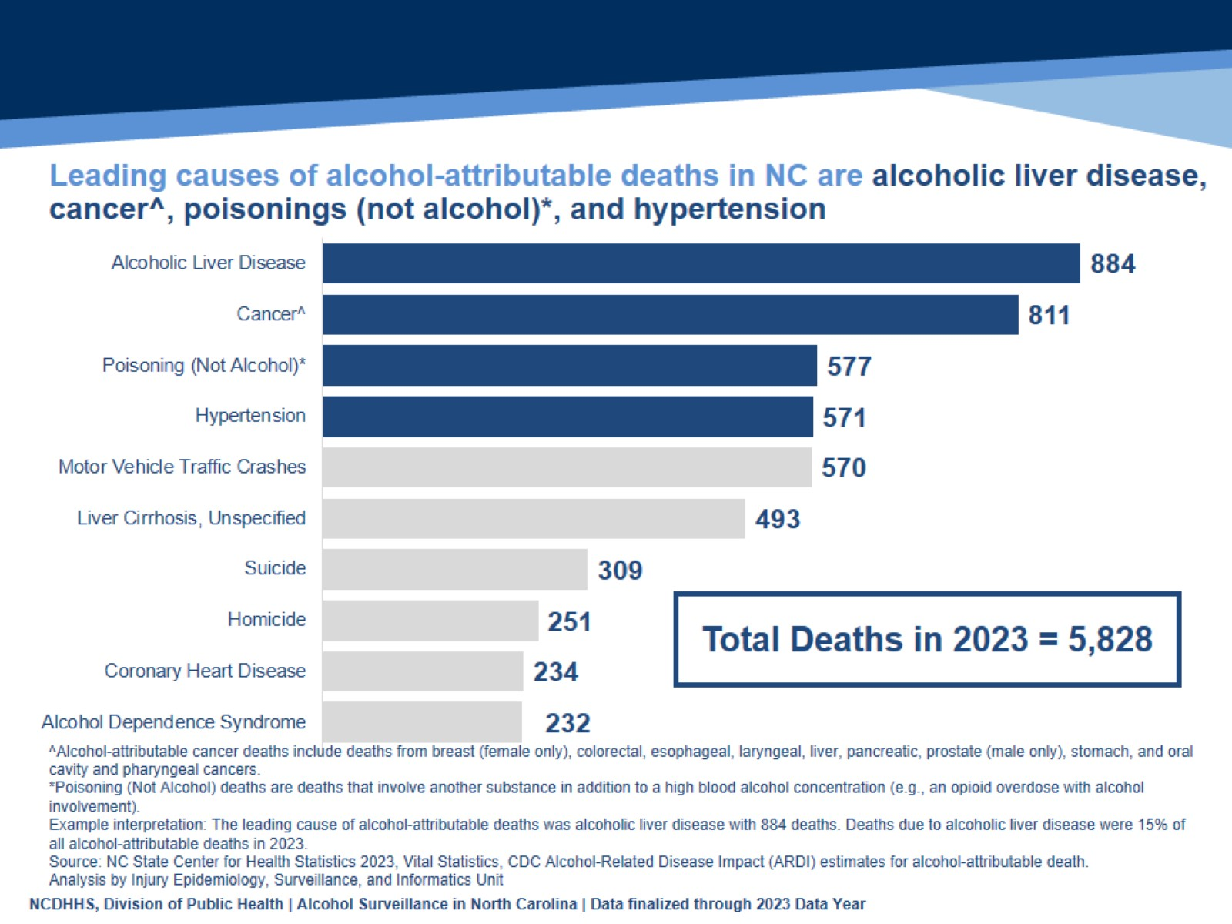
Leading causes of alcohol-attributable deaths in NC are alcoholic liver disease, cancer^, poisonings (not alcohol)*, and hypertension
Notes:
Speaker’s notes: Leading causes of alcohol-attributable deaths in NC are alcoholic liver disease, cancer, poisonings (not alcohol), and hypertension.
884 of alcohol-attributable deaths in 2023 were due to alcoholic liver disease. Deaths due to alcoholic liver disease were 15% of all alcohol-attributable deaths in 2023.
Technical Notes: Alcohol-attributable deaths include deaths from 58 acute and chronic causes of death due to excessive use of alcohol. However, estimates calculated for cancer causes of death are due to any alcohol use based on evidence that shows cancer is linked even to low levels of alcohol use. The Alcohol-Related Disease Impact (ARDI) methodology is used to calculate estimates over a specified period. The methodology is not set up to examine trends over time due to year-to-year variations in these estimates that may not be due to alcohol use. All estimates are currently based on alcohol use patterns of 2020-2021. All death estimates are directly related to alcohol, but estimates are calculated with either direct or indirect alcohol-attributable fractions (AAFs). AAFs are used to express the extent to which alcohol use contributes to a health outcome. Direct AAFs are based on scientific studies that have directly measured the relationship between excessive alcohol use and a given health outcome. Indirect AAFs use pooled risk estimates obtained from meta-analyses on the relationship between alcohol and various causes as well as data on the prevalence of alcohol use at specific levels. All AAFs, except the AAF for motor vehicle crashes, are national, not state-specific. For more information on the ARDI methodology, please visit https://nccd.cdc.gov/DPH_ARDI/default/default.aspx.
The Division of Public Health Alcohol Data Dashboard (https://www.dph.ncdhhs.gov/programs/chronic-disease-and-injury/injury-and-violence-prevention-branch/north-carolina-alcohol-and-related-harms-data) and Alcohol Use Webpage (https://injuryfreenc.dph.ncdhhs.gov/DataSurveillance/alcohol.htm) share state and county-level estimates of acute, chronic, and total alcohol-attributable deaths.

Slide 16
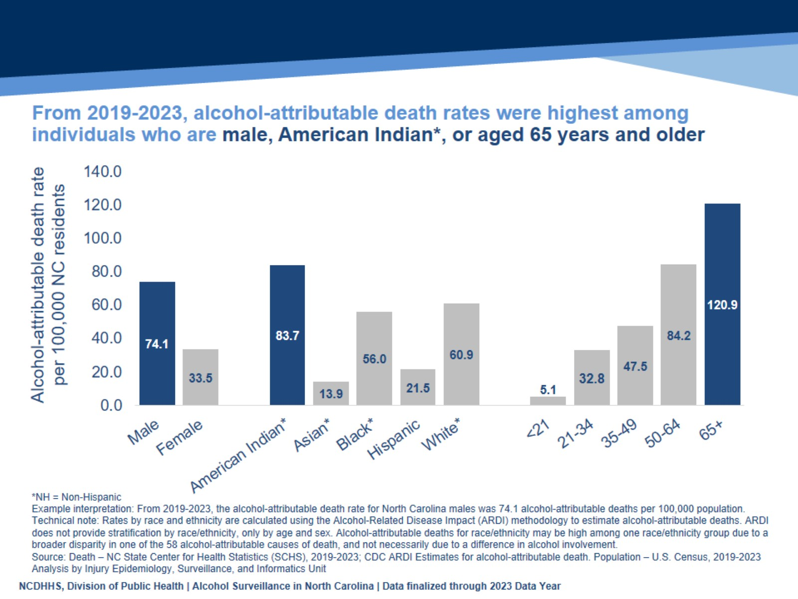
From 2019-2023, alcohol-attributable death rates were highest among individuals who are male, American Indian*, or aged 65 years and older
Notes:
Speaker’s notes: Looking at the most recent five years of available data (2019-2023), we can analyze descriptive trends within these alcohol-attributable deaths. Males have a higher rate of alcohol attributable deaths, at 74.1 per 100,000 population, compared with females at a little under half of that. American Indian non-Hispanic (NH) residents have a higher rate of alcohol attributable death, at 83.7 per 100,000 population, with the next highest group being White NH residents at 60.9 per 100,000 population. Socioeconomic conditions and historical trauma have led to persistent racial and ethnic disparities. These inequities, along with other factors, have contributed to the observed health disparity in alcohol-attributable death rates. Rates of alcohol-attributable death increased by age group. Even though the percent of older adults who report excessive drinking is low, the rates of alcohol-related death are high among this group. This is because the Alcohol-Related Disease Impact (ARDI) methodology considers both chronic and acute causes of death that are attributable to alcohol.
Technical notes: Alcohol-attributable deaths include deaths from 58 acute and chronic causes of death due to excessive use of alcohol. However, estimates calculated for cancer causes of death are due to any alcohol use based on evidence that shows cancer is linked even to low levels of alcohol use. The Alcohol-Related Disease Impact (ARDI) methodology is used to calculate estimates over a specified period. The methodology is not set up to examine trends over time due to year-to-year variations in these estimates that may not be due to alcohol use. All estimates are currently based on alcohol use patterns of 2020-2021. All death estimates are directly related to alcohol, but estimates are calculated with either direct or indirect alcohol-attributable fractions (AAFs). AAFs are used to express the extent to which alcohol use contributes to a health outcome. Direct AAFs are based on scientific studies that have directly measured the relationship between excessive alcohol use and a given health outcome. Indirect AAFs use pooled risk estimates obtained from meta-analyses on the relationship between alcohol and various causes as well as data on the prevalence of alcohol use at specific levels. All AAFs, except the AAF for motor vehicle crashes, are national, not state specific. For more information on the ARDI methodology, please visit https://nccd.cdc.gov/DPH_ARDI/default/default.aspx.
Rates were calculated for 2019 to 2023 by sex, age, and race/ethnicity using the ARDI methodology to estimate alcohol-attributable deaths. ARDI methodology only includes sex- and age-specific AAFs, which aid in the calculation of alcohol-attributable deaths. Due to AAFs not being available by race/ethnicity, alcohol-attributable deaths may be higher amongst one race/ethnicity due to a broader disparity in one of the 58 alcohol-attributable causes of death, and not necessarily attributable to alcohol's involvement. For example, one race/ethnicity may have a higher rate of drowning (acute cause of death), which would lead to a higher total and acute alcohol-attributable rate estimate. In addition, with race/ethnicity data, demographic misclassifications could have occurred during the death certification process. For more information on the ARDI methodology, please visit https://nccd.cdc.gov/DPH_ARDI/default/default.aspx.
The NC Division of Public Health Alcohol Data Dashboard (https://www.dph.ncdhhs.gov/programs/chronic-disease-and-injury/injury-and-violence-prevention-branch/north-carolina-alcohol-and-related-harms-data) and Alcohol Use Webpage (https://injuryfreenc.dph.ncdhhs.gov/DataSurveillance/alcohol.htm) share state and county level estimates of acute, chronic, and total alcohol-attributable deaths.

Slide 17
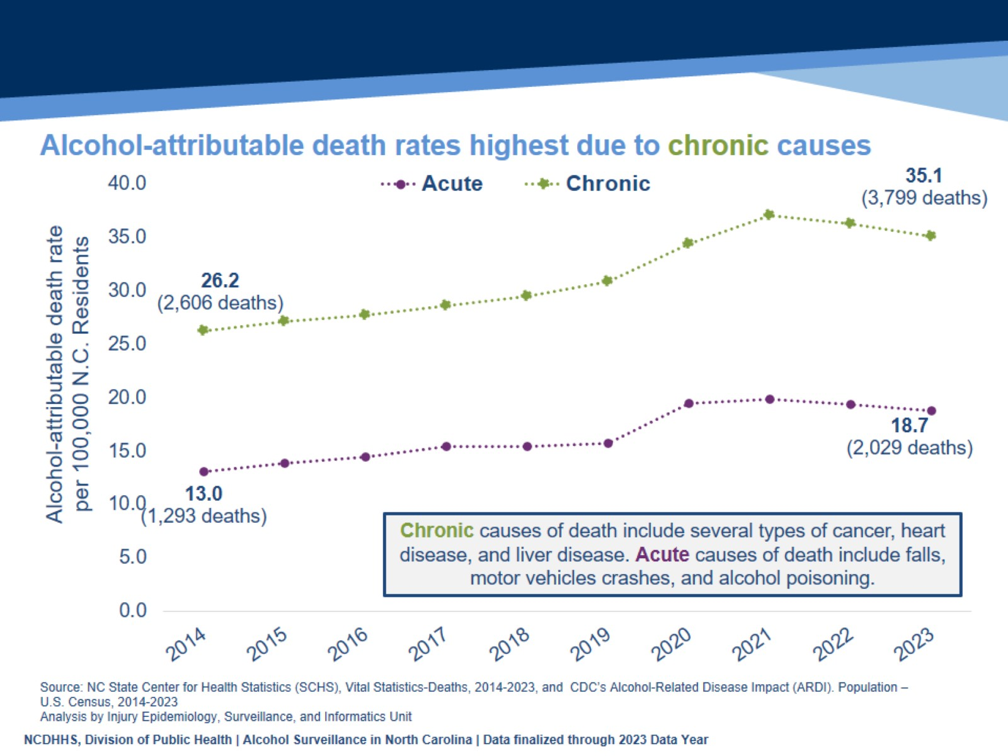
Alcohol-attributable death rates highest due to chronic causes
Notes:
Speaker’s Notes: From 2014 to 2023, alcohol-attributable death rates were highest due to chronic causes. However, rates increased for both chronic and acute causes of alcohol-attributable death, a 34% increase for chronic causes and a 44% increase for acute causes. For chronic causes, the rate increased from 26.2, an estimated 2,606 deaths, to 35.1, an estimated 3,799 deaths, per 100,000 population. For acute causes, the rate increased from 13.0, an estimated 1,293 deaths, to 18.7, an estimated 2,029 deaths, per 100,000 population.
Technical Notes: Alcohol-attributable deaths include deaths from 58 acute and chronic causes of death due to excessive use of alcohol. However, estimates calculated for cancer causes of death are due to any alcohol use based on evidence that shows cancer is linked even to low levels of alcohol use. The Alcohol-Related Disease Impact (ARDI) methodology is used to calculate estimates over a specified period. The methodology is not set up to examine trends over time due to year-to-year variations in these estimates that may not be due to alcohol use. All estimates are currently based on alcohol use patterns of 2020-2021. All death estimates are directly related to alcohol, but estimates are calculated with either direct or indirect alcohol-attributable fractions (AAFs). AAFs are used to express the extent to which alcohol use contributes to a health outcome. Direct AAFs are based on scientific studies that have directly measured the relationship between excessive alcohol use and a given health outcome. Indirect AAFs use pooled risk estimates obtained from meta-analyses on the relationship between alcohol and various causes as well as data on the prevalence of alcohol use at specific levels. All AAFs, except the AAF for motor vehicle crashes, are national, not state-specific. For more information on the ARDI methodology, please visit https://nccd.cdc.gov/DPH_ARDI/default/default.aspx.
The Division of Public Health Alcohol Data Dashboard (https://www.dph.ncdhhs.gov/programs/chronic-disease-and-injury/injury-and-violence-prevention-branch/north-carolina-alcohol-and-related-harms-data) and Alcohol Use Webpage (https://injuryfreenc.dph.ncdhhs.gov/DataSurveillance/alcohol.htm) share state and county-level estimates of acute, chronic, and total alcohol-attributable deaths. Chronic alcohol-attributable deaths often result from long-term, excessive use of alcohol. However, estimates calculated for cancer causes of death, which are chronic causes of death, are due to any alcohol use based on evidence that shows cancer is linked to low levels of alcohol use. Acute alcohol-attributable deaths often result from short-term, excessive use of alcohol.

Slide 18
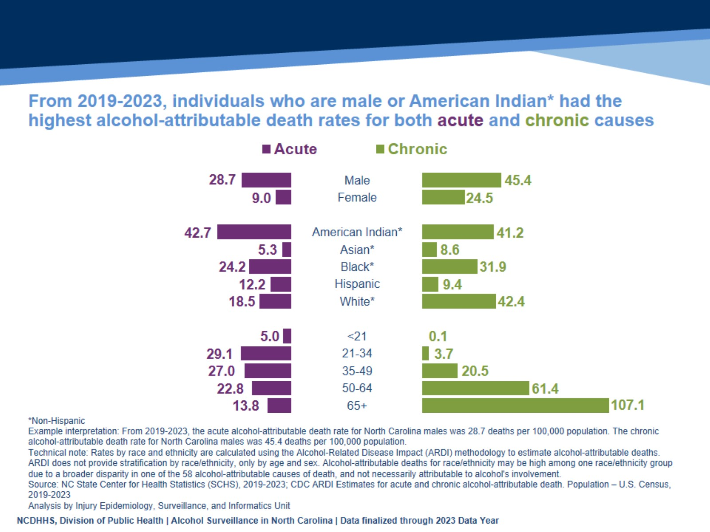
From 2019-2023, individuals who are male or American Indian* had the highest alcohol-attributable death rates for both acute and chronic causes
Notes:
Speaker’s notes: Looking at the most recent five years of available data (2019-2023), we can analyze descriptive trends within acute and chronic alcohol-attributable deaths. Acute and chronic alcohol-attributable death rates were similar by sex, with male residents having higher rates than female residents.
Acute alcohol-attributable death rates were highest among individuals who are American Indian non-Hispanic (NH) or Black NH. Chronic alcohol-attributable death rates were highest among individuals who are American Indian NH or White NH. Socioeconomic conditions and historical trauma have led to persistent racial and ethnic disparities. These inequities, along with other factors, have contributed to the observed health disparity in both acute and chronic alcohol-attributable death rates.
Acute alcohol-attributable death rates were highest among those aged 21 to 34, with a death rate of 29.1 per 100,000 population. Among chronic alcohol-attributable deaths, the death rates increase with age, with a death rate of 107.1 per 100,000 population for people aged 65 and older.
Technical notes: Alcohol-attributable deaths include deaths from 58 acute and chronic causes of death due to excessive use of alcohol. However, estimates calculated for cancer causes of death are due to any alcohol use based on evidence that shows cancer is linked even to low levels of alcohol use. The Alcohol-Related Disease Impact (ARDI) methodology is used to calculate estimates over a specified period. The methodology is not set up to examine trends over time due to year-to-year variations in these estimates that may not be due to alcohol use. All estimates are currently based on alcohol use patterns of 2020-2021. All death estimates are directly related to alcohol, but estimates are calculated with either direct or indirect alcohol-attributable fractions (AAFs). AAFs are used to express the extent to which alcohol use contributes to a health outcome. Direct AAFs are based on scientific studies that have directly measured the relationship between excessive alcohol use and a given health outcome. Indirect AAFs use pooled risk estimates obtained from meta-analyses on the relationship between alcohol and various causes as well as data on the prevalence of alcohol use at specific levels. All AAFs, except the AAF for motor vehicle crashes, are national, not state-specific. For more information on the ARDI methodology, please visit https://nccd.cdc.gov/DPH_ARDI/default/default.aspx.
Rates were calculated for 2019 to 2023 by sex, age, and race/ethnicity using the ARDI methodology to estimate alcohol-attributable deaths. ARDI methodology only includes sex- and age-specific AAFs, which aid in the calculation of alcohol-attributable deaths. Due to AAFs not being available by race/ethnicity, alcohol-attributable deaths may be higher amongst one race/ethnicity due to a broader disparity in one of the 58 alcohol-attributable causes of death and not necessarily attributable to alcohol's involvement. For example, one race/ethnicity may have a higher rate of drowning (acute cause of death), which would lead to a higher total and acute alcohol-attributable rate estimate. In addition, with race/ethnicity data, demographic misclassifications could have occurred during the death certification process. For more information on the ARDI methodology, please visit https://nccd.cdc.gov/DPH_ARDI/default/default.aspx.
The Division of Public Health Alcohol Data Dashboard (https://www.dph.ncdhhs.gov/programs/chronic-disease-and-injury/injury-and-violence-prevention-branch/north-carolina-alcohol-and-related-harms-data) and Alcohol Use Webpage (https://injuryfreenc.dph.ncdhhs.gov/DataSurveillance/alcohol.htm) share state and county-level estimates of acute, chronic, and total alcohol-attributable deaths. Chronic alcohol-attributable deaths often result from long-term, excessive use of alcohol. However, estimates calculated for cancer causes of death, which are chronic causes of death, are due to any alcohol use based on evidence that shows cancer is linked to low levels of alcohol use. Acute alcohol-attributable deaths often result from short-term, excessive use of alcohol.

Slide 19
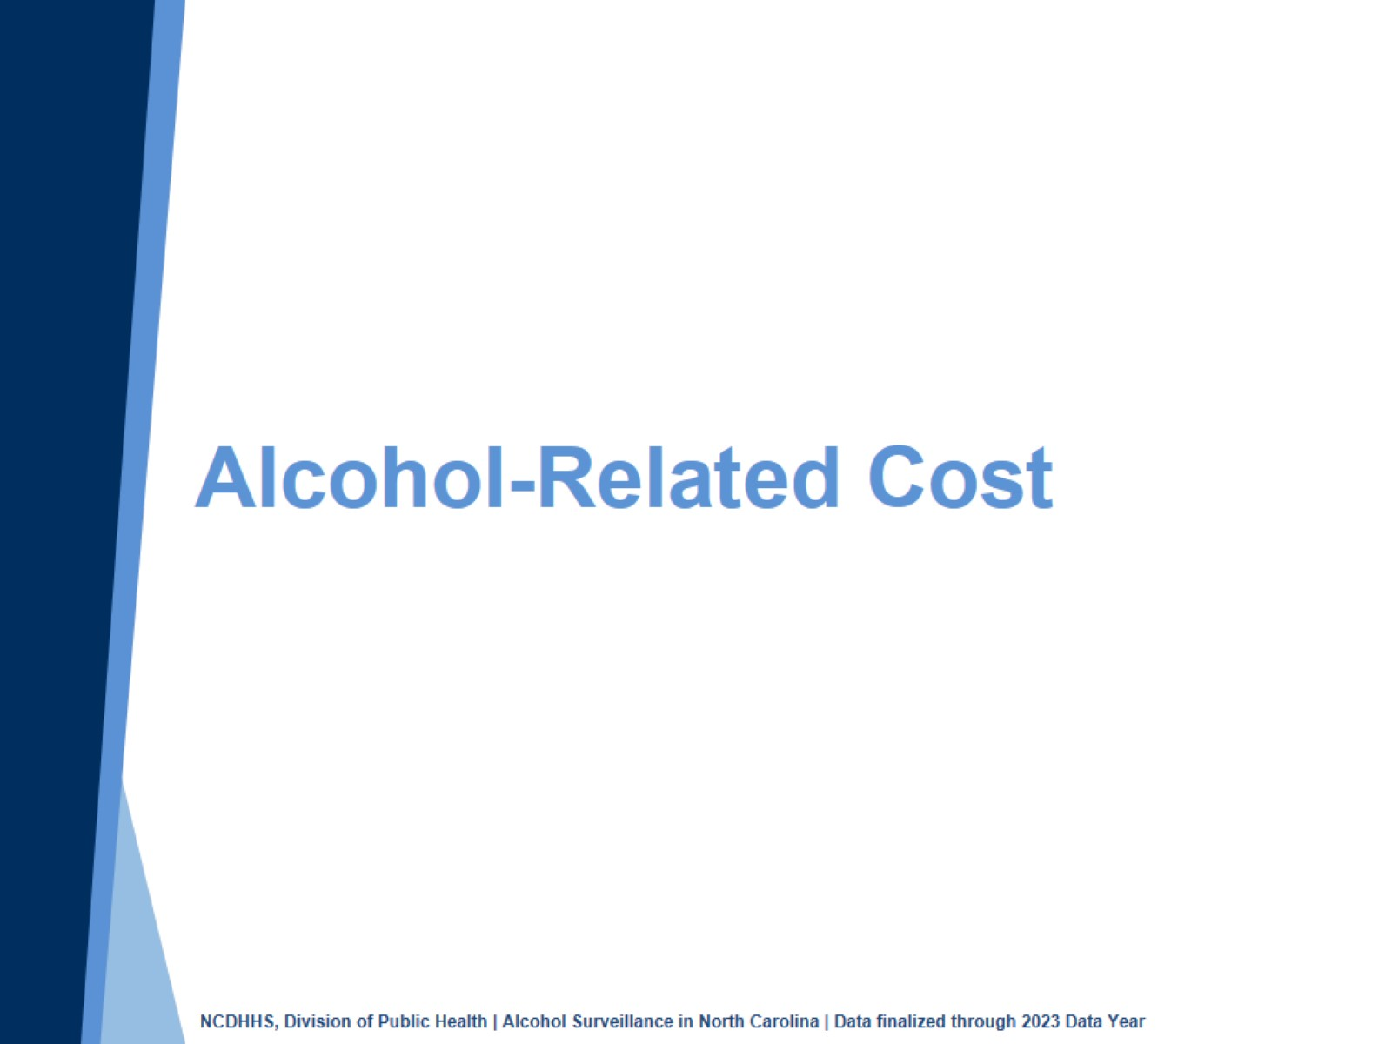
Notes:
Speaker’s notes: Excessive alcohol use can also impact the economy of North Carolina.

Slide 20
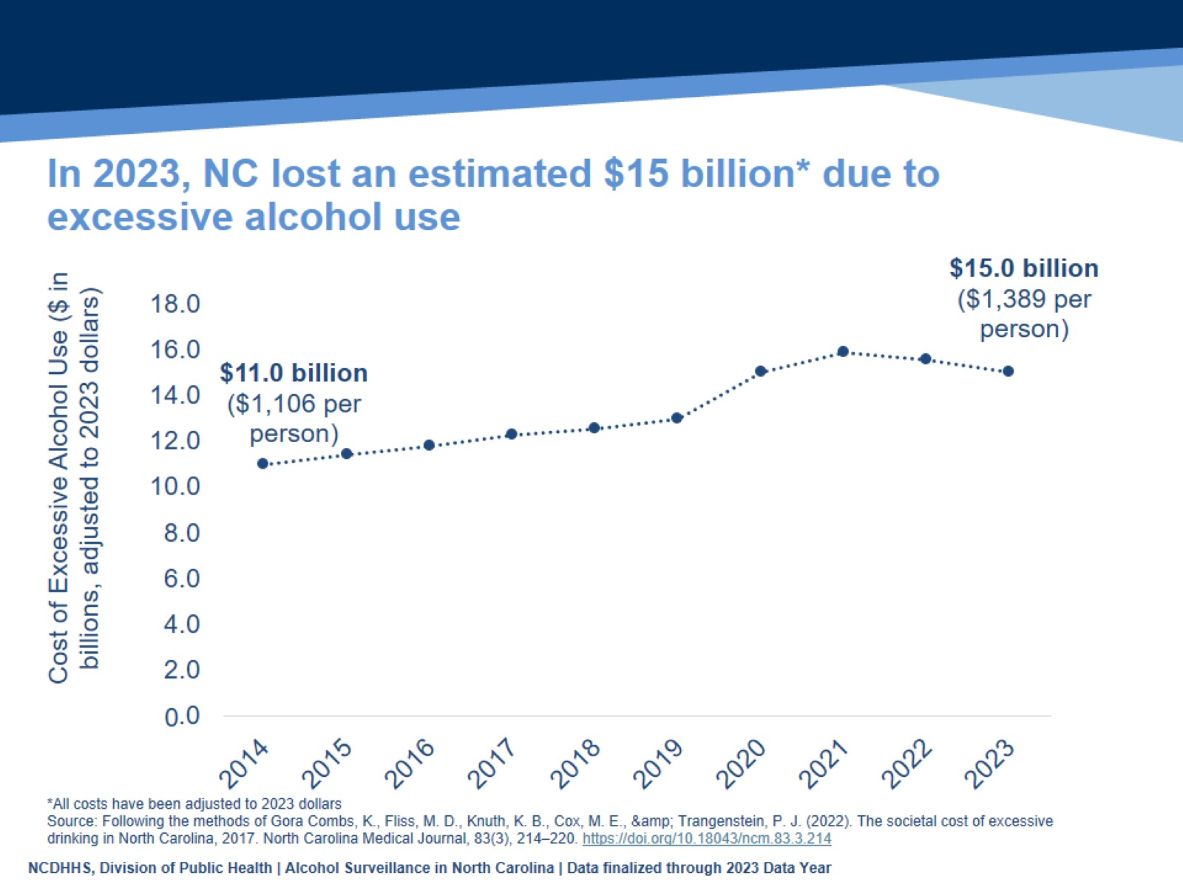
In 2023, NC lost an estimated $15 billion* due to excessive alcohol use
Notes:
Speaker’s notes: The economic cost of excessive alcohol use includes losses in productivity, healthcare costs, criminal justice expenses, and motor vehicle crashes for one year. In 2023, NC lost an estimated $15 billion due to excessive alcohol use, roughly $1,389 per person.
Technical notes: The numbers generated in this slide were estimated using the methods by Combs et. al, 2017 study, “The Societal Cost of Excessive Drinking in North Carolina, 2017” (https://pubmed.ncbi.nlm.nih.gov/35504714/), and adjusted to changes in inflation and alcohol-attributable death rates.

Slide 21
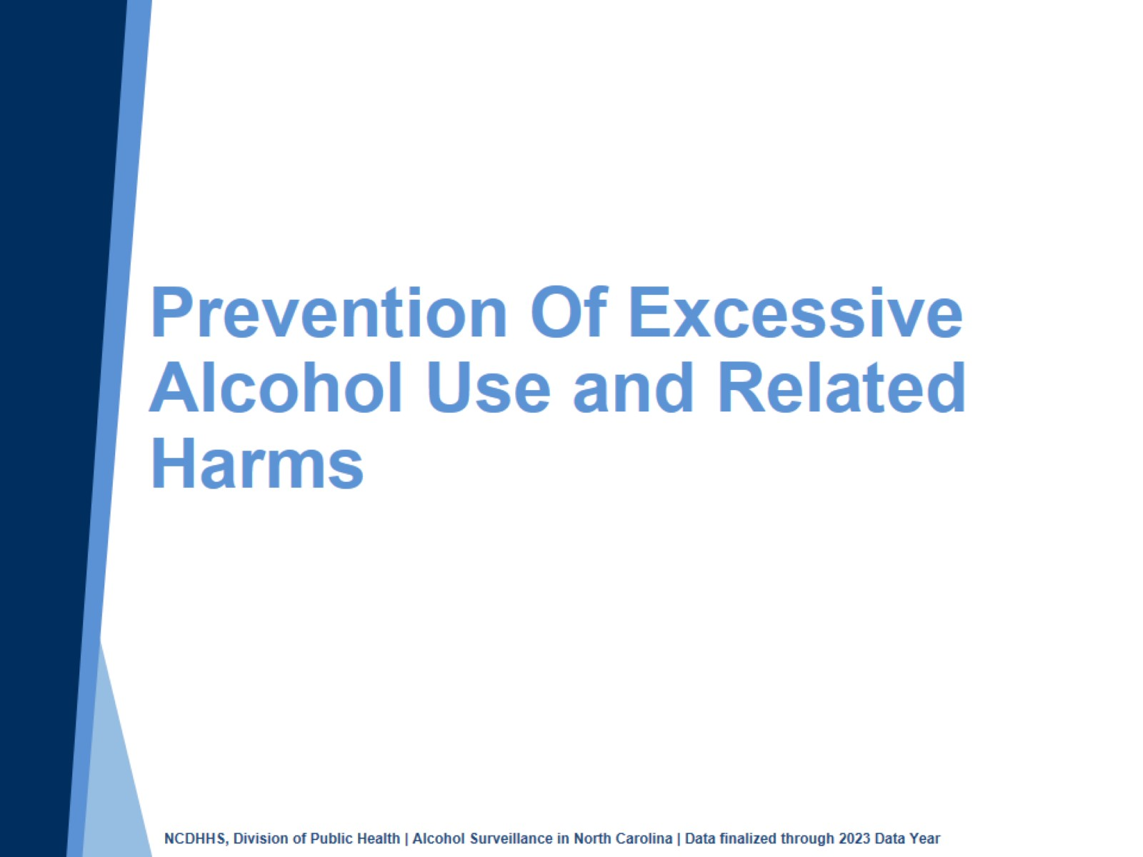
Prevention Of Excessive Alcohol Use and Related Harms
Notes:
Speaker’s notes: In light of these trends, there are numerous opportunities for prevention and reduction of excessive alcohol use and its related harms.

Slide 22
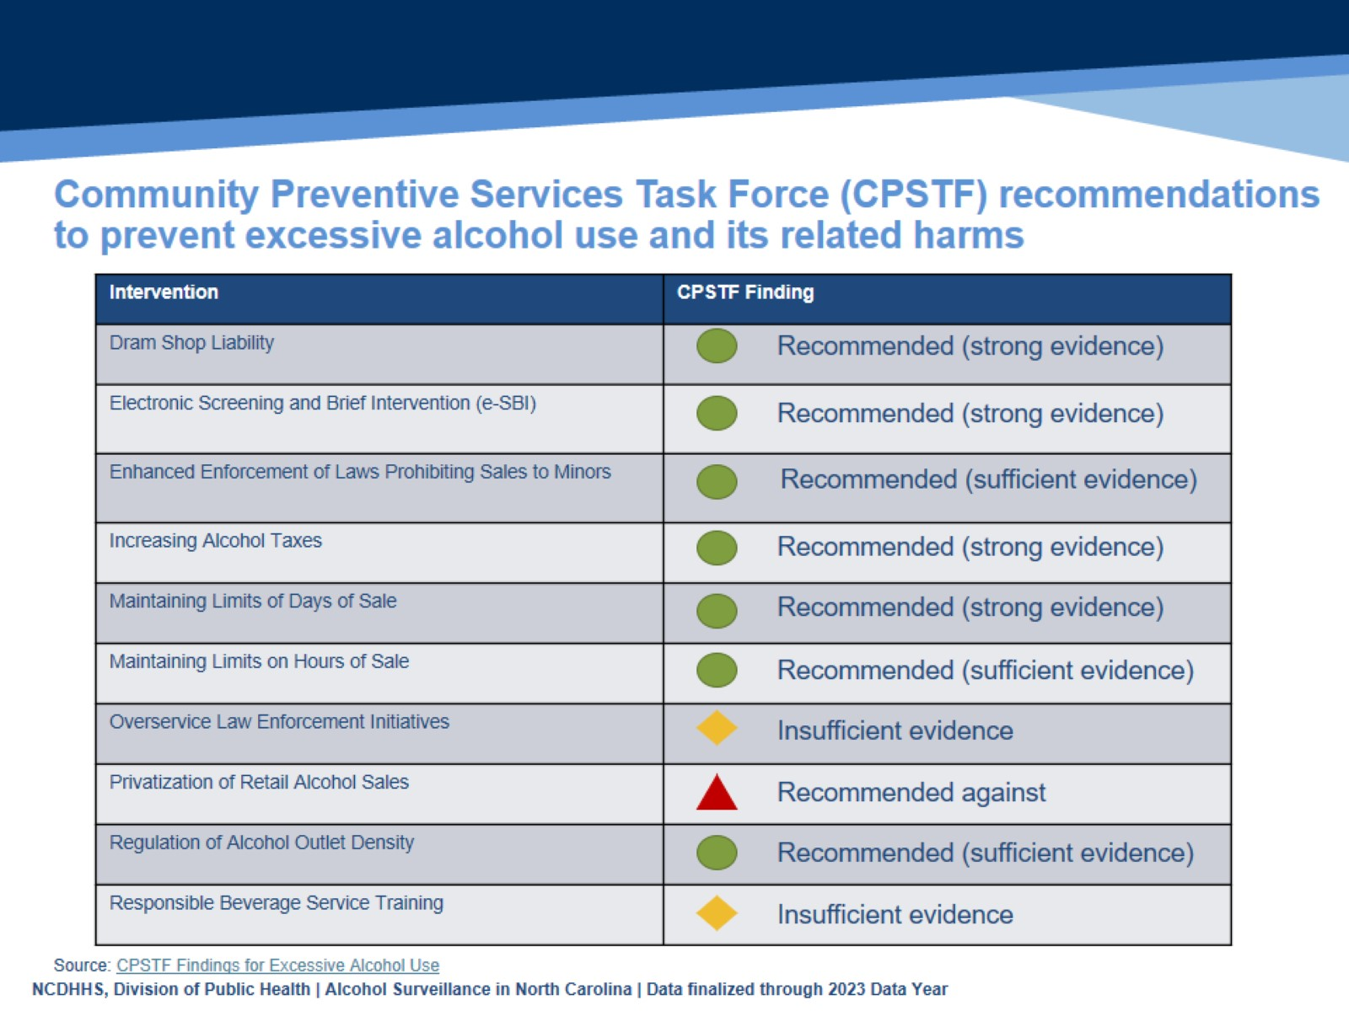
Community Preventive Services Task Force (CPSTF) recommendations to prevent excessive alcohol use and its related harms
Notes:
Speaker’s notes: The Community Preventive Services Task Force recommends several evidence-based strategies for reducing excessive drinking and its related harms. These recommendations focus on limiting access and availability to alcohol, which reduces excessive alcohol use and its related harms.
Technical notes: The Community Preventive Services Task Force (CPSTF) is an independent, non-federal, volunteer body of public health and prevention experts. CPSTF provides recommendations and findings on programs, services, and other interventions to protect and improve population health. The recommendations and findings are based on systematic reviews of evidence on the effectiveness and economic impact. For more information on CPSTF and excessive alcohol use prevention strategies, please visit https://www.thecommunityguide.org/topics/excessive-alcohol-consumption.html.

Slide 23
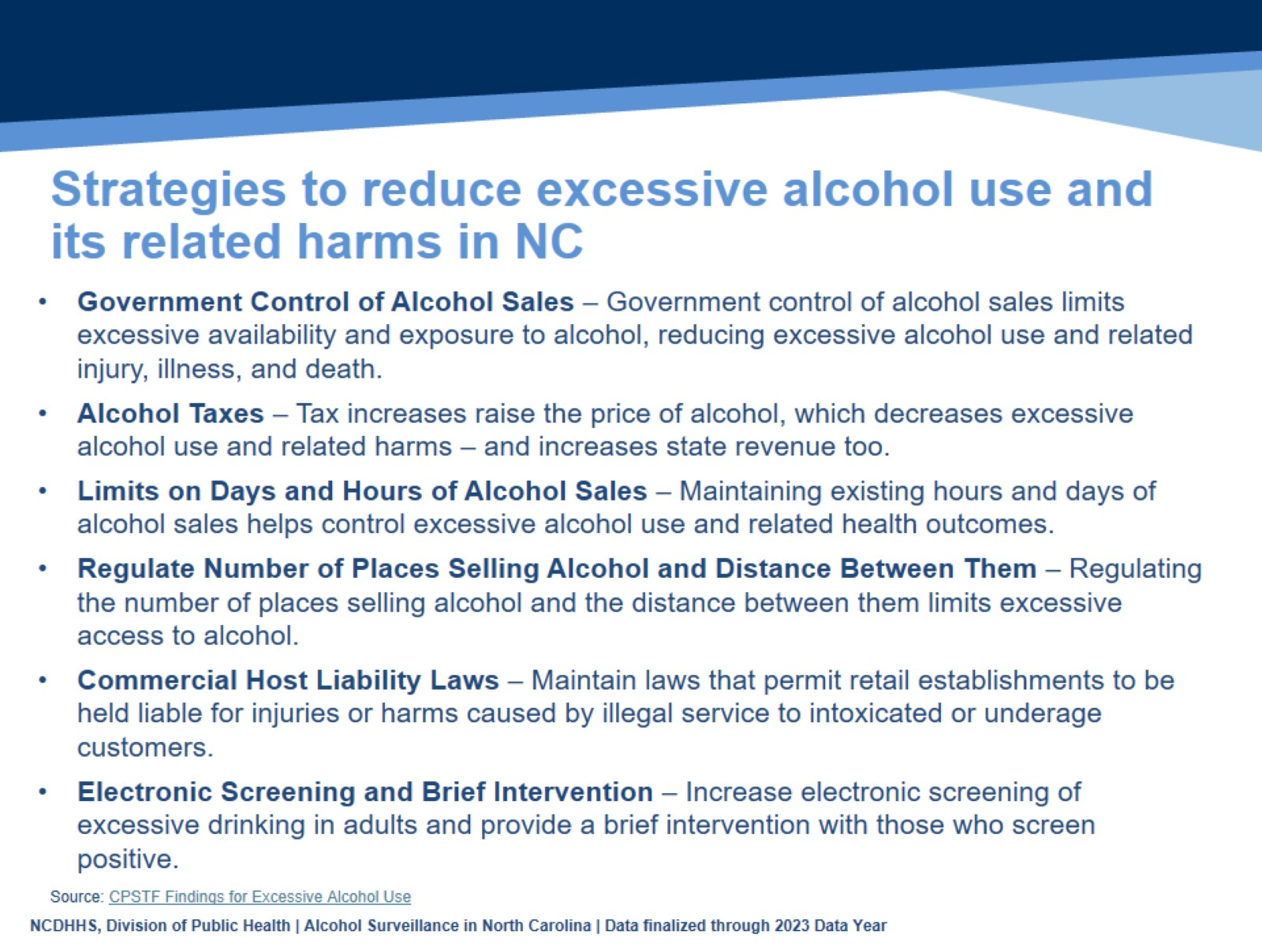
Strategies to reduce excessive alcohol use and its related harms in NC
Notes:
Speaker’s notes: The Community Preventive Services Task Force issued several evidence-based recommendations for reducing excessive drinking. When alcohol is less available, less accessible, and more expensive, people tend to drink less. The following proven strategies work to prevent excessive alcohol use to create communities that promote health and well-being:
Government Control of Alcohol Sales – In NC, the sale of liquor is limited to ABC stores where price is controlled by the Alcoholic Beverage Control (ABC) Commission. Government control of alcohol sales limits excessive availability and exposure to alcohol, which in turn reduces excessive alcohol use and related injury, illness, and death. Laws that privatize alcohol sales by removing government control increase the number of places that sell alcohol, which increases excessive alcohol use and alcohol-related harms, such as child maltreatment and neglect, domestic violence, and motor vehicle crashes.
Alcohol Taxes – An excise tax is levied on alcoholic beverages sold in and/or shipped into NC. Tax increases raise the price of alcohol, which decreases excessive alcohol use and related harms – and increases revenue too. Laws that decrease alcohol excise taxes lead to increases in motor vehicle crash deaths, violence, and lower state revenue.
Limit the days and hours of alcohol sales – NC limits the sale of alcohol to particular hours and days of the week and prohibits sales on certain holidays. Maintaining existing hours and days of alcohol sales helps control excessive alcohol use and negative health outcomes. Increases to hours and days of sale lead to increases in motor vehicle injuries, as well as alcohol-related assaults and other injuries.
Regulate Number of Places Selling Alcohol and Distance Between Them – Regulating the number of places selling alcohol and the distance between them limits excessive access to alcohol. Having more places that sell alcohol leads to increases in disorderly conduct, property damage, crime, and other community disruptions.
Commercial host liability laws – These laws permit retail establishments to be held liable for injuries or harms caused by illegal service to intoxicated or underage customers.
Electronic alcohol screening and brief intervention (e-SBI) – Increase electronic screening of excessive drinking in adults and provide a brief intervention with those who screen positive.
Technical notes: The Community Preventive Services Task Force (CPSTF) is an independent, non-federal, volunteer body of public health and prevention experts. CPSTF provides recommendations and findings on programs, services, and other interventions to protect and improve population health. The recommendations and findings are based on systematic reviews of evidence on the effectiveness and economic impact. For more information on CPSTF and excessive alcohol use prevention strategies, please visit https://www.thecommunityguide.org/topics/excessive-alcohol-consumption.html
.

Slide 24
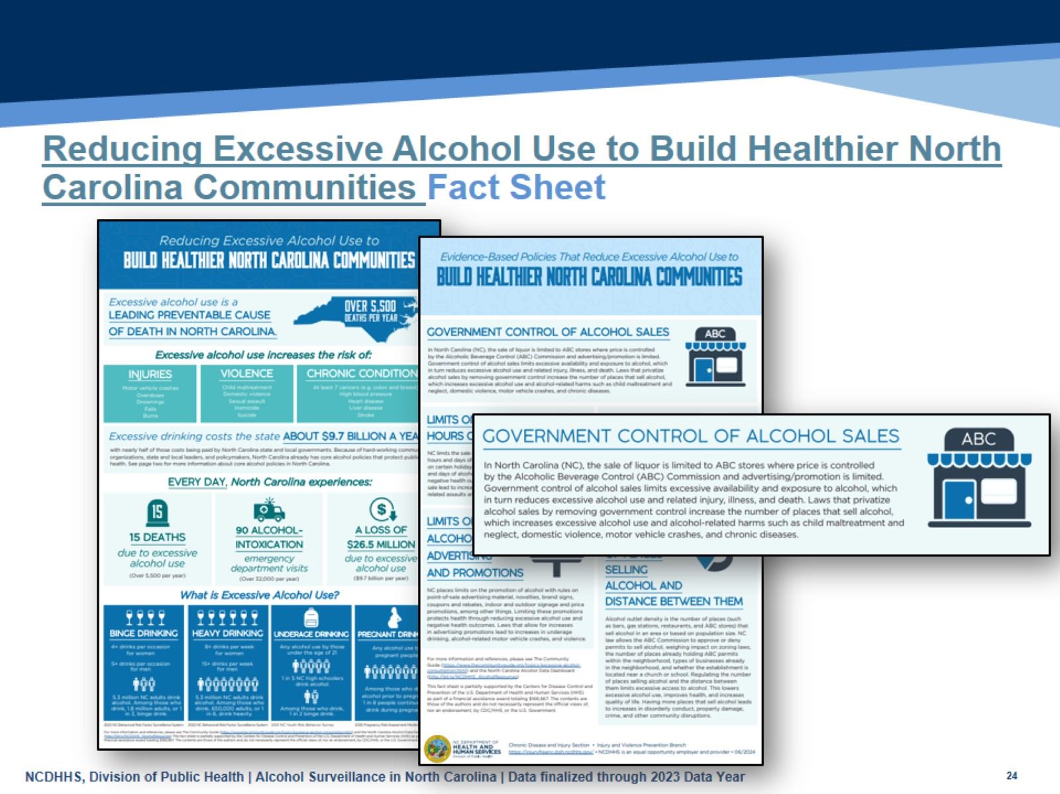
Reducing Excessive Alcohol Use to Build Healthier North Carolina Communities Fact Sheet
Notes:
Speaker’s notes: The Reducing Excessive Alcohol Use to Build Healthier North Carolina Communities fact sheet provides an overview of excessive alcohol use, the evidence-based policies to reduce excessive alcohol use, and the status of those policies in NC.
North Carolina has many existing core alcohol policies that protect public health due to the hard-work of many community advocates and policymakers. These policies focus on reducing the availability and accessibility of alcohol. The fact sheet focuses on the five following policies: government control of alcohol sales; limits on days and hours of sale; alcohol taxes; limits on promotions; and regulation of alcohol outlet density.
The fact sheet can be found at https://www.dph.ncdhhs.gov/reducing-excessive-alcohol-use-build-healthier-north-carolina-communities/open.

Slide 25
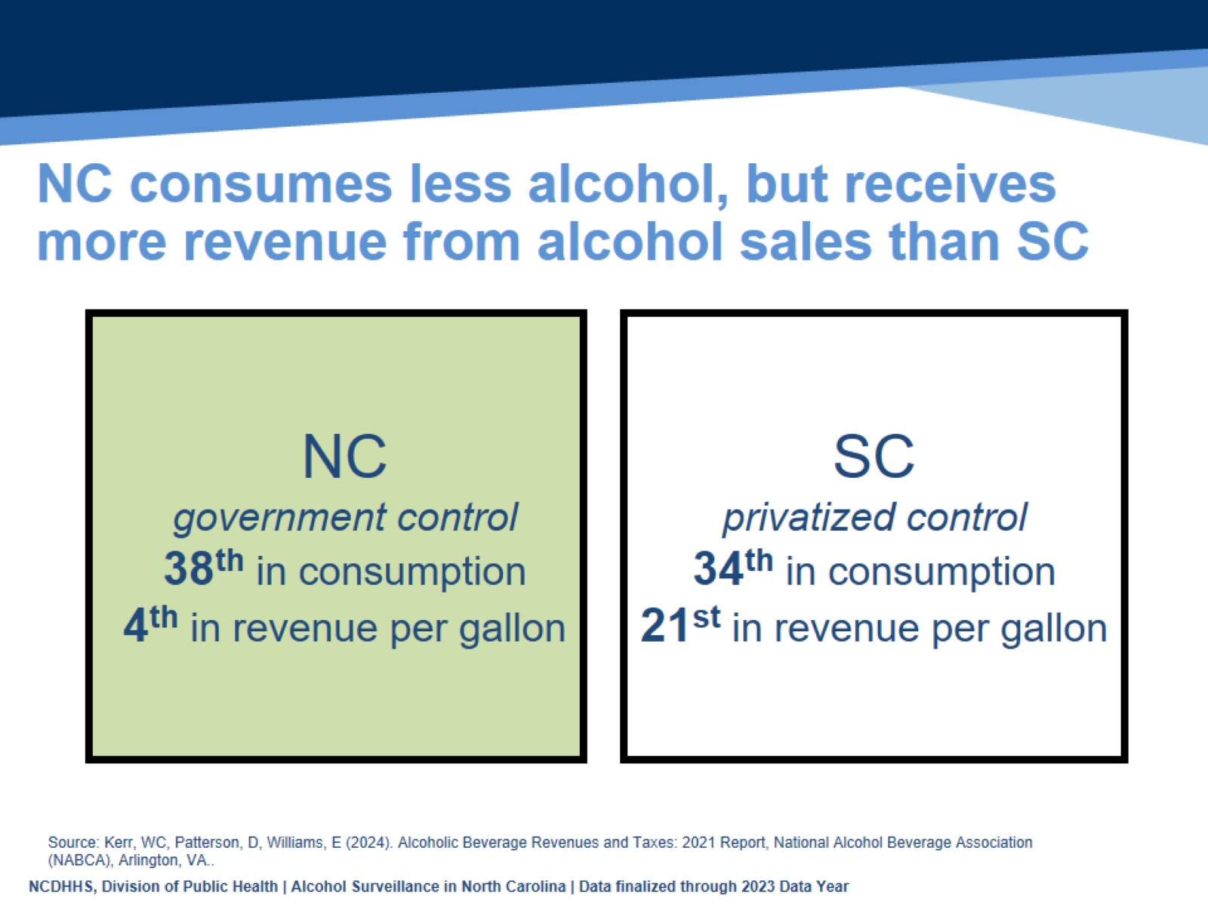
NC consumes less alcohol, but receives more revenue from alcohol sales than SC
Notes:
Speaker’s notes: North Carolina is one of 17 states with government-controlled alcohol sales, while South Carolina has a privatized system. Government control of alcohol sales means that government agencies control the sale of distilled spirits, and in some cases, wine and beer at the wholesale level. Privatized control of sales means that government control of alcohol sales have been repealed, allowing commercial agencies to sell alcoholic beverages.
North Carolinians consume less alcohol than South Carolinians, and North Carolina receives more revenue from alcohol sales than South Carolina. North Carolina ranks 38th per capita in gallons consumed and 4th in revenue per gallon, while South Carolina, ranks 34th in consumption and 21st in revenue.
Technical notes: The Alcoholic Beverage Revenues and Taxes: 2021 Report aims to provide comparable information regarding alcoholic beverage taxation and revenues for both control states and license states in the U.S..

Slide 26
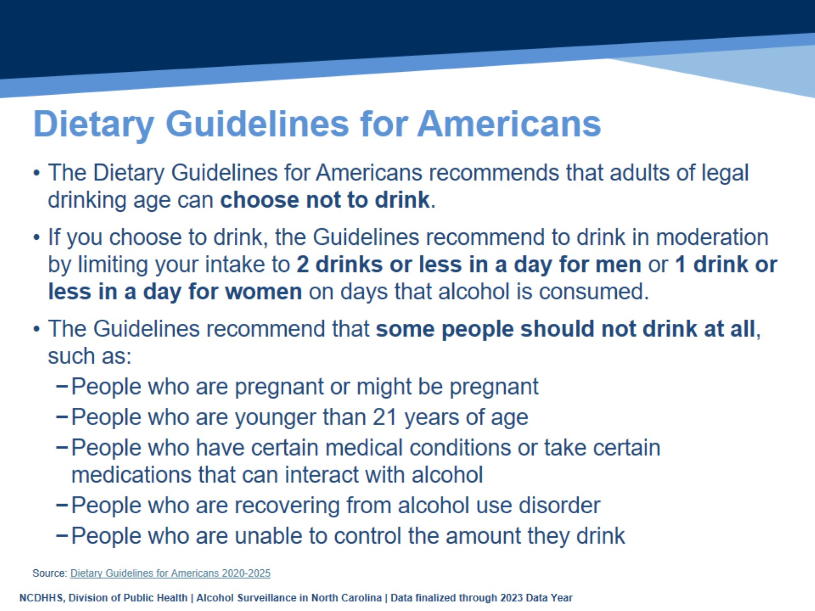
Dietary Guidelines for Americans
Notes:
Speaker’s notes: The Dietary Guidelines for Americans recommends that all adults of legal age (i.e., 21 years or older) can choose not to drink. If you choose to drink, it is recommended to drink in moderation by limiting your intake to 2 drinks or less in a day for men or 1 drink or less in a day for women on days when alcohol is consumed. The guidelines recommend that some people should not drink at all. This includes people that are pregnant or may be pregnant, people that are younger than 21, people that have certain medical conditions or take certain medications that can interact with alcohol, people that are recovering from alcohol use disorder, and people that are unable to control the amount they drink.
Technical note: The Dietary Guidelines for Americans provides advice on what to eat and drink to meet nutrient needs, promote health, and prevent disease. It is updated and released by the U.S. Department of Agriculture and U.S. Department of Health and Human Services every five years. Each edition reflects the current body of nutrition science. The most current edition, Dietary Guidelines for Americans 2020-2025 can be found at https://www.dietaryguidelines.gov/sites/default/files/2021-03/Dietary_Guidelines_for_Americans-2020-2025.pdf.

Slide 27
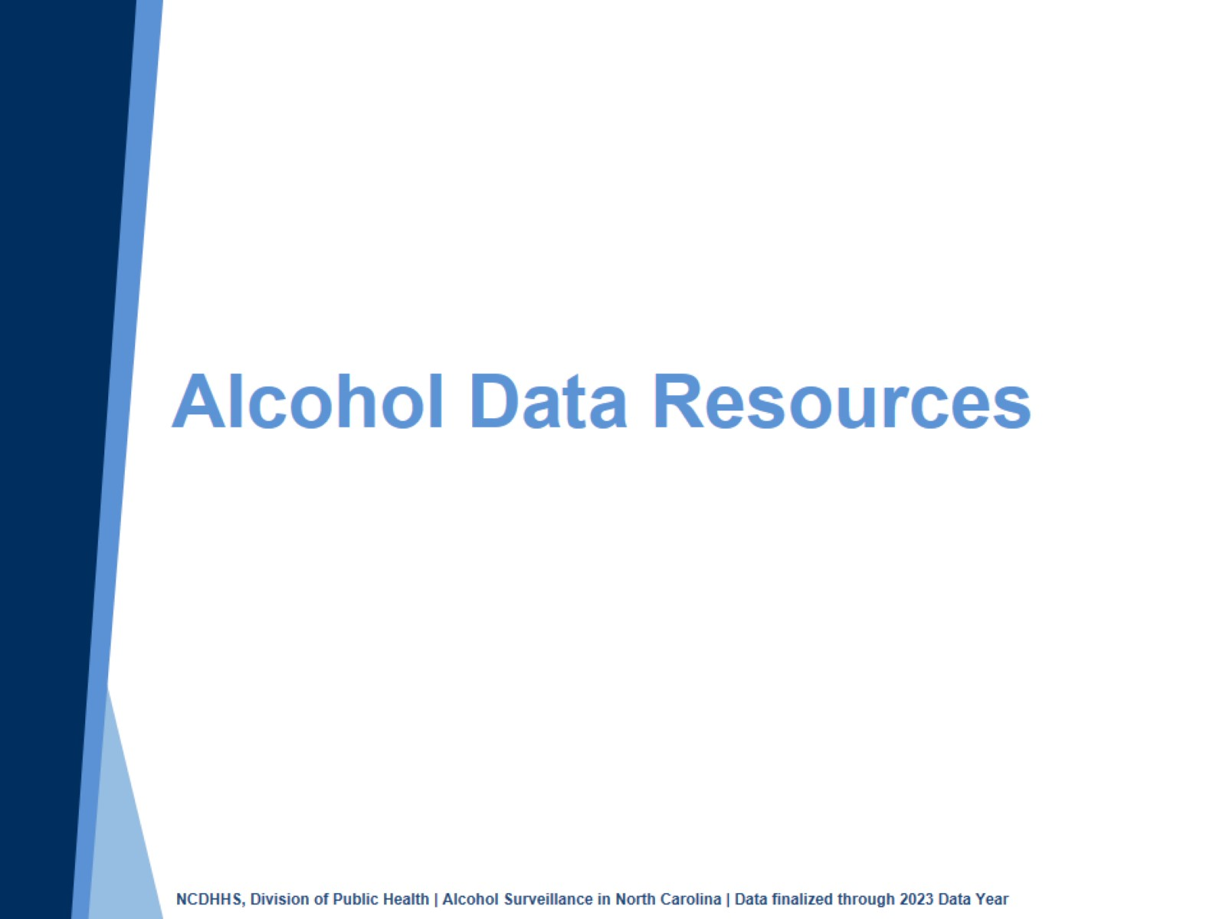
Alcohol Data Resources
Notes:
Speaker’s notes: Division of Public Health maintains several resources to help understand the burden of excessive alcohol use in our state.

Slide 28
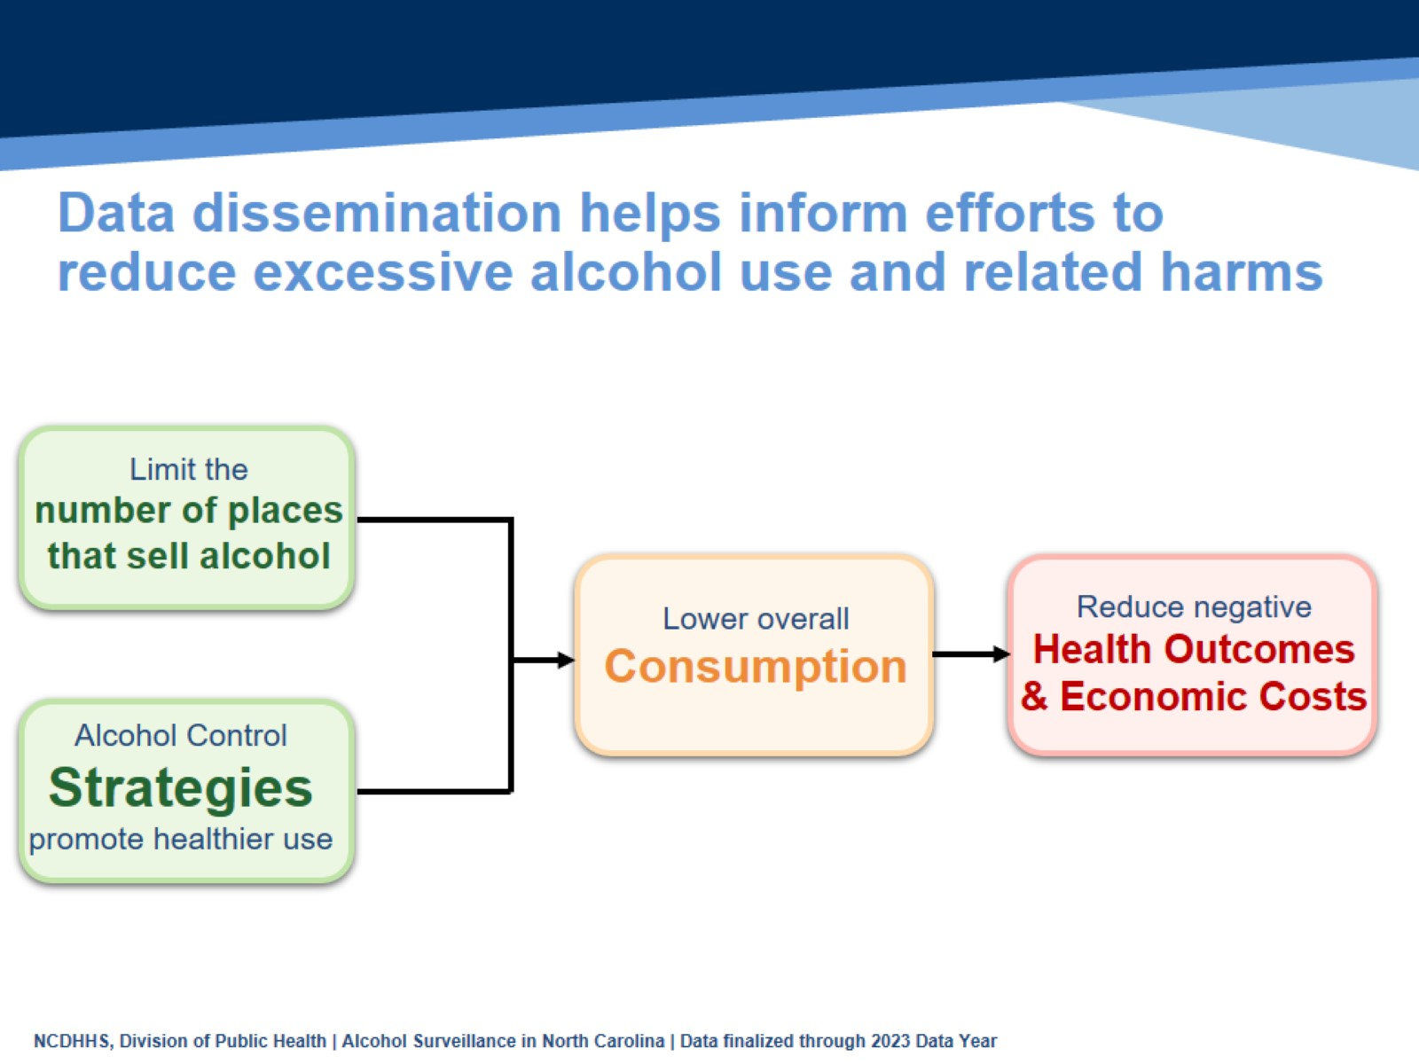
Data dissemination helps inform efforts to reduce excessive alcohol use and related harms
Notes:
Speaker’s notes: Public health surveillance and data dissemination are key parts of prevention. There are evidence-based strategies we can implement to reduce the harms of excessive alcohol use, and surveillance efforts help us understand the overall impact of these strategies. This logic model is the basis of the Alcohol Data Dashboard. Alcohol Control Strategies, like the government control of alcohol sales that we currently have in NC and limiting the number of places that sell alcohol result in lower overall consumption of alcohol, which reduces negative health outcomes and economic costs. Surveillance efforts inform each of these pieces.

Slide 29
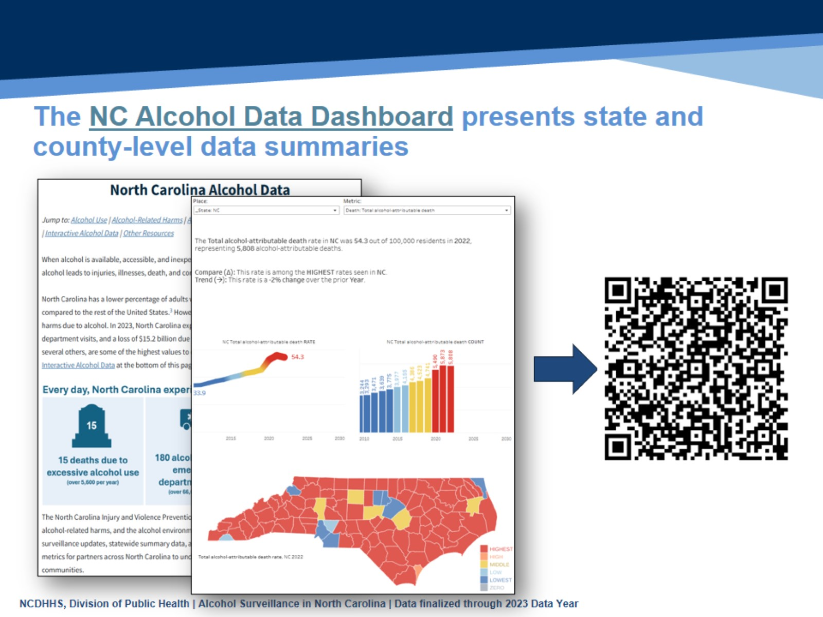
The NC Alcohol Data Dashboard presents state and county-level data summaries
Notes:
Speaker’s notes: The North Carolina Alcohol Data Dashboard walks through the public health narrative of the acute and chronic impacts of excessive alcohol use. We use many different data sets to tell this story. The Behavioral Risk Factor Surveillance System and Youth Risk Behavior Surveillance System give us survey data on consumption, emergency department visits illustrate the impacts on the healthcare system, and death data provide estimates of those who died due to excessive alcohol use. We pull this all together and present both state- and county-level information. These can be very helpful when pulling together presentations and grant applications. The QR code will take you to the Alcohol data dashboard, also found at: https://www.dph.ncdhhs.gov/programs/chronic-disease-and-injury/injury-and-violence-prevention-branch/north-carolina-alcohol-and-related-harms-data

Slide 30
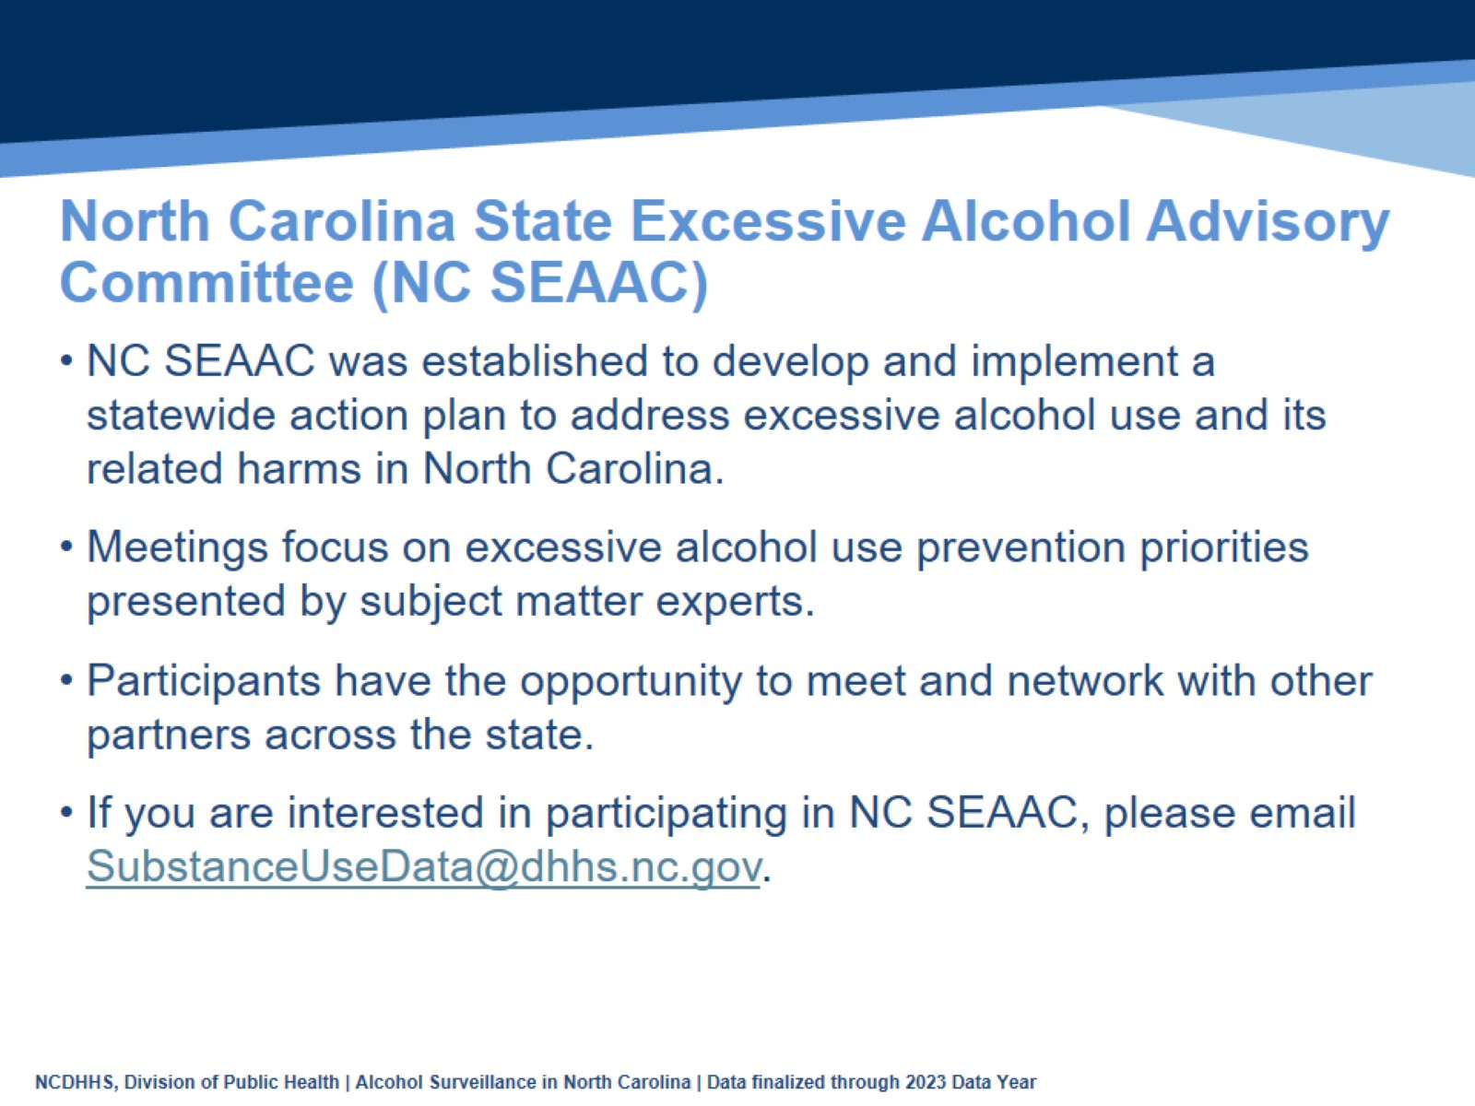
North Carolina State Excessive Alcohol Advisory Committee (NC SEAAC)
Notes:
Speaker’s notes: Engaging partners allows the Division of Public Health to better understand and address excessive alcohol use at both the local and state level. The North Carolina State Excessive Alcohol Advisory Committee (NC SEAAC) was established to engage partners working in preventing excessive alcohol use and its related harms across the state. The committee hopes to develop and implement a statewide plan to address excessive alcohol use and its related harms in the state. In addition, the committee meets twice a year to network and hear presentations on excessive alcohol use prevention strategies by subject matter experts. If you are interested in participating in NC SEAAC, please email SubstanceUseData@dhhs.nc.gov.

Slide 31
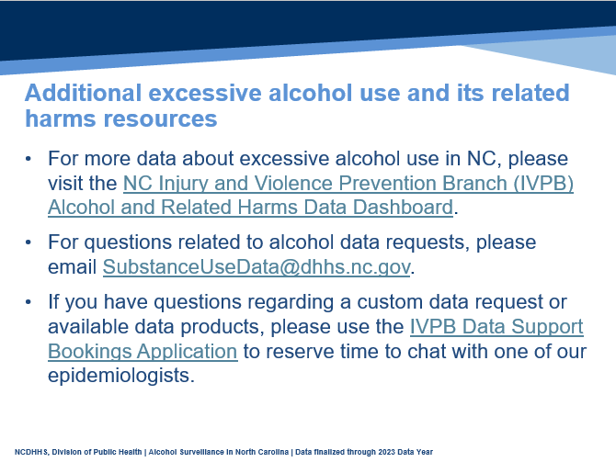
Additional excessive alcohol use and its related harms resources
Notes:
Speaker’s notes: The Injury and Violence Prevention Branch (IVPB) Alcohol and Related Harms Data Dashboard (https://www.dph.ncdhhs.gov/programs/chronic-disease-and-injury/injury-and-violence-prevention-branch/north-carolina-alcohol-and-related-harms-data) provides additional data on excessive alcohol use. IVPB also provides data and technical support for excessive alcohol use. For data requests, please email SubstanceUseData@dhhs.nc.gov. If you have additional questions regarding excessive alcohol use data resources, please use the IVPB data support bookings application (https://outlook.office365.com/owa/calendar/IVPBDataSupport@ncconnect.onmicrosoft.com/bookings/) to reserve time to chat with one of our epidemiologists.

Slide 32
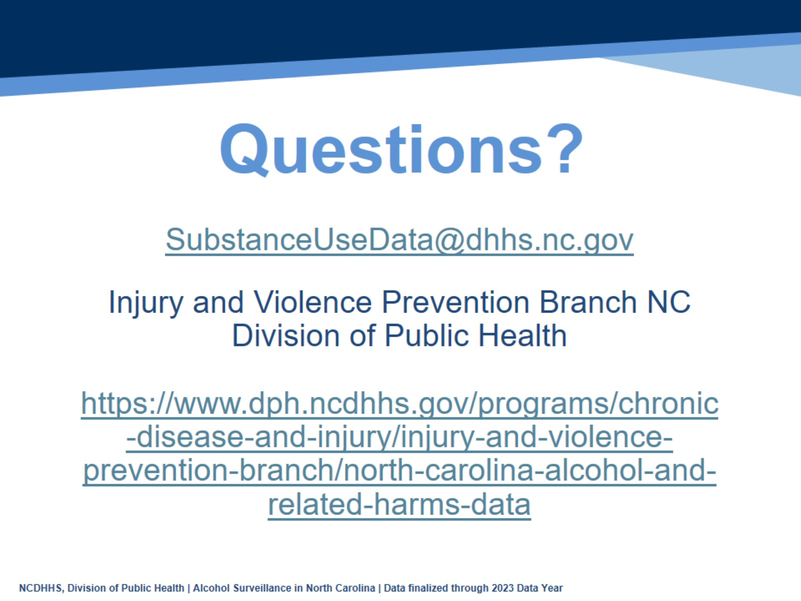
Questions?
Notes:
Speaker’s notes: Please reach out if you have any further questions, suggestions for improvement, or data requests.

