Slide 1
Leading Causes of Injury in North Carolina, 2024
Division of Public Health
Data updated: January 9, 2026
Notes:
This slide set was created to provide basic data trends and public health surveillance around mortality and morbidity of the leading causes of injury in North Carolina. They are meant to offer a state-level background on the leading causes of injury. If you’d like a copy of the slides, please visit the “Data Surveillance” page on our branch website, www.dph.ncdhhs.gov/programs/chronic-disease-and-injury/injury-and-violence-prevention-branch. The direct link is also shared at the end of this presentation.
Feel free to incorporate these slides into your own presentations, grant proposals, reports, or any other way they may be useful.
Please read both the speaking and technical notes to ensure that data are presented in a consistent manner.

Slide 2
Leading Causes of Injury Technical Notes
Surveillance methods have been updated to identify any mention of an injury in our morbidity data sources. Individual records with multiple injuries listed will be included in the total for each of those injuries but counted only once for the overall total injury count. Previously, only the first listed injury was counted, which has increased in number of specific injuries identified.
For questions or for more information, see the technical notes document.
Notes:
For more detailed technical notes on any of the data shared in this slide set, please contact us at InjuryData@dhhs.nc.gov.

Slide 3
Injury deaths are just the tip of the iceberg.
In 2024, injuries resulted in:
10,339
Deaths
55,464
Hospitalizations
Despite NC’s extensive reporting systems,
the total burden
of injuries in the
state is
unknown.
972,089
ED Visits
? EMS
? Outpatient Injuries
? Medically Unattended Injuries
INJURY ICEBURG
Limited to NC Residents, 2024
Source: NC State Center for Health Statistics, Vital Statistics Deaths (2024) and Hospital Discharge Data (2024); NC DETECT (2024)
Analysis by the DPH, Injury and Violence Prevention Branch, Injury Epidemiology, Surveillance and Informatics Unit
Notes:
In 2024 there were 10,339 deaths, 55,464 hospitalizations, and 972,089 emergency department visits associated with injuries in North Carolina. However, this is just the tip of the iceberg and the total burden of injury in North Carolina is unknown.

Slide 4
Injury Deaths

Slide 5
Injury deaths among NC residents decreased in 2024, but remain higher than 2020
3%
increase
Data limited to NC residents, 2020-2024
Source: NC State Center for Health Statistics, Vital Statistics Deaths (2020-2024)
Analysis by the DPH, Injury and Violence Prevention Branch, Injury Epidemiology, Surveillance and Informatics Unit
Notes:
The number of injury deaths in North Carolina decreased in 2024 but remain 3% higher than 2020

Slide 6
Leading causes of injury death among NC Residents, 2024
The leading cause of injury death in 2024 was unintentional poisoning.
Total Deaths = 10,339
MVT = Motor Vehicle Traffic; Unintentional poisoning includes both medication/drug overdoses and non-drug poisonings
Data limited to NC residents, 2024
Source: NC State Center for Health Statistics, Vital Statistics Deaths (2024)
Analysis by the DPH, Injury and Violence Prevention Branch, Injury Epidemiology, Surveillance and Informatics Unit
Notes:
In 2024, there were 10,339 injury deaths in North Carolina. The leading cause of injury death was unintentional poisoning (n=2,865), followed by unintentional falls (n=1,985) and unintentional motor vehicle traffic-related injury (n=1,747).

Slide 7
Percent change in leading causes of injury death among NC residents, 2020-2024
Unintentional natural/environmental had the largest five-year increase.
MVT = Motor Vehicle Traffic
Data limited to NC residents, 2020 & 2024
Source: NC State Center for Health Statistics, Vital Statistics Deaths (2020 & 2024)
Analysis by the DPH, Injury and Violence Prevention Branch, Injury Epidemiology, Surveillance and Informatics Unit
Notes:
Over the past five years (2020-2024), the number of deaths due to unintentional natural/environmental increased the most (199% increase), followed by unintentional falls (21% increase) and self-inflicted firearm deaths (14% increase). The 51% decrease in deaths for unspecified injuries notes a shift toward better injury coding practices.

Slide 8
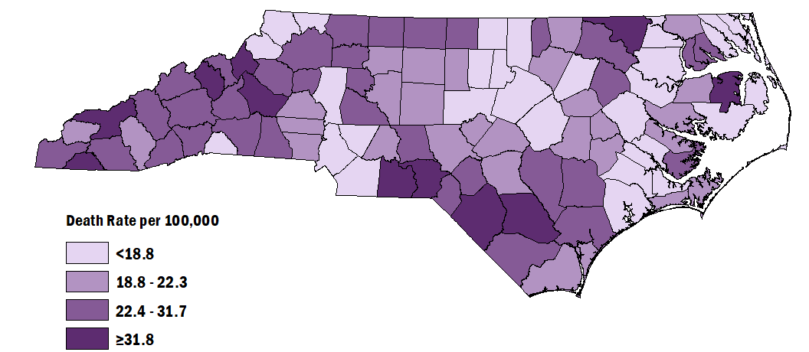
Injury Death Rates among NC Residents by County, 2020-2024
Statewide, the rate of injury deaths from 2020-2024 was 20.2 per 100,000 people.
Data limited to NC residents, 2020-2024
Source: NC State Center for Health Statistics, Vital Statistics Deaths (2020-2024)
Analysis by the DPH, Injury and Violence Prevention Branch, Injury Epidemiology, Surveillance and Informatics Unit
Notes:
The rate of injury deaths among North Carolinians from 2020 to 2024 was 20.2 per 100,000 residents. Counties with the highest rates included Tyrell (40.9 per 100,000), Clay (37.9 per 100,000), and Yancey (37.2 per 100,000). Counties with the lowest rates included Wake (10.8 per 100,000), Watauga (10.9 per 100,000), and Orange (11.2 per 100,000).

Slide 9
Injury Hospitalizations

Slide 10
Injury-related hospitalizations increased by 11% over the last five years
11%
increase
Data limited to NC residents, 2020-2024
Source: Hospitalization Discharge Data (2020-2024)
Analysis by the DPH, Injury and Violence Prevention Branch, Injury Epidemiology, Surveillance and Informatics Unit
Notes:
In 2024, the number of injury-related hospitalizations in North Carolina increased by 11% since 2020.

Slide 11
Leading causes of injury hospitalization among NC Residents, 2024
The leading cause of injury hospitalization in 2024 was unintentional falls.
Total Hospitalizations = 55,464
MVT = Motor Vehicle Traffic; Unintentional poisoning includes both medication/drug overdoses and non-drug poisonings
Data limited to NC residents, 2024
Source: Hospital Discharge Data (2024)
Analysis by the DPH, Injury and Violence Prevention Branch, Injury Epidemiology, Surveillance and Informatics Unit
Notes:
In 2024, there were 55,464 injury-related hospitalizations in North Carolina. The leading cause of injury hospitalization was unintentional falls (n=29,975), followed by unintentional motor vehicle traffic-related injury (n=7,531) and unintentional poisoning (n=5,152).

Slide 12
Percent change in leading causes of injury hospitalization among NC residents, 2020-2024
Unintentional natural/environmental injuries had the largest five-year increase.
MVT = Motor Vehicle Traffic
Data limited to NC residents, 2020 & 2024
Source: Hospital Discharge Data (2020 & 2024)
Analysis by the DPH, Injury and Violence Prevention Branch, Injury Epidemiology, Surveillance and Informatics Unit
Notes:
Over the past five years (2020-2024), the number of hospitalizations due to unintentional natural/environmental injury increased the most (31% increase).

Slide 13
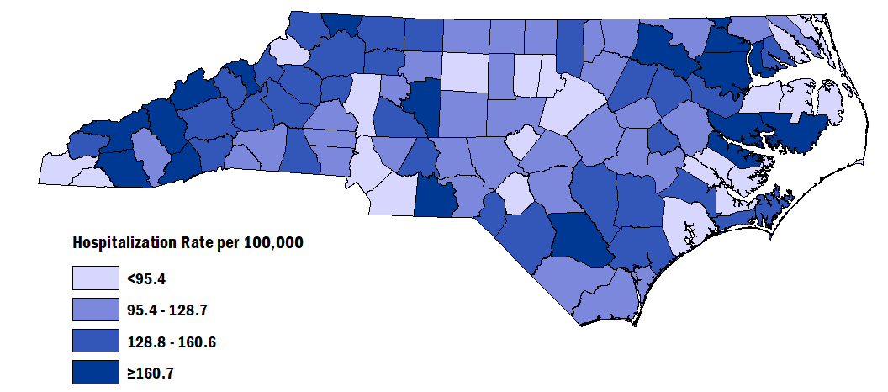
Injury Hospitalization Rates among NC Residents by County, 2020-2024
Statewide, the rate of injury hospitalizations from 2020-2024 was 109.8 per 100,000 people.
Data limited to NC Residents, 2020-2024
Source: Hospital Discharge Data (2020-2024)
Analysis by the DPH, Injury and Violence Prevention Branch, Injury Epidemiology, Surveillance and Informatics Unit
Notes:
The rate of injury hospitalization among North Carolinians from 2020 to 2024 was 109.8 per 100,000 residents. Counties with the highest rates included Hertford (775.6 per 100,000), Hyde (196.0 per 100,000), and Halifax (180.0 per 100,000). Counties with the lowest rates included Currituck (30.1 per 100,000), Onslow (55.8 per 100,000), and Pasquotank (57.3 per 100,000).

Slide 14
Injury Emergency Department (ED) Visits

Slide 15
Injury-related ED visits increased by 30% over the last five years
30%
increase
Data limited to NC residents, 2020-2024
Source: NC DETECT, 2020-2024
Analysis by the DPH, Injury and Violence Prevention Branch, Injury Epidemiology, Surveillance and Informatics Unit
Notes:
The number of injury-related emergency department visits in North Carolina has increased by 30% over the last 5 years (2020-2024). Pre-pandemic, there were 922,123 ED visits in 2019, but visits decreased dramatically in 2020 and have since returned to normal levels.

Slide 16
Leading causes of injury ED Visits among NC residents, 2024
The leading cause of injury ED visits in 2024 was unintentional falls.
Total ED Visits = 972,089
Data limited to NC residents, 2024
Source: NC DETECT, 2024
Analysis by the DPH, Injury and Violence Prevention Branch, Injury Epidemiology, Surveillance and Informatics Unit
Notes:
In 2024, there were 972,089 injury-related ED visits in North Carolina. The leading cause of injury ED visit was unintentional falls (n=284,874) and unintentional motor vehicle traffic-related injury (n=121,758). The high number of ED visits with no mechanism or intent determined (n=292,569) shows the need for better injury coding practices in emergency department settings.

Slide 17
Percent change in leading causes of injury ED visits among NC residents, 2020-2024
Unintentional falls had the largest five-year increase.
Data limited to NC residents, 2020 & 2024
Source: NC DETECT, 2020 & 2024
Analysis by the DPH, Injury and Violence Prevention Branch, Injury Epidemiology, Surveillance and Informatics Unit
Notes:
Over the past five years (2020-2024), the number of ED visits due to unintentional falls increased the most (47% increase).

Slide 18
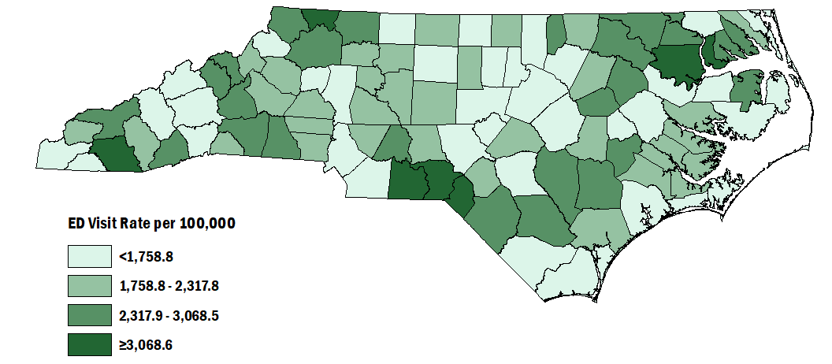
Injury ED Visit Rates among NC residents by County, 2020-2024
Statewide, the rate of injury ED visits from 2020-2024 was 1,970.9 per 100,000 people.
Data limited to NC residents, 2020-2024
For more information on these data, see the Injury Surveillance Technical Notes: https://injuryfreenc.dph.ncdhhs.gov/DataSurveillance/Technical-Notes.pdf
Source: NC DETECT, 2020-2024
Analysis by the DPH, Injury and Violence Prevention Branch, Injury Epidemiology, Surveillance and Informatics Unit
Notes:
The rate of injury ED visits among North Carolinians from 2020 to 2024 was 1,970.9 per 100,000 residents. Counties with the highest rates included Anson (3,956.3 per 100,000), Bertie (3,663.4 per 100,000), and Richmond (3,629.3 per 100,000). Counties with the lowest rates included Clay (728.7 per 100,000), Currituck (927.4 per 100,000), and Caswell (1,079.3 per 100,000).

Slide 19
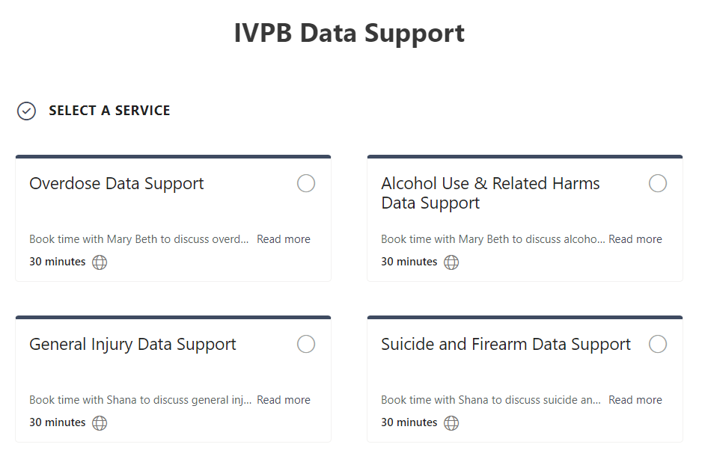

IVPB Data Support now available!
Book time with an IVPB epidemiologist to discuss available data products, to talk through custom data requests, or for general data questions.
IVPB Data Request Policy
IVPB Data Support Bookings

Slide 20
Questions?
InjuryData@dhhs.nc.gov
Injury and Violence Prevention Branch
NCDHHS Division of Public Health
www.dph.ncdhhs.gov/programs/chronic-disease-and-injury/injury-and-violence-prevention-branch

