Slide 1
Unintentional Drowning Among Children:
North Carolina, 2019-2023
Division of Public Health, Injury and Violence Prevention Branch
Epidemiology, Surveillance, and Informatics Unit
Data updated March 17, 2025
Notes:
This slide set was created to provide basic data trends and public health surveillance around mortality of unintentional child drownings. They are meant to offer a state-level background on unintentional child drowning. If you’d like a copy of the slides, please visit the “Drowning and Water Related Injuries” page on our branch website, https://www.dph.ncdhhs.gov/programs/chronic-disease-and-injury/injury-and-violence-prevention-branch. The direct link is also shared at the end of this presentation.
Feel free to incorporate these slides into your own presentations, grant proposals, reports, or any other way they may be useful.
Please read both the speaking and technical notes to ensure that data are presented in a consistent manner.

Slide 2
Between 2014 and 2023, 255 children under the age of 18 died because of unintentional drowning in North Carolina
The rate of unintentional drowning death among children was generally lower in North Carolina than in the U.S. as a whole
Limited to NC residents ages 0-17
Source: NC State Center for Health Statistics, Deaths (2014-2023); US Census Bureau Population Estimates (2014-2023); CDC WISQARS
Analysis by the DPH Injury Epidemiology, Surveillance, and Informatics Unit
Notes:
Between 2014 and 2023, 255 children under 18 years old died due to unintentional drowning in North Carolina. The rate of unintentional drowning deaths among children was generally lower in NC than in the United States overall.

Slide 3
Unintentional drowning deaths made up 12% of all unintentional injury deaths among North Carolina children under the age of 18 from 2019 to 2023
Unintentional Drowning Deaths
Other Unintentional Injury Deaths
Limited to NC residents ages 0-17
Source: NC State Center for Health Statistics, Deaths (2019-2023)
Analysis by the DPH Injury Epidemiology, Surveillance, and Informatics Unit
Notes:
From 2019-2023, drownings made up 12% of unintentional injury death among North Carolina Children.

Slide 4
Unintentional drowning was the third leading cause of unintentional injury death among North Carolina children from 2019 to 2023
Limited to NC residents ages 0-17; MVT = Motor Vehicle Traffic
Source: NC State Center for Health Statistics, Deaths (2019-2023)
Analysis by the DPH Injury Epidemiology, Surveillance, and Informatics Unit
Notes:
From 2019-2023, unintentional drownings made up the third leading cause of unintentional injury death among North Carolina children, after suffocation and motor vehicle traffic injuries.

Slide 5
Unintentional child drowning deaths were highest among those ages 1-4, followed by ages 15-17
Limited to NC residents ages 0-17
Source: NC State Center for Health Statistics, Deaths (2019-2023)
Analysis by the DPH Injury Epidemiology, Surveillance, and Informatics Unit
Notes:
The highest percentage of unintentional drowning deaths occurred among children ages 1 to 4, followed by those ages 15-17. Males also accounted for the majority of child drowning deaths from 2019-2023.

Slide 6
Percentages of unintentional child drownings were highest among males, NH White residents, and children ages 1-4
Limited to NC residents ages 0-17; NH = non-Hispanic
Source: NC State Center for Health Statistics, Deaths (2019-2023)
Analysis by the DPH Injury Epidemiology, Surveillance, and Informatics Unit
Notes:
From 2019-2023, the highest percentage of unintentional child drownings were among males, non-Hispanic White residents, and children ages 1 to 4 years old.

Slide 7
Nearly half of unintentional child drownings occurred in a swimming pool and close to one-third occurred in a natural water body
Limited to NC residents ages 0-17
Source: NC State Center for Health Statistics, Deaths (2019-2023)
Analysis by the DPH Injury Epidemiology, Surveillance, and Informatics Unit
Notes:
Unintentional child drowning deaths differed by water source. From 2019-2023, 47% of deaths occurred due to a swimming pool, followed by 30% in natural water.

Slide 8
Unintentional drowning deaths for younger ages occurred most often in swimming pools, while drowning deaths for older ages occurred most often in natural bodies of water
Bathtub
Swimming Pool
Natural Water
Other/Unspecified
Limited to NC residents ages 0-17
Source: NC State Center for Health Statistics, Deaths (2019-2023)
Analysis by the DPH Injury Epidemiology, Surveillance, and Informatics Unit
Notes:
Unintentional drowning death water source also varied by age group. Children ages 1 to 4 years old most often drowned in swimming pools, whereas drowning deaths occurred more often in natural water for older children, ages 15 to 17.

Slide 9
Unintentional child drownings were highest in the summer months, nearly one-quarter of which occurring in July
Limited to NC residents ages 0-17
Source: NC State Center for Health Statistics, Deaths (2019-2023)
Analysis by the DPH Injury Epidemiology, Surveillance, and Informatics Unit
Notes:
Unintentional child drownings often occurred in the summer months, especially in July. 24% of unintentional child drowning deaths occurred in July from 2019-2023.

Slide 10
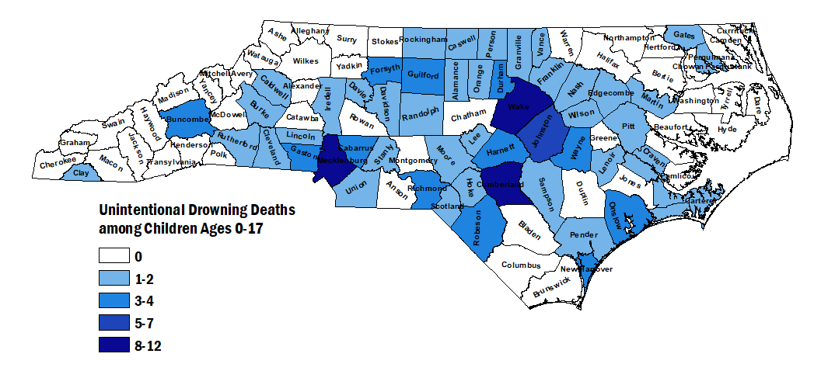
Wake, Mecklenburg, and Cumberland counties had the highest counts of unintentional drowning deaths among children under the age of 18 from 2019 to 2023
Limited to NC residents ages 0-17
Source: NC State Center for Health Statistics, Deaths (2019-2023)
Analysis by the DPH Injury Epidemiology, Surveillance, and Informatics Unit
Notes:
By county, the highest number of unintentional child drowning deaths from 2019-2023 occurred in Wake, Mecklenburg, and Cumberland counties.

Slide 11
Unintentional drownings are preventable
Top Safety Tips
Watch children when they are in or around water
Teach yourself and children to swim
Learn CPR and basic rescue skills
Learn how to perform CPR on children and adults
Ensure swimming pools have 4-sided fencing at least 4 feet high
Source: Safe Kids North Carolina
Notes:
Tips to prevent unintentional drownings include watching children when around water, teaching yourself and children to swim, learning CPR, and ensuring swimming pools are enclosed with fences at least 4 feet tall.

Slide 12
Resources
Safe Kids North Carolina
www.ncosfm.gov/community-risk-reduction/safe-kids
Division of Public Health, Injury and Violence Prevention Branch
injuryfreenc.dph.ncdhhs.gov
Centers for Disease Control and Prevention: Drowning Prevention
www.cdc.gov/drowning/about
National Drowning Prevention Alliance
ndpa.org
US Consumer Product Safety Commission – Pool Safety
www.poolsafely.gov
Notes:
For more information on drowning prevention, please visit the linked sites.

Slide 13
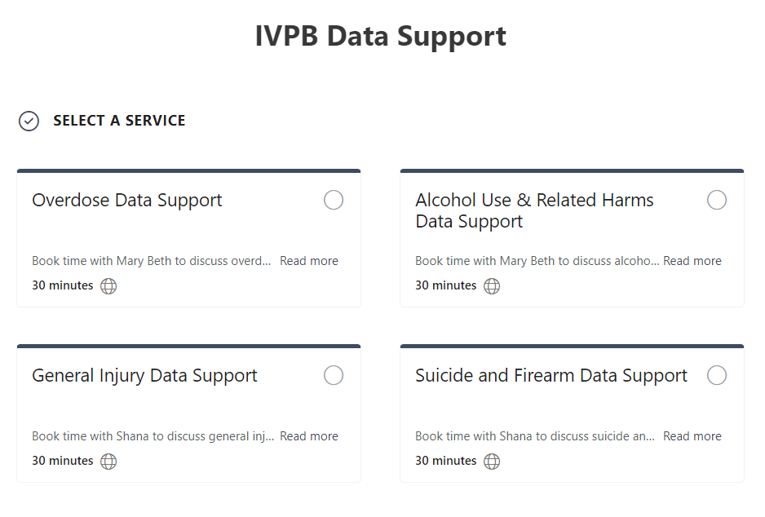

IVPB Data Support now available!
Book time with an IVPB epidemiologist to discuss available data products, to talk through custom data requests, or for general data questions.
IVPB Data Request Policy
IVPB Data Support Bookings

Slide 14
Questions?
InjuryData@dhhs.nc.gov
Injury and Violence Prevention Branch
Division of Public Health
www.dph.ncdhhs.gov/programs/chronic-disease-and-injury/injury-and-violence-prevention-branch

