Slide 1
15A NCAC 18A .1300
Rules Governing the Sanitation of Hospitals, Nursing Homes, Adult Care Homes, and Other Institutions
Notes:
-This course is designed to give an overview of the “Rules Governing the Sanitation of Hospitals, Nursing Homes, Adult Care Homes, and Other Institutions”.
-This course includes information about the Rules and how to document violations on the inspection form.

Slide 2
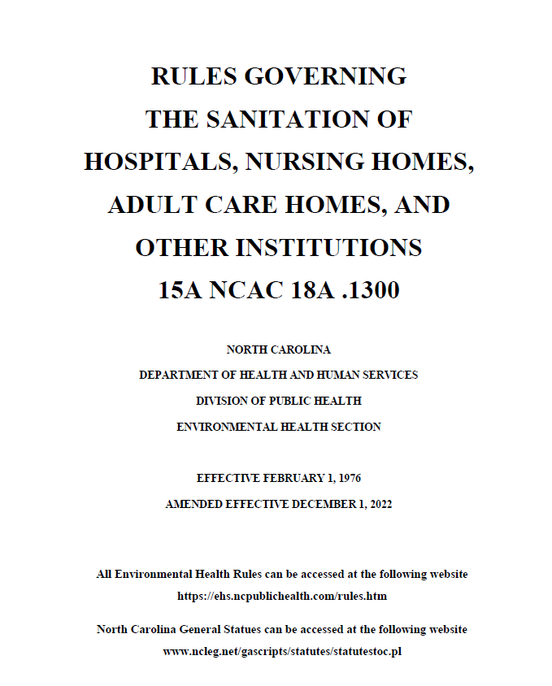
Notes:
-The “Rules Governing the Sanitation of Hospitals, Nursing Homes, Adult Care Homes, and Other Institutions” are listed under 15A NCAC 18A .1300.
-Please make sure to have a copy of these Rules and inspection form 1223 to reference during this presentation.
-A link to these Rules is provided on the NC Division of Public Health, Environmental Health Services Section – Food Protection and Facilities website.

Slide 3
What is an Institution?
"Institution" includes the following establishments that provide room or board and for which a license or certificate of payment must be obtained from the Department:
  Hospital
  Nursing Home
  Physical, Behavioral, or Mental Health (13 or more persons)
  Adult Care Home
  Residential Child Care Facility
Notes:
-The definition of “institutions” will be listed under .1301.
-Hospital: as defined in G.S. 131E-76 including doctors' clinics with food preparation facilities
-Nursing Home: as defined in G.S. 131E-76
-An establishment, other than hospital and nursing home, for the recuperation and treatment of 13 or more persons suffering from physical, behavioral, or mental health conditions
-Adult Care Home: As defined at G.S. 131D-2.1
-Residential childcare facility: As defined at G.S. 131D-10.2(13)
-Facilities that provide room and board to individuals but are exempt from licensure under G.S. 131D-10.4(1)
-Does not include a childcare facility, adult day service facility, or residential care facility which are regulated under different rules.

Slide 4


Who Issues the License?
Facilities are licensed by the NC Division of Health Service Regulation (DHSR).
Environmental Health does not permit the institution or the institution kitchen.
When a change in ownership occurs:
  Create a list of non-compliant items
  Assign a new ID number to the facility
Notes:
-EH does not issue permits or transitional permits to institutions or institution kitchens (unless the kitchen is permitted as a Type 01 facility). 3rd party vendors may require a “permit form” to initiate the “I” status for a facility.
-It is recommended that the REHS provide a non-compliant list to the administrator. Cannot require facility to correct items on this list.
-Permits do not exist, so there is nothing that expires or to be revoked.
-If major issues exist in the facility, notify DHSR.
-DHSR is a division of NCDHHS.

Slide 5
Definitions (.1301)
Definitions include:
Activity kitchen
Administrator
Ancillary kitchen
Bed linens
Clean
Dietary kitchen
EPA registered disinfectant
Garbage
Good repair
Nourishment station
Rehabilitation kitchen
Resident
Sanitize
Time/Temperature Control for Safety
Notes:
-Here is a list of some of the definitions listed under .1301.
-The next few slides review definitions relating to food services in an institution (in italics on the screen).

Slide 6
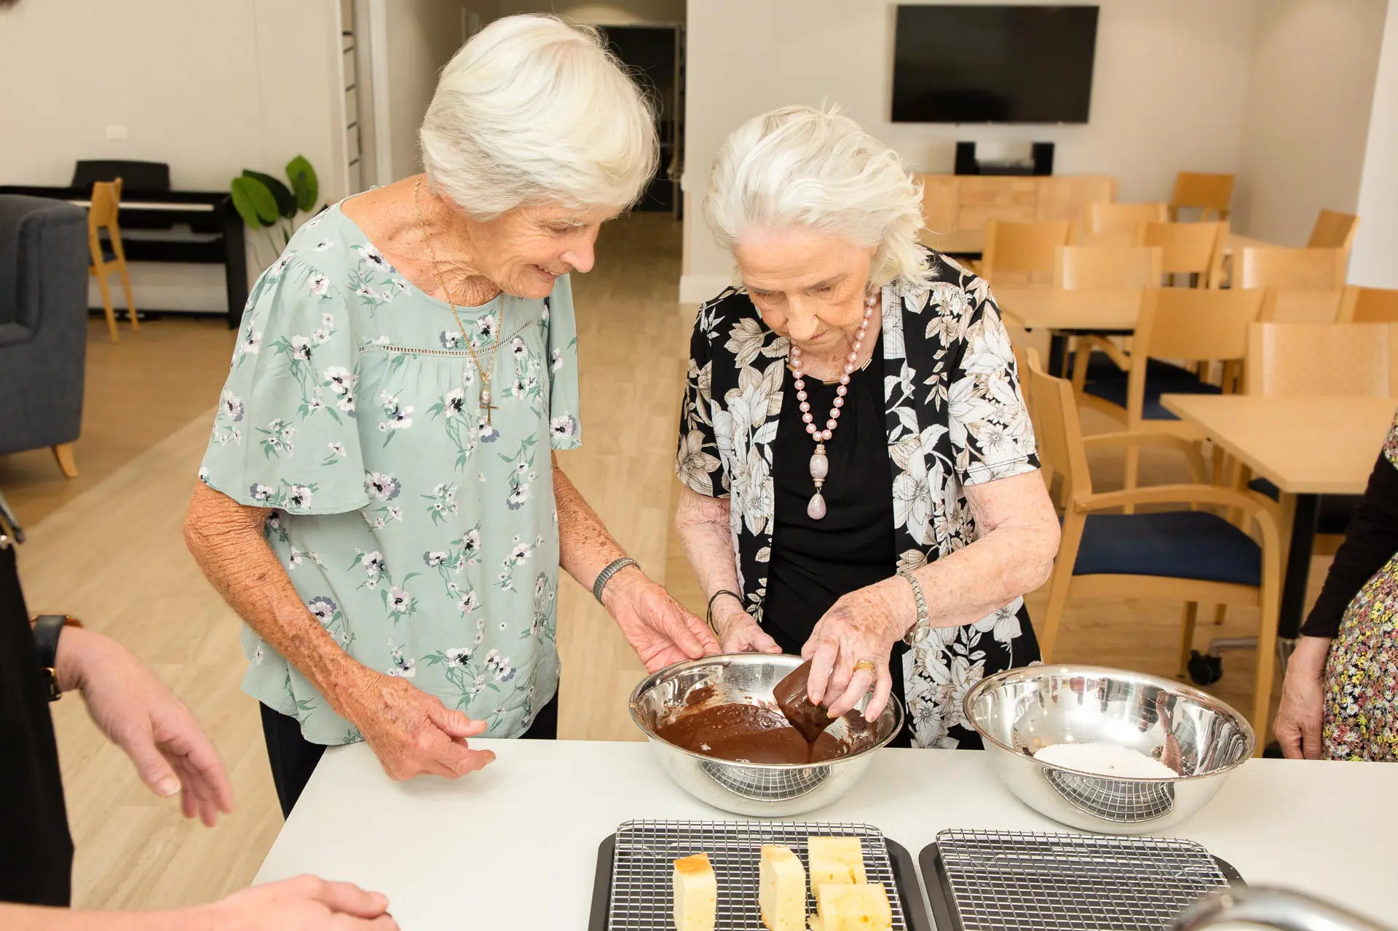
Activity Kitchen
Kitchen for residents of an institution and their guests for preparing food for individual or group activities
Available to residents or employees of a residential care facility if located in the same building
Notes:
-“Activity kitchen” means a kitchen that is available to residents of an institution and their guests for the purpose of preparing food for individual or group activities. Nothing in this Section shall prohibit residents or employees of a residential care facility, as that term is defined at 15A NCAC 18A .1601 or their guests, from using an activity kitchen when an institution’s activity kitchen is in the same building where a residential care facility is located.

Slide 7
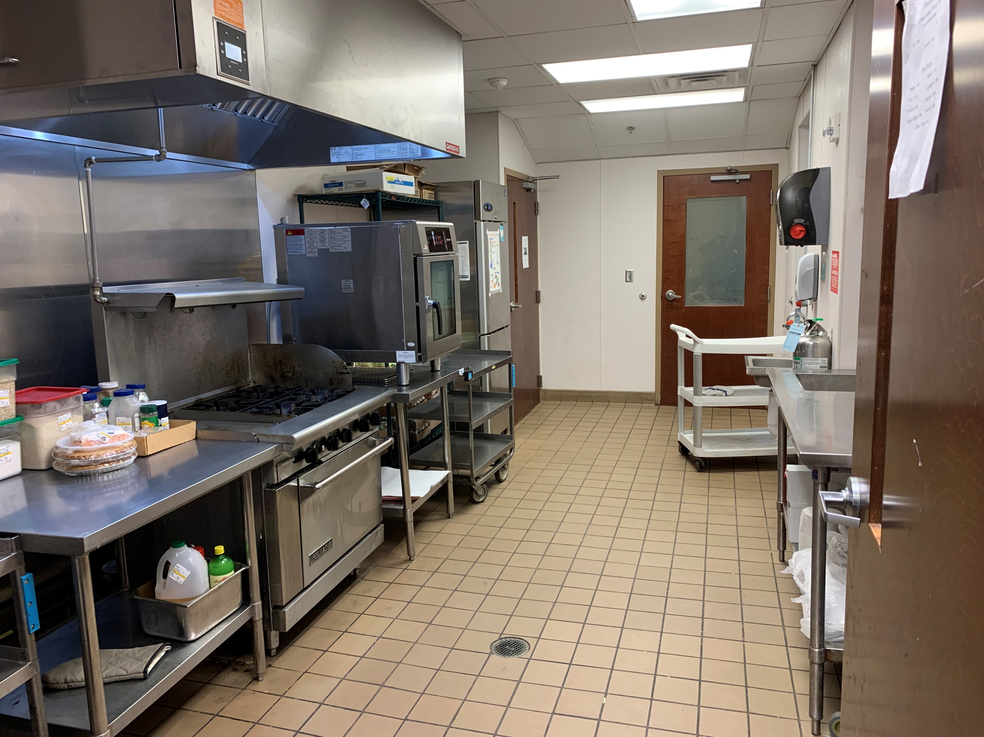
Ancillary Kitchen
Used by the institution’s employees for meal preparation and other work to support the dietary kitchen
Shall meet .2600 Rules
Notes:
-“Ancillary kitchen” means a kitchen that is used by the institution’s employees for meal preparation and other work to support the dietary kitchen. Ancillary kitchens shall meet the requirements of 15A NCAC 18A .2600.
-Inspected using the food establishment inspection form.

Slide 8
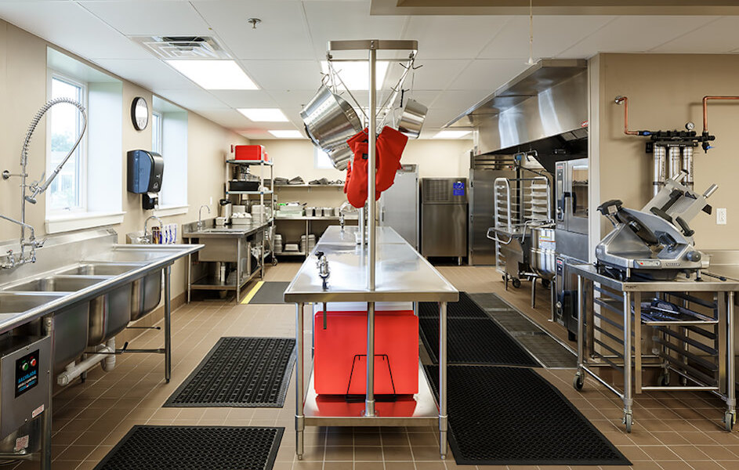
Dietary Kitchen
Main kitchen used to provide meals and nutrition services to the institution’s residents, employees, and guests
Shall meet .2600 Rules
Notes:
-“Dietary kitchen” means the primary kitchen in the institution that is used to provide meals and nutrition services to the institution’s residents, employees, and guests. Dietary kitchens shall meet the requirements of 15A NCAC 18A .2600.
-Inspected using the food establishment inspection form.

Slide 9
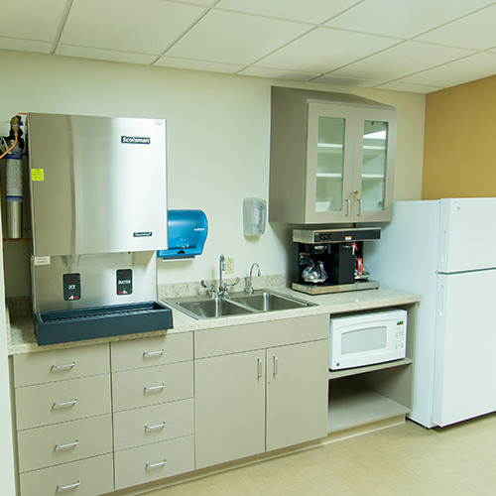
Nourishment Station
Area where commercially packaged food that is used to provide nourishment to an institution’s residents, employees, or guests is stored
Notes:
-“Nourishment station” means an area where commercially packaged food that is used to provide nourishment to an institution’s residents, employees, or guests is stored.

Slide 10
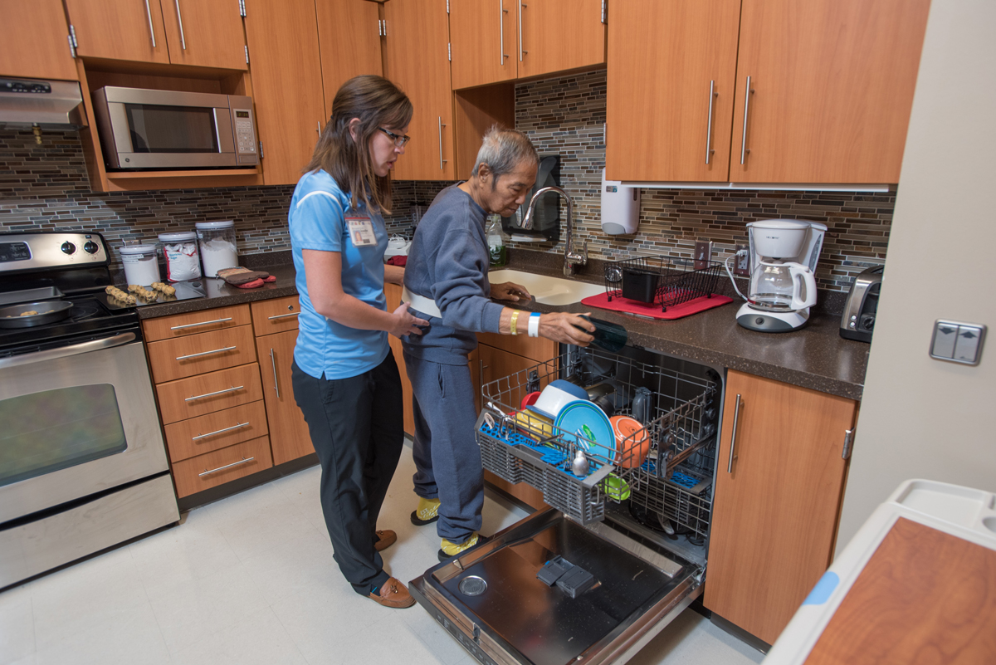
Rehabilitation Kitchen
Used solely for the purpose of providing supervised therapeutic activities to residents, including occupational or physical therapy
Food prepared shall not be consumed by anyone who is not a participant in the therapeutic activity
Notes:
-“Rehabilitation kitchen” means a kitchen used solely for the purpose of providing supervised therapeutic activities to residents, including occupational or physical therapy. Food prepared in a rehabilitation kitchen shall not be consumed by anyone who is not a participant in the therapeutic activity being conducted in the rehabilitation kitchen.

Slide 11
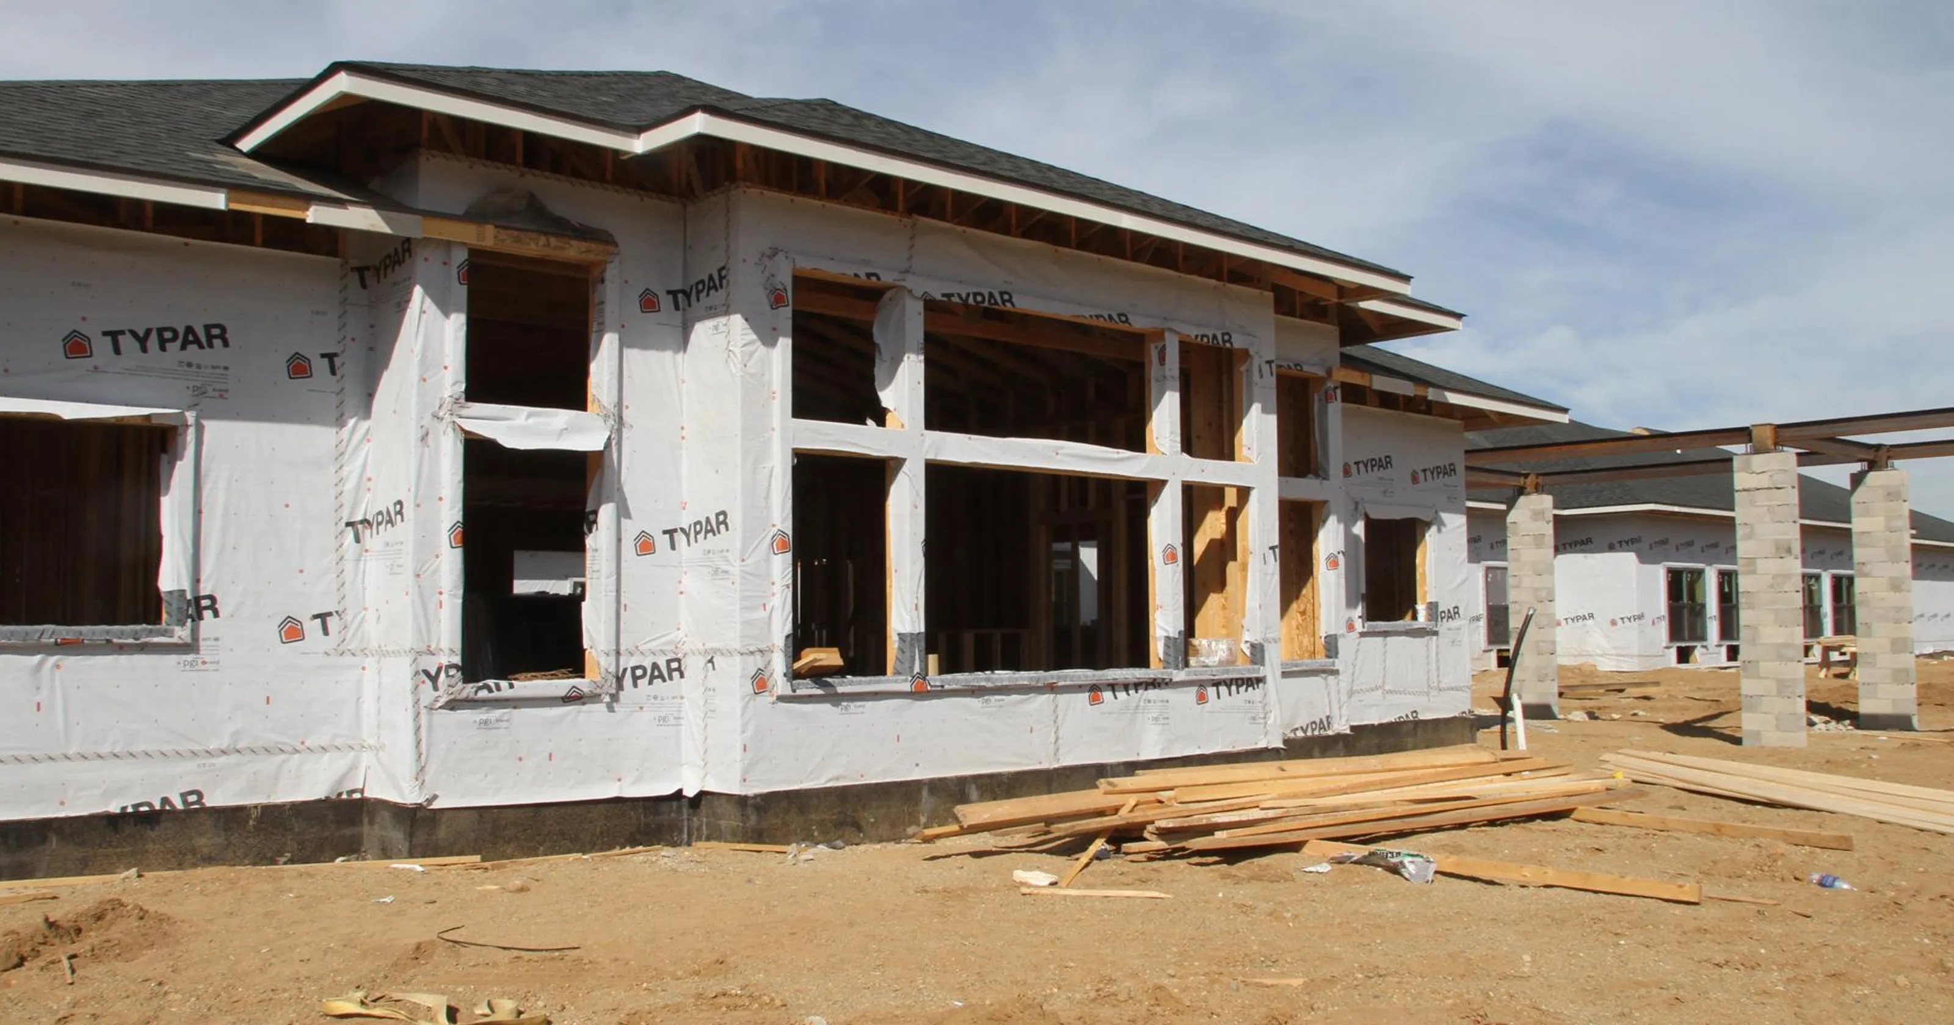
Approval of Plans (.1302)
Construction plans submitted to the local health department by the licensee
Review and approval required prior to construction
Notes:
-Licensure requirements will come from DHSR. Check with the licensing agency to ensure that plans have been reviewed and approved.​
-Type 01 kitchen plans must be reviewed AND approved by EH prior to construction.​
-Don’t forget to work with local building and fire inspection departments during plan review and construction visits.

Slide 12

Inspections (.1304)(a)
Institution buildings are inspected once in a six-month period
Food services are inspected quarterly UNLESS...
A facility is certified by Medicare/Medicaid, food services are inspected at a minimum once per fiscal year
General Statute 130A-235 (a1)
http://www.medicare.gov/NursingHomeCompare/search.aspx
Notes:
-Food service is a different inspection altogether, institution food service (Type 16). If they serve the public/guests, they should be permitted as a restaurant (Type 01).
-Food service inspection does not include activity kitchens. Those areas are inspected during building inspection.
-Refer to G.S. 130A-235 (a1).
*Notwithstanding any law, rule, or policy to the contrary, the frequency of food service inspections in nursing homes or nursing home beds licensed under Part 1 of Article 5 of Chapter 131E of the General Statutes or Part 1 of Article 6 of Chapter 131E of the General Statutes that are also certified by the Centers for Medicare and Medicaid Services shall be reduced to a minimum of two inspections per year until October 1, 2012, and thereafter reduced to a minimum of one inspection per year, if the facility achieved as grade “A” sanitation score. If the facility received a grade “B” or lower its annual food service inspection the county may conduct inspections until the food service operation achieves a grade “A” sanitation score. Nothing in this section prohibits the county from conducting an evaluation or inspection in response to a complaint or in the interest of public safety.*
And 10A NCAC 46 .0213

Slide 13
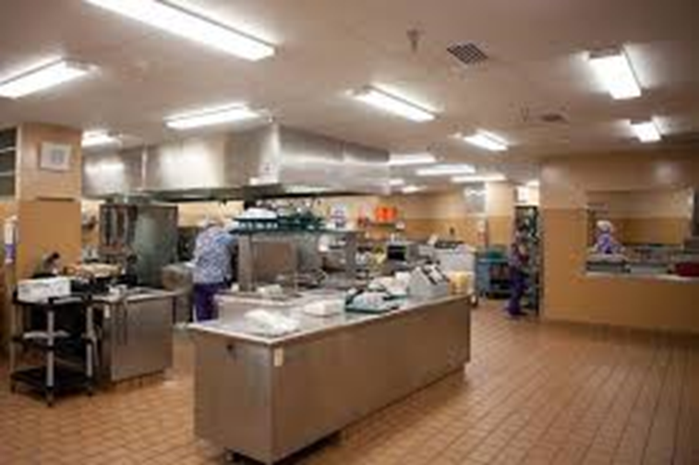
Inspections (.1304)(c)
Facilities in operation prior to March 1, 2003:
  May continue to use equipment and construction in use on that date if no imminent hazard exists
  No points are deducted if equipment and construction is clean and performs task for which it is used
  Equipment that is replaced shall comply with .2600 Rules
Notes:
-Some examples include square-cornered utensil and prep sinks, lighting, and other kitchen equipment.

Slide 14
Grading Residential Care Facilities in Institutions
(.1305)
Some institutions contain residential care facilities that provide room or board for 12 persons or fewer
The .1600 Rules shall apply and be used when grading these residential care facilities
Notes:
-An example would be a facility within the institution licensed as a residential care facility and would be graded under the .1600 Rules. Areas outside of this licensed space would be graded using the .1300 Rules.
-15A NCAC 18A .1600 “Rules Governing the Sanitation of Residential Care Facilities”.

Slide 15
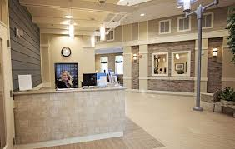
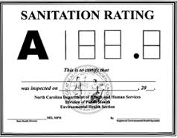
Public Display of Grade Cards (.1306)
REHS posts the grade card
Grade card posted where it can be readily observed by the public when entering the facility
96.0
This Photo by Unknown Author is licensed under CC BY-ND
This Photo by Unknown Author is licensed under CC BY-ND
Notes:
-May have to post multiple grade cards if there are multiple entrances used by residents/guests.
-Grade cards may need to be posted at all entrances (multiple in hospitals).

Slide 16
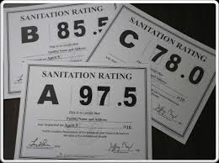
Re-inspections (.1307)
Re-inspections are unannounced
Requested by facility to raise the alphabetical grade
Must be conducted within 30 calendar days of request
Notes:
-Review of Rule .1307.

Slide 17
Scoring System (.1308)(a)
Grading based on ten-point scale
Sanitation score is a percentage determined by deducting points from 100 for each item found not to be in compliance
Deductions based on actual violations observed during the inspection
Zero, one-half, or full deduction based on severity or recurring nature of the violation
A 90-100
B 80-89.5
C 70-79.5
No Grade <70
Notes:
-Review of Rule .1308 (a).

Slide 18

Scoring System (.1308)(b)
If the institution or institution's dietary kitchen fails to score at least 70%:
  REHS shall notify the licensing agency within 24 hours of completing the inspection
  Provide copy of the inspection report to the licensing agency within two business days of the date of the inspection
Notes:
-Be sure to notify the EH Supervisor, Health Director, and Social Services (Adult Care Home Consultant) if dangerous conditions exist,
or if the facility receives a poor sanitation rating.
-Dangerous conditions include issues such as sewage backing up into the facility, failing septic system, unsafe water source, lack of adequate refrigeration, microbial growth/air quality issues, vector/pest infestation.
-The marking instructions with point values will be listed in .1308 of this section.

Slide 19
NC Division of Health Service Regulation
Complaint Main Number
919-855-4500
Website
https://info.ncdhhs.gov/dhsr/
*No permit action since this is a licensed facility
Notes:
-Contact information for DHSR.
-Make sure to also have contact numbers for adult care home specialists with local Social Services Departments.

Slide 20
Marking Instructions (.1308)(c)
(1) Violation of Rule .1309 of this Section regarding the cleanliness and repair of floors and carpet equal no more than two points.
(2) Violation of Rule .1310(a) of this Section regarding walls and ceilings shall equal no more than two points.
(3) Violation of Rule .1310(b) of this Section regarding ceiling attachments shall equal no more than one point.
(4) Violation of Rule .1311(a) of this Section regarding lighting levels shall equal no more than one point.
Notes:
ANIMATION
-Rule .1308 serves as the marking instructions for the inspection form.
-On the slide you’ll see a screenshot of items 1-4 (click for each item below to highlight on the slide):
Item number
Rule citation
Brief description of violation
Maximum point deduction that can be assessed.
Make sure that you use these marking instructions during the inspection to help familiarize yourself with the new rules and inspection form.
-Inspection form is on the next two slides.

Slide 21
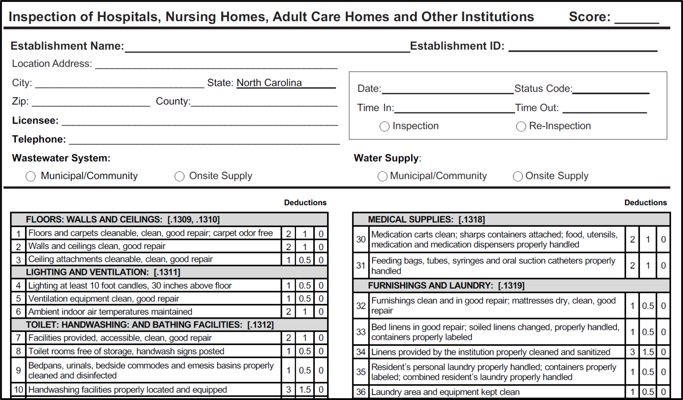
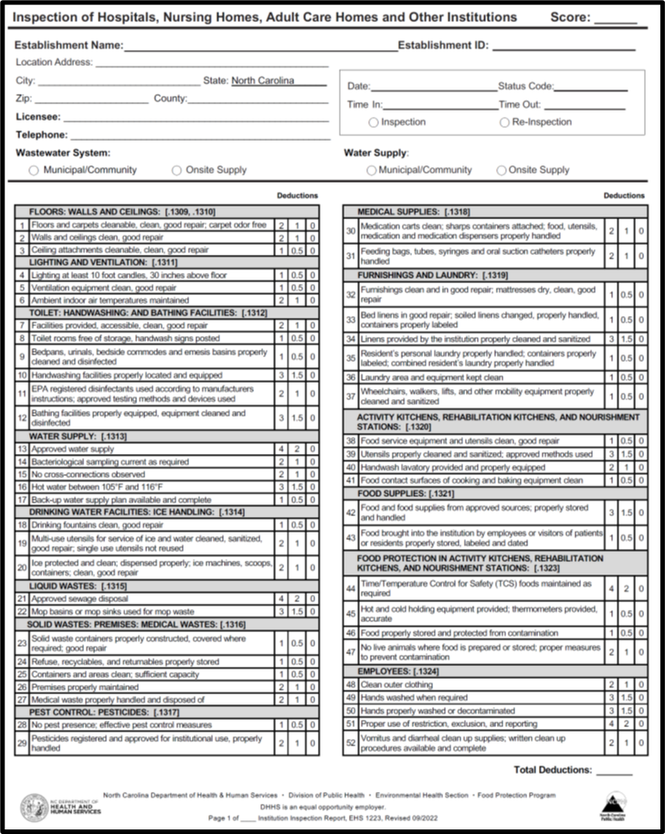
Notes:
-Here is a screenshot of the inspection form (click for inspection form to enlarge).
-The inspection form uses the same format as the food inspection form (click for each item below to highlight on the slide).
-Demographical information and inspection score are at the top.
-Inspection items listed below in two columns.
-Each section has a heading with applicable rule number.

Slide 22
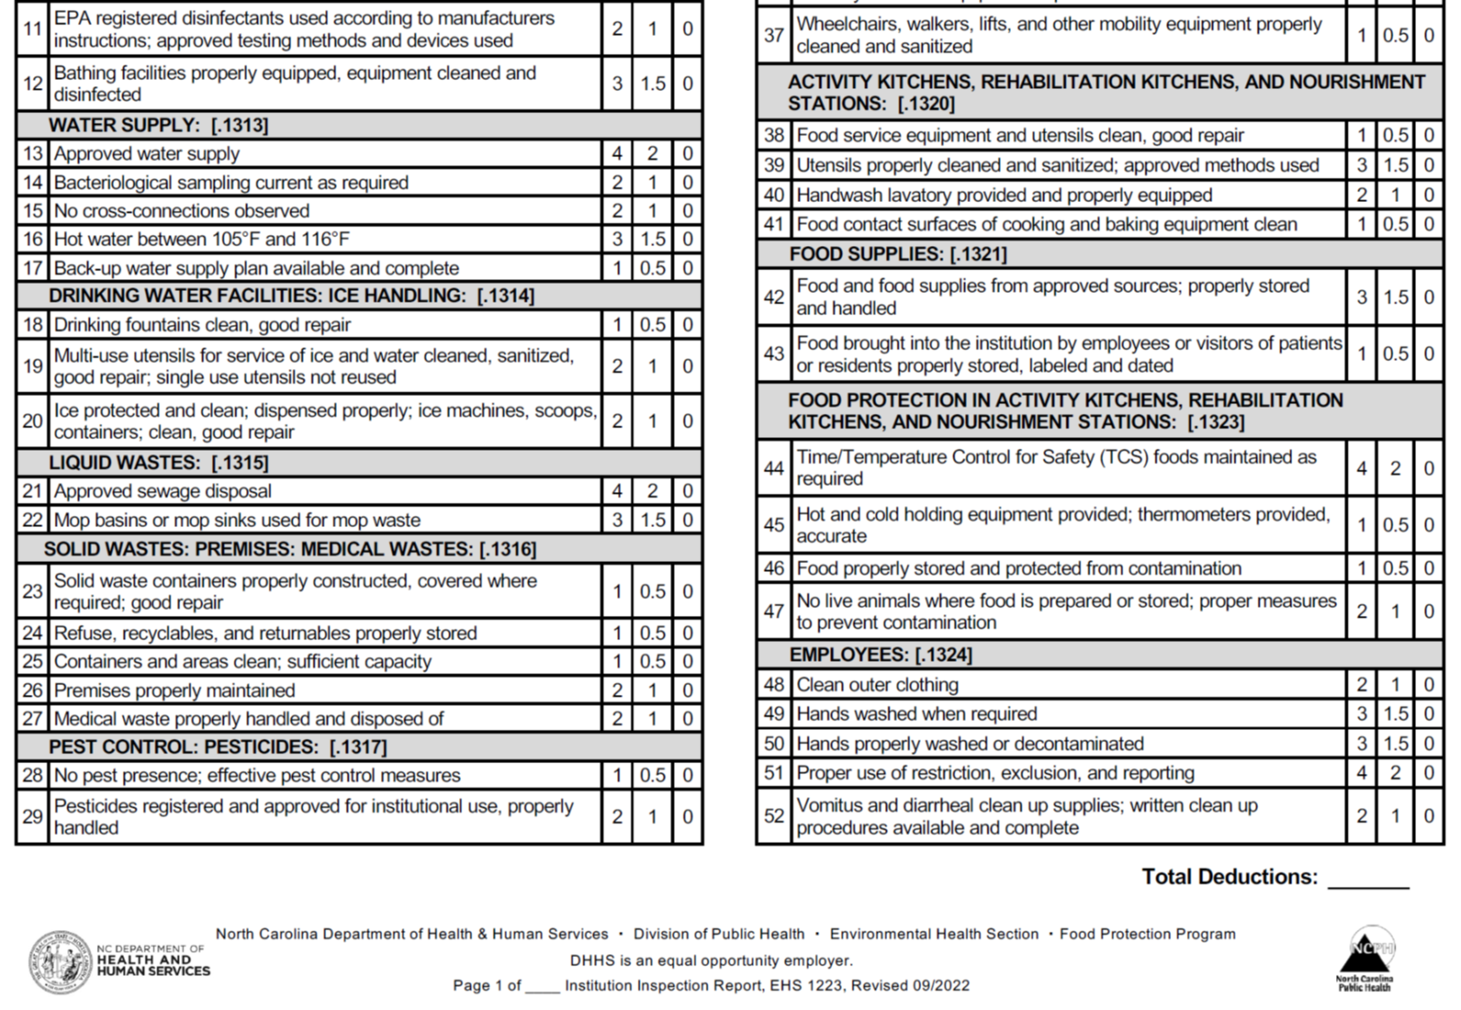
Notes:
-Here is a screenshot of the bottom of the report (click for the inspection form to enlarge).

Slide 23

Preparing for the Inspection

Slide 24

Establishment File Review
Review establishment file
  Inspection history
  (1-3 previous inspections)
  Complaints
  Onsite wastewater/water system information
  Verify demographical information
Notes:
-Conducting a good file review can help you focus on repeat violations and other issues that need follow-up from previous inspections.
-Be knowledgeable of on-site wastewater system serving the facility. Verify documentation/permits when necessary. If you notice any issues with the tanks/lids, pump box, or surfacing of effluent alert the on-site wastewater section.
-Be knowledgeable of the water supply serving the facility. If the water supply is a well, it must meet .1700 Rules and sampling requirements.
-Backup water supply plan may be in the file (recommended).

Slide 25
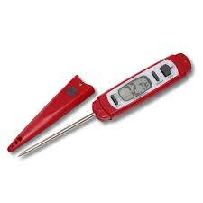
Do You Have Your Equipment?
  Thermometer/thermocouple
  Chemical test kits
  Flashlight
  Forms and administrative materials
Notes:
-Here is a list of items needed to conduct an institution inspection.

Slide 26

Conducting the Inspection

Slide 27

When You Arrive
Enter the main entrance of the facility
Introduce yourself
Ask the Administrator to accompany you during the inspection
Suggest housekeeping, maintenance, and any other staff members to accompany you
ADMINISTRATOR
DIDN’T YOU JUST DO THIS INSPECTION?
Notes:
-When you introduce yourself, show your ID badge, identify the agency you work for, state the purpose of your visit, and ask to speak to the Administrator.
-If facility requires you to sign in or out, please follow their policy.

Slide 28
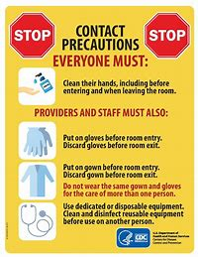
When You Arrive
Ask the administrator:
  Any active outbreaks in the facility?
    COVID-19
    Viral (Norovirus)
    Bacterial (C. difficile)
  Isolation/quarantine areas to avoid?
  Procedures when entering resident/patient rooms
Notes:
-Ask if there are any active outbreaks in the facility when you arrive. This includes COVID, viral outbreaks, bacterial outbreaks, etc. Where are these outbreaks located? Are they isolated? It is recommended that you avoid these areas. If there is an active outbreak throughout the facility, it is recommended that you postpone the inspection if possible. In addition, you should not be conducting an inspection if you feel sick.
-Ask the administrator how they would like for you to enter resident/patient care areas with regards to hand hygiene and infection control. Do they require handwashing, single-use gloves, hand sanitizer? It is recommended that you abide by the facility’s policies.

Slide 29

Communication
Establish rapport
Be an active listener
Ask strategic questions
Sell EH concepts
Be respectful
Be interactive
Notes:
29
29
-Ask open-ended questions, like “ When are bedpans cleaned” or “Can you explain how bedpans are cleaned”
-Use stories and examples to sell concepts in order to help the facility meet the Rules.
-Respect the administrator and employees. Be mindful of cultural differences.

Slide 30
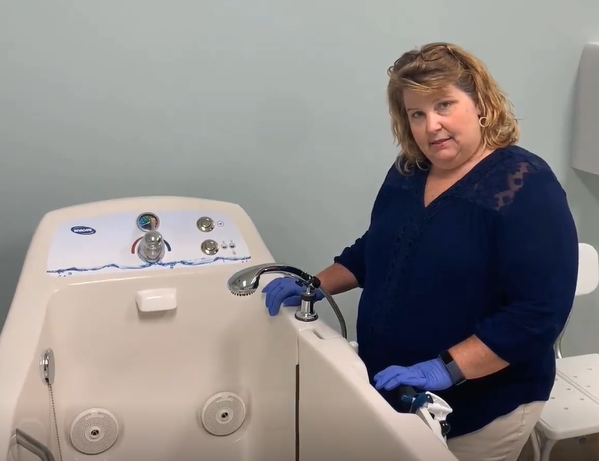
Communication
Ask a lot of open-ended questions
Ask for on-site correction of violations
Set a good example
  Handwashing, hand sanitizer, gloves
Ask to see documentation early
  Backup water supply plan
  Hand hygiene program (if required)
  Vomit & diarrheal event clean-up plan
Notes:
Opportunity for REHS to learn by asking questions. Don’t assume anything. There are a lot of topics to cover ranging from bedpans to medication storage. Make sure to cover them all. In the picture you see Jennifer asking how the whirlpool tub is cleaned.
In every case try to get on-site correction-just like a restaurant inspection.
If on-site correction doesn’t occur don’t get side-tracked it can wait to the end, make note and move on
Make sure you are washing hands, using disposable gloves or hand sanitizer when moving room to room to prevent possible transmission of communicable diseases between resident rooms and areas. Ask about hand hygiene policies.
Don’t forget to ask for this documentation (like the backup water supply & vomit/diarrhea cleanup plans) early to ensure that you have it by the time you sit down to write your report.

Slide 31

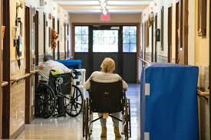
Remember Public Perception
Administrator
Housekeeping
Maintenance
Medical Staff
Residents
Notes:
-In every case, remember that you need to act professional to everyone. We all have a job to do. Act professional if you expect to be treated as a professional.
-Please remember in many cases you are inside residents’ homes. Treat this facility as if you are a guest in their home.
-Be careful not to be loud in hallways or leave their personal spaces in disarray after inspecting.

Slide 32
Notes:
-Now we will work our way down the inspection form.
-We will first discuss items 1-3.
-Please make sure participants have a copy of the inspection report and marking instructions as these topics are discussed.

Slide 33
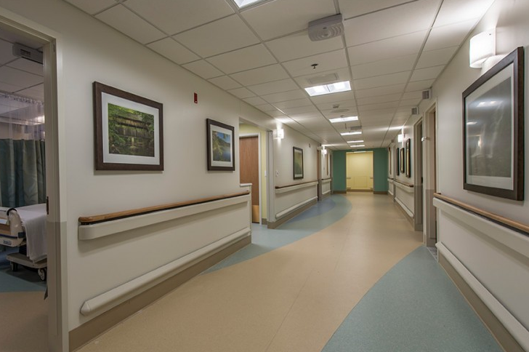
Floors (.1309)
Smooth & non-absorbent material
Kept clean & in good repair
Carpet odor-free
#1 on inspection form
Notes:
.1309
-Floors smooth and non-absorbent. Helps with keeping them clean.
-Floors kept clean and in good repair throughout the facility.
-Carpet clean, in good repair, and odor-free.
-Requirement for floor drains removed in new rules. Plan review issue addressed through licensing agency.
#1 on inspection form

Slide 34
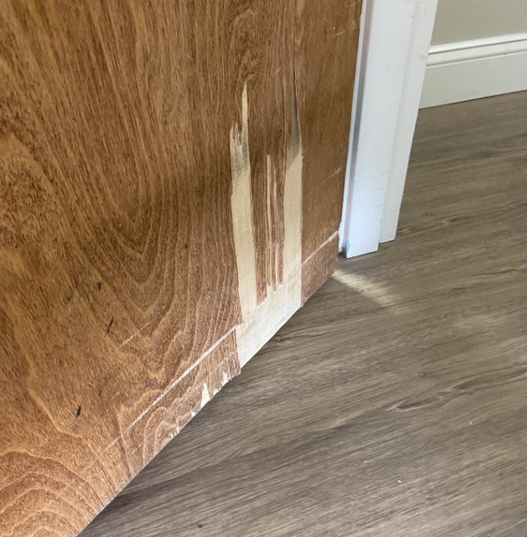
Walls & Ceilings (.1310)(a)
Interior walls & ceilings
Kept clean & in good repair
Doors, windows, and window trim
#2 on inspection form
Notes:
.1310 (a)
-Interior walls and ceilings clean and in good repair.
-Includes doors, windows, and window trim.

Slide 35
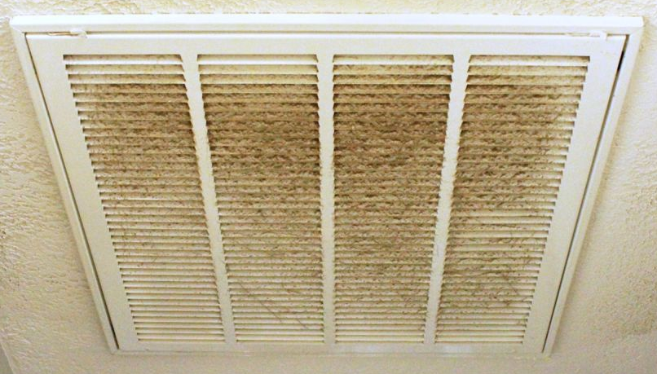
Ceiling Attachments (.1310)(b)
Ceiling attachments
Kept clean & in good repair
Light fixtures, fans, vents
#3 on inspection form
Notes:
.1310 (b)
-Ceiling attachments kept clean and in good repair.
-Includes light fixtures, fans, vents/covers, etc.
-Look for fixtures that are broken or dirty, molded ceiling vents, etc.
#3 on inspection form

Slide 36
Notes:
-Items 4-6

Slide 37
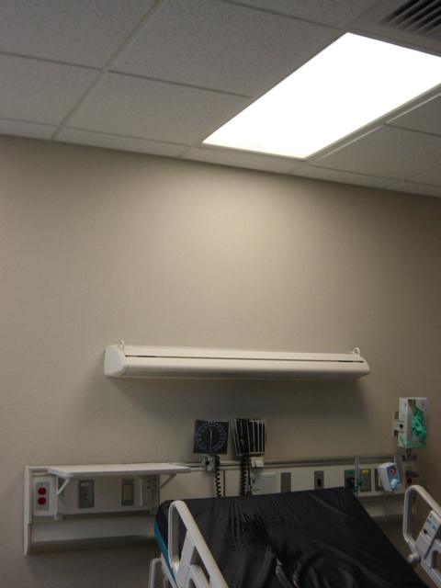
Lighting (.1311)(a)
At least 10 fc of light at 30 inches above the floor in all interior areas
#4 on inspection form
Notes:
.1311 (a)
-Maintain at least 10 foot-candles of light at 30 inches above the floor in all areas (same as before).
-Lighting in the dietary and ancillary kitchens must comply with .2600 Rules and would be addressed on the food inspection form.
-To assess lighting, use a light meter and document readings on inspection report if violations exist.
#4 on inspection form

Slide 38
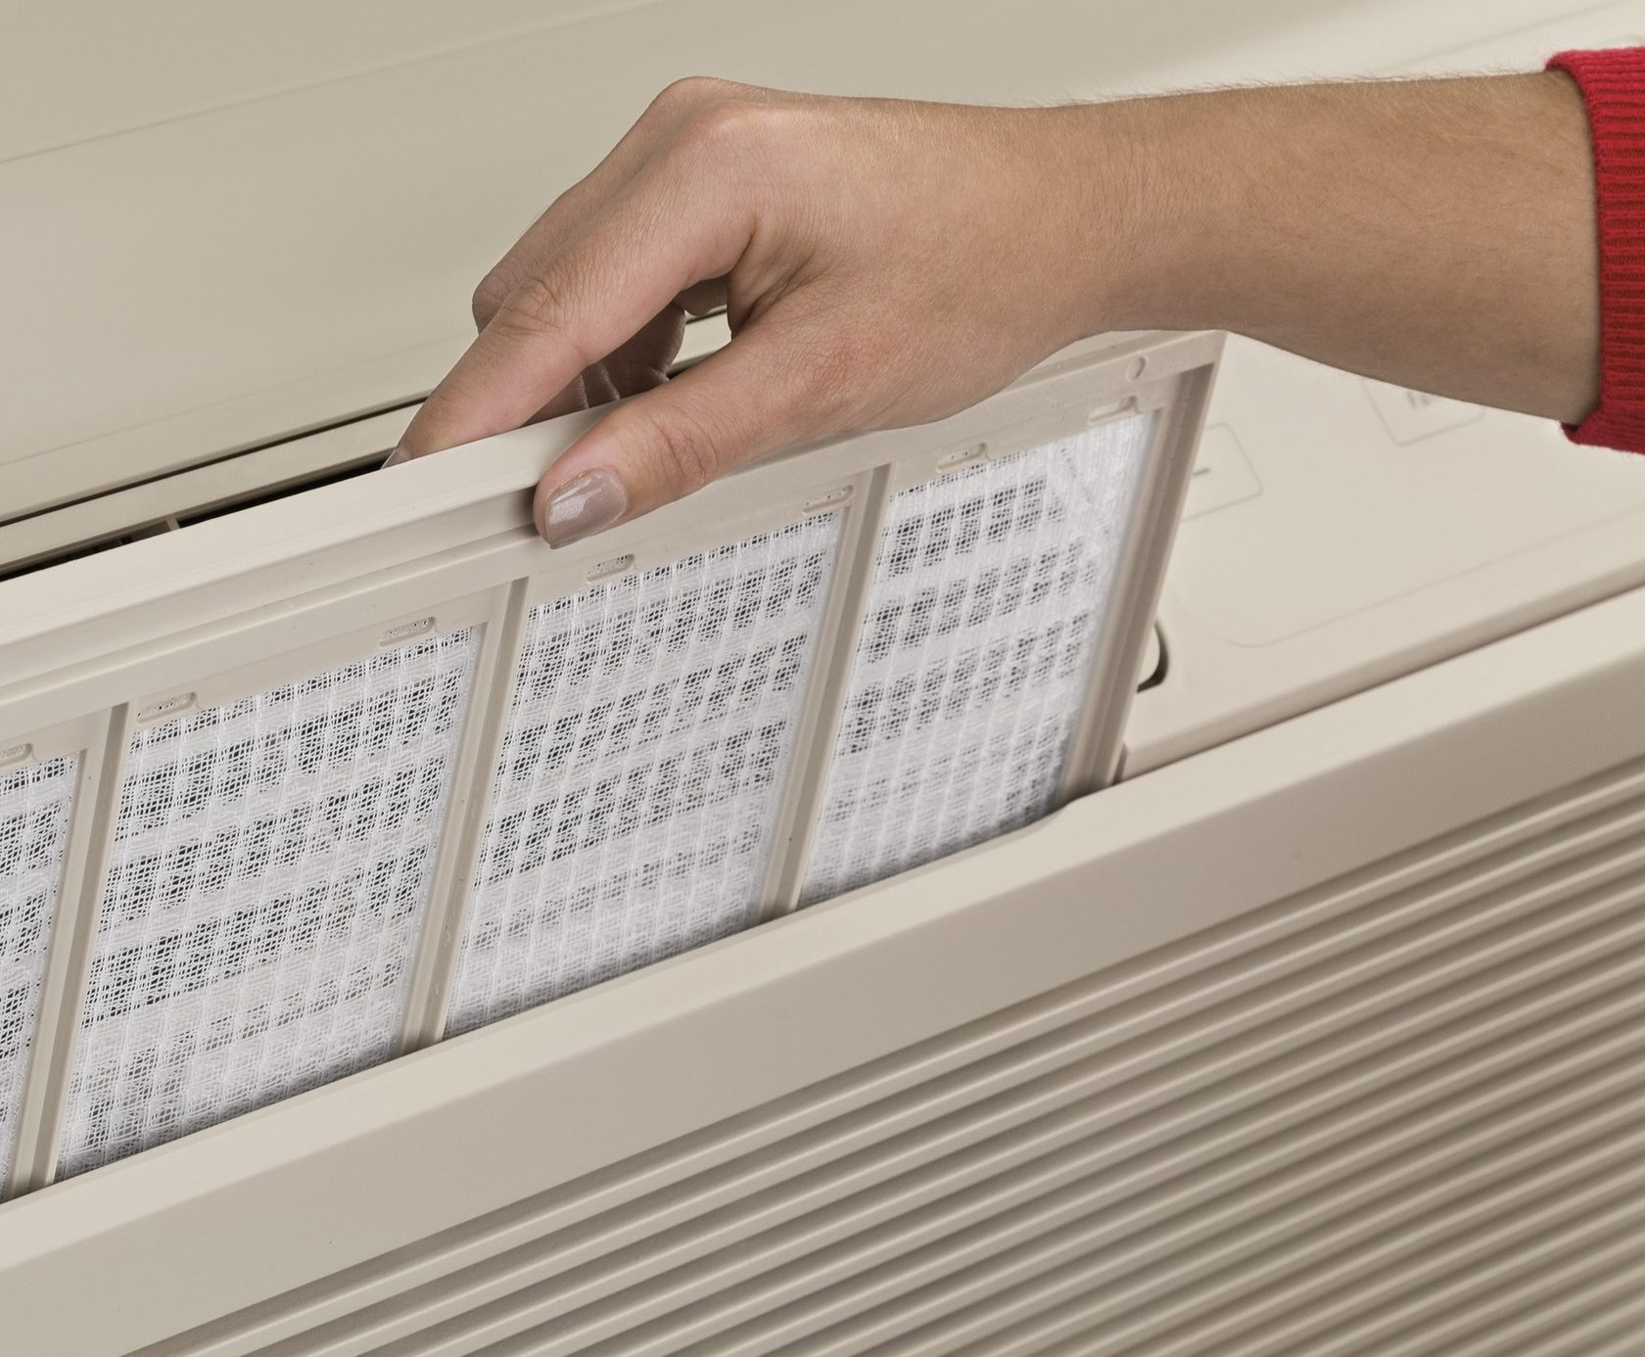
Ventilation (.1311)(b)
Ventilation equipment kept clean, in good repair
#5 on inspection form
Notes:
.1311 (b)
-Ventilation equipment kept clean and in good repair.
-Includes HVAC units and filters.
#5 on inspection form

Slide 39
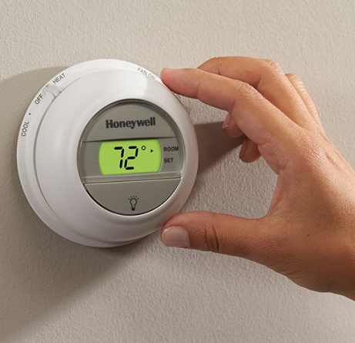
Indoor Air Temperature (.1311)(c)
Ambient indoor air temperature maintained at or below 85°F
#6 on inspection form
Notes:
.1311 (c)
-Ambient indoor air temperature maintained at or below 85 F.
#6 on inspection form

Slide 40
Notes:
-Items 7-12

Slide 41
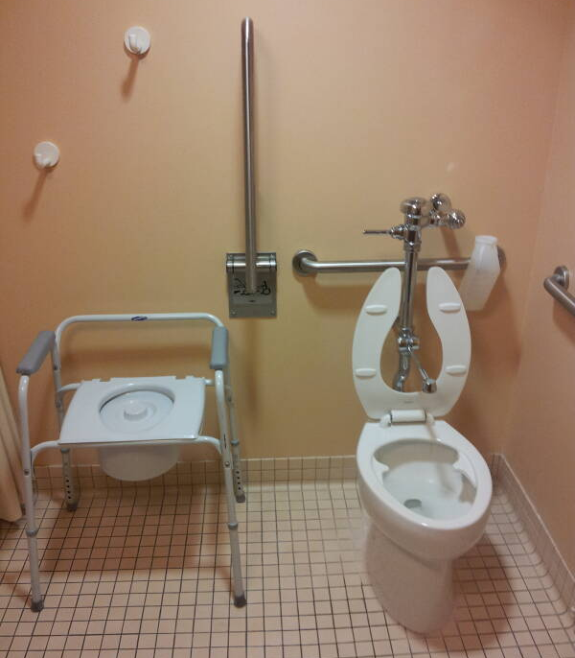
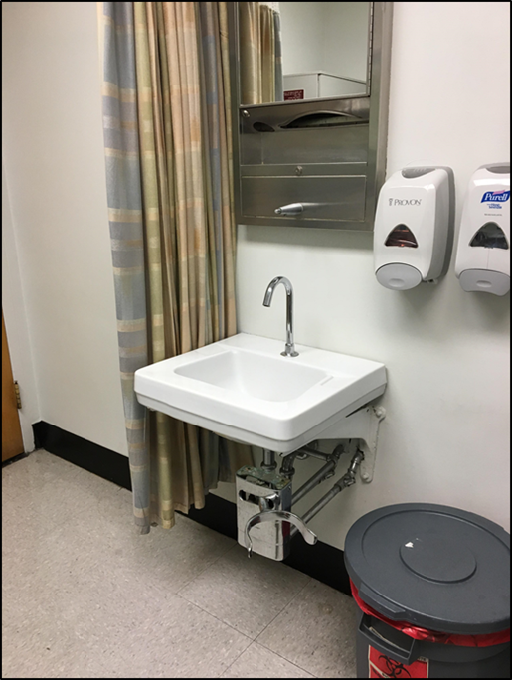
Toilet: Handwashing: and Bathing Facilities (.1312)(a)
Accessible to residents and staff
Kept clean and in good repair
#7 on inspection form
Notes:
.1312 (a)
-Toilet, handwashing, and bathing facilities accessible to residents and staff.
-Kept clean and in good repair.
-This would include sinks/faucets, toilets, potty chairs/seats, shower curtains/rods, fixtures, shower inserts, shower heads, cabinets/storage units in these areas, etc.
#7 on inspection report

Slide 42
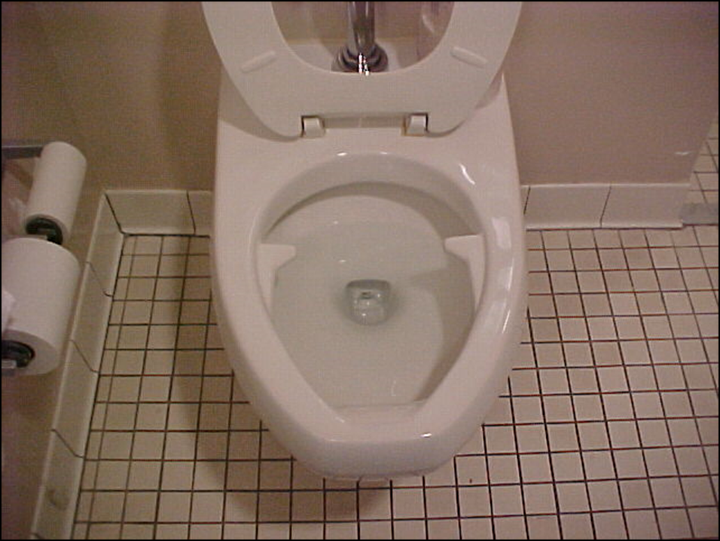
Toilet Rooms (.1312)(b)
Toilet rooms not used for storage
Handwashing sign posted in rooms used by institution employees
#8 on inspection form
Notes:
.1312 (b)
-Toilet rooms shall not be used for storage. This would include boxes of files, extra wheelchairs/equipment, and bulk cleaning supplies.
-Handwashing signs posted in ALL toilet rooms used by institution employees directing them to wash hands before returning to work (not just toilet rooms used by food service employees).
#8 on inspection form

Slide 43
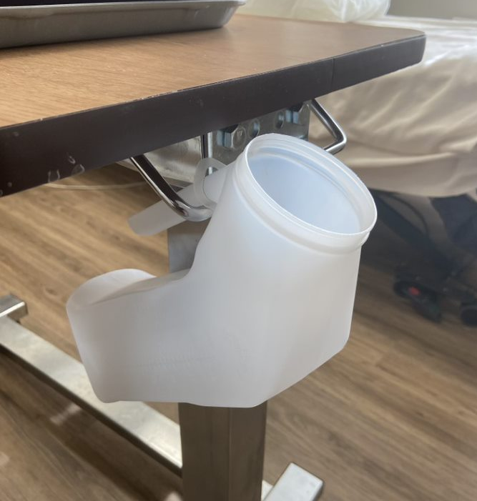
Bedpans, Bedside Commodes, Urinals & Emesis Basins (.1312)(c)
Facilities provided for emptying, cleaning, and disinfecting
Kept clean
Disinfected before use by other residents
Includes shared diaper changing surfaces
Notes:
.1312 (c)
-Facilities for emptying, cleaning, and disinfecting must be provided. Good open-ended questions are needed here. Let the employee(s) explain how they do this. Are they using the hand sink? Do they have a hopper?
-Items must be kept clean. Do a quick visual. Disinfection is only required when the item will be used by another resident (not common these days since most are disposable).
-Be on the lookout for diaper changing surfaces (new addition). Another good opportunity for open-ended questions. Do they have one? If so, how/when is it cleaned and disinfected?

Slide 44
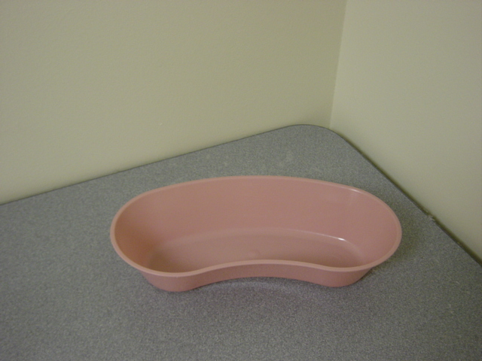
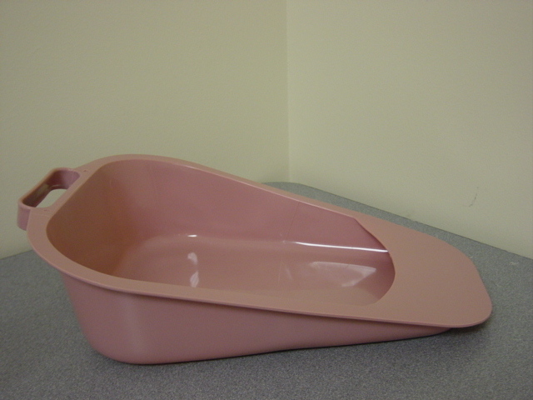
Bedpans, Bedside Commodes, Urinals & Emesis Basins (.1312)(c)
When reused, labeled so they are associated with an individual resident
Shall not be used by more than one resident
#9 on inspection form
James M.
131A
Notes:
.1312 (c)
-If reused, these items must be labeled so they are associated with an individual resident. Resident name, room/bed number, or other effective method allowed.
-Items should not be used by more than one resident.
#9 on inspection form

Slide 45
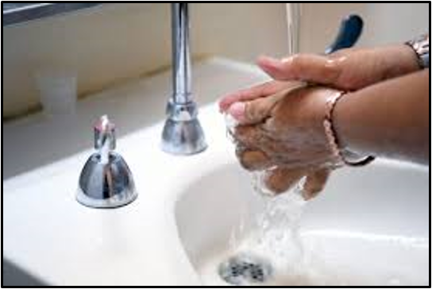
Handwashing Facilities (.1312)(d)
Located per licensing agency requirements:
  Patient rooms
  Toilet rooms (unless connected to a patient room with hand sink)
  Therapy rooms
  Drug storage and preparation areas
  Clean and soiled utility
  Nursing units
  Nourishment stations
#10 on inspection form
Notes:
.1312 (d)
-Handwashing facilities provided in areas designated by the licensing agency (10A NCAC 13D .3201, Required Spaces). Other references listed below:
10A NCAC 13B – 5411 (11)
10A NCAC 13D – 3201 (F)
10A NCAC 13F – 0305 (j); (F5); (E 1)
10A NCAC 13K – 1109 (B2); (C4); 1204 (C1); (D 1F); (2C); (3C); 1205 (B 1d, D)
-Patient rooms, not necessarily toilet rooms connected to patient rooms; toilet rooms (unless connected to a patient room with a hand sink); therapy rooms or space; minimum of 1 hand lavatory for each 5 residents; adjacent to drug storage and preparation areas; clean and soiled utility rooms; nursing units; nourishment stations.
#10 on inspection form

Slide 46
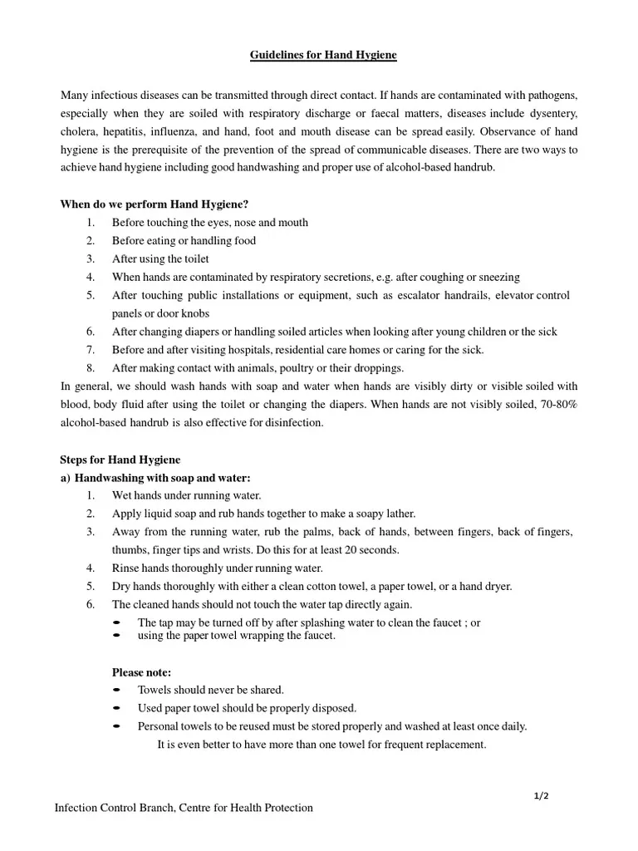
Hand Hygiene Program (.1312)(d)
Written plan implemented when handwashing facilities are not located in required areas
Must be approved by the LHD prior to implementation; written approval provided to licensee
Notes:
.1312 (d)
-When handwashing facilities are not provided in required locations, a written hand hygiene plan must be implemented. This is typically seen in older facilities.
-Plan must be approved by the local health department PRIOR to implementation.

Slide 47
Hand Hygiene Program (.1312)(d)
Plan should address:
  Type and frequency of activities that involve employee or resident contact with bodily excretions or secretions
  The number of handwashing facilities on each wing or floor of an institution’s building or buildings
#11 on inspection form
Notes:
.1312 (d)
-Discuss what should be provided in the plan (on the slide).
#11 on inspection form

Slide 48
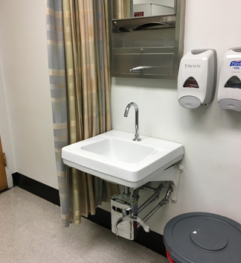
Handwashing Facilities (.1312)(d)
Equipped with:
  Running water
  Tempering device
Supplied with:
  Soap
  Disposable or individual towel or hand-drying devices
#10 on inspection form
Notes:
.1312 (d)
-Requirements for handwashing facilities. Discuss slide.
-Will typically see knee/foot pedals or automatic faucets in larger facilities and hospitals.
-Some sinks may be equipped with individual tempering devices (mixing valves) that may need adjustment during the inspection.
#10 on inspection form

Slide 49
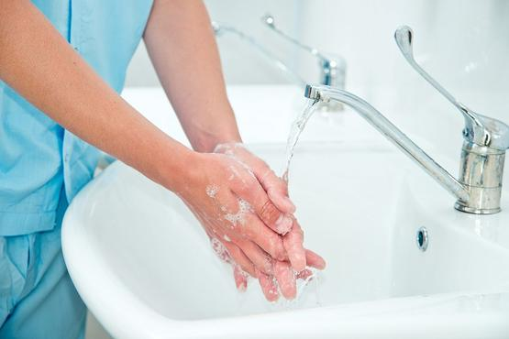
Handwashing Facilities (.1312)(d)
Can be used only for handwashing
Cannot be used for disposal of bodily fluids or washing items that are not clean
#10 on inspection form
Notes:
.1312(d)
-Handwashing facilities only used for handwashing.
-Cannot be used for disposal of bodily fluids or washing unclean items. This would include bedpans, emesis basins, etc.
#10 on inspection form

Slide 50
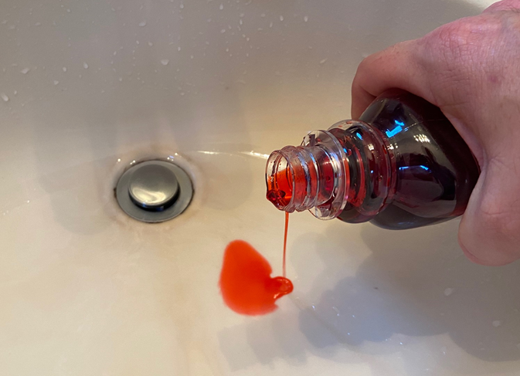
Handwashing Facilities (.1312)(d)
In Resident Rooms:
  Personal hygiene
  Rinsing feeding tubes
  Obtaining drinking water
  Disposal of medications or non-TCS liquids as long as the handwashing facility is kept clean and is disinfected daily
Notes:
.1312(d)
-Handwashing facilities in resident rooms can be used for certain activities. Read and discuss slide.
-Personal hygiene includes brushing teeth, rinsing mouth, shaving, etc.
-Disposal of medication or non-TCS liquids as long as the handwashing facility is kept clean and is disinfected daily

Slide 51
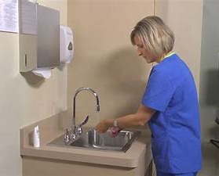
Handwashing Facilities (.1312)(d)
  Hand sinks in medication rooms may be used to dispose of medications
  In accordance with manufacturer's instructions
Notes:
.1312(d)
-This will typically be seen in med rooms. Good open-ended question opportunity. Do they dispose of medications in the sink? If so, where?

Slide 52
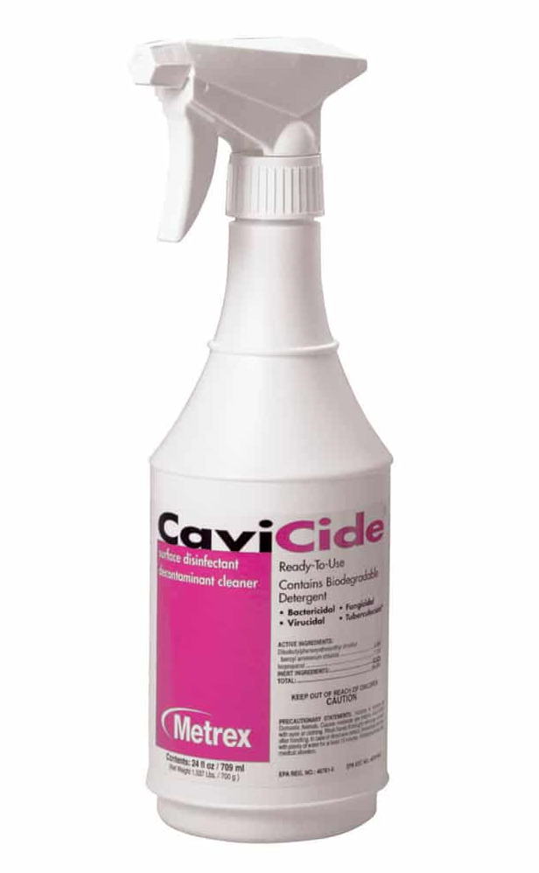
Disinfectants (.1312)(e)
Disinfectants:
  EPA registered
  Used in accordance with manufacturer's instructions
Measuring device, chemical testing device, or the methods and devices prescribed by the chemical manufacturer used when disinfectant is mixed and prepared by institution employees
#11 on inspection form
Notes:
.1312(e)
-Good open-ended questions. What do you use to disinfect bathing surfaces? Where is the disinfectant stored? Does it come in pre-mixed bottles? Do you mix the disinfectant on-site? If so, how do you verify the concentration? How long do you allow the disinfectant to remain on the surface (check the label for requirements)?
#11 on inspection form

Slide 53
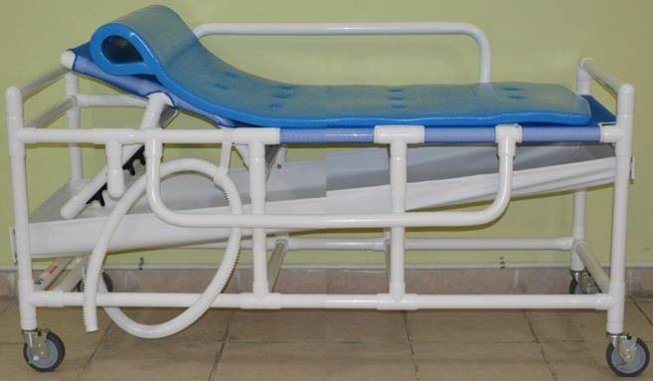
Bathing Facilities (.1312)(f)
Bathing facilities equipped:
  Running water
  Tempering device
Bathing equipment that has contact with a resident’s skin and is used by more than one resident kept clean and disinfected between resident uses
#12 on inspection form
Notes:
.1312(f)
-Bathing facilities equipped with running water and tempering device.
-Bathing equipment that has contact with a resident’s skin and is used by MORE THAN ONE RESIDENT is cleaned AND disinfected between resident uses.
-Good open-ended question. Is this equipment used by more than one resident? If so, how and when is it cleaned and disinfected? What chemicals do you use? How long do you allow the disinfectant to remain on the surface (check label for requirements)?
#12 on inspection form

Slide 54
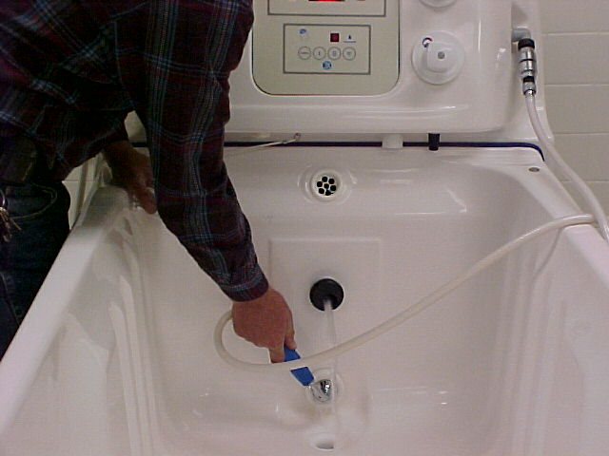
Bathing Facilities (.1312)(f)
Bathing equipment that uses a pump to move water kept clean in accordance with the manufacturer’s instructions
#12 on inspection form
Notes:
.1312(f)
-Good open-ended questions. Ask the person you are with “who is responsible for cleaning bathing equipment that is shared?” Once you find out, see if you can get that person to come to the area and ask them “when do you clean bathing equipment?“, “what is the process for cleaning bathing equipment between users?”. Do not lead them into the disinfecting process or contact time with initial questioning. Ask responsible staff to demonstrate process if necessary.
#12 on inspection form

Slide 55
Notes:
-Items 13-17

Slide 56

Water Supply (.1313)(a-c)
Community
Non-community
  Meets .1700 Rules
  Bacteriological sample collected once a year
No cross-connections
#13, #14, and #15 on inspection form
Notes:
.1313(a)
-Facility served by a community or non-community system.
-If facility is served by a well, the well must meet .1700 Rules.
-If issues are noted with the well or well head, consult a Supervisor or REHS that is authorized in Wells.
#13 on inspection form
.1313(b)
-If facility is served by a well, the water supply must be sampled at least annually for bacteria.
#14 on inspection form
.1313(c)
-There should be no cross-connections in the plumbing system. Remember, a cross-connection is a physical connection between the potable water supply and the wastewater disposal system.
#15 on inspection form

Slide 57
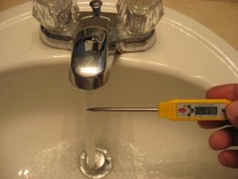
Water Supply (.1313)(d)
Water heating facilities provided
Hot and cold running water under pressure provided and sufficient to carry out all operations
Hot water shall be provided between 105°F-116°F at handwashing and bathing facilities
#16 on inspection form
Notes:
.1313(d)
-Read and discuss slide.
-Note the water temperature change.
#16 on inspection form

Slide 58
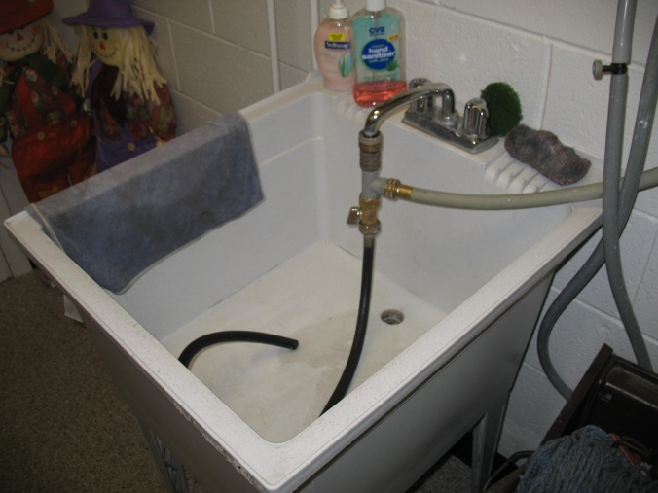
Notes:
-This picture shows a potential cross-connection.

Slide 59
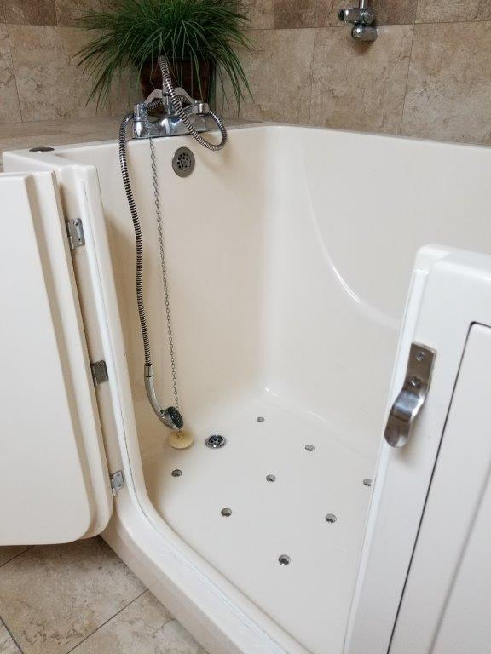
Notes:
-Another potential cross-connection when door to the tub is closed.

Slide 60
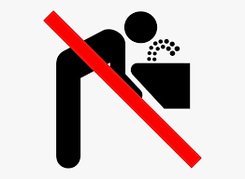
Interruption of Water Supply (.1313)(e)
Water supply interrupted >4 consecutive hours, licensing agency & LHD notified
Written plan provided to obtain backup water supply or alternate water source
  Two liters of potable water per day per resident and employee for drinking
  Potable water provided for other activities
  Relocation of residents
Sources labeled or hooded to prevent use
#17 on inspection form
Notes:
.1313(e)
-Administrator of the institution is responsible for contacting the licensing agency and the local health department if water supply is interrupted for more than 4 hours.
-Written plan is required. Must provide at least 2 liters of potable water per day per resident & employee for drinking. Other activities include food preparation, hand washing, bathing, cleaning, dishwashing, laundry and disposal of bodily waste. In some cases, residents may have to be relocated.
-Some plans are very generic and basic. Good open-ended questions would be necessary in this case to determine if the facility is in compliance with this requirement. Are changes/additions needed in the plan?
-Sinks, water fountains, and other sources of drinking water would need to be labeled or hooded to prevent use by residents and employees. Faucets could be turned off at the source as well to prevent use.
#17 on inspection form

Slide 61
Notes:
-Items 18-20

Slide 62
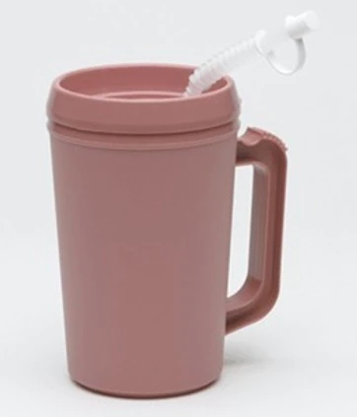
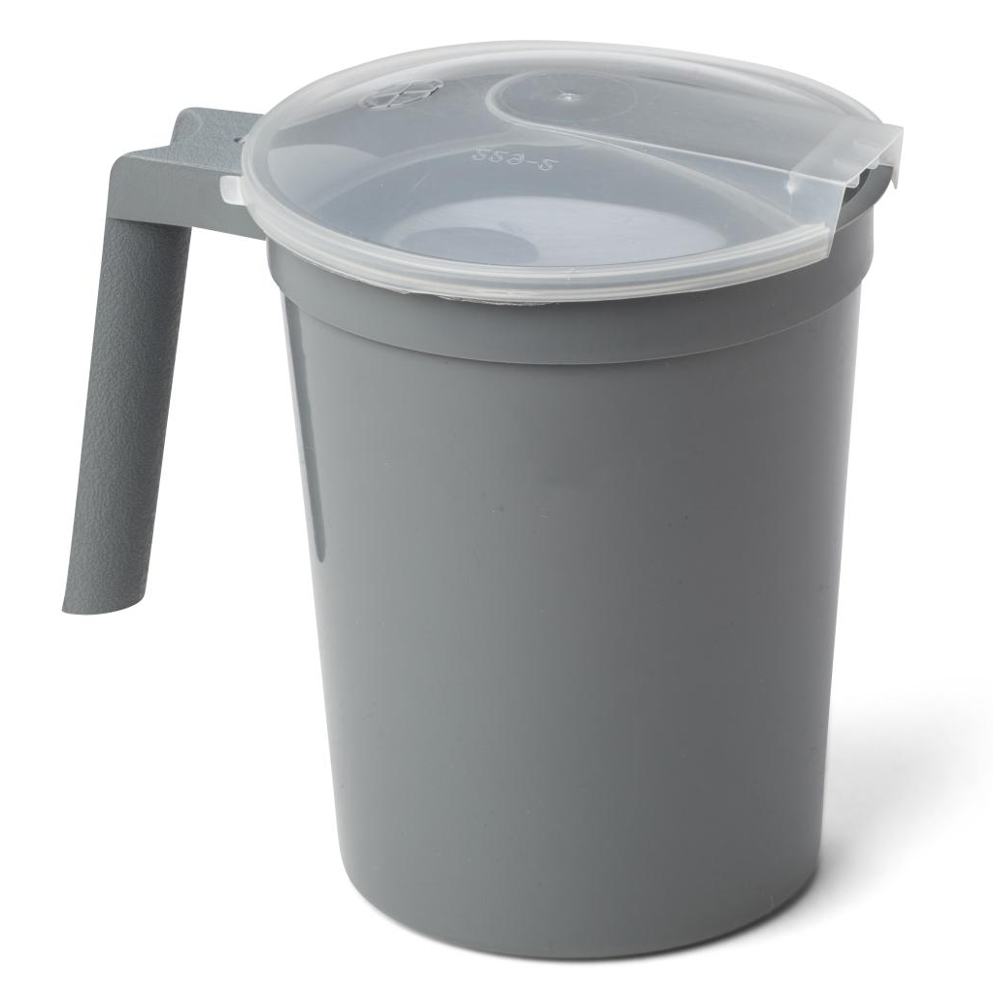
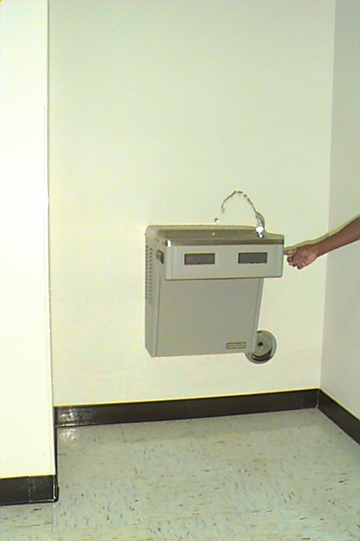
Drinking Water Facilities (.1314)(a & b)
Water fountains:
  Kept clean & in good repair
Multi-use utensils for service of water and ice:
  Kept clean & in good repair
  Sanitized before being provided to a resident for use
Disposable, single-service utensils used by only one person
#18 and #19 on inspection form
Notes:
.1314(a)
-Water fountains kept clean and in good repair. Quickly check them as you walk by. Many have been turned off since COVID-19.
#18 on inspection form
.1314(b)
-Multi-use utensils, such as water pitchers, should be taken to the dietary kitchen to be washed, rinsed, and sanitized between resident uses. Pictured top-left on the slide. Pitcher could remain in a resident’s room for several days before cleaning. This is okay as long as it is visibly clean. Good open-ended questions. Where are pitchers cleaned and sanitized? How (3-compartment sink or dish machine)? Keep in mind that the straws that come with the pitchers are hard to clean and sanitize. Recommend that the facility uses disposable straws instead.
-Disposable, single-use pitchers are to be used by only one person. Pictured top-right on the slide. No labeling is required in the Rules.
#19 on inspection form

Slide 63
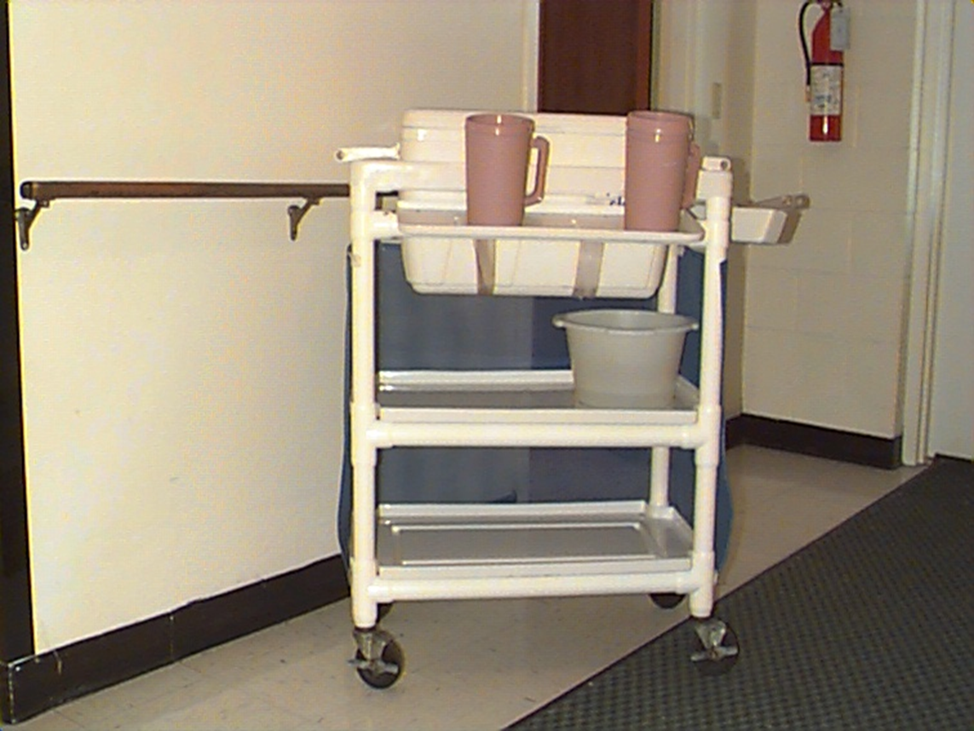
Ice Handling (.1314)(c)
Ice protected against physical, chemical, and biological contamination and kept clean
Ice machines, buckets, and scoops kept clean and in good repair
Ice machines and storage chests accessible to residents, guests, or the public:
  Ice provided through automatic ice dispensing equipment
  Ice cannot be accessed using a scoop or bucket
#20 on inspection form
Notes:
.1314(c)
-Read and discuss slide.
-Monitor hallways for unattended ice chests/carts. Good open-ended questions. Is the cart in use? Where is it stored when it is not in use? How often is the cooler/ice scoop cleaned? Where are these items clean?
-Monitor dining rooms and common areas for bowls of ice with a scoop.
-How do you protect an ice machine located in a dining area or other accessible area? Work with administrator or maintenance staff to come up with a solution. Lock?
#20 on inspection report

Slide 64
Notes:
-Items 21-22

Slide 65
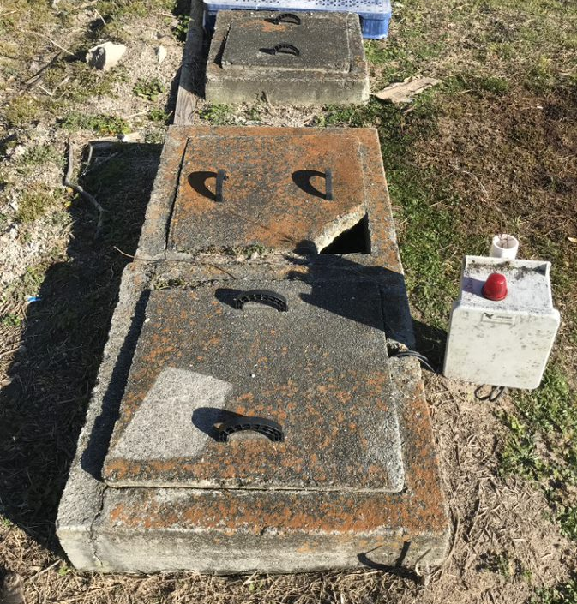
Liquid Waste (.1315)(a & b)
Approved wastewater disposal system
  Publicly operated
  On-site system
Mop basin or mop sink used to wash mops and dispose of mop water
#21 and #22 on inspection form
Notes:
.1315(a)
-Wastewater disposed of using a public or on-site wastewater disposal system (operated in accordance with .1900 Rules).
-Remember, file review is important to determine if the facility is served by an on-site wastewater disposal system and where it is located.
-If issues are observed with the on-site wastewater disposal system, contact your Supervisor or other REHS that is authorized in on-site wastewater.
#21 on inspection form
.1315(b)
-Good open-ended question. Where is mop water disposed of? Do you have a mop sink or basin?
-Watch for signs of mop water being dumped outside on the grass or in the parking lot.
#22 on inspection form

Slide 66
Notes:
-Items 23-27

Slide 67
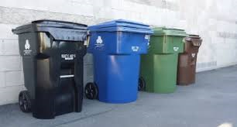
Solid Waste (.1316)(a & b)
Stored in leak-proof, non-absorbent containers with tight-fitting lids when not in use
Refuse, recyclables, and returnables stored in containers, rooms, or designated areas
#23 and #24 on inspection form
Notes:
.1316 (a)
-First bullet
#23 on inspection form
.1316(b)
-Second bullet
#24 on inspection form

Slide 68
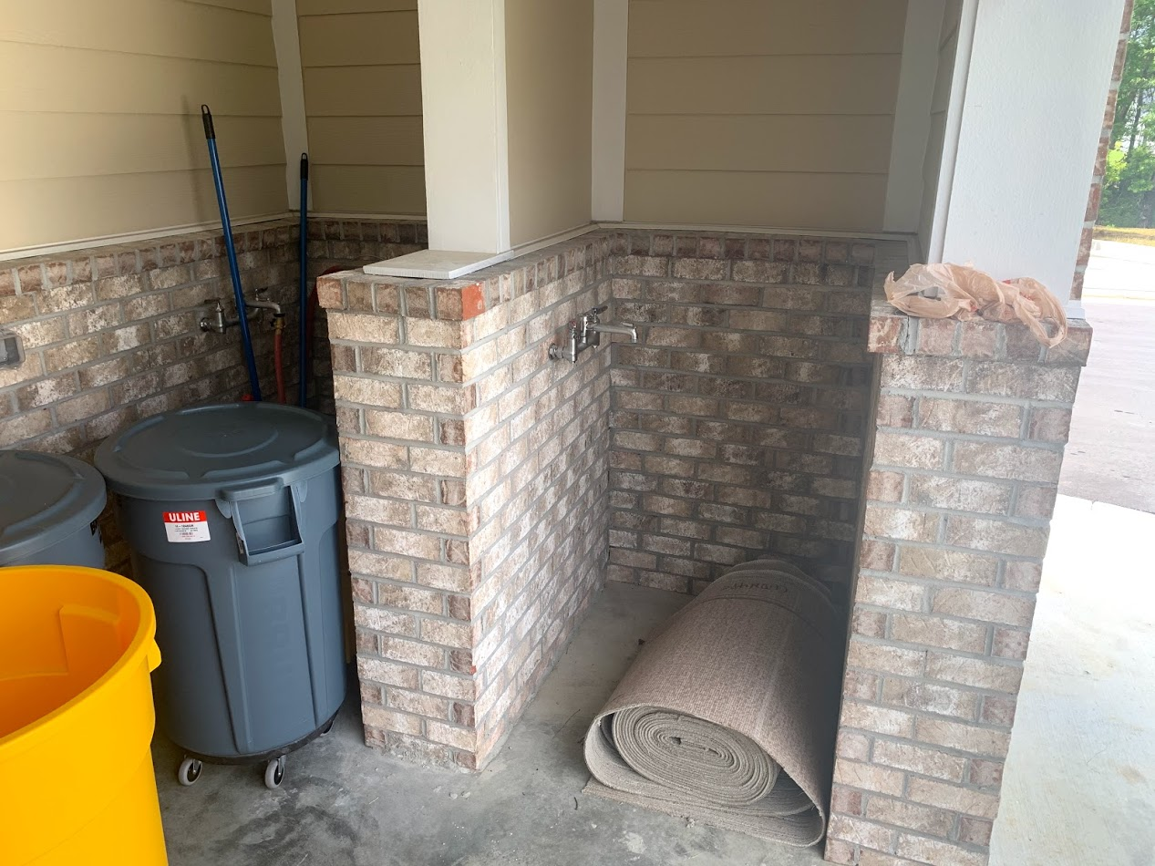
Solid Waste (.1316)(c)
Designated rooms and containers adequate and kept clean
Cleaning facilities for containers provided
#25 on inspection form
Notes:
.1316(c)
-Read and discuss slide.
-This is an example of an outside can-cleaning and equipment cleaning area that has hot/cold water and drain.
#25 on inspection form

Slide 69

Premises (.1316)(d)
Exterior and interior premises kept free of garbage, solid waste, yard trash, pest harborages
#26 on inspection form
Notes:
.1316(d)
-Read and discuss slide. Remember to walk around the property to see if any issues exist.
#26 on inspection form

Slide 70

Medical Waste (.1316)(e)
Medical wastes shall be handled and disposed of as required in NC "Solid Waste Management Rules" 15A NCAC 13B .1200
#27 on inspection form
This Photo by Unknown Author is licensed under CC BY-SA
Notes:
.1316(e)
-For a review, ask participants what they consider medical waste. Put answers in the chat.
-Items considered medical waste:
• Containers, catheters, or tubes containing blood, blood products or OPIM
• Surgical specimens
• Dialyzers and tubing
• Microbiology specimens, used culture plates, tubes, bottles and devices
• Blood spill clean-up materials
• Needles and syringes, scalpel blades, lancets
• Glass pipettes, slides and tubes
• Broken glass
• Staples and wires (Cardio-catheter wires)
• Disposable suture sets and biopsy forceps
-Explain to participants what items are NOT considered medical waste:
Expired medications
• PPE, unless saturated with blood or other potentially
infectious material (OPIM)
• Empty IV bags, bottles and tubing (without needles)
• Empty urine and stool containers, Foley/catheter bags.
Stool and urine should be poured down the toilet
(includes stool and urine from an isolation patient)
• Disposable basins, bedpans, urinals
• Diapers, chux/bed pads (unless grossly soiled with blood or OPIM)
• Adhesive bandages
• Exam gloves
• Sanitary napkins and tampons (personal)
• Unused medical products and supplies
-Use caution around medical waste containers. Observe to make sure medical waste is stored in the container correctly. DON’T TOUCH!!!
-"Medical waste" means any solid waste which is generated in the diagnosis, treatment, or immunization of human beings or animals, in research pertaining thereto, or in the production or testing of biologicals, but does not include any hazardous waste identified or listed pursuant to this Article, radioactive waste, household waste as defined in 40 Code of Federal Regulations § 261.4(b)(1) in effect on 1 July 1989, or those substances excluded from the definition of "solid waste" in this section.
-All medical waste shall be handled and disposed of as required in 15A NCAC 13B. 1200 Medical Waste Management. These rules can be found by doing a quick search online.
#27 on inspection form

Slide 71
Notes:
-Items 28-29

Slide 72

Pest Control (.1317)(a)
Buildings free of pests
Openings to the outside equipped with:
  Self-closing doors
  Closed windows
  Window screening
  Controlled air curtains
#28 on inspection form
Notes:
.1317(a)
-Buildings free of pests. Ask participants what type of pests would we typically see in an institution. Put answers in the chat.
Mice, roaches, flies, bedbugs
-Ways to prevent vermin from entering the facility:
Self-closing doors
Closed windows
Window screening
Controlled air curtains
-Make sure to look at windows and doors closely for compliance. Look under doors to the outside to check for gaps where pests can enter.
#28 on inspection form

Slide 73

Pesticides (.1317)(b)
Registered
Used, handled, and stored per manufacturer's instructions
#29 on inspection form
Notes:
.1317(b)
-Read and discuss slide.
-Good open-ended question. Do you do apply pesticides on-site? If so, where are they stored? (Not our jurisdiction, but are they licensed?)
#29 on inspection form

Slide 74
Notes:
-Items 30-31

Slide 75

Medical Supplies (.1318)(a)
Medication carts kept clean
Food, utensils, medications, and medication dispensing equipment used on med carts kept clean
Sharps containers on med carts attached or secured to prevent spilling
#30 on inspection form
Notes:
.1318(a)
-Don’t be afraid to have the nurse open the drawers to check for cleanliness.
-Check food & beverage items on the cart to ensure they are stored properly and held per manufacturer’s instructions (TCS food items held at 41 F or below or using TPHC procedures). Good open-ended question. What type of food items do you use on the med carts? Typically going to see apple sauce, pudding, shake mix, or non-TCS beverages. However, some facilities may use TCS foods like yogurt or milk.
-Check the cleanliness of the pill crusher.
-Check the compartment holding the cups/straws/spoons for cleanliness.
-Check to make sure that the sharps container is not stored over consumables, and make sure that gloves/tissues are not stored on top of the sharps container.
#30 on inspection form

Slide 76


Medical Supplies (.1318)(b)
Feeding bags, tubes, syringes, and oral suction catheters stored and used in accordance with the manufacturer’s instructions
#31 on inspection form
Notes:
.1318(b)
-Feeding bags, tubes, syringes, and oral suction catheters stored properly.
-Good open-ended questions: Is there anyone in the facility using feeding bags, tubes, syringes, or oral suction catheters? Where are feeding tubes, syringes, and oral suction catheters stored when not in use? How often are these items replaced? How often are they being cleaned? Where are they cleaned? How are these items labeled?
-On the slide, there is a picture of a feeding syringe with tube and a liquid supplement used for tube feeding (hung from an IV pole).
-Typically, feeding items are used for 24 hours. Syringes and tubes are typically labeled with the name of the resident and placed (clean) back into the original packaging for storage. Ask questions!
#31 on inspection form

Slide 77
Notes:
-Items 32-37

Slide 78

Furnishings (.1319)(a)
Includes:
  Furniture
  Mattresses/bed springs
  Curtains, rugs, & blinds
Kept clean and in good repair
Mattresses clean, dry, and in good repair
#32 on inspection form
Notes:
.1319(b)
-Be sure to open drawers, look in closets, look at blinds, look at mattress pads/mattresses, bedframes, inside of refrigerators, and check dusting of furniture/pictures.
-Remember, you are in a resident’s home. Make sure to ask permission to look in their rooms and be respectful. Use gloves as well when necessary.
-If housekeeping is available, have them correct items when needed.
-For furnishings not provided by the facility that are not in good condition, work with the facility to encourage correction. (Remind participants not to have
facilities throw out personal belongings. Be understanding.)
#32 on inspection form

Slide 79


Linens (.1319)(b)
Clean linen:
  Free from holes and tears
  Changed when no longer clean
Unclean linen:
  Placed in a covered and labeled container at point of use
  Handled and stored separately from cleaned and sanitized linen
#33 on inspection form
Notes:
.1319(b)
-Clean linen free from holes and tears. Make sure that you are looking at random resident beds for damaged/unclean linens.
-Keep in mind that staff may not have reached some rooms prior to your inspection. Residents may get back into the bed with dirty shoes or food after the staff has already checked the bed. Good open-ended questions. Has the CNA/housekeeper made it to this room? If so, has the bed been checked today? How often are the linens changed?
-Unclean linen shall be placed in covered container or bag at the point of use and stored/handled so as to contain and minimize aerosolization of and exposure to any waste products.
-Suggest carrying a marker with you so that soiled linen containers can be easily re-labeled when needed.
Unclean linens stored and handled separately from clean/sanitized linens. Good open-ended questions. Where is unclean linen stored? How does it travel to the laundry area? Where is clean/sanitized linens stored/handled?
-When in soiled utility areas, be careful not to handle anything that may be contaminated. If you or staff members have to handle anything in a soiled utility area, use gloves and wash hands or follow hand hygiene program.
#33 on inspection form

Slide 80

Laundry (.1319)(c & e)
Hot Water:
  Per manufacturer's instructions
Chemical:
  Solution of at least 50 ppm chlorine
  Approved laundry sanitizer
Laundry areas & equipment kept clean
#34 and #36 on inspection form
Notes:
.1319(c)
-All common linen including sheets, pillowcases, absorbent pads, towels, gowns, and wash cloths provided by the facility must be sanitized between residents using hot water or one of the chemical methods on the slide.
-Good open-ended questions. Does the washer use hot water or chemicals to clean/sanitize linens? If hot water, how is the hot water temperature checked/verified? If chemical, how is the sanitizer solution checked? Or, do the labels on the product being used meet the requirements in the Rules?
-Some washing machines lock during the cycle and disinfection cannot be verified during the inspection. Ask administrator to see the latest inspection report from the servicing company to verify proper disinfection levels.
-Some larger facilities have a laundry service and they do not do laundry on-site. Make sure to ask.
-Good open-ended questions: How is unclean linen handled in the laundry area? Is there a separation between clean/sanitized and unclean linens? Unclean carts labeled?
-Are staff members washing their hands when required? Is a handwashing facility or hand hygiene policy provided and used?
-Let's see about providing more guidance for assessing sanitizer in laundry – COS
#34 on inspection report
.1319(e)
-Laundry areas and equipment kept clean.
-Look for buildup of dust and debris on equipment and in laundry areas.
#36 on inspection report

Slide 81

Resident Personal Laundry (.1319)(d)
Unclean clothing & linens:
  Placed in a covered and labeled container or bag
  Handled and stored separate from cleaned laundry
Must use hot water or chemical method if laundry for more than one resident is combined
#35 on inspection form
Notes:
.1319(d)
-Most facilities have smaller residential washers/dryers for resident laundry.
-Good open-ended questions. Where do you wash resident laundry? Do you mix laundry from different residents? Where is unclean laundry stored? Are containers/bags cleaned? How often?
#35 on inspection form

Slide 82

Other Furnishings (.1319)(f)
Includes:
  Wheelchairs
  Walkers
  Lifts
  Other mobility equipment
Kept clean
Sanitized between uses by different residents
#37 on inspection form
Notes:
.1319(f)
-Furnishings also includes the items listed on the slide (used to be referred to as “patient contact items”).
-Good open-ended questions. Where are wheelchairs and walkers cleaned? Is there an inside/outside cleaning area with drain? Are they cleaning these items outside on the ground or in the parking lot?
-Items SANITIZED between residents, not DISINFECTED. We will not discourage the use of disinfectant on these furnishings.
#37 on inspection form

Slide 83
Notes:
-Items 38-41

Slide 84

Activity Kitchens, Rehabilitation Kitchens, and Nourishment Stations (.1320)(a & c)
Food service equipment and utensils kept clean and in good repair
Domestic equipment allowed
Handwashing facility provided where food is portioned, served, or handled
#38 and #40 on inspection form
Notes:
.1320(a)
-Food service equipment and utensils in these areas clean and in good repair.
-Remember to open drawers, cabinets, ovens, microwaves, etc. to check for cleanliness and repairs.
-Domestic/residential equipment is allowed in these areas.
#38 on inspection form
.1320(c)
-Handwashing facility must be provided where food is portioned, served, or handled. This is typically seen in memory care or rehab food service areas. Ask good opened-ended questions about what goes on in these areas.
#40 on inspection form

Slide 85

Activity Kitchens, Rehabilitation Kitchens, and Nourishment Stations (.1320)(b & d)
Utensils returned to the dietary kitchen for cleaning & sanitizing unless:
  Two-compartment sink with drain board or countertop space provided
  NSF approved dishwashing machine provided
Food contact surfaces of cooking & baking equipment kept clean
#39 and #41 on inspection form
Notes:
.1320(b)
-Multi-use utensils must be returned to the dietary kitchen for cleaning and sanitizing unless approved utensil washing equipment is provided (on the slide). The sink basins must be large enough to submerge and clean/sanitize utensils used.
#39 on inspection form
.1320(d)
-Includes equipment such as microwave ovens.
-No sanitization required for food contact surfaces of cooking and baking equipment.
#41 on inspection form

Slide 86
Notes:
-Items 42-43

Slide 87

Food Supplies (.1321)(a)
Food supplies must comply with .2600 Rules:
  Sources
  Storage
  Handling
#44 on inspection form
Notes:
.1321(a)
-Food sources, storage, and handling must comply with the .2600 Rules.
Approved sources
Storage to prevent cross-contamination
No BHC
Datemarking
Other requirements listed in the .2600 Rules
Separate requirement for milk under .1322 no longer exists.
#44 on inspection form

Slide 88

Food Supplies (.1321)(b)
Food brought from home by employees or visitors:
  Stored separately from institution’s food supply
  Name of employee or resident
  Date food was brought into the institution
Labeling NOT required for food items stored in employee-designated or individual resident’s refrigerators or rooms
#45 on inspection form
Notes:
.1321(b)
-Be sure to look in refrigerated units in these areas. Look for proper storage and labeling of food items brought from home. Ask questions!
-This requirement does not apply to employee-designated or individual resident refrigerators.
#45 on inspection form

Slide 89
Notes:
-Items 44-47

Slide 90

Food Protection (.1323)(a-c)
TCS food temperatures maintained during storage, preparation, transportation, display, and service
Hot and cold holding equipment used to maintain temperatures of TCS foods
Thermometer provided in each refrigeration unit
Food stored at least 6 inches above the floor and protected from contamination
#44, #45, and #46 on inspection form
Notes:
-The information below does not pertain to dietary or ancillary kitchens.
.1320(a)
-TCS food temperatures maintained as required in the .2600 Rules
Hot/cold holding
Cooking
Cooling
Reheating
Other temperature requirements in the .2600 Rules
#44 on inspection form
.1323(b)
-Hot/cold holding equipment provided to maintain temperatures of TCS foods
-Thermometer provided in each refrigerated unit. Does not apply to individual resident refrigerators.
#45 on inspection form
.1323(c)
-Food stored above the floor, protected from splash/spillage/drippage, etc.
#46 on inspection form

Slide 91

Time as a Public Health Control
TPHC can be used for TCS foods
Written procedures are NOT required

Slide 92

Live Animals (.1323)(d)
Not allowed where food is prepared or stored
Allowed in dining areas if no physical contact with:
  Food-handlers
  Serving dishes
  Utensils
  Tableware
  Unwrapped single-service/single-use articles
  Food contact/food service items
Notes:
.1323(d)
-Read and discuss slide.
#47 on inspection form

Slide 93
Live Animals
Dogs and cats in outdoor dining areas provided that dogs and cats are physically restrained and do not pass through any indoor dining areas of the facility
#47 on inspection form
Vet records for resident pets are NOT REQUIRED
Notes:
.1323(d)
-Animals in aquariums, display tanks, enclosed terrariums, or glass enclosed aviaries
-Patrol dogs accompanying police or security officers and sentry dogs running loose in outside fenced areas
-Service animals accompanying individuals with disabilities in areas that are not used for food preparation
-Reminder that vet records are not required.
#47 on inspection form

Slide 94
Notes:
-Items 48-52

Slide 95

Employees (.1324)(a)
Clean outer clothing
Wash hands:
  Before beginning work
  After each visit to the toilet
  Before & after resident contact
  After coughing, sneezing, using a handkerchief or disposable tissue, using tobacco, eating, or drinking
  After removing gloves
#48 and #49 on inspection form
Notes:
.1323(a)
-Applies to all institution employees.
-Clean outer clothing marked under #48 on inspection form
-When to wash hands marked under #49 on inspection form

Slide 96

Employees (.1324)(b)
Employees shall wash their hands as required for food employees in the .2600 Rules
When hands are visibly clean, alcohol-based hand antiseptics acceptable for decontamination of hands
During interruption of the institution’s water supply or when handwashing facilities are inaccessible, hand decontamination can be achieved using detergent containing towelettes and alcohol-based hand antiseptics
#50 on inspection form
Notes:
.1324(b)
-Read and discuss slide.
#50 on inspection form

Slide 97

Employees (.1324)(c)
Institution employees comply with requirements for exclusion from work and restriction due to communicable disease or illness
#51 on inspection form
Notes:
.1324(c)
-Institution employees shall comply with the requirements for exclusion from work and restriction due to communicable disease or illness required for food employees as set forth in Parts 2-201.12 and 2-201.13 of the Food Code incorporated by reference at 15A NCAC 18A .2650 as amended by 15A NCAC 18A .2652.
#51 on inspection form

Slide 98
Vomit & Diarrheal Events (.1324)(d)
Gloves, PPE, disinfectant, individual disposable towels, and coagulating agent on-site for employees to use
Written procedure that specifies actions to minimize the exposure of employees, residents, guests, food, and additional surfaces to vomitus or fecal matter
#52 on inspection form
Notes:
.1324(d)
-Read and discuss slide.
-Recommend using the plan AND placard used for food service facilities if the institution does not have a policy in effect. However, ask first! Most facilities have policies and procedures for clean-up in their operations manual. Review their current policy to determine if it is in compliance.
#52 on inspection form

Slide 99

Hospitals
Check different departments for compliance:
  Imaging
  ER
  Maternity
  Lab
  OR
  ICU
Requirements are the same as in a nursing/assisted living home
Notes:
-In these areas, you will be looking for the same items that were discussed earlier for nursing homes, such as floors/walls/ceilings, lighting, ventilation, furnishings clean/good repair, items on med carts stored properly, nourishment areas clean and approved, hot water, handwashing sinks, disinfectant, etc.
-Make sure to follow the policies and procedures of the facility when inspecting each department, especially areas such as the lab, OR, ICU, and imaging.

Slide 100

Finishing the Inspection
Filling Out the Inspection Report & Exit Interview

Slide 101

Proper Rule Citation & Number Marked
It is important to use the .1300 rules to verify that citations are correct
Comments should consist of the rule number, the violation noted, what is required in the rules
Suggest using the Institutions marking guide as a reference
REHS AFTER FINISHING AN INSTITUTION INSPECTION
Notes:
-When documenting violations, the rule number, violation noted, and what is required in the rules should be noted.
-Marking instructions will be provided once the new rules are implemented.
-Don’t just write “Clean tubs”. Instead, write “Need to properly clean the bathtubs in the central bathing areas in order to remove buildup and debris”.

Slide 102

Paperwork
Demographical information is provided and correct
Repeat violations are properly documented and marked on the inspection report
Inspection reports are signed by REHS and authorized recipient
Point deductions and score are correct
Notes:
-Refer to previous inspection reports in order to verify that repeat violations exist.
-Verify that demographical information is correct.

Slide 103
Finishing Up
Exit interview is conducted with the administrator or designee and paperwork is provided
The explanation of violations and issues noted on the inspection report are clear and understandable
The comments on the inspection report should be clear, complete, legible, free of spelling mistakes, and accurate
Paperwork is filed properly and in a timely manner
Notes:
-Use spell check.
-REHS must hang their grade card(s).
-Refrain from using squared numbers on the grade cards. Use rounded numbers, which are harder to change by operators.
-Grade cards should be neat and legible.

Slide 104
End of Presentation
If you have questions about this presentation, please contact your Regional Specialist.
Notes:
-Please complete the distance learning guide for this presentation.

