Slide 1
Foodborne Illnesses
CIT Distance Learning
FPF Introductory Topics
Notes:
This presentation will cover the basics of the most common foodborne illnesses and biological hazards.

Slide 2
Hazards Found in Food
Biological | Biological hazards are biological agents that have the capacity to cause harmful effects in humans.
Chemical | Chemical hazards can be naturally occurring or added that can affect a person’s health.
Physical | Physical hazards occur when a foreign object gets into food identally, or natural objects are left in food.
Notes:
Biological
Biological hazards can be introduced into food from the environment (soil bacteria, agricultural run-off) or from inadequate sanitation practices and cross-contamination during transportation, handling, processing, and storage.
Biological hazards include bacteria, viruses, parasites, and fungi
Chemical
Chemical hazards can be naturally occurring or added that can affect a person’s health.
Chemical hazards include toxins, cleaners, sanitizer, insecticides, medications, and metals
Physical
Physical hazards can be introduced into food by contamination or poor handling procedures throughout the food chain.
Physical contaminants include dirt, hair, nail polish flakes, insects, broken glass, nails, staples, plastic fragments, bones, or fruit pits.
This presentation will focus on biological hazards and naturally-occurring chemical hazards.

Slide 3
Classifications of Foodborne Disease
Infection | Caused when a living microorganism is ingested as part of the food. After ingestion, the microorganism grows in the body
Intoxication | Caused when a living microorganism grows in or on a food and produces a toxin. The food containing the toxin is then ingested and the toxin itself causes illness
Toxicoinfection (Toxin-mediated infection) | Caused when a living microorganism is consumed (like an infection) and then the microorganism produces a toxin in the body, as opposed to in the food, that leads to illness
Notes:
Examples include:
Infection: Listeria monocytogenes, Norovirus
Intoxication: Staphylococcus aureus / Clostridium botulinum
Toxicoinfection: E. Coli O157:H7

Slide 4
Control Measures
Key concepts
Proper Handwashing
No Bare Hand Contact
Employee Health Policy
"Three-legged stool"
Proper Handwashing
No Bare Hand Contact with RTE Foods
Health Policy / Exclusions & Restrictions
Notes:
Control measures for preventing foodborne illness includes proper handwashing, no bare hand contact with ready to eat foods, and implementation of an employee health policy that includes requirements for exclusion and restriction of ill food employees.
These three concepts make up the “three-legged stool” approach to food safety. If one leg is not in place, the stool will topple over.

Slide 5
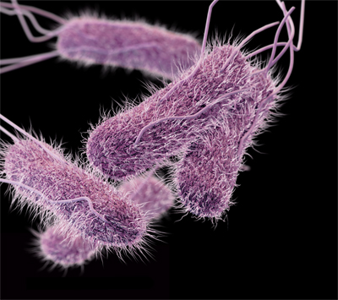
Salmonella typhi
Causes typhoid fever
Symptoms
Diarrhea
Stomach pain
Headache
Control Measures
Three-legged stool
Cook food properly
Prevent cross-contamination
Sources
Food-handlers
Ready to eat foods
Beverages
Notes:
One of the Big 6 reportable foodborne illnesses.

Slide 6
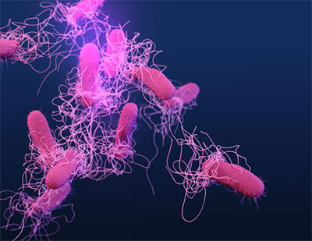
Salmonella
Non-typhoidal
Symptoms
Vomiting
Nausea
Cramps
Fever
Control Measures
Cook food properly
Cool foods quickly
Prevent cross-contamination
Three-legged stool
Sources
Raw and undercooked eggs
Raw and undercooked poultry/meats
Dairy products
Produce
Food-handlers
Notes:
One of the Big 6 reportable foodborne illnesses.

Slide 7
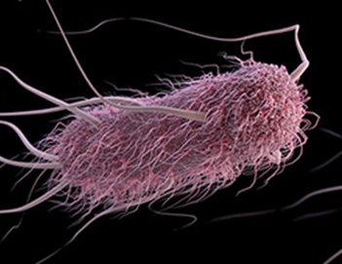
Escherichia coli
Shiga toxin-producing E. Coli
Symptoms
Severe diarrhea, sometimes bloody
Dehydration
Cramps
Renal (kidney) failure, severe cases
Control Measures
Cook ground beef properly
Prevent cross-contamination
Wash produce
Food from approved sources
Three-legged stool
Sources
Raw ground beef
Produce
Raw milk
Food-handlers
Notes:
One of the Big 6 reportable foodborne illnesses.

Slide 8
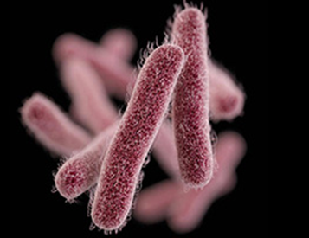
Shigella
Symptoms
Diarrhea
Cramps
Dehydration
Fever/chills
Control Measures
Three-legged stool
Control flies
Wash produce thoroughly
Sources
Food-handlers
Foods easily contaminated by hands, such as salads
Contaminated water
Flies
Notes:
One of the Big 6 reportable foodborne illnesses.

Slide 9
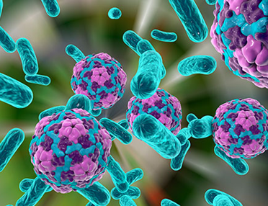
Hepatitis A
Disease of the liver, long incubation time
Symptoms
Diarrhea​
Nausea​
Fever​
Jaundice (yellowing of eyes/skin)
Control Measures
Purchase shellfish from approved sources​
Three-legged stool
Sources
Ready to eat foods​
Shellfish from contaminated waters​
Food-handlers
Notes:
One of the Big 6 reportable foodborne illnesses.
Hepatitis A is classified as a virus.
According to the CDC, Hepatitis A has an average incubation time of 28 days (range 15-50 days). Therefore, it could take some time before symptoms show.
Jaundice is the yellowing of the eyes and skin.

Slide 10
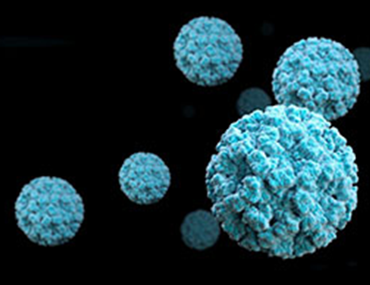
Norovirus
Highly infectious illness
Symptoms
Vomiting
Diarrhea
Nausea
Control Measures
Purchase shellfish from approved sources
Three-legged stool
Sources
Food-handlers
Shellfish from contaminated waters
Notes:
One of the Big 6 reportable foodborne illnesses.
Norovirus is classified as a virus and is HIGHLY contagious.
According to CDC, it takes less than 100 viral particles to make someone sick. Individuals infected with Norovirus can shed BILLIONS of viral particles in their vomit and stool.

Slide 11
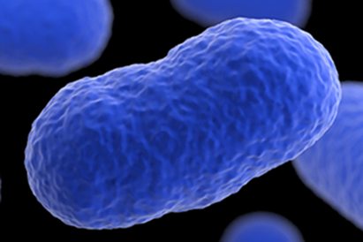
Listeria monocytogenes
Symptoms
Flu-like symptoms
Pregnant women – possible miscarriage
Newborns – pneumonia, meningitis, sepsis
Headache
Control Measures
Control time and temperature
Cook foods properly
Food from approved sources
Prevent cross-contamination
Sources
Ready to eat foods
Unpasteurized dairy products
Produce
Notes:
Can grow under refrigerated conditions.
Ready to eat foods include items such as deli meats and salads.
Time-temperature control for safety (TCS) foods should be held for no more than 7 days at 41°F or below to prevent illnesses such as Listeria monocytogenes.

Slide 12
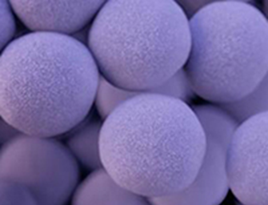
Staphylococcus aureus
Toxin-producing bacteria
Symptoms
Vomiting
Diarrhea
Nausea
Stomach cramps
Control Measures
Three-legged stool
Time and temperature control
Food cooled quickly
Do not work with skin infections or wounds on hands or arm
Sources
Food-handlers
Ready to eat foods
Notes:
Toxin-producing bacteria
Could result from improper holding food at the correct temperatures, including cooling.
Food-handlers should not work with skin infections or wounds on their hands or arms where food could be contaminated.

Slide 13
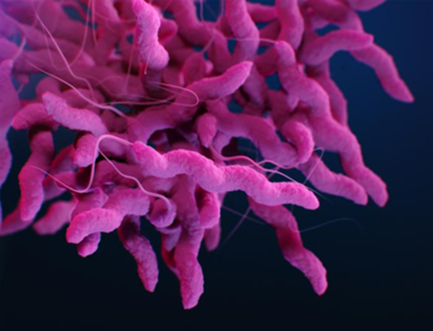
Campylobacter jejuni
Symptoms
Vomiting
Diarrhea (bloody/watery)
Fever
Stomach cramps
Control Measures
Cook foods properly
Time and temperature control
Prevent cross-contamination
Sources
Poultry
Contaminated water
Raw milk
Notes:
Non-spore forming bacteria
Typically seen when foods such as poultry are not properly cooked or held at the proper temperature. Improper cleaning and sanitizing of surfaces can also lead to cross-contamination.

Slide 14
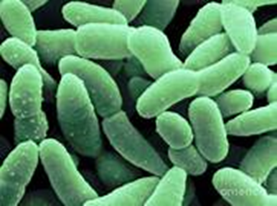
Clostridium perfringens
Symptoms
Diarrhea
Severe abdominal pain
Control Measures
Cool foods quickly
Reheat foods properly
time and temperature control
Sources
Poultry/meat
Stews/gravies made with meat and poultry
Notes:
Spore forming bacteria
Typically associated with improperly cooled or reheated foods such as stews or gravies that contain meat.

Slide 15
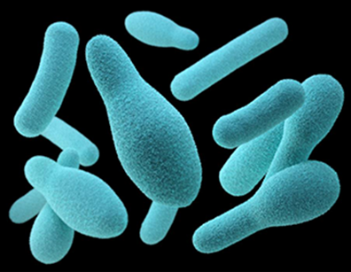
Clostridium botulinum
Toxin-producing bacteria
Symptoms
Initially: Nausea and vomiting
Later: Double-vision, difficulty speaking/swallowing, possible death
Control Measures
Cool, hold, and reheat foods correctly
Inspect canned foods for damage
Time and temperature control
Sources
Incorrectly canned foods
Reduced-oxygen packaged (ROP) foods
Temperature-abused vegetables (baked potatoes)
Untreated garlic-and-oil mixtures
Notes:
Toxin-producing and spore forming bacteria
Can lead to death if left untreated
Can survive in anaerobic conditions (absent of oxygen) produced by improperly canned foods, foods in ROP environments, temperature abused vegetables (tightly wrapped baked potatoes), and untreated garlic-and-oil mixtures.
Inspect canned foods for damage around the seals.
Proper cooling, reheating, and time/temperature control is essential to control Clostridium botulinum.

Slide 16
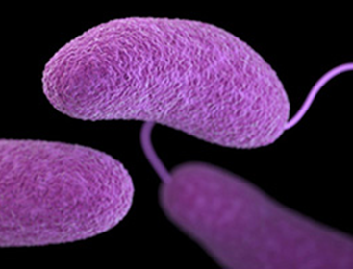
Vibrio spp.
Vibrio vulnificus and Vibrio parahaemolyticus
Symptoms
Diarrhea
Vomiting
Cramps/abdominal pain
Fever/chills
Control Measures
Cook shellfish properly
Purchase shellfish from an approved source
Sources
Shellfish from contaminated waters
Notes:
Non-spore forming bacteria
Tends to be found in shellfish harvested from warmer contaminated waters
Purchasing shellfish from an approved source and proper cooking can help prevent illness.

Slide 17
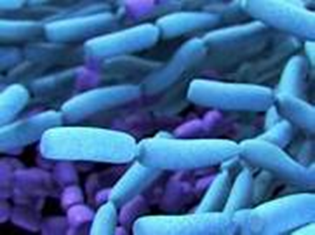
Bacillus cereus
Symptoms
Watery diarrhea
Vomiting
Nausea
Control Measures
Cook, hold, and cool food properly
Time and temperature control
Sources
Cooked vegetables, such as rice
Meat
Milk
Notes:
Spore forming bacteria
Two types; emetic and diarrheal (see Slide 20 for more info)
Typically found cooked vegetables, such as rice
Proper cooking, holding, and cooling can help prevent illness.

Slide 18
Non-Spore Forming Bacteria
Notes:
Here is a helpful chart summarizing non-spore forming bacteria that were discussed on the previous slides.

Slide 19
Non-Spore Forming Bacteria
Notes:
Here is a helpful chart summarizing non-spore forming bacteria that were discussed on the previous slides.

Slide 20
Spore Forming Bacteria
Notes:
Here is a helpful chart summarizing spore forming bacteria.

Slide 21
Viruses
Notes:
Here is a helpful chart summarizing viruses.

Slide 22
Parasites
Notes:
In addition to bacteria and viruses, parasites are considered a biological hazard in food.
Here is a helpful chart summarizing common parasites that can be found in food.

Slide 23
Naturally Occurring Chemical Hazards
Notes:
In addition to biological hazards, naturally-occurring chemical hazards can impact food safety.
Here is a chart summarizing common naturally-occurring chemical hazards that can be found in food.

Slide 24
Competitive Microflora
Surfaces of raw meat, poultry and fish have aerobic spoilage bacteria, mold, and yeasts
Spoilage organisms outcompete pathogenic bacteria
Slows bacterial growth
Controls toxin formation
Exceptions
Scombroid species (temperature abused prior to cooking)
Reduced oxygen packaging of TCS foods (ROP)
Notes:
Surfaces of raw meat, poultry, and fish naturally have aerobic (oxygen) spoilage bacteria, mold and yeasts.
These organisms compete with pathogenic bacteria, essentially helping to control their growth and toxin-formation.
However, there are some exceptions to this:
Cooking will not prevent scombrotoxins in temperature-abused fish.
Reduced oxygen packaging (ROP) creates an anaerobic (without oxygen) environment, thus limiting competitive microorganisms and creating conditions for anaerobic bacteria such as Clostridium botulinum to grow.

Slide 25
END OF PRESENTATION
If you have any questions about this presentation, please contact your Regional Specialist.
Notes:
Please complete the distance learning guide for this presentation.

