Slide 1
NC Department of Health and Human Services
Viral Hepatitis B and C Epidemiology in North Carolina, 2024
Division of Public Health/Epidemiology Section/Communicable Disease Branch
October 2025

Slide 2
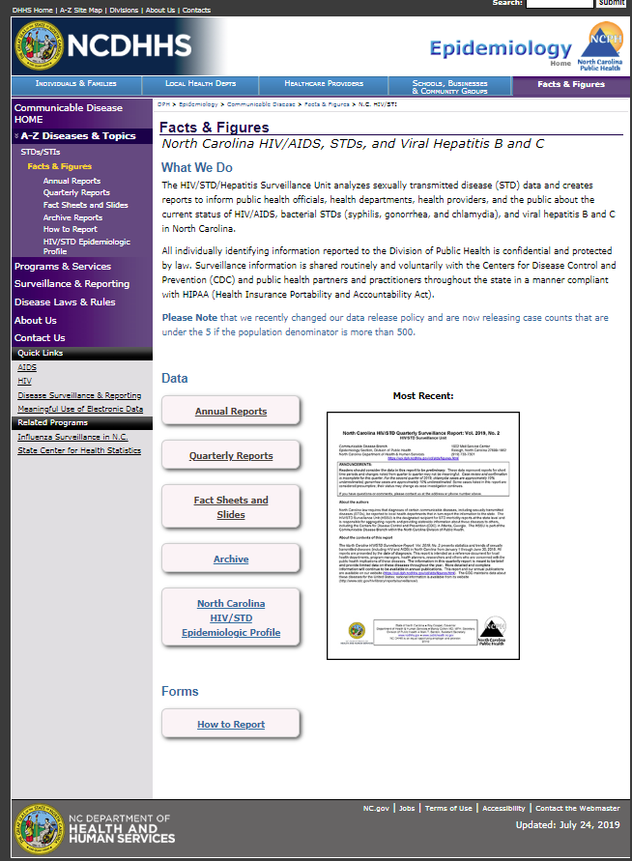
Where to find Hepatitis B/C Surveillance Information?
http://epi.publichealth.nc.gov/cd/stds/figures.html

Slide 3
Viral Hepatitis B (HBV)

Slide 4
Hepatitis B in United States and North Carolina
Number of reported acute HBV cases in 2023¹: 2,214
  Estimated number of new HBV cases in 2023¹: 14,400
Using national prevalence data, CDC estimates that 640,000 people are living with HBV in the U.S.²
Data reveal 47%-70% of people living with HBV in the U.S. were born in other countries where routine HBV immunization was introduced more recently than U.S.³
  Of people with HBV born outside the U.S., an estimated 58% migrated from Asia⁴
In North Carolina ⁵:
  177 people were diagnosed with acute HBV in 2024*
  There were 27,019 people diagnosed with chronic HBV and presumed alive at the end of 2024
  1,119 people were newly diagnosed with chronic HBV in 2024*
¹Data only available for 2023. Centers for Disease Control and Prevention. Viral Hepatitis Surveillance Report – United States, 2023. https://www.cdc.gov/hepatitis-surveillance-2023/about/index.html. Published April 2025.
²Hepatitis B Overview. https://www.cdc.gov/hepatitis-b/about/index.html.
³Centers for Disease Control and Prevention. Recommendations for identification and public health management of persons with chronic hepatitis B virus infection. MMWR. 2008;57(RR-08):1-18. https://archive.cdc.gov/#/details?url=https://www.cdc.gov/hepatitis/statistics/2014surveillance/commentary.htm.
⁴Kowdley KV, Wang CC, Welch S, Roberts H, Brosgart CL. Prevalence of chronic hepatitis B among foreign-born persons living in the United States by country of origin. Hepatology 2012;56(2):422-33. https://archive.cdc.gov/#/details?url=https://www.cdc.gov/hepatitis/statistics/2014surveillance/commentary.htm.
⁵Data Source: North Carolina Electronic Disease Surveillance System (NC EDSS) (data as of September 2025)
*The hepatitis B case definition was updated in 2024; therefore, comparisons with previous years should be interpreted with caution. The 2024 case definition increased the sensitivity and specificity of acute case classification by increasing the liver enzyme cutoff level, removing the clinical signs/symptoms requirements, and adding criteria for excluding persons with previous history of hepatitis B or evidence of hepatitis B reactivation.

Slide 5
Acute HBV Rates in North Carolina and United States, 2000-2024
*2020 data should be treated with caution due to reduced availability of testing caused by the COVID-19 pandemic.
^The hepatitis B case definition was updated in 2024; therefore, comparisons with previous years should be interpreted with caution.
Data Source: North Carolina Electronic Disease Surveillance System (NC EDSS) (data as of September 2025) and Surveillance for Viral Hepatitis, United States, 2000-2023 CDC reports (https://www.cdc.gov/hepatitis-surveillance-2023/hepatitis-b/index.html).

Slide 6
Acute HBV Cases by Gender in North Carolina 2000-2024
*Note: 2020 data should be treated with caution due to reduced availability of testing caused by the COVID-19 pandemic.
^The hepatitis B case definition was updated in 2024; therefore, comparisons with previous years should be interpreted with caution.
Data Source: North Carolina Electronic Disease Surveillance System (NC EDSS) (data as of September 2025).

Slide 7
Acute HBV Rates by Gender in North Carolina and United States, 2000-2024
*Note: 2020 data should be treated with caution due to reduced availability of testing caused by the COVID-19 pandemic.
^The hepatitis B case definition was updated in 2024; therefore, comparisons with previous years should be interpreted with caution.
Data Source: North Carolina Electronic Disease Surveillance System (NC EDSS) (data as of September 2025) and Surveillance for Viral Hepatitis, United States, 2000-2023 CDC reports (https://www.cdc.gov/hepatitis-surveillance-2023/hepatitis-b/index.html).

Slide 8
Age Distribution of Acute HBV Cases by Gender in North Carolina, 2024
Data Source: North Carolina Electronic Disease Surveillance System (NC EDSS) (data as of September 2025).

Slide 9
Acute HBV Cases by Race, North Carolina
2020-2024
146
*Note: 2020 data should be treated with caution due to reduced availability of testing caused by the COVID-19 pandemic.
^The hepatitis B case definition was updated in 2024; therefore, comparisons with previous years should be interpreted with caution.
Data Source: North Carolina Electronic Disease Surveillance System (NC EDSS) (data as of September 2025).

Slide 10
Acute HBV Rates by Race, North Carolina
2020-2024
*Note: 2020 data should be treated with caution due to reduced availability of testing caused by the COVID-19 pandemic.
^The hepatitis B case definition was updated in 2024; therefore, comparisons with previous years should be interpreted with caution.
Data Source: North Carolina Electronic Disease Surveillance System (NC EDSS) (data as of September 2025).

Slide 11
Acute HBV Cases by Ethnicity, North Carolina
2020-2024
177
146
112
108
*Note: 2020 data should be treated with caution due to reduced availability of testing caused by the COVID-19 pandemic.
^The hepatitis B case definition was updated in 2024; therefore, comparisons with previous years should be interpreted with caution.
Data Source: North Carolina Electronic Disease Surveillance System (NC EDSS) (data as of September 2025).

Slide 12
Acute HBV Rates by Ethnicity, North Carolina
2020-2024
*Note: 2020 data should be treated with caution due to reduced availability of testing caused by the COVID-19 pandemic.
^The hepatitis B case definition was updated in 2024; therefore, comparisons with previous years should be interpreted with caution.
Data Source: North Carolina Electronic Disease Surveillance System (NC EDSS) (data as of September 2025).

Slide 13
Acute HBV Cases by Self-Reported Risk^
North Carolina 2015-2024
*Note: 2020 data should be treated with caution due to reduced availability of testing caused by the COVID-19 pandemic.
^People may report more than one risk, so totals may not add up to the case total. Rates are not presented due to the lack of population data for the exposure groups.
Data Source: North Carolina Electronic Disease Surveillance System (NC EDSS) (data as of September 2025).
Notes:
Of course IDU maybe appear to us as “unknown”; rising number of unknown may reflect rising % of PWID or county inability/decision not to investigate cases

Slide 14
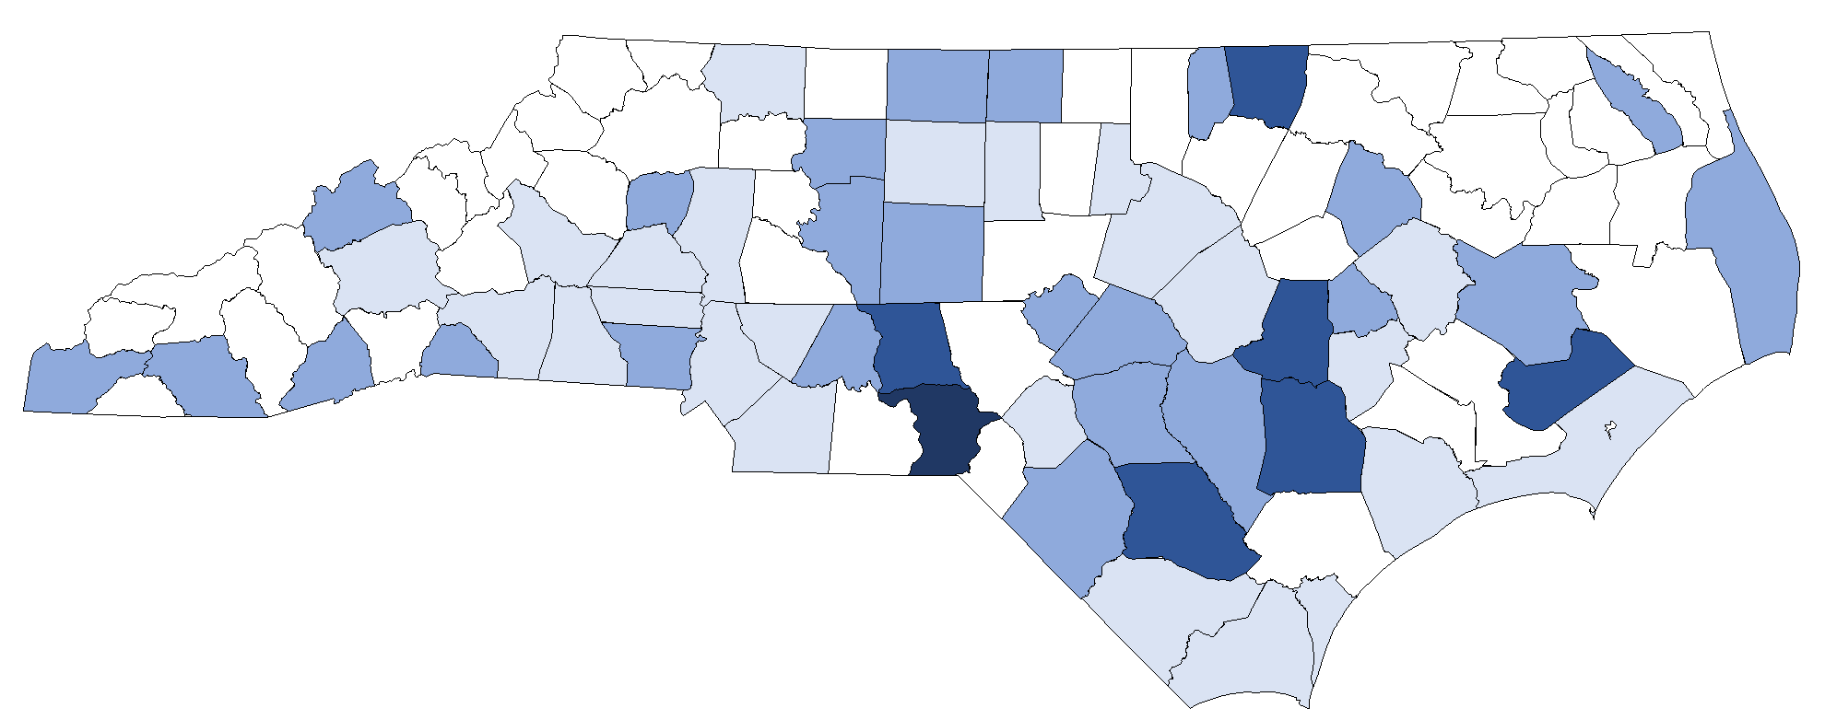
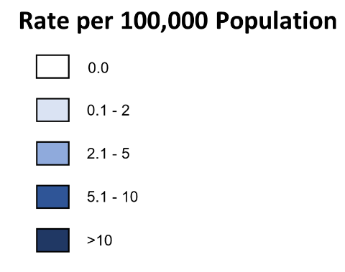
Acute HBV County Rates in North Carolina 2024
Data Source: North Carolina Electronic Disease Surveillance System (NC EDSS) (data as of September 2025).

Slide 15
Number of Newly Reported Chronic HBV Reported in North Carolina, 2020-2024
*Note: 2020 data should be treated with caution due to reduced availability of testing caused by the COVID-19 pandemic.
^The hepatitis B case definition was updated in 2024; therefore, comparisons with previous years should be interpreted with caution.
Data Source: North Carolina Electronic Disease Surveillance System (NC EDSS) (data as of September 2025).

Slide 16
Newly Diagnosed Chronic HBV Rates in North Carolina and United States, 2016-2024
*Note: 2020 data should be treated with caution due to reduced availability of testing caused by the COVID-19 pandemic.
^The hepatitis B case definition was updated in 2024; therefore, comparisons with previous years should be interpreted with caution.
Data Source: North Carolina Electronic Disease Surveillance System (NC EDSS) (data as of September 2025) and Surveillance for Viral Hepatitis, United States, 2000-2023 CDC reports (https://www.cdc.gov/hepatitis-surveillance-2023/hepatitis-b/index.html).

Slide 17
Chronic HBV Cases By Gender
North Carolina, 2000-2024
*Note: 2020 data should be treated with caution due to reduced availability of testing caused by the COVID-19 pandemic.
^The hepatitis B case definition was updated in 2024; therefore, comparisons with previous years should be interpreted with caution.
Data Source: North Carolina Electronic Disease Surveillance System (NC EDSS) (data as of September 2025).

Slide 18
Newly Diagnosed Chronic HBV Cases by Race, North Carolina, 2020-2024
1,108
1,172
1,119
926
1,006
Number of Cases
Year of Diagnosis
*Note: 2020 data should be treated with caution due to reduced availability of testing caused by the COVID-19 pandemic.
^The hepatitis B case definition was updated in 2024; therefore, comparisons with previous years should be interpreted with caution.
Data Source: North Carolina Electronic Disease Surveillance System (NC EDSS) (data as of September 2025).

Slide 19
Newly Diagnosed Chronic HBV Rates by Race, North Carolina, 2020-2024
Rates per 100,000 population
Year of Diagnosis
*Note: 2020 data should be treated with caution due to reduced availability of testing caused by the COVID-19 pandemic.
^The hepatitis B case definition was updated in 2024; therefore, comparisons with previous years should be interpreted with caution.
Data Source: North Carolina Electronic Disease Surveillance System (NC EDSS) (data as of September 2025).

Slide 20
Newly Diagnosed Chronic HBV Cases by Ethnicity, North Carolina, 2020-2024
1,108
1,172
1,119
926
1,006
Number of Cases
Year of Diagnosis
*Note: 2020 data should be treated with caution due to reduced availability of testing caused by the COVID-19 pandemic.
^The hepatitis B case definition was updated in 2024; therefore, comparisons with previous years should be interpreted with caution.
Data Source: North Carolina Electronic Disease Surveillance System (NC EDSS) (data as of September 2025).

Slide 21
Newly Diagnosed Chronic HBV Rates by Ethnicity, North Carolina, 2020-2024
Rates per 100,000 population
Year of Diagnosis
*Note: 2020 data should be treated with caution due to reduced availability of testing caused by the COVID-19 pandemic.
^The hepatitis B case definition was updated in 2024; therefore, comparisons with previous years should be interpreted with caution.
Data Source: North Carolina Electronic Disease Surveillance System (NC EDSS) (data as of September 2025).

Slide 22
Newly Diagnosed Chronic HBV Cases By Self-Reported Risk, North Carolina, 2024
*Other risk includes health care exposure or contact with a positive hepatitis B individual.
^People may report more than one risk, so totals may not add up to the case total. Rates are not presented due to the lack of population data for the exposure groups.
Data Source: North Carolina Electronic Disease Surveillance System (NC EDSS) (data as of September 2025).

Slide 23
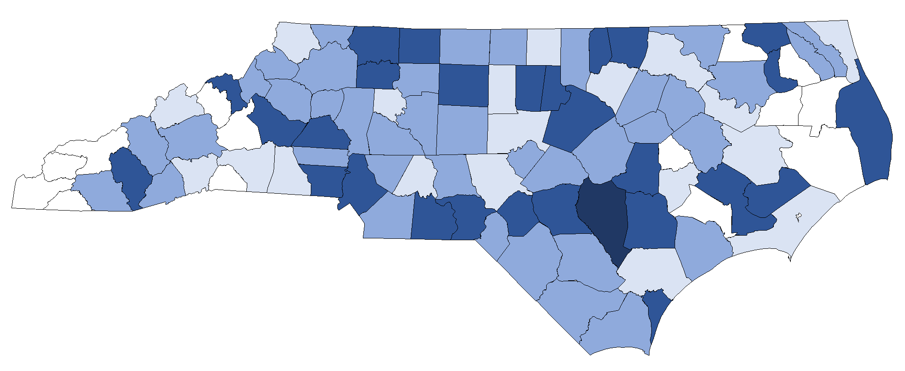
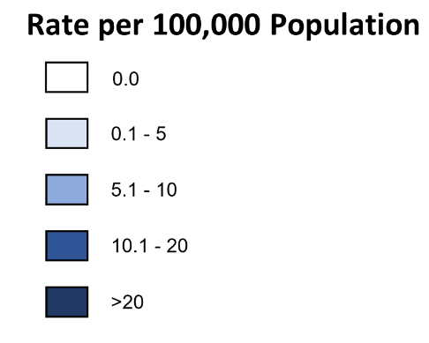
Newly Diagnosed Chronic HBV County Rates, North Carolina 2024
Data Source: North Carolina Electronic Disease Surveillance System (NC EDSS) (data as of September 2025).

Slide 24
Hepatitis C (HCV)

Slide 25
Hepatitis C in United States and North Carolina
Number of reported acute HCV cases in 2023¹: 4,966
  Estimated number of new HCV cases in 2023¹: 69,000
Using national prevalence data, CDC estimates that 2.4 million people – and as many as 4 million people – are living with HCV in the U.S.²
In North Carolina, we estimate at least 200,000 people are living with HCV
In North Carolina³:
  44 people were diagnosed with acute HCV in 2024
  There were 97,292 people diagnosed with chronic HCV and presumed alive at the end of 2024
  8,966 people were newly reported with chronic HCV in 2024
There is no vaccine for HCV, but there is a cure!!
¹Data only available for 2023. Centers for Disease Control and Prevention. Viral Hepatitis Surveillance Report – United States, 2023. https://www.cdc.gov/hepatitis-surveillance-2023/about/index.html. Published April 2025.
²Hepatitis C Basics. https://www.cdc.gov/hepatitis-c/about/index.html
³Data Source: North Carolina Electronic Disease Surveillance System (NC EDSS) (Data as of September 2025).

Slide 26
Acute HCV Rates in North Carolina and United States, 2000-2024
*2020 data should be treated with caution due to reduced availability of testing caused by the COVID-19 pandemic.
^Case definition for hepatitis C changed in 2016 and in 2020.
Data Source: North Carolina Electronic Disease Surveillance System (NC EDSS) (data as of September 2025) and Surveillance for Viral Hepatitis, United States, 2000-2023 CDC reports (https://www.cdc.gov/hepatitis-surveillance-2023/hepatitis-c/index.html).

Slide 27
Acute HBV and HCV Rates in North Carolina and United States, 2000-2024
*2020 data should be treated with caution due to reduced availability of testing caused by the COVID-19 pandemic.
^Case definition for hepatitis C changed in 2016 and in 2020.
^^The hepatitis B case definition was updated in 2024; therefore, comparisons with previous years should be interpreted with caution.
Data Source: North Carolina Electronic Disease Surveillance System (NC EDSS) (data as of September 2025) and Surveillance for Viral Hepatitis, United States, 2000-2023 CDC reports (https://www.cdc.gov/hepatitis-surveillance-2023/hepatitis-c/index.html).

Slide 28
Acute HCV Cases by Gender in North Carolina 2000-2024
Note: *2020 data should be treated with caution due to reduced availability of testing caused by the COVID-19 pandemic.
^Case definition for hepatitis C changed in 2016 and then again in 2020.
Data Source: North Carolina Electronic Disease Surveillance System (NC EDSS) (data as of September 2025).

Slide 29
Acute HCV Rates by Gender in North Carolina and United States, 2000-2024
*2020 data should be treated with caution due to reduced availability of testing caused by the COVID-19 pandemic.
^Case definition for hepatitis C changed in 2016 and in 2020.
Data Source: North Carolina Electronic Disease Surveillance System (NC EDSS) (data as of September 2025) and Surveillance for Viral Hepatitis, United States, 2000-2023 CDC reports (https://www.cdc.gov/hepatitis-surveillance-2023/hepatitis-c/index.html).

Slide 30
Age Distribution of Acute HCV Cases by Gender in North Carolina, 2024
Data Source: North Carolina Electronic Disease Surveillance System (NC EDSS) (data as of September 2025).

Slide 31
Acute HCV Cases by Race
North Carolina, 2020-2024
112
105
77
80
44
*Note: 2020 data should be treated with caution due to reduced availability of testing caused by the COVID-19 pandemic.
^Case definition for hepatitis C changed in 2016 and in 2020.
Data Source: North Carolina Electronic Disease Surveillance System (NC EDSS) (data as of September 2025).

Slide 32
Acute HCV Rates by Race
North Carolina, 2020-2024
*Note: 2020 data should be treated with caution due to reduced availability of testing caused by the COVID-19 pandemic.
^Case definition for hepatitis C changed in 2016 and in 2020.
Data Source: North Carolina Electronic Disease Surveillance System (NC EDSS) (data as of September 2025).

Slide 33
Acute HCV Cases by Ethnicity
North Carolina, 2020-2024
112
105
77
80
44
*Note: 2020 data should be treated with caution due to reduced availability of testing caused by the COVID-19 pandemic.
^Case definition for hepatitis C changed in 2016 and in 2020.
Data Source: North Carolina Electronic Disease Surveillance System (NC EDSS) (data as of September 2025).

Slide 34
Acute HCV Rates by Ethnicity
North Carolina, 2020-2024
*Note: 2020 data should be treated with caution due to reduced availability of testing caused by the COVID-19 pandemic.
^Case definition for hepatitis C changed in 2016 and in 2020.
Data Source: North Carolina Electronic Disease Surveillance System (NC EDSS) (data as of September 2025).

Slide 35
Acute HCV Cases by Self-Reported Risk^
North Carolina 2011-2024
*Note: 2020 data should be treated with caution due to reduced availability of testing caused by the COVID-19 pandemic.
^Risk is based on a hierarchical risk. Rates are not presented due to the lack of population data for the exposure groups. Other risk includes healthcare exposure or contact with a positive HCV individual.
**It is likely that sexual contact (heterosexual or MSM), while true for the patient, is not the transmission route for the virus. These data likely reflect under-reporting of higher-risk exposures such as injecting drug use.
^^Case definition for hepatitis C changed in 2016 and in 2020.
Data Source: North Carolina Electronic Disease Surveillance System (NC EDSS) (data as of September 2025).
Notes:
For hepatitis C, we look at a hierarchical risk, as opposed to someone fitting in any category. As you can see, IDU is among the highest self-reported risk among people newly diagnosed with acute hepatitis C, followed by unknown risk and sexual contact. It is likely that sexual contact (heterosexual or MSM), while true for the patient, is not the transmission route for the virus. These data likely reflect under-reporting of higher-risk exposures such as injecting drug use.

Slide 36
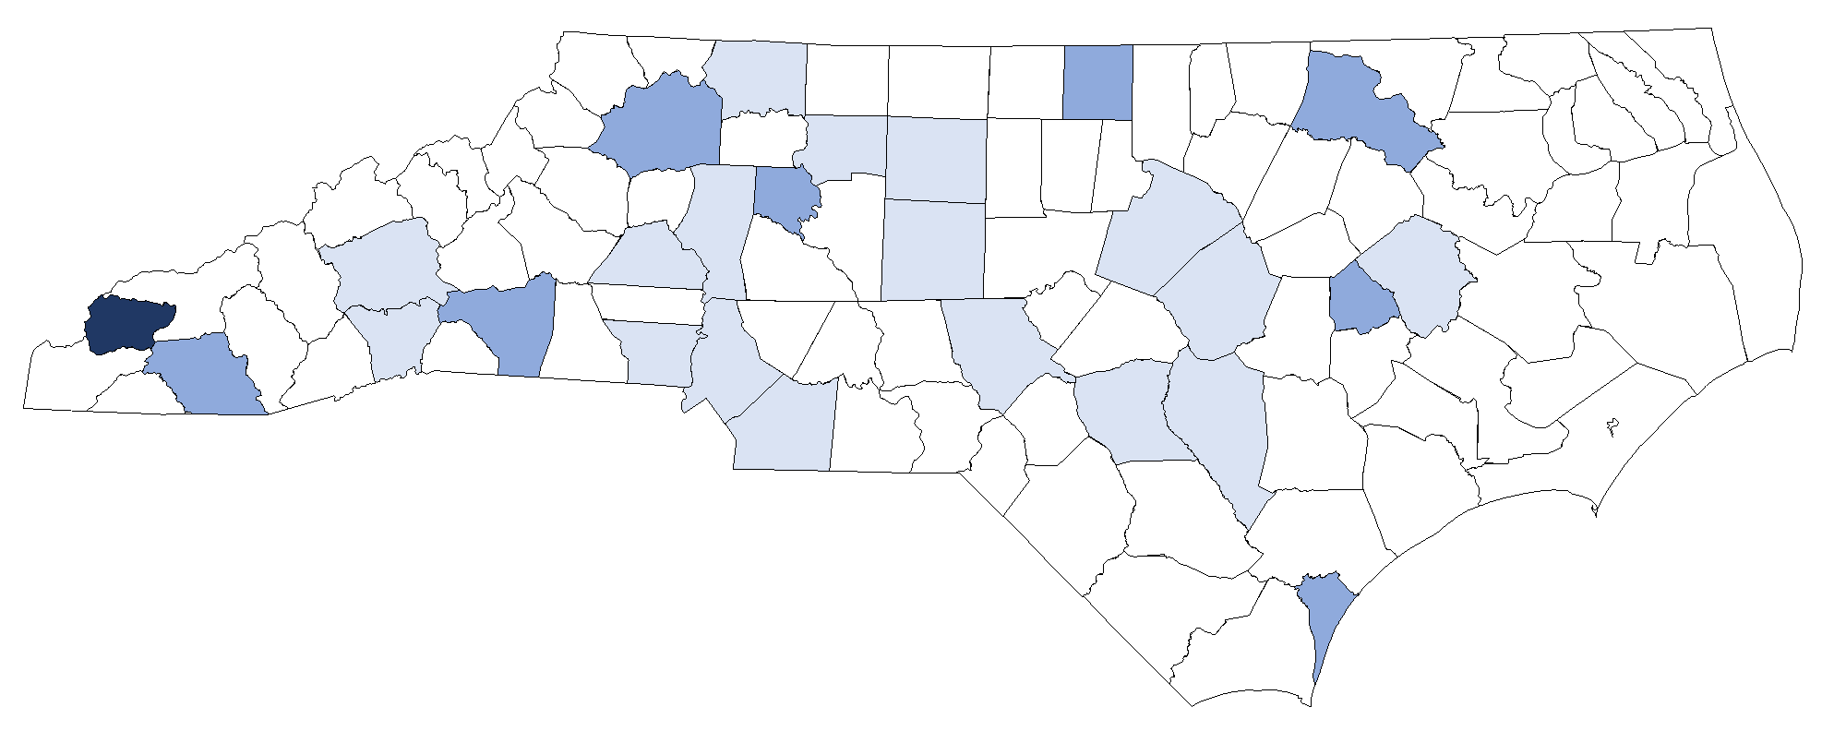
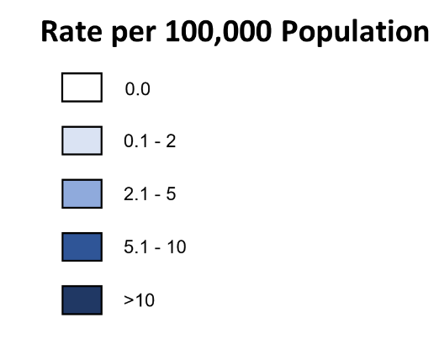
Acute HCV County Rates in North Carolina 2024
.
Data Source: North Carolina Electronic Disease Surveillance System (NC EDSS) (data as of September 2025).

Slide 37
Number of Newly Reported Chronic HCV in North Carolina, 2020^-2024
*Note: 2020 data should be treated with caution due to reduced availability of testing caused by the COVID-19 pandemic.
^Case definition for hepatitis C changed in in 2020.
Data Source: North Carolina Electronic Disease Surveillance System (NC EDSS) (data as of September 2025).

Slide 38
Newly Reported Chronic HCV Rates in North Carolina and United States, 2016^-2024
*2020 data should be treated with caution due to reduced availability of testing caused by the COVID-19 pandemic.
^Case definition for hepatitis C changed in 2016 and then again in 2020.
Data Source: North Carolina Electronic Disease Surveillance System (NC EDSS) (data as of September 2025) and Surveillance for Viral Hepatitis, United States, 2000-2023 CDC reports (https://www.cdc.gov/hepatitis-surveillance-2023/hepatitis-c/index.html).

Slide 39
Age Distribution of Newly Reported Chronic HCV Cases by Gender in North Carolina, 2024
Data Source: North Carolina Electronic Disease Surveillance System (NC EDSS) (data as of September 2025).

Slide 40
Newly Reported Chronic HCV Cases by Race, North Carolina 2024
Data Source: North Carolina Electronic Disease Surveillance System (NC EDSS) (data as of September 2025).

Slide 41
Newly Reported Chronic HCV Cases by Ethnicity, North Carolina 2024
Data Source: North Carolina Electronic Disease Surveillance System (NC EDSS) (data as of September 2025).

Slide 42
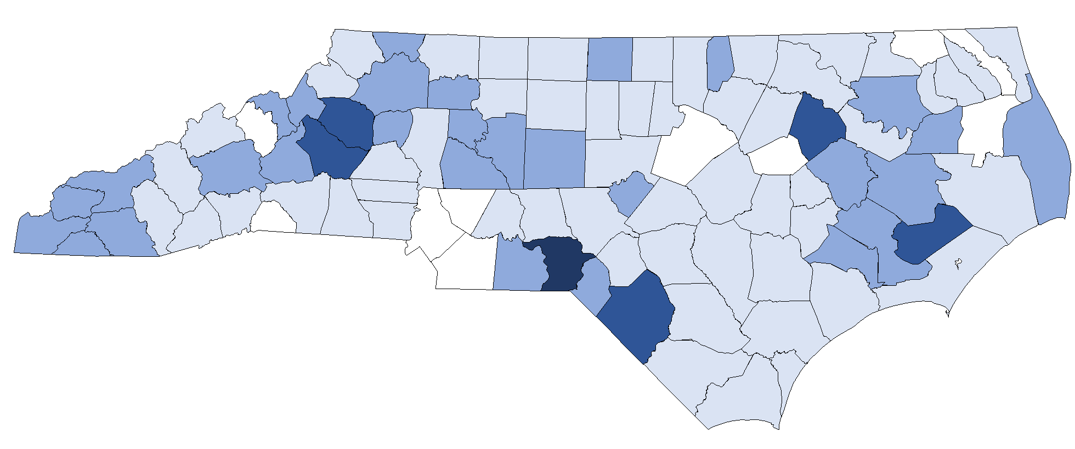
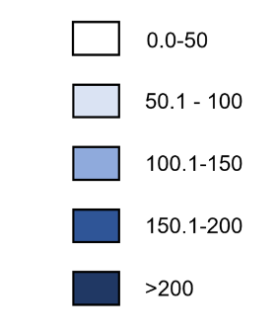
Newly Reported Chronic HCV County Rates in North Carolina 2024
Rate per 100,000 Population
Data Source: North Carolina Electronic Disease Surveillance System (NC EDSS) (data as of September 2025).

Slide 43
Hepatitis C Treatment Cascade

Slide 44
Hepatitis C Surveillance-Based Treatment Cascade
Anyone reported with HCV, including acute HCV in 2023 and over the age of three
Based on labs only
Anyone alive at the end of 2023
Hepatitis C Treatment Outcome | Definition
1.) RNA detectable | Classified as “confirmed” in NC EDSS
2.) Engaged in care | Having an additional HCV RNA or genotype after their initial date of report to public health
3.) RNA negative* within 30 days of last positive | Having positive HCV RNA or genotype, followed by a negative HCV RNA within 30 days (potential indicator of natural clearance)
4.) RNA negative* more than 30 days, but within 365 days of last positive | Having a negative or undetectable HCV RNA ≥31 days but within a year of last positive
*negative RNA results are reported into the surveillance system only where an HCV record matches to a subsequent negative test

Slide 45
Hepatitis C Clearance Cascade, North Carolina 2020-2024
^Engaged in care is defined as having an additional RNA after their initial date of report to public health.
^^RNA-negative less than 30 days of positive is a potential indicator of natural clearance and therefore is its own parameter.
^^^Defined as the minimum number of all confirmed HCV cases that achieved SVR. This is likely a significant underestimate of treatment and cure as not all negative laboratory results are reported and persons may not receive a final RNA result after treatment. Negative RNA results are reported into the surveillance system only where an HCV record matches to a subsequent negative test.
Case definition for hepatitis C changed in 2016 and in 2020.
Includes people reported with acute hepatitis C starting in 2020.
Data Source: North Carolina Electronic Disease Surveillance System (NC EDSS) (data as of September 2025).
Notes:
This figure represents our surveillance-based treatment cascade for hepatitis C cases from 2020 to 2024. This cascade is based on laboratory results that are reported to us. In North Carolina, negative laboratory results are not required to be reported by law however, we do receive some negative RNA test results through voluntary reporting.
This figure represents treatment and cure through several proportions.
The proportion of confirmed HCV cases (RNA +)
The proportion of confirmed cases engaged in care
The proportion of confirmed cases that had a negative RNA more than 31 days but within 365 days after the last positive, which we use as a proxy for sustained virologic response or SVR.
At a minimum we believe that 17% of all confirmed HCV cases achieve SVR. This is likely a significant underestimate of treatment and cure as not all negative laboratory results are reported and persons may not receive a final RNA result after treatment.

Slide 46
Viral Hepatitis and HIV

Slide 47
Conquering the Syndemic: The Impact of HCV, HIV, and Opioid Overdoses in North Carolina
HCV
Reported acute HCV, 2024¹ = 44
Estimated people living with chronic HCV in U.S., 2020² = 2.4 million (Trends in mortality and curative treatment indicate the prevalence is lower today.)
Average lifetime treatment cost of chronic HCV³ = $100,000/person
(By mid-2020, average cost per treatment is one-sixth of initial treatment costs)
Syndemic
Estimate 7-13% of HIV-infected people in NC are co-infected with HCV (CDC estimates 21%)^{4,5}
At least 6% of people diagnosed with HIV in NC in 2024 were exposed through injection drug use¹
An estimated 62%‒80% of HIV-infected people who inject drugs are co-infected with HCV⁵
Around 34% of people with acute HCV in 2024 reported injection drug use¹
Based on surveillance data, 23% of people coinfected with HIV/HCV achieved SVR through 2022¹
Opioid Overdoses
HIV Infections
Drug overdose deaths in NC, 2024⁶ = 3,060 (27.7 per 100,000)
Illicit opioid deaths, 2024⁶ = 2,246 (20.3 per 100,000)
CDC estimates the cost of drug overdose deaths in NC, 2016⁷ = $1.3 billion
Newly reported HIV, 2024¹ = 1,391
People living with HIV, 2024¹ = 38,614
Average lifetime treatment cost of HIV⁸ = >$370,000/person
¹NC HIV/STD/Hepatitis Annual Surveillance Report, 2024; ²CDC Surveillance for Viral Hepatitis (https://www.cdc.gov/hepatitis-c/hcp/clinical-overview/index.html). ³In the absence of liver transplant (National Viral Hepatitis Roundtable and Center for Health Law and Policy Innovation of Harvard Law School https://stateofhepc.org/wp-content/uploads/2023/02/State-of-Hep-C-Treatment-Costs-Fact-Sheet.pdf);⁴Based on estimates from NC Ryan White CAREWare and the Medical Monitoring Project in NC;⁵People Coinfected with HIV and Viral Hepatitis https://www.cdc.gov/hepatitis/populations/hiv.htm; ⁶ Opioid and Substance Use Action Plan Data Dashboard https://www.dph.ncdhhs.gov/programs/chronic-disease-and-injury/injury-and-violence-prevention-branch/north-carolina-overdose-epidemic-data; ⁷https://www.ncdhhs.gov/prescription-fact-sheet-sec-final-03-07-17/download. ⁸Bingham A, Shrestha R, Khurana N, et al. Estimated lifetime HIV-related medical costs in the United States. Special Issue of Sex Transm Dis 2021

Slide 48
2024 HIV/Hepatitis B/Hepatitis C Coinfection
HCV
N = 94,038
N=1,050
N=1,626
N=84
HBV
N=24,901
HIV
N=35,911
N=993
.
Data Source: North Carolina Electronic Disease Surveillance System (NC EDSS) (data as of September 2025) and enhanced HIV/AIDS Reporting System (NC EDSS) (data as of July 2025).

Slide 49
HIV and HCV Coinfected Clearance Cascade, 2020-2024
100%
100%
^Engaged in care is defined as having an additional RNA after their initial date of report to public health.
^^RNA-negative less than 30 days of positive is a potential indicator of natural clearance, and therefore is its own parameter.
Negative RNA results are reported into the surveillance system only where an HCV record matches to a subsequent negative test.
Case definition for hepatitis C changed in 2016 and in 2020.
Includes people reported with acute hepatitis C starting in 2020.
Data Source: North Carolina Electronic Disease Surveillance System (NC EDSS) (data as of September 2025).

