Slide 1
NC Department of Health and Human Services
Chlamydia Epidemiology in North Carolina 2024
Division of Public Health/Epidemiology Section/Communicable Disease Branch
HIV/STD/Viral Hepatitis Surveillance Unit
September 2025

Slide 2
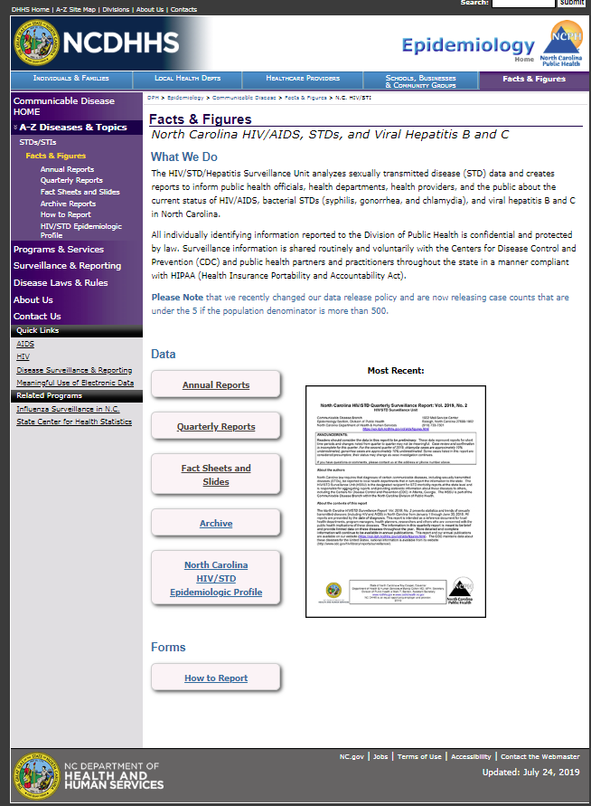
Where to find STI Surveillance information?
http://epi.publichealth.nc.gov/cd/stds/figures.html

Slide 3
Chlamydia Cases by Gender, 2014-2024
62,010
*2020 data should be treated with caution due to reduced availability of testing caused by the COVID-19 pandemic.
Data Source: North Carolina Electronic Disease Surveillance System (NC EDSS) (data as of July 1, 2025).

Slide 4
Chlamydia Rates by Gender
North Carolina and United States
2014-2024
*2020 data should be treated with caution due to reduced availability of testing caused by the COVID-19 pandemic.
Data Source: North Carolina Electronic Disease Surveillance System (NC EDSS) (data as of July 1, 2025)
and 2024 Sexually Transmitted Infections Surveillance (Provisional Data), CDC (https://www.cdc.gov/sti-statistics/annual/index.html).

Slide 5
Age Distribution of Chlamydia Cases by Gender, 2024
Data Source: North Carolina Electronic Disease Surveillance System (NC EDSS) (data as of July 1, 2025).

Slide 6
Chlamydia Cases by Race 2020-2024
64,489
65,150
64,670
65,919
62,010
711
*2020 data should be treated with caution due to reduced availability of testing caused by the COVID-19 pandemic. Data is italicized for this reason.
Data Source: North Carolina Electronic Disease Surveillance System (NC EDSS) (data as of July 1, 2025).

Slide 7
Chlamydia Cases by Ethnicity 2020-2024
64,489
65,150
64,670
65,919
62,010
*2020 data should be treated with caution due to reduced availability of testing caused by the COVID-19 pandemic. Data is italicized for this reason.
Data Source: North Carolina Electronic Disease Surveillance System (NC EDSS) (data as of July 1, 2025).

Slide 8
Chlamydia Rates by Race 2020-2024
*2020 data should be treated with caution due to reduced availability of testing caused by the COVID-19 pandemic.
Data Source: North Carolina Electronic Disease Surveillance System (NC EDSS) (data as of July 1, 2025).

Slide 9
Chlamydia Rates by Ethnicity 2020-2024
*2020 data should be treated with caution due to reduced availability of testing caused by the COVID-19 pandemic.
Data Source: North Carolina Electronic Disease Surveillance System (NC EDSS) (data as of July 1, 2025).

Slide 10
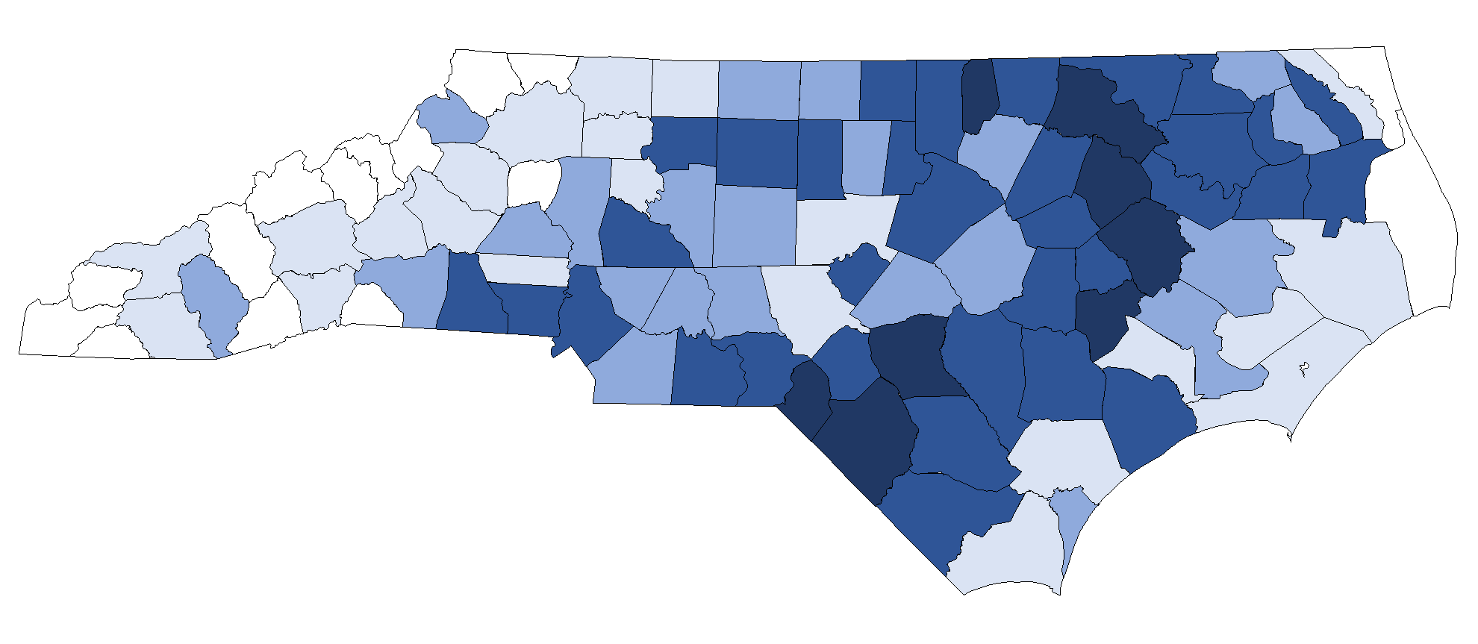
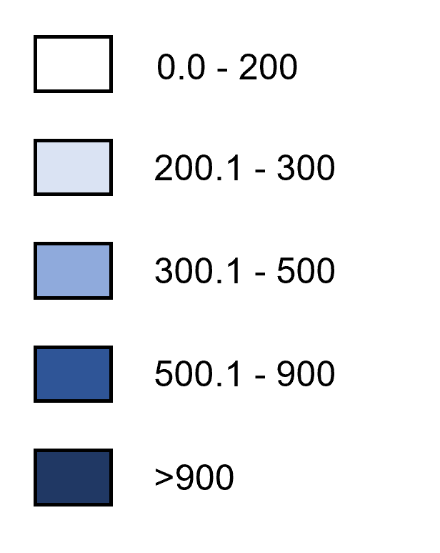
Chlamydia Rates by County, 2024
Rate per 100,000 Population
Data Source: North Carolina Electronic Disease Surveillance System (NC EDSS) (data as of July 1, 2025).

