Slide 1
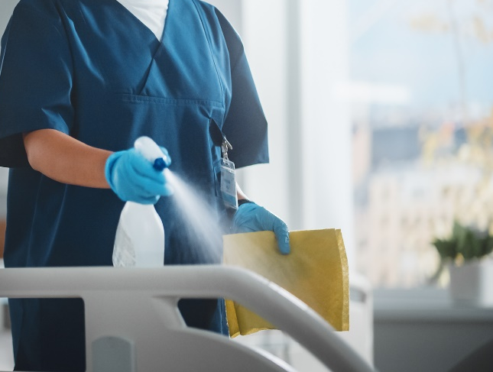

Cleaning and Disinfection
Infection Prevention Education
Notes:
Welcome participants

Slide 2
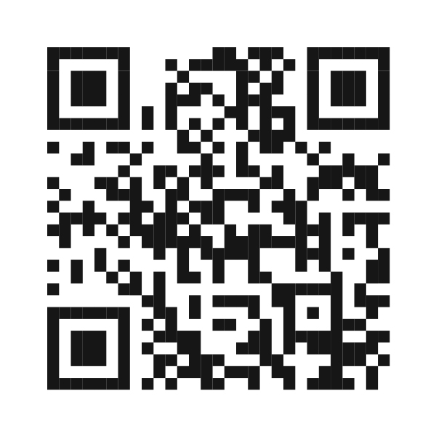
Pre-assessment https://forms.office.com/g/8QhSJvQsqK
Notes:
Please take 5 minutes to complete this pre-assessment. If you do not have a smart phone, please partner up with another participant. All responses will be kept anonymous. This assessment allows the infection prevention team to monitor the impact of our modules.
https://forms.cloud.microsoft/g/g2e0WYkgXf

Slide 3
Know, Want to Know, Learned (KWL) Chart
Want to Know
Know
Learned
Notes:
Before we start today’s module, we will complete the first two sections of a KWL chart. A KWL chart is a “Know, Want to Know, Learned” chart. Please partner up in groups of three. With your sticky notes, please write down everything you already know about cleaning and disinfection practices and what you would like to know about them. You will have 7 minutes to brainstorm ideas. Please select one representative from your group to share what you all came up with and add your sticky notes to the group chart.

Slide 4
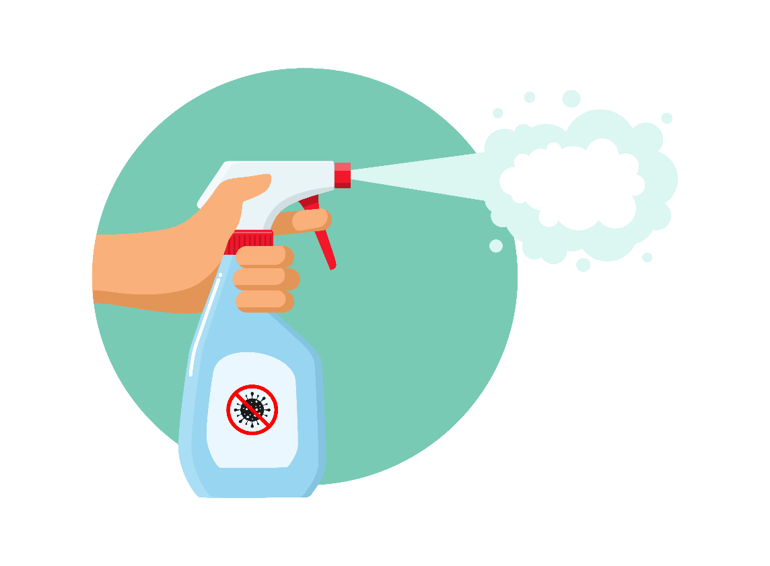
Overview
Pre-assessment
KWL Chart
Presentation
Glucometer Disinfection Demo
KWL Chart
Post-assessment
Notes:
For today’s module, we will focus on these 6 focus areas, two of which you’ve already completed! Next, we will have a presentation on cleaning and disinfection. Then we will have a demonstration on how to properly disinfect this facility’s glucometers and then we will complete the rest of the KWL chart. Once we have completed these activities, you will be asked to complete a post-assessment and we will be done for the day.

Slide 5
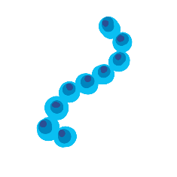

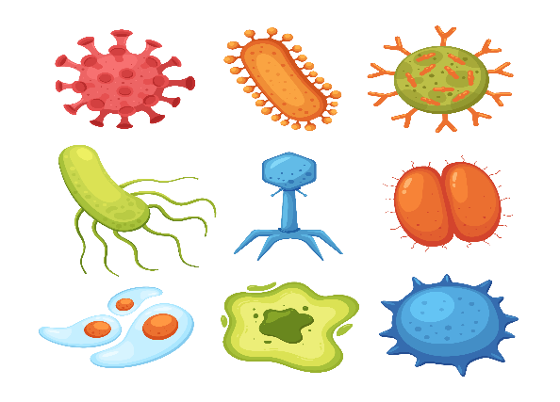





Transmission of infectious agents in the environment
MRSA, C. difficile, Norovirus and others are shed by colonized or infected patients and contaminate surfaces in their environments
Cleaning and disinfection is essential to interrupt transmission of organism(s)
Notes:
Within our field of work, it is important to protect patients and residents from contagious diseases. One of the best ways we can offer that protection is through cleaning and disinfection. Surfaces and patient environments require regular cleaning and disinfection to stop the transmission of infectious agents. Major pathogens like MRSA, C. difficile, Norovirus and others are shed by colonized or infected patients and contaminate surfaces in their environments at levels sufficient for transmission. Routine cleaning and disinfection is essential to interrupt transmission of organism(s).

Slide 6
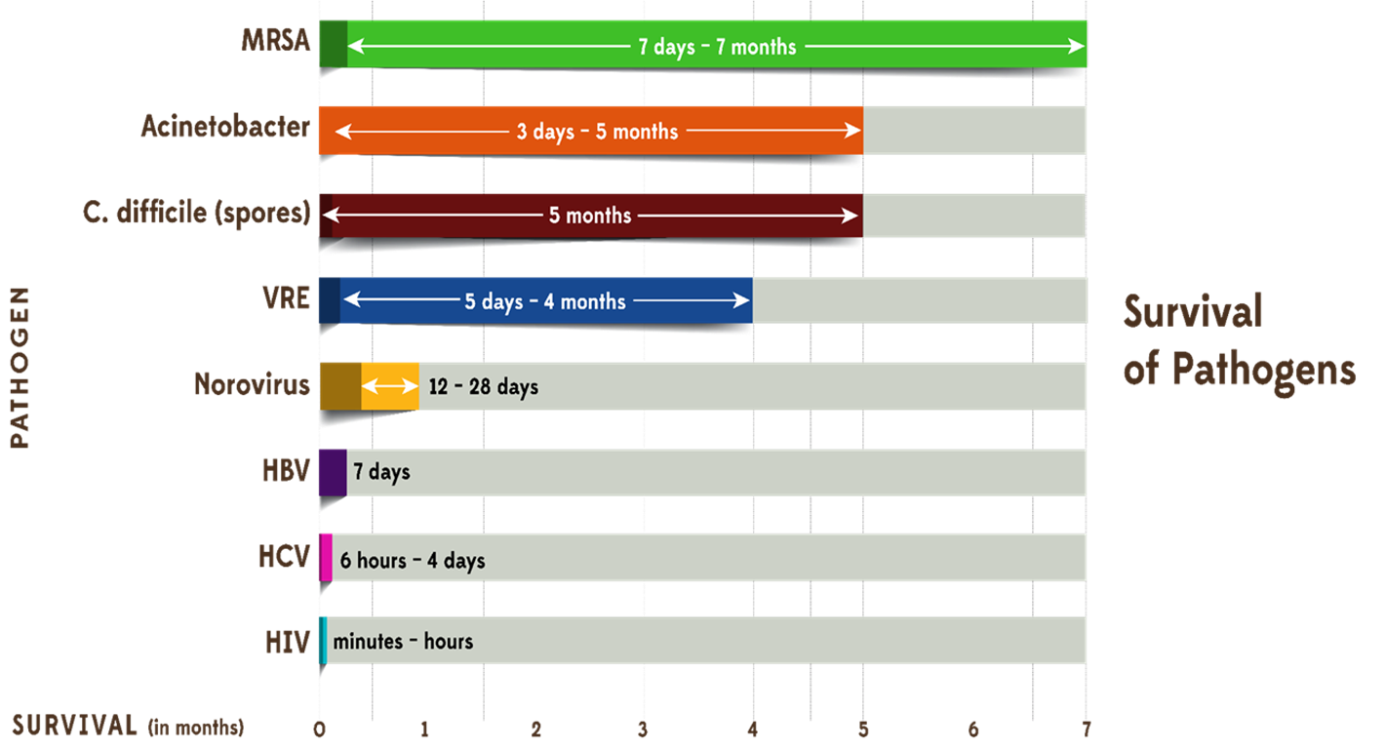
Pathogens Survival Timelines
Notes:
Different pathogens, like the ones mentioned in the previous slide, can live for varying amounts of time. This graph shows differences in pathogen survival times. By cleaning and disinfecting surfaces and equipment frequently, we can reduce the number pathogens that can live on surfaces near patients.

Slide 7
The Chain of Infection
Infectious agent
Susceptible host
Reservoirs
Portal of entry
Portal of exit
Mode of transmission
Notes:
The chain of infection is a model that outlines the interconnected steps necessary for the transmission of infectious diseases, consisting of six key links: Infectious Agent, Reservoir, Portal of Exit, Mode of Transmission, Portal of Entry, and Susceptible Host. There are many infection prevention practices we can put in place to break the chain, or stop the spread of infection, one of which is cleaning and disinfecting environments and medical equipment. In this visual, environments and medical equipment are represented as reservoirs. Through cleaning and disinfection, we can kill infectious agents, like bacteria and other pathogens, where they live. This module will take a deep dive into cleaning and disinfection practices so that you can be better equipped to stop the spread of infection.

Slide 8
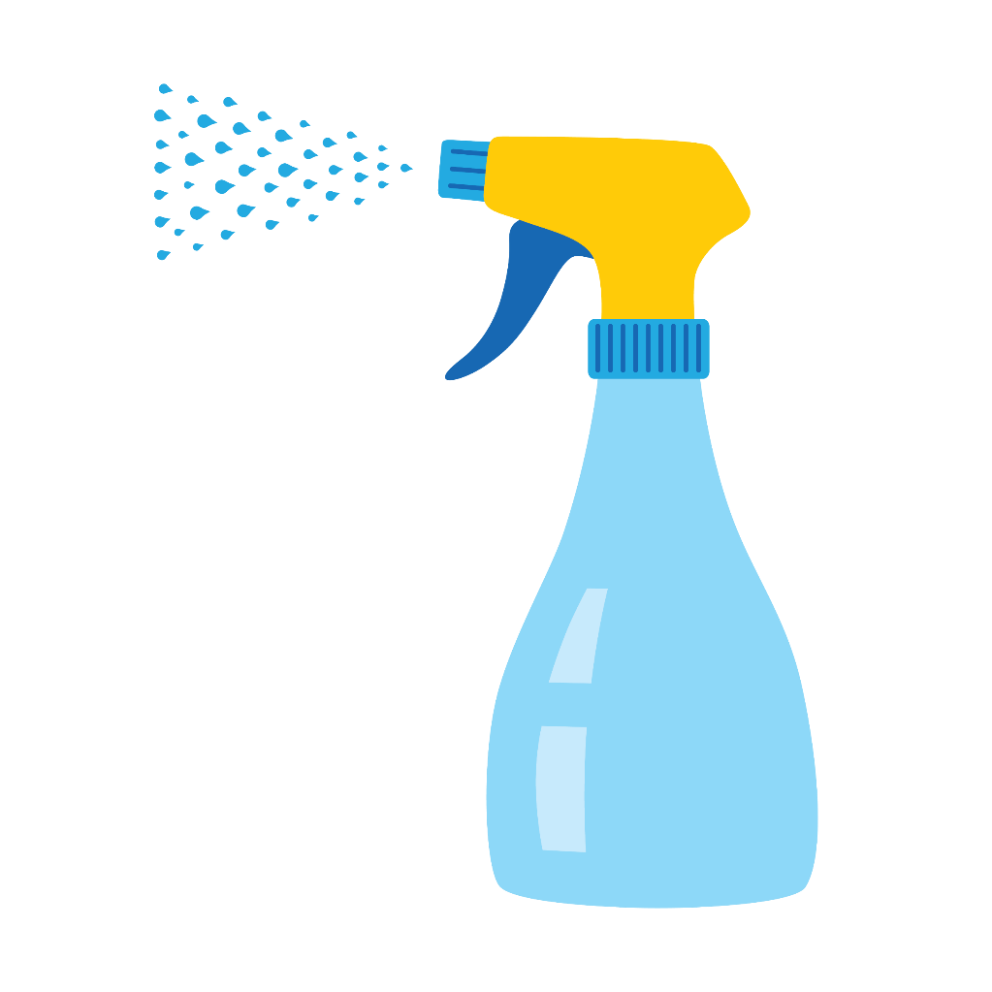
Cleaning vs. Disinfection
Cleaning
Disinfection
The process of removing debris, dirt, and germs from surfaces
The process that kills or inactivates germs on surfaces or objects
Cleaning and disinfecting often occur at the same time when applying a disinfectant to a surface
Notes:
When we clean, we are removing debris, dirt, and even germs from environmental surfaces. However, when we disinfect, we are killing or inactivating most, if not all the germs that might be on the surface. This is why it is vital to complete both steps when protecting a patients environment. Most disinfectants registered with the EPA combine cleaning and disinfecting as a one step process. Be sure to read the disinfectant label and follow manufacturer’s instructions.

Slide 9

Steps to clean & disinfect the patient environment and medical equipment:
Follow facility’s cleaning & disinfection protocols
Ensure high-touch surfaces are cleaned frequently
  Bed rails, call bells
  Bedside tables
  Counter tops
Dedicate equipment to patients whenever possible or clean and disinfect between each patient
  Glucometers
  Stethoscopes
  Vital sign machine
  Blood pressure cuffs
  Lifts
  PT/OT equipment
Notes:
To adequately clean and disinfect the patient environment, it’s important to follow these three steps. First, follow your facility’s cleaning and disinfection protocols. Second, clean high-touch surfaces frequently such as bed rails and call buttons. Third, when possible, dedicate equipment to individual patients or clean and disinfect all equipment between patients.

Slide 10
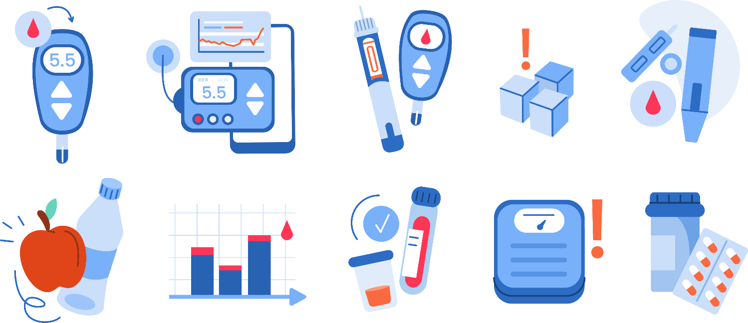
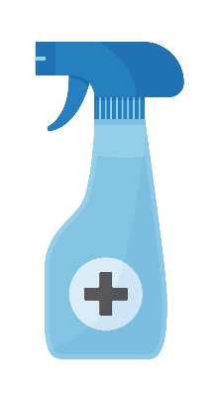


Different equipment may need different disinfectants
Follow the manufacturer’s instructions for what disinfection product and practices are required
  Some items may be single-use only and should not be disinfected/reused. Examples: bath basins, respiratory equipment
Make sure the disinfectant is an EPA-registered disinfectant
Notes:
When choosing a disinfectant, it’s important to follow the manufacturer’s instructions and select a disinfectant that is registered with the EPA. Manufacturers of medical equipment should provide care and maintenance instructions specific to their equipment. These instructions should include information about
a. the equipments’ compatibility with chemical germicides,
b. whether the equipment is water-resistant or can be safely immersed for cleaning, and
c. how the equipment should be decontaminated if servicing is required.

Slide 11
Different pathogens may need different disinfectants
C. auris
MRSA
C. difficile (spores)
Acinetobacter
Norovirus
HBV
HCV
HIV
Notes:
Just like different types of medical equipment require different disinfectants, different pathogens may need different disinfectants as well. You can check the disinfectant's packaging or the EPA’s website for which disinfect is required to kill specific pathogens.

Slide 12
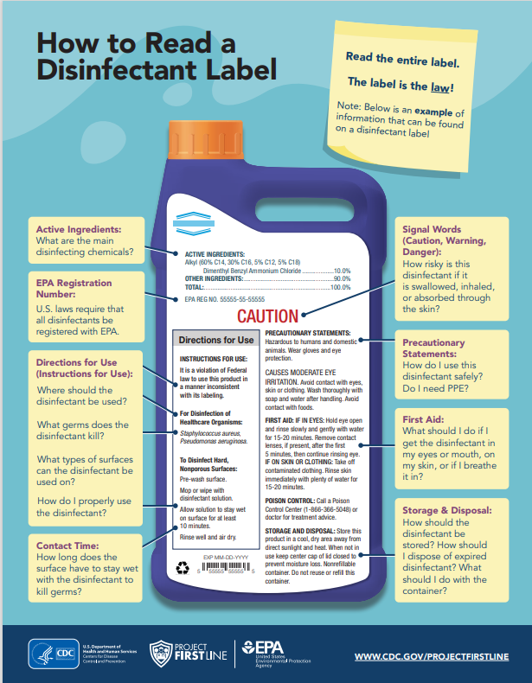
Notes:
As we mentioned earlier, reading a disinfectant label is vital to understanding the proper use of a disinfect. In the next few slides we will go over some of the features you should be most familiar with.

Slide 13
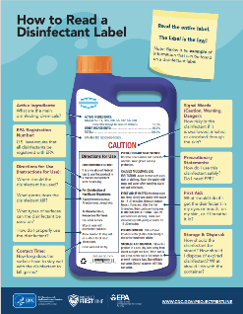
Directions for use
Where a product can be used
  Counter tops
  Medical equipment
  Beds, etc.
How to properly use the product
  Products can be wipes, liquids, sprays or powders.
  Apply according to the use directions.
    How to apply wipes
    How much to dilute the product before using
How long it takes for the product to work (contact time)
What PPE to use while using the product (e.g., gloves)
Notes:
When reading the product label, one of the most important sections is the Directions for Use section (sometimes also called Use Directions). This section provides all the necessary information needed by consumers to properly and effectively use disinfectant products.
This section provides information on:
-Where a product can be used
-How to properly use the product
-How long it takes a product to work
-And what PPE to use with this specific product
https://www.epa.gov/pesticide-registration/selected-epa-registered-disinfectants#use

Slide 14


Contact Time
(kill time, wet time, etc.)
How long it takes the product to work
The time the product must remain on the surface for it to be effective
The surface should be visibly wet for the entire contact time
Product may need to be reapplied
Notes:
Make sure to pay attention to a product's contact time, which is how long it takes the product to work. This is the amount of time a product must remain on a surface for it to be effective. Throughout the entire period, the surface should be visibly wet. If at any point during the contact time the surface appears dry, the product should be reapplied.
Selected EPA-Registered Disinfectants | US EPA https://www.epa.gov/pesticide-registration/selected-epa-registered-disinfectants#how

Slide 15
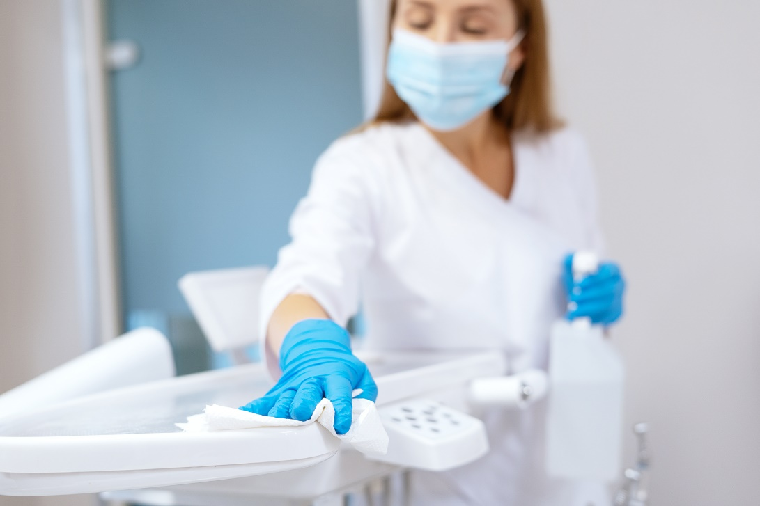
Contact Time Example
Contact time for Staphylococcus aureus is 4 minutes
If dry in 2 minutes, reapply
Notes:
For example, if the product label has a contact time of 4 minutes for a particular pathogen, the surface should remain visibly wet for at least 4 minutes after application of the product. If after 2 minutes the surface is not visibly wet, more product should be applied to the surface.
Selected EPA-Registered Disinfectants | US EPA https://www.epa.gov/pesticide-registration/selected-epa-registered-disinfectants#how

Slide 16
EPA Registration Number
EPA Reg. No. 55555-55
  Primary registration number
Look at EPA lists to see if your disinfectant is effective against the pathogen you are trying to kill
Notes:
Each label has a registration number. This number is a unique identifier of the product. The same product can have different names and be sold under a variety of company names (if the EPA number has a third set numbers, as shown above, that is the supplemental supplier number). The only way to accurately identify a product is by the EPA registration number. The registration number can tell you whether or not that disinfectant is appropriate for the specific pathogen you are trying to kill.

Slide 17
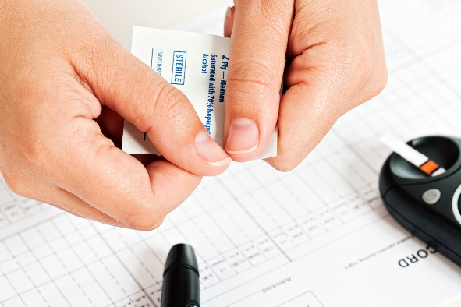
Disinfect the glucometer
Disinfect the glucometer according to manufacturer recommendations.
a. Properly disinfect glucometers to prevent spread of diseases like Hepatitis B, Hepatitis C, and HIV. Even when devices are used by a single person only, consider the potential for contamination during storage and disinfect accordingly.
*Note: DO NOT assume that a glucometer was cleaned after the last use.
b. Wipe down the front, back, and sides of the meter with an EPA-registered disinfectant compatible with the meter, wearing proper PPE. Take care to not get liquid in the test strip port of the meter.
c. Follow the manufacturer’s recommended chemical contact (dwell) time, before using the meter.
*Note: DO NOT use alcohol to disinfect a glucometer, as this is not adequate for disinfection to prevent cross contamination, and it can damage equipment.
Disinfecting the glucometer right after returning to the med cart will allow it enough time to dry.
*Note: Do not place the glucometer in the med cart without cleaning and letting it dry first. Place the glucometer on a clean surface to dry to reduce cross-contamination.
Notes:
Now we will move onto the demonstration portion of our presentation. Together, we will go step by step through the cleaning and disinfection process of one of your facility’s glucometers. These steps are a general overview of how to properly disinfect a glucometer, but we will also follow the manufacturer’s instructions for this specific make and model of glucometer.
(When it is time, pull up the EPA website and show participants how to search for the EPA registration number)
Tips for Glucometer Use and Care https://www.hhs.texas.gov/sites/default/files/documents/glucometer-use-care-quality-control.pdf

Slide 18
Know, Want to Know, Learned (KWL) Chart
Want to Know
Know
Learned
Notes:
Now that we have finished our presentation, let’s revisit our KWL chart. Please get back into your groups and brainstorm different things you learned from today’s presentation. Fill out your sticky notes and select one representative again to share your thoughts with the larger group.

Slide 19

Post-assessment https://forms.office.com/g/F4GYFp87hL
Notes:
Please take 5 minutes to complete this post-assessment. All responses will be kept anonymous. This assessment allows the infection prevention team to monitor the impact of our modules.
https://forms.office.com/g/F4GYFp87hL

Slide 20
Thank you!
infectionprevention@dhhs.nc.gov
Notes:
Congratulations! You have completed the cleaning and disinfection infection prevention education module. If there are no further questions at this time, we will conclude for today. If any questions arise in the future, please feel free to email them to our team at infectionprevention@dhhs.nc.gov.

