Slide 1
NC Department of Health and Human Services
Gonorrhea Epidemiology in North Carolina 2024
Division of Public Health/Epidemiology Section/Communicable Disease Branch
HIV/STD/Viral Hepatitis Surveillance Unit
September 2025

Slide 2
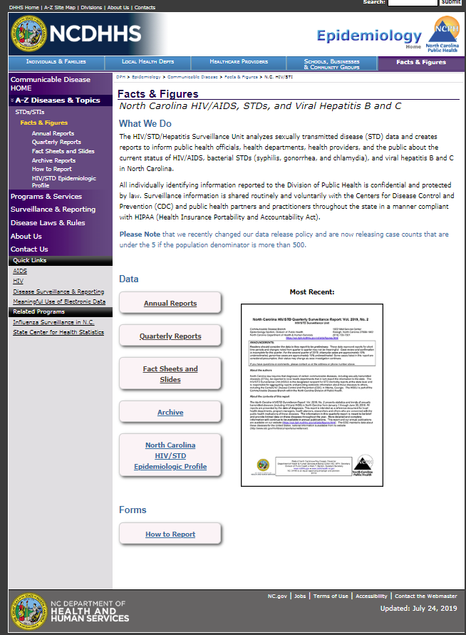
Where to find STI Surveillance information?
http://epi.publichealth.nc.gov/cd/stds/figures.html

Slide 3
Gonorrhea Cases by Gender, 2014-2024
22,255
*2020 data should be treated with caution due to reduced availability of testing caused by the COVID-19 pandemic.
Data Source: North Carolina Electronic Disease Surveillance System (NC EDSS) (data as of July 1, 2025).

Slide 4
Gonorrhea Rates by Gender
North Carolina and United States,
2014-2024
*2020 data should be treated with caution due to reduced availability of testing caused by the COVID-19 pandemic.
Data Source: North Carolina Electronic Disease Surveillance System (NC EDSS) (data as of July 1, 2025)
and 2024 Sexually Transmitted Infections Surveillance (Provisional Data), CDC (https://www.cdc.gov/sti-statistics/annual/index.html).

Slide 5
Age Distribution of Gonorrhea Cases by Gender, 2024
Data Source: North Carolina Electronic Disease Surveillance System (NC EDSS) (data as of July 1, 2025).

Slide 6
Gonorrhea Cases by Race 2020-2024
28,092
29,224
26,877
26,390
22,255
*2020 data should be treated with caution due to reduced availability of testing caused by the COVID-19 pandemic. Data is italicized for this reason.
Data Source: North Carolina Electronic Disease Surveillance System (NC EDSS) (data as of July 1, 2025).

Slide 7
Gonorrhea Cases by Ethnicity 2020-2024
28,092
29,224
26,877
26,390
22,255
*2020 data should be treated with caution due to reduced availability of testing caused by the COVID-19 pandemic. Data is italicized for this reason.
Data Source: North Carolina Electronic Disease Surveillance System (NC EDSS) (data as of July 1, 2025).

Slide 8
Gonorrhea Rates by Race 2020-2024
*2020 data should be treated with caution due to reduced availability of testing caused by the COVID-19 pandemic.
Data Source: North Carolina Electronic Disease Surveillance System (NC EDSS) (data as of July 1, 2025).

Slide 9
Gonorrhea Rates by Ethnicity 2020-2024
*2020 data should be treated with caution due to reduced availability of testing caused by the COVID-19 pandemic.
Data Source: North Carolina Electronic Disease Surveillance System (NC EDSS) (data as of July 1, 2025).

Slide 10
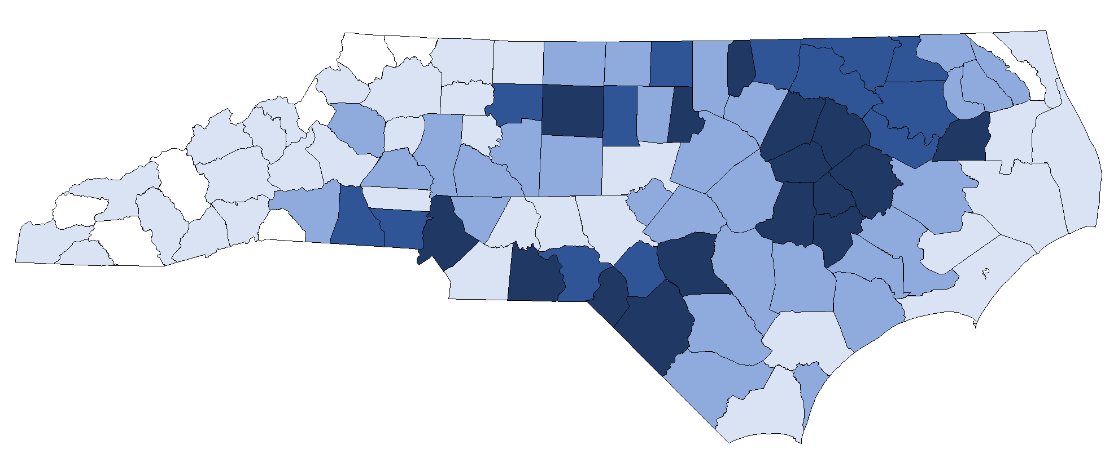
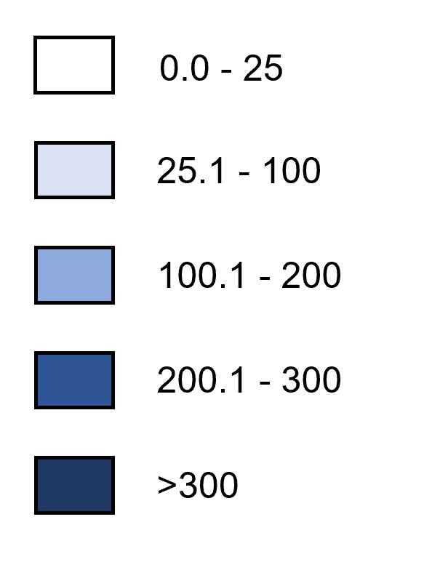
Gonorrhea Rates by County, 2024
Rate per 100,000 Population
Data Source: North Carolina Electronic Disease Surveillance System (NC EDSS) (data as of July 1, 2025).

Slide 11
Gonorrhea Coinfection with HIV

Slide 12
People with Gonorrhea Coinfected with HIV^^ by Gender, 2014-2024
^^HIV diagnosed prior to OR within 30 days of gonorrhea diagnosis.
*2020 data should be treated with caution due to reduced availability of testing caused by the COVID-19 pandemic.
Data Source: North Carolina Electronic Disease Surveillance System (NC EDSS) (data as of July 1, 2025) and enhanced HIV/AIDS Reporting System (eHARS) (data as of July 2025).

Slide 13
People with Gonorrhea Coinfected with HIV^^ by Race 2020-2024
^^HIV diagnosed prior to OR within 30 days of gonorrhea diagnosis.
*2020 data should be treated with caution due to reduced availability of testing caused by the COVID-19 pandemic.
Data Source: North Carolina Electronic Disease Surveillance System (NC EDSS) (data as of July 1, 2025).

Slide 14
People with Gonorrhea Coinfected with HIV^^ by Ethnicity 2020-2024
^^HIV diagnosed prior to OR within 30 days of gonorrhea diagnosis.
*2020 data should be treated with caution due to reduced availability of testing caused by the COVID-19 pandemic.
Data Source: North Carolina Electronic Disease Surveillance System (NC EDSS) (data as of July 1, 2025).

