Slide 1
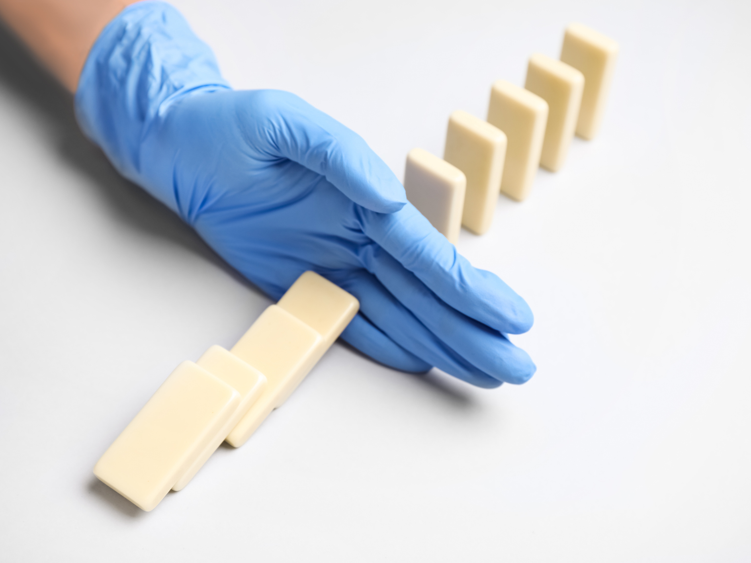

Infection Prevention and Control
Infection Prevention Education
Notes:
Welcome participants

Slide 2

Pre-assessment https://forms.office.com/g/8QhSJvQsqK
Notes:
Please take 3 minutes to complete this pre-assessment. If you do not have a smart phone, please partner up with another participant. All responses will be kept anonymous. This assessment allows the infection prevention team to monitor the impact of our modules. https://forms.office.com/Pages/ResponsePage.aspx?id=3IF2etC5mkSFw-zCbNftGZwLhkl927NJtGWhRDsHuapUOElJUUs1VlNNNkxEUTQ2NFFUVjBKVUQ4Ny4u

Slide 3
Know, Want to Know, Learned (KWL) Chart
Want to Know
Know
Learned
Notes:
Before we start today’s module, we will complete the first two sections of a KWL chart. A KWL chart is a “Know, Want to Know, Learned” chart. Please partner up in groups of three. With your sticky notes, please write down everything you already know about the chain of infection and what you would like to know about it. You will have 7 minutes to brainstorm ideas. Please select one representative from your group to share what you all came up with and add your sticky notes to the group chart.

Slide 4
Overview
Pre-assessment
KWL Chart
Infection Prevention and Control
KWL Chart
Post-assessment
Notes:
For today’s module, we will focus on these 6 focus areas, two of which you’ve already completed!

Slide 5

Chain of Infection
Chain of Infection
Infectious agent
Susceptible host
Reservoirs
Portal of entry
Portal of exit
Mode of transmission
Notes:
The chain of infection is a model that outlines the interconnected steps necessary for the transmission of infectious diseases, consisting of six key links: Infectious Agent, Reservoir, Portal of Exit, Mode of Transmission, Portal of Entry, and Susceptible Host. All these links in the chain have to happen for someone to get an infection (make a circular motion with your hands).

Slide 6

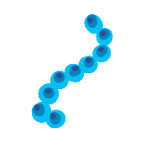



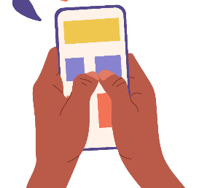
Chain of Infection
Infectious Agent
Bacteria
Viruses
Fungi
Parasites
Arthropods
Reservoirs
Human
Blood
Skin
Digestive tract
Respiratory tract
Urinary tract
Environment
Doorknobs
Light switches
Phones
Counter tops
Personal items
Notes:
Infectious Agent: This is the pathogen (bacteria, virus or fungus) that causes disease.
Reservoir: The place where the infectious agent lives, grows, and multiplies. Reservoirs can be humans, animals, or environmental sources like soil and water. For example, a person with a cold acts as a human reservoir, while a contaminated doorknob can serve as an environmental reservoir.

Slide 7
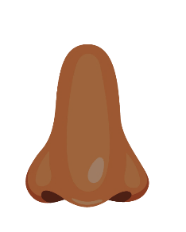
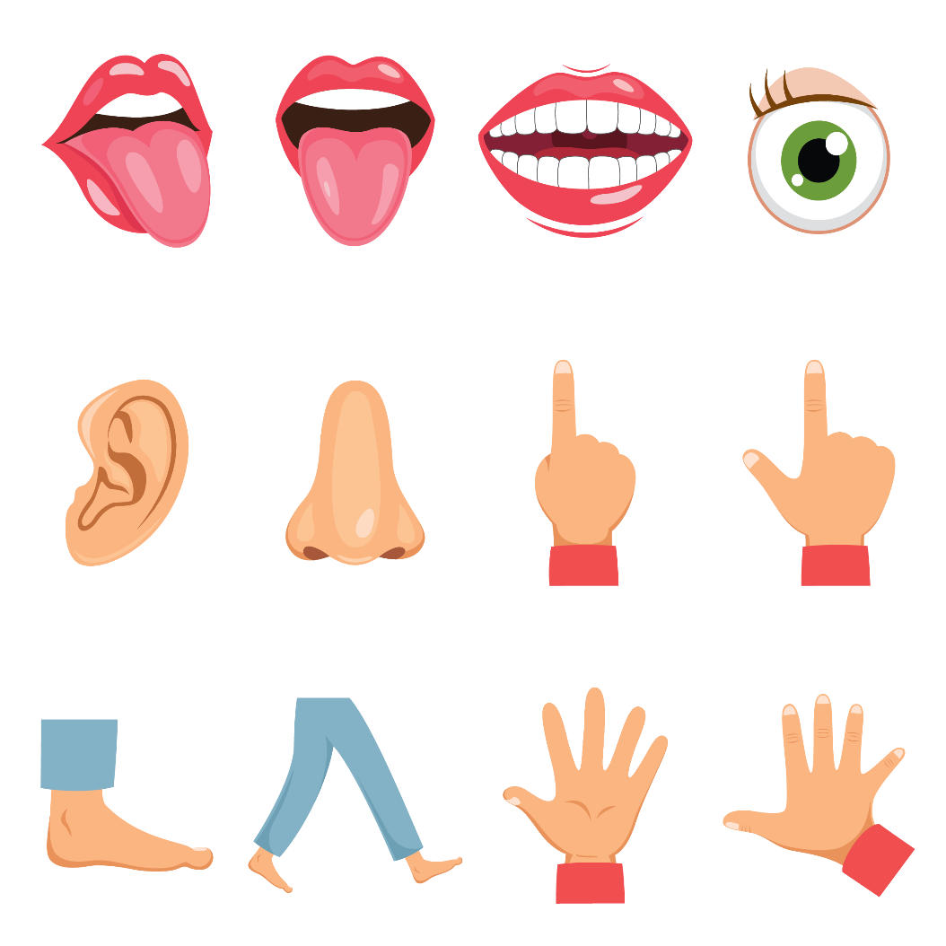
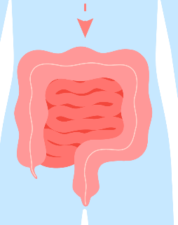
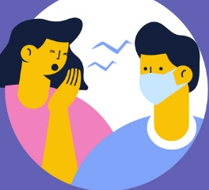
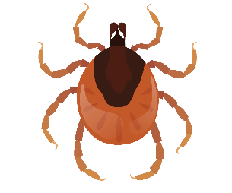
Chain of Infection
Portal of Exit
Nose and mouth
Gastrointestinal tract
Skin
Mode of Transmission
Contact
Droplets
Airborne
Vectors (e.g., ticks)
Notes:
Portal of Exit: The route by which the infectious agent leaves its reservoir (or how its leaves our bodies). This can occur through various means, such as respiratory droplets from coughing or sneezing, blood from an open wound, or fecal matter.
Mode of Transmission: This describes how the pathogen travels from the reservoir to a new host (or person-to-person or the environment to the person). Transmission can occur through direct contact (e.g., touching or kissing), indirect contact (e.g., touching contaminated surfaces), airborne transmission, or vector-borne transmission (e.g., through insects like ticks and mosquitoes).

Slide 8
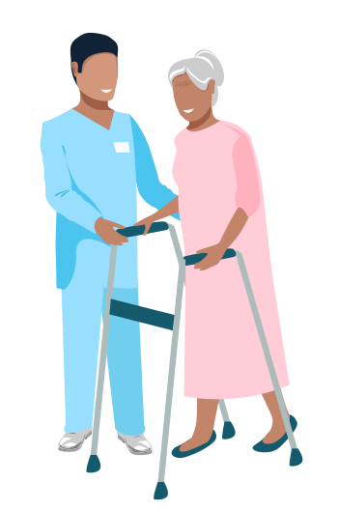
Chain of Infection
Portal of Entry
Nose and mouth
Gastrointestinal tract
Skin
Susceptible Person
Age (very young or old)
Stress
Fatigue
Poor diet
Chronic illness
Unvaccinated
Open wounds
Medications
Notes:
Portal of Entry: The pathway through which the infectious agent enters our bodies. Germs can enter our bodies through mucous membranes (like our nose or mouth), openings in the skin (like a cut), or gastrointestional tract (through our stomach).
Susceptible Host: Someone who is at risk of infection. Some people are more likely to get infections due to factors like age, health status, or lack of immunity. That could include infants, the elderly, and individuals with weakened immune systems.

Slide 9
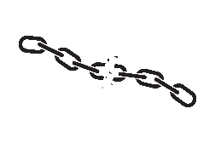

Breaking the Chain
Notes:
As healthcare providers, it’s important to stop the spread to the best of your ability. We call this breaking the chain. There are multiple ways we can break the chain, some of which we will review now.

Slide 10
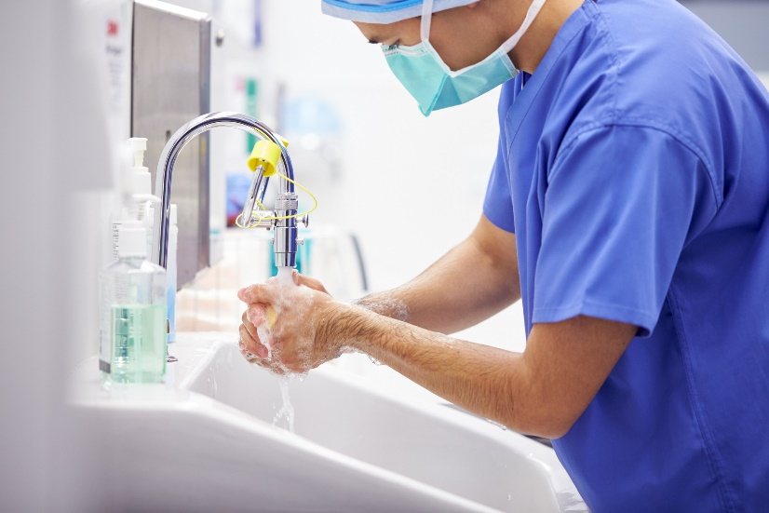
Hand Hygiene
Alcohol based hand sanitizer (gel or foam)
Handwashing with soap and water
Reduces spread to patients, Reduces spread of resistant germs, Reduces risk to you!
Notes:
Hand hygiene is the number one way to stop the spread of infections. Hand hygiene protects both healthcare personnel and patients. Hand hygiene means using an antiseptic hand rub (like alcohol-based foam or gel hand sanitizer) or cleaning your hands by washing them with soap and water.
Cleaning your hands reduces:
The potential spread of deadly germs to patients.
The spread of germs, including those resistant to antibiotics.
The risk of healthcare personnel colonization or infection caused by germs received from the patient.
Some healthcare personnel may need to clean their hands as often as 100 times during a work shift to keep themselves, patients and staff safe.
https://www.cdc.gov/clean-hands/hcp/clinical-safety/index.html

Slide 11
Hand Hygiene – When to clean your hands
Immediately before touching a patient
Before performing an aseptic task such as dressing a wound or inserting a catheter
Before moving from work on a soiled body site to a clean body site
After touching a patient or patient's surroundings
After contact with blood, body fluids, or contaminated surfaces
Immediately after glove removal
Notes:
When should you perform hand hygiene?
Immediately before touching a patient.
Before performing an aseptic task such as placing an indwelling device or handling invasive medical devices.
Before moving from work on a soiled body site to a clean body site on the same patient.
After touching a patient or patient's surroundings.
After contact with blood, body fluids, or contaminated surfaces.
Immediately after glove removal.
https://www.cdc.gov/clean-hands/hcp/clinical-safety/index.html

Slide 12
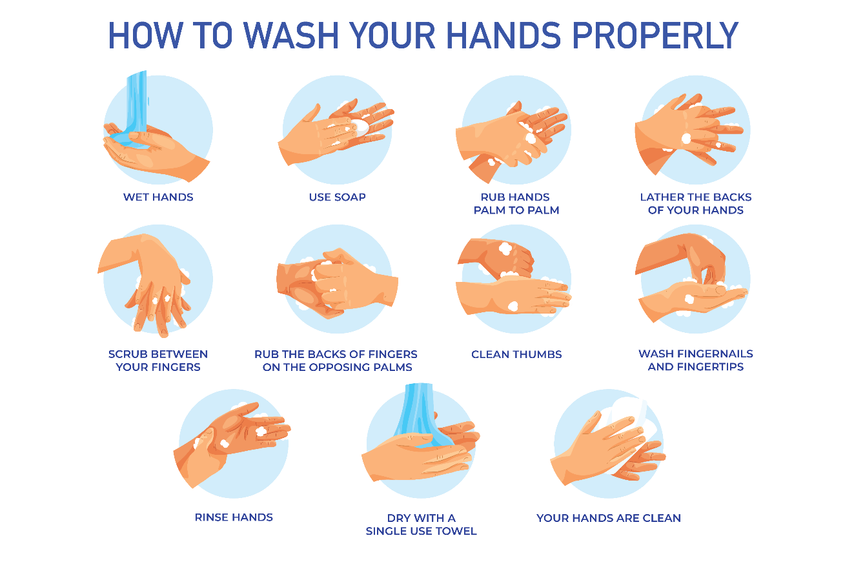

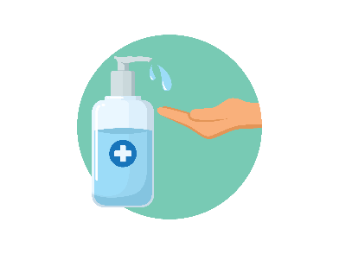
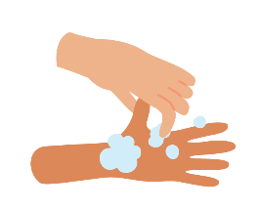
Hand Hygiene – How to clean your hands
Alcohol-based hand sanitizer | Soap and Water
Put product on hands and rub hands together Cover all surfaces and rub until hands feel dry This should take around 20 seconds Pay attention to the areas frequently missed: Thumbs Fingertips Between fingers | Wet hands with water Apply soap Rub hands together to cover all surfaces of the hands and fingers for at least 15 seconds Rinse hands with water Dry hands completely using a clean, single-use towel
20 sec
15 sec
12
Notes:
To use alcohol-based hand sanitizer:
Put an adequate amount of product on your hands and rub your hands together. Cover all surfaces and rub until hands feel dry. This should take around 20 seconds.
Pay attention to areas frequently missed such as thumbs, fingertips and between the fingers for at least 15 second. Rinse your hands. Dry your hands completely using a clean, single-use towel.
To wash your hands with soap and water:
Wet your hands with water, apply an adequate amount of soap. Rub your hands together to cover all surfaces of the hands
https://www.cdc.gov/clean-hands/hcp/clinical-safety/index.html

Slide 13
Hand Hygiene – When to use soap and water
Use soap and water (rather than alcohol-based hand sanitizer) when:
When hands are visibly soiled Before, during and after preparing food After using the restroom During the care of patients with suspected or confirmed infection during outbreaks of C. diff and norovirus
13
Notes:
Use soap and water, rather than using hand sanitizer, when hands are visibly soiled; before, during and after preparing food; after using the restroom; and during the care of patients with suspected or confirmed infection during outbreaks of C. diff and norovirus.
https://www.cdc.gov/clean-hands/hcp/clinical-safety/index.html

Slide 14
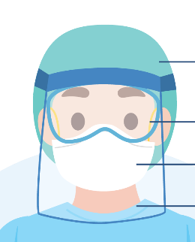
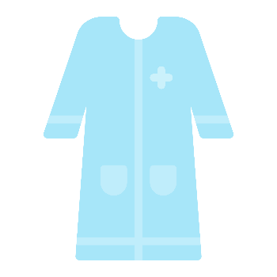

Standard Precautions – every patient every time
Perform hand hygiene
Wear PPE if there is an “anticipated exposure” to blood, body fluids, secretions, or excretions​
Follow respiratory hygiene/cough etiquette
Ensure appropriate patient placement
Properly handle, clean and disinfect patient care equipment and instruments/devices
Handle textiles carefully
Follow safe injection practices
Notes:
Another tactic to break the change is to follow standard precautions, which includes hand hygiene. Standard Precautions are used for all patient care, every patient, every time. They're based on a risk assessment and make use of common sense practices and personal protective equipment that protect healthcare providers from infection and prevent the spread of infection from patient to patient.
Standard precautions include: hand hygiene, PPE for anticipated exposure, respiratory hygiene, appropriate patient placement, cleaning and disinfection of equipment, careful handling of textiles, and safe injection practices.

Slide 15
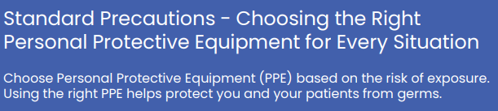
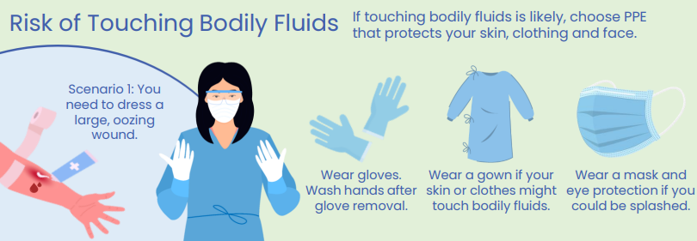
Notes:
Another part of standard precautions (remember, every patient every time) is using appropriate PPE for the situation/type of care you are providing. You can always wear PPE to protect yourself. For example, if you are touching bodily fluids, wear gloves. If the care you are providing may get your clothes dirty, you may want to wear a gown.

Slide 16
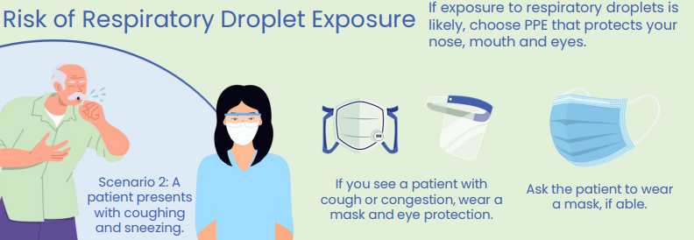
Notes:
If someone is coughing or sneezing, consider wearing a mask and/or goggles to protect your mouth, nose and eyes

Slide 17
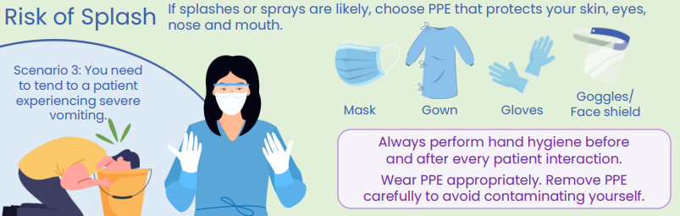
Notes:
If there is a risk of splash, you may want to use a face shield or goggles to protect your mouth nose and eyes; and perhaps a gown and gloves to protect your hands and clothing.

Slide 18
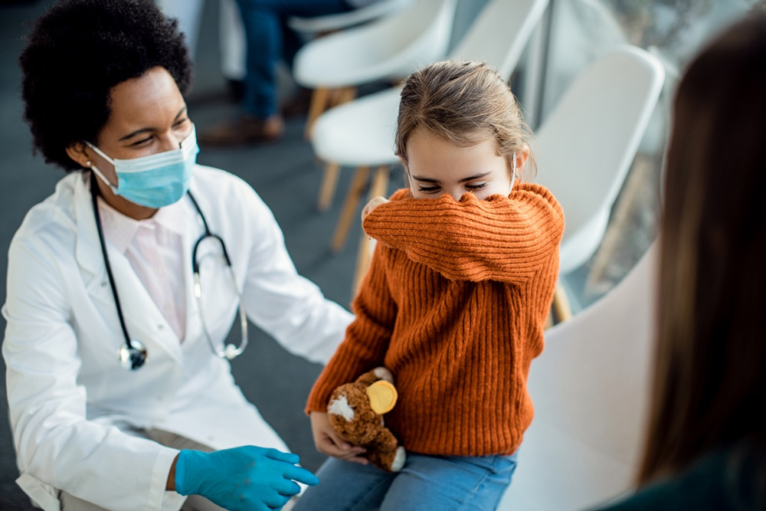
Transmission-Based Precautions
Contact Precautions
  Spread through touch
  Example: Multidrug-resistant organisms (MDRO)
Droplet Precautions
  Spread through respiratory droplets
  Example: Influenza
Airborne Precautions
  Spread through small respiratory particles that linger in the air
  Example: Tuberculosis
Enhanced Barrier Precautions (nursing homes only)
  Spread through touch
  Example: MDRO, large wounds, indwelling devices
Notes:
Transmission-Based Precautions are to be used in addition to Standard Precautions for patients who may be infected or colonized with certain infectious agents for which additional precautions are needed to prevent infection transmission. Those include contact precautions, droplet precautions, and airborne precautions. There are other types of transmission-based precautions you may see in your facility, such as enhanced barrier precautions in nursing homes, or "special droplet" for use with COVID patients. Your facility should let you know when a patient is on transmission-based precautions by hanging a sign at their door. Wear your PPE appropriately and remove your PPE before caring for the next patient and before leaving the room. Always follow your facility’s specific guidelines. In the next few slides, we will go over what each precautionary measure should include.

Slide 19


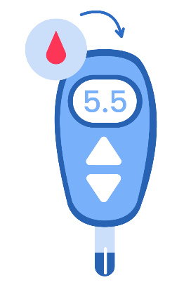
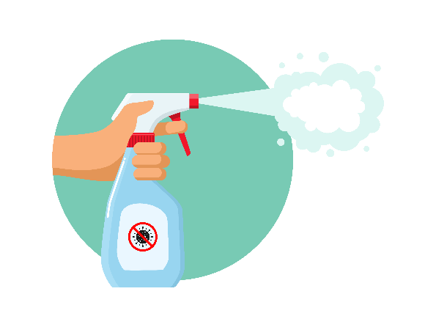
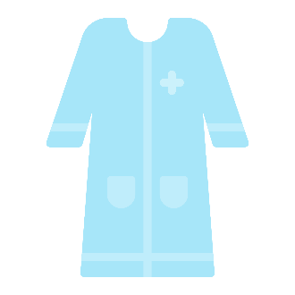

Contact Precautions – spread by touch
Always follow facility specific guidelines
  Use PPE appropriately – Gown and Gloves
  Place in a private room or choose roommates with a similar condition
  Limit transport and movement of patients
  Use disposable or dedicated patient-care equipment
  Prioritize cleaning and disinfection of rooms
Notes:
Use contact precautions for patients with known or suspected infections that represent an increased risk for contact transmission.
-Wear a gown and gloves when caring for patients on contact precautions
-Choose room placement and roommates carefully to reduce risk of transmission to others
-Limit transport and movement of patients outside of the room to medically-necessary purposes. When transport or movement is necessary, cover or contain the infected of the patient's body.
-Use disposable or dedicated patient-care equipment (e.g., blood pressure cuffs). If common use of equipment for multiple patients is unavoidable, clean and disinfect such equipment before use on another patient.
-Prioritize cleaning and disinfection of the rooms of patients on contact precautions ensuring rooms are frequently cleaned and disinfected
https://www.cdc.gov/infection-control/hcp/basics/transmission-based-precautions.html

Slide 20
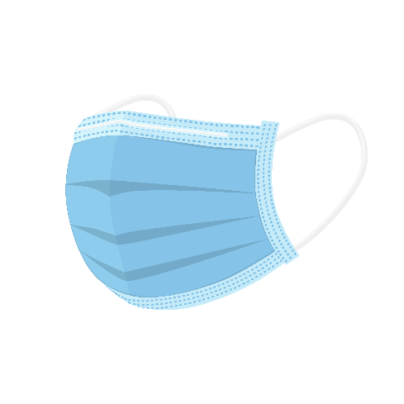

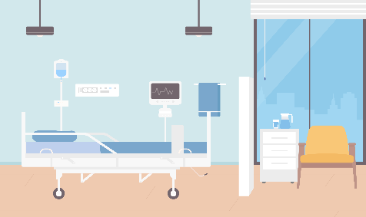
Droplet Precautions – spread by respiratory droplets
Always follow facility specific guidelines
  Use PPE appropriately - Mask
  Have the patient wear a mask (if able)
  Place in a private room or chose roommates with similar condition
  Limit transport and movement of patients
Notes:
Use droplet precautions for patients known or suspected to be infected with pathogens transmitted by respiratory droplets that are generated by a patient who is coughing, sneezing or talking.
-Wear a mask when caring for patients on droplet precautions
-Contain pathogens at the source, have the patient wear a mask if they are able
-Choose room placement and roommates carefully to reduce risk of transmission to others. Those on droplet precautions should have a private room when possible
-Limit transport and movement of patients outside of the room to medically-necessary purposes. If transport or movement outside of the room is necessary, instruct patient to wear a mask and follow Respiratory Hygiene/Cough Etiquette.
https://www.cdc.gov/infection-control/hcp/basics/transmission-based-precautions.html

Slide 21
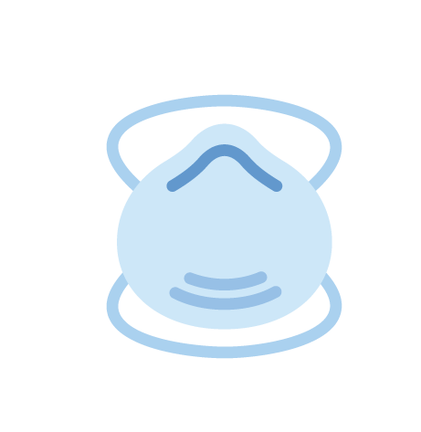


Airborne Precautions – spread by particles in the air
Always follow facility specific guidelines
  Use PPE appropriately – N95 Mask
  Have the patient wear a mask (if able)
  Place patient in an airborne infection isolation room (AIIR)
      Patient may need to transfer to a different facility
  Limit transport and movement of patients
Notes:
Use airborne precautions for patients known or suspected to be infected with pathogens transmitted by the airborne route like TB, measles, chickenpox).
-Use personal protective equipment (PPE) appropriately, including a fit-tested NIOSH-approved N95 or higher level respirator for healthcare personnel
-Contain pathogens at the source, have the patient wear a mask if they are able
-Ensure appropriate patient placement in an airborne infection isolation room (AIIR) constructed according to the Guideline for Isolation Precautions. This may require the patient being transferred to another facility if your facility does not have an airborne infection isolation room
-Limit transport and movement of patients outside of the room to medically-necessary purposes
https://www.cdc.gov/infection-control/hcp/basics/transmission-based-precautions.html

Slide 22


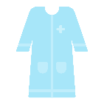

Enhanced Barrier Precautions (EBP) – spread by touch
Nursing Homes Only
Wear gloves and a gown for high-contact care activities. Do not wear the same PPE to care for more than one resident
Residents with indwelling medical devices, wounds, or those who are colonized or infected with a MDRO should be placed on EBP
  Each resident on EBP should have a sign hanging outside their door
Use EBP during high-contact patient care activities:
  Dressing or bathing
  Transferring
  Changing linens
  Assisting with toileting
  Accessing indwelling medical devices
  Providing wound care
Notes:
Finally, a resident in a long-term care facility, specifically nursing homes, may be placed on enhanced barrier precautions due to colonization or infection with a Multidrug-resistant organism also called a MDRO. Patients on EBP will have a sign hanging outside of their room to notify staff. When a patient is on EBP, it is important to clean hands before entering and leaving a residents room, wear gloves and gowns for high-contact care activities, dispose of PPE in resident’s room, do not wear the same PPE to care for more than one resident.

Slide 23
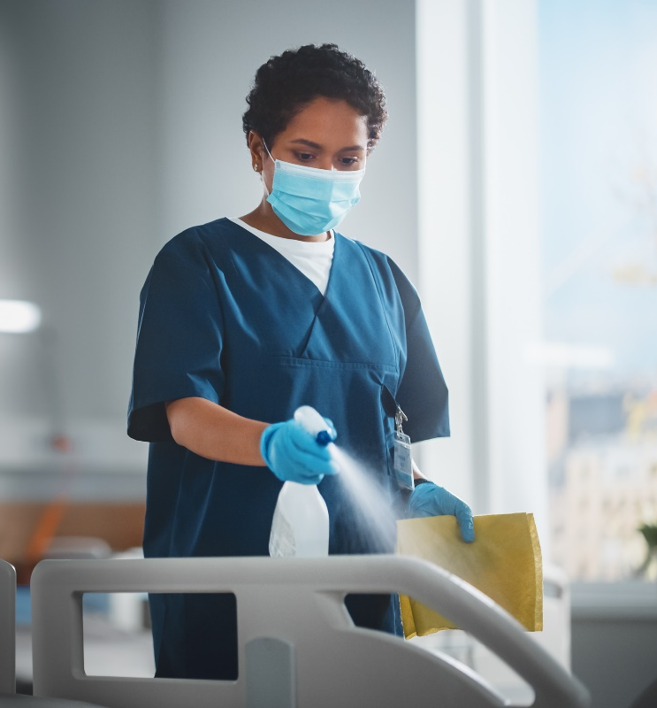
Steps to clean & disinfect the patient, environment and medical equipment:
Follow facility’s cleaning & disinfection protocols
Ensure high-touch surfaces are cleaned frequently
  Bed rails
  Light switches
  Call buttons
Dedicate equipment to patients whenever possible or clean and disinfect between each patient
  Stethoscopes
  Blood pressure cuffs
  Lifts
  PT/OT equipment
Notes:
Pathogens can be transmitted via contaminated surfaces. To adequately clean and disinfect the patient environment, follow your facility’s cleaning and disinfection protocols. Clean high-touch surfaces frequently such as bed rails and call buttons. When possible, dedicate equipment to individual patients or clean and disinfect all equipment between patients.

Slide 24
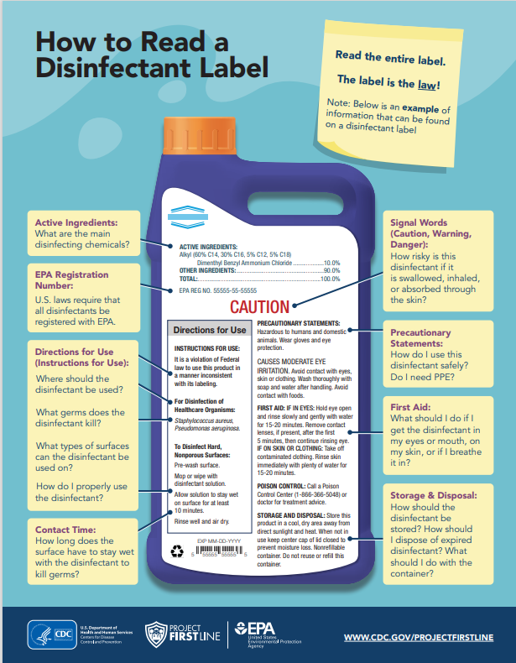
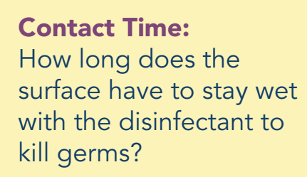

Notes:
When using cleaning and disinfectant products, it is important to read and understand the disinfectant label. Disinfectant labels have important information to make sure your disinfectant kills the harmful pathogens we want to kill. The disinfectant label will tell you what pathogens it is effective against. The disinfectant label will also tell you how to use the disinfectant, like what surfaces it can be used on, how to apply the product, and what the contact time, also called wet time or kill time, is for the product. Contact time is the time a disinfectant has to stay wet on a surface to effective kill germs.

Slide 25
Team Trivia!
In your KWL groups, do your best to answer the following questions. The team with the most correct answers wins bragging rights!

Slide 26
Question 1:
What is the number one thing you can do as a health care provider to stop the spread of infections?

Slide 27
Answer:
Perform hand hygiene
Notes:
Answer: perform hand hygiene

Slide 28
Question 2:
Name at least 3 of the 6 health care scenarios when you should perform hand hygiene
(bonus point for each additional scenario)
Notes:
For example, you should perform hand hygiene immediately after removing gloves. So now you only have to come up with 2 additional scenarios in which hand hygiene is required. You can receive a bonus point for every additional scenario.

Slide 29
Immediately before touching a patient.
Before performing an aseptic task such as placing an indwelling device or handling invasive medical devices.
Before moving from work on a soiled body site to a clean body site on the same patient.
After touching a patient or patient's surroundings.
After contact with blood, body fluids, or contaminated surfaces.
Immediately after glove removal.
Answer:
Notes:
Immediately before touching a patient.
Before performing an aseptic task such as placing an indwelling device or handling invasive medical devices.
Before moving from work on a soiled body site to a clean body site on the same patient.
After touching a patient or patient's surroundings.
After contact with blood, body fluids, or contaminated surfaces.
Immediately after glove removal.

Slide 30
Question 3:
What is the preferred method of hand hygiene in most clinical situations?

Slide 31
Answer:
Alcohol-based hand sanitizer
Notes:
Answer: alcohol-based hand sanitizer
Use soap and water when hands are visibly soiled and after caring for patients with suspected or confirmed infection during outbreaks of C. diff and norovirus

Slide 32
Question 4:
What should you do with equipment before using it with another patient?

Slide 33
Answer:
Clean/Disinfect
Notes:
Answer: Clean/Disinfect

Slide 34
Question 5:
What PPE should you consider wearing if there is a risk of splash?

Slide 35
Mask
Face shield/goggles
Consider adding a gown and gloves if your hands/clothes could also get dirty
Answer:
Notes:
Answer: Mask and/or a face shield/googles

Slide 36
Question 6:
What is the minimum type(s) of PPE should you wear for Contact Precautions?

Slide 37
Answer:
Gown and gloves
Notes:
Answer: Gown and gloves

Slide 38
Question 7:
What does contact time/kill time mean for a disinfectant?

Slide 39
Answer:
The amount of time a disinfectant has to stay wet on a surface to effectively kill germs.
Notes:
Answer: The amount of time a disinfectant has to stay wet on a surface to effectively kill germs.

Slide 40
Know, Want to Know, Learned (KWL) Chart
Want to Know
Know
Learned
Notes:
Great work everyone! Now we will revisit our KWL chart from the beginning of this presentation. In your groups, please brainstorm different things you learned from today. Fill out your sticky notes and select one representative again to share your thoughts with the larger group.

Slide 41

Post-assessment https://forms.office.com/g/JrYmjCcpEt
Notes:
Please take 3 minutes to complete this post-assessment. All responses will be kept ano nymous. This assessment allows the infection prevention team to monitor the impact of our modules. https://forms.office.com/Pages/ResponsePage.aspx?id=3IF2etC5mkSFw-zCbNftGZwLhkl927NJtGWhRDsHuapUN1BUUk1OQlIyS0JCQlJMSzhJMFA2UlZSTC4u

Slide 42
Thank you!
infectionprevention@dhhs.nc.gov
Notes:
Congratulations! You have completed the infection prevention and control education module. If there are no further questions at this time, we will conclude for today. If any questions arise in the future, please feel free to email them to our team at infectionprevention@dhhs.nc.gov.

Slide 43
This is the end of the slide deck. Please do not present past this slide.

Slide 44


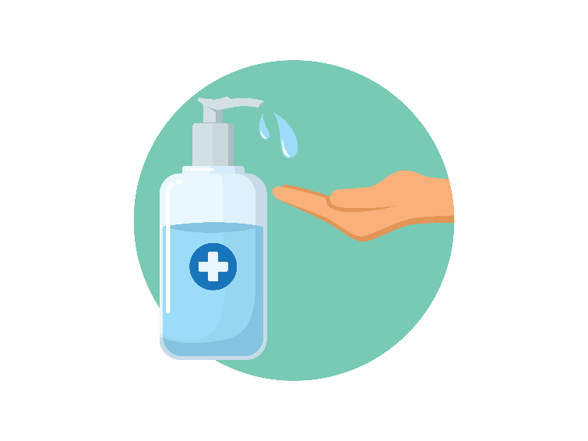
Breaking the chain
Infectious Agent
Vaccinations/immunizations
Reservoir
Environmental cleaning
Disinfection/sterilization
Hand hygiene
Notes:
One way to stop the spread of infection is to vaccinate against diseasses we have vaccines for. For reservoirs, we can focus on cleaning, disinfection and hand hygiene.

Slide 45

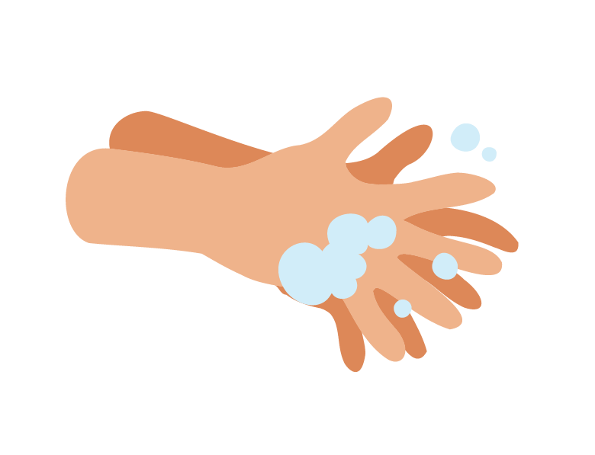
Breaking the chain
Portal of Exit
Source control
Keeping wounds covered
Contain secretions/bodily fluids
Hand hygiene
Mode of Transmission
Standard/Transmission based precautions
Hand Hygiene
Handling linen correctly
Insect repellant
Notes:
To continue to break the chain, the portal of exit can be broke through source control, covering wounds and containing bodily fluids, as well as hand hygiene. As for the mode of transmission link, we can break the chain through standard and transmission-based precautions, hand hygiene, the correct handling of linen, and insect repellant.

Slide 46

Breaking the chain
Portal of Entry
Standard/Transmission based precautions
Hand hygiene
Remove indwelling devices
Susceptible Host
Good nutrition
Adequate rest
Vaccinations/immunizations
Glycemic control
Notes:
For the portal of entry, we can break the chain of infection with standard and transmission based precautions, hand hygiene, and removing indwelling devices. For susceptible hosts, we can make sure patients are receiving good nutrition, getting adequate rest, are full immunized, and controlling glycemic levels.

Slide 47

Personal Protective Equipment - Gloves
Wear gloves when in contact with:
  Blood or body substances
  Mucous membranes
  Non-intact skin
  Insertion point of invasive or indwelling device
  And when required for isolation precautions (such as contact precautions)
Notes:
Wear gloves when anticipating contact with a patient’s: • Blood or body substances (i.e., fluids or solids) • Mucous membranes (e.g., nasal, oral, genital area) • Non-intact skin (e.g., wound or surgical incision) • Insertion point of a patient’s invasive or indwelling device. If wearing gloves with an isolation gown, ensure gloves cover your wrist

Slide 48

Personal Protective Equipment - Gowns
Wear a gown when in contact with:
Expected contact with blood or body substances
During procedures where contact is likely
Handling containers or patient fluids
And when required for isolation precautions (such as contact precautions)
Notes:
Wear when contact between clothing or skin with patient blood or body substances is expected. For example: • Contact with patient’s non-intact skin (e.g., wounds) • During procedures likely to generate a splash or spray of blood or body fluid • Handling containers or patient fluids likely to leak, splash or spill

Slide 49
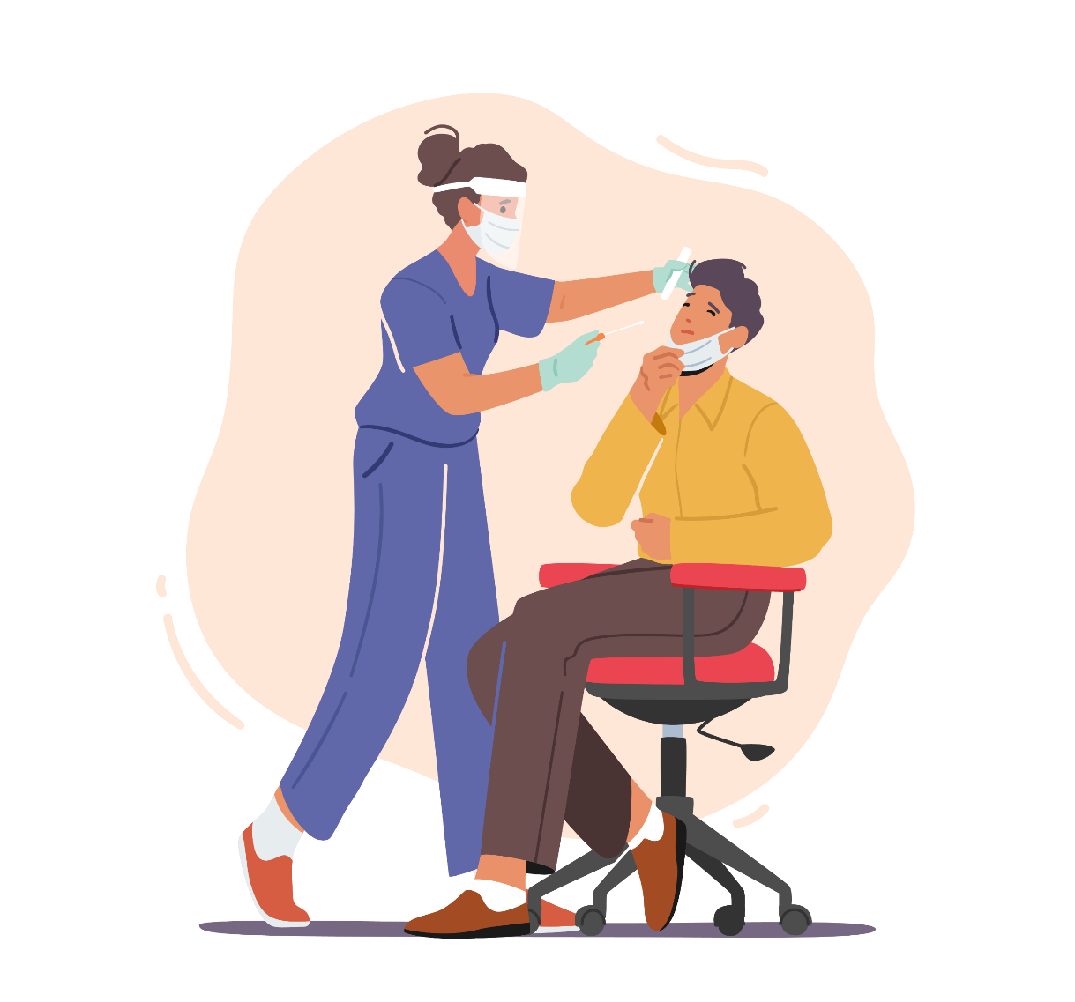
Personal Protective Equipment – Face Masks and Protective Eye Coverage
Expected splashes or spray during care
Face masks: protects nose and mouth
Goggles: protects eyes
Face shields: entire face
X Personal eyeglasses
Notes:
Wear when anticipating potential splashes or sprays of blood/body substances during patient care Face Masks–protect nose and mouth Goggles–protect eyes Face shields–protect face (i.e., nose, mouth and eyes) Personal eyeglasses and contact lenses are not considered adequate eye protection

