Slide 1
Monthly Epi Section Update for LHDs
May 13, 2025

Slide 2
Agenda
Opening Remarks | Zack Moore, MD, MPH State Epidemiologist and Epidemiology Section Chief
Rabies, Vector borne, Zoonotic | Carl Williams, DVM, DACVPM State Public Health Veterinarian
VPD: Measles Update | Justin Albertson, MS Vaccine-Preventable Disease Epidemiologist Timothy Davis, PharmD, BCNP, PMP Medical Countermeasures Coordinator
Vaccine Update | Carrie Blanchard, Pharm D, MPH Immunization Branch Director
Question & Answer Session | Open for Questions — Please use the Zoom Q&A function

Slide 3
Agenda
Opening Remarks | Zack Moore, MD, MPH State Epidemiologist and Epidemiology Section Chief
Rabies, Vector borne, Zoonotic | Carl Williams, DVM, DACVPM State Public Health Veterinarian
VPD: Measles Update | Justin Albertson, MS Vaccine-Preventable Disease Epidemiologist Timothy Davis, PharmD, BCNP, PMP Medical Countermeasures Coordinator
Vaccine Update | Carrie Blanchard, Pharm D, MPH Immunization Branch Director
Question & Answer Session | Open for Questions — Please use the Zoom Q&A function

Slide 4
Agenda
Opening Remarks | Zack Moore, MD, MPH State Epidemiologist and Epidemiology Section Chief
Rabies, Vector borne, Zoonotic | Carl Williams, DVM, DACVPM State Public Health Veterinarian
VPD: Measles Update | Justin Albertson, MS Vaccine-Preventable Disease Epidemiologist Timothy Davis, PharmD, BCNP, PMP Medical Countermeasures Coordinator
Vaccine Update | Carrie Blanchard, Pharm D, MPH Immunization Branch Director
Question & Answer Session | Open for Questions — Please use the Zoom Q&A function

Slide 5
NC Department of Health and Human Services
LHD Updates Measles
Justin Albertson, MS
Epidemiologist, Vaccine-Preventable Diseases
May 13, 2025

Slide 6
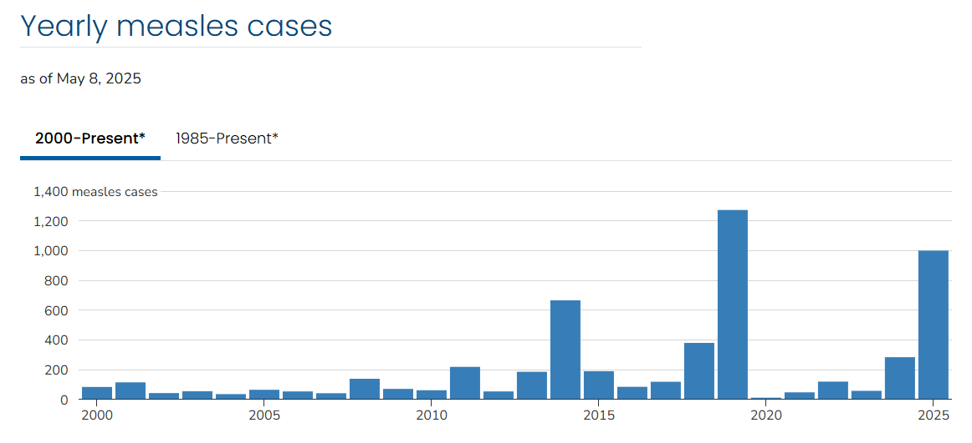
Measles Trends: National, 2000-2025
https://www.cdc.gov/measles/data-research/index.html
Notes:
The graph shows the number of measles cases reported nationally since the year 2000, and you can see that 2025 has the highest number of cases since 2019. 2019 and 2025 are the worst years for measles in the U.S. since the early ‘90s.

Slide 7
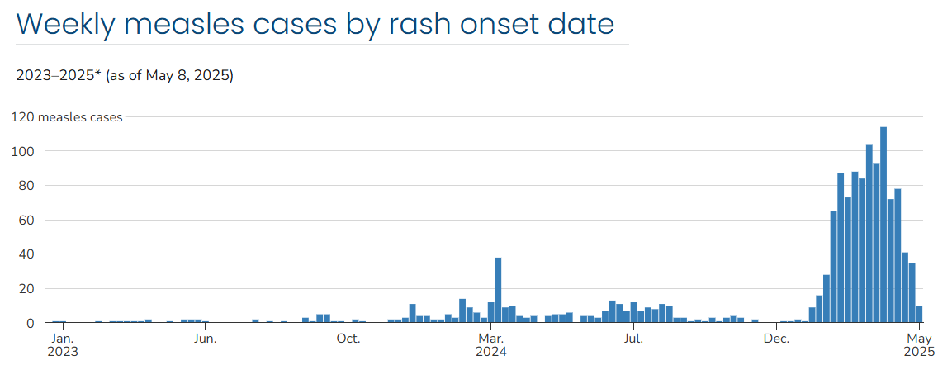
Measles Trends: National, 2023-2025
https://www.cdc.gov/measles/data-research/index.html
Notes:
1,001 cases in 2025 as of May 8, 2025 including 709 cases in the Texas outbreak. Cases have been reported by 31 jurisdictions but not North Carolina; no cases have been reported in North Carolina in 2025.
You can see in this graph that measles cases have surged in 2025. Cases seemed to have slowed a bit compared to the peak in March, but are still high compared to recent years. The most recent weeks are likely incomplete due to reporting lag.

Slide 8
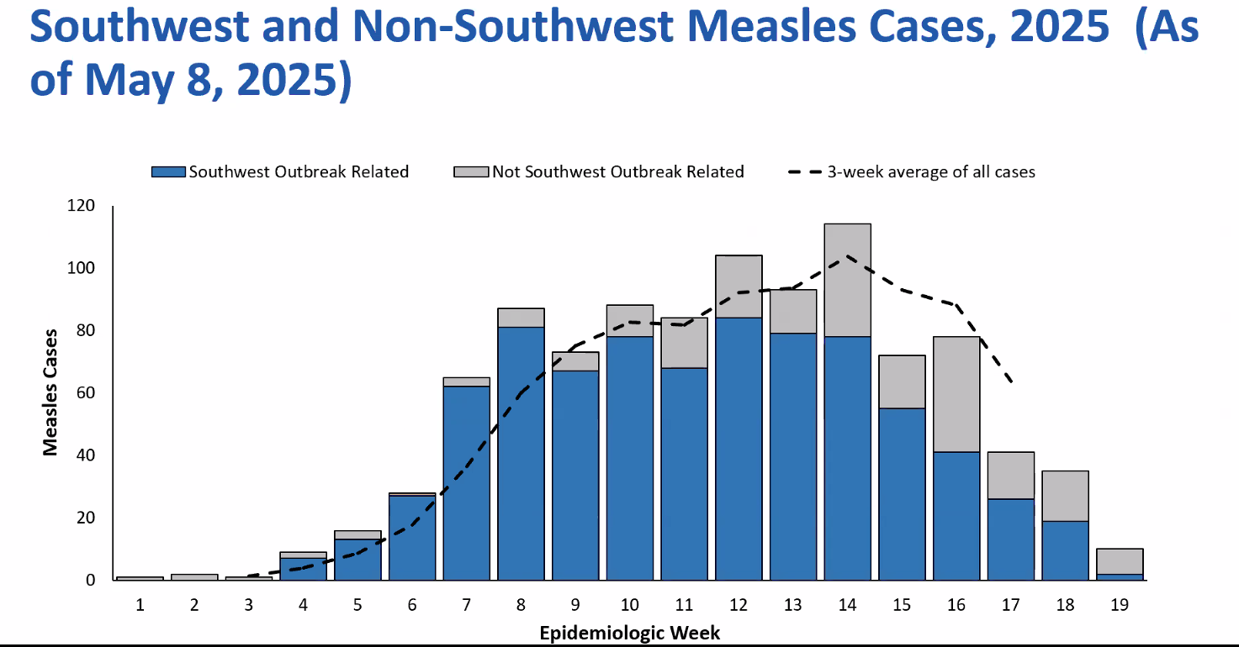

Slide 9
https://www.dph.ncdhhs.gov/programs/epidemiology/communicable-disease/measles
Notes:
Reminder that we have a nice updated measles web page on the website now that has guidance and resources, including a page for health care providers. This is the main measles page, and the link to the health care providers section can be seen on the top right.

Slide 10
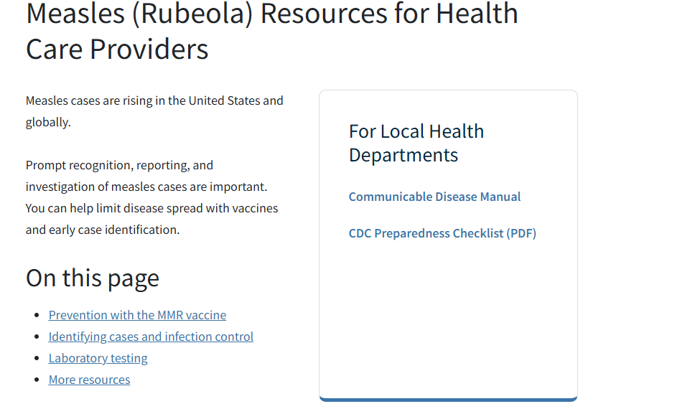
https://www.dph.ncdhhs.gov/programs/epidemiology/communicable-disease/measles/providers
Notes:
On that page, you can find guidance on MMR vaccine, case reporting and infection control, and laboratory testing.
Guidance for schools on measles preparedness has been distributed to schools, and we are also working on a web page with guidance specifically for educational facilities, including child care, schools, and higher ed, so be on the lookout for those updates.

Slide 11
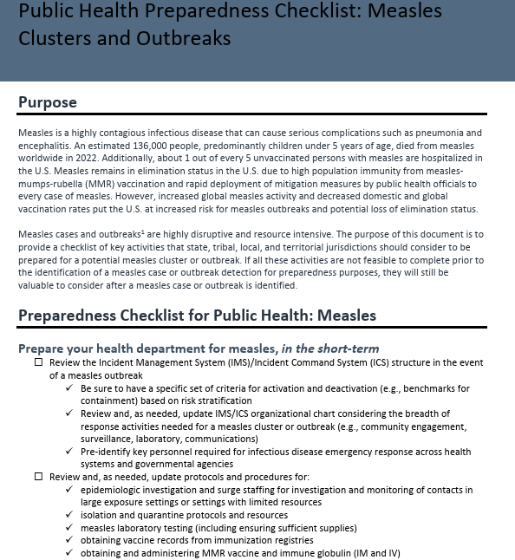
Preparedness Checklist
https://www.cdc.gov/measles/media/pdfs/2025/02/CDC-Public-Health-Checklist_Sept18_FINAL-updatedlinks-508.pdf
Notes:
Another reminder that CDC has a measles public health preparedness checklist on their website. We encourage every local health department to review this checklist to help with measles preparedness activities and identify obvious gaps in resources or response capabilities.
This is a five-page document, with just the first part shown here.

Slide 12
Is Your LHD Ready?
Infection prevention office plan
Adhere to Standard and Airborne precautions for known or suspected patients
Staff immunization policy and records
Safe specimen collection
Ensure necessary supplies and equipment are available
What locations can test for measles in your county?
Surge capacity
Contact tracing- phone calls and data entry
Vaccination of eligible contacts, catch up vaccinations for non-immune
Fielding inquiries from media and community partners
Communication strategy
Legal preparedness including isolation and quarantine orders
Know your LHD and State partners
Use CDC’s Public Health Preparedness Checklist

Slide 13
Guidance on Measles Assessment and Testing at LHDs
LHDs may not have a provider available to evaluate potential measles patients.
LHDs are recommended to work with hospitals and medical facilities in their jurisdiction to plan for patient measles evaluation
LHDs should be prepared to collect and send specimens to SLPH from patients suspected to have measles who are at high-risk. Risk level is based on factors in consultation with CDB and include:
Immunization status
Clinical signs/symptoms
Epidemiology (travel and contacts)
A standing order template for measles specimen collection is available on the CD manual
Help Us Assess Measles Preparedness – Quick Survey for LHD Nurses
Notes:
We’ve received some questions for guidance on local health department capacity for evaluating and testing potential measles patients. We recognize that many LHDs will not have the capacity for medical evaluation and assessment of patients. We recommend that you work with hospitals and other medical facilities to plan for how to assess and test patients suspected to have measles who are not severely ill and do not require urgent medical care.
For patients who are at high-risk for measles, and do not need urgent medical care we do expect LHDs to be able to collect and send specimens for that patient to SLPH. The risk level of a patient can be decided in consultation with CDB, and includes an assessment of the patient’s clinical picture, vaccination history, and epidemiologic risk factors, particularly travel history.

Slide 14
Measles Lab Testing
PCR (preferred)
Collect throat or nasopharyngeal swab
Urine is also a valid specimen but should be paired with a swab
Preferable to collect within 3 days of rash onset (up to 10 days is acceptable)
Swab specimens should be collected using swabs with a Dacron® tip and aluminum or plastic shaft.
NC SLPH can perform measles PCR
IgM antibody
Serum specimen
Preferable to collect 3 days or later after rash onset
Can be difficult to interpret in some circumstances (e.g. in vaccinated individuals)
Notes:
Here is another reminder, this time about lab testing. PCR is the preferred test for suspected measles patients and a specimen for PCR testing should ideally be collected as soon as possible, within 3 days if possible. Testing for IgM antibody is also a valid test, but interpretation can be difficult in certain circumstances, so PCR should be prioritized.
The North Carolina state laboratory can perform on-site PCR testing for measles and accepts nasopharyngeal swabs in viral transport media. Other types of specimens and collection in other types of media will require the specimen to be sent out to a VPD reference center lab.

Slide 15
Testing Approval
Testing for measles at SLPH must be pre-approved by the Communicable Disease Branch
Please call the epi-on-call (919-733-3419) or reach out to the VPD team if you become aware of a potential case
Commercial lab testing is also available if SLPH testing is not approved and the health care provider still wishes to test.

Slide 16
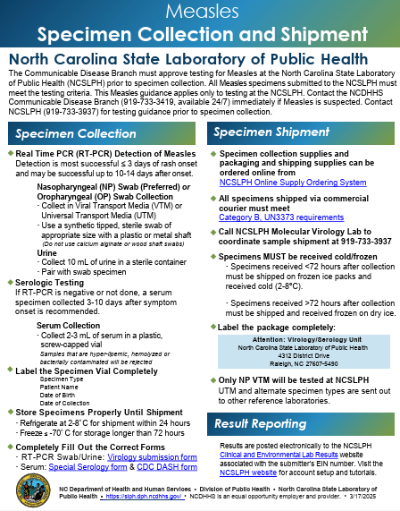
https://www.dph.ncdhhs.gov/epidemiology/communicable-disease/ncslph-measles-specimen-collection-and-shipment-guidancepdf/download?attachment
Notes:
We now have a one-page guidance document for measles testing at SLPH on our website.

Slide 17
Ordering Tests and Supplies from SLPH
Specimen submission forms:
Virology DHHS 3431 https://slph.dph.ncdhhs.gov/Forms/3431-Virology.pdf
Serology DHHS 3445 https://slph.dph.ncdhhs.gov/Forms/SpecialSerologyForm-3445.pdf?ver=1.1
CDC DASH form https://centersfordiseasecontrol.sharefile.com/share/view/sed42e98472b646ad87bf7f30a1df5085
The NCSLPH Online Supply Ordering System must be used to order supplies. Supplies may be ordered by going through the NCSLPH website https://slphreporting.ncpublichealth.com/labportal/
Notes:
Here are links to the SLPH and CDC forms that need to be completed if a measles specimen is approved for testing. The online supply ordering system link is also here.

Slide 18
Medical Countermeasures for Post-Exposure Prophylaxis
MMR Vaccine
Must be administered within 72 hours of initial measles exposure
Preferred PEP if individual > 12 months of age; can be given to individuals 6-11 months of age
Immunoglobulin (IG)
Must be administered within 6 days of exposure
Can be given to individuals < 6 months of age
Intramuscular (IM) and intravenous (IV) varieties:
GamaSTAN ® (IGIM)
0.5 mL/kg (up to max dose 15 mL) given as IM injection
IGIV
400 mg/kg given IV in hospital/clinic setting
Reserved for pregnant women w/o evidence of immunity and severely immunocompromised individuals
Reference: https://www.cdc.gov/mmwr/preview/mmwrhtml/rr6204a1.htm

Slide 19
Measles MCM Preparedness
State Stockpile of GamaSTAN ® (IMIG)
IG & MMR can be requested, if needed, once CDB has made the determination of eligibility
LHDs should have plans/procedures to administer MMR vaccine or IMIG following an exposure
LHDs should coordinate with hospitals and other local providers:
Who has local inventory of IMIG or IVIG?.... Consider local procurement now!
Who has capability to administer IMIG? Administer IVIG?
Measles Resources for Healthcare Providers
Product | NDC | Vial Size | Lot | Expiration Date | Quantity
GamaSTAN | 13533-0335-12 | 10 mL | A02G081833 | 09/27/2025 | 81
GamaSTAN | 13533-0335-12 | 10 mL | A02J045103 | 05/27/2027 | 7
GamaSTAN | 13533-0335-04 | 2 mL | B01H094293 | 09/24/2026 | 18
Notes:
We’ve shown this slide before, so this is nothing new for most of you, but here are some of the key preparedness points that we’ve drawn out.

Slide 20
Agenda
Opening Remarks | Zack Moore, MD, MPH State Epidemiologist and Epidemiology Section Chief
Rabies, Vector borne, Zoonotic | Carl Williams, DVM, DACVPM State Public Health Veterinarian
VPD: Measles Update | Justin Albertson, MS Vaccine-Preventable Disease Epidemiologist Timothy Davis, PharmD, BCNP, PMP Medical Countermeasures Coordinator
Vaccine Update | Carrie Blanchard, Pharm D, MPH Immunization Branch Director
Question & Answer Session | Open for Questions — Please use the Zoom Q&A function

Slide 21
General Updates
& Reminders

Slide 22
Vaccineinfo Email Subscription
Be sure you are receiving and reviewing emails from Vaccineinfo (vaccineinfo@dhhs.nc.gov).
Vaccineinfo emails go to primary vaccine coordinators, back–up vaccine coordinators, and medical directors. If you are not receiving emails, make sure you update staff changes or email changes through the Provider Update Smartsheet.
If you would like to receive NCIP Communications and you are NOT a primary vaccine coordinators, back–up vaccine coordinators, or medical directors, you can sign up here: Sign up for NCIP Communications | Division of Public Health.
Do Not Unsubscribe from vaccineinfo@dhhs.nc.gov to ensure you continue receiving NCIP communications.
If you have unsubscribed, fill out the NCIP Resubscribe Form 2025 to continue receiving email updates.

Slide 23
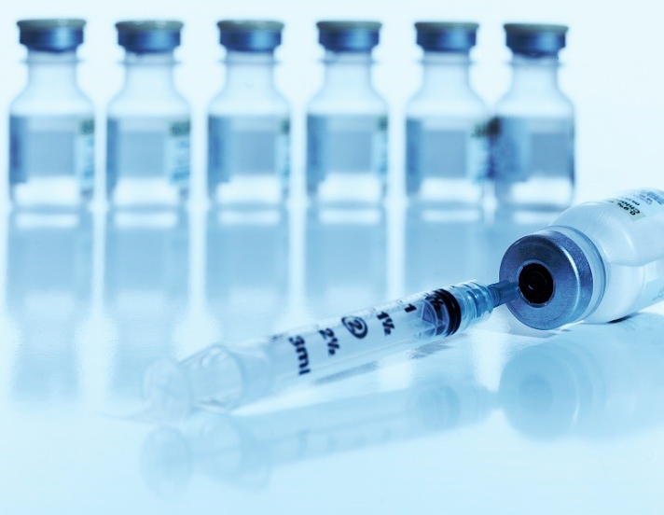
New Funding Code for Vaccines for Adult (VFA) Providers
For providers who see both VFA (317) and VFC eligible patients, when placing an order for VFA (317) vaccines, you must indicate in the comments section of the NCIR ordering page which vaccines (and the amount) will be used for VFA (317) patients.
For any provider who orders VFA (317) doses (including those who only serve VFA eligible adults), when the order arrives, check the packing slip against the contents of the package, then call the Help Desk at 1-877-873-6247 to have the VFA (317) doses appropriately designated to the VFA (317) funding code PRIOR to accepting the doses into NCIR inventory.
For those on data exchange, you must also ensure the VFA (317) code has been added to your EHR in order for the doses to decrement from your inventory correctly. Questions regarding data exchange can be sent to: ncirdataexchange@dhhs.nc.gov.

Slide 24
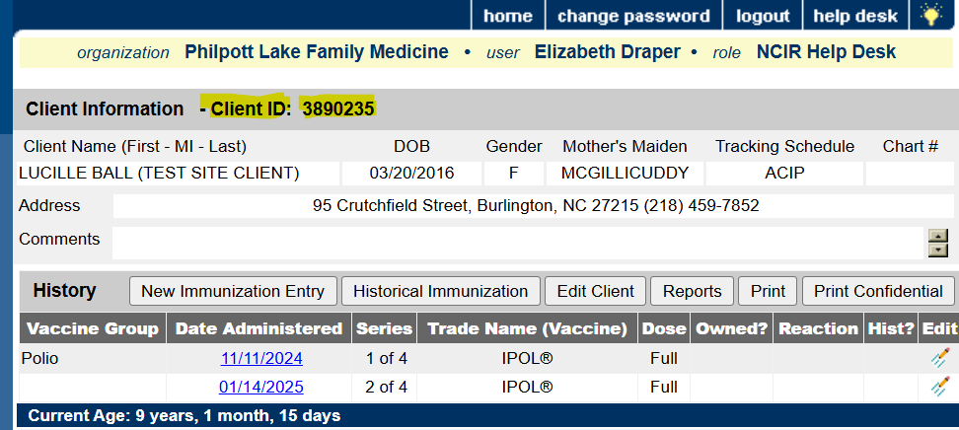
Reminder – Use NCIR Client ID in Emails
VFC providers: email the NCIR Client ID if you have a question about a specific patient. DO NOT INCLUDE name or date of birth.
Only provide patient information that is appropriate for email to ensure HIPAA compliance.
Notes:
If asked about encrypted emails-not all encryption is created equal.

Slide 25
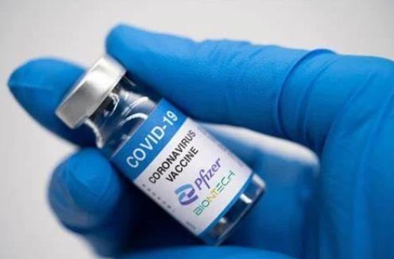
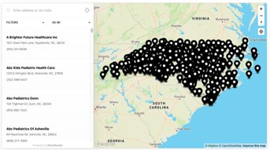
Reduced Shelf Life for Pfizer’s COVID-19 Vaccine
NC Vaccines For Children (VFC) Provider Finder Map To Go-Live on DHHS Website
We anticipate reduced shelf life for Pfizer’s COVID-19Vaccine for persons 12y+ (NDC# 000069-2432-10).
May 20th is our go-live date!
Hosted on our NCIP website, this finder will be a searchable, online map of all VFC providers in North Carolina.
Designed for families and community health workers, this took will make it easier to find local VFC providers.
A section in the Provider Profiles questionnaire will capture the necessary information to populate the finder.
Link will be shared once site is live.
Between mid-February and mid-March, Pfizer’s COVID-19 vaccine shelf life will be reduced to 8-11 weeks from delivery.
This is a temporary change, so plan your orders accordingly to ensure timely usage.
This reduced shelf life only applies to the direct-shipped Pfizer vaccine and does not affect Pfizer COVID-19 vaccines shipped through McKesson.

Slide 26
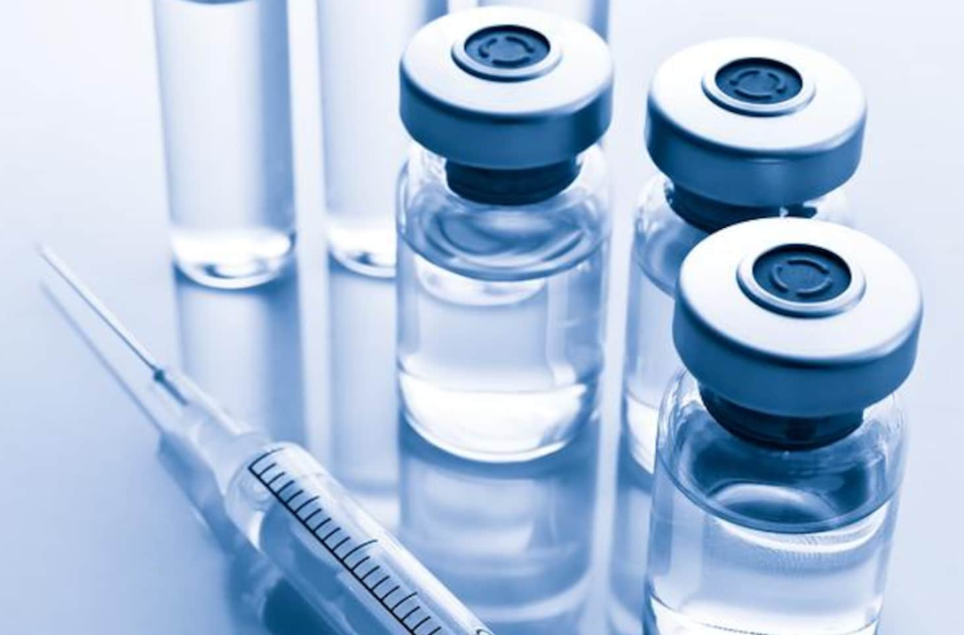
ACIP Meeting Summary
Meningococcal Vaccine Recommendations
Penmenvy (GSK) pentavalent MenABCWY
Vaccine may be used when both MenACWY and the Bexsero (GSK) brand of MenB vaccine are recommended during the same visit.
2. VFC Recommendation
Approved updated resolution for meningococcal disease prevention.
Inclusion of Penmenvy in the Vaccines for Children (VFC) Program.
RSV Recommendations
Currently, RSV vaccination is recommended as a single dose only. Persons who have already received RSV vaccination is NOT recommended to receive another dose.
Adults 50-59 years at increased risk of severe RSV disease should receive a single age-appropriate dose of RSV vaccine.
RSV vaccine can be administered with any product licensed in this age group.
*Recommendations are pending CDC director approval

Slide 27
ACIP Meeting Summary Cont'd
Chikungunya Recommendations
1. Virus-Like Particle Vaccine (CHIK-VLP)
For persons aged ≥12 years traveling to a country or territory where there is a chikungunya outbreak.
For persons aged ≥12 years traveling to a country for extended stay (≥6 months) in countries without an outbreak, but with elevated risk may be considered.
Laboratory workers with potential for exposure to chikungunya virus.
2. Live Attenuated Chikungunya Vaccine (CHIK-LA)
For persons aged ≥18 years traveling to a country or territory where there is a chikungunya outbreak.
For persons aged ≥18 years traveling to a country for extended stay (≥6 months) in countries without an outbreak, but with elevated risk may be considered.
Note age ≥65 is a precaution for use of CHIK-LA.
*Recommendations are pending CDC director approval

Slide 28
Agenda
Opening Remarks | Zack Moore, MD, MPH State Epidemiologist and Epidemiology Section Chief
Rabies, Vector borne, Zoonotic | Carl Williams, DVM, DACVPM State Public Health Veterinarian
VPD: Measles Update | Justin Albertson, MS Vaccine-Preventable Disease Epidemiologist
Vaccine Update | Carrie Blanchard, Pharm D, MPH Immunization Branch Director
Question & Answer Session | Open for Questions — Please use the Zoom Q&A function

Slide 29
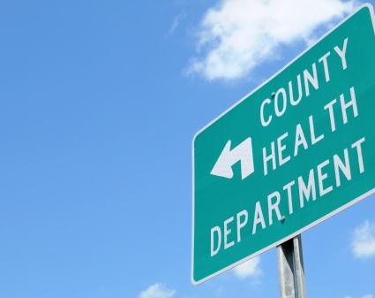
Questions?

