Slide 1
Strengthening Infection Prevention:
Addressing Healthcare-Associated Infections (HAIs) Reduction
through Site Visits
February 11th, 2025

Slide 2
Welcome
Dr. Megan Davies

Slide 3
Agenda
HAI Update
Trends for 2023/2024
CPO Rule Change
Infection Prevention: conducting On-site Visits in LTCFs
Break
Tales From the Field (LHD)
On-Site Assessment Scenarios
GAS (Wound Care)
MDRO (Transmission Based Precautions)
Bloodborne Pathogens (Safe Injection Practices)

Slide 4
HAI Trends for 2023/2024
Catie Bryan, MPH, a-IPC
4

Slide 5
Diseases Defined
CRE
Carbapenem resistant Enterobacterales
Previously reportable until October 2024
CPO
Carbapenemase-producing organism
Reportable starting Nov 1st, 2024.
C. auris
Emerged in NC in 2023
Invasive Group a Streptococcus
STSS (streptococcus toxic shock syndrome)
Notes:
Before we dive into case counts, I just wanted to quickly go over reportable HAIs in NC.

Slide 6
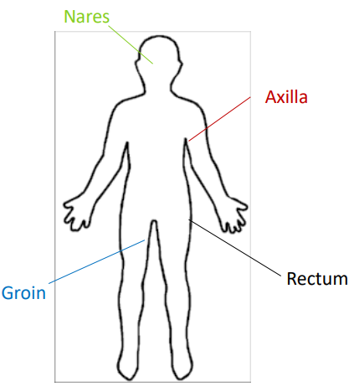
Colonization vs Infection
Colonization
Common Sites of Colonization
Infection
  Organisms live on or in the body without having an active infection
  Can increase the risk for developing an infection
  Colonized residents can serve as a source of transmission to others
  Can be colonized indefinitely
  Causes illness due to body being invaded by bacteria
  Difficult to treat due to resistance
  Requires more toxic antibiotics
  Often have poor patient outcomes
  Easily transmitted in healthcare settings (via) contaminated hands or equipment during procedures
Notes:
To better understand MDROs and other HAIs, it is important to know the difference between colonization and infection.

Slide 7
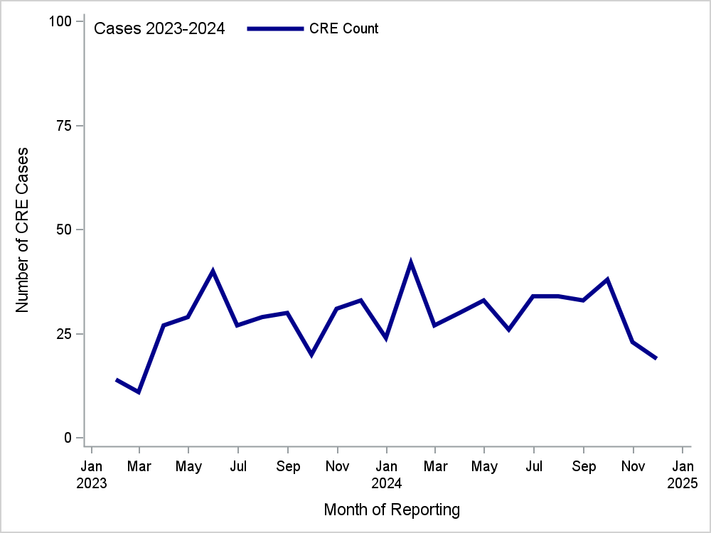
Reported Cases of Carbapenem Resistant
Enterobacterales (CRE), NC, 2023-2024
CRE/CPO
Notes:
CREs (CPOs starting in Nov 2024) do not have much of a seasonal pattern. As pictured, you can see there were peaks in June 2023, Feb 2024, and Nov 2024

Slide 8
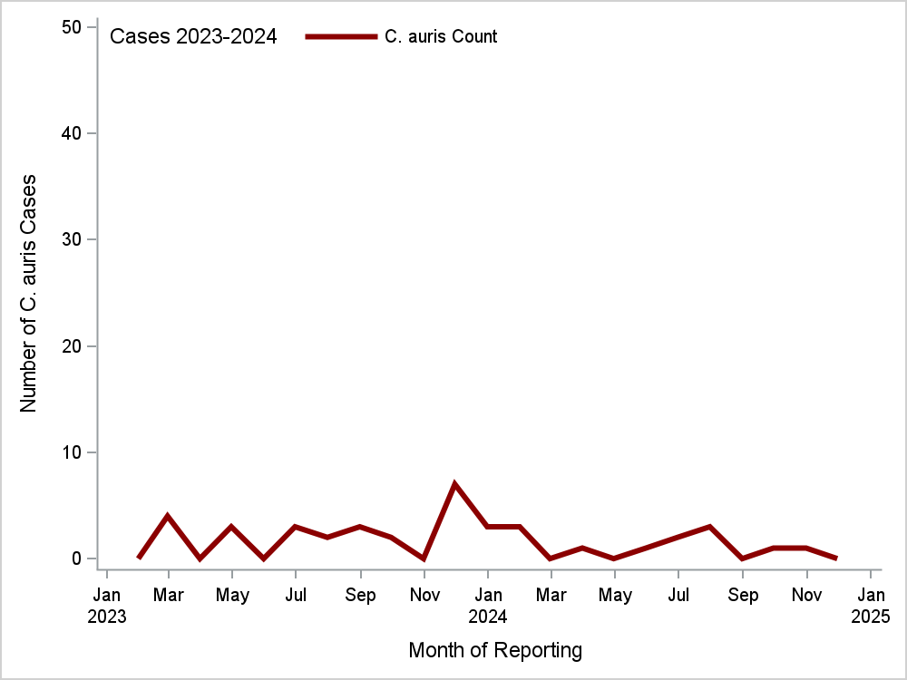
Reported Cases of Candida auris NC, 2023-2024
C. auris
Notes:
C. Auris is rarer in NC averaging about 2 cases per month.

Slide 9
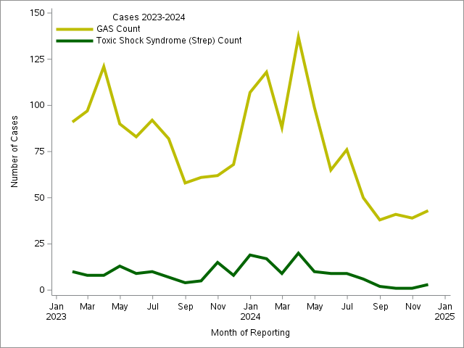
Reported Cases of Invasive Group a Strep and
STSS, NC, 2023-2024
Invasive Group a Strep and STSS
Notes:
While the overall trend is down, we have not seen the same trend in LTC facilities. Now, Lauren will discuss CPOs, specifically the rule change and investigation steps.

Slide 10
Carbapenemase Producing Organisms
and Investigation
Lauren Pasutti, MPH
10

Slide 11
Carbapenemase Producing Organism (CPO)
Case Definition
Effective November 1, 2024, identification of any carbapenemase-producing organism is reportable in North Carolina within 24 hours under Administrative Code Rule 10A NCAC 41A .0101.
Laboratory Confirmatory Criteria
  Positive phenotypic test result for carbapenemase production in a specimen,
  Or
  Positive molecular test result detecting a carbapenemase gene
  Or
  Detection of carbapenemase gene by next generation sequencing
Notes:
Some bacteria produce enzymes called carbapenemases which break down carbapenem antibiotics. These are called carbapenemase-producing organisms (CPO). CPO can be spread in healthcare settings from patient to patient, by healthcare workers’ hands and through environmental contamination. CPO are a primary public health concern and an investigation should be opened within 24 hours of confirming identification of CPO.
Effective November 1, 2024, identification of any carbapenemase-producing organism is reportable in North Carolina within 24 hours under Administrative Code Rule 10A NCAC 41A .0101
Laboratory Criteria Confirmatory laboratory evidence:
• Positive phenotypic test* result for carbapenemase production in a specimen,
OR •
Positive molecular test** result detecting a carbapenemase gene*** (with or without organism identification),
OR
• Detection of carbapenemase gene by next generation sequencing

Slide 12
Request Isolates be sent to the NCSLPH for additional testing.
If an organism is found to be carbapenem-resistant, laboratories should perform carbapenemase testing.
Submission of CRE, CRPA, and CRAB isolates to NCSLPH is requested even when laboratories conduct their own carbapenemase testing.
Notes:
If an organism is found to be carbapenem-resistant, laboratories should perform carbapenemase testing to determine if it is a CPO. If a laboratory does not have the capabilities to test for carbapenemase-production, the LHD should request the isolate be sent to the state lab for additional testing.
Submission of CRE, CRPA, and CRAB isolates to NCSLPH is requested even when laboratories conduct their own carbapenemase testing. The purpose of isolate submission to the state la is to support statewide efforts to prevent the spread of multidrug-resistant organisms (MDROs) and facilitate coordination between clinical and public health partners. This testing it is not to confirm the results of completed clinical testing. All CRE, CRPA, and CRAB testing and shipping is free through NCSLPH.

Slide 13
Surveillance in NCEDSS
The CRE disease workflow in NCEDSS will be retired and replaced with a CPO workflow.
Continue to use the CRE workflow with the new case definition applied.
Surveillance in NCEDSS
Notes:
The SHARPPS HAI team is working with the NCEDSS and ELR teams to streamline CPO surveillance. The CRE disease workflow in NCEDSS will be retired and replaced with a CPO workflow. Questions will be updated to reflect the new case classifications, Clinical and risk history packages will be streamlined, and labs will be updated. Until the CPO workflow is live, please continue to use the CRE workflow with the new case definition applied. All CRE question packages are applicable to CPO and should be completed.

Slide 14
CPO Investigation Steps for LHDs
1. Confirm Case Meets Definition
2. Implement Control Measures
3. Assess Healthcare Exposures
4. Perform a Risk Assessment
5. Consult Communicable Disease Branch
6. Reevaluate
https://epi.dph.ncdhhs.gov/cd/cre/CPO_Investigation_Steps_Aug2024.pdf
Notes:
1 Confirm the case meets the definition
2 Implement Control Measures by Notifying the ordering facility/provider(s) and any other healthcare providers/systems where the patient received care. - Review healthcare exposure(s) (typically for the past 90 days) Notify identified healthcare facilities • Implement appropriate precautions based on the healthcare setting as soon as CPO is identified (Contact Precautions or Enhanced Barrier Precautions [LTCF only]), private room, flag chart for future encounters, appropriate environmental cleaning)
3 Assess Healthcare Exposures by Reviewing the patient’s recent (past 90 days) risk factors including: - International hospitalizations - Domestic hospitalizations (notify facility if appropriate) - Long term care admissions (document name of facility and notify facility) - Hemodialysis treatment, Procedures (endoscopies, surgeries, etc.) - Indwelling medical device use (intravenous catheters, urinary catheters, tracheostomy tubes, etc.) - Open wounds and wound care.
4 Perform a Risk Assessment by investigating opportunities for transmission and infection prevention practices - Patient's risk of transmission to others (indwelling devices, total care, etc.) - Shared areas within the healthcare facility (shared rooms, bathrooms, shower rooms) - Implementation of appropriate precautions for the healthcare setting during their healthcare encounters - Environmental reservoirs (facility cleaning and disinfection practices) – AND Interfacility communication regarding multidrug-resistant organisms if the patient was transferred
5 Consult CDB HAI program (SHARPPS) to determine if MDRO screening is necessary • CDC recommends considering a point prevalence survey (PPS) and screening of epidemiologically linked patients at healthcare facilities where the CPO case is currently and was recently admitted • Consider who to screen: - Mechanism of resistance - When appropriate precautions (based on the healthcare setting) were initiated - Risk of transmission •
We are available to facilitate colonization screening and coordination with the Antibiotic Resistance Laboratory Network (ARLN) • A site visit to one or more facilities may be recommended
6 Reevaluate. Expanding screening efforts may be necessary depending on the results of the initial screening • Continue to respond to any infection prevention concerns at the facility • Monitor for new CPO cases at the facility

Slide 15
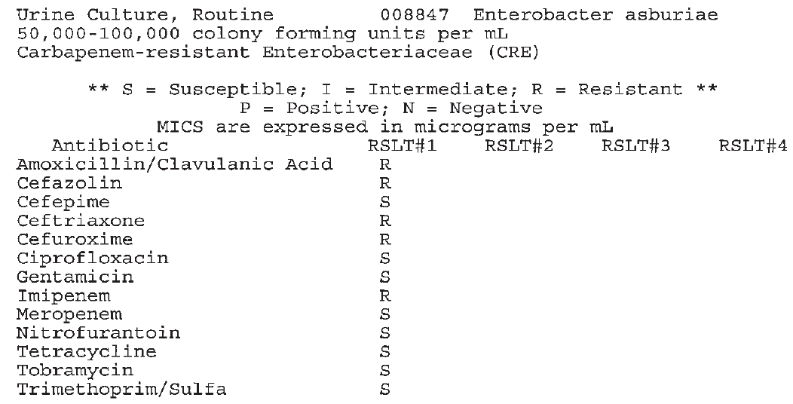
Carbapenem Resistance Results in NCEDSS
Notes:
Review the pages of lab examples provided to you… see antibiotic susceptibility report.
Carbapenem resistance.
This Enterobacter asburiae is resistant to Imipenem, and sensitive to Meropenem. This result IS classified as a carbapenem resistant organism, even though the isolate is sensitive to one carbapenem. This isolate should be forwarded onto the SLPH

Slide 16
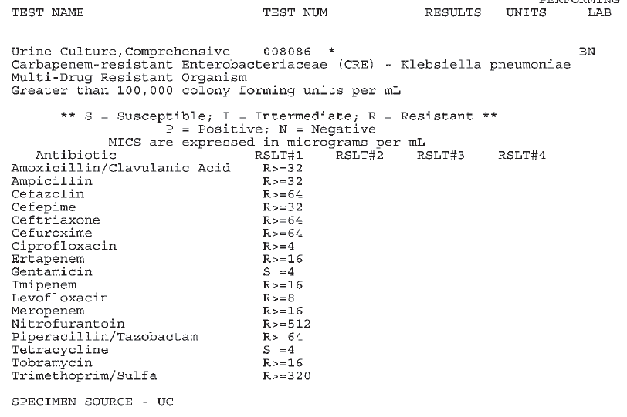
Carbapenem Resistance Results in NCEDSS
Notes:
Carbapenem resistance.
Here is an additional result of a Klebsiella isolate resistant to three carbapenems; Ertapenem, Imipenem, and Meropenem.

Slide 17
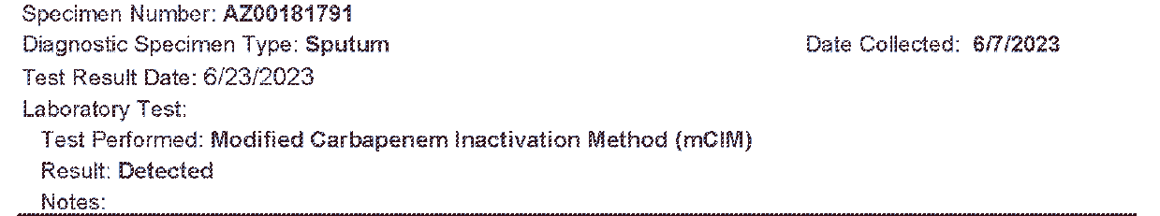
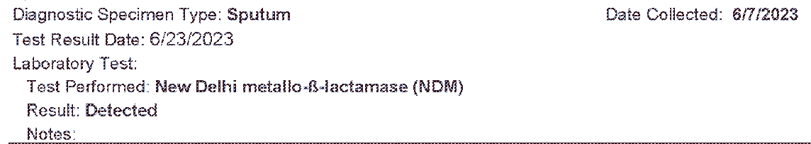
Carbapenemase Results in NCEDSS
Notes:
Illustrated here are two tests, modified carbapenem Inactivation method or mCIM is a phenotypic test, and shows a positive result as “Detected” followed by the molecular test, showing detected for New Deli Metallo - B- Lactamase or NDM carbapenemase.
Neither results identifies an organism isolated from this sputum specimen. However, it meets the case definition for a reportable Carbapenemase producing organism requiring further investigation and possibly screening at a facility.

Slide 18
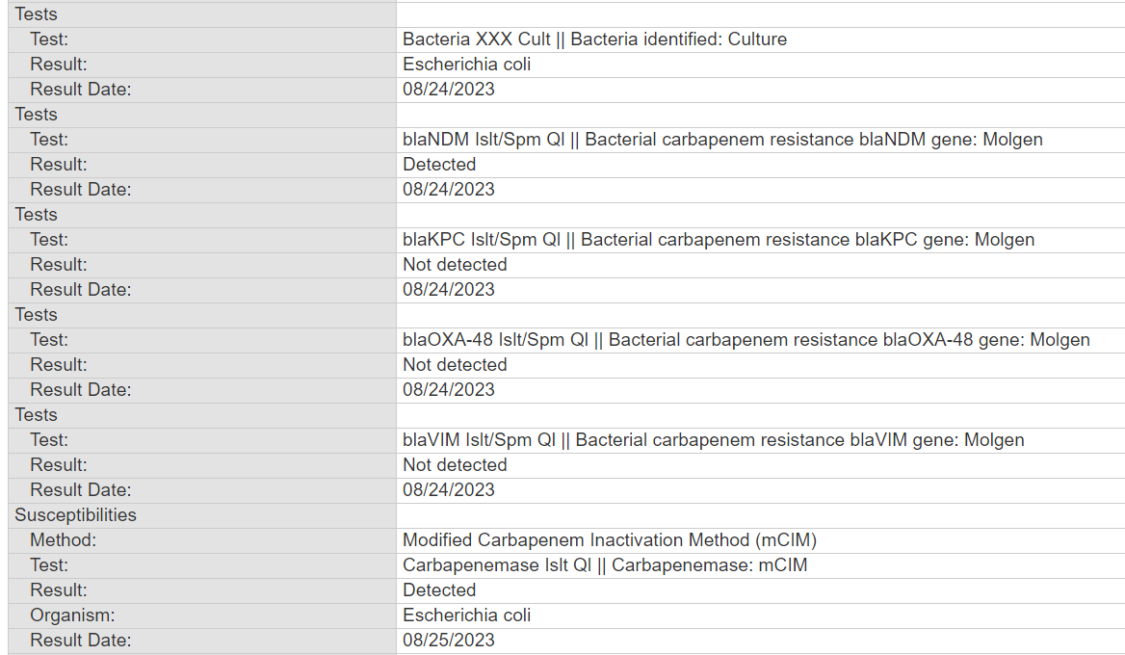
Carbapenemase Results in NCEDSS
Notes:
Here is a second style of result that fed into NCEDSS from the SLPH. This
Two tests, modified carbapenem Inactivation method demonstrates a positive result as “Detected” followed by the molecular test, showing detected for New Deli Metallo - B- Lactamase or NDM carbapenemase.

Slide 19
North Carolina Communicable Disease Manual Resources
CPO Case Definition
Algorithm for New Cases
CPO Guidance for LHD Staff
CPO investigation Steps
Notes:
Slide 19, resources for CPO and investigations
Case definition for reference, case classification information, differentiating between clinical and screening cases, comprehensive confirmatory lab testing result details.
Algorithm for distinguishing a new CPO case
CPO guidance tailored for LHD, that includes recommendations for immediate steps following identification of a case.
Sheet detailing the CPO investigation steps
Transition to IP Write something. Now Taylor will talk to you more about how prevent these organisms from spreading through interruption of transmission and education.

Slide 20

Infection Prevention: Conducting On-Site Visits
Taylor Breeyear, MPH, BSN, RN, CIC
20

Slide 21
The Role of Public Health
Prevent Transmission/Harm to Others
Offer Guidance and Education
Notes:
Purpose of today's session-basic IP knowledge-state IP team is always available to attend with you or on your behalf

Slide 22
Why are you there?
IP Breach
Possible Transmission of Pathogen
Routine Assessment

Slide 23
Top Things to Look For
Policies/Procedures
Standard Precautions
Transmission-Based precautions
Environmental Cleaning/Disinfection
Notes:
Reminder yourself, why are you there

Slide 24
Standard Precautions
Hand Hygiene
Wear PPE to prevent possible exposure
Respiratory hygiene/cough etiquette
Patient placement
Clean/disinfect patient care equipment, instruments/devices, environment
Handle textiles and laundry carefully
Safe injection practices

Slide 25
Transmission-Based Precautions
Contact
Gown, gloves
Cleaning/disinfection
Droplet
Mask
Source Control
Airborne
Fit-tested NIOSH-approved N95 or higher-level respirator for healthcare personnel
Airborne infection isolation room (AIIR)
Source Control
*Enteric Precautions
Use soap and water
Notes:
Contact source control
Limit transport and movement of patient
Patient placement

Slide 26
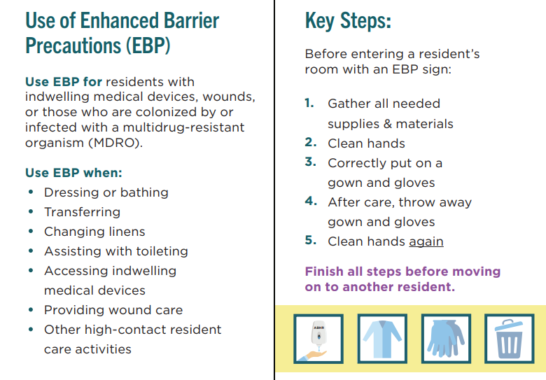
Enhanced Barrier Precautions
*Can only be used in nursing homes when contact precautions do not apply
https://www.cdc.gov/long-term-care-facilities/hcp/prevent-mdro/PPE.html
Notes:
CDC. (2024, April 2). Implementation of Personal Protective Equipment (PPE) Use in Nursing Homes to Prevent Spread of Multidrug-resistant Organisms (MDROs). Centers for Disease Control and Prevention. https://www.cdc.gov/long-term-care-facilities/hcp/prevent-mdro/PPE.html

Slide 27

Environmental Cleaning/Disinfection
General cleanliness
Observe EVS
Equipment
Supplies available at point-of-use
Sink Hygiene
Notes:
EVS
How often are rooms and common areas cleaned, process for cleaning transmission-based precaution rooms, PPE changed after each room, what are they using to clean (proper concentrations), top to bottom, clean to dirty, what type of mop heads are they using (no double dipping, changed at least after each room)
Equipment
How do you know if it is clean, who is cleaning it (clinical vs EVS), is it being cleaned/disinfected correctly (type of equipment, contact time)

Slide 28
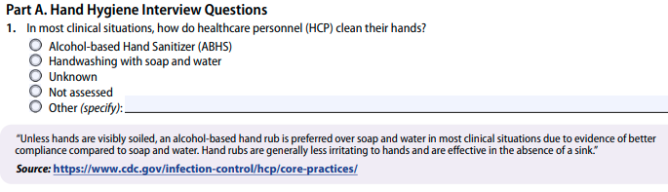
ICAR Tool
Training, Audits, Feedback | Hand Hygiene
Transmission-Based Precautions | Environmental Services
High-Level Disinfection and Sterilization | Injection Safety
Point of Care Blood Testing | Wound Care
Healthcare Laundry | Antibiotic Stewardship
Water Exposure
ICAR instructions
Demographics to collect about facility
Facilitator guide assessment modules
Observations forms
https://www.cdc.gov/healthcare-associated-infections/php/toolkit/icar.html
Notes:
CDC. (2024h, April 16). Infection Control Assessment and Response (ICAR) tool for General Infection Prevention and Control (IPC) across settings. Centers for Disease Control and Prevention. https://www.cdc.gov/healthcare-associated-infections/php/toolkit/icar.html

Slide 29
Being a Resource: Education
Tailor to the
Setting
Audience
Topic

Slide 30
Being a Resource: Empower the Infection Preventionist
.0206
CDC Modules
SPICE
Education
IP mentorship program
APIC NC
Project Firstline
https://www.cdc.gov/infection-control/hcp/training/strive.html
https://spice.unc.edu/
https://community.apic.org/northcarolina/home
https://www.cdc.gov/project-firstline/index.html

Slide 31
Being a Resource: For the Future
Provide a report
Provide resources
Provide contact information
LHD
NC DPH HAI Team
infectionprevention@dhhs.nc.gov
Recommendations and observations

Slide 32

Break
Return @ 9:50

Slide 33
Tales from the Field
Tonya Jolly, RN, MBA, LNHA (formerly Forsyth County)
Judith Easter MBA, BSN, RN (Henderson County)
Ashley Vaughn, ADN (Surry County)
33

Slide 34
MDRO Outbreaks – How are they Different?
Colonization is a huge problem
  Mortality and morbidity are very high. MDROs are extremely dangerous for compromised patients but they also can make healthy people very sick.
  MDROs can live on surfaces and in other environmental reservoirs for extended periods making environmental cleaning an important factor.
Coordination
  Often multiple different agencies, levels of care, counties and (at times) states are involved.
  Tracking, testing or screening activity continues for months or years.
  When patients move within the health care system it creates another ripple that could result in more exposures and additional need for screening.
  LTC facilities may need some strategic hands-on help from LHD to facilitate large screening projects. Knowledge of the facilities and their key staff is very helpful.
  Coordination with the SLPH is crucial to avoid lost specimens.

Slide 35
Prolonged GAS Outbreak: Challenges
Henderson
Nature of Disease
Setting Complexities
Operational Barriers
Communication Challenges
Judith Easter, MBA, BSN, RN

Slide 36
Surry County HBV Outbreak
  HBV Outbreak Investigation: Surry County HD was made aware of HBV in a patient from LTCF. Upon the investigation of Acute Hepatitis B, the patient had not left the facility in a year. The big question, How did this patient contract Hepatitis B?
  Site Visits using the mini ICAR assessment tool: Of course, the facility was distraught at the possibilities. We had to build a good rapport with the facility to complete a thorough investigation. Long term care facilities associate the word “State” with CMS and other regulatory facilities. By providing education for the purpose of our visits and reinforcing that the LHD and State Health department are NOT punitive, but support, helped build that good working relationship.
  BBP focused with HBV as the cause of concern: Per state recommendations, all diabetic patients were screened for BBP. The source patient was identified as a chronic Hep B carrier. This patient was on the same hall, directly across the hall from index patient. Both patients are diabetic, with finger sticks taken just minutes apart several times a day. Proper hand hygiene, glucometer use, and wound care where a heavy focus during the site visits.
  State support for recommendations: Having State support really helped with recommendations for process improvement and policy changes. These facilities have challenges with corporate policies. Individual glucometers and new policies were in place within a month of our investigation starting.
  Provide feedback and support to facility: Follow up calls with the State and LHD were crucial to keep everyone looped in as the investigation continued, and recommendations were made and implemented.

Slide 37
Break
Return @ 10:25

Slide 38
Interactive: Onsite Facility Assessments
GAS - Wound Care
(30 min)
MDROs - Transmission based precautions
(15 min)
Bloodborne Pathogens - Safe injection practices
(15 min)

Slide 39
Breakout Sessions
Group 1
GAS
Group 2
MDRO
BBP
Group 1
MDRO
BBP
Group 2
GAS
15 minutes
15 minutes

Slide 40
THANK YOU!
NCHAI@DHHS.NC.GOV
INFECTIONPREVENTION@DHHS.NC.GOV

