Slide 1
NC Department of Health and Human Services
NC Public Health
Perinatal Hepatitis B Case Management – Discerning Discrepant Labs and Other Key Points
Candy Graham, RN, CPHN,
Perinatal Hepatitis B Coordinator
TATP Webinar April 10, 2025

Slide 2
Learning Objectives
Participants will be able to know where to find the ACIP guidance and how to case manage infants born to HBsAg positive or unknown status mothers.
Participants will be able to identify a discrepant lab situation during pregnancy and understand to call the State Perinatal Hepatitis B Coordinator for guidance.
Participants will be advised of the newly added Perinatal Hepatitis B Chapter to the North Carolina Hepatitis B Public Health Program Manual and how to access it.

Slide 3
NC EDSS and PHB Case Management
Review maternal labs to determine if they meet case definition.
  Just because they do not meet case definition, or the OB or provider says they do not have Hep B, DOES NOT MEAN THE INFANT HAS NOT BEEN EXPOSED IN UTERO.
  We will discuss discrepant labs later
  This is also coming up more often because providers do not order the tests we need to confirm a false positive HBsAg, some labs do not perform the correct confirmatory test, the mother could be in the process of immune clearing etc.
Follow the Business Rules in the manual to do the investigation and tracking. Assign event to PCM within 30 days of notification.
Once infant delivers:
  Create infant’s event and link to mother’s current pregnancy event
  Complete the Mother’s event’s Clinical or Subsequent Report Package and assign both the mother’s event and infant’s event to PCM
  The infant’s event must be assigned to PCM within 30 days of birth
4. The LHD will follow the infant at least until 9-12 months until the PVST is obtained

Slide 4
Resources to Have to Provide PHB Case Management
NC Communicable Disease Public Health Laws
Prevention of Hepatitis B Virus Infection in the United States: Recommendations of the ACIP MMWR January 12, 2018
Triple Panel Recommendations MMWR document March 10, 2023
4. North Carolina Hepatitis B Public Health Program Manual
    Includes the Perinatal Hepatitis B Chapter
Your LHD’s signed 510 General Communicable Disease Control Agreement Addendum
Your LHD’s signed 715 Immunization Action Plan Agreement Addendum
Notes:
How do I know how to case manage these mothers and babies? Where do I start?? These documents/websites are what you need to know how to manage these events.

Slide 5
NC Public Health Law
10A NCAC 41A .0101 REPORTABLE DISEASES AND CONDITIONS
10A NCAC 41A .0102 METHOD OF REPORTING
10A NCAC 41A .0210 DUTIES OF ATTENDING PHYSICIANS
10A NCAC 41A .0203 CONTROL MEASURES ‑ HEPATITIS B
10A NCAC 41A .0101
The following named diseases and conditions are declared to be dangerous to the public health and are hereby made reportable within the time period specified after the disease or condition is reasonably suspected to exist:
(26) hepatitis B - 24 hours;
(27) hepatitis B carriage - 7 days;
Links to the law and information can be found in The North Carolina Communicable Disease Manual
Notes:
We cannot give legal advice. This is information for where you can find the law and the general topic in that particular law.
“A local health director may file an action for injunctive relief in a superior court.” (p. 31 Chapter 4 of book NC Communicable Disease Law by Jill D. Moore)
NCAC41A .0101 – this lists all the diseases that are required to be reported to the State and the time frame that they must be reported from when you are made aware.
NCAC41A .0102 – explains how you are to make those reports
NCAC41A .0210 – requirements of physicians regarding control measures and reporting
NCAC41A .0203 – specific requirements for control measures for Hepatitis B and Perinatal Hepatitis B

Slide 6
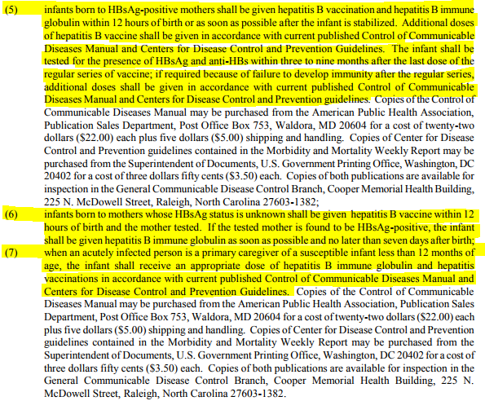
10 A NCAC 41A .0203 CONTROL MEASURES HEPATITIS B
(b) The following are the control measures for persons reasonably suspected of being exposed:

Slide 7
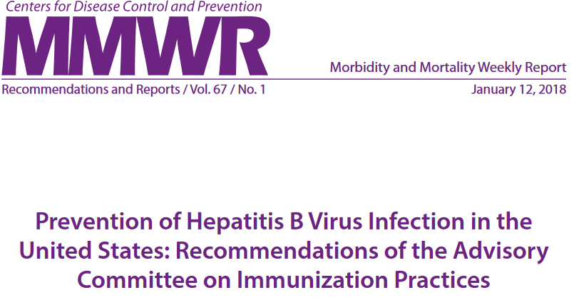
ACIP Recommendations for Infants Born to Hepatitis B + or Unknown Status Mothers
Prevention of Hepatitis B Virus Infection in the United States: Recommendations of the ACIP MMWR January 12, 2018

Slide 8
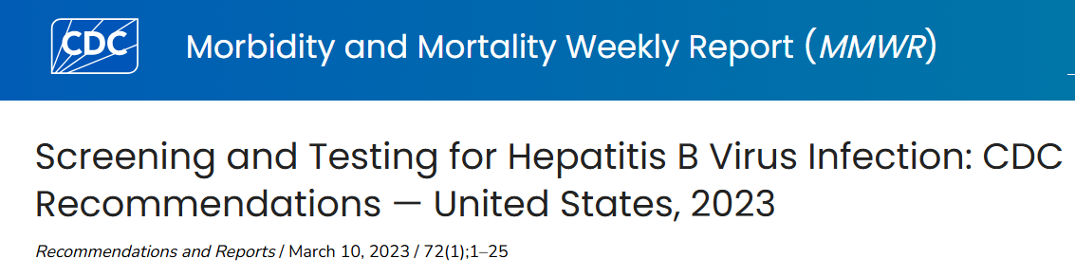
New Triple Panel Recommendations as it Applies to Pregnancy
All pregnant person during each pregnancy, preferably in the first trimester, regardless of vaccination status or history of testing should receive a Triple Panel Screen
  HBsAg
  HBsAb
  Total anti – HBc
LHD’s should be educating all OB providers on the new recommendations and ensure they receive a copy of MMWR document.
Remember this is a recommendation/standard of care. This is not a NC law requirement or an AA measure that has to be met for Perinatal Hep B.
HBsAg is still required by NC law on every pregnant woman and required by your AA.
Triple Panel Recommendations MMWR document March 10, 2023

Slide 9
Triple Panel Screening Recommendations
Published in an MMWR March 10, 2023
Expands CDC’s previously published HBV screening recommendations
Makes pregnancy labs even more nuanced
These recommendations compliments the 2022 ACIP recommendations to vaccinate all adults aged 19-59 years against Hep B by providing a means to establish immunity or current or previous infection
Triple Panel = HBsAg, Total anti-HBc, and HBsAb
Recommended for:
  All adults age 18 years and older at least once during a lifetime
  All pregnant person during each pregnancy preferably in the 1st trimester regardless of vaccination status or history of testing
    Pregnant person who have a history of triple panel screening with no new HBV exposure since triple panel screen, only need HBsAg screening
Screening and Testing for Hepatitis B Virus Infection: CDC Recommendations March 10, 2023
Notes:
*Triple Panel Screening are CDC recommendations.
*The NC Law has not changed, and this is not required by your AA.
*It is the CDC current recommendations and therefore a standard of care you should be advising your providers including OB providers about.

Slide 10
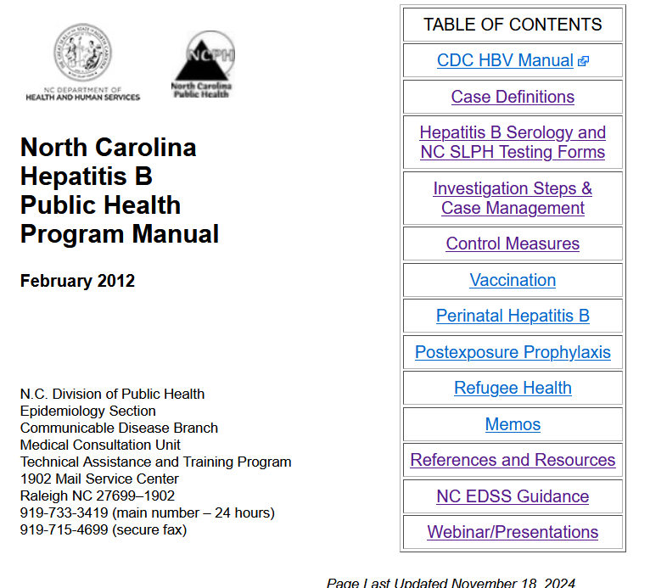
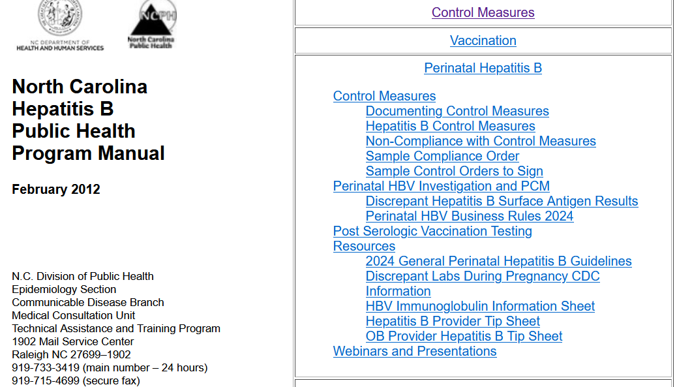
NC Hepatitis B Program Manual
NC Hep B Manual

Slide 11
NC Perinatal Heb B Discrepant Lab Protocol
Definition of Discrepant Labs:
In events where a mother has an original HBsAg positive lab result and then has a repeat HBsAg lab result that is negative or if initial hepatitis B test results are indeterminate, please contact the State Perinatal Hepatitis B coordinator at 919-707-5575 or candy.graham@dhhs.nc.gov for further guidance.
**If the recommended f/u labs are not obtained for any reason, the LHD must follow the mother and infant as if the mother were HBsAg positive**
NC Hepatitis B Public Health Program Manual
https://epi.dph.ncdhhs.gov/cd/lhds/manuals/hepB/pdfs/SurfaceAntigenResults.pdf
Notes:
The thing I want you to take away from this lab discussion is 1. to be able to identify discrepant labs and 2. know that you need to call for help to determine if it is truly a false positive or if you need to recommend more labs and what those labs are. If we need more labs to make a determination and the patient does not have those labs drawn for whatever reason, you have no choice but to follow the mother and the baby in PCM.

Slide 12
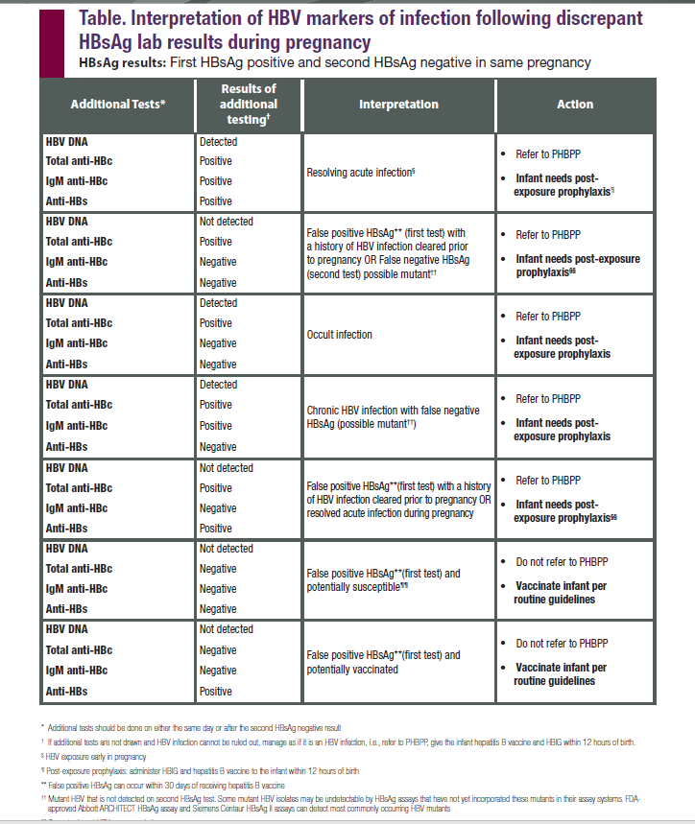
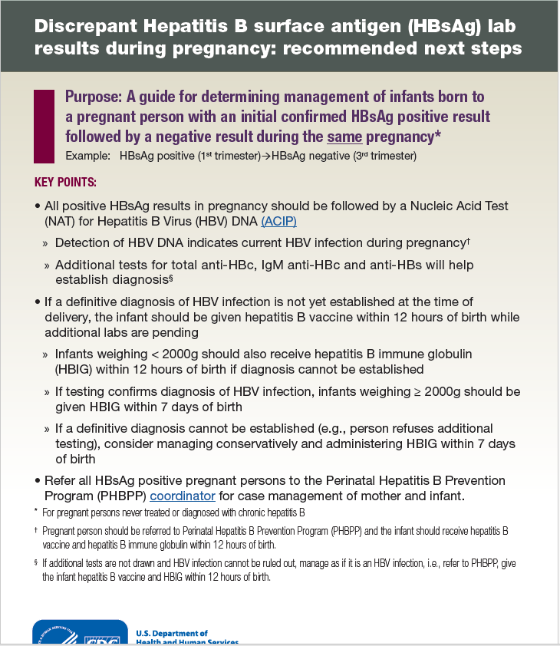
CDC Discrepant Labs Resource
CDC Discrepant HBsAg Lab Results During Pregnancy reference 2023

Slide 13
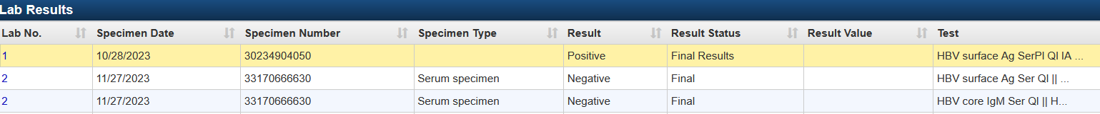
Example #1
First HBsAg on 10-28-23 is positive
Second HBsAg on 11-27-23 is negative
Only having a core IgM with the negative HBsAg on 11-27-23 is not enough to say this is a false negative.
I consulted with Dr. Rick Moore who advised we needed to recommend either a core total antibody or an HBV core IgG. He also recommended an HBV DNA, e antibody, e antigen and HBsAb to more completely assess their status.

Slide 14
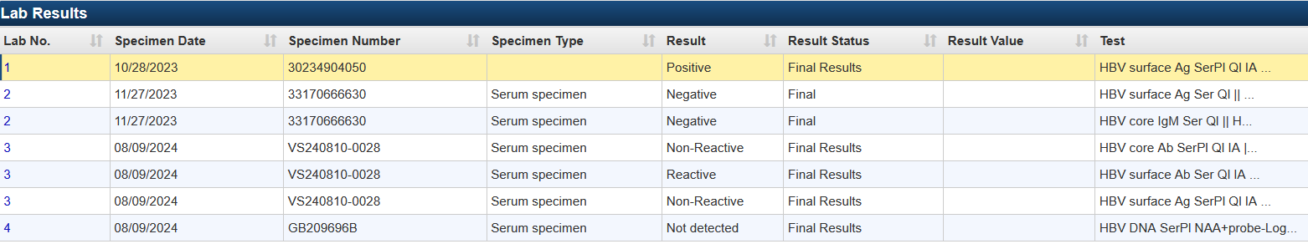
Continue #1
So now on 8-9-24 we have a more complete picture.
  Total core is negative
  HBsAg and DNA are both negative
  HBsAb is reactive
Dr. Moore was able to review labs and confirm the patient had an original false positive and is immune.

Slide 15
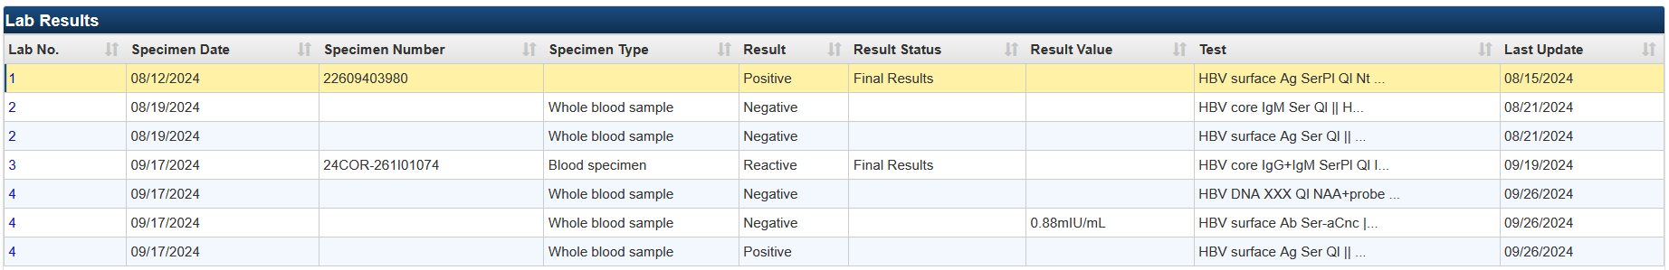
Example #2
Aug 12 – HBsAg + and lab result says “positive result confirmed by neutralization”
Aug 19 – Core IgM neg, HBsAg neg
Sept 17 – total core positive, DNA neg, HBsAg positive again
Mother’s EDC was 2-4-25 (possibly pregnant from 5-4-24)
  OB notes stated the provider felt like it was a false positive but then ordered the labs done in September
What does the LHD do? Do they follow the baby? How do you know what to do? See Next Slide

Slide 16
Example #2 is about as complex as it gets
First: know this is a discrepant lab scenario and refer it to the PHB State Coordinator
After consultation with Dr. Moore:
  This patient is likely in the inactive phase of HBV infection but is still infected
  People can have low or undetectable HBV DNA levels during this period
  RECOMMENDATION: follow the baby through PCM and baby should get HBIG and Hep B vaccine within 12 hours of birth. And mom needs repeat DNA testing between 26 and 28 weeks to ensure DNA levels stay below 200,000
  Why we want to follow the mom and baby?
  It is possible to have a relapse and have high DNA levels even after DNA levels have been low or undetectable.

Slide 17
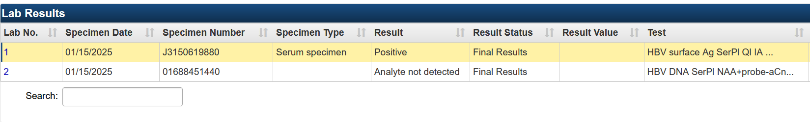
Maternal lab example #3
There was no confirmatory done on the HBsAg screen which was positive
DNA was negative
This is a discrepant lab
This had to be referred to Dr. Moore recommended repeating surface antigen and doing core antibody, and surface antibody to determine true status
No follow up labs back yet. If not received, must follow mom and baby in PCM
Notes:
Dr. Moore recommended Repeating surface antigen and doing core antibody, and surface antibody to determine true status

Slide 18
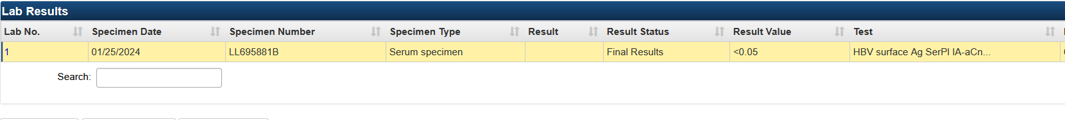
Example #4
According to notes, LHD originally interpreted lab as positive and requested additional testing
Note also said no confirmatory test done
Consulted with Dr. Moore who requested LHD call and confirm with lab that the result was negative and to scan in actual lab result to event
Once Dr. Moore reviewed actual lab he could determine this was a negative they just reported it as a quantitative instead of qualitative result
Notes:
Once Dr. Moore reviewed actual lab he could determine this was a negative they just reported it as a quantitative instead of qualitative result

Slide 19
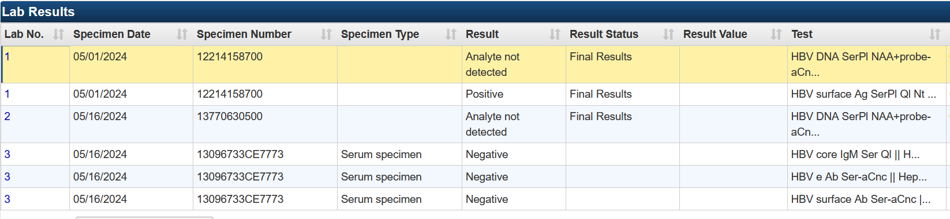
Example #5
According to notes on the dashboard “per provider she does not have HBV infection…fully immunized”
Notice there is no repeat HBsAg
Dr. Moore recommended to obtain core antibody total/IgG and repeat HBsAg and HBsAb to evaluate further and make sure she is not in an inactive carrier state with a negative HBV DNA.
No follow up labs back yet. If not received, must follow mom and baby in PCM
Notes:
Dr. Moore recommended to obtain core antibody total/IgG and repeat HBsAg and HBsAb to evaluate further and make sure she is not in an inactive carrier state with a negative HBV DNA.

Slide 20
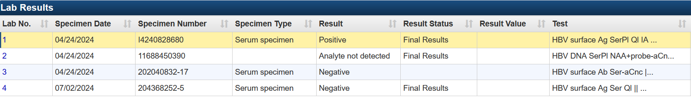
Example # 6
Notice there is no core total
Notice amount of time between positive HBsAg and negative HBsAg
Dr. Moore recommended to obtain a core IgG or a total antibody to confirm that she is not in an inactive carrier state.
No follow up labs back yet. If not received, must follow mom and baby in PCM
Notes:
Consulted with Dr. Moore re discrepant labs. Dr. Moore recommends to obtain a core IgG or a total antibody to confirm that she is not in an inactive carrier state.

Slide 21
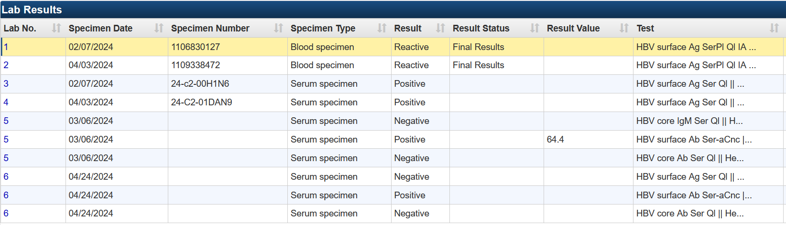
Example # 7
Pt was referred to GI specialist. LHD was able to obtain follow up testing
Consulted with Dr. Moore – labs do indicate a false positive
Notes:
Consulted with Dr. Moore – labs do indicate a false positive

Slide 22
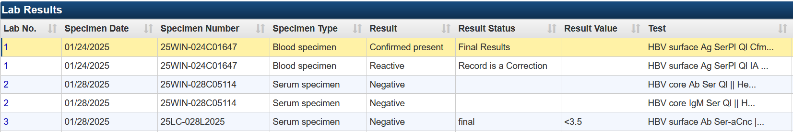
Example # 8
These were the labs we originally had which included that the neutralization confirmatory assay was negative
Consulted with Dr. Moore who requested a follow up HBsAg

Slide 23
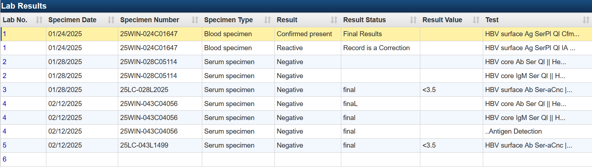
# 8 Continued
With Follow up labs Dr. Moore was able to confirm the original positive was a false positive. No need to follow baby

Slide 24
Discrepant Lab Take-Aways
You need to be able to identify discrepant labs
  An initial confirmed HBsAg positive result followed by a negative result during the same pregnancy or a mix of positive and negative lab results
Just because a provider says the patient is a false positive or doesn’t have hepatitis B, does not mean that the LHD does not have to follow the mother and baby in Perinatal Case Management. ****Just because the subsequent testing is negative for ongoing infection does not mean they were not infected at the time of the initial test.
Know that you need to call/email the State PHB Coordinator for further guidance.
Obtain all the actual Hep B lab results and scan them into the chart for the State to review for every PHB event with discrepant labs. ( We will be adding this to the manual.)
Every scenario can have a different answer
If we need more labs to make a determination and the patient does not have those labs drawn for whatever reason, the LHD should follow the mother and the baby in PCM. Meaning…the infant should receive PEP within 12 hour of birth, the Hep B vaccine series per ACIP recommendations and PVST at 9-12 months of age.
Notes:
The Hep B labs are very complex and complicated. It is NC policy that when you have discrepant labs, the LHD refers the event to the PHB Coordinator so that the Hep B Medical Director can be consulted.

Slide 25
Standard Investigation Practices
Very important to establish a relationship with the mother as you will be tracking her through her pregnancy and until infant is 9-12 months of age or older if necessary. Physically pick up the phone and call her.
Ask all the questions in the Risk History Package
Ask all the signs and symptoms in the Clinical Package (this may not be in the medical record notes)
Provide Control Measures for mother and infant and document in the Clinical Package.
  Even if mother has been reported before, you should review control measures for both mother and infant and document in the event
If there are discrepant labs, scan all the actual Hepatitis lab results into the event
They are only lost to follow up if:
  You have reached out to all your resources: WIC, the Medicaid office to verify demographics, looked in NCIR
  You have made a home visit; leave a letter in their door if no one is home
  You have found when their next WIC or OB appointment is and been at the office at their appointment time
    And no one shows up and none of these resources give you any different information
    All these attempts must be documented on the dashboard
Notes:
If you follow these standards for investigations, then it will not be as difficult to have a conversation with the patient if you need to request they receive more labs.

Slide 26
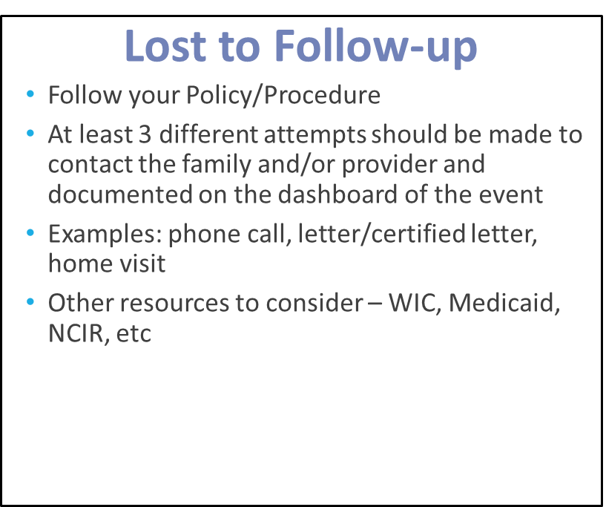
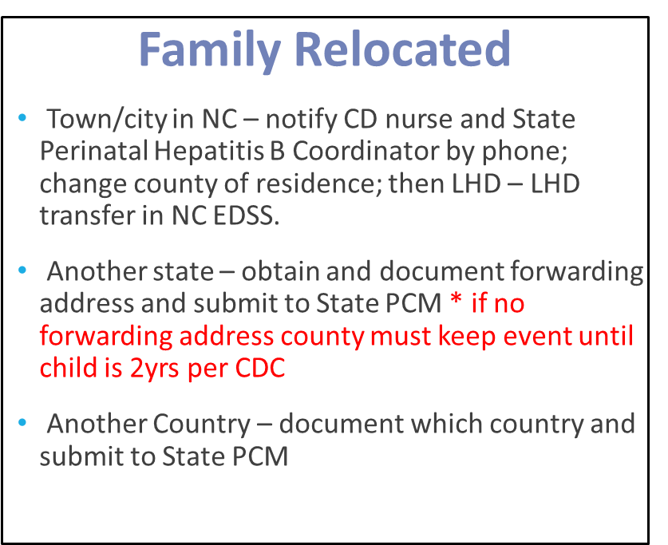
Lost to Follow-Up/Family Relocated

Slide 27
Parent Non-Compliant with Control Measures
Per the NC Hepatitis B Manual:
It is the responsibility of the Communicable Disease nurse to ensure that control measures have
been issued to persons known to be infected with a communicable disease such as hepatitis B.
Best practice for issuing control measures would be for the nurse to meet face to face with the
client, explain the control measures required by law for hepatitis B infection, review written
information with the client about hepatitis B, allow time for the client to ask questions, and then
have the client sign a letter which indicates that control measures have been explained (see
sample letter in this section). For practical reasons, this cannot always be done. Sometimes it is
necessary to issue control measures verbally over the phone to the client or by mailing written
control measures and information to the client.
If all attempts have been exhausted, your Health Director may need to consult the local health department’s legal counsel for further guidance.
  Document that the health director has been notified on the dashboard of the event and any further steps taken

Slide 28
Contact Information
Candy Graham, RN, CPHN
Candy.graham@dhhs.nc.gov – preferred method of contact and I will call you back
919-707-5575 – nurse on call number

Slide 29
THANK YOU

