Slide 1


Transmission-Based Precautions
Infection Prevention Education
Notes:
Welcome participants

Slide 2

Pre-assessment https://forms.office.com/g/J3zJGb6eNp
Notes:
Please take 5 minutes to complete this pre-assessment. If you do not have a smart phone, please partner up with another participant. All responses will be kept anonymous. This assessment allows the infection prevention team to monitor the impact of our modules.

Slide 3
Know, Want to Know, Learned (KWL) Chart
Want to Know
Know
Learned
SOURCE:
Notes:
Before we start today’s module, we will complete the first two sections of a KWL chart. A KWL chart is a “Know, Want to Know, Learned” chart. Please partner up in groups of three. With your sticky notes, please write down everything you already know about enhanced barrier precautions and what you would like to know about them. You will have 7 minutes to brainstorm ideas. Please select one representative from your group to share what you all came up with and add your sticky notes to the group chart.

Slide 4
Overview
Pre-assessment
KWL Chart
Presentation
PPE Activity
KWL Chart
Post-assessment

Slide 5
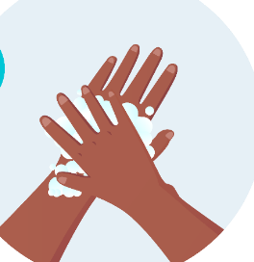

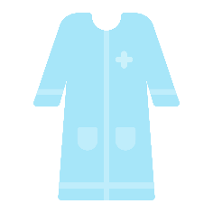

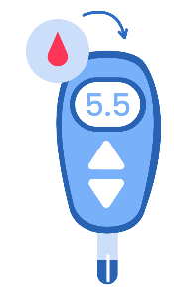
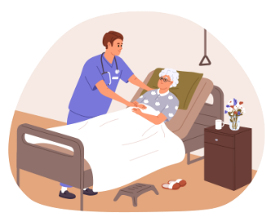

Standard Precautions
Every patient, every time
Hand Hygiene
Appropriate PPE
Respiratory hygiene/cough etiquette
Patient placement
Clean and disinfect equipment
Handle textiles carefully
Safe injection practices
Notes:
Standard Precautions must always be used in any healthcare setting for all patient/resident care. You have probably heard the saying, every patient, every time. Standard precautions are based on a risk assessment and make use of common sense practices and personal protective equipment that protect healthcare providers from infection and prevent the spread of infection from patient to patient.
Standard precautions includes: everyone must clean hands before entering and when leaving a room, practice respiratory hygiene, and wear appropriate PPE. All healthcare personnel must handle, clean and disinfect medical equipment and devices, handle laundry and textiles carefully, and follow safe injection practices.

Slide 6

Hand Hygiene
Alcohol based hand sanitizer (gel or foam)
Handwashing with soap and water
Reduces spread to patients, Reduces spread of resistant germs, Reduces risk to you!
Notes:
Hand hygiene is the number one way to stop the spread of infections. Hand hygiene protects both healthcare personnel and patients. Hand hygiene means using an antiseptic hand rub (like alcohol-based foam or gel hand sanitizer) or cleaning your hands by washing them with soap and water.
Cleaning your hands reduces:
The potential spread of deadly germs to patients.
The spread of germs, including those resistant to antibiotics.
The risk of healthcare personnel colonization or infection caused by germs received from the patient.
Some healthcare personnel may need to clean their hands as often as 100 times during a work shift to keep themselves, patients and staff safe.
https://www.cdc.gov/clean-hands/hcp/clinical-safety/index.html

Slide 7
Hand Hygiene – When to clean your hands
Immediately before touching a patient
Before performing an aseptic task such as dressing a wound or inserting a catheter
Before moving from work on a soiled body site to a clean body site
After touching a patient or patient's surroundings
After contact with blood, body fluids, or contaminated surfaces
Immediately after glove removal
Notes:
When should you perform hand hygiene?
Immediately before touching a patient.
Before performing an aseptic task such as placing an indwelling device or handling invasive medical devices.
Before moving from work on a soiled body site to a clean body site on the same patient.
After touching a patient or patient's surroundings.
After contact with blood, body fluids, or contaminated surfaces.
Immediately after glove removal.
https://www.cdc.gov/clean-hands/hcp/clinical-safety/index.html

Slide 8
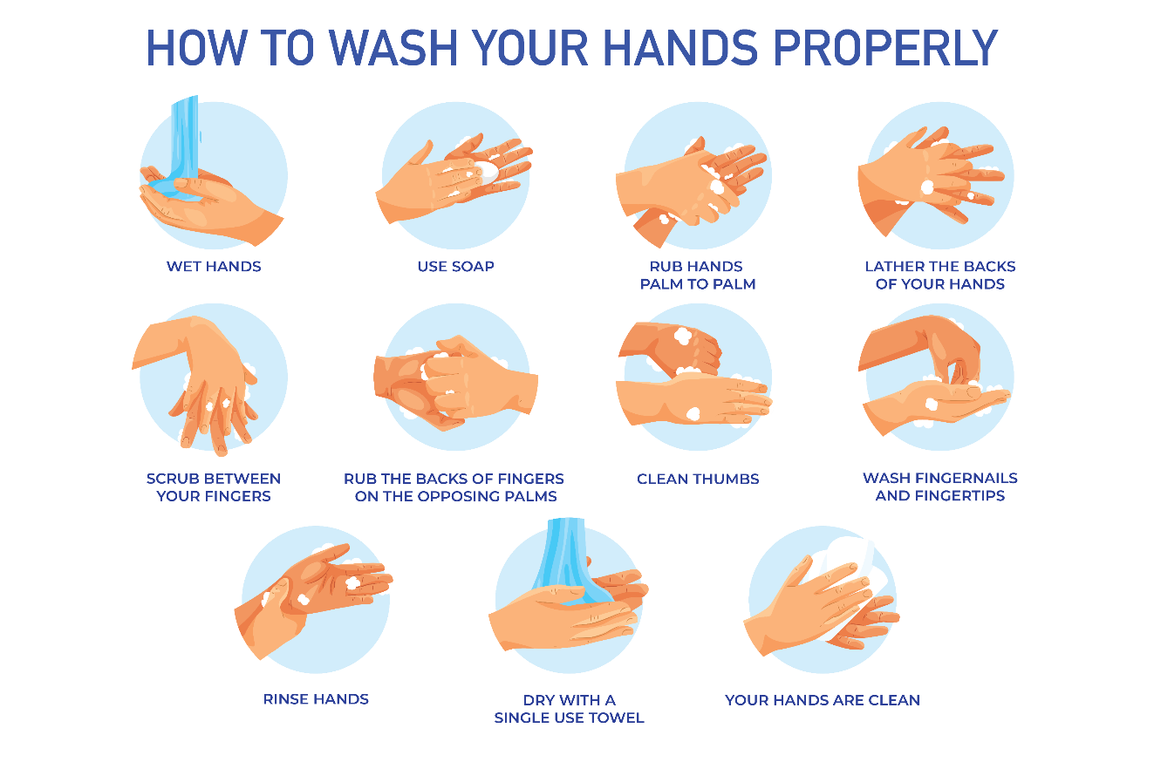

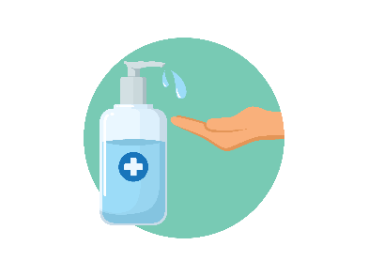
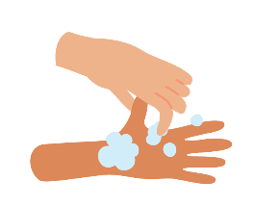
Hand Hygiene – How to clean your hands
Alcohol-based hand sanitizer | Soap and Water
Put product on hands and rub hands together Cover all surfaces and rub until hands feel dry This should take around 20 seconds Pay attention to the areas frequently missed: Thumbs Fingertips Between fingers | Wet hands with water Apply soap Rub hands together to cover all surfaces of the hands and fingers for at least 15 seconds Rinse hands with water Dry hands completely using a clean, single-use towel
20 sec
20 sec
8
Notes:
To use alcohol-based hand sanitizer:
Put an adequate amount of product on your hands and rub your hands together. Cover all surfaces and rub until hands feel dry. This should take around 20 seconds.
Pay attention to areas frequently missed such as thumbs, fingertips and between the fingers for at least 15 second. Rinse your hands. Dry your hands completely using a clean, single-use towel.
To wash your hands with soap and water:
Wet your hands with water, apply an adequate amount of soap. Rub your hands together to cover all surfaces of the hands
https://www.cdc.gov/clean-hands/hcp/clinical-safety/index.html

Slide 9
Hand Hygiene – When to use soap and water
Use soap and water (rather than alcohol-based hand sanitizer) when:
Hands are visibly soiled Before, during and after preparing food After using the restroom During the care of patients with suspected or confirmed infection during outbreaks of C. diff and norovirus
9
Notes:
Use soap and water, rather than using hand sanitizer, when hands are visibly soiled; before, during and after preparing food; after using the restroom; and during the care of patients with suspected or confirmed infection during outbreaks of C. diff and norovirus.
https://www.cdc.gov/clean-hands/hcp/clinical-safety/index.html

Slide 10
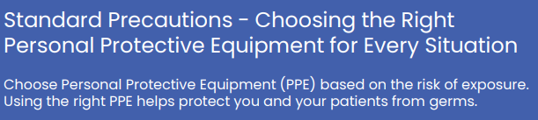
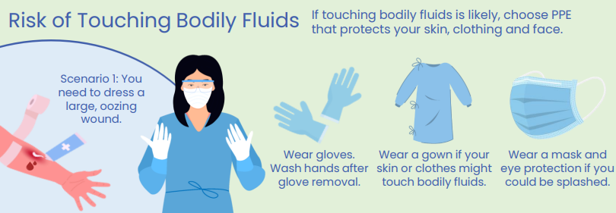
Notes:
Another part of standard precautions (remember, every patient every time) is using appropriate PPE for the situation/type of care you are providing. You can always wear PPE to protect yourself. For example, if you are touching bodily fluids, wear gloves. If the care you are providing may get your clothes dirty, you may want to wear a gown.

Slide 11
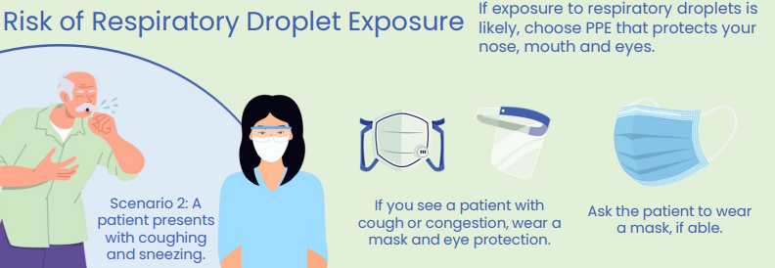
Notes:
If someone is coughing or sneezing, consider wearing a mask and/or goggles to protect your mouth, nose and eyes

Slide 12
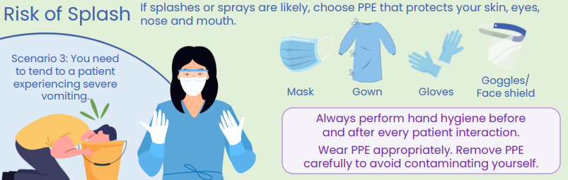
Notes:
If there is a risk of splash, you may want to use a face shield or goggles to protect your mouth, nose and eyes; and perhaps a gown and gloves to protect your hands and clothing.

Slide 13
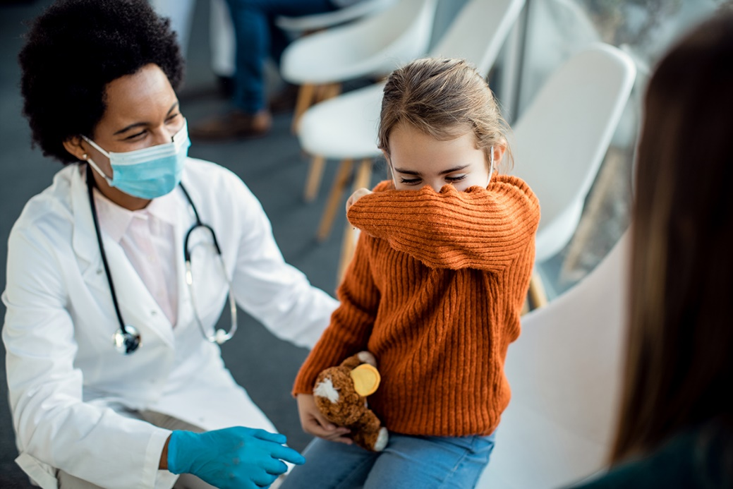
Transmission-Based Precautions
Contact Precautions
Enhanced Barrier Precautions *nursing homes only*
Droplet Precautions
Airborne Precautions
Look for signage on the patient's door or ask the charge nurse
Notes:
Transmission-Based Precautions are to be used in addition to Standard Precautions for patients who may be infected or colonized with certain infectious agents for which additional precautions are needed to prevent infection transmission. Those include contact precautions, droplet precautions, and airborne precautions. There are other types of transmission-based precautions you may see in your facility, such as enhanced barrier precautions in nursing homes, or "special droplet" for use with COVID patients. Your facility should let you know when a patient is on transmission-based precautions by hanging a sign at their door. Always follow your facility’s specific guidelines. In the next few slides, we will go over what each precautionary measure should include.
We will talk more about how to wear and remove PPE after we talk about the types of transmission-based precautions.

Slide 14

Contact Precautions
Transmission by touch, such as
  Multidrug-resistant organisms (MDRO)
  Norovirus
  Scabies
  Uncontained, draining wounds
Notes:
Use contact precautions for patients with known or suspected infections that are known to be transmitted via touch or contact. Patients on contact precautions can infect others through direct contact. Some common conditions that warrant contact precautions include MDROs, C. auris, Scabies, RSV, uncontained draining wounds, and other medical conditions.

Slide 15



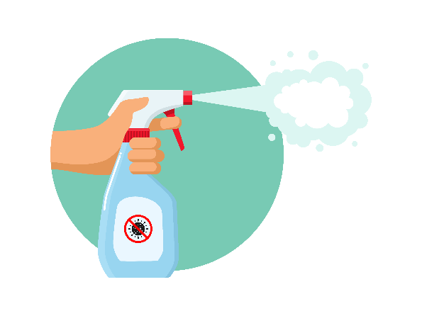
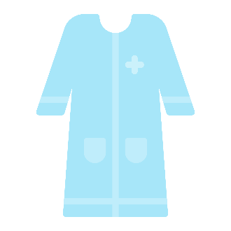

Contact Precautions – spread by touch
Always follow facility specific guidelines
  Use PPE appropriately – Gown and Gloves
  Choose roommates with the same condition
  Limit transport and movement of patients
  Use disposable or dedicated patient-care equipment
  Prioritize cleaning and disinfection of rooms
Notes:
Use contact precautions for patients with known or suspected infections that represent an increased risk for contact transmission.
-Wear a gown and gloves when caring for patients on contact precautions
-Choose room placement and roommates carefully to reduce risk of transmission to others
-Limit transport and movement of patients outside of the room to medically-necessary purposes. When transport or movement is necessary, cover or contain the infected of the patient's body.
-Use disposable or dedicated patient-care equipment (e.g., blood pressure cuffs). If common use of equipment for multiple patients is unavoidable, clean and disinfect such equipment before use on another patient.
-Prioritize cleaning and disinfection of the rooms of patients on contact precautions ensuring rooms are frequently cleaned and disinfected
https://www.cdc.gov/infection-control/hcp/basics/transmission-based-precautions.html

Slide 16
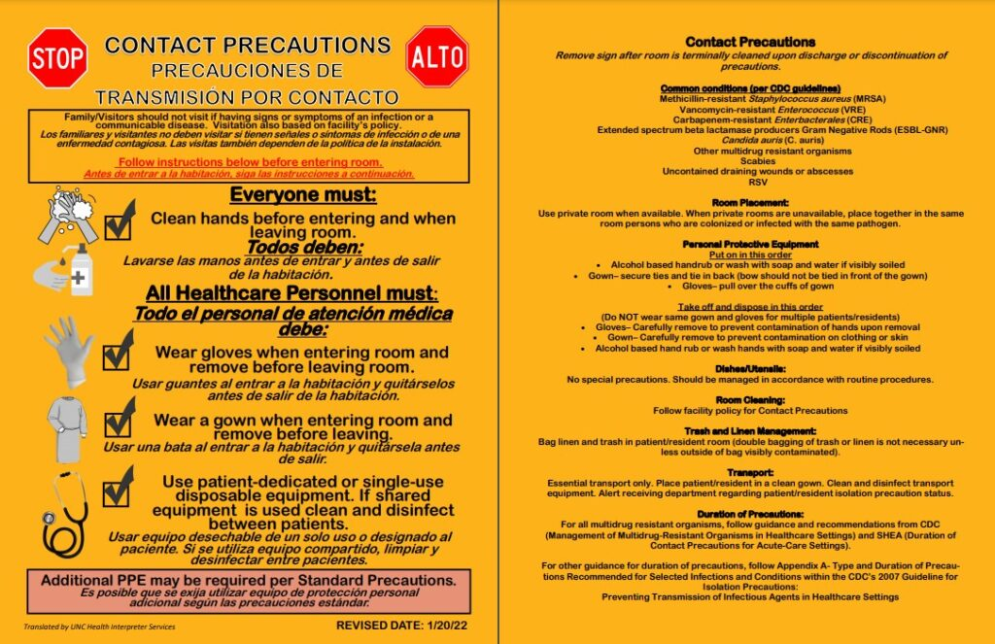
Contact Precautions
Signage
Notes:
Here you will see an example of what a contact precautions sign looks like. This will be placed outside of a patient’s door when they are on contact precautions.

Slide 17

Enhanced Barrier Precautions (EBP)
*nursing homes only*
Transmission by touch, such as
  Multidrug-resistant organisms (MDRO)
  Wounds
  Indwelling devices
Notes:
Moving on, we will take a look at Enhanced Barrier Precautions, otherwise called EBP. Like Contact Precautions, patients on Enhanced Barrier Precautions can spread infections through touch. EBP, however, are specific to nursing home residents. Residents with a history of MDROs and residents with wounds or indwelling devices should be placed on EBP.

Slide 18
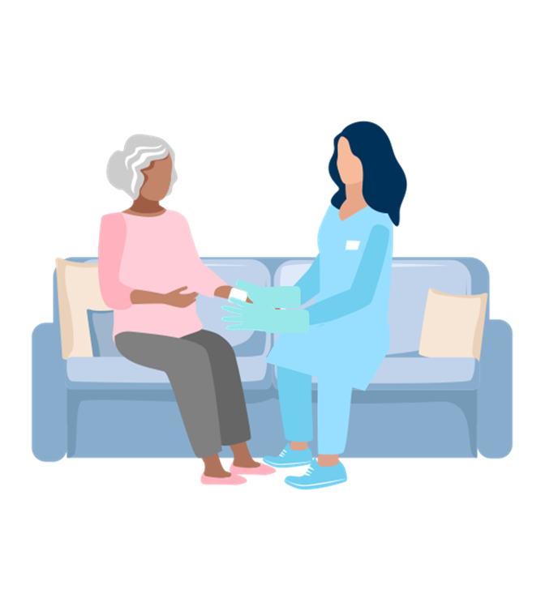
Enhanced Barrier Precautions (EBP) – spread by touch
Nursing Homes Only
Wear gloves and a gown for high-contact care activities. Do not wear the same PPE to care for more than one resident.
Use EBP during high-contact patient care activities:
  Dressing or bathing
  Transferring
  Changing linens
  Assisting with toileting
  Accessing indwelling medical devices
  Providing wound care
Notes:
Make sure you use appropriate PPE (gown and gloves) when caring for residents during high-contact care activities. These include things like dressing, bathing, providing hygiene, assisting with toileting, device care and wound care.

Slide 19
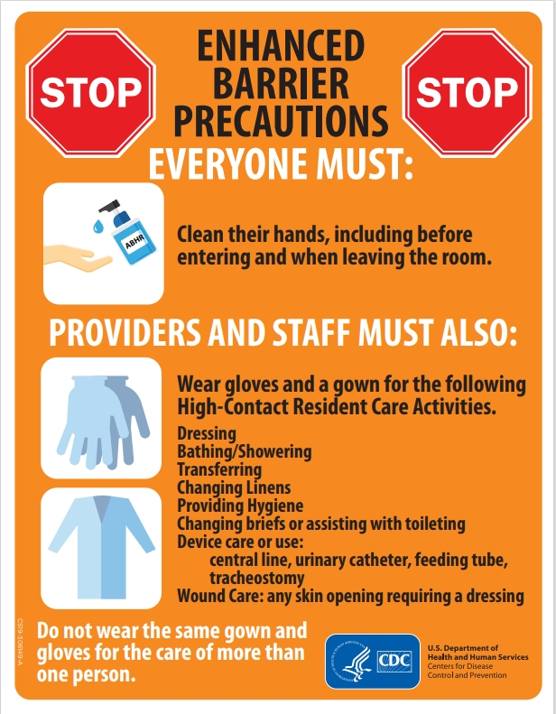
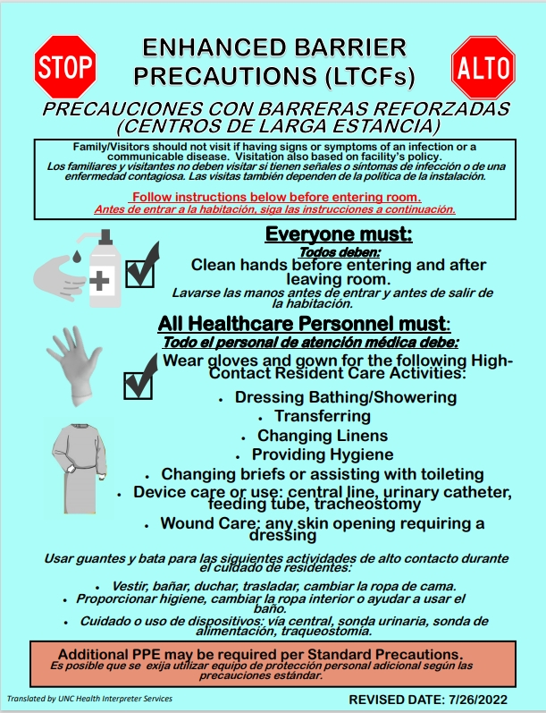
Enhanced Barrier Precautions
Signage
Notes:
Here you will see examples of what an EBP sign will look like outside of a resident’s room.

Slide 20
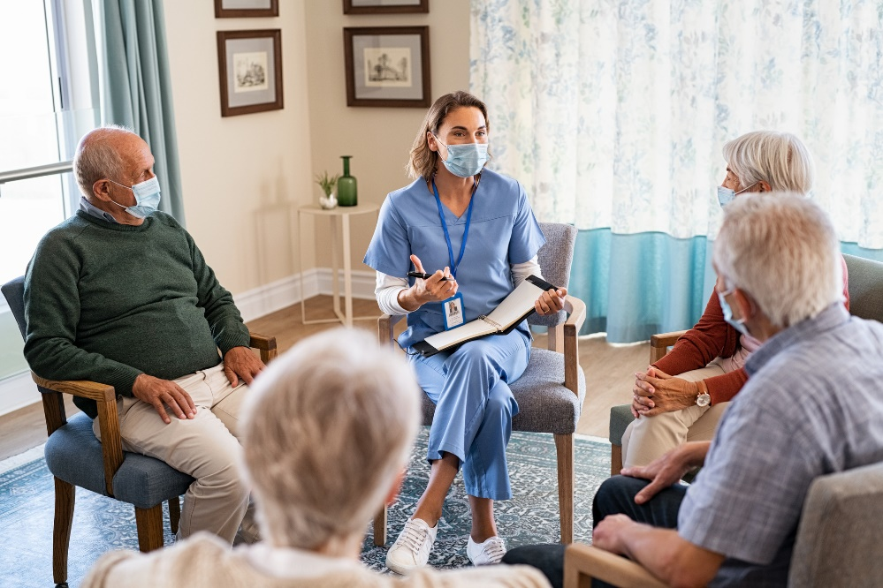
Droplet Precautions
Infections that spread via respiratory droplets, such as:
  Influenza
  The common cold (Rhinovirus)
  Pertussis (Whooping cough)
Notes:
Next, let’s look at Droplet Precautions. Like the name suggests, droplet precautions are put in place for patients who might transmit an infection via respiratory droplets. A few examples of conditions that require droplet precautions include the flu, colds and pertussis (whooping cough).

Slide 21
Droplet Precautions
Use PPE appropriately – Mask
Have the patient wear a mask (if able)
Place in a private room or chose roommates with the same condition
Limit transport and movement of patients
Notes:
-Wear a mask when caring for patients on droplet precautions
-Contain pathogens at the source, have the patient wear a mask if they are able
-Choose room placement and roommates carefully to reduce risk of transmission to others. Those on droplet precautions should have a private room when possible
-Limit transport and movement of patients outside of the room to medically-necessary purposes. If transport or movement outside of the room is necessary, instruct patient to wear a mask and follow Respiratory Hygiene/Cough Etiquette.

Slide 22
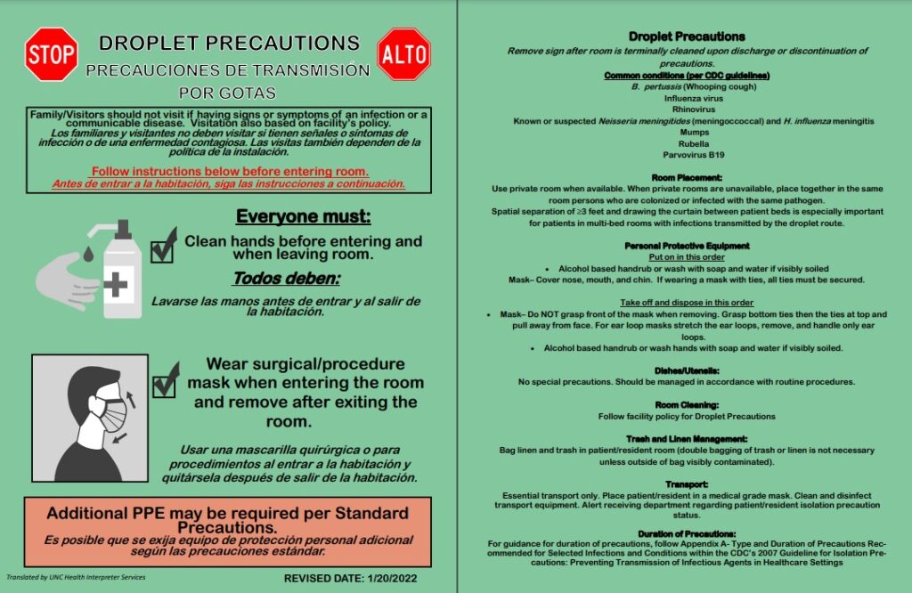
Droplet Precautions
Signage
Notes:
Here you will see an example of what the droplet precautions sign should look like.

Slide 23

Airborne Precautions
Transmission by air, such as:
  Mycobacteria tuberculosis (TB)
  Measles
Airborne infection isolation room is required (negative pressure room)
  Keep the door closed
COVID-19 requires an N95 mask but usually does not require transfer (does not require an airborne infection isolation room in most cases)
Notes:
And finally, airborne precautions. Airborne precautions are put in place for infections that are transmitted by air. If your facility does not have an airborne infection isolation room, the patient will need to be transferred to another facility.

Slide 24

Airborne Precautions
Wear a fit tested, NIOSH-approved respirator (N95) or higher while in the room/with the patient
​
Ask the patient to wear a mask
(if able)
Private room or with a roommate with the same illness
Limit the patient's movement in the facility
Notes:
Use airborne precautions for patients known or suspected to be infected with pathogens transmitted by the airborne route like TB, measles, chickenpox).
-Use personal protective equipment (PPE) appropriately, including a fit-tested NIOSH-approved N95 or higher level respirator for healthcare personnel
-Contain pathogens at the source, have the patient wear a mask if they are able
-Requires a private room or with a roommate with the same airborne pathogen
-Limit transport and movement of patients outside of the room to medically-necessary purposes

Slide 25
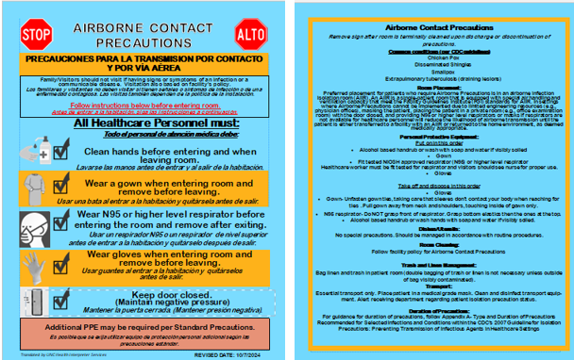
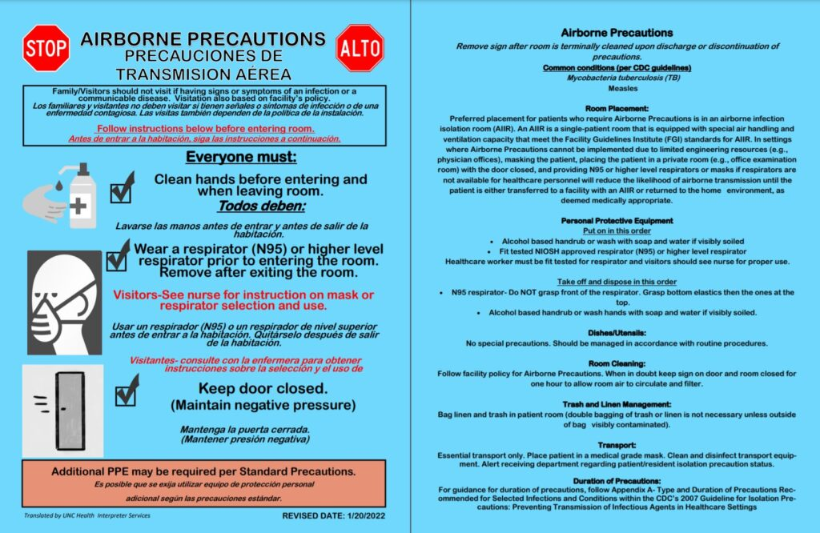
Airborne Precautions
Signage
Notes:
Here are some examples of airborne precautions signs you will see outside of a patient’s room.

Slide 26
Combination of Precautions
Droplet Precautions
Droplet & Contact
Contact Precautions
Airborne & Contact
Airborne Precautions
Notes:
Sometimes you will see a combination of transmission-based precautions, depending on the patient’s condition. When this happens, be sure to check that you are meeting the requirements for both sets of guidance.

Slide 27

Transmission-Based Precaution Signage
Communicates what precautions are necessary
Leave upon discharge so EVS knows how to clean/disinfect the room

Slide 28

Donning PPE
Wear PPE properly
  Mask over nose and mouth
  Gown tied
  Gloves over wrists
  Eye protection=goggles or a face shield that covers the front and sides of the face
Notes:
The appropriate use of PPE requires the appropriate donning and doffing of equipment. We will now quickly go over how to correctly put on PPE and remove it. Required PPE will vary based on different precautions that are in place. While this will be a lot of information, we want to highlight these few things. To wear PPE correctly, make sure your mask is fitted over your nose and mouth, your gown is tied, and gloves are pulled up over your wrists. Proper eye protection should cover the front and sides of your face to adequately protect your eyes from all directions.

Slide 29
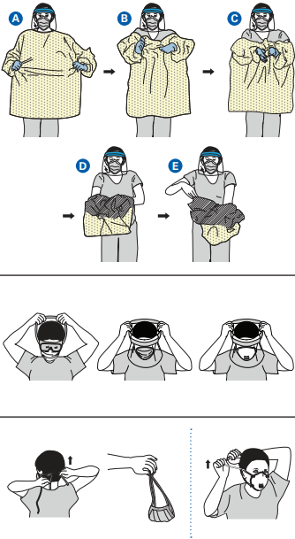
Doffing PPE
Remove PPE carefully to
reduce contamination
Gown and Gloves
Goggles or face shield
Mask or respirator
Hand hygiene
Perform hand hygiene between steps if hands become contaminated
Notes:
When removing your PPE, be careful not to contaminate yourself and dispose of your equipment inside of the room unless stated otherwise.
This is one example of how to remove PPE properly. Begin with removing your gown and gloves at the same time.
Grasp the gown in the front and pull away from your body so that the ties break, touching outside of gown only with gloved hands
While removing the gown, fold or roll the gown inside-out into a bundle
As you are removing the gown, peel off your gloves at the same time, only touching the inside of the gloves and gown with your bare hands. Place the gown and gloves into a waste container.
To remove your goggles or face shield
Remove goggles or face shield from the back by lifting head band and without touching the front of the goggles or face shield
If the item is reusable, place in designated receptacle for reprocessing. Otherwise, discard in a waste container
Mask or respirator
Grasp bottom ties or elastics of the mask/respirator, then the ones at the top, and remove without touching the front
Discard in a waste container
Use an alcohol-based hand sanitizer or wash your hands with soap and water immediately after removing all PPE
https://www.cdc.gov/infection-control/media/pdfs/Toolkits-PPE-Sequence-P.pdf

Slide 30
Doffing PPE
Remove and discard all PPE inside the room
  Respirators can be removed outside the room
Most PPE is single use only – discard after removal
  Eye protection is often reusable but should be disinfected between use
Never wear the same PPE for multiple patients
Notes:
Remove and discard all PPE inside the room. Most PPE is single use only and should be discarded after removal. Some types of eye protection is reusable but should be disinfected between uses. Never wear the same PPE for multiple patients.

Slide 31

PPE Activity
Supplies:
  Hand sanitizer
  Gloves
  Mask
  Gown
  Face shield
Notes:
Now that you have learned about different transmission based precautions and required PPE, we are going to practice donning and doffing PPE based on different types of transmission-based precautionss. Please rejoin your KWL chart groups from the beginning of this module. You will receive these items. One person in your group will don and doff the appropriate PPE for the TBP listed on the slide. Use the signage to help you remember which PPE is required. Be sure to don and doff PPE in the correct order!

Slide 32
Contact Precautions PPE

Slide 33
Enhanced Barrier Precautions PPE

Slide 34
Droplet Precautions PPE

Slide 35
Airborne Precautions PPE

Slide 36
Know, Want to Know, Learned (KWL) Chart
Want to Know
Know
Learned
Notes:
Now that we have completed today’s module, we will complete the “Learned” section of the KWL chart. You will have 7 minutes to brainstorm ideas. Please select one representative from your group to share what you all came up with and add your sticky notes to the group chart.

Slide 37

Post-assessment https://forms.office.com/g/CkxpFithT4
Notes:
Please take 5 minutes to complete this post-assessment. All responses will be kept anonymous. https://forms.office.com/Pages/ResponsePage.aspx?id=3IF2etC5mkSFw-zCbNftGZwLhkl927NJtGWhRDsHuapUNVRJTFhWTlZQS0U4RDhKS1BZSlM4TDFKSi4u

Slide 38
Thank you!
infectionprevention@dhhs.nc.gov
Notes:
Thank you for participating in today’s module on Enhanced Barrier Precautions! If you have any additional questions beyond today’s session, please feel free to reach out to our team at infectionprevention@dhhs.nc.gov!

Slide 39
This is the end of the slide deck. Please do not present past this slide.

Slide 40
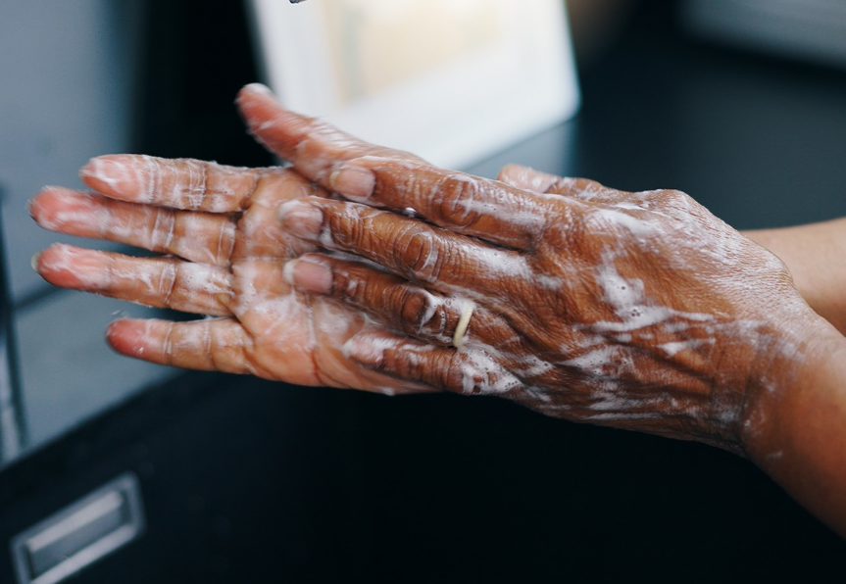
Enhanced Barrier Precautions
Hand hygiene
Everyone must: Clean their hands before entering and leaving a room
Providers and Staff must also: Wear gloves and gown for high-contact care activities
Notes:
When a resident is placed on EBP, everyone must continue to practice hand hygiene before entering and when leaving a resident’s room. Additionally, you muse wear gown and gloves for high-contact care activities. We will go over what these activities are in more detail on a future slide.

Slide 41
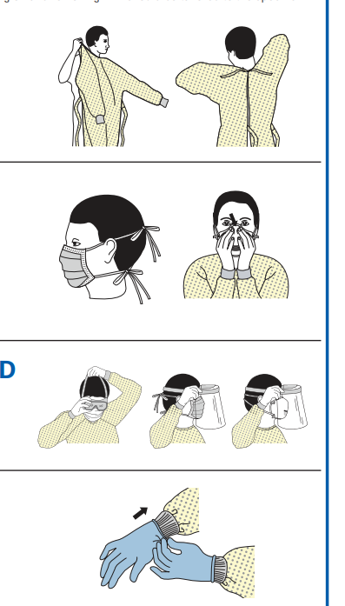
Donning PPE
Gown
  Cover torso from neck to knees, arms to end of wrists, and wrap around back
  Fasten in back of neck and waist
Mask or respirator
  Secure ties or elastic bands at middle of head and neck
  Fit flexible band to nose bridge
  Fit snug to face and below chin
  Fit-check respirator
Notes:
https://www.cdc.gov/infection-control/media/pdfs/Toolkits-PPE-Sequence-P.pdf

Slide 42
Donning PPE
Goggles or face shield
  Place over face and eyes and adjust to fit
Gloves
  Extend to cover wrist of isolation gown

Slide 43
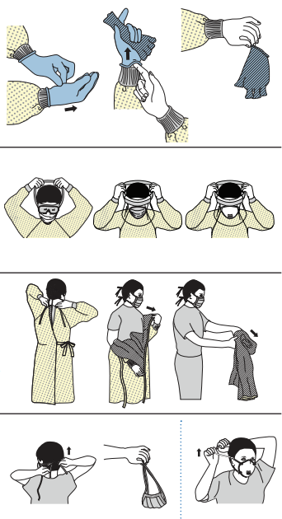
Doffing PPE
Be careful not to contaminate
yourself
Gloves
Goggles or face shield
Gown
Mask or respirator
Hand hygiene
Notes:
There are a variety of ways to safely remove PPE without contaminating your clothing, skin, or mucous membranes with potentially infectious materials. Remove all PPE before exiting the patient room except a respirator, if worn. We’ll look at two examples of how to remove PPE safely. Always remove the respirator after leaving the patient room and closing the door.
For this example sequence, you will begin with removing the gloves:
Remember the outside of the gloves are contaminated. If your hands are contaminated during removal, immediately perform hand hygiene
Using a gloved hand, grasp the palm area of the other glove hand and peel off first glove
Hold removed glove in gloved hand
Slide fingers of ungloved hand under remaining glove at wrist and peel off second glove over first glove
Discard gloves in waste container
Goggle or face shield:
Remove goggles or face shield from the back by lifting head band or ear pieces
If the item is reusable, place in designated receptacle for reprocessing. Otherwise, discard in a waste container
Gown
Unfasten gown ties, taking care that sleeves don’t contact your body when reaching for ties
Pull gown away from neck and shoulders, touching inside of gown only
Turn gown inside out
Fold or roll into a bundle and discard in a waste container
Mask or respiratory
Grasp bottom ties or elastics of the mask/respirator, then the ones at the top, and remove without touching the front
Discard in a waste container
Once all PPE is removed, immediately perform hand hygiene

Slide 44

Contact Precautions
When to use
Signage
Limit transport and movement of patients outside of the room to medically-necessary purposes.
Use disposable or dedicated patient-care equipment (e.g., blood pressure cuffs).
Prioritize cleaning and disinfection patient rooms
Notes:
As mentioned in the previous slides, patients are placed on contact precautions when they have an infection that can be transmitted by touch. You will know when to follow contact precautions for these patients when you see a sign posted outside of their room. Be sure to follow this sign and your facility’s guidelines carefully.
When a patient is on contact precautions, it is important to limit transport and movement outside of their room to medically-necessary purposes. When transport or movement is necessary, cover or contain the infected or colonized areas of the patient's body.
Use disposable or dedicated patient-care equipment (e.g., blood pressure cuffs). If common use of equipment for multiple patients is unavoidable, clean and disinfect such equipment before use on another patient.
Prioritize cleaning and disinfection patient rooms

