Slide 1
NC Department of Health and Human Services
NC Public Health
Things that make you go poo
2025 Communicable Disease Conference
February 12, 2025

Slide 2
Objectives
Recognize the purpose of the initial steps of an outbreak investigation
Identify the importance of creating and maintaining a line list
Notes:
This talk is about enterics and applies to all diseases.

Slide 3



Initial steps of an enteric outbreak
Identify your resources
Does an outbreak exist?
Verify diagnosis

Slide 4
Reporting
RedCap
  As soon as you establish you have an outbreak
  Serves as your reporting mechanism to the state
  Link: https://survey.dph.ncdhhs.gov/surveys/?s=9LA8PLAE88
Notes:
This talk is about enterics and applies to all diseases.

Slide 5
Line lists
What it is
  List of ill persons and their characteristics (i.e. clinical, lab, exposures, etc.)
What we use it for
  Organizes data collected during the outbreak
  Provides essential investigation data (i.e. incubation period, demographic, onsets for epi curve, common exposures, outliers, etc.)
Importance of starting it early
  Easier to maintain in real time rather than backtrack
Notes:
This talk is about enterics and applies to all diseases.

Slide 6
Any questions?

Slide 7
Outbreak Example
Your County
  Church meal for Thanksgiving
  Food prepared in homes of church members
  Prepared food brought to the church for packaging and distribution
  Prepared food distributed to home bound church members @ 8am
  First onset within 4 hours
    Food also went to senior center and group home
  Two foods were tested by Dept of Ag
Notes:
This talk is about enterics and applies to all diseases.

Slide 8
How do these scenarios affect you?
Wedding of 300 ppl. 100+sick
Potluck of 30 people with 7 ill
1 Hep A in a food handler
Acute Typhoid case
Notes:
1. Do you need to close clinic or do you have enough staff to maintain business as usual during outbreak investigation?
2. Do the 7 people have something else in common? Are they in the same household? Are they coworkers? Are their symptoms GI vs respiratory or something else?
3. This is why you need to check your high consequence workflow
VERIFY DIAGNOSIS
Talk to the state to help determine other resources. For example, norovirus. SLPH has norovirus kits available and we can help coordinate to get the specimen kits to you.

Slide 9
Does an outbreak exist?
Wedding of 300 ppl. 100+sick
Potluck of 30 people with 7 ill
1 Hep A in a food handler
Acute Typhoid case

Slide 10
Verify the diagnosis
Wedding of 300 ppl. 100+sick
Potluck of 30 people with 7 ill
1 Hep A in a food handler
Acute Typhoid case

Slide 11
Line lists
DEMO

Slide 12
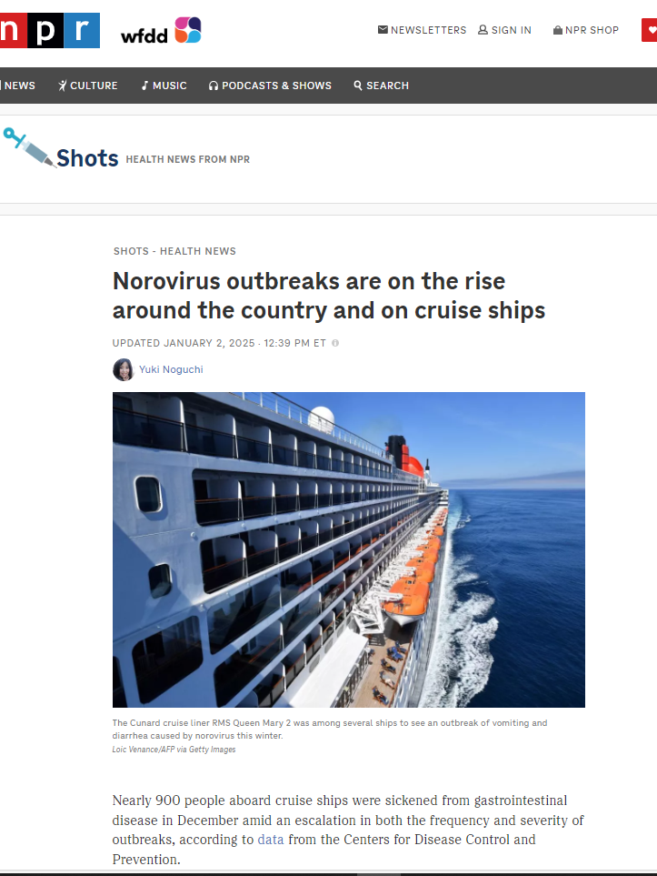
From NC to NPR
Source: https://www.npr.org/sections/shots-health-news/2025/01/01/nx-s1-5244061/norovirus-outbreak-spreads-symptoms-cruise-ships
Notes:
The increase in norovirus cases and outbreaks made national news last month. This awareness of something above the norm, on a national level, is important.

Slide 13
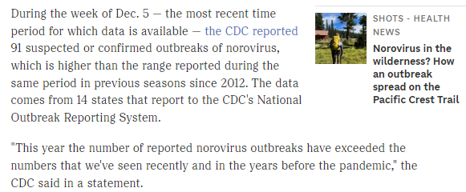
From NC to NPR
Source: https://www.npr.org/sections/shots-health-news/2025/01/01/nx-s1-5244061/norovirus-outbreak-spreads-symptoms-cruise-ships
Notes:
North Carolina is one of the 14 states here. When you submit a RedCap event, Vanessa Brown-Moore enters that into CDC’s National Outbreak Reporting System. We have monthly calls with the other 13 states and CDC to discuss noro activity and what we’re seeing.
Reporting outbreaks are important, including what form of transmission you suspect (i.e. person to person, foodborne, etc.).

Slide 14
Timely reporting and closing

Slide 15
Wrapping it all up
Provide finalized data in NC EDSS
Close outbreak event and assign to the state
Notes:
This talk is about enterics and applies to all diseases.

Slide 16
Points to remember
Food testing
  NC SLPH does not do food testing
  NCDA does food testing but for a limited number of pathogens
  CDC food testing must be approved
  Submitter must know what pathogens to request testing for all laboratories
    Info on the line list informs likely pathogen based on clinical picture and incubation period
Notes:
This talk is about enterics and applies to all diseases.

Slide 17
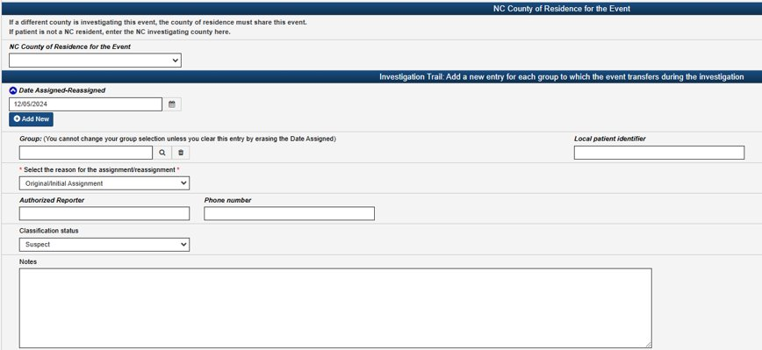
Good practice
Complete NCEDSS drop downs when possible
Enter name and direct phone number (not main number) in admin trail
  We need to contact the interviewer directly with questions
Add any notes you want to share with the state about this event here, this is your box.
Notes:
This talk is about enterics and applies to all diseases.

Slide 18
Norovirus season reminder..
We need your help to test specimens
  Only 2 specimens are needed for SLPH testing
  Testing up to 3 days after symptoms resolve
  SLPH has testing kits available. To order kits, email slph.norovirus@dhhs.nc.gov

Slide 19
Enterics Team
Carl Williams, Public Health Veterinarian
  Carl.Williams@dhhs.nc.gov
Nicole Lee, Epidemiologist
  Nicole.lee@dhhs.nc.gov
  919-218-9829
Tammra Morrison, Enterics Nurse Consultant
  Tammra.Morrison@dhhs.nc.gov
  919-397-7716
Vanessa Brown-Moore
  Vanessa.brown-moore@dhhs.nc.gov
  919-210-8977
Melanie D’Angelo (until June 1, 2025)
  Melanie.dangelo@dhhs.nc.gov
Notes:
This talk is about enterics and applies to all diseases.

