Slide 1


Wound Care
Infection Prevention Education
Notes:
Welcome participants

Slide 2

Pre-assessment https://forms.office.com/g/kGAGbpCWmE
Notes:
Please take 5 minutes to complete this pre-assessment. If you do not have a smart phone, please partner up with another participant. All responses will be kept anonymous. This assessment allows the infection prevention team to monitor the impact of our modules.

Slide 3
Know, Want to Know, Learned (KWL) Chart
Want to Know
Know
Learned
SOURCE:
Notes:
Before we start today’s module, we will complete the first two sections of a KWL chart. A KWL chart is a “Know, Want to Know, Learned” chart. Please partner up in groups of three. With your sticky notes, please write down everything you already know about wound care regarding infection prevention. Once you have don that, on separate sticky notes, write down what you would like to know. You will have 7 minutes to brainstorm ideas. Please select one representative from your group to share what you all came up with and add your sticky notes to the group chart.

Slide 4
Overview
Pre-assessment
KWL Chart
Wound Care Presentation
Activity
KWL Chart
Post-assessment
Notes:
For today’s module, we will focus on these 6 focus areas, two of which you’ve already completed! Next, we will have a presentation on wound care and infection prevention. We will follow this presentation with some more group activities. Once we have completed these activities, you will be asked to complete a post-assessment and we will be done for the day.

Slide 5
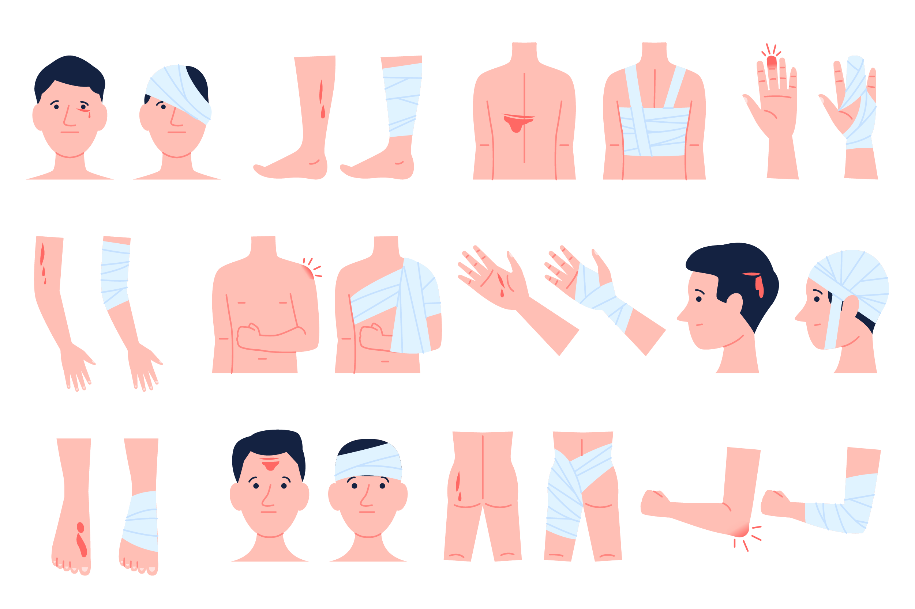
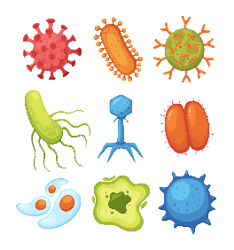
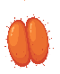
First Line of Defense
Skin is the first line of defense against pathogens and infection
Intact skin vs. Non-intact skin
Wounds are tissue injuries caused by cutting, piercing, pressure or tearing
Notes:
Skin is the largest organ in the human body, and it acts as the first line of defense against infections. When skin breakdowns occur due to cuts, injuries, or wounds, we lose that first line of defense against pathogens. Wounds create non-intact skin, making the body more vulnerable to infection, dehydration, and environmental toxins.

Slide 6

Acute versus Chronic Wounds
  Acute wounds heal as expected with routine intervention
  Chronic wounds require extensive treatment and care and take longer to heal than expected
Notes:
When wounds occur among patients, one way to classify them as acute or chronic. Acute wounds require minimal intervention, while chronic wound require aggressive treatment and care. No matter what the wound is classified as, prompt care is vital to prevent serious infections.

Slide 7
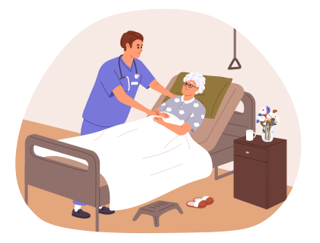
Interventions to Prevent Skin Breakdown
Change pads frequently for incontinent patients
Reposition every 2 hours
Maintain warmth and prevent chilling of the extremities
Assess skin integrity frequently
Avoid friction and shearing forces
Use pressure-relieving cushions
Infection Prevention Guide: To Long-Term Care: 2nd edition: APIC
Notes:
As health care providers, we can take steps to help prevent infections within our patient population. These interventions are especially important in patients who might have a harder time moving on their own. Some important interventions include:
Changing pads frequently for patients who experience incontinence
Repositioning patients who are bed bound every two hours
Making sure patients stay warm
Assessing skin on a frequent basis for any new areas of breakdown
Avoiding friction and shearing forces on the patient’s skin
And using pressure-relieving cushions for those who can’t move much on their own
Reference source: Infection Prevention Guide: To Long-Term Care:2nd edition: APIC

Slide 8
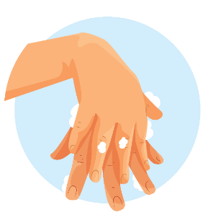

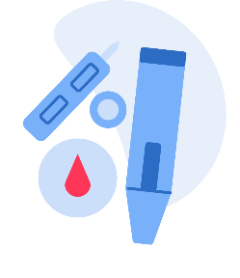

Wound Care Techniques
Wash hands carefully
Prepare a clean field
Use clean gloves
Use sterile instruments
Prevent direct contamination of materials and supplies
Clean Technique
Notes:
Based on the type of wound, there are two techniques that can be used for management. The first and most likely to be used in long term care facilities is the "Clean Technique". Clean Technique reduces the number of germs to prevent or reduce the risk of transmission and infection. It involves meticulous handwashing, maintaining a clean environment by preparing a clean field (clean field means to be free of dirt, marks, or stains), using clean gloves, sterile instruments, and preventing direct contamination of materials and supplies.

Slide 9

Wound Care Techniques
Thorough handwashing
Sterile field
Sterile gloves
Sterile dressing
Sterile instruments
Sterile Technique
Notes:
Sterile technique is generally defined as meaning completely free from germs. Sterile technique reduces exposure to microorganisms and maintains objects and areas as free from microorganisms as much as possible. Sterile technique involves thorough hand washing, use of a sterile field, use of sterile gloves for application of a sterile dressing, and use of sterile instruments. This is most appropriate in acute care hospital settings, for patients at high risk for infection, and for certain procedures such as sharp instrumental wound debridement.

Slide 10
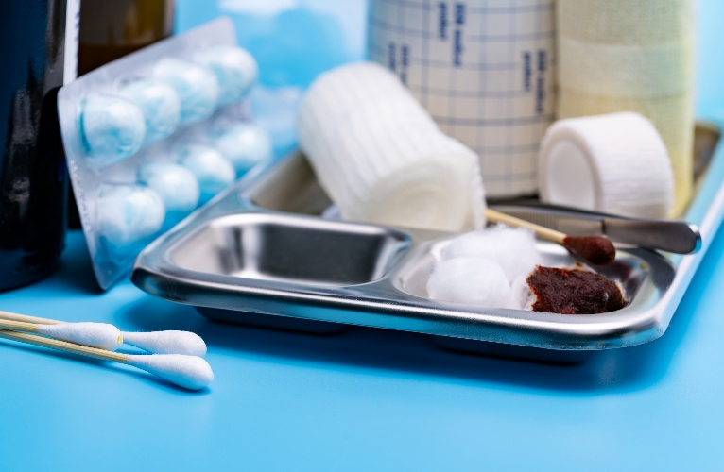
Overview of Changing Dressings
Disinfect area where supplies will be placed
Have a trash bag nearby
Gather all necessary supplies and equipment
Perform hand hygiene
Don clean disposable gloves
Remove and dispose of tape and outer dressings in trash bag
Assess wound
Doff and dispose of soiled gloves
Perform hand hygiene
Don clean gloves
Apply dressing and secure
Dispose of all supplies
Remove gloves and perform hand hygiene
Notes:
This slide lists the general rules you should follow when changing wound dressings.
Disinfect area where supplies will be placed
Have a trash bag nearby
Gather all necessary supplies and equipment
Perform hand hygiene
Put on clean disposable gloves
Remove and dispose of tape and outer dressings in trash bag
Assess wound
Take off and dispose of soiled gloves
Perform hand hygiene
Put on new, clean gloves
Apply new wound dressing and secure it
Dispose of all supplies
Remove gloves and perform hand hygiene

Slide 11
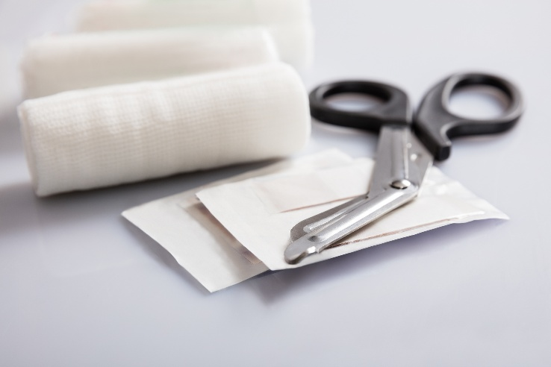
Wound/
Bandage
Scissors
Avoid bringing scissors in the room
  Cut needed supplies prior to entering the room
  Unwrap the old dressing rather than cutting it from the patient
Disposable scissors are best
Patients on Transmission-Based Precautions must have their own pair of scissors
Clean and disinfect with an EPA-approved disinfectant after each use
Scissors labeled as single use should be discarded after a single use
Scissors used for debridement (contact with a wound) must be sterile
Notes:
What about scissors?​
Best practice is to avoid taking scissors in the patient room or treatment room. Cut necessary clean supplies before entering the room. Avoid using scissors to remove old dressings, unwrap rather than cutting the old dressing when possible.
When using scissors with dressing changes and wound care, disposable is the best option. If disposable scissors are not available, we encourage dedicating a pair of scissors to that patient. ​
If the patient is on transmission-based precautions, scissors must be disposable OR dedicated to the patient.
Scissors must be cleaned and disinfected with an EPA-registered health care disinfectant after each use.
Scissors labeled as single use should be discarded after a single use.
Scissors used for debridement or wound management (contact with wound) must be sterile. Scissors that touch wounds need to be cleaned and disinfected in a special way and should not be used on another patient until that disinfection process (or sterilization) has been done.

Slide 12
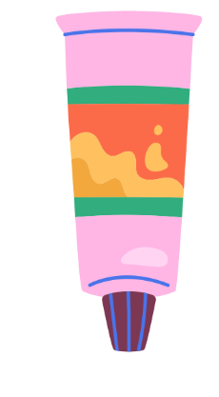
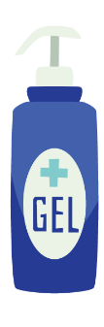
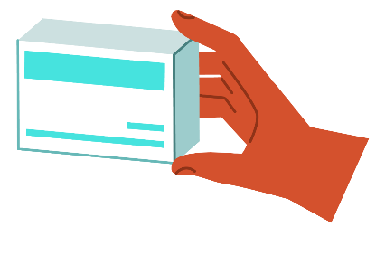
Medications
Dedicate multi-dose wound care meds to a single patient
Store in the patient’s room
When multi-dose medications must be shared between patients:
  Store in a centralized location
  Take a small amount in a clean container into the patient’s room
    Never take the container of medication into a patient’s room or treatment area
Notes:
For wound care medications, make sure you:
Dedicate multi-dose wound care medications to a single patient (i.e., ointments, creams) and store in the patient’s room, when possible
When multi-dose medications must be shared between patients:
Store the medication in a centralized location
Take a small amount in a clean container into the patient’s room
Never take the full medication into a patient’s room or treatment area

Slide 13
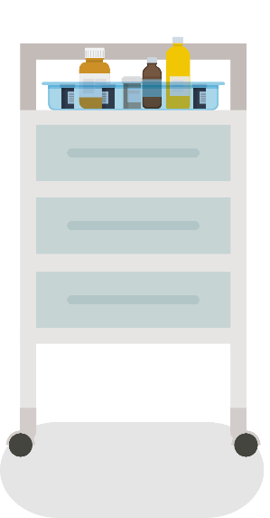
Wound Care Supply Cart
Never enter the patient’s room (or wound care treatment area) with the wound care cart
Never access the wound care cart or touch clean supplies while wearing gloves or without performing hand hygiene first
Gather all supplies ahead of time
Notes:
The wound care supply cart must be kept outside of a patient’s room or wound care treatment area to prevent the cart and supplies from becoming contaminated. Also, never access the wound care cart or touch clean supplies while wearing gloves or without performing hand hygiene first. To help with appropriate handling of the wound care supply cart, gather all your supplies ahead of time

Slide 14

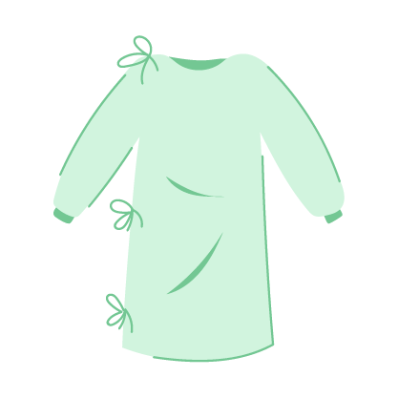

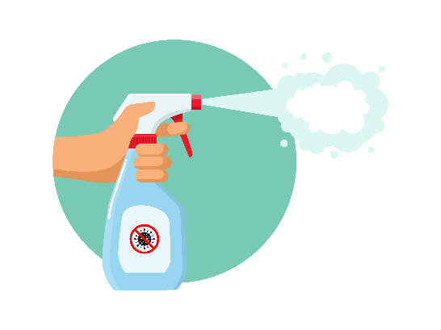
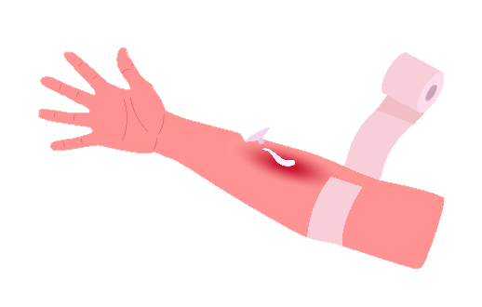
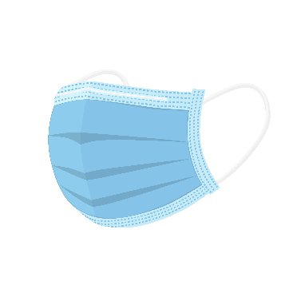

Additional Wound Care Guidance
Wear the appropriate PPE for anticipated exposure
Irrigation should be performed in a way that minimizes cross-contamination to other surfaces (reduce splash)
Always perform hand hygiene and change gloves when moving from a dirty task to a clean task
Always clean and disinfect surfaces after a dressing change
Notes:
When caring for a wound, choose your PPE based on anticipated exposure. If there is a risk of getting bodily fluids on your skin or clothing, wear a gown
If your facility is experiencing a group A Streptococcus outbreak, a mask should be worn during wound care
If there is a risk of splash, consider wearing a mask and/or eye protection
Irrigation of a wound often creates splash. Try to perform irrigation in a way that reduces splash as much as possible and in an area that reduces contamination of surrounding surfaces and supplies
Always perform hand hygiene and change gloves when moving from a dirty task to a clean task, such as when removing a dirty dressing and then applying a new, clean dressing
When done, clean and disinfect surfaces that may have become contamination during the dressing change

Slide 15
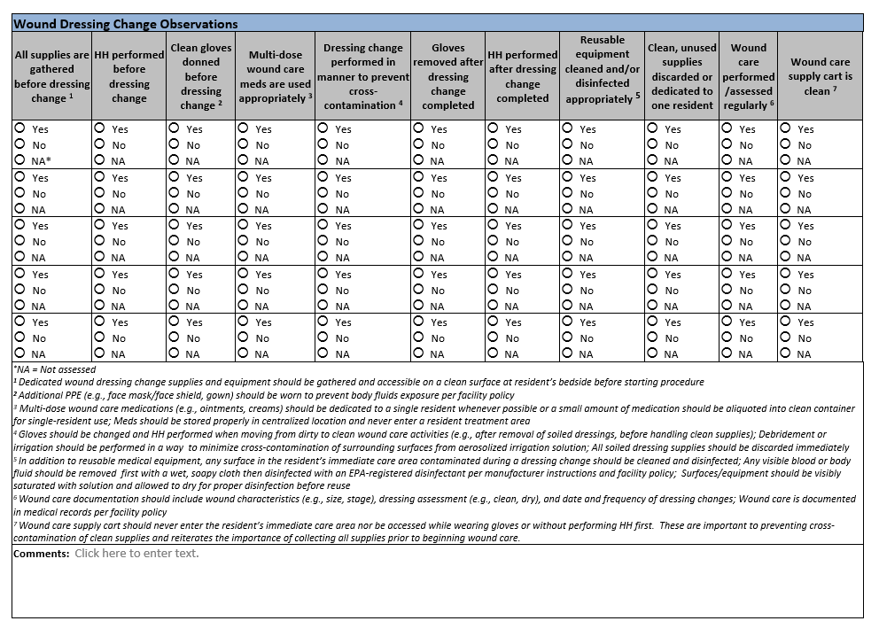
Notes:
Here is a wound care observation tool developed by CDC and adapted by NC SPICE that can be used to cover some of the important things we discussed today about proper wound dressing changes. This can be downloaded at the NC SPICE website, spice.unc.edu

Slide 16
Activity
Notes:
Now that you have completed the presentation portion of our module, we will rejoin our groups from earlier.

Slide 17
Activity: Rearrange the wound care steps to the correct order
Don clean gloves
Dispose of all supplies
Perform hand hygiene
Don clean disposable gloves
Disinfect area where supplies will be placed
Gather all necessary supplies and equipment
Assess wound
Doff and dispose of soiled gloves
Perform hand hygiene
Apply dressing and secure
Remove gloves and perform hand hygiene
Have a trash bag nearby
Remove and dispose of tape and outer dressings
Notes:
Now that you are back in your groups, please choose one person to be a scribe. For this activity, your team will have 5 minutes to rearrange these rules for changing dressings into the correct order. The order you see on the screen is incorrect. Please write the steps in the right order and turn in your team’s submission when you’re done.
Additional resource: https://www.infectioncontrolma.org/docs/How-to-Change-a-Dressing-LTC.pdf-LTC.pdf

Slide 18
Know, Want to Know, Learned (KWL) Chart
Want to Know
Know
Learned
Notes:
Now that we have completed today’s module, we will complete the “Learned” section of the KWL chart. Please share any new information you learned during today’s module. You will have 7 minutes to brainstorm ideas. Please select one representative from your group to share what you all came up with and add your sticky notes to the group chart.

Slide 19

Post-assessment https://forms.office.com/g/iGgaen29fD
Notes:
Please take 5 minutes to complete this post-assessment. All responses will be kept anonymous. https://forms.office.com/Pages/ResponsePage.aspx?id=3IF2etC5mkSFw-zCbNftGZwLhkl927NJtGWhRDsHuapUNVRJTFhWTlZQS0U4RDhKS1BZSlM4TDFKSi4u

Slide 20
Thank you!
infectionprevention@dhhs.nc.gov
Notes:
Thank you for participating in today’s module on wound care and infection prevention! If you have any additional questions beyond today’s session, please feel free to reach out to our team at infectionprevention@dhhs.nc.gov!

Slide 21
Additional Resources
Infection Control Assessment and Response (ICAR) Tool | (CDC) (www.cdc.gov/healthcare-associated-infections/php/toolkit/icar.html) See module 8
Core Infection Prevention and Control Practices for Safe Health care Delivery | CDC (www.cdc.gov/infection-control/hcp/core-practices/index.html)
Recommendations for Disinfection and Sterilization in Health care Facilities | CDC (www.cdc.gov/infection-control/hcp/disinfection-sterilization/summary-recommendations.html)
Demonstrating Wound Care and the Clinician’s Role in Preventing Wound Colonization and Infection | Train PA (www.train.org/pa/course/1125056/details)
Adherence Monitoring Wound Care (PDF) | CDPH (www.cdph.ca.gov/Programs/CHCQ/HAI/CDPH Document Library/AdherenceMonitoring_WoundCare.pdf)

