Slide 1
NCIR Access for Immunizing Pharmacists
NCID registration, accessing the NCIR, patient search, and documenting doses administered.

Slide 2
Current Pharmacy Locations
Unable to log in to NCIR
If your pharmacy is already associated with the NCIR and you are unable to login.
There may be several reasons why.
Follow the steps below:
1. Confirm that your pharmacy administrator has added you as a user
2. Contact the Immunization Branch at 919-707-5595
3. Confirm whether your pharmacy is active or inactive in NCIR
If your location is not active with NCIR we may need a new agreement signed; or there may be other underlying circumstances we will need to discuss.

Slide 3
New Store Openings
New Store Openings Procedures
When a new store opening arises, please complete the following steps:
1. Contact the Immunization Branch at 919-707-5595.
2. Confirm who will be responsible for training the new store.
Either a certified trainer (who has completed the training webinar
offered through the Immunization Branch) or another employee.
3. The pharmacy administrator will be required to take a competency test once you have reviewed this power point presentation.
4. Once they have passed the competency test, they will be given access to NCIR and are then required to train other staff who will be using NCIR.
5. The pharmacy administrator is responsible for activating and inactivating users at their store. It is important to inactivate an employee who is no longer employed at your pharmacy.
*Important: Please do not register for a “Username or User ID” until you have been approved.

Slide 4
The Registration Process
Creating a user id for the NCIR
  Self-register through NCID for a NCIR username (also referred to as a user id)
  Activate your account by entering the 6-digit code, from the email, sent from NCID
  Select and answer the challenge questions to complete your registration
  Give your username to the NCIR Administrator*
Once the NCIR Administrator adds you into the system, you will be able to log in.
  There are two user roles for pharmacies
    Pharmacy Administrator
    Pharmacy Typical User
*NCIR Administrator, the Immunization Branch employee who will add your pharmacy in the NCIR.

Slide 5
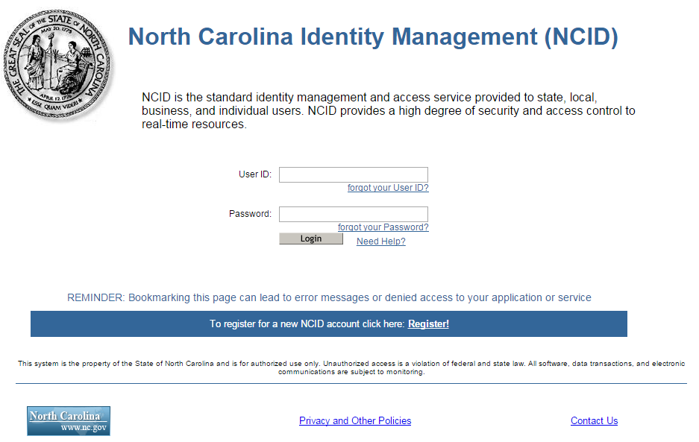
Registration Steps
Go to the NCIR website: https://ncir.dhhs.state.nc.us.
Click on the Register link.
Register
Notes:
Go to the NCIR website: https://ncir.dhhs.state.nc.us
Click on Register

Slide 6
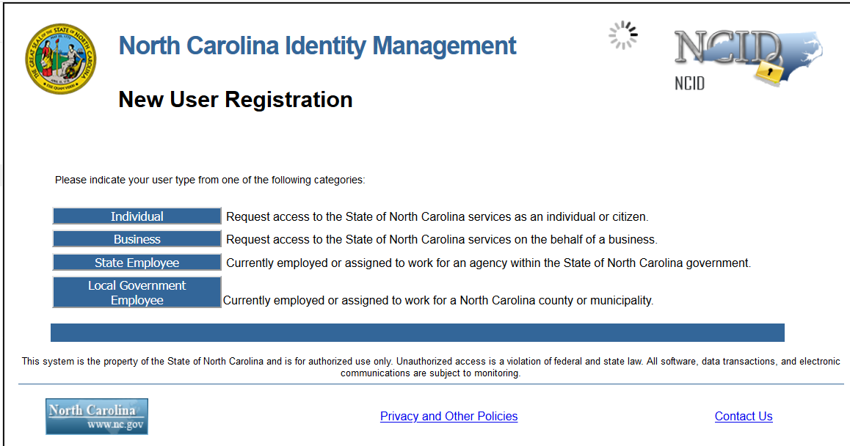
1. Select Business Account
Notes:
Under New User Registration ALWAYS select Business User. Do not register for an Individual Account.

Slide 7
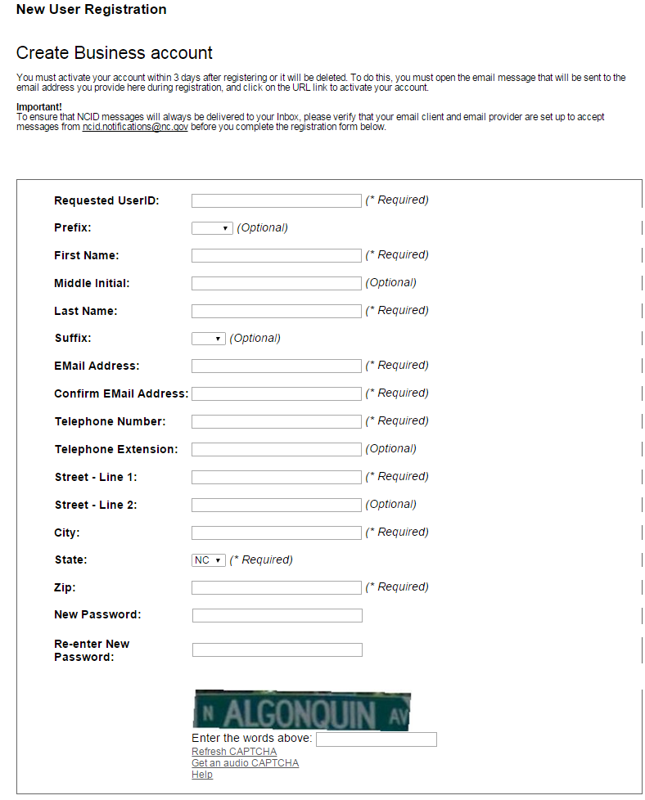

Registration Steps
Complete the new user registration form.
  Use your BUSINESS email, phone, and address.
  If your requested User ID is not available, NCID suggests one for you.
Notes:
Create the username that you want to use. This will always be your username when you log into the NCIR.
When choosing your password make sure that you have at least eight characters, one number, and one special character (ex. !*#@$%^..)
You will have 15 minutes to complete your registration.

Slide 8
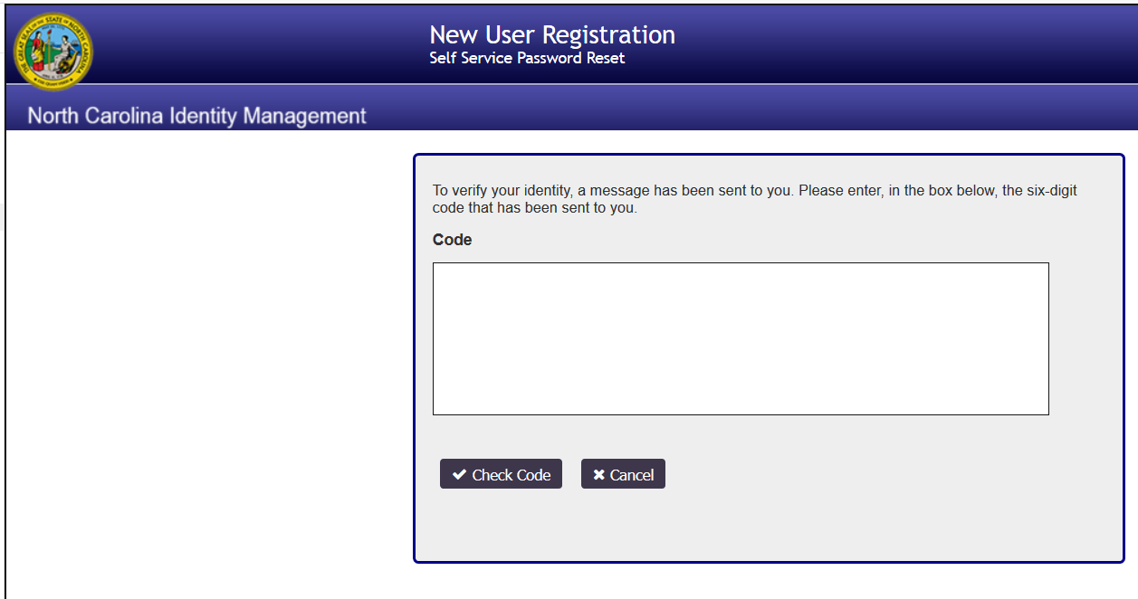
Registration Steps
You will need to retrieve the 6-digit code from your email account.

Slide 9
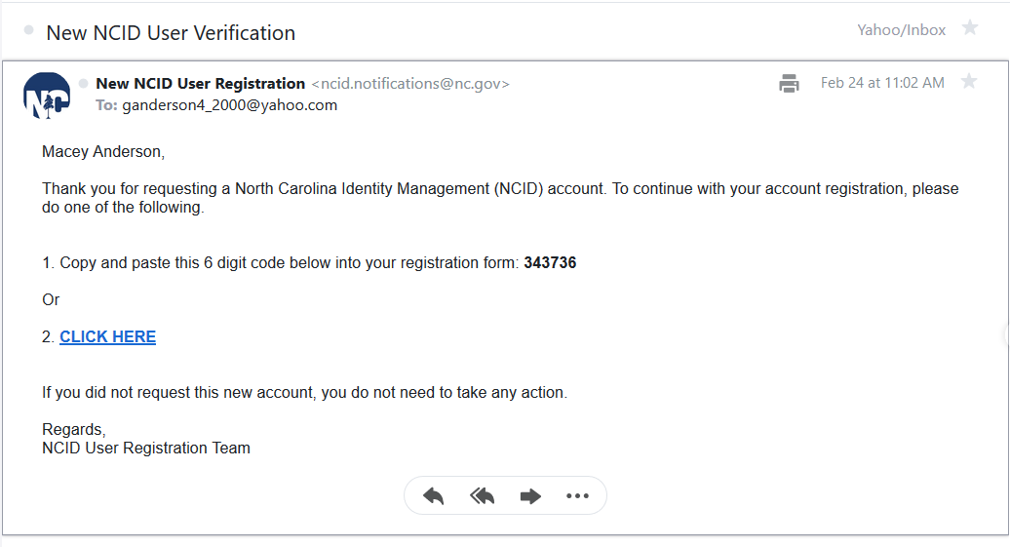
Registration Steps

Slide 10
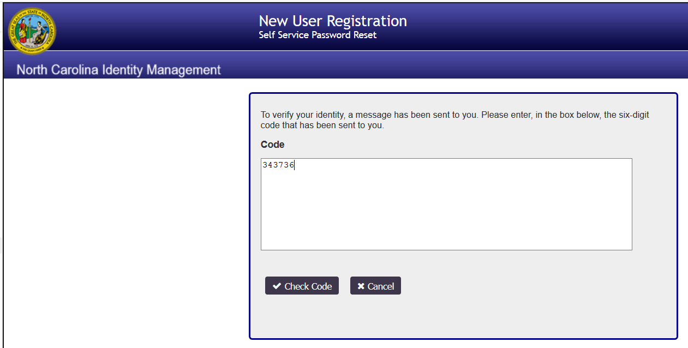
Registration Steps

Slide 11
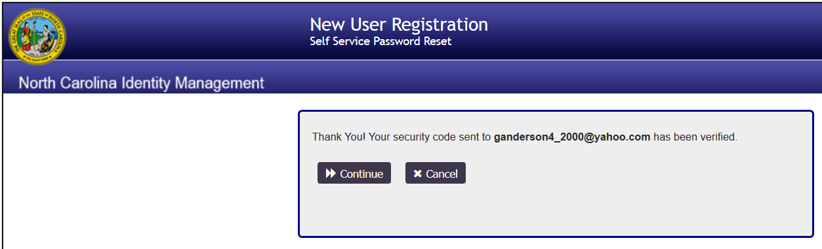
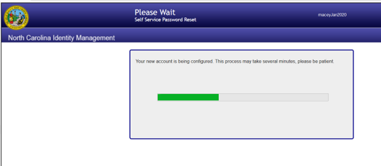
Registration Steps

Slide 12
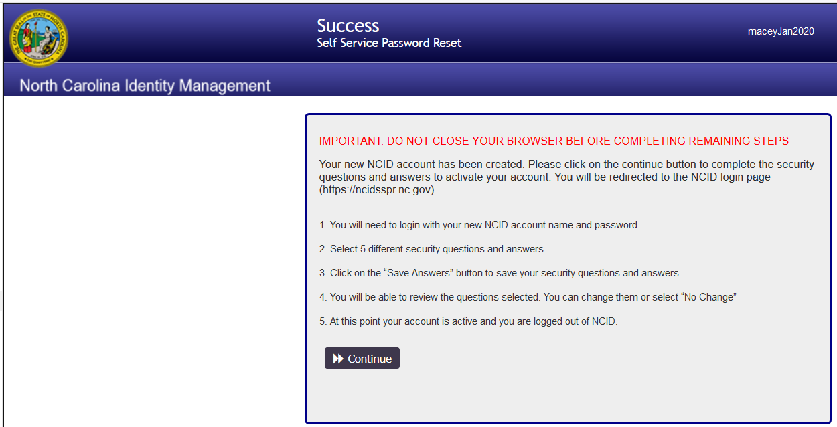
Registration Steps

Slide 13
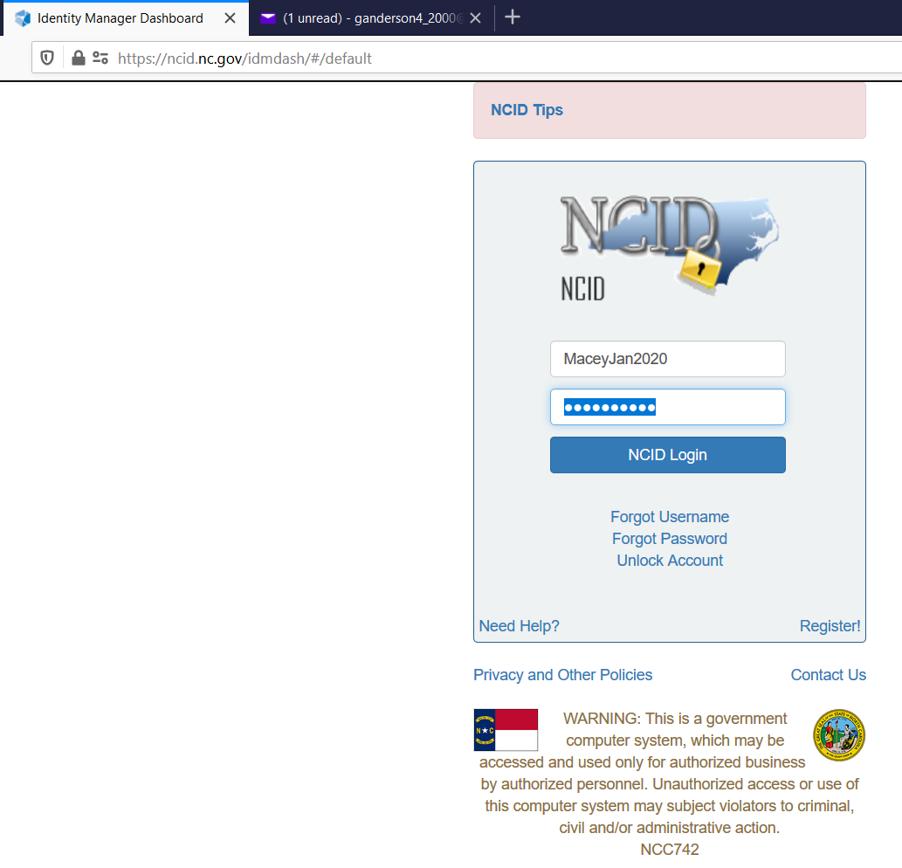
Registration Steps

Slide 14
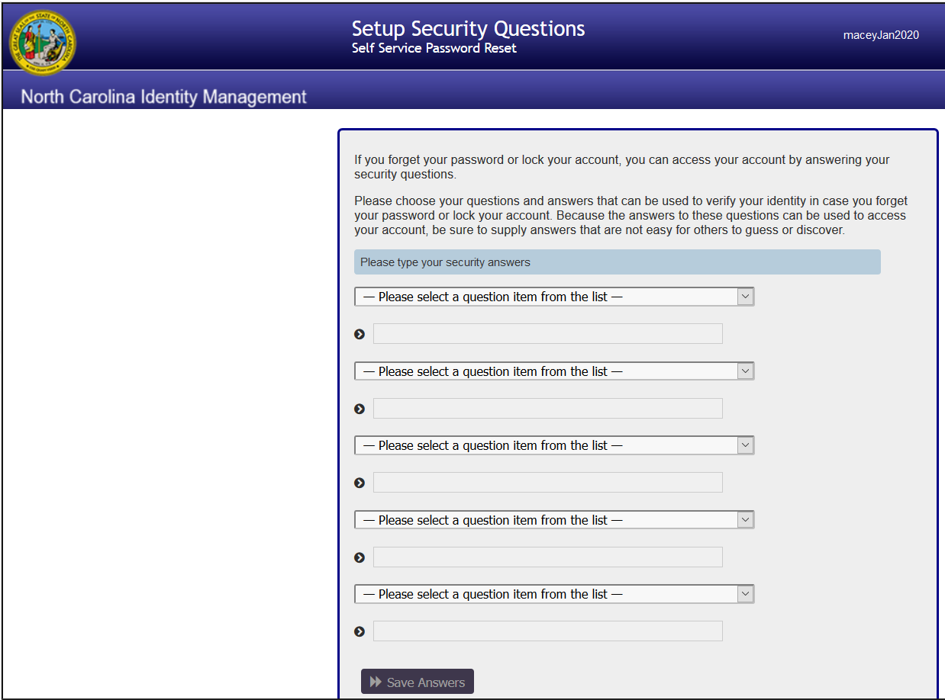
Registration Steps

Slide 15
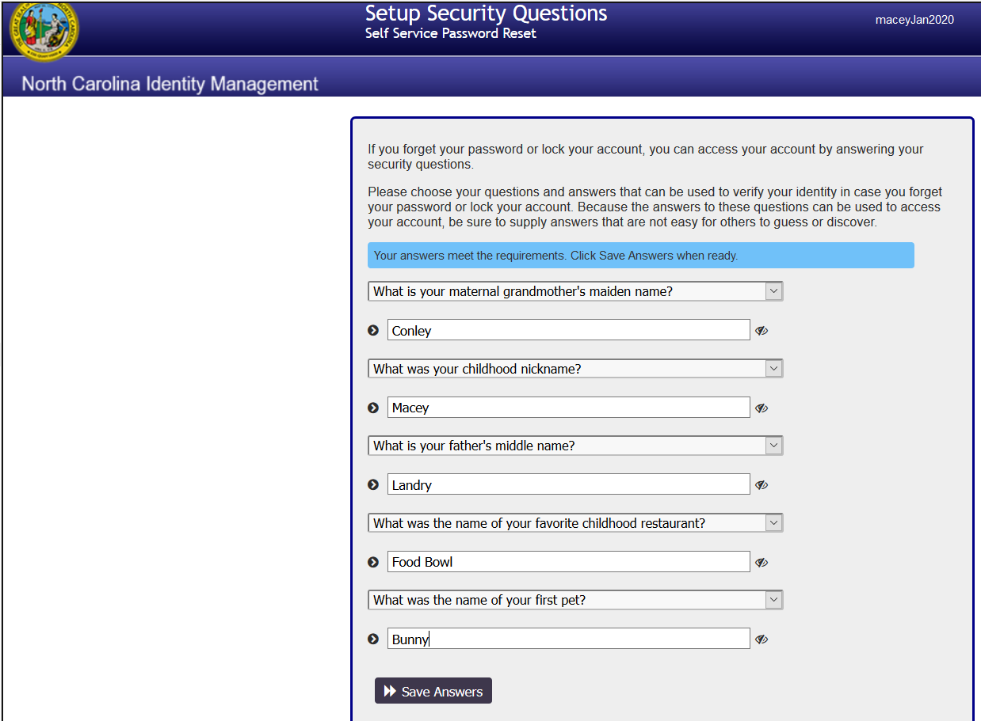

Slide 16
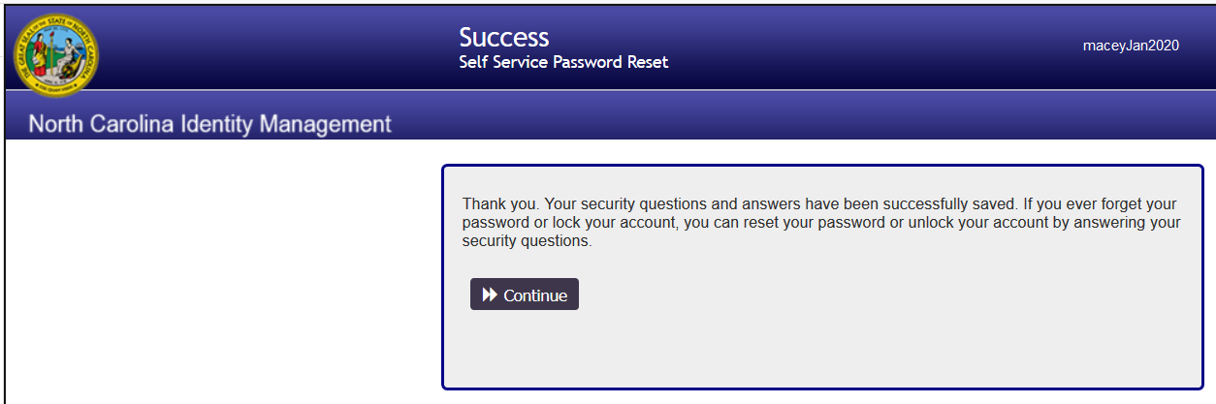
Registration Steps

Slide 17
Registration Steps
Give your user name/ID (not password) to the NCIR administrator, if you are the first person to register.
You will be given the Pharmacy Administrator user role, which gives you the ability to add other employees.
After the NCIR administrator adds you to the system, you have access to go to the NCIR website https://ncir.dhhs.state.nc.us and log in using your user name/ID and password.

Slide 18
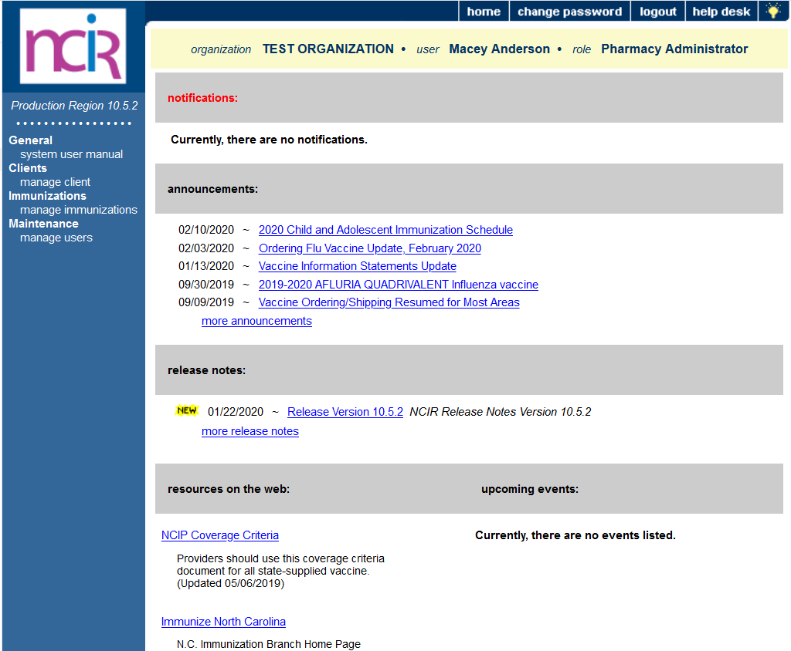
The NCIR Home Page
Your organization name, your name and your user role shown here
Important NCIR announcements
(NEW = unread)
Release notes (details about recent NCIR version updates)
Links to info about upcoming events

Slide 19
Pharmacy User Roles
There are only two Pharmacy User Roles in NCIR
Pharmacy Administrator can:
  Activate/inactivate users
  Switch user roles within the organization
  Enter and edit patient and immunization information
  There should be 2 pharmacy administrators at each location
Pharmacy Typical User
  Enter and edit patient and immunization information

Slide 20
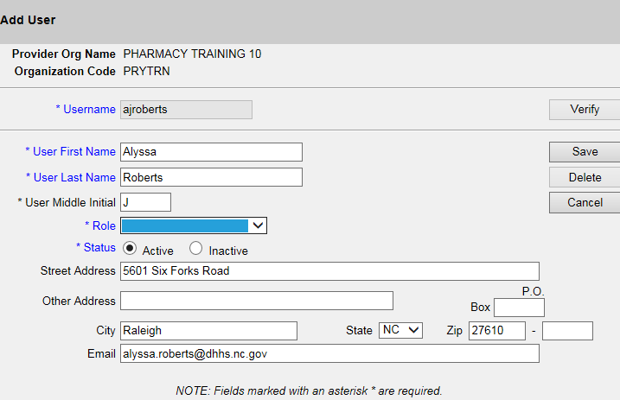
Activating Pharmacy Users
Pharmacy Administrator Role Only
6. A message will appear informing you that the user has been successfully saved.
Under the Maintenance Category, select the “Manage Users” link
Then, select the ‘Add User’ button, which takes you to the ‘Add User” Screen.
3. Click Verify
2. Enter employees’
username
If the Individual created their username correctly, their information should prepopulate below when you click verify.
5. Click Save
4. Select the user’s role: Either a Pharmacy Administrator or a Pharmacy Typical User.

Slide 21
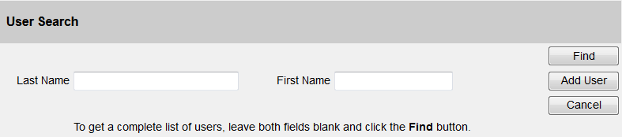
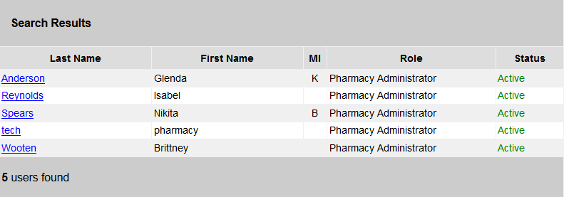
Inactivating Pharmacy Users
Pharmacy Administrator Role Only
Under the Maintenance Category, select the “Manage Users” link.
Then, select the ‘Find’ button, this will generate a prepopulated list of users within your pharmacy.
1.Click Find.
2. A complete list of all users who are both active and inactive will appear below.
3. Select the hyperlink of the employee’s last name, and that will bring you back to the “Edit User” screen.

Slide 22
Look up patients
Click on the manage client link

Slide 23
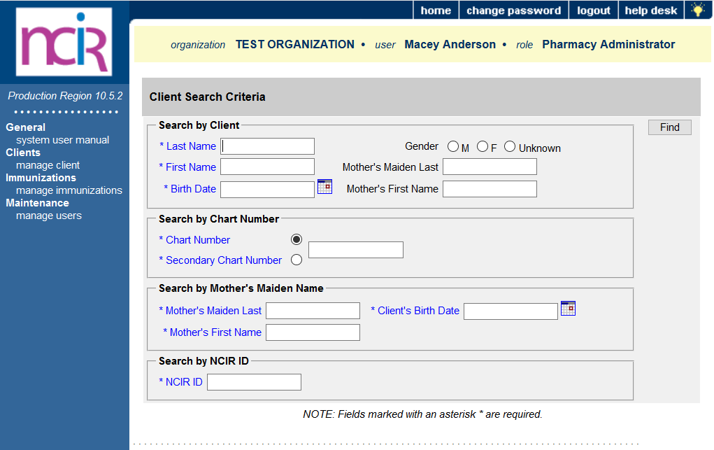
Look up patients
Enter the Last Name, First Name and Birth Date of the patient, click the Find button.

Slide 24
Documenting immunizations
First you must search for the client.
If you have conducted a client search and you receive the following message: “no clients were found for the requested search criteria”. Try searching with less information (i.e., full last name and initial of first name). If your client is not located in the NCIR, then:
You can add the patient into the NCIR by selecting the “Add This Client” button.

Slide 25
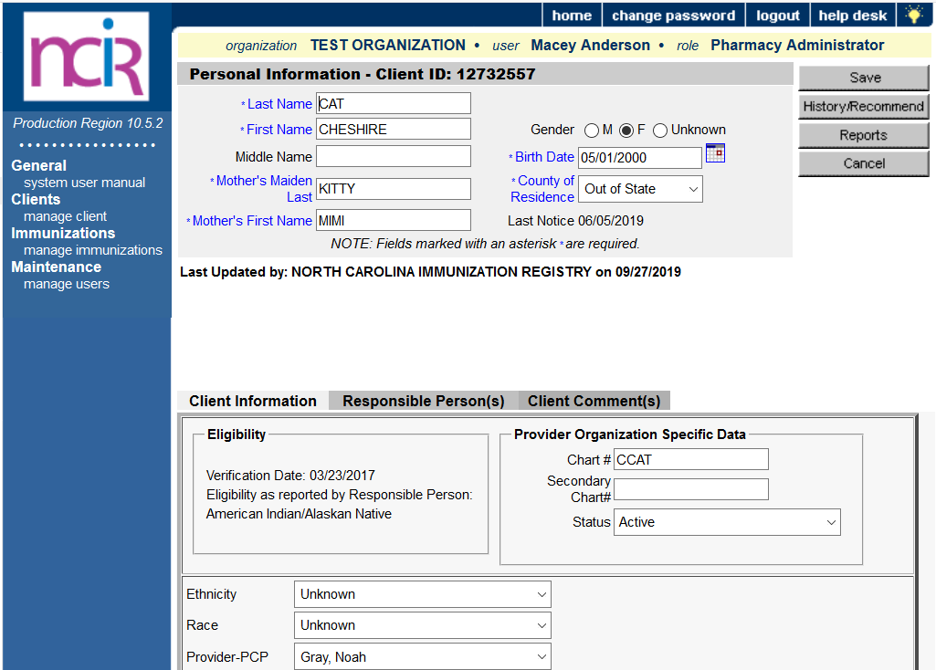
Look up patients
If there is a patient match, you will see the personal information screen.
If there are more than one possible patient match you will see a list at the bottom of this screen.
Look closely at both patients before you make your selection.
That will ensure you choose the correct patient.

Slide 26
Review History/Recommend Screen
To review a patient record click history/recommend
Click the History/Recommend button

Slide 27
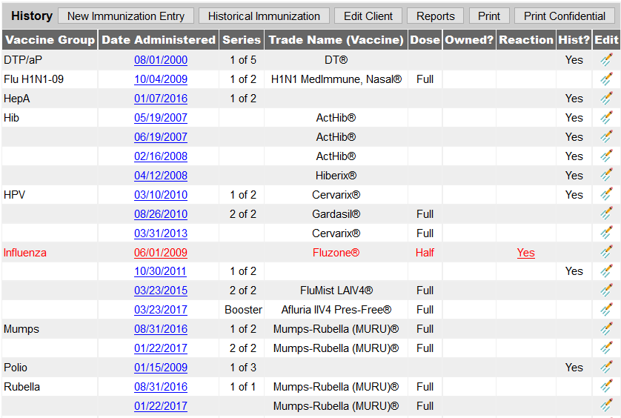
Review History
Example: Documenting Flu shot. Look at last shot administered.

Slide 28
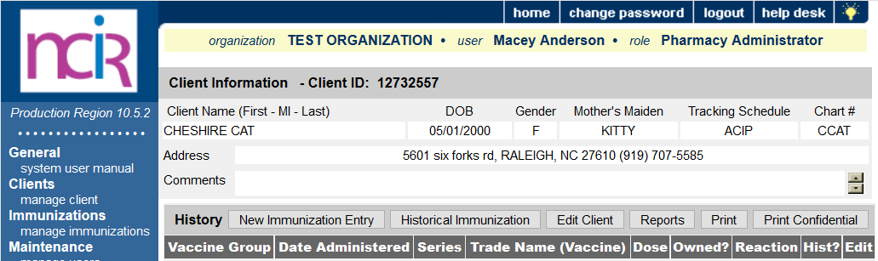
Documenting Dose Administered
Click on the Historical Immunization button.
Below are the vaccines that must be entered into NCIR:
Pneumococcal polysaccharide or pneumococcal conjugate vaccines
Herpes zoster vaccine
Hepatitis B vaccine
Meningococcal polysaccharide or meningococcal conjugate vaccines and Serogroup B meningococcal vaccines
Tetanus-diphtheria, tetanus and diphtheria toxoids and pertussis, tetanus and diphtheria toxoids and acellular pertussis, or tetanus toxoid vaccines
Human Papillomavirus vaccine
Hepatitis A vaccine
Not required to be entered but highly suggested
Influenza vaccine

Slide 29
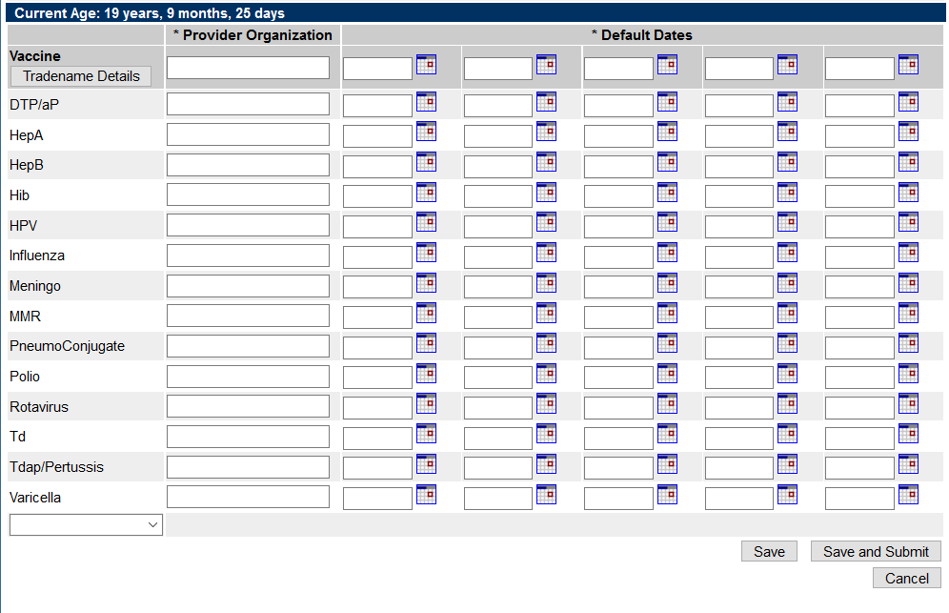
Documenting Dose Administered
If you do not see the vaccine you are trying to add, click the down arrow under Varicella.

Slide 30
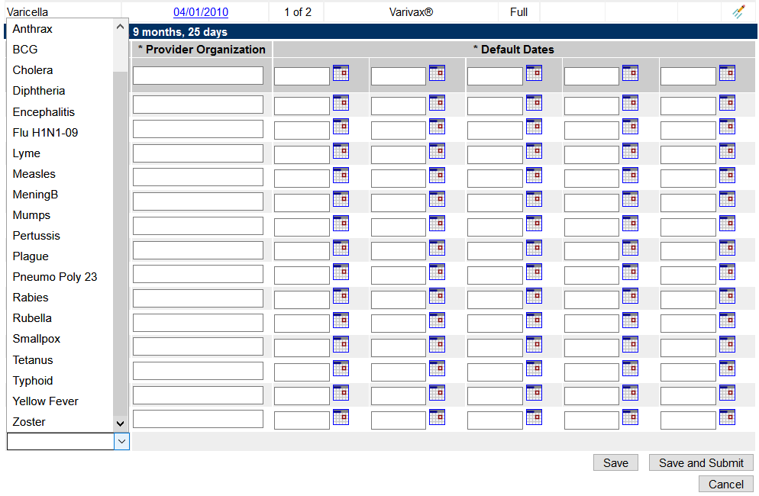
Documenting Dose Administered
You will see a list of additional vaccines you can add.

Slide 31
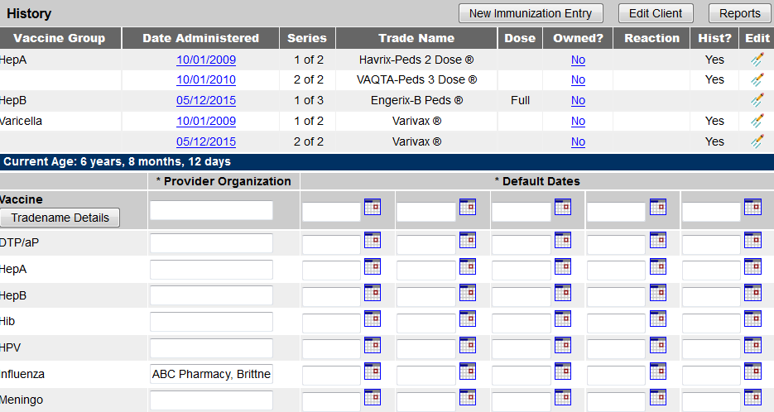
Vaccine Documentation:
Provider Organization Column
Please place the following information within this column:
1. Pharmacy Name & Number (if applicable): ABC Pharmacy
2. Name of Pharmacist who administered the vaccine: Brittney Williams
3. Credentials of Pharmacist who administered the vaccine: PharmD

Slide 32
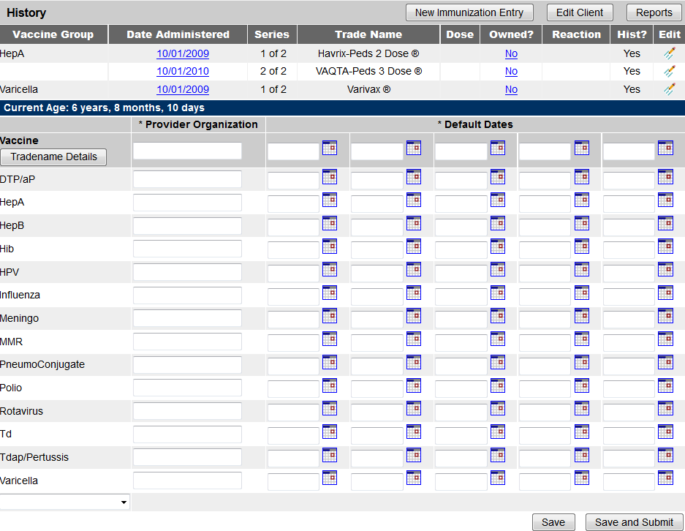
Vaccine Documentation:
Documenting a Vaccine You’ve Administered
5. Don’t forget the Trade Name & Lot Number! Select the “Trade Name Details” button.
Select the vaccine from the Vaccine Group Column.
4. Enter the Date of Administration in the next column.
3. Enter the appropriate information in the Provider Organization Column
If the vaccine is not listed, locate it in the drop-down box below and it will be added to the vaccine group grid.

Slide 33
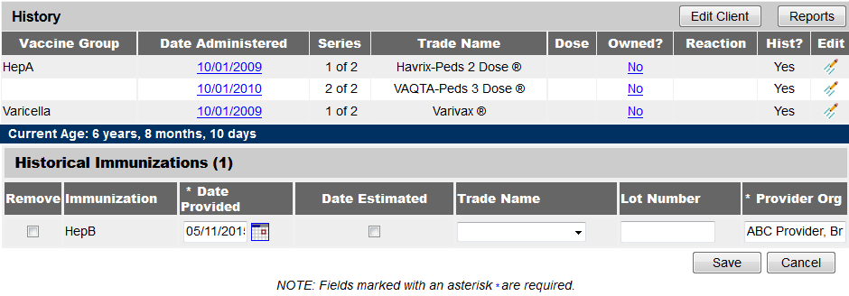
Vaccine Documentation:
Documenting Trade Name and Lot #
7. Document the Lot # from the drop-down box.
6. Select the trade name from the drop-down box.
8. Click SAVE.

Slide 34
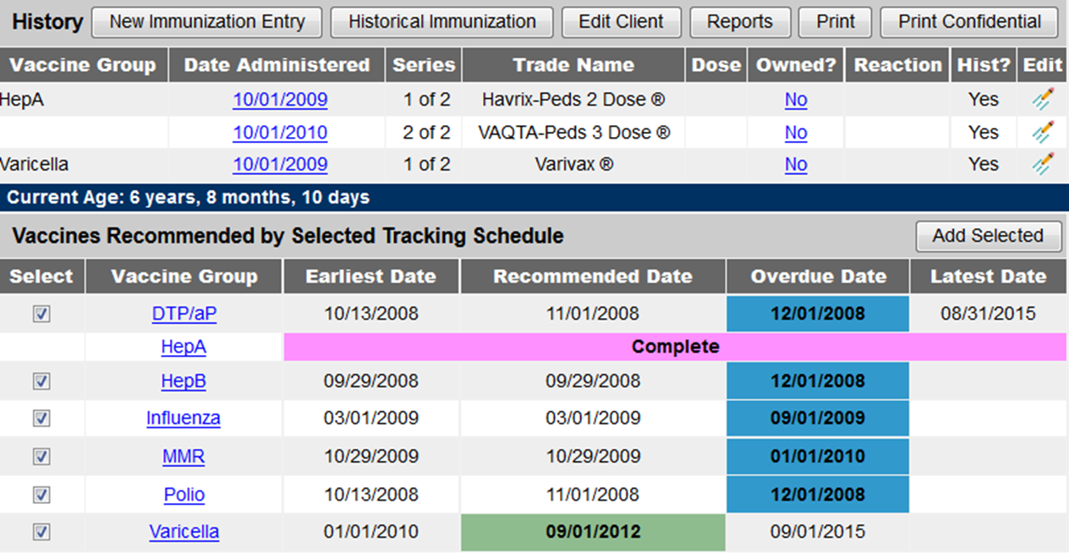
Printing an official immunization record from the History/Recommendation Screen:
To print an official record: click reports

Slide 35
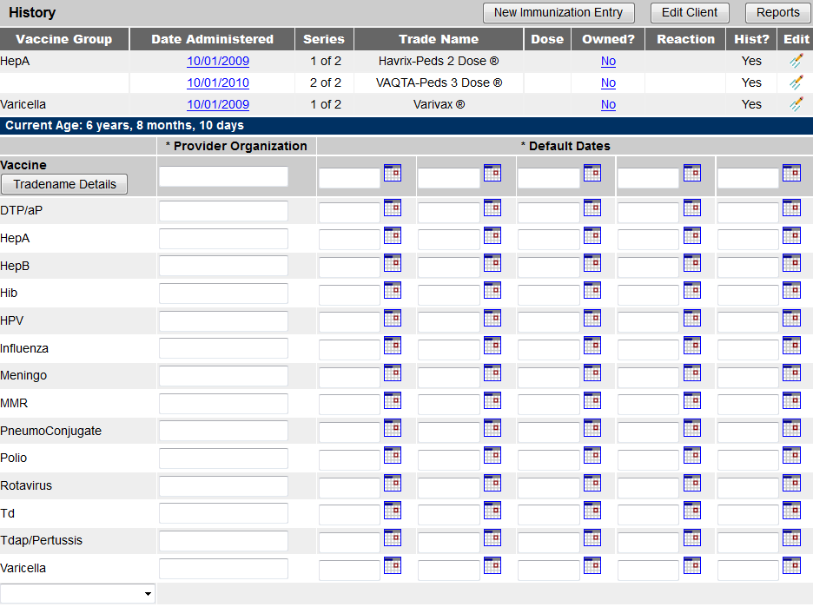
Vaccine Documentation Errors:
Tdap/Td vs. DTaP
DTaP is for a child 6 years old and under!
Tdap/Td is for patients aged 7 years and older!

Slide 36
Vaccine Documentation:
Time between Documentation & Administration
According to House Bill 832:
An immunizing pharmacist who administers a vaccine must also do the following:
  Except for influenza vaccines administered under G.S.90-85.15B(b)(6), access the North Carolina Immunization Registry prior to administering the vaccine or immunization and record any vaccine or immunization administered to the patient in the registry within 72 hours after the administration. In the event the registry is not operable, an immunizing pharmacist shall report as soon as reasonably possible.

Slide 37
Vaccine Documentation:
According to House Bill 388:
  Pharmacists may now administer the influenza vaccine to people 10 years of age and older.
  Pharmacists may also administer vaccines recommended by the Centers for Disease Control and Prevention (CDC) to people at least 18 years of age pursuant to a written protocol to increase access to vaccines in the best interest of the public health of the citizens of North Carolina.
  Pharmacists may administer an influenza vaccine to persons at least six years of age pursuant to a specific prescription order initiated by a prescriber following a physical examination of the patient by the prescriber.

Slide 38
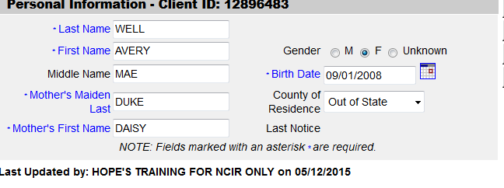
Frequently Asked Questions
1. Can out of state residents be entered into the registry?
Yes, however – if they currently live out of state, please make sure the county of residence selected is “out of state”.

Slide 39
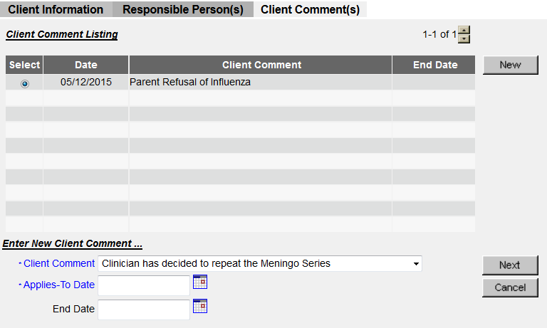
Frequently Asked Questions
2. Is there a place to document declination?
Yes, in the client comments section – there is a drop-down list of items to choose from. Items in this list include things like if the patient has an anaphylactic reaction to a dose or has serological immunity. The patient’s refusal can be documented through these client comments as well. The important thing to note is that an applies to date must be selected.

Slide 40
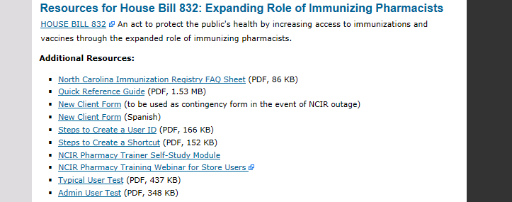
Frequently Asked Questions
3. Does the flu have to be entered into the registry?
Flu is not a required immunization that must be entered into the registry, but the Immunization Branch encourages the documentation of flu.
4. What if I cannot log on to the registry when I give the vaccine?
You are required to have an alternative place to record immunization information in the event that the internet or NCIR is down. The information should then be entered into the NCIR as soon as reasonably possible. New Client Forms are available on our website for this purpose. You may print copies to keep in your store.

Slide 41
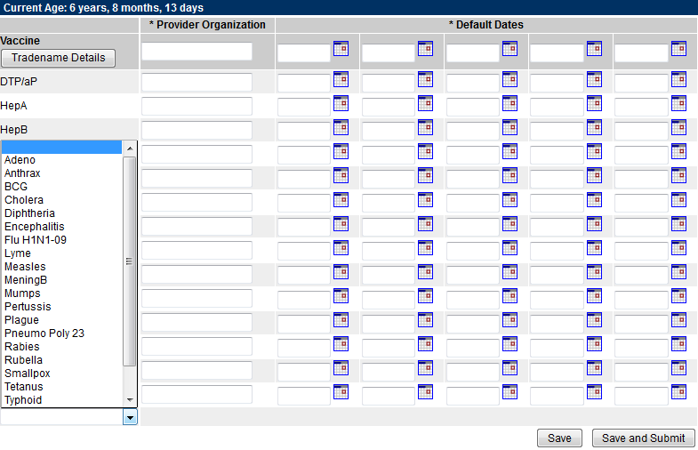
Frequently Asked Questions
5. What if I cannot find the vaccine in the registry?
To enter a dose of vaccine that is not visible in the vaccine column on the grid for entering doses, click on the drop-down menu at the bottom of the column. Select the vaccine. You should now see it listed on the grid and can document the dose.

Slide 42
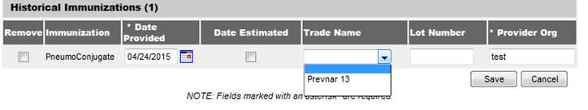
Frequently Asked Questions
6. How do I locate Prevnar in the registry?
Enter the required information (provider organization name, date of administration) in the Pneumo Conjugate line on the historical immunization screen. Then, prior to clicking save, select the Tradename Details button on the top left. This is where you’ll be able to enter the specific Prevnar product used and the lot number information. Here’s a screen shot:
7. Which pharmacies are currently active in the registry?
We have over 1,600 pharmacy organizations using the registry. This includes all of the CVS, Walgreens, Walmart's, Rite Aids, Kerr Drugs, Mutual pharmacies and Independent pharmacies. All of the major corporate pharmacy chains are on and using the NCIR.
8. Which pharmacies are not using the NCIR?
We estimate the pharmacy group still not using the NCIR is the independent pharmacy organizations, many of whom may not even be immunizing.

Slide 43
Frequently Asked Questions
9. If a pharmacy documents the vaccine, they administered in the NCIR, does it fulfill the requirement for them to notify the patient’s primary care provider?
No. Documenting the immunization in the registry does not satisfy this requirement. Pharmacists are expected to use traditional channels to notify the patient’s physician of the immunization.

Slide 44
Reminders
Confidentiality Agreements
All pharmacy employees who have access to NCIR are to sign a User Confidentiality Agreement. These are to be kept in file at the pharmacy in case they need to be reviewed.

Slide 45
Reminders Continued
Pharmacy Administrators are responsible for reviewing a list of current, active users within your pharmacies on the NCIR.
As Pharmacy Administrators are reviewing each user, please verify the following information:
    1. Are they still associated with your pharmacy?
    If not, please deactivate them immediately.
    2. Is there a signed confidentiality agreement on file for each user?
    If not, please have each employee sign a confidentiality agreement. Please keep it onsite at your facility.
    3. Do they have a NC business address listed?
    If not, please have the user update their address provided with a NC business address.

Slide 46
Reminders
Under the Maintenance Category, select the “Manage Users” link
1.Click Find.
2. A complete list of all users who are both active and inactive will appear below.
3. Select the hyperlink of the employee’s last name, and that will bring you back to the “Edit User” screen. Once that screen opens click “inactive” and click save.

Slide 47
Questions?
Contact the Immunization Branch at 919-707-5595

