Slide 1
Managing Clinicians and Physicians
Only for users with an Administrator Role
Notes:
You will need to follow the steps in this presentation to register for a NCID account to access the NCIR.

Slide 2
Managing Clinicians
Clinician information is used to indicate the individuals who ordered and administered an immunization (i.e. Ordering Authority and Administered By).
Clinician information is required when documenting new immunizations.

Slide 3
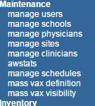
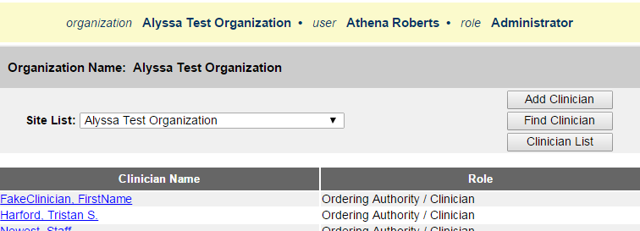
Steps for Adding a Clinician
Select Manage Clinicians from the menu on the left-side panel
Select Add Clinician
Notes:
To correctly enter a shot, you will need to document the ordering authority and the clinician who gave the immunization.
Please Note: Every user who give shots will need to be added as a clinician. Manage Users and Managing Clinicians are two separate entities of the NCIR. Registering as a user does not automatically make you a clinician.

Slide 4
Steps for Adding a Clinician
Select a Role and Credentials
Clinician: An individual who physically immunizes clients (their name will be an option in the ‘Administered By’ pick list when documenting a new immunization)
Ordering Authority is a MD, DO, PA, NP who signs standing orders for patients to receive vaccines (their name will be an option in in the ‘Ordering Authority’ pick list when documenting a new immunization)
Ordering Authority/Clinician is an individual with both of the above roles (their name will be an option in both pick lists when documenting a new immunization)
Notes:
To correctly enter a shot, you will need to document the ordering authority and the clinician who gave the immunization.
Please Note: Every user who give shots will need to be added as a clinician. Manage Users and Managing Clinicians are two separate entities of the NCIR. Registering as a user does not automatically make you a clinician.

Slide 5
Steps for Adding a Clinician
Select a Role and Credentials
‘Ordering Authority’ and
‘Clinician / Ordering Authority’ credentials
‘Clinician’ credentials
An Ordering Authority is an individual who is licensed by the state of North Carolina to authorize the giving of immunizations to a client.
Clinicians can be anyone in the organization who physically gives shots.
Notes:
To correctly enter a shot, you will need to document the ordering authority and the clinician who gave the immunization.
Please Note: Every user who give shots will need to be added as a clinician. Manage Users and Managing Clinicians are two separate entities of the NCIR. Registering as a user does not automatically make you a clinician.

Slide 6
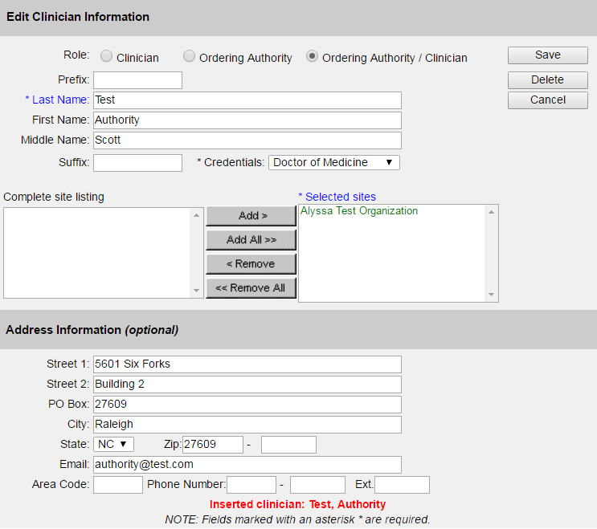
Steps for Adding a Clinician
Complete the identifying information, including address information.
Notes:
To correctly enter a shot, you will need to document the ordering authority and the clinician who gave the immunization.
Please Note: Every user who give shots will need to be added as a clinician. Manage Users and Managing Clinicians are two separate entities of the NCIR. Registering as a user does not automatically make you a clinician.

Slide 7
Steps for Adding a Clinician
Double click on each site (or use the Add button) to move the clinician’s site from the left box into the Selected sites box - there is usually only one site.
Click Save.
Notes:
To correctly enter a shot, you will need to document the ordering authority and the clinician who gave the immunization.
Please Note: Every user who give shots will need to be added as a clinician. Manage Users and Managing Clinicians are two separate entities of the NCIR. Registering as a user does not automatically make you a clinician.

Slide 8
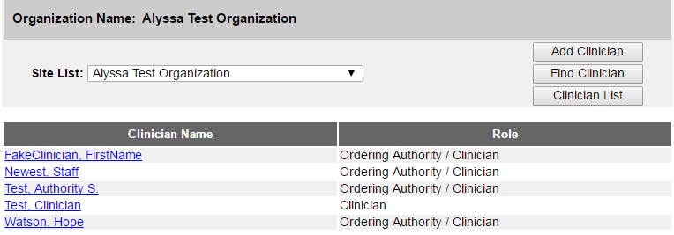
Steps for Editing a Clinician
Select Manage Clinicians
Click on the blue, underlined name of the clinician you want to edit.
Update the information and click Save.
Notes:
To correctly enter a shot, you will need to document the ordering authority and the clinician who gave the immunization.
Please Note: Every user who give shots will need to be added as a clinician. Manage Users and Managing Clinicians are two separate entities of the NCIR. Registering as a user does not automatically make you a clinician.

Slide 9
Managing Physicians
Physician information is used to associate a client with a Primary Care Provider (PCP).
Anyone in an administrator role can link a client to a primary care physician from the Edit Client screen in that client’s record.
In the request reminder (reminder/recall) function, a report can be run to target clients from one specific physician to contact for follow up.
Client Information Tab in Client Record
Associate client with Provider-PCP here
Run reminder/recall for Provider-PCP clients
Reminder Recall

Slide 10
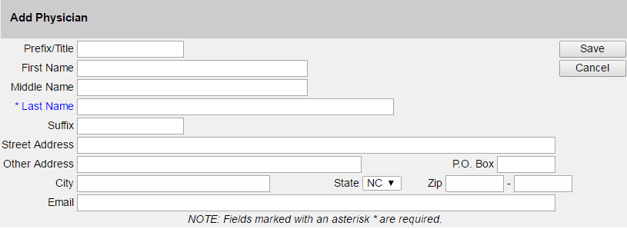
Steps for Adding a Physician
Select Manage Physicians
Select Add Physician
Complete the identifying information.
Click Save.
Notes:
Any physician entered on this screen will be available for selection when assigning a physician as a primary care provider to a particular client within your organization using the Edit Client screen. This is helpful for NCIR functions such as the Reminder Recall (R/R) Report. When running the R/R Report, users may target clients from one specific physician to contact for follow up. Only users with the Administrator role can access the manage physicians screen.

Slide 11
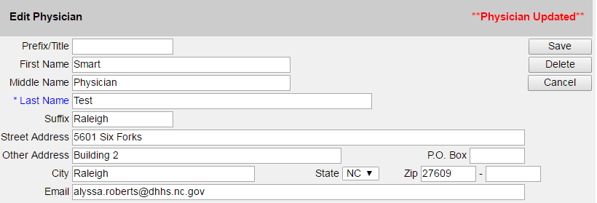
Steps for Editing a Physician
Select Manage Physicians
Click on the physician’s name.
Make all changes.
Click Save.
Notes:
Any physician entered on this screen will be available for selection when assigning a physician as a primary care provider to a particular client within your organization using the Edit Client screen. This is helpful for NCIR functions such as the Reminder Recall (R/R) Report. When running the R/R Report, users may target clients from one specific physician to contact for follow up. Only users with the Administrator role can access the manage physicians screen.

