Slide 1
Managing Users
Only for users with an Administrator Role

Slide 2
Adding New Users
Reminder!
In order to add a user into the system, the user must have successfully registered with NCID and given you their user id (i.e. username).

Slide 3
Provider Responsibilities
Reminder!
The NCIR Agreement requires the following:
Each practice must have at least 2 administrators.
Administrators are responsible for adding new staff and must inactivate users when they leave the practice.
A copy of the User Confidentiality agreement must be kept on file for all staff who access the NCIR.
Every user must have their own user ID (multiple users sharing a single account is now allowed).

Slide 4
Steps for Adding New Users
Select Manage Users from the left-side menu.
Click Add User.
Type in the Username.
Click Verify.
Notes:
If you attempt to add a user who has not registered for a NCID or has not verified their account through email you will see the following message
“Cannot add this user. This user is not defined in NCID.”
If you attempt to add a user who has already been added to the organization, you will see the following message:
Cannot add this user. This user has already been defined in this organization.
Passwords and User names are case sensitive.

Slide 5
Steps for Adding New Users
The system will retrieve the user’s personal information. Confirm that the information is correct
Choose the appropriate user Role.
Click Save.

Slide 6
User Roles
Reports Only
Searches for clients and views/prints client specific records
Typical User
Has all functionality that the reports only role has
Manages (add & edit) clients
Manages immunization information
Inventory Control
Has all functionality that the reports only and typical user roles have
Manages inventory and ordering
Administrator (at least 2 required per organization)
Has all functionality that the other roles have
Manages users, sites, and clinicians
Runs practice-level reports, including reminder/recall

Slide 7
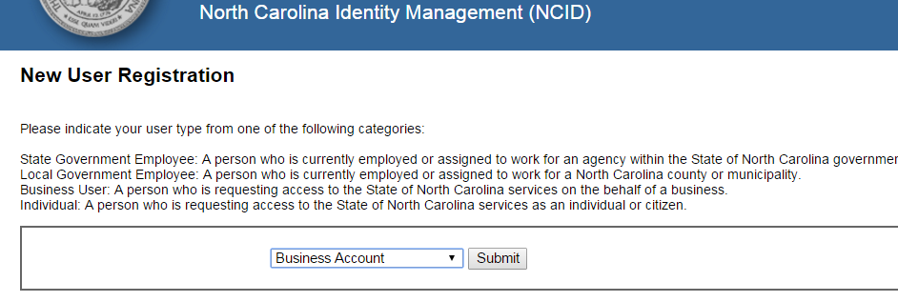
Things to Remember when Adding Users
You cannot add a user who registered for an ‘individual account’ type. You will receive this error message:
The user must re-register for a new account with NCID and select ‘Business Account’ type (*not applicable to LHDs).

Slide 8
Things to Remember when Adding Users
If the user has not registered correctly, has not activated their account through the email link from NCID, or if the user ID you entered was incorrect, you will get an error message.
If you attempt to add a user who has already been added to the organization, you will see the following message:
It is possible that the user is inactive. In that case, you would need to activate instead of add the user.
User names are case sensitive.

Slide 9
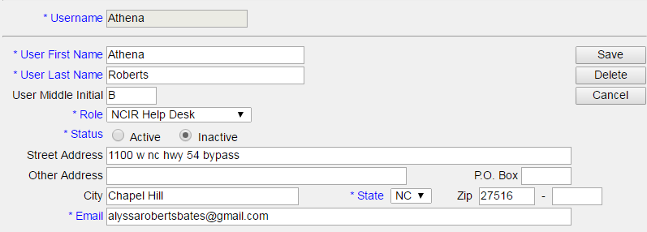
Steps for Editing/Inactivating Users
Select Manage Users from the left-side menu.
Click Find
Select the Last Name hyperlink
Update the user.
To inactivate, change the Status by clicking the ‘Inactive’ button.
Click Save.

