Slide 1
Reporting and Returning Expired Vaccine

Slide 2
Expired Public Inventory vs. Expired Private Inventory
You can modify your expired private inventory on your own.
Expired state supplied inventory must be:
Physically on hand (accounted for) or not physically on hand (unaccounted for), expired/spoiled public vaccine must be documented in the NCIR.
Unaccounted for vaccine must be reported to the Immunization Branch.
Vaccine that is physically on hand must be returned to McKesson.

Slide 3
Expired State Supplied Vaccine
There are 3 possible scenarios:
Vaccine Physically on Hand: vaccine that is physically located at your facility (counter/box)
Vaccine not on Hand: vaccine that is no longer located at your facility
A combination of doses on hand and some that can not be located: Some of the vaccine is physically on hand at your facility and some cannot be located

Slide 4
Scenario 1: Expired Public Vaccine IS Physically On-Hand
Process:
Document the vaccine expired as expired in the NCIR
Wait for the following items:
Wasted/Expired Report that will be emailed from the Immunization Branch with a specific Vaccine Return ID number for your vaccine
Emailed shipping labels from McKesson, these ship the expired vaccine back to McKesson.

Slide 5
Scenario 2: Expired Public Vaccine is No Longer On-Hand
Quick Notes:
The most common reasons for this discrepancy:
Vaccine was administered physically but not documented in the NCIR
An immunization (from an earlier date) was deleted from a shot record and can not be found in the physical inventory
These doses are considered unaccounted doses so please remember to document all doses administered into the NCIR.
THE ONLY THING you need to do is contact the NCIR Help Desk at 877-873-6247 and ask them to remove the vaccine from inventory.
Follow this Process:

Slide 6
Scenario 3: Some Expired Public Vaccine is Physically On-Hand and Some Is Not
Quick Notes:
The most common reason for this discrepancy is that the vaccine was administered but not documented.
Document in the NCIR the expired vaccine you have physically to send back
Call the Help Desk and ask them to remove the remaining unaccounted doses from your NCIR inventory.
Ship the returnable vaccine to McKesson (with required labels)
Follow this Process:

Slide 7
Steps to Document Expired Vaccine
It’s a good idea to count your expired vaccines before you begin the process to document them in the NCIR. This helps ensure that the physical count of vaccines matches what the NCIR reports your facility as having on hand.
Click Manage Transfers, under the Inventory section
Click Manage Transfer

Slide 8
Steps to Document Expired Vaccine
You should get a pop-up for the expired vaccine. Click OK.
Click New Transfer.
Click Transfer All Expired.

Slide 9
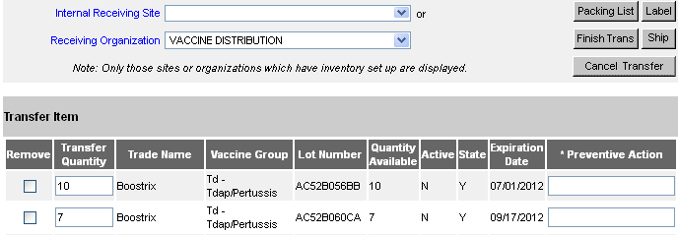
Steps to Document Expired Vaccine
In the Transfer Quantity box, enter the number of doses that you are PHYSICALLY sending back. Make sure this number matches EXACTLY what the NCIR says you have (Quantity Available).
If it matches, move to the next step.
If the numbers DO NOT match call the NCIR Help Desk at 877-873-6247 and ask them to remove the excess doses from your inventory
Enter a Preventive Action (e.g. “Use before expires”).
Quantity Available
Preventive Action
Transfer Quantity

Slide 10
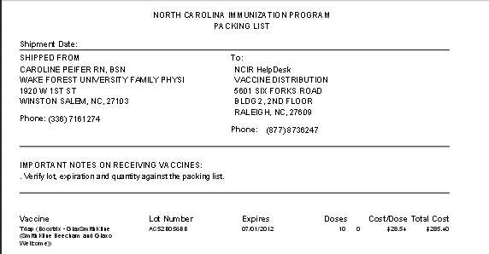
Steps to Document Expired Vaccine
Click Save (and make sure you see the blue “Saved Successfully” message).
Click Packing List.
Print the Packing List. You MUST do this in order to finish the transfer. (This will popup in a separate window, if you have your popup blocker on, click Allow)

Slide 11
Steps to Document Expired Vaccine
Click Ship
Verify ship date (do not change the date)
and Click Ship again.
Look for the “Transfer Successfully Shipped” message (very important!).

Slide 12
After Completing the Transfer
Wait 1-2 business days until you receive TWO emails to help you ship your expired or spoiled vaccine back to McKesson
A Wasted/Expired Vaccine report and instructions email from an Immunization Branch Representative- this form includes a Vaccine Return ID Number that is required to process the return.
A Shipping Label from McKesson- this will also arrive by email
Reminder: ALL State Supplied Expired/ Spoiled vaccines will be returned to McKesson for processing, unless it is an open multi-dose vial (waste on site).

Slide 13
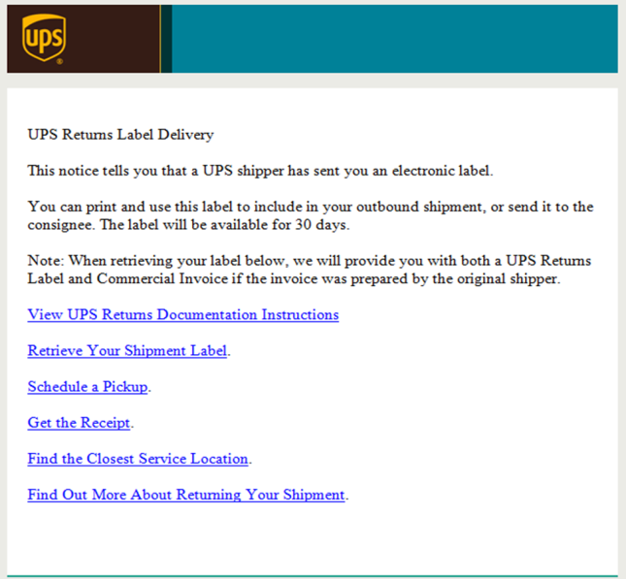
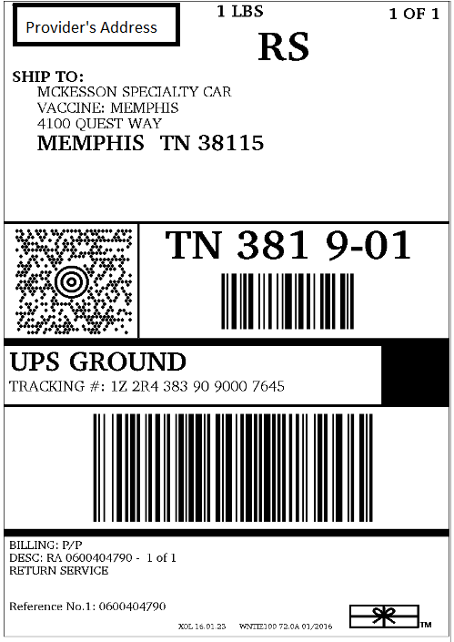
To: Vaccine Shipping Contact
This email is to provide instruction for a new process to return expired state supplied vaccines to McKesson. Please read the instructions listed below carefully and should any questions arise please contact the NCIR Help Desk at NCIRhelp@dhhs.nc.gov
YOU WILL RECEIVE THE FOLLOWING INFORAMTION VIA EMAIL:
1. Wasted/Expired Form (included in this email) with the REQUIRED codes for you to return the expired vaccine to McKesson.
2. UPS Shipping Label email from McKesson (included in separate email- See Below for example)
** If you do not receive this email from McKesson within 1-2 business day please contact the NCIR Help Desk at NCIRhelp@dhhs.nc.gov **
Step 1: Print the Wasted/Expired Form attached to this email and include in the box when the expired vaccines are returned to McKesson.
Step 2: Open the email from McKesson containing the UPS shipping label, click the “Retrieve Your Shipment Label” link to print your return label, and follow the remaining instructions.
The following is an example of the email from McKesson containing the shipping label for your return. This label will be delivered to the same email address as this message was received, within 1-2 business day.
From: McKesson Specialty Care Dist
Sent: Tuesday, March 22, 2016 9:08 AM To: NCIP Provider Subject: UPS Label Delivery, 1Z2R43839090007645
Email containing the shipping labels will look like this, only click “Retrieve Your Shipping Label” link
Emailed Instruction Sheet from the Immunization Branch will look like this
Shipping labels will look like this

