Slide 1
Managing Your Vaccine Orders

Slide 2
Learning Objectives
Navigate through the following screens successfully:
Manage Site Information Screen
Create Order / Modify Order Screens
Manage Order Screen
View Order Screen
View Transfer Screen
Accept Your State Supplied Order
Add/Edit Vaccine Inventory Information Screen
Identify key functionality changes that impact your ordering process.
Notes:
Today, you are going to learn how to successfully navigate through 6 screens that been altered to align with VTrckS:
Manage Site Screen
Create / Modify Order Screen
View Order
View Transfer
Add/ Edit Vaccine Inventory Information Screen.
You are going to be able to Identify the key functionality changes that have impacted your ordering process. The key changes have been identified throughout the presentation.

Slide 3
Manage Site Information Screen
Notes:
We will begin with the changes made on the Manage Site Information Screen.

Slide 4
Manage Site Information Screen
Please Note:
The Contact Name can now be edited from this screen.
Fax # is now a required field.
The Delivery Hours format has changed.
Notes:
There are three changes to this screen:
Those with an Administrator user role will now have the ability to edit (and update) the Contact Name on this screen.
Please be aware that it needs to be the Shipping Contact: The person who is responsible for verifying the vaccine order when it physically comes in.
The Fax Number is in blue - now a required field.
The number included here should be the fax that is most easily accessible within your office.
3. Change in format with the Delivery Hours: It has now been broken down into Delivery Windows 1 and 2.
Notice: the shipping instructions and vaccine delivery are still the same.

Slide 5
Create Order and Modify Order Screen
Notes:
On the next slide you will see an example of the Create Order screen: But please be aware that both screens (Modify Order & Create Order screens) share the same new functionality and overall format changes.

Slide 6
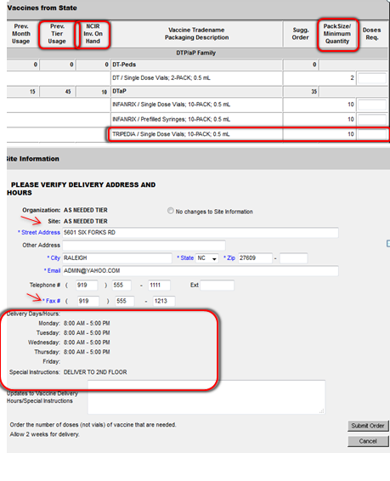
New Create Order Screen
Notes:
The Original Screen (that you’ve been utilizing) is to your left. The new screen w/ highlighted changes is to your right.
Here is a brief overview of the cosmetic changes that have taken place:
Prev. Tier Usage: Change in wording: Your ordering schedule has not been affected – no change.
NCIR Inv. On hand: Chang in wording: Your actual physical inventory on hand should correspond to this
Dose/unit column: Removed completely.
Pack size/Min. Quantity: New addition (right) - will go more in depth on how to use this column when creating an order in a few.
Display of Delivery Hours: The same format change with the manage site screen has been transposed here. The delivery window; delivery hours and special instructions have not changed.
Removal of Contact Name: Will go a little more in depth.
Fax # Added – now required.
Trade name and packaging description format has changed:
The manufacturer was removed.
The trade name, packaging description and dose size display is all on the same order by line item.
It is the most current presentation that is available: this presentation will provide greater clarity on the specific package being ordered to help eliminate confusion.
If you need assistance placing/creating an order. Please contact the help desk and/or your consultant.

Slide 7
Contact Name Removal
The ability to edit a contact name has been removed from the Create Order Screen.
Only NCIR Administrators will be able to change the contact on the manage site screen.
This contact must be the Shipping Contact.
Notes:
As mentioned with the Manage Site Screen earlier: You will no longer be able to change the contact name on the CO screen.
And again: This applies to Administrators only – and it must be the shipping contact (i.e – the person responsible for verifying the order when it comes in).
However, if you are not an administrator and a contact name needs to be changed, inform your admin and have them do it for you.
The Immunization Branch can still see who placed the order for the vaccinations.

Slide 8
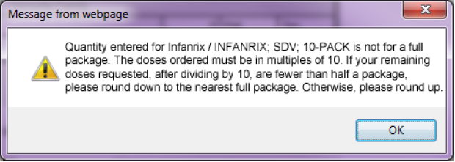
Pack Size / Minimum Quantity Column
Create Order and Modify Order Continued
Please Note:
Packaging descriptions are now provided within each vaccine family.
Within this column, you want to select in multiples of the pack size.
13
10
Notes:
A NEW FUNCTIONAL CHANGE on the CO/MO screens is: The Pack Size / Minimum Quantity Column.
The packaging description will help guide you when placing an order – now all one line item under the vaccine family.
Within this column Example:
Infanxrix/10 dose vial – the pck size/min. quantity is 10. So, you would want to order either: 10, 20, 30, etc doses.
Another example: Order 13 instead of 10
(You will receive the error message pop-up)
When entering a dose, it must be divisible by the minimum order quantity.
The error message will also provide guidance with rounding up or down in regards to your Suggested Order.
For example: Suggested Order Quantity:
For Large Providers: If your suggested order quantity is 98, order 100 doses.
For Small Providers: If your suggested order quantity is 7 order 10 doses.
This error message will help to create a more efficient and accurate order by guiding you when placing an order.
Again: If you need assistance – contact the helpdesk or your consultant.

Slide 9
“No Thanks” Button
Create Order and Modify Order Continued
Please Note:
You now have the ability to say “No Thanks” to a specific vaccine being ordered.
The “No Thanks” button (and error message) will be activated if you do not order a vaccine with a suggested order quantity greater than zero.
Double-check your inventory on hand and make sure that the vaccine is not needed.
You can only order every other month!
Notes:
Another New Functionality is the implementation of the “No Thanks” Button.
Prior to this functionality change, the internal process was that once an order was placed, we would verify that order. If an order item was left blank, then we would call you (providers) to gain more insight on the status of the vaccine (to discover if it was needed).
The implementation of “No Thanks” now allows the NCIR to complete this verification process automatically. It will be up to you to verify whether the vaccine is needed.
So, whether you happen to overlook (and forgot) to enter a vaccine, or you intentionally left that particular field blank; by selecting the “No Thanks” button, that let’s us know that you purposely do not want to order that vaccine.

Slide 10
Manage Order Status
Notes:
Manage Order Status Change

Slide 11
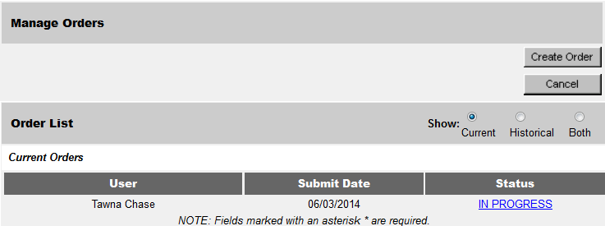
Manage Order Status
Notes:
This is just a follow up in regards to the contact name removal on the create order screen.
On the Mange Order Status Change, you can still view who placed an order for your organization.

Slide 12
Order Statuses
Current Order Statuses:
Pending: The order has not been reviewed by the Immunization Branch. This type of order an still be modified by the Ordering Organization.
In Progress: This indicates the order has been received and is being reviewed by the Immunization Branch. At this status, this type of order can no longer be modified.
Shipped: This indicates all approved order lines have been shipped to the Ordering Organization. At this status, this type of order can no longer be modified.
Cancelled: The order was cancelled by the Ordering Organization. This type of order can no longer be modified, and is considered a historical order.
Partial Ship: This indicates the order was approved and exported to CDC. The order remains in this status until shipments are received for this order. At this status, this type of order can no longer be modified.
Denied: This indicates the entire order was denied by the Immunization Branch. Please see the comments at the top of the view order screen for more information. At this status, this type of order is not submitted for processing, can no longer be modified, and is considered a historical order.
Notes:
Please be aware that the functionality has not changed.

Slide 13
Order Statuses
On Hold: This indicates the order is being reviewed by the Immunization Branch and has been placed on Hold. The order will remain in this status until it is either Denied or Approved. Please see the comments at the top of the view order screen for more information. At this status, the order can no longer be modified.
Sent to CDC: This indicates the order was approved and exported to the CDC. The order remains in this status until shipments are received for this order. At this status, this type of order can no longer be modified.
Approved: This indicates the order has been reviewed and approved. At this status this type of order can no longer be modified.
Notes:
And to introduce 3 new additional statuses:
Due to these new status changes: We highly encourage and recommend that you to check your order status regularly to stay up to date with the process of your order.
To view these statuses:
You can check your status by clicking on the manage orders link. From there, you will see the blue link on the right hand side. (as indicated within the screenshot below).
Are there any questions?

Slide 14
View Order Screen
Notes:
Next…

Slide 15
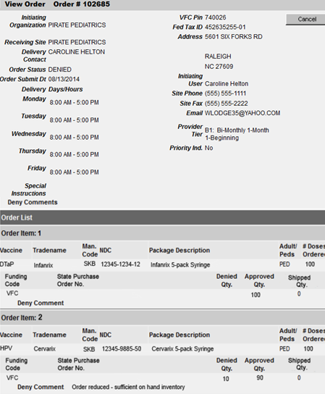
View Order Screen
Notes:
Cosmetic Changes:
VFC Pin
Order #
Fax #
Provider Tier #: again – no change in your ordering schedule.
Display format of Delivery Hours: has been transposed on the VO screen as well.
Below: “Funding Code”, “NDC” & “Adult/Peds” categories: This is utilized by help desk staff for documentation purposes - not a concern for you.
Two main items on the VO to focus on is the:
Ordering Status
Deny Comments: In regards to the “denied” and “on hold” statuses: which I will be reviewing next!

Slide 16
Denied Order Status and Comments
There are two possible ways that a “deny comment” would exist:
The entire order has been denied.
An individual item (i.e a order quantity of a vaccine) has been denied.
Notes:
To provide more clarity, I am going to walk you through an example of each of these possible scenarios.

Slide 17
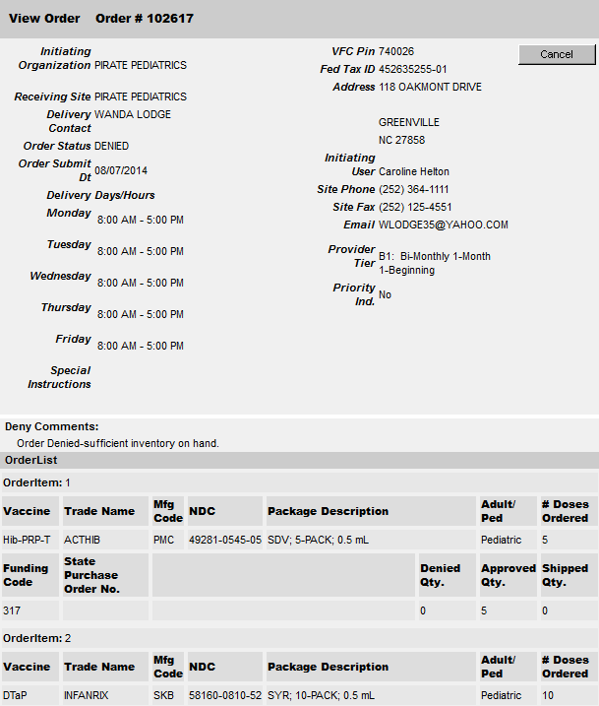
Example: An Entire Order is denied.
Denied Order Status and Comments Continued
When an entire order is denied, the following comments will be listed:
Out of compliance for more than 2 weeks, a new order must be submitted.
Providers would be considered out of compliance when they are not meeting the requirements for the NCIP Program.
Order Denied – sufficient inventory on hand.
Notes:
First Scenario : An entire order is denied.
The following comments will be listed: As indicated in the screenshot to the right:
Order Status: Denied
Deny Comment: Order Denied due to sufficient inventory on hand.

Slide 18
Example: An Individual Item is denied.
Denied Order Status and Comments Continued
Possible comments for a individual item being denied:
Order reduced – sufficient on hand inventory.
Order Reduced - limited vaccine supply
Out of stock – vaccine not currently available.
Order split to accommodate funding sources.
Not available for your current enrollment population.
Order on hold – contact the NC Immunization Program at (877)-873-6247.
Presentation not available – a substitution has been made.
Notes:
Second Scenario: An individual Item is denied.
The possible comments could be listed when an individual order item is denied:
Example:
If you notice on the right hand side with the screen shot (under Order Item # 2):
You now have the ability to review your status (via Order Status) and then review the reason of why your order was placed within this status.
Please check the status of your vaccine order. (You can by selecting the manage orders link, and selecting the link in blue on the right hand side).

Slide 19
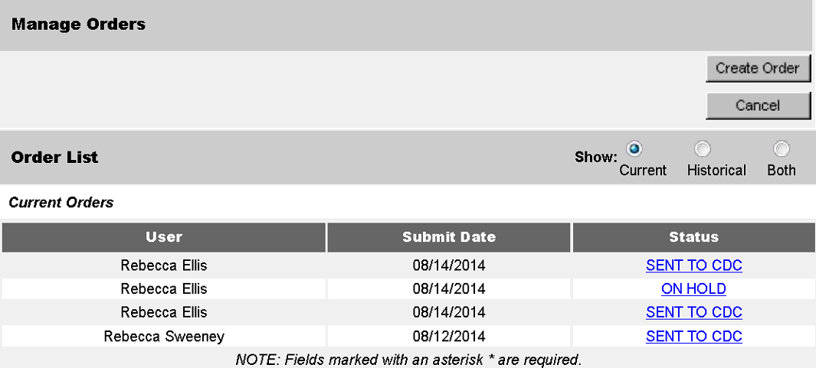
On Hold Status
Possible On-Hold Status Comments:
Order on hold until temperature log submitted.
Order on hold until inventory is submitted.
Order on hold until a current Provider Enrollment Agreement is submitted.
Order on hold until current temperature incident has been resolved.
Please contact the NC Immunization Program at (877)-873-6247.
Temporarily suspended from the NC VFC program.
Notes:
On Hold Status: The Immunization Branch recommends that you check you order status at least 24 hours after submission.
If you notice that your order has an “on hold” status, check the possible reason why.
Then, at your earliest convenience - attempt to resolve the issue (i.e – submit your temperature log, send in your provider enrollment agreement), and this will allow your order to continue through the normal ordering process.
We understand that you’re schedules are very hectic – and if you do not have the time to try to resolve the issue after noticing that your order is on hold, please call the help-desk for assistance.

Slide 20
View Transfer Screen
Notes:
Next View Transfer!

Slide 21
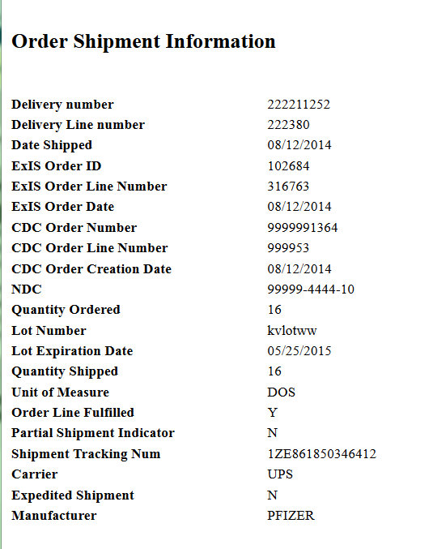
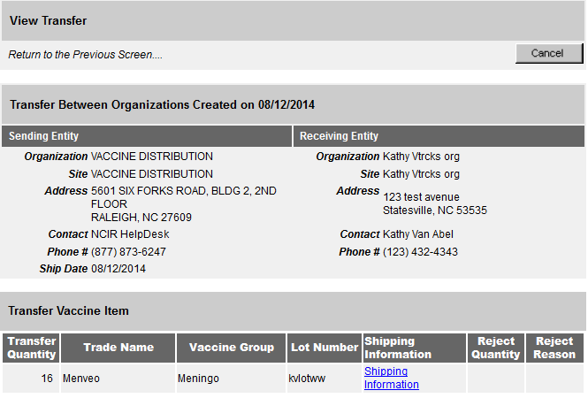
View Transfer Screen
Providers now have the ability to track their vaccines being shipped and will be provided a tracking number.
Notes:
There are no cosmetic changes here!
From the View Transfer Screen you can now view the shipping information (i.e tracking number) for your orders.
Please be aware: The View Transfer screen is only available for: shipped and partial shipped orders.
You will not see the button to view transfer with any other statuses other than: shipped and partial shipped statuses.

Slide 22
View Transfer Screen Continued.
Instructions to reach the “View Transfer” Screen.
From the Manage Orders screen, you would want to select your order with a “shipped” or “partial shipped” status.
Next, select the “View Transfer” button at the top, right-hand side.
Click the “Shipping Information” link under the Shipping Information column.
Notes:
Just a review on how to properly navigate to the View Transfer screen on the NCIR:

Slide 23
Accept Your State Supplied Order

Slide 24
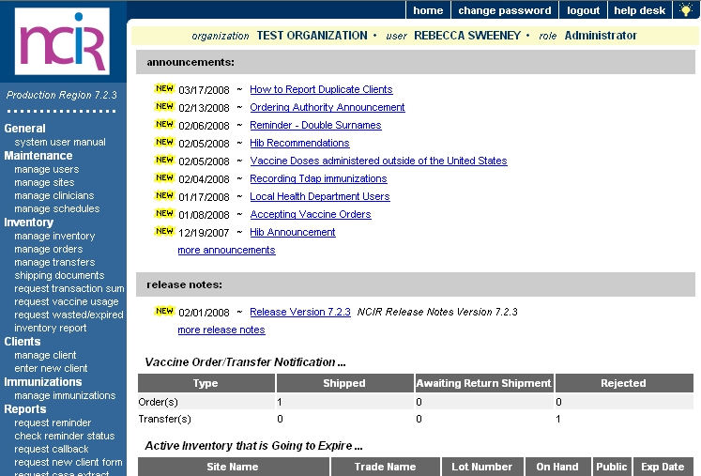
How to accept your state supplied order
When you place a state supplied order through the NCIR, you will be able to accept it straight into inventory. In order to do this, the Immunization Branch sends the order as a Transfer from our inventory to yours. So, to accept your order you will need to go into your transfers. Let’s see!
Click on Manage Transfers
Notes:
How to accept your state supplied order
When you place a state supplied order through the NCIR, you will be able to accept it straight into inventory. In order to do this, the Immunization Branch sends the order as a Transfer from our inventory to yours. So, to accept your order you will need to go into your transfers. Let’s see!
Click on Manage Transfers

Slide 25
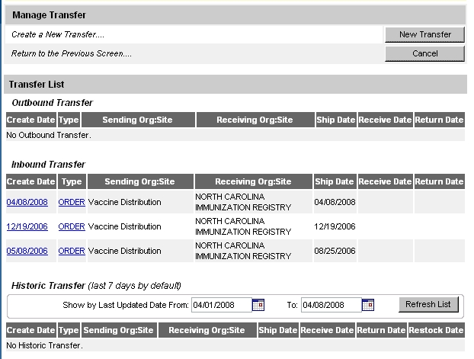
Find your order under the Inbound Transfers.
Click on the Create Date in blue. This is going to take you to where you can view your order.
Notes:
Find your order under the Inbound Transfers.
Click on the Create Date in blue. This is going to take you to where you can view your order.

Slide 26
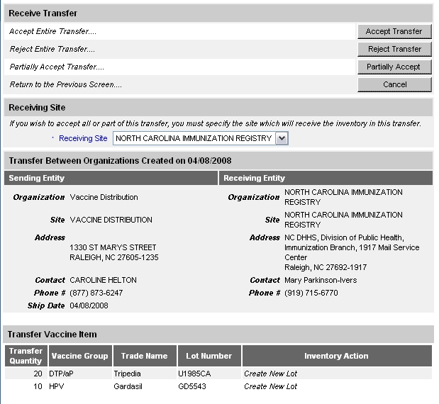
If your invoice matches the NCIR order then you can accept it straight into your inventory by clicking Accept Transfer.
Accept the transfer and it will be loaded into your inventory
Before you reject or
partially accept your
transfer you must
call the Help Desk for
assistance.
When you click Accept Transfer you will see a pop up message like below.
Click OK
You will see your order at the bottom of the screen. You must verify that these lot numbers and amounts match what you have on your invoice from the vaccine shipping box. If they do not match, please call the Help Desk at 877-873-6247
Notes:
You will see your order at the bottom of the screen. You must verify that these lot numbers and amounts match what you have on your invoice from the vaccine shipping box. If they do not match, please call the Help Desk at 877-873-6247
You can Accept the transfer and it will be loaded into your inventory. Before you reject or partially accept your transfer you must call the Help Desk for assistance.
If your invoice matches the NCIR order then you can accept it straight into your inventory by clicking Accept Transfer.
When you click Accept Transfer you will see a pop up message like below.
Click OK

Slide 27
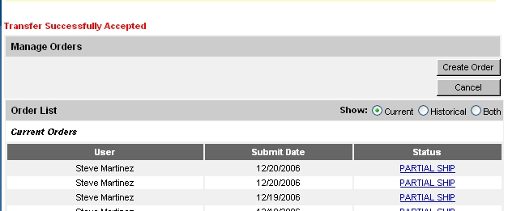
When you have successfully added your order into your NCIR inventory then you will see the message below in red. You can double check to make sure your inventory is in the NCIR by going back to Manage Inventory and then clicking Show Inventory.
Notes:
When you have successfully added your order into your NCIR inventory then you will see the message below in red. You can double check to make sure your inventory is in the NCIR by going back to Manage Inventory and then clicking Show Inventory.

Slide 28
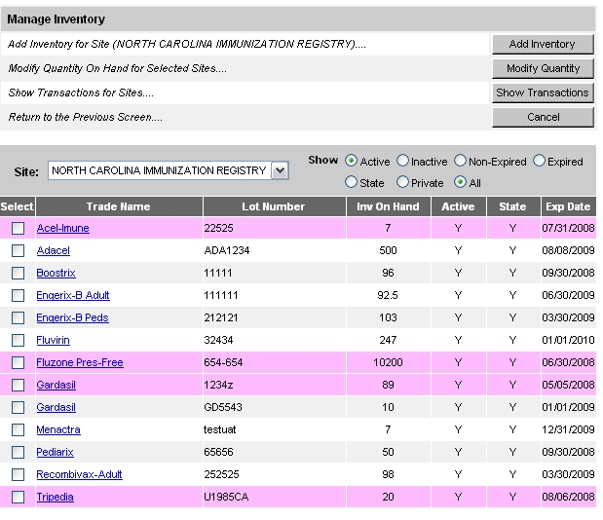
You can verify the vaccine has been entered into NCIR inventory.
Notes:
You can verify the vaccine has been entered into NCIR inventory.

Slide 29
Add / Edit Vaccine Inventory Information Screen
Notes:
The final set of changes applies to the Add/Edit Vaccine Inventory Information Screen.

Slide 30
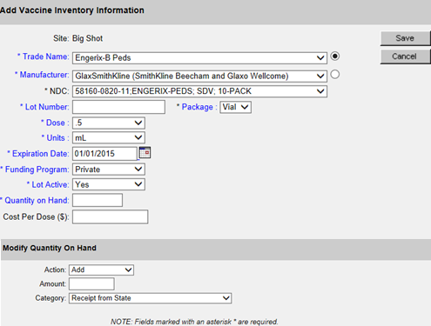
Add/Edit Inventory Screen
Notes:
Another new Functionality is the addition of the NDC Number.
When a NDC is selected, it will prepopulate the: package, dose size and units.

Slide 31
NDC Number
What is a NDC?
It is the National Drug Code; a universal product identifier for human drugs.
Notes:
The NDC is broken down within three segments:
The labeler code (assigned by the FDA): Identifies any firm that manufactures/distributes the drug.
The product code: Identifies a specific strength/dosage form..
The Package code: Identifies package sizes and types.

Slide 32
Notes:
There are 3 particular places where to locate the NDC:
The right NDC to utilize (that is also documented within the NCIR) – would be the NDC on the vaccine package box.
Next, let’s take a closer look on how the NDC has impacted private inventory functionality.

Slide 33
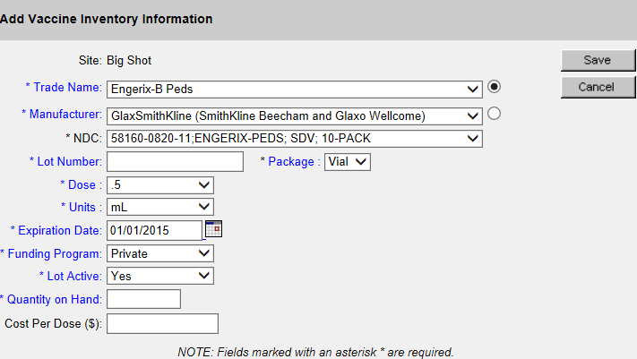
Adding/ Editing Private Vaccine Inventory Information Screen
The following has been implemented for Private Vaccines.
When a NDC is entered, it will prepopulate the following:
Doses
Units
Package
Notes:
Make sure to continue to enter the Cost Per Dose as this will not be pre-populated.
As for state vaccine inventory: Once again you will never have to enter a state-supplied vaccine due to the changes implemented within the registry.

Slide 34
Thank you!
Questions and or Concerns?

