Slide 1
Reporting Wasted Vaccine
This presentation applies ONLY to state supplied vaccine

Slide 2
Process for Reporting Wasted Vaccine
There are 2 steps to correctly reporting wasted state supplied vaccine when using the NCIR:
Document wasted vaccine in the NCIR by subtracting the doses from inventory and providing a reason and preventive action.
Complete the wasted/expired form and send it to the Immunization Branch, only if you do not use the registry to document vaccines.

Slide 3
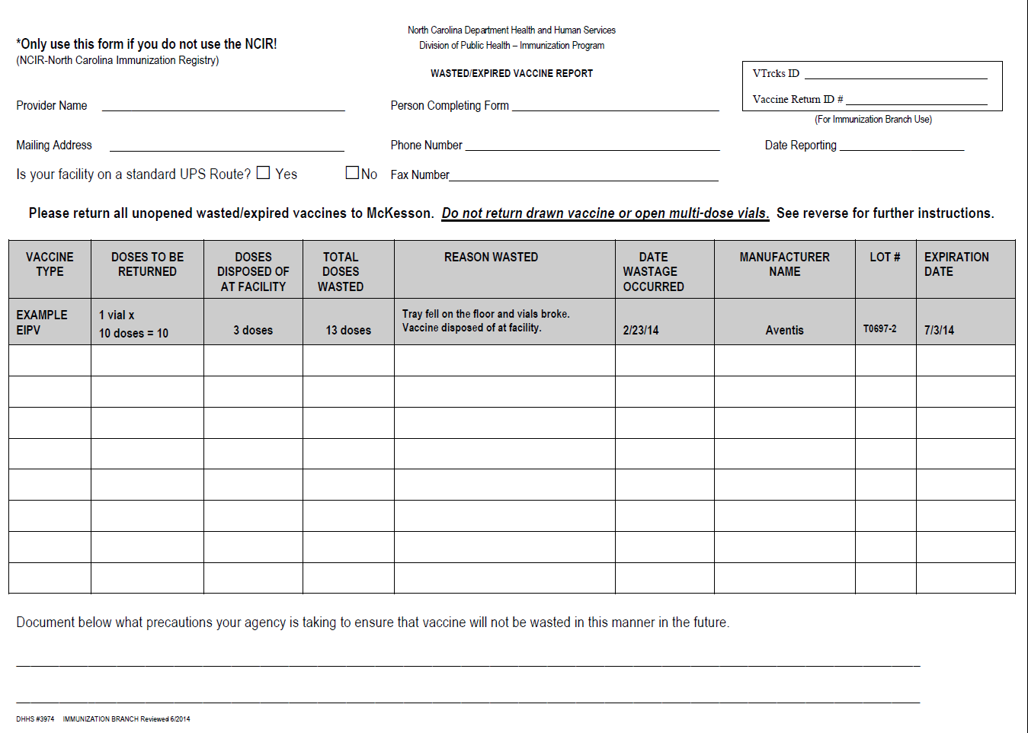
Non-NCIR Users Reporting Wasted Vaccine
If your site does not use the registry to document vaccines, you will need to complete a wasted/expired vaccine report which can be found on the website
http://immunize.nc.gov/providers/ncip/pdf/vaccine_wasted_form.pdf

Slide 4
Steps to Document Wasted Vaccine
Click Manage Inventory.
Click Show Inventory.
Notes:
Start by clicking Manage Inventory.
Click Show Inventory
If you have private expired vaccine when you click to go to another screen, you will get a similar warning message. This let’s you know that you have vaccine that needs to be removed. Click OK to remove the expired vaccine. If there is private expired vaccine in NCIR inventory, a pop up will display when moving between screens. This pop up will appear until the expired vaccine is removed.
2. Click Show Inventory.

Slide 5
Steps to Document Wasted Vaccine
Click on the State or Private radio button to display only state or private vaccine.
Find each Trade Name and Lot Number for the vaccine that was wasted.
Click the Select box next to the vaccine so the check appears.
Click Modify Quantity.
Note: Instead of steps 6-7, you can also click the blue Tradename to modify each Trade Name/Lot Number individually.
Y = Yes (i.e. state vaccine)
Notes:
3. From here, you want to click on the Expired radio button and this will display all your expired vaccine, both State and Private. By then clicking on the Private radio button, we will be able to bring up just the privately purchased expired vaccine.
4. Find the vaccine that needs to be removed.
5. Select the vaccine by clicking in the Select box next to the vaccine you want to remove until you see a green check mark. You can also click click the blue Tradename to modify each Trade Name/Lot Number individually.
6. Once you have selected the vaccine to remove, you need to click Modify Quantity and this is going to let you subtract the expired vaccine from your inventory.

Slide 6
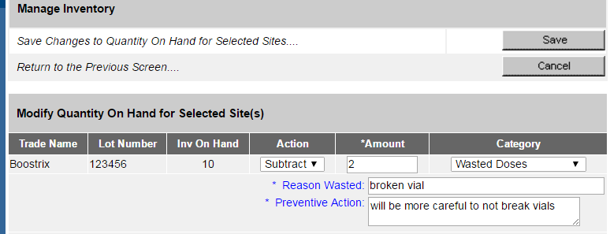
Steps to Document Wasted Vaccine
In the Modify Quantity On Hand section, choose ‘Subtract’ from the Action drop down list.
Enter the number of doses wasted in the Amount column.
Choose ‘Wasted Doses’ from the Category drop down box.
This brings up the Reason Wasted and Preventive Action boxes. Document what happened to the vaccine and how it can be prevented. Both of these boxes are required.
Click Save.
Notes:
This is the same Modify Quantity screen that you have seen before in managing your inventory. From here you will be able to subtract the doses that were wasted and provide a reason.
Choose Subtract from the Action drop down list.
Enter the number of doses wasted under the Amount column.
Choose Wasted Doses from the Category drop down box. This will bring up the Reason Wasted and Preventive Action boxes for you to document what happened to the vaccine and how it can be prevented. Both of these boxes are required.
When Finished click Save

Slide 7
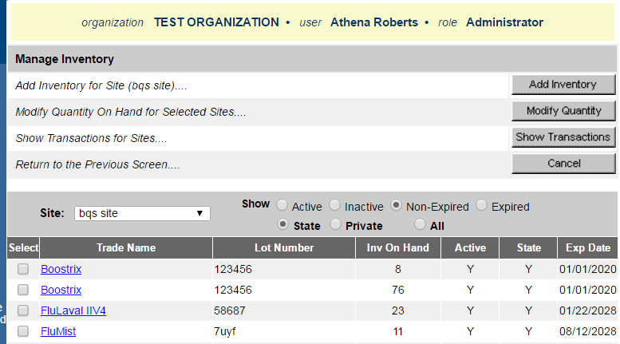
Steps to Document Wasted Vaccine
You are redirected back to the Show Inventory screen, where you can check to see that the dose(s) were subtracted.
Notes:
If you wanted to wait to run this report once a month, you could enter the dates to cover a month’s period. This part really depends on how much vaccine is wasted and or expired in your facility.
In order to view the wasted/ expired report, you will need to enter the From Date and the To Date. This date range will give you all the wasted and expired transactions for that period.
Click Generate to view report

Slide 8
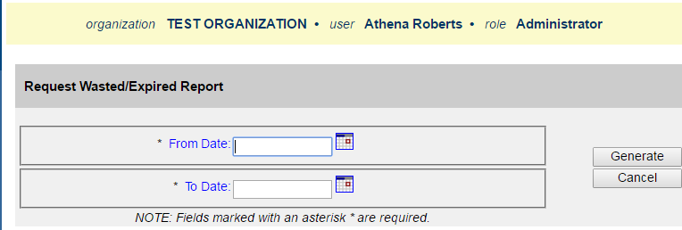
Steps to Run and Send Wasted/Expired Report
If you wanted to wait to run this report once a month, you could enter the dates to cover a month’s period. This part really depends on how much vaccine is wasted and or expired in your facility.
Click on request wasted/ expired.
Enter the From Date and the To Date. This date range will give you all the wasted and expired transactions for that period.
Click Generate to view the report.
Notes:
When you finish subtracting the wasted vaccine from inventory, you will be redirected back to the Show Inventory screen where you can check to see that the dose(s) were subtracted.
Now that you have completed the first step in reporting wasted vaccine, you are ready to print out the wasted/ expired report so that you can send it back to the Immunization Branch. Click on request wasted/ expired.

Slide 9
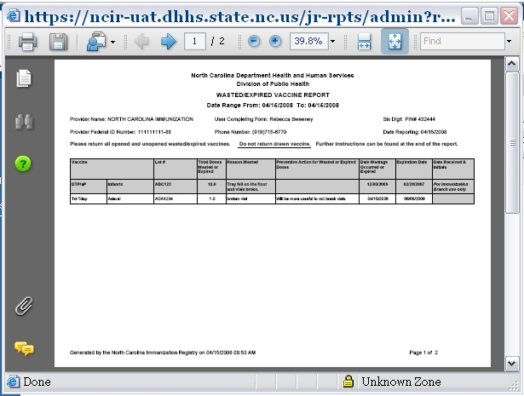
Steps to Run and Send Wasted/Expired Report
The wasted/ expired report will appear as a pop-up.
Make sure the pop-up blocker is not turned on for the NCIR. You may need to make the report bigger to view. In some computers it will be a small pop up and in others it will be bigger already. The report is viewed through Adobe Reader.
Notes:
The wasted/ expired report will appear as a pop-up, so you will need to make sure that the pop-up blocker is not turned on for the NCIR. You may need to make the report bigger to view. In some computers it will be a small pop up and in others it will be bigger already.

Slide 10
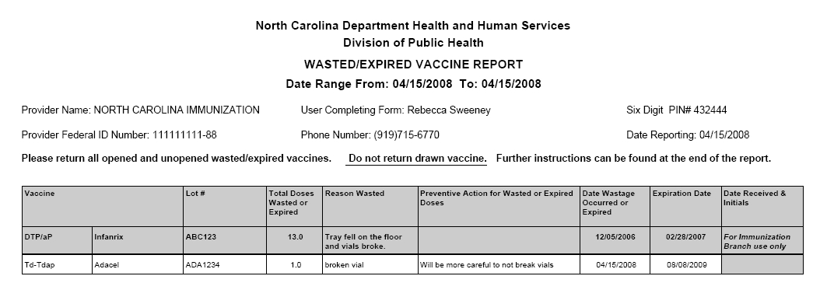
Steps to Run and Send Wasted/Expired Report
This report shows the doses you documented as wasted. You can print this report for your office’s records.
Notes:
The wasted/ expired report will appear as a pop-up, so you will need to make sure that the pop-up blocker is not turned on for the NCIR. You may need to make the report bigger to view. In some computers it will be a small pop up and in others it will be bigger already.

Slide 11
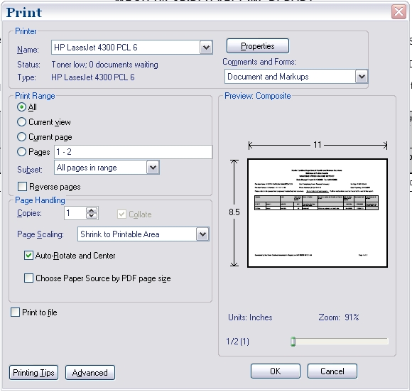
Click the print icon.
Click Ok.
Notes:
This is your wasted/ expired report for the doses you documented as wasted. The report is viewed through Adobe Reader. You will need to print out this report and send to the Immunization Branch.
To print this report click the print icon on the Adobe Reader toolbar and the print options box will pop up.
From this options box, click Ok to print out report.

