Slide 1

Human Trafficking Awareness:
A Broad Overview
Nancy E. Hagan, PhD
North Carolina Human Trafficking Commission
Aug 26, 2022

Slide 2
Learning objectives
Provide an overview of human trafficking
Address myths and misconceptions
Identify vulnerabilities to trafficking
Briefly discuss the impacts of trauma on victims and survivors
Learn where to get more information, make reports and seek support
Notes:
My hope is that I learn from you and can bring new insights back to the HTC.

Slide 3


What is Human Trafficking ?
Most of us are familiar with the term human trafficking, but we might not be quite sure what it means.
Where have you
heard about trafficking?
What comes to mind when you hear the term?
Notes:
The same platforms that are often used to recruit and exploit people, also promote myths about trafficking

Slide 4
Definition of Human Trafficking
Human trafficking is defined as using force, fraud, or coercion to manipulate someone into performing labor or sex acts in exchange for something of value.
Any commercial sex act with minors is legally considered trafficking.
Notes:
22 U.S.C. §§ 7101-7113 (2014)
Also see - State Law : NC General Statutes § 14-43.10A (2013)
22 U.S.C. §§ 7101-7113 (2014)
Also see - State Law : NC General Statutes § 14-43.10A (2013)

Slide 5
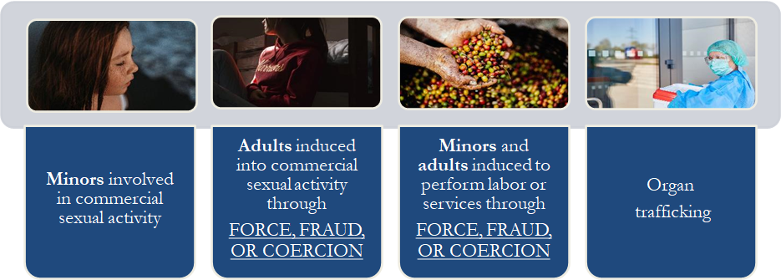
Types of Human Trafficking
https://www.youtube.com/watch?v=1j0VQZ3Kqgo
Notes:
https://www.youtube.com/watch?v=1j0VQZ3Kqgo

Slide 6
NC Safe Harbor Act
All minors under the age of 18 are protected from prosecution on charges of prostitution.
Consent of a minor under the age of 18 cannot be used as a defense.
Mistake of age cannot be used as a defense.
Prostitution offense can be erased from a human trafficking victim’s record.
Notes:
Like much state law, modelled closely on federal TVPA and Renewals

Slide 7
Awareness
Victims, traffickers, and buyers can look like anyone one of us.
Trafficking is often referred to as a crime that occurs in plain sight, or alternatively, just beneath the surface.
Most of us have not engaged in commercial sex. “I would never do that.”
But as consumers, we likely benefit from forced labor.
Notes:
Both sex and labor trafficking are transactional; labor is ongoing and woven into the fabric and ethos of our society. Sex acts may be more likely to be identified as discrete, singular, or more readily apparent.

Slide 8
Words matter

Slide 9
*Trafficking* implies motion or movement
Human Trafficking does not require movement or transportation
People can be trafficked At home
At school
At Church
As well across state lines or national borders

Slide 10
Modern day slavery child prostitute underage woman survival sex victim survivor rescue escape save

Slide 11
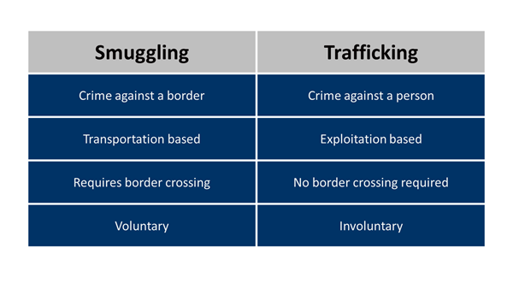
Words matter

Slide 12
Myths
*It doesn’t happen here.
Human trafficking has been identified in every county in the United States, in rural, suburban, and urban areas.
*I would know it if I saw it.
Trafficking victims and survivors may look like any one of us. We have all probably encountered trafficking without realizing.
It only happens to *them.*
Trafficking victims come from all walks of life, but some people are especially vulnerable.

Slide 13
Myths
And probably the most common myth of all:
*Most trafficking occurs between strangers and involves the use of force such as abduction or physical violence.
Traffickers and victims typically are known to each other prior.

Slide 14

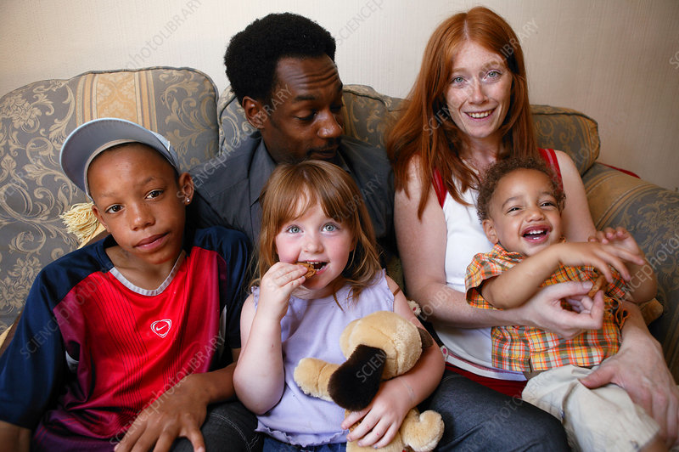


Fact check
Mom says Southwest Airlines thought she was trafficking her biracial daughter.
Jenn Selva and Gregory Lemos, CNN, Nov 8, 2021
Notes:
https://www.sciencephoto.com/media/1044655/view John Bindsell Social issues photo library https://www.sciencephoto.com/media/1035523/view/multiracial-family

Slide 15
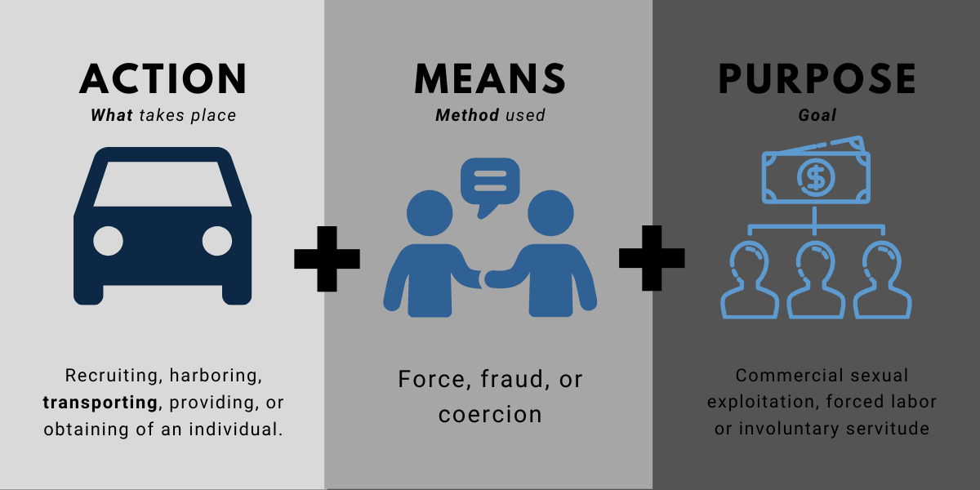
Definitional Clarity: The A-M-P Model
Notes:
Fix this slide, which was used for the transportation training . unhighlight transpo and find another image

Slide 16
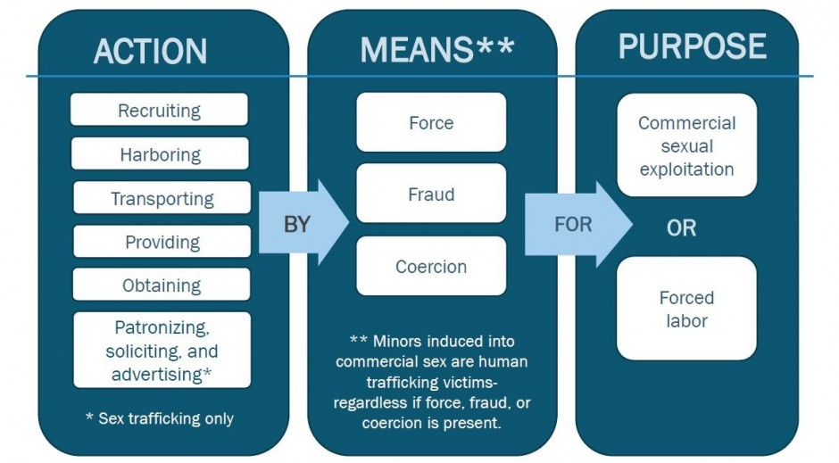

Slide 17
N.C.G.S 14-43.11
(a) A person commits the offense of human trafficking when that person
(i)knowingly or in reckless disregard of the consequences of the action recruits, entices, harbors, transports, provides or obtains by any means another person with the intent that the other person be held in involuntary servitude or sexual servitude or
(ii) willfully or in reckless disregard of the consequences of the action causes a minor to be held in involuntary servitude or sexual servitude

Slide 18
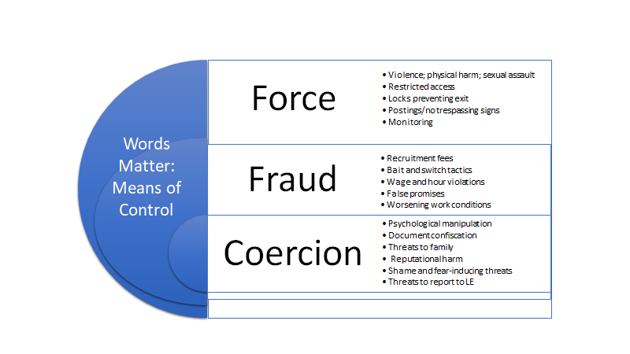

Slide 19
Force, fraud, and coercion
Fewer than 10% of child sex trafficking cases involve force
Many labor trafficking cases involve fraudulent job offers
Most human trafficking involves coercion
The manipulation of a relationship: family, friend, “love” relationship
https://files.eric.ed.gov/fulltext/EJ1189039.pdf
https://www.modernslaveryresearch.org/
Notes:
Can you identify force, fraud or coercion? Is there an act, a means and a purpose? Does this rise to the level of trafficking?

Slide 20
Framework of understanding:
The socio-ecological model

Slide 21
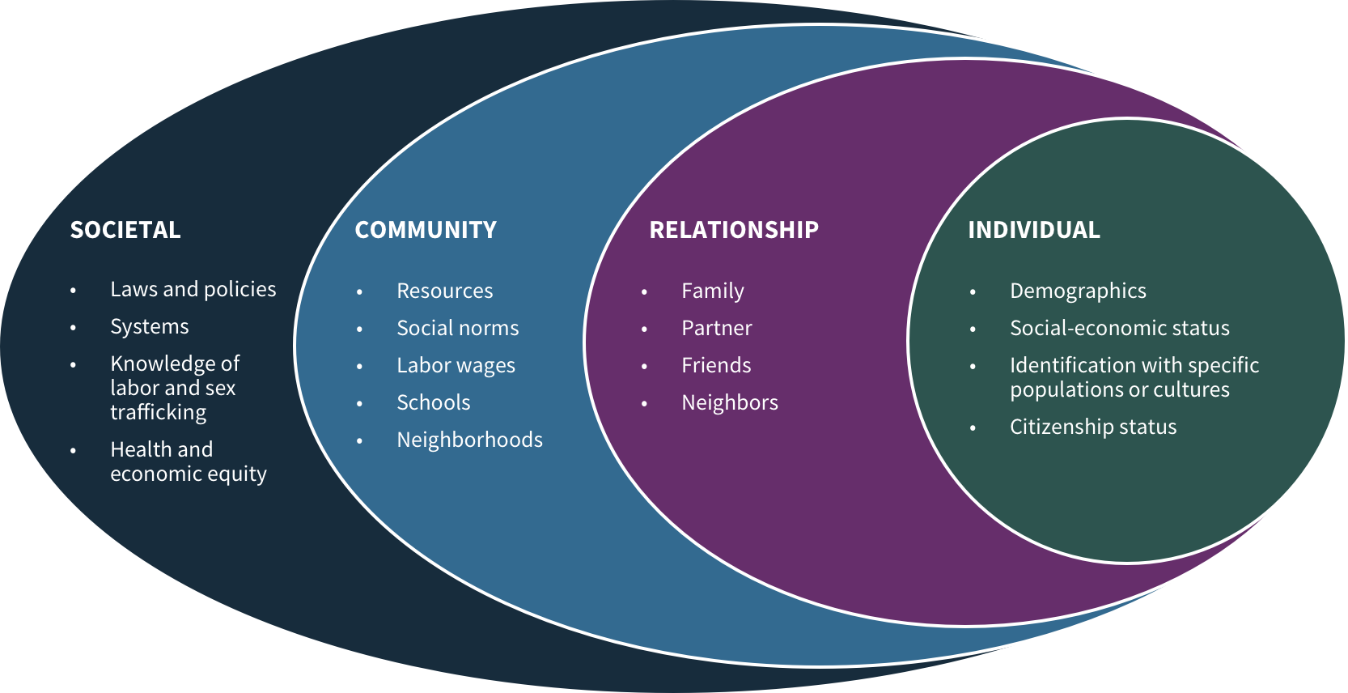
https://nhttac.acf.hhs.gov/soar/eguide/respond/Using_Social_Determinants_to_Inform_Approach
Notes:
Bronfenbrenner, socio-ecological modelhttps://nhttac.acf.hhs.gov/soar/eguide/respond/Using_Social_Determinants_to_Inform_Approach

Slide 22
Vulnerabilities:
Traffickers prey on vulnerabilities and take advantage of others for their own gain.
Who may be especially vulnerable?
People from underserved communitties
Youth: Especially runaway, foster, and homeless youth
Children and adults with histories of trauma (ACES)
People with family conflict and/or lack of social supports
People with substance use disorders or any addiction
Immigrants or people new to the area/people without legal status
People experiencing financial instability or loss of income
People displaced through natural disasters
Previously incarcerated
College students
Victims can look like any of us, while vulnerabilites vary and may intersect.

Slide 23


Family
In 2020, among all forms of trafficking whose recruitment relationships were known (4,142), the proportion of victims recruited by a family member or caregiver increased significantly – from 21% of all victims in 2019 to 31% in 2020 – a 47% increase.
Recruitment by family members and intimate partners was particularly noteworthy in sex trafficking situations.
In 2020, situations of sex trafficking or sex and labor trafficking combined, of the 2,448 victims whose recruitment was known:
42% were brought into trafficking by a member of their own families.
39% were recruited via an intimate partner or a marriage proposition.
Notes:
https://polarisproject.org/2020-us-national-human-trafficking-hotline-statistics/

Slide 24
North Carolina Data NHTHL
The limits of analytics:
Identification and data collection are challenging since this is a hidden crime that often goes unidentified and undisclosed.
Recorded calls to the hotline do not indicate reliable incidence or prevalence.
Notes:
Reliable data are hard to come by

Slide 25
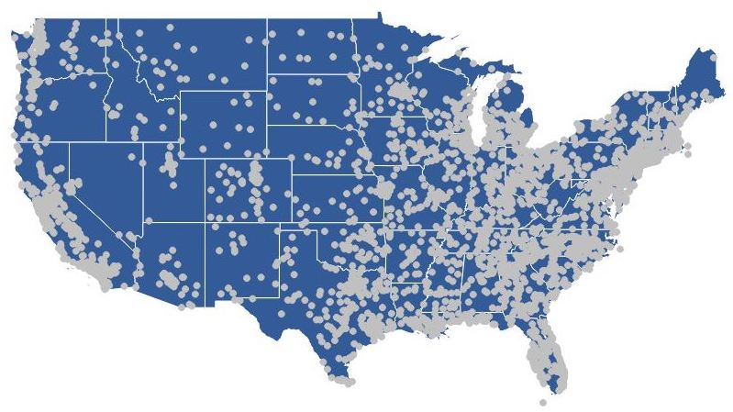
Trafficking happens in North Carolina
NC is consistently ranked within the top 10 states in the country for calls to the National Human Trafficking Hotline
Calls do not encompass all cases in North Carolina.
Heat map, 2019, Source.NHTRC https://polarisproject.org/wp-content/uploads/2019/10/heat-map.jpeg
Notes:
Map is the 2019 call “hotspots”.
* Based solely on calls to the Polaris hotline; does not include unreported cases and does not encompass all reported cases in North Carolina.

Slide 26
North Carolina Calls to the National Human Trafficking Hotline 2020
Type of trafficking | Number of contacts | Percentage
Sex | 176* | 68%
Labor | 35 | 13%
Sex and Labor | 10 | 4%
Trafficking type not specified | 39 | 15%
Total | 260 | 100%
* 84 calls had no venue specified
Hotel/motel calls = 22 or 8%
Each request submitted to the hotline is evaluated for evidence of potential human trafficking. In North Carolina, a total of 260 unique situations (incidents) of potential human trafficking were reported to the hotline.
https://humantraffickinghotline.org/sites/default/files/North%20Carolina%20State%20Report%20For%202020.pdf

Slide 27
North Carolina Calls to the National Human Trafficking Hotline 2020
Victim Demographics | # of Situations | % of Situations
Adults | 156 | 60%
Minors | 66 | 25%
Females | 217 | 83%
Males | 24 | 9%
Gender minorities | <3 --not disclosed | Not disclosed
US citizens | 22 | 8%
Foreign born | 38 | 15%
 |  | Non cumulative
https://humantraffickinghotline.org/sites/default/files/North%20Carolina%20State%20Report%20For%202020.pdf

Slide 28
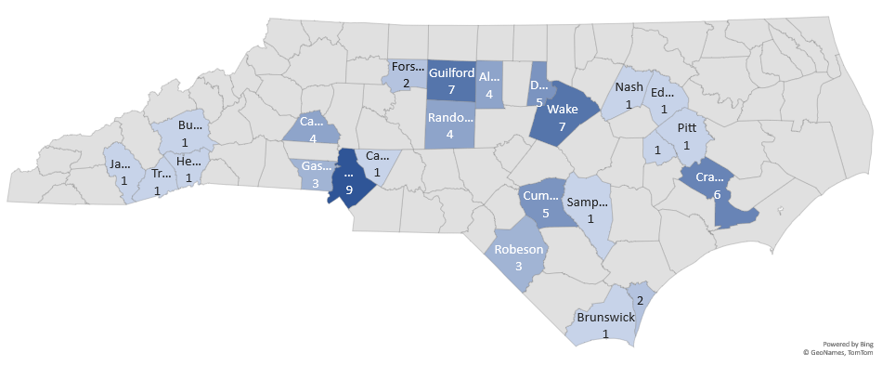
Location and Number of NHTH Tips Jan-May 2020
Durham
Mecklenburg
Notes:
NCHTC, 2021

Slide 29
Type of Trafficking tips to NHTH, January-may 2020
NCHTC, 2021
Notes:
NCHTC, 2021

Slide 30
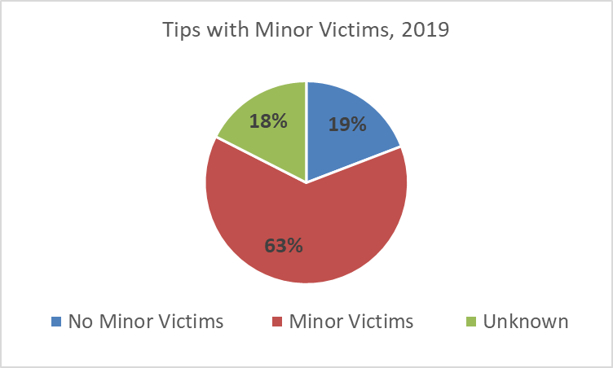
Percentage of tips with minor victims, 2017-2019
NCHTC, 2021

Slide 31
Types of commercial sex trafficking, January-may 2020
Type of labor trafficking,
January-may 2020

Slide 32
Criminal charges in North Carolina, 2020
14-43:11 (A)
139
Ht adult victim
62
Human trafficking child victim
40
Invol servitude adult
1
Sexual servitude child
24
Sexual servitude adult
12
Notes:
Source: NCHTC data base, 2021 full citation

Slide 33
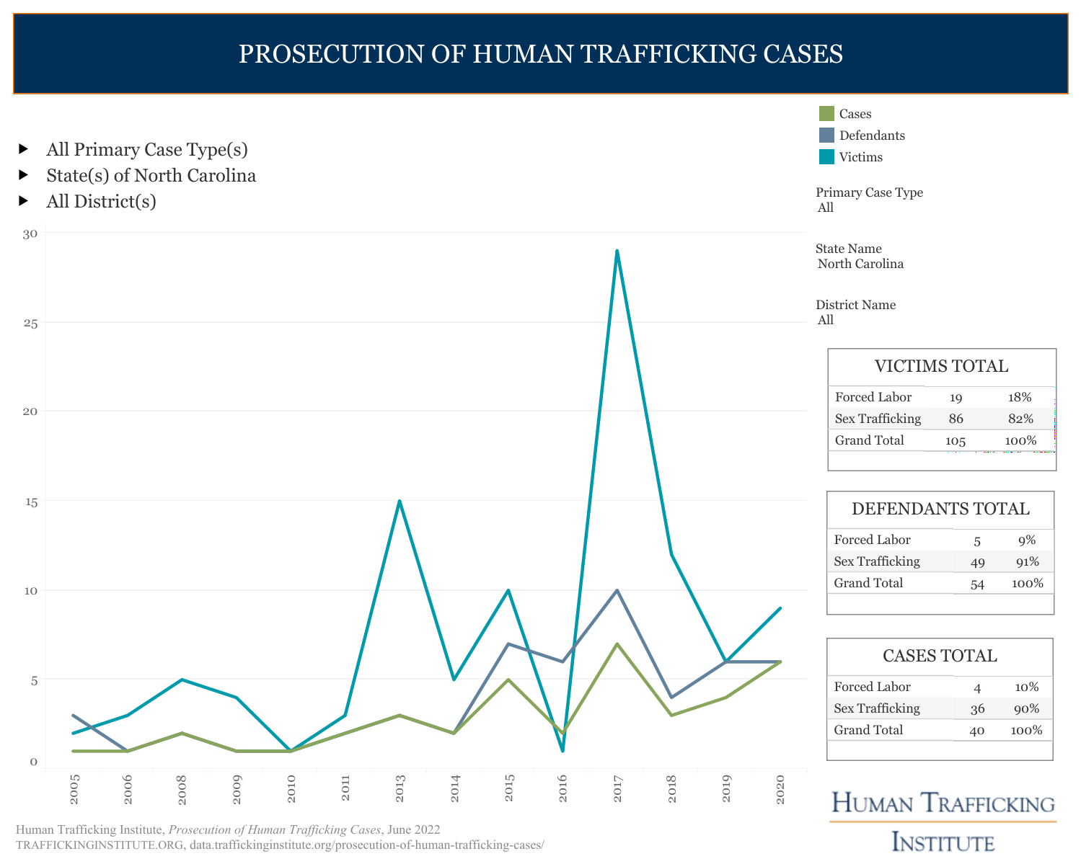

Slide 34
Human trafficking is big business, and it intersects with legitimate businesses in the public and private sectors.
“When traffickers count on ignorance or apathy – whether within the general population or a market sector -- to exploit a human being, an opportunity exists for a ... trained and vigilant individual... to recognize what is actually happening and take action.
“Every person, working within their sphere of influence, can play a critical role in fighting this crime.”
A-Roadmap-for-Systems-and-Industries-to-Prevent-and-Disrupt-Human-Trafficking-Transportation-Industry.pdf

Slide 35
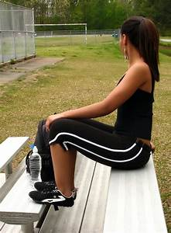
Phase one of Trafficking:
Recruitment
How: Increasingly Online
Apps and social media
Family members
“Trusted” members of the community
Gang affiliates
Love interest
Increased risk during COVID pandemic
Who: Vulnerable children and youth
LGBTQ+
People of color
Those living in poverty, rural areas, underserved areas

Slide 36
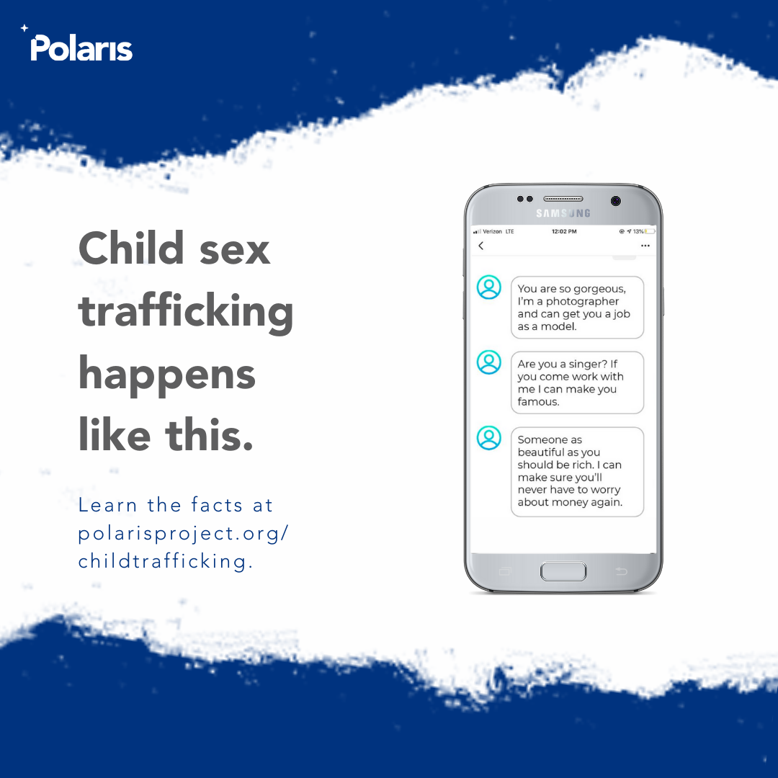

Notes:
What’s wrong with this picture?

Slide 37
Exploitation
May include: the production, trade and sale of pornography; sexual servitude
Forced labor:
Unpaid wages
OSHA violations
Forced turnover of pay to others
Forced criminality:
Recruitment of others
Theft
Drug sales
Notes:
Truckers against trafficking

Slide 38
Beyond Identification
Those positioned to build trust and to develop relationships with vulnerable people:
Family and friends
Members of the community, including faith community
Health care professionals
School personnel
Sometimes law enforcement
Disclosure is usually to a trusted family member or friend, generally not to a service provider
Most people do not self report
Recovery is prologed, and is typically not a linear process
Notes:
Truckers against trafficking

Slide 39
Origin of reports to the NHTH 2020
Notes:
Other includes CPS, DSS, teacher, nurse, advocate
Less victims calling; few victim/survivors disclose

Slide 40
Reintegration
Trauma informed care
Culturally competent
Long term: needs are complex
Shelter/housing: emergency, transitional and permanent
Schooling
Employment training
Creation and sustenance of support systems
Prosecution
NC currently has no dedicated housing and programming solely for child and youth survivors of human trafficking.
Their needs are met in a variety of settings including therapeutic foster homes, group homes, DV/SA shelters, and some dedicated space within other agencies.

Slide 41

The lived experience of trafficking survivors
https://hermeneutrix.com/2020/08/24/speaking-of-intersectionality/

Slide 42
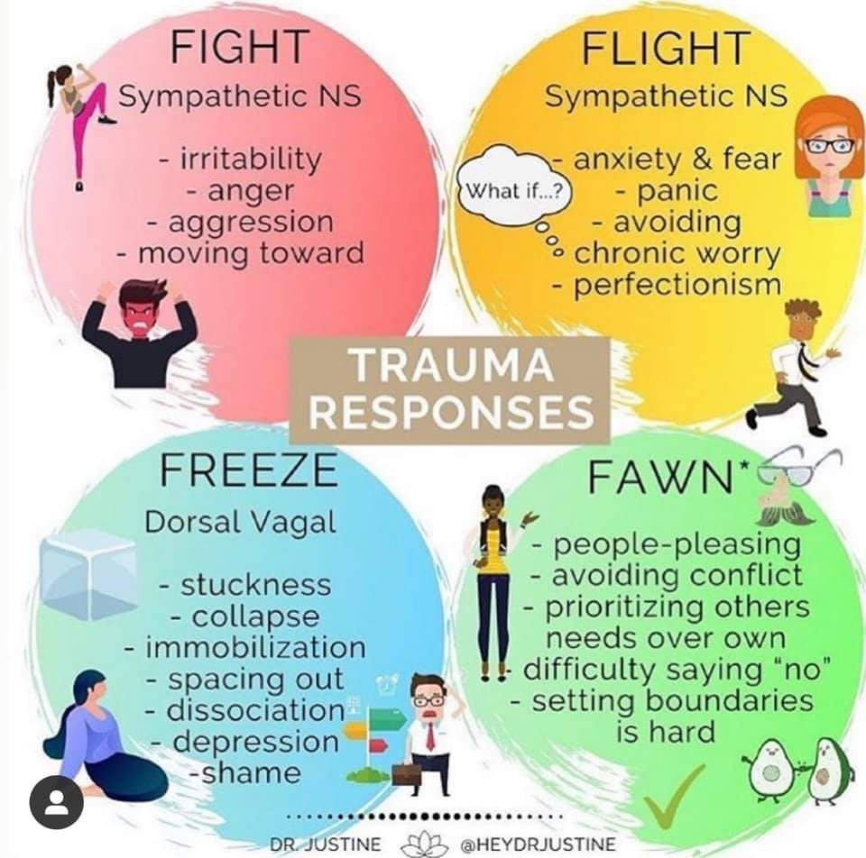
Trauma responses: Fight-flight-freeze-fawn (flirt)

Slide 43
You might hear…
He loves me
Why should I trust you
You don’t get it.
I’m fine.
Go away.
I love him.
None of your business.
Yeah…
Notes:
What else?

Slide 44
4 Ps of anti-human trafficking work
Victim
Survivor
Prosecution
Protection
Partnerships
Prevention

Slide 45


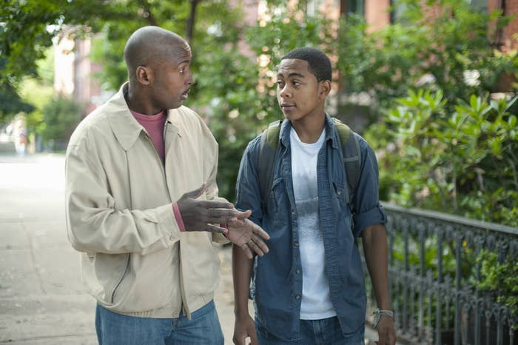
Making a difference
You know your community well.
You build trusting relationships with children.
Notes:
https://www.hhttps://www.bing.com/images/search?view=detailv2&iss=sbi&form=SBIIDP&sbisrc=ImgDropper&q=imgurl:https%3A%2F%2Fwww.communityreachcenter.org%2Fwp-content%2Fuploads%2F2018%2F10%2FCommunity-Reach-Center-Father-and-Son-Talking.jpg&idpbck=1&selectedindex=0&id=https%3A%2F%2Fwww.communityreachcenter.org%2Fwp-content%2Fuploads%2F2018%2F10%2FCommunity-Reach-Center-Father-and-Son-Talking.jpg&ccid=cVb%2FIAXI&simid=608053513990377495&ck=35D7CB2C704C8E41EEAD8ABE1BF9045B&thid=OIP.cVb_IAXImtO-pt9yuLBPwQHaD3&mediaurl=https%3A%2F%2Fwww.communityreachcenter.org%2Fwp-content%2Fuploads%2F2018%2F10%2FCommunity-Reach-Center-Father-and-Son-Talking.jpg&exph=627&expw=1200&cdnurl=https%3A%2F%2Fth.bing.com%2Fth%2Fid%2FR.7156ff2005c89ad3bea6df72b8b04fc1%3Frik%3Dnp2RhfBYZF87bQ%26pid%3DImgRaw%26r%3D0&vt=2&sim=11ealthychildren.org/English/ages-stages/teen/dating-sex/Pages/Birth-Control-for-Sexually-Active-Teens.aspx
https://www.google.com/search?q=photo+of+adult+and+teenager&tbm=isch&ved=2ahUKEwjms6rf9Yn0AhXXL1kFHVWdCM4Q2-cCegQIABAA&oq=photo+of+adult+and+teenager&gs_lcp=CgNpbWcQDFCfD1i7EWC0IWgAcAB4AIABUIgBmwKSAQE0mAEAoAEBqgELZ3dzLXdpei1pbWfAAQE&sclient=img&ei=wrKJYebKJ9ff5NoP1bqi8Aw&bih=604&biw=1396#imgrc=IxECeBj2KvMSbM

Slide 46
SB 199
Suspected abuse, neglect or dependency
LE must report to Child Welfare and vice versa
20XX
Reports must be made regardless of custody status if serious bodily injury, serious physical injury, or sexual offense are involved.
Within 24 hours
.
Everyone over the age of 18 in North Carolina is a mandatory reporter
SB 199;
N.C.G.S 14-318.6.

Slide 47

Call. Text. 24/7 200 languages
National Human Trafficking Hotline
888-37-37-888
Text: befree (233733)
Spanish: ayuda
Email: human traffickinghotline.org
Notes:
https://www.goodfreephotos.com/albums/vector-images/mobile-cellphone-vector-clipart.png

Slide 48
Trafficking can be hard to recognize:
A caution about red flags or indicators
Indicators do not necessarily mean that trafficking is occurring, but pay attention to behaviors such as:
Children selling or soliciting donations door to door at night or alone
People dressed inappropriately for the weather and/or setting
Unexplained injuries
Sudden changes in behavior
Truancy
Consistent tardiness to school
Missed court dates or therapy appointments
Repeated running away, especially if to the same place/person
Notes:
Fix for this audience

Slide 49
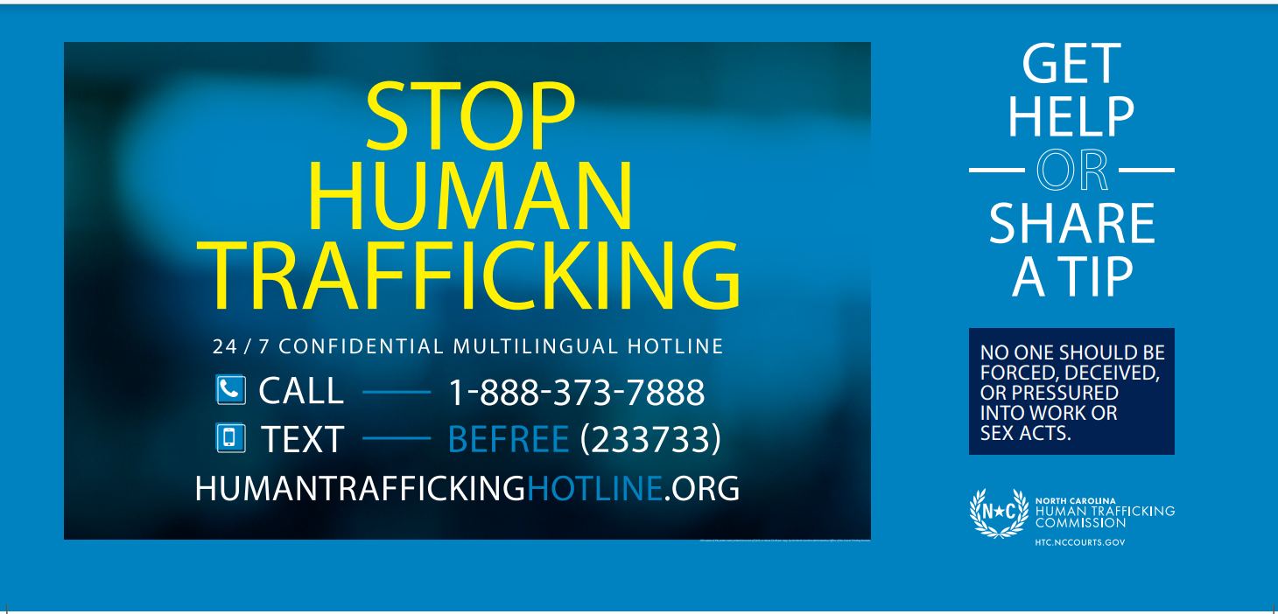
The North Carolina Human Trafficking Commission
In 2017, S.L. 201-57 required certain businesses, hospitals, public transportation facilities, and employment offices to post a human trafficking public awareness sign.

Slide 50
Remember...
Do no additional harm.
Pay attention to details.
Record descriptions and details if it’s safe to do so.
One indicator does not prove trafficking.
If you witness a dangerous or violent situation, call 911.
Safety first.
Do not try to intervene if it would put the victim or others at risk.
Mandatory reporting to law enforcement and child welfare.

Slide 51
For more information:
The Polaris Project: https://polarisproject.org/
The North Carolina Human Trafficking Commission: https://www.nccourts.gov/commissions/human-trafficking-commission
https://speakupnc.org/
UNC School of Government: sog.unc.edu -> search for “trafficking”
Shared Hope International https://sharedhope.org/

Slide 52
Contact:
Nancy.E.Hagan @nccourts.org
This project was supported by Grant number
2018-V2-GX-0061 awarded by the Office of Victims of Crime,
U.S. Department of Justice. The opinions, findings,
conclusions, and recommendations expressed in this
publication, program/exhibition are those of the author(s)
and do not necessarily reflect the views of the
Department of Justice, Office of Victim’s Crime.

