Slide 1
FIREARM INJURY PREVENTION PARTNERSHIP (FIPP)
Donna Rosser, MPH
Durham County Department of Public Health
May 23, 2023

Slide 2
HISTORY
RESOLUTION
In 1999, the Durham County Gun Safety Team was established through a resolution from the Durham County Board of Health to address the rising trend of deaths and injuries of children where firearms in the home were unlocked and loaded with ammunition.
Durham County Board of Health Resolution Regarding Gun Safety.
WHEREAS, the…
Notes:
In 1999, the Durham County Gun Safety Team (GST) was established as a county program through a resolution from the Durham County Board of Health to address the rising trend of deaths and injuries of children where firearms are in the home, unlocked and loaded.

Slide 3
MISSION STATEMENT
"To reduce death/injury related to firearms through broad based and preventive strategies to promote a safe (violence free) environment for our children.”
WHO WE ARE AND WHAT WE DO
Interdisciplinary, apolitical
Partners on education & public awareness
Increase community safety

Slide 4
TEAM MEMBERS
Alliance Health
Bull City United
Criminal Justice Resource Center
Duke Children’s Primary Care
Duke Health
Duke Trauma Services
Duke Violence Recovery Program
Durham VA Health Care System
Durham County Department of Social Services DHS, CPS
Durham County Sheriff’s Office
Durham Housing Authority
Durham Public Schools
Insight Human Services
North Carolinians Against Gun Violence
Project Build (Gang Reduction)
Religious Coalition for a Nonviolent Durham
Notes:
Team meets on the 4th Wednesday of each month, from 9AM-10:30AM.

Slide 5
Initiatives
Asking Saves Kids
Distribution of Gun Locks
Notes:
Some of the first GST initiatives included the following:
Safe Storage of Firearms Messaging
Distribution of Free Gunlocks and the
Asking Saves Kids (ASK) Campaign
Safe storage of firearms reduces unintentional death,
injury, and hospitalization.
Additionally, when firearms are stored safely,
they are less available as a means of suicide, unintentional shootings or
intentional harm to others.
This is especially true for children and youth.
https://injuryfreenc.dph.ncdhhs.gov/safestorage/
NC Safe Storage Law
The team provides information on safe storage of firearms during events and
educational sessions
Distribution of Free Gun Locks
To-date,
the GST has distributed approximately 25,000 free gunlocks.
Gunlocks were originally provided to the team from
Project Child Safe.
Safe Kids-Durham used grant funding to provide gunlocks for the team.
Gunlocks now provided to the team by the Durham VA Medical Center Suicide Prevention Program.
***

Slide 6
FIREARMS IN THE HOME
Firearms are the leading cause of death in children and teens
One in three homes in the United States has at least one firearm
4.6 million children live in a home where a firearm is unlocked and loaded
The question is, is there a gun in the home where my child visits?
Notes:
FIREARMS IN THE HOME
• Firearms are the leading cause of injury-related death in children and teens
• One in three homes in the United States has at least one firearm
• 4.6 million children live in a home where a firearm is unlocked and loaded
However, more than a third of all unintentional shootings of children take place in the homes of their friends, neighbors, or relatives.
That's why it is also important to
make sure kids are safe when
they spend time where other people live.

Slide 7
ASKING SAVES KIDS
American Academy of Pediatrics
END FAMILY FIRE
This initiative encourages parents to ask about firearms in the places that their children visit to make sure they are properly stored – locked, unloaded with ammunition stored separately
Brady Campaign
Notes:
The Just Ask campaign,
now ASKING SAVES KIDS (ASK),
was first established with
the American Academy of Pediatrics in
2000 and
is currently administered by the Brady Campaign.
This initiative encourages parents to
ask about firearms in
the places that their children play or visit,
to make sure they are properly stored –
locked, unloaded with
ammunition stored separately
ASK has been a part of the GST educational initiatives almost since the team’s inception. Brady Campaign End Family Fire

Slide 8
COMMUNITY EVENTS
To-date we have given away over 25,000 gunlocks and spoken to thousands of people about safe storage and Asking Saves Lives
Venues Include:
Corporate and Public Health Fairs
Schools (fairs, activities, PTA’s)
Civic Organizations
Health Care Clinics
Religious & Faith Based Communities
Child Care Centers
Neighborhood Events

Slide 9
HEALTHCARE PROVIDER PROGRAM
Healthcare providers ask patients and families about storage of firearms in the home as part of the preventative safety assessment
Education: Asking Saves Kids
Intervention: Free Gun Locks
Based on the Durham County Gun Safety Team-Duke Health Model
To date 29 health clinics in 7 counties are providing this service
Notes:
This program started in 2014.
Healthcare providers ask patients and families about storage of firearms in the home as part of the preventative safety assessment
Education: Asking Saves Kids
Intervention: Free Gun Locks
Based on the Durham County GST Duke Health Model
To date roughly 20 health clinics in 7 counties are providing this service.

Slide 10
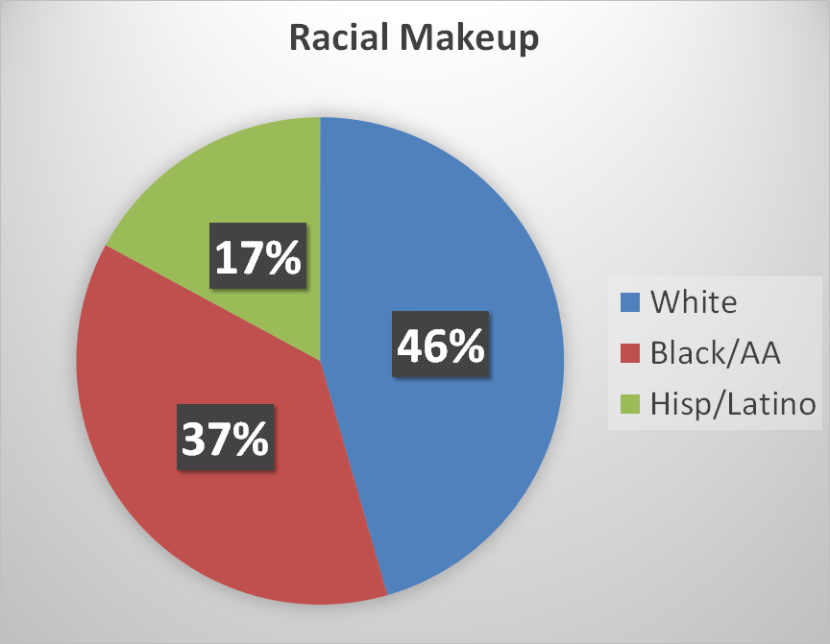
Durham County Snapshot
Durham County is located in the east-central part of the Piedmont region of NC.
6th largest county in NC by population (324,833)
Bordered by Person, Wake, Granville, Orange and Chatham counties.
Part of the Research Triangle Region, known for its technology companies and scholarly institutions, such as Duke University.
The City of Durham accounts for 269,702 of the residents in the county. Over 94% live in urban areas.
Age Breakdown:
•21.1% under 18
•6.6% under 5
•78.9% over 18
•12.6% over 65
•Median age is 35
Notes:
Wikipedia/Google for general geographic info
US Census Bureau Quick Facts: https://www.census.gov/quickfacts/fact/table/US/PST045221

Slide 11
FIREARMS IN DURHAM COUNTY
Households: 131,104
~43,701 homes with guns
Based on 1:3 homes have a firearm
Handgun permits issued by Durham County Sheriff:
2020: 7,429
2021: 42,009
Not included: illegal or non-permitted firearms (long guns)
Notes:
Total number of households from US Census Bureau Quick Facts
Estimates for homes without children: ~42%, so 1/3 is a conservative estimate

Slide 12
NC VDRS Data
Homicides peaked among those aged 20-24
while suicides peaked among those aged 75-84.
Between 2010-2019, there were 639 violent deaths in Durham County
271 suicides
40.6% with firearms
341 homicides
81.2% with firearms
Notes:
https://injuryfreenc.dph.ncdhhs.gov/DataSurveillance/ViolentDeathData.htm (County level data sheets)
NC VDRS Data Dashboard: https://dashboards.ncdhhs.gov/t/DPH/views/NCVDRSDashboard/NC-VDRSDashboard?%3AshowAppBanner=false&%3Adisplay_count=n&%3AshowVizHome=n&%3Aorigin=viz_share_link&%3AisGuestRedirectFromVizportal=y&%3Aembed=y

Slide 13
SKIPP
Skills & Knowledge for Injury Prevention Partners (SKIPP)
Fall 2018-Spring 2019
UNC Gillings School of Global Public Health
Goals:
To establish a gun safety team in Orange County based on the Durham model
To create an implementation manual that can be used for any county to create their own gun safety team
Notes:
Skills and Knowledge for Injury Prevention Partners (SKIPP)
Fall 2018-Spring 2019
UNC Gillings School of Global Public Health
Project supported through a grant funded by the John Rex Endowment
Goals:
Create an implementation guide that could be replicated in any county
Start an Orange County GST based on this model
Orange County team established in March 2019
Toolkit/Implementation Guide lives on NC DHHS website and used by groups to start their own GST

Slide 14
2021 COMPREHENSIVE SUICIDE PREVENTION GRANT RECIPIENT
Awarded almost $200,000 grant
North Carolina Department of Health and Human Services
Division of Public Health
Chronic Disease and Injury Section / Injury and Violence Prevention Branch
GST Deliverables
Develop a curriculum and provide virtual and in-person trainings for (minimum of 5) counties to establish their own Gun Safety Team based on the Durham model
* As of May 2023, 17 Counties have completed the training.
Hire part-time position working with DCoDPH and the GST to coordinate suicide prevention and awareness program

Slide 15
EXPANSION
1999
2019
2021
2022
2023
All 100 NC Counties
Durham
Orange
Pitt
Wake
Tyrell
Martin
Catawba
Johnson
Washington
Mecklenburg
Cabarrus
Granville
Hoke
Iredell
Vance
Mecklenburg

Slide 16
NEXT STEPS
Continue to expand the Durham GST
Offer GST trainings to interested counties through FY 2024
Produce at least one campaign around gun safety in Durham

Slide 17
DCoDPH STAFFING
Donna Rosser, Health Education Specialist
Javonna Rozario, CSP Coordinator
Willa Robinson Allen, Program Manager
Health Promotion (Chronic Disease) & Injury Prevention

