Slide 1
NC Department of Health and Human Services
Requesting Records
Kerry Young
NC Local CFPT State Coordinator
July 25, 2024
Notes:
This is the first of our monthly webinars for local CFPTs. This months was scheduled to take a look at requesting records
Come explore this topic, all are welcome!
Webinar will be held on July 18th from 2-3pm
Register for this webinar at

Slide 2
Agenda
Who is part of the North Carolina Child Fatality Prevention System/program overview
Who makes up a CFPT team
Requesting records
Who to request for: quarterly packets
What to request
Resources for requesting records
Transition for future

Slide 3
North Carolina Child Fatality Prevention System
Local Child Fatality Prevention Teams (CFPT)
Community Child Protection Teams (CCPT)
NC Child Fatality Prevention Team (State Team)
NC Child Fatality Task Force (Task Force)
**********************
Partner: State Division of Social Services Child Fatality Review (State DSS) – Intensive Reviews
Notes:
A quick look at our basics

Slide 4
Local CFPT Program Overview
Established in 1993 by State Statute Article 14, 7B-1406
One team in every county—also few identified Health Districts
Review child fatalities of children born alive, ages 0-17 and were residents of your county at time of death
Review child deaths that are not due to suspected abuse and/or neglect
Report findings of reviews to the Program Coordinator
Notes:
This is a basic overview of the Local CFPT program—we will talk about some of these points again during this training

Slide 5
Who makes up a CFPT team?
DSS Director and a member of the Director’s staff
Local Law Enforcement
Attorney from the District Attorney’s Office
Executive Director of the community action agency or designee
Superintendent of a local school or designee
DSS Board Member
Local mental health professional
Local Guardian ad litem Coordinator or designee
Health Director
Local health care provider
An EMS or firefighter
A district court judge
County Medical Examiner
Representative from local Childcare facility or Head Start
Parent of a child who died before their 18th birthday
**The Board of County Commissioners may appoint five additional members to represent county agencies or at large members
Notes:
Here’s where we start to cross over between the two type of local teams. Remember back to our flow chart after a child fatality. There are CCPT’s and CFPT’s. Recall that CCPT’s have a mandate to review child deaths associated with abuse and neglect. They CAN choose to review other types of death OR they can choose not to. If they choose not to, that is when a CFPT is born.
Therefore, based on state statute, the above listed 10 members shall be the same on the counties CCPT and CFPT teams. Meaning that the same appointed individual represents the same discipline on both Teams. Remember, many of these local teams have merged in the counties.
Each CFPT shall consist of representatives of public and nonpublic agencies in the community that provide services to children and their families and other individuals who represent the community.
With that being said, each Local Team shall consist of the following persons:
The director of the county department of social services.
A member of the director’s staff.
A local law enforcement officer, appointed by the board of county commissioners.
An attorney from the district attorney’s office, appointed by the district attorney.
The executive director of the local community action agency, as defined by the Department of Health and Human Services, or the executive director’s designee.
The superintendent of each local school administrative unit located in the county, or the superintendent’s designee.
A member of the county board of social services, appointed by the chair of that board.
A local mental health professional, appointed by the director of the area authority.
The local guardian ad litem coordinator or the coordinator’s designee.
The director of the local department of public health.
A local health care provider, appointed by the local board of health.
An emergency medical services provider or firefighter, appointed by the board of county commissioners.
A district court judge, appointed by the chief district court judge in that district.
A county medical examiner, appointed by the Chief Medical Examiner.
A representative of a local child care facility or Head Start program, appointed by the director of the county department of social services.
A parent of a child who died before reaching the child’s eighteenth birthday, to be appointed by the board of county commissioners.
The board of county commissioners may appoint a maximum of five additional members to represent county agencies or the community at large to serve on the local CFPT. The Team Coordinator shall serve as an ex officio member of each Local Team that reviews the records of additional child fatalities.
I suggest to use the County Profile Form to maintain an in-house list of team members, monitor vacancies, assess the need for additional members, and confirm each position is filled appropriately. (See Appendix 2-2)

Slide 6
CFPT Requesting Records

Slide 7
CCPT and CFPT: The process
CCPT
CFPT
Notes:
For starters, here is the process. There is a list of all child fatalities for a quarter that list figuratively dumps into the CCPT bucket.
The CCPT bucket has a filter. This filter is for their statutory requirements. Everything else, dumps into the CFPT bucket.
Let’s take a look at that a little closer

Slide 8
CCPT and CFPT working as one: The process
Selected active cases of child abuse/neglect and
Cases in which a child died as result of suspected abuse/neglect
AND a report of abuse or neglect was made about the child or their family within the previous 12 months
OR the child’s family was a recipient of CPS services within 12 months. They are established in every county of the State.
CCPT
Notes:
The list of all child fatalities for a quarter dumps into the CCPT bucket.
CCPT’s were established in 1991 to review two main components
selected active cases of child abuse/neglect and
cases in which a child died as result of suspected abuse/neglect
AND a report of abuse or neglect was made about the child or their family within the previous 12 months
OR the child’s family was a recipient of CPS services within 12 months. They are established in every county of the State.
Any Community Child Protection Team that determines it will not review additional child fatalities shall notify the Team Coordinator.
So, the cases from the full list, now in the CCPT bucket fall through a filter. This filter is for their statutory requirements
Everything else, dumps into the CFPT bucket.

Slide 9
CCPT and CFPT working as one: The process
Selected active cases of child abuse/neglect and
Cases in which a child died as result of suspected abuse/neglect
AND a report of abuse or neglect was made about the child or their family within the previous 12 months
OR the child’s family was a recipient of CPS services within 12 months. They are established in every county of the State.
CCPT
CFPT
Notes:
So, the cases caught by the CCPT filter get reviewed by the CCPT and everything else, dumps into the CFPT bucket.
Any Community Child Protection Team that determines it will not review additional child fatalities, a CFPT is formed, this has happened in every county across our state.
The CFPT were established in 1993 to review all “additional” child fatalities and make recommendations to state policy makers. The purpose of these reviews is to improve local and statewide systems to better protect children
So, the CFPT can be thought of the '

Slide 10
Before each meeting
Quarterly packets: a list of child fatalities (provisional data), death certificate transcripts, medical examiner reports (with a list of Pending case), birth certificate information, and injury data are sent to the Review Coordinator.
A confidential memo is sent to all Team members requesting they check their agency records regarding the upcoming cases.
Asking yourself: What do we need to know for the review?
CFPT

Slide 11
Quarterly Packets Should Contain:
Monthly connections: CFPT Connections is a document provided to share information with the local child fatality prevention teams, update on upcoming trainings, and provide suggestions for the monthly prevention topic
County List of Fatalities
Medical Examiner Certification List: Only cases with ME Cert-Y, and ME Decline-N will have an OCME certificate
Hospital Discharge for non-fatal injuries
Death Certificate
Birth/Death Information is only included for infants. There will not be anything for children born outside NC
7. Office of the Chief Medical Examiner Certificates

Slide 12
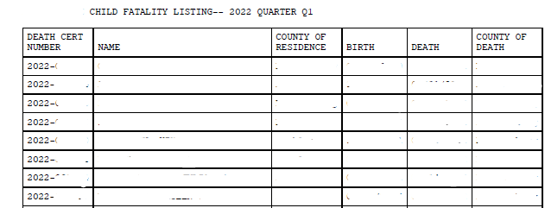
2: County List of Fatalities
West
West
West
West
West
West
West
West
West
The county name will be listed at the top of the page and will match all county of residence columns.
All fatalities listed for the noted county will be provided on this document. *Note: Some cases may qualify for a CCPT review or Intensive review.

Slide 13
3. Medical Examiner Listing
Doe, Jane
West
East
EXAMPLE: Jane Doe, who, died in East county, is a resident of West county. This fatality would be sent and reviewed by West County.
Only cases with ‘Y’ under ME CERT column, and ‘N’ under ME DECLINE will have accompanying documents from the medical examiner system.
Information noted under ‘SPECIFIC CAUSE’ may be included in the CFPT Report form’s description of the child’s death, more details are needed—where other team member’s shared information is needed.

Slide 14
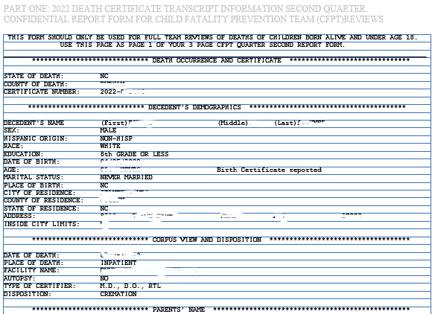
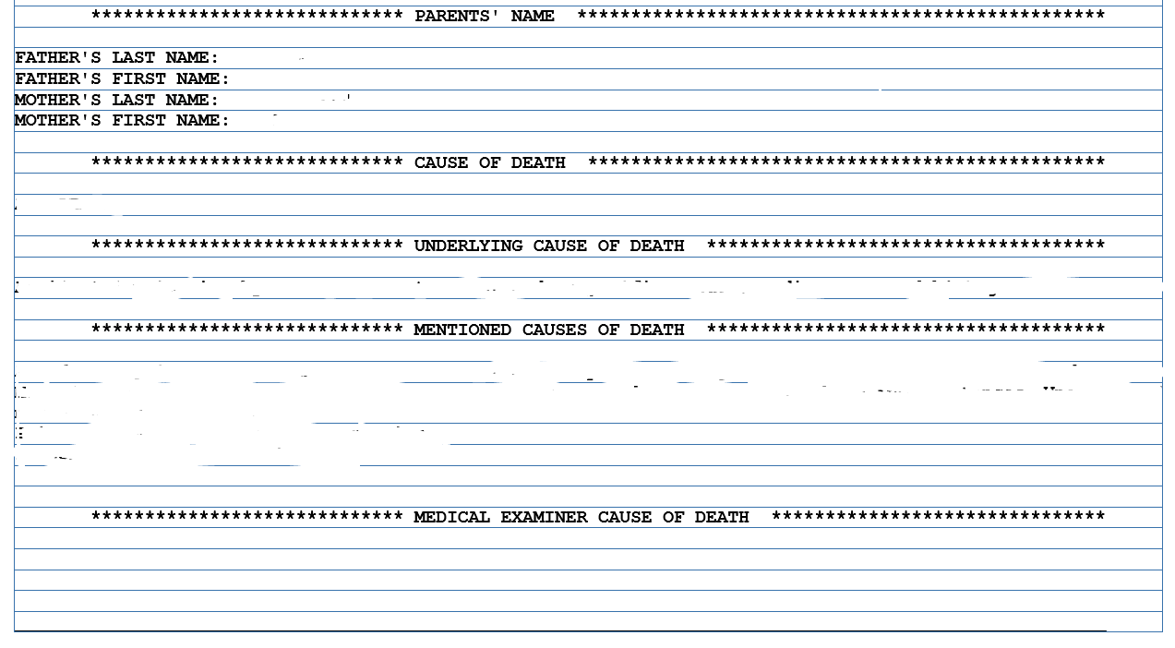
5. Death Certificate
A Death Certificate will be provided for each fatality reviewed.
Mother and father’s first and last name will be noted.
Autopsy “No” - No Medical Examiner autopsy document will not be provided as it does not exist
Autopsy “Yes” - Should have an OCME certificate and should be consistent with the ME Listing.
If a case is under Medical Examiner jurisdiction, there will be an notation under the Medical Examiner Cause of Death

Slide 15
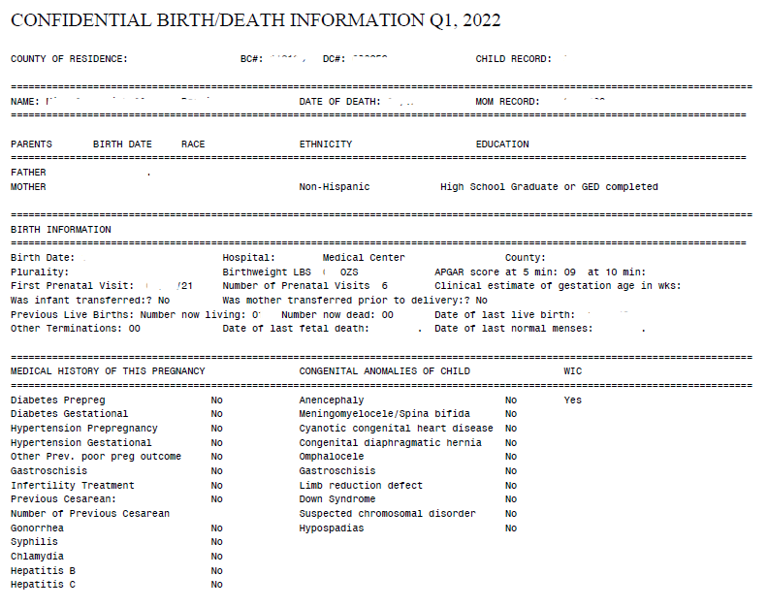
6. Confidential Birth/Death Information
Only children under 1 year of age will have this document in the fatality packet

Slide 16
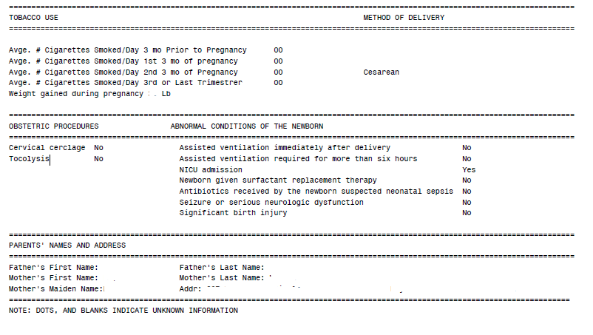
6. Confidential Birth/Death Information

Slide 17
What else?
Now that you know what is provided in the quarterly packets, what else do you need to know?
Was there an investigation by law enforcement?
DSS history?
What services was this family connected with?
Was the child seeing a pediatrician regularly
Etc.

Slide 18
What to request?
What to request (not all-encompassing):
LE/EMS records (utilize reps on the team)
Medical and mental health records (pediatrician, hospital discharge, birth/prenatal care, etc)
Education records (utilize education rep on the team)
Social services history

Slide 19
Resources
Letter to request in-state records
Letter to request out-of-state records
Requesting information from WIC/other services (Buncombe Co)

Slide 20
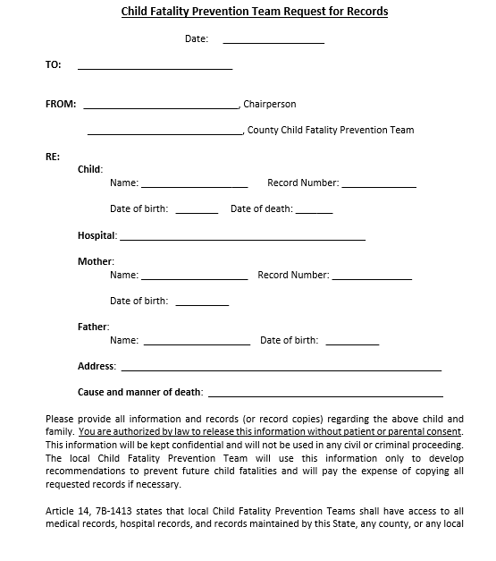
Letter to request in-state records

Slide 21
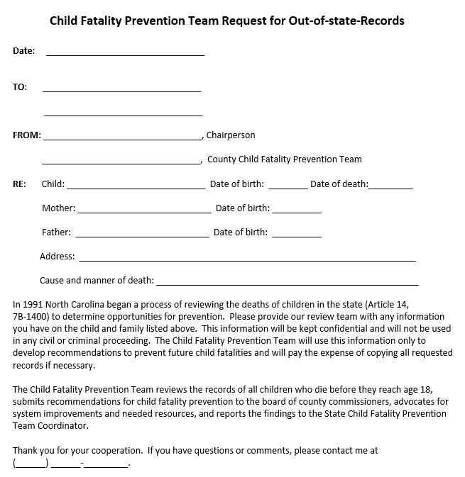
Letter to request out-of-state records

Slide 22
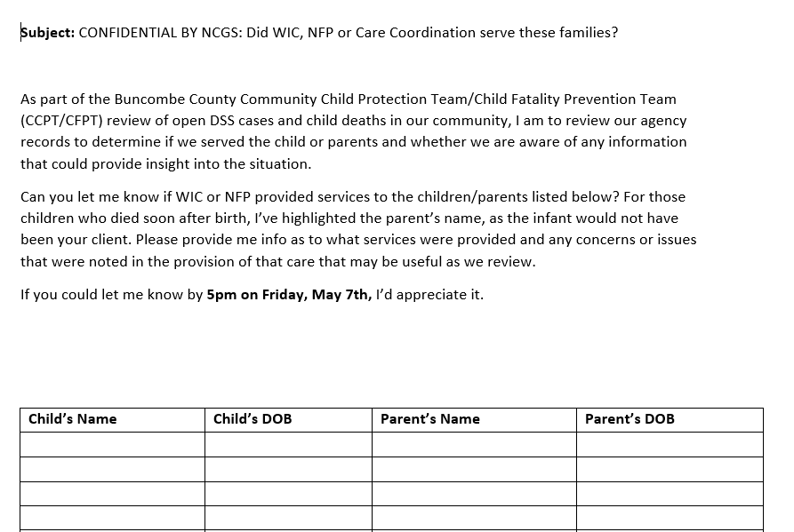
Requesting information from WIC/other services (Buncombe Co)

Slide 23
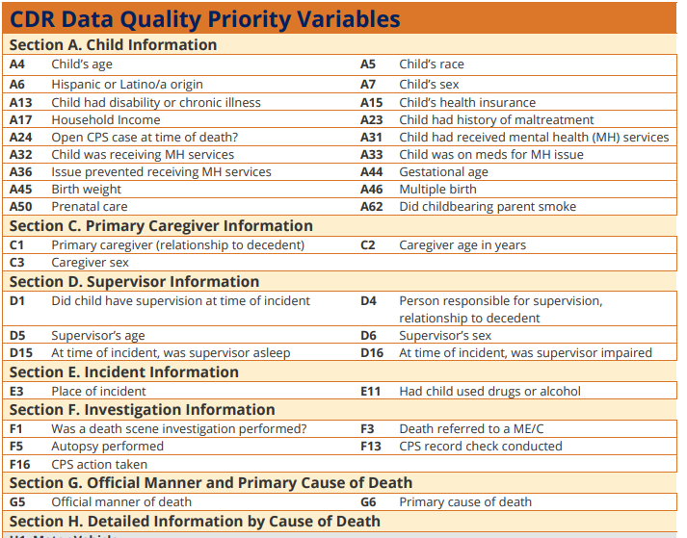
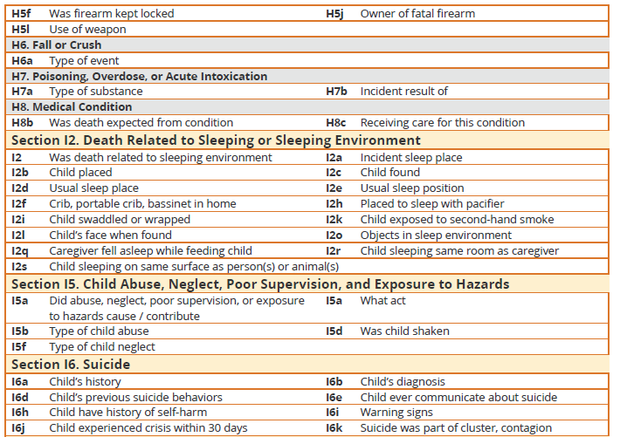
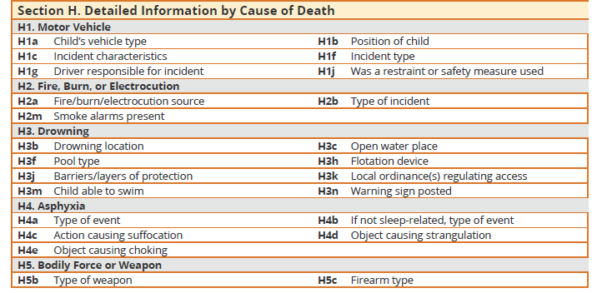
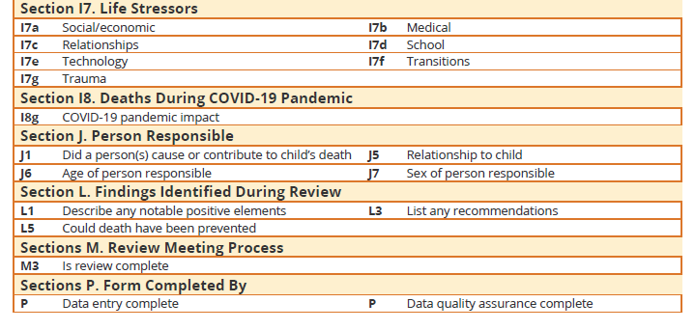
How will you answer these future questions…
National Child Fatality Review and Prevention Data System
Priority variables
Notes:
These are the questions the local team will be responsible for answering in the new fatality review system. How will you answer these in the future?

Slide 24
Questions?
Kerry Young, Local CFPT State Coordinator
Phone
984-302-0747 (Cell)
919-707-5623 (office)
Kerry.Young@dhhs.nc.gov

