Slide 1
NC Department of Health and Human Services
NC Comprehensive Suicide Prevention
Youth Suicide Trends
Isley Cotton, MSW
Youth Suicide Prevention Coordinator
December 15, 2023

Slide 2
Welcome!

Slide 3
Learning Objectives
Learn about safe language and messaging
Demystify myths about suicide
Review youth suicide data from NC VDRS/YRBS
Discuss suicide prevention efforts in NC
Notes:
Here are the objectives for this presentation:

Slide 4
Compassionate Communication Matters
Avoid saying...
Try this instead...
Committed suicide
Failed suicide attempt
Successful suicide attempt
Died by suicide, killed him/herself
Suicide attempt or nonfatal suicide attempt
Suicide
Notes:
The language we use in talking about suicide is very important. The term committed suicide brings up a strong negative image. The word commit is a verb that means to carry out or perpetrate (e.g. a mistake, crime, or immoral act). As a result, using the term committed can increase emotions like shame, guilt, and anger. Also, do not use completed or successful suicide because that suggest suicide is an accomplishment, which may make suicide sound positive.
Words matter. Let's use the right words!
Do not use the word 'commit’ - people commit crimes, sin, and are committed to mental health clinics.
People don't commit heart attack or cancer; neither do people commit suicide.
People die of suicide.
'Unsuccessful suicide’ - No
Words matter! We know that words matter.
ANNE: the words on the left are stigmatizing and judgemental. Let's not use those words. Let's not judge people for being in crisis and having suicidal thoughts.

Slide 5
Common Myths

Slide 6
Busting Myths
Myth
Reality
If I ask about it, I am putting the idea into their head.
I'm sure I will say the 'wrong thing' and make it worse.
People plan for months.
If someone is thinking about suicide, you can't do anything to stop them.
The person wants to be asked; it is a relief to have someone ask.
Saying something is better than saying nothing.
71% of people who attempt suicide only consider it for less than an hour before the attempt.
24% of these people contemplated their attempt for less than 10 minutes.
You can stop a person from a suicide attempt by de-escalating the situation, listening to them, and removing lethal means.
Notes:
Alright, here we are going to do some myth busting, to get everyone on the same page.
You can't cause intention. You cannot cause intention.
You are not going to give someone the idea of suicide.

Slide 7
NC Data & Trends on Youth Suicide Behavior

Slide 8
Data & Trends on Youth Suicide Behavior
Suicide is the second leading cause of death for youth in North Carolina ages 10 to 18, and the third leading cause of death for those ages 19 to 34.
Although most suicides were among urban youth (67%), rates were higher for youth in rural counties.
Suicide rates are highest among non-Hispanic white (5.8) and American Indian (5.6) youth.
In 2021, firearms were the lethal means used in 58% of youth suicides (and 78% of youth homicides).
Source: North Carolina Violent Death Reporting System (NC-VDRS), 2020. Rate per 100,000; 10-yr data aggregated to provide rates for all groups Limited to NC Residents ages 10-18.

Slide 9
Recent Crisis is an Important Risk Factor
54%
of youth (10-18) who died by suicide experienced
crisis
Source: North Carolina Violent Death Reporting System, 2016-2020
Notes:
Paying close attention to our youth in crisis is crucial.
Youth are more susceptible to crisis than older adults
That can be attributed to numerous things like lack of experience, or social supports, etc.
Overall message: Regardless of age, crisis plays a massive role in suicide. Crisis is a significant risk factor.
Data slide on youth
Of the 313 residents suicide deaths, ages 10-18, 94.6% (N= 296) had circumstance information available
161 experienced a crisis
54% of suicide decedents ages 10-18 experienced a crisis

Slide 10
Among youth, suicides are increasing.
Of the 1,436 suicides in 2020*, 67 (5.6%) were among school-aged youth (10-18).
2020* Suicide
Rate per 100,000
Rate increase from 2011-2020*
Source: North Carolina Violent Death Reporting System (NC-VDRS), 2011-2020*
*2020 data are provisional and subject to change; Note: Limited to NC Residents

Slide 11
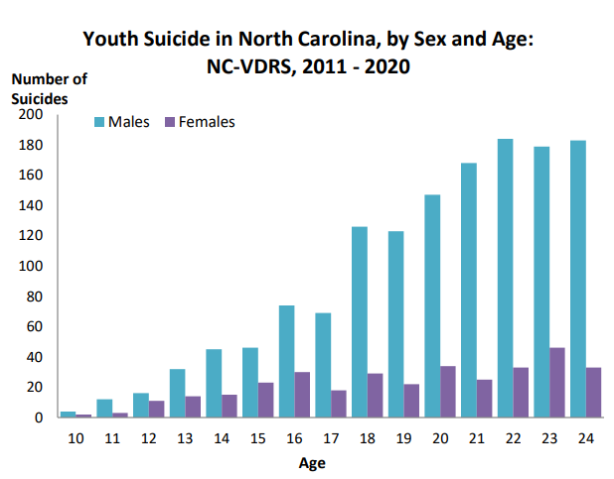
Youth Suicide in North Carolina, Ages 10-24, 2011-2020
From 2011 to 2020, 4,321 North Carolina residents ages 10 to 24 died as a result of violence. Of these violent deaths, 1,746 (40.4%) were suicides.
Males consistently had a higher number of suicides than females, regardless of age.
The number of suicide deaths peaked for males at age 22 (184 suicides) and for females at age 23 (46 suicides).
Seventy percent of all youth suicide victims were identified as non-Hispanic (NH) white, 17.8% as NH Black, 7.3% as Hispanic, and 5.3% as belonging to other racial/ethnic groups.
Source: North Carolina Violent Death Reporting System (NC-VDRS), 2020. Limited to NC Residents ages 10-18

Slide 12
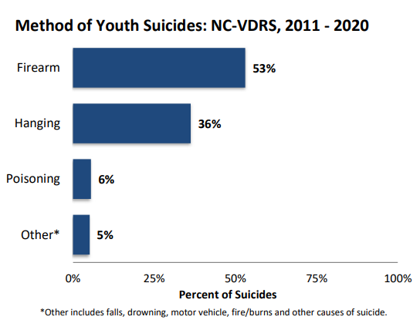
Method of Youth Suicides: NC-VDRS, 2011-2020
Overall, the most common method of suicide among youth was firearms (53%), followed by hanging, strangulation, suffocation (36.3%) and poisoning (5.6%).
Only 5.2% of suicides involved a method other than firearms, hanging, strangulation, suffocation, or poisoning.
Source: North Carolina Violent Death Reporting System (NC-VDRS), 2020. Limited to NC Residents ages 10-18

Slide 13
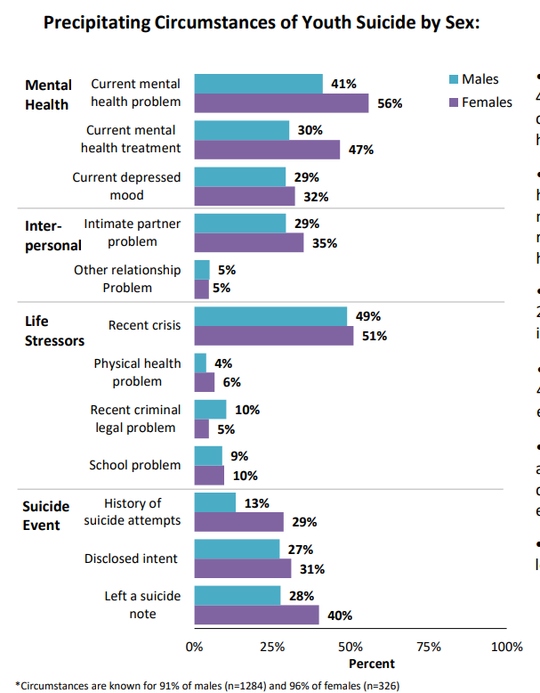
Precipitating Circumstances of Youth Suicide by Sex:
Fifty-six percent (55.8%) of female and 41.1% of male suicide victims were characterized as having a current mental health problem when they died by suicide.
A similar trend was seen for mental health treatment. Females (46.6%) were more likely than males (30.4%) to be receiving treatment for a current mental health problem at the time of suicide.
Thirty-five percent (35.0%) of female and 29.3% of male suicide victims had an intimate partner problem.
Fifty-one percent (50.9%) of female and 48.9% of male suicide victims had experienced a recent or imminent crisis.
Thirty-one percent (31.0%) of female and 27.3% of male suicide victims had disclosed their suicide intent to someone else before they died.
Females (39.9%) were more likely to leave a suicide note than males (27.6%).
Source: North Carolina Violent Death Reporting System (NC-VDRS), 2020. Limited to NC Residents ages 10-18

Slide 14
Poisoning was the leading cause of youth self-harm ED visits.
2020 Self-Harm ED Visits by Mechanism/Method
Source: NC-DETECT Emergency Department Visits, 2020; Limited to NC residents ages 10 and older

Slide 15
Suicidal behavior* is more prevalent among youth identifying as gay, lesbian, or bisexual.
In the past 12 months:
Seriously considered attempting suicide
Made a plan to attempt suicide
Attempted suicide
Made a suicide attempt that resulted in injury requiring medical treatment
* Responses related to suicidal behavior in the previous 12 months
Source: North Carolina High School Youth Risk Behavior Survey, 2019; Spell, L. & Essex, E. (2020, Sept 23). Whole School, Whole Community, Whole Child: Data Drives the Work [PowerPoint Presentation to the CFTF Intentional Death Committee]

Slide 16
The Trevor Project: 2022 National Survey on LGBTQ Youth Mental Health
LGBTQ youth who live in a community that is accepting of LGBTQ people reported significantly lower rates of attempting suicide than those who do not.
LGBTQ youth who felt high social support from their family reported attempting suicide less than half the rate of those who felt low or moderate social support
LGBTQ youth who found their school to be LGBTQ-affirming reported lower rates of attempting suicide.

Slide 17
Suicide Prevention in North Carolina

Slide 18
Suicide Prevention in North Carolina
Funding
2020
CDC grant
$4.8 million over 5 years
Identified Populations
Men
Veterans
Rural residents
Youth, specifically LGBTQIA2S+
Major Deliverables
State-wide Advisory Council
Gatekeeper Training
Counseling on Access to Lethal Means (CALM)
Firearm Safety Teams
Suicide Prevention Academies
Community Support through RFA

Slide 19
What is a gatekeeper?
Individuals who have face-to-face contact with large numbers of community members
Can “gatekeep” access to resources and services
Can include:
Faith leaders
Youth sport coaches
Hair-dressers and barbers
Doctors
Teachers
Notes:
After establishing what we can all do to prevent suicide, we want to offer you all some concrete ways you organiation and community can get involved with programs and trainings that are being offered right now.
First we have Gatekeeper trainings. These gatekeeper trainings are like CPR: identify someone in crisis, keep them stable, call for help. For suicide prevention, identify someone is in crisis, stay with them, refer to help.
Gatekeepers are anyone in a community who may be able to interact with people at risk and get them help. This can be everyone from a youth sports coach to a barber. We are all gatekeepers.
Through the CSP grant we offer three programs to access gatekeeper trainings:
Faith Leaders for Life: provide gatekeeper training to faith leaders and faith communities
2. Start with Veterans: provide gatekeeper training to those who intersect with veterans
3. ASIST: suicide intervention training, how to approach a person in crisis
We will go into each next in more detail.

Slide 20
What is gatekeeper training?
Teaches the knowledge and skills needed to intervene and care for persons at potential risk for suicide
Similar to CPR
Train thousands in CPR for the off chance they will need to use it
More likely to encounter people at risk for suicide than people who need CPR
Notes:
After establishing what we can all do to prevent suicide, we want to offer you all some concrete ways you organization and community can get involved with programs and trainings that are being offered right now.
First we have Gatekeeper trainings. These gatekeeper trainings are like CPR: identify someone in crisis, keep them stable, call for help. For suicide prevention, identify someone is in crisis, stay with them, refer to help.
Gatekeepers are anyone in a community who may be able to interact with people at risk and get them help. This can be everyone from a youth sports coach to a barber. We are all gatekeepers.
Through the CSP grant we offer three programs to access gatekeeper trainings:
Faith Leaders for Life: provide gatekeeper training to faith leaders and faith communities
2. Start with Veterans: provide gatekeeper training to those who intersect with veterans
3. ASIST: suicide intervention training, how to approach a person in crisis
We will go into each next in more detail.

Slide 21
Gatekeeper Training: Suicide Prevention & Intervention Skills Training
Faith Leaders for Life
Provide gatekeeper training to faith leaders and faith communities
Start with Veterans
Provide gatekeeper training to those who intersect with veterans
Applied Suicide Intervention Skills Training (ASIST)
Suicide intervention training, how to approach a person in crisis
Notes:
After establishing what we can all do to prevent suicide, we want to offer you all some concrete ways you organization and community can get involved with programs and trainings that are being offered right now.
First we have Gatekeeper trainings. These gatekeeper trainings are like CPR: identify someone in crisis, keep them stable, call for help. For suicide prevention, identify someone is in crisis, stay with them, refer to help.
Gatekeepers are anyone in a community who may be able to interact with people at risk and get them help. This can be everyone from a youth sports coach to a barber. We are all gatekeepers.
Through the CSP grant we offer three programs to access gatekeeper trainings:
Faith Leaders for Life: provide gatekeeper training to faith leaders and faith communities
2. Start with Veterans: provide gatekeeper training to those who intersect with veterans
3. ASIST: suicide intervention training, how to approach a person in crisis
We will go into each next in more detail.

Slide 22
Fire Safe Storage
Promote safe storage practices through creation of local Firearm Safety Teams (FST).
Example is the Durham Gun Safety Team
https://injuryfreenc.dph.ncdhhs.gov/safestorage/docs/CreatingaGunSafetyTeamImplementationGuide.pdf
Member examples:
Health department
Health care providers
Faith Leaders
Domestic violence groups
Mental Health Providers
Neighborhood watches
3. NC S.A.F.E. (ncsafe.org)
Notes:
After establishing what we can all do to prevent suicide, we want to offer you all some concrete ways you organization and community can get involved with programs and trainings that are being offered right now.
First we have Gatekeeper trainings. These gatekeeper trainings are like CPR: identify someone in crisis, keep them stable, call for help. For suicide prevention, identify someone is in crisis, stay with them, refer to help.
Gatekeepers are anyone in a community who may be able to interact with people at risk and get them help. This can be everyone from a youth sports coach to a barber. We are all gatekeepers.
Through the CSP grant we offer three programs to access gatekeeper trainings:
Faith Leaders for Life: provide gatekeeper training to faith leaders and faith communities
2. Start with Veterans: provide gatekeeper training to those who intersect with veterans
3. ASIST: suicide intervention training, how to approach a person in crisis
We will go into each next in more detail.

Slide 23
Means Safety Education
Provide Counseling on Access to Lethal Means (CALM)
Counseling on Access to Lethal Means | CALM (calmamerica.org)
Includes firearms, medications, other methods
CALM is a conversation between a provider and the at-risk person and/or their family. It is discussion about ways to safeguard the home during the critical time period in which suicide risk is present.
Trainees: medical, health care, mental health, counselor, community resource
Notes:
After establishing what we can all do to prevent suicide, we want to offer you all some concrete ways you organization and community can get involved with programs and trainings that are being offered right now.
First we have Gatekeeper trainings. These gatekeeper trainings are like CPR: identify someone in crisis, keep them stable, call for help. For suicide prevention, identify someone is in crisis, stay with them, refer to help.
Gatekeepers are anyone in a community who may be able to interact with people at risk and get them help. This can be everyone from a youth sports coach to a barber. We are all gatekeepers.
Through the CSP grant we offer three programs to access gatekeeper trainings:
Faith Leaders for Life: provide gatekeeper training to faith leaders and faith communities
2. Start with Veterans: provide gatekeeper training to those who intersect with veterans
3. ASIST: suicide intervention training, how to approach a person in crisis
We will go into each next in more detail.

Slide 24
Why Do Means Matter?
Seventy-one percent of survivors of nearly lethal attempts stated that they deliberated for an hour or less.
Approximately 82.5% of intentionally self-inflicted suicide attempts using firearms are fatal.
The short time period of someone acting on suicidal ideation supports separation of ideation and method.
Creating any gap in time between the thought of suicide and lethal means can provide time for self-interruption or intervention by others
Notes:
After establishing what we can all do to prevent suicide, we want to offer you all some concrete ways you organization and community can get involved with programs and trainings that are being offered right now.
First we have Gatekeeper trainings. These gatekeeper trainings are like CPR: identify someone in crisis, keep them stable, call for help. For suicide prevention, identify someone is in crisis, stay with them, refer to help.
Gatekeepers are anyone in a community who may be able to interact with people at risk and get them help. This can be everyone from a youth sports coach to a barber. We are all gatekeepers.
Through the CSP grant we offer three programs to access gatekeeper trainings:
Faith Leaders for Life: provide gatekeeper training to faith leaders and faith communities
2. Start with Veterans: provide gatekeeper training to those who intersect with veterans
3. ASIST: suicide intervention training, how to approach a person in crisis
We will go into each next in more detail.

Slide 25
Ways Your Community Can Get Involved
Hospitals and medical establishments (CALM, Start, ASIST)
Businesses (Start With Veterans)
Faith communities (Faith Leaders for Life, Start)
Community (Start with Veterans, create an FST, organize or join a walk)
Town and schools (Start, also supporting any programming that decreases bullying, violence in dating, etc. because all of that is also suicide prevention)
Public health & non-profits (Start, Start With Veterans, Asist, CALM, create an FST)
Notes:
After establishing what we can all do to prevent suicide, we want to offer you all some concrete ways you organization and community can get involved with programs and trainings that are being offered right now.
First we have Gatekeeper trainings. These gatekeeper trainings are like CPR: identify someone in crisis, keep them stable, call for help. For suicide prevention, identify someone is in crisis, stay with them, refer to help.
Gatekeepers are anyone in a community who may be able to interact with people at risk and get them help. This can be everyone from a youth sports coach to a barber. We are all gatekeepers.
Through the CSP grant we offer three programs to access gatekeeper trainings:
Faith Leaders for Life: provide gatekeeper training to faith leaders and faith communities
2. Start with Veterans: provide gatekeeper training to those who intersect with veterans
3. ASIST: suicide intervention training, how to approach a person in crisis
We will go into each next in more detail.

Slide 26
Comprehensive Suicide Prevention Advisory Council (CSPAC)
Structure
1 ½ hours
Meets quarterly
Includes program updates, partner presentations, new resources, notice of education and community events
Peer learning environment
Next meeting: Nov 8, 2023
Membership
Email Megan Lueck at Mlueck@email.unc.edu to apply to attend CSPAC meetings.
Notes:
After establishing what we can all do to prevent suicide, we want to offer you all some concrete ways you organization and community can get involved with programs and trainings that are being offered right now.
First we have Gatekeeper trainings. These gatekeeper trainings are like CPR: identify someone in crisis, keep them stable, call for help. For suicide prevention, identify someone is in crisis, stay with them, refer to help.
Gatekeepers are anyone in a community who may be able to interact with people at risk and get them help. This can be everyone from a youth sports coach to a barber. We are all gatekeepers.
Through the CSP grant we offer three programs to access gatekeeper trainings:
Faith Leaders for Life: provide gatekeeper training to faith leaders and faith communities
2. Start with Veterans: provide gatekeeper training to those who intersect with veterans
3. ASIST: suicide intervention training, how to approach a person in crisis
We will go into each next in more detail.

Slide 27
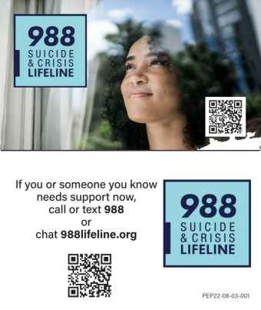
988: Suicide & Crisis Lifeline
The National Suicide Lifeline 1-800-273-8255 has changed to a three-digit number as of July 16, 2022
Notes:
After establishing what we can all do to prevent suicide, we want to offer you all some concrete ways you organization and community can get involved with programs and trainings that are being offered right now.
First we have Gatekeeper trainings. These gatekeeper trainings are like CPR: identify someone in crisis, keep them stable, call for help. For suicide prevention, identify someone is in crisis, stay with them, refer to help.
Gatekeepers are anyone in a community who may be able to interact with people at risk and get them help. This can be everyone from a youth sports coach to a barber. We are all gatekeepers.
Through the CSP grant we offer three programs to access gatekeeper trainings:
Faith Leaders for Life: provide gatekeeper training to faith leaders and faith communities
2. Start with Veterans: provide gatekeeper training to those who intersect with veterans
3. ASIST: suicide intervention training, how to approach a person in crisis
We will go into each next in more detail.

Slide 28
Resources
Reporting on Suicide
N.C. DPH: IVP Branch: Data and Surveillance (ncdhhs.gov)
988 Suicide & Crisis Lifeline | SAMHSACrisis Text Line | Text HOME To 741741 free, 24/7 Crisis CounselingThe Trevor Project | For Young LGBTQ LivesSuicide Prevention Resource Center (sprc.org)
Counseling on Access to Lethal Means | CALM (calmamerica.org)
NC S.A.F.E. (ncsafe.org)
NC Healthy Schools Data | NC DPI
Notes:
After establishing what we can all do to prevent suicide, we want to offer you all some concrete ways you organization and community can get involved with programs and trainings that are being offered right now.
First we have Gatekeeper trainings. These gatekeeper trainings are like CPR: identify someone in crisis, keep them stable, call for help. For suicide prevention, identify someone is in crisis, stay with them, refer to help.
Gatekeepers are anyone in a community who may be able to interact with people at risk and get them help. This can be everyone from a youth sports coach to a barber. We are all gatekeepers.
Through the CSP grant we offer three programs to access gatekeeper trainings:
Faith Leaders for Life: provide gatekeeper training to faith leaders and faith communities
2. Start with Veterans: provide gatekeeper training to those who intersect with veterans
3. ASIST: suicide intervention training, how to approach a person in crisis
We will go into each next in more detail.

Slide 29
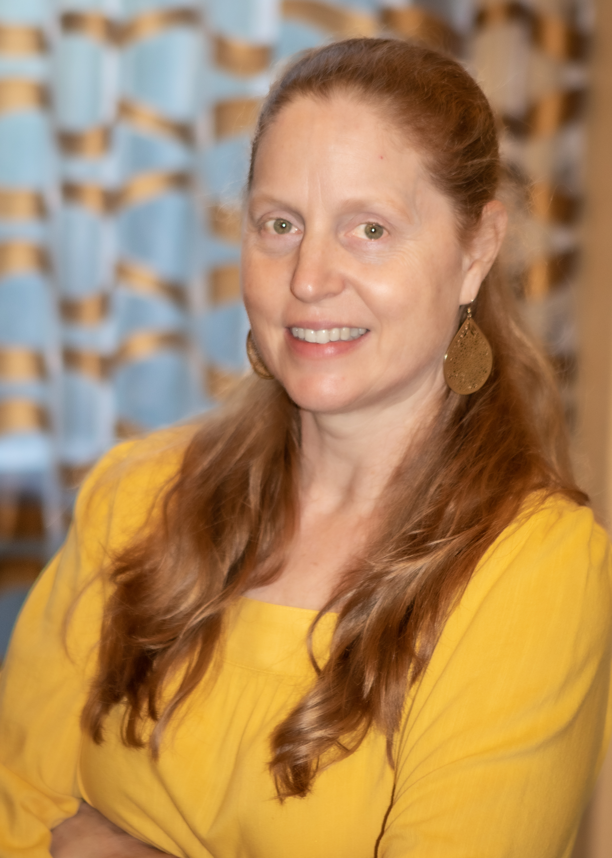
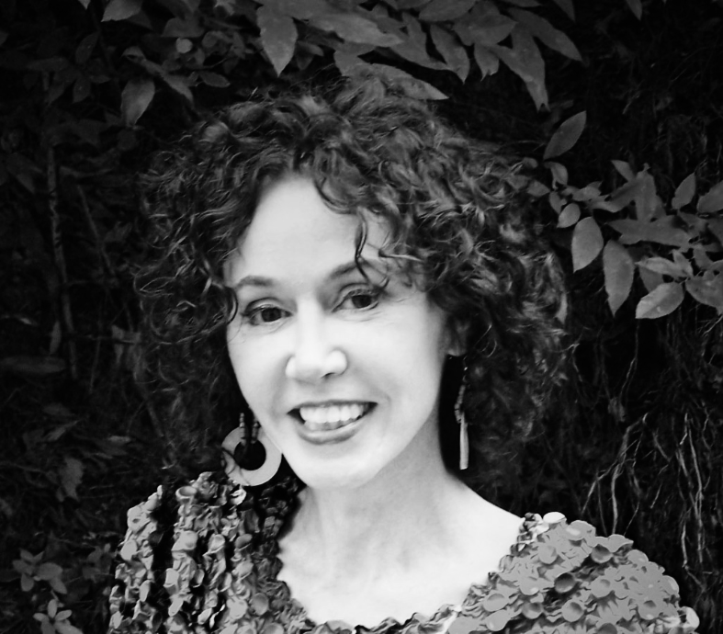
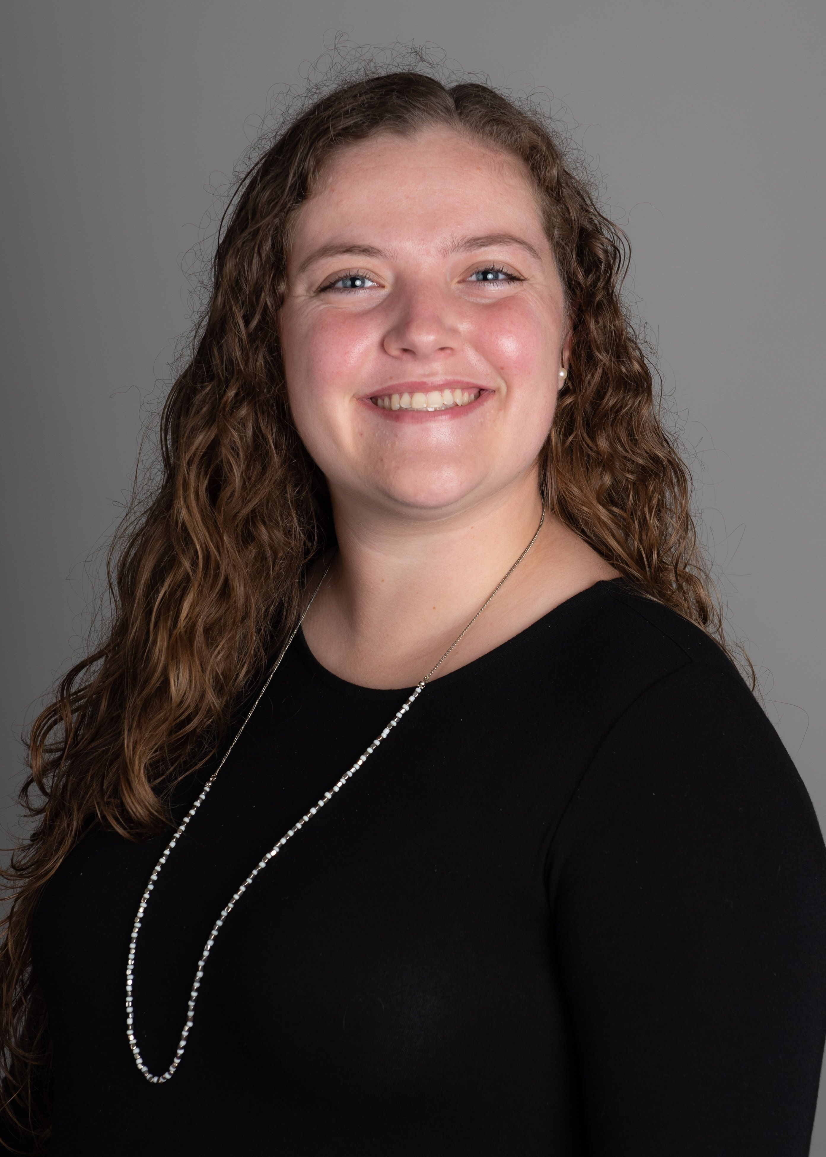
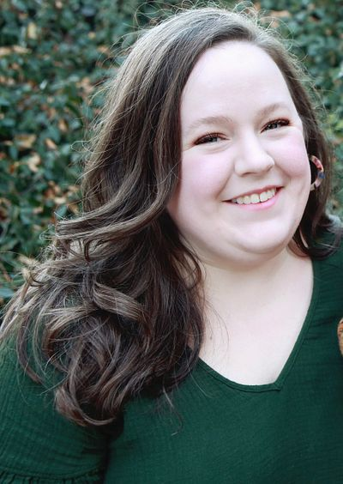
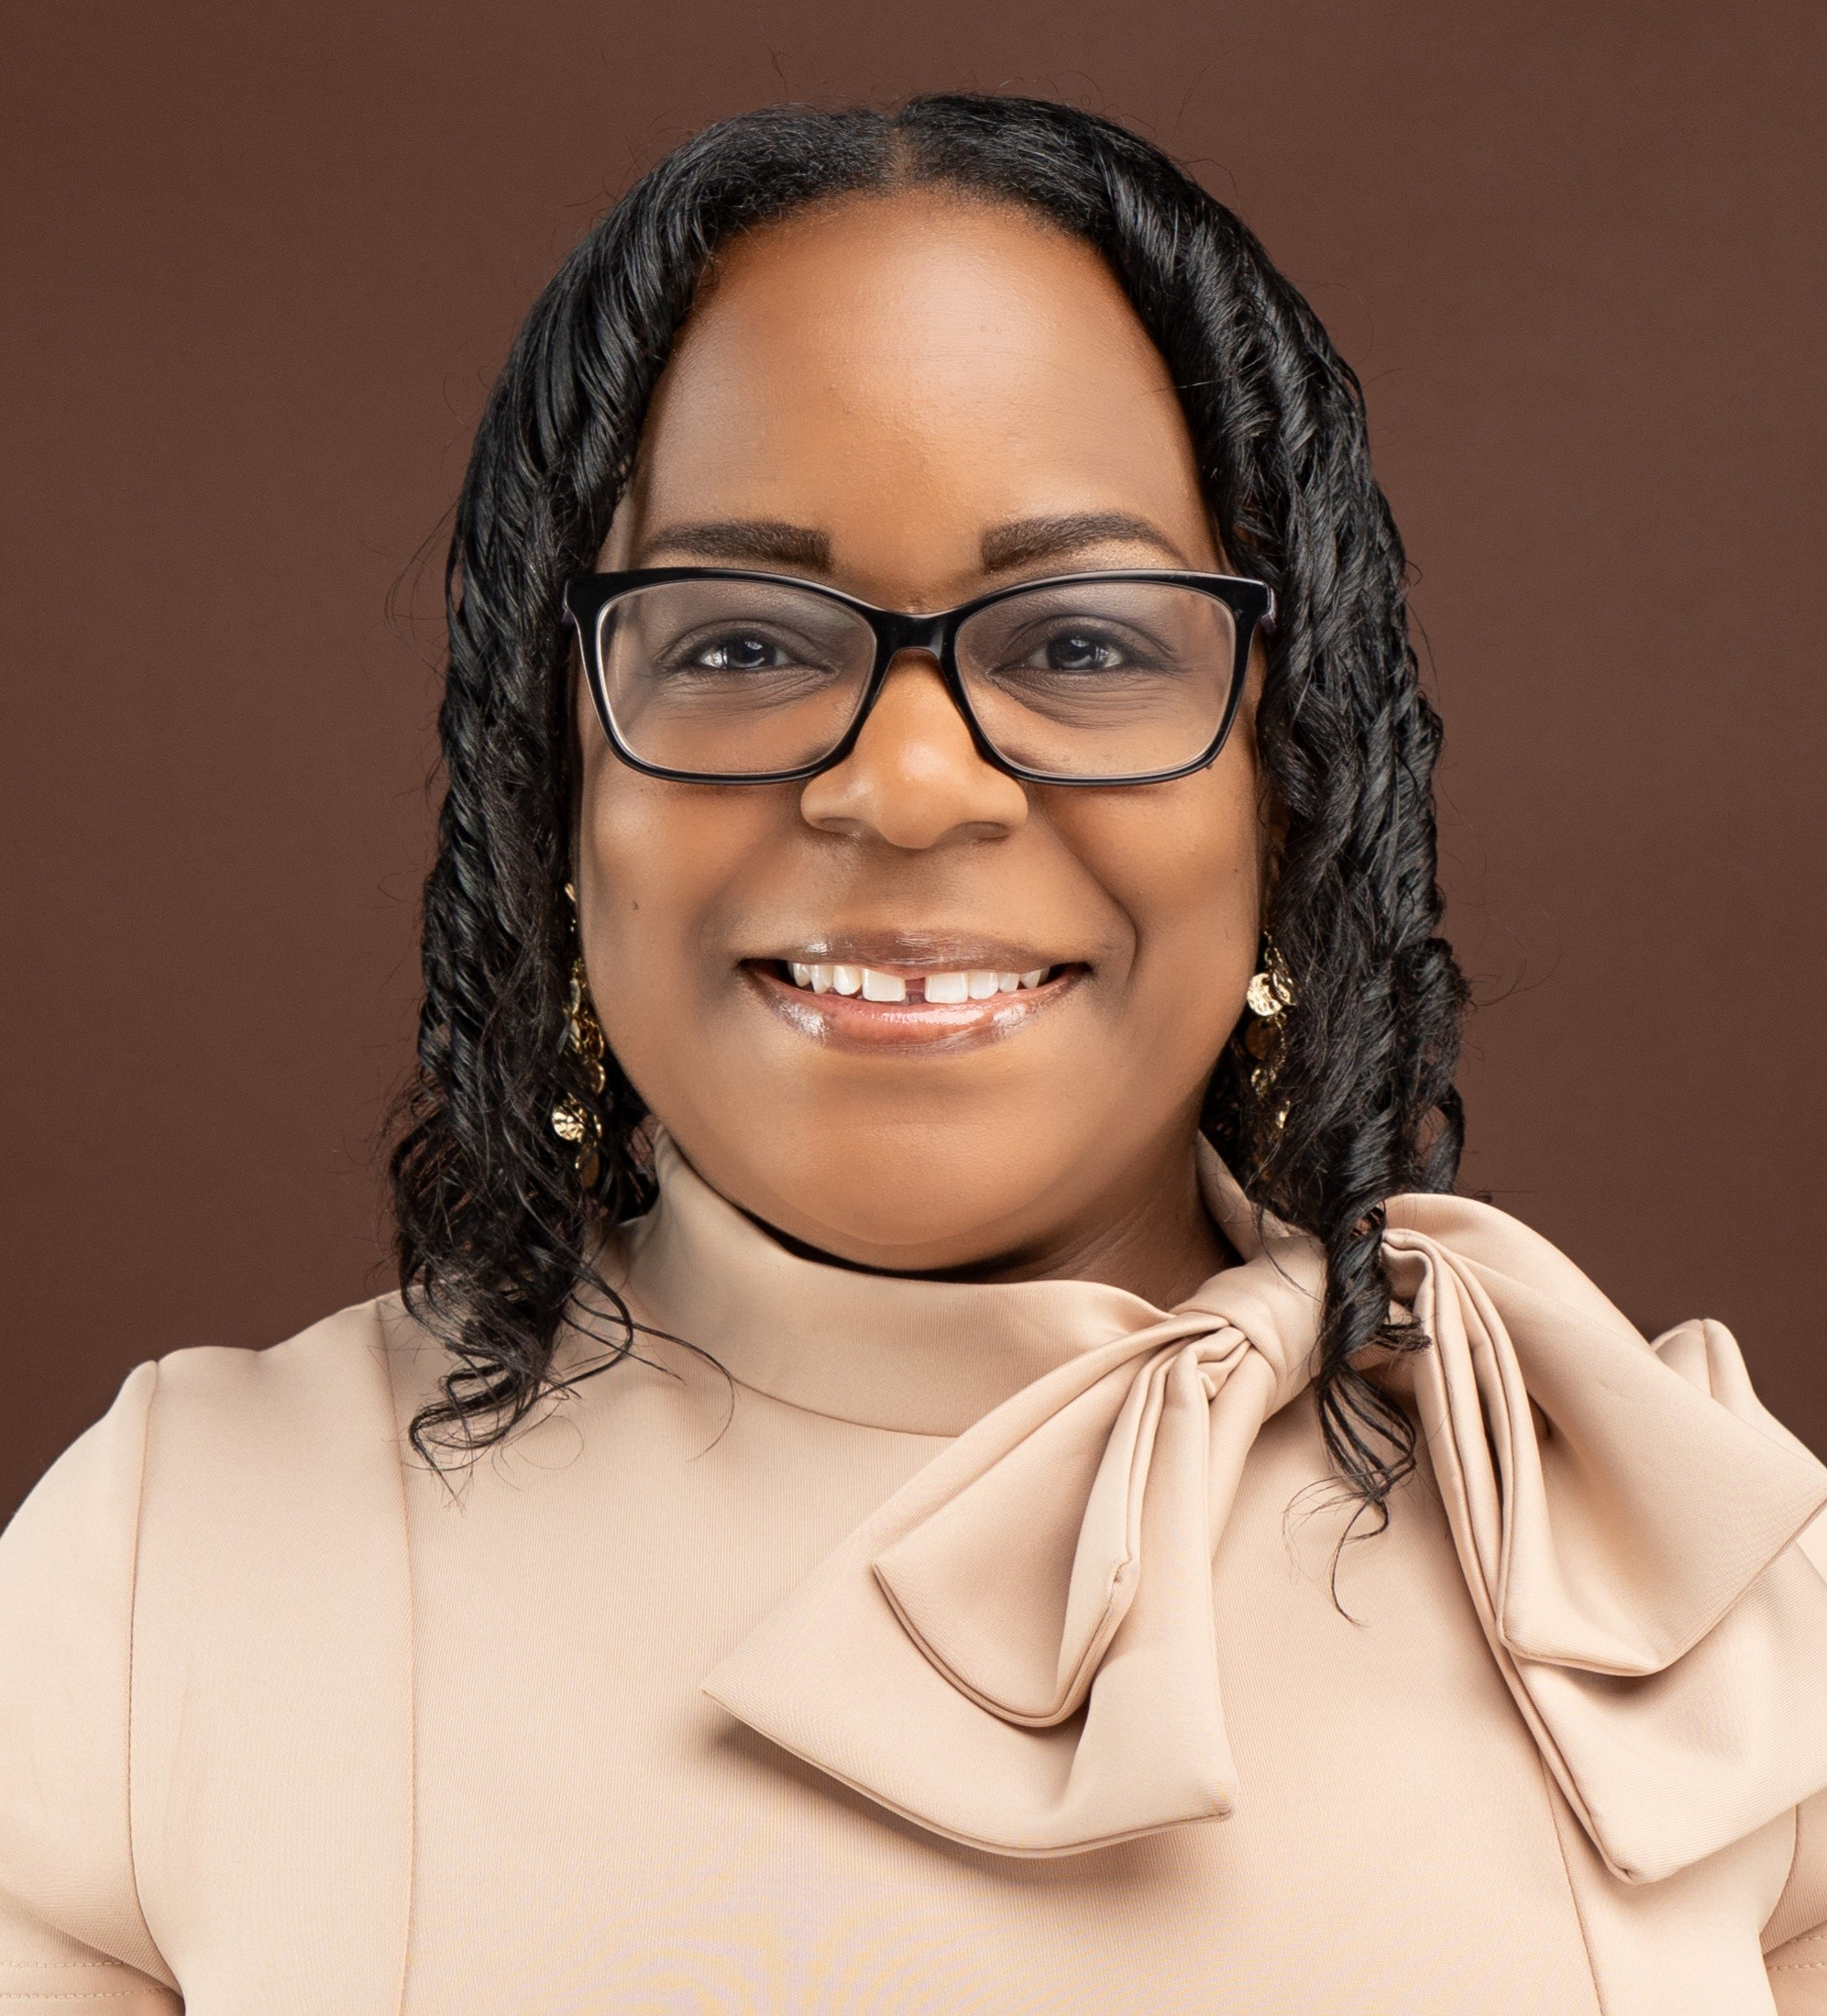
CSP Team Contact Information
Anne L. Geissinger
Leadership, Collaboration & Partnership
Anne.geissinger@dhhs.nc.gov
Jane Ann Miller
Suicide Prevention Expert, Programming & Counseling on Access to Lethal Means (CALM)
Jane.miller@dhhs.nc.gov
Abby Coffey
Evaluation, Faith Leaders for Life (FLFL) & Start with Veterans (SWV)
Abigail.coffey@dhhs.nc.gov
Megan Lueck
Communication Expert, Advisory Council (CSPAC) & Firearm Safety Teams (FST)
Mlueck@email.unc.edu
Isley Cotton
Youth Suicide Prevention Expert
Isley.cotton@dhhs.nc.gov

