Slide 1


Enhanced Barrier Precautions
Infection Prevention Education
Notes:
Welcome participants

Slide 2
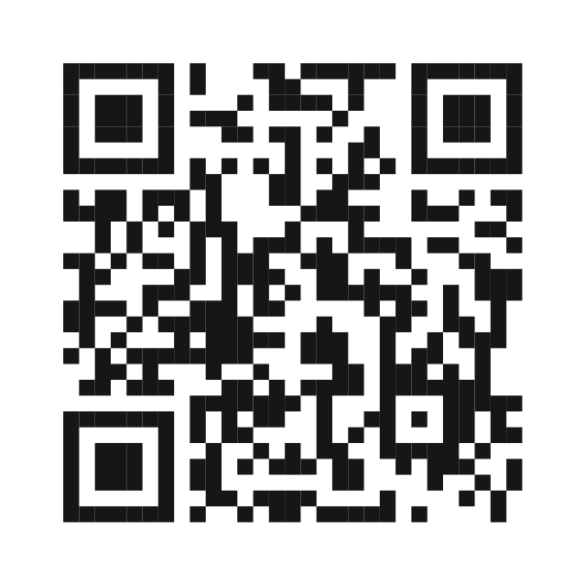
Pre-assessment https://forms.office.com/g/swQ9i2PAJK
Notes:
Please take 5 minutes to complete this pre-assessment. If you do not have a smart phone, please partner up with another participant. All responses will be kept anonymous. This assessment allows the infection prevention team to monitor the impact of our modules.

Slide 3
Know, Want to Know, Learned (KWL) Chart
Want to Know
Know
Learned
SOURCE:
Notes:
Before we start today’s module, we will complete the first two sections of a KWL chart. A KWL chart is a “Know, Want to Know, Learned” chart. Please partner up in groups of three. With your sticky notes, please write down everything you already know about enhanced barrier precautions and what you would like to know about them. You will have 7 minutes to brainstorm ideas. Please select one representative from your group to share what you all came up with and add your sticky notes to the group chart.

Slide 4
Overview
Pre-assessment
KWL Chart
EBP Presentation
Real Life Scenarios
KWL Chart
Post-assessment
Notes:
For today’s module, we will focus on these 6 focus areas, two of which you’ve already completed! Next, we will have a presentation on enhanced barrier precautions. We will follow this presentation with some more group activities. We will go over some real life scenarios and complete the rest of the KWL chart. Once we have completed these activities, you will be asked to complete a post-assessment and we will be done for the day.

Slide 5

What are Enhanced Barrier Precautions?
A way to help stop the spread of infections, such as multidrug-resistant organisms (MDROs)
Notes:
To begin, let’s define enhanced barrier precautions, otherwise called EBP. EBP are a way to help stop the spread of infections, or germs, from spreading to residents. For example, multidrug-resistant organisms, also referred to as MDROs, are infections that residents can get that can not be treated with some antibiotics.

Slide 6

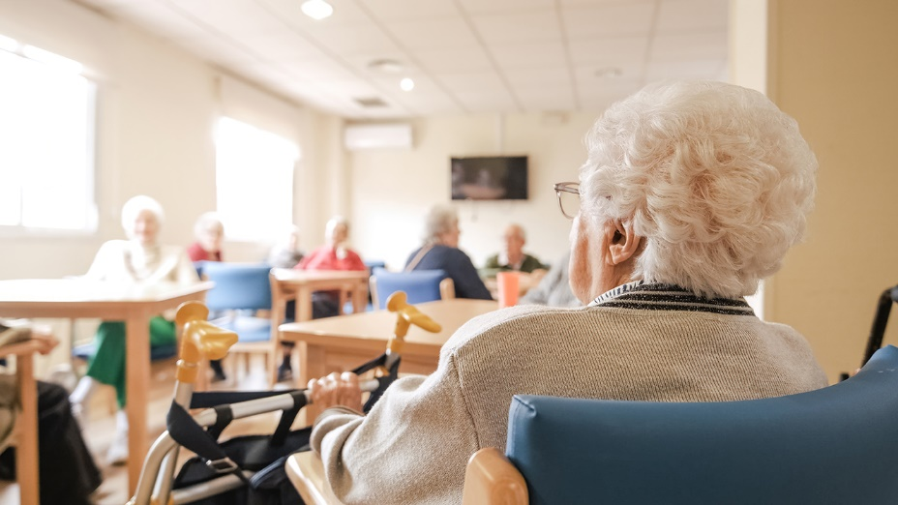
What are Enhanced Barrier Precautions?
A way to help stop the spread of infections, such as multidrug-resistant organisms (MDROs)
Specific to nursing homes
Notes:
Enhanced barrier precautions are specific to nursing homes.

Slide 7


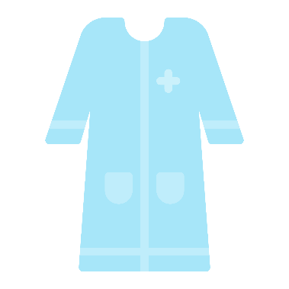

What are Enhanced Barrier Precautions?
A way to help stop the spread of infections, such as multidrug-resistant organisms (MDROs)
Specific to nursing homes
Require gown and glove use during high-contact resident care activities
Notes:
When EBP are in place, health care providers are required to use a gown and gloves during high-contact resident care activities. We will go over what those involve later in the presentation.

Slide 8
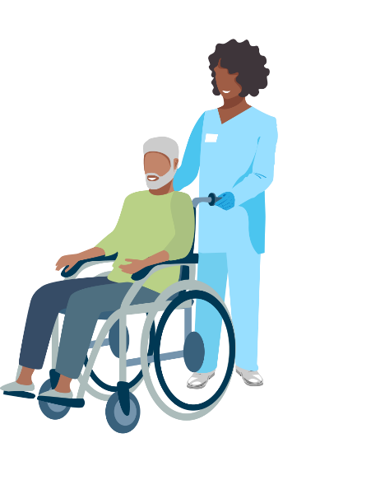
What are Enhanced Barrier Precautions?
A way to help stop the spread of infections, such as multidrug-resistant organisms (MDROs)
Specific to nursing homes
Require gown and glove use during high-contact resident care activities
Specifically for residents known to have a MDRO or at risk of becoming infected with a MDRO
Notes:
EBP are put in place specifically for residents known to have a MDRO or are at risk of becoming infected with a MDRO. Your facility leadership will inform you when a resident should be placed on EBP.

Slide 9
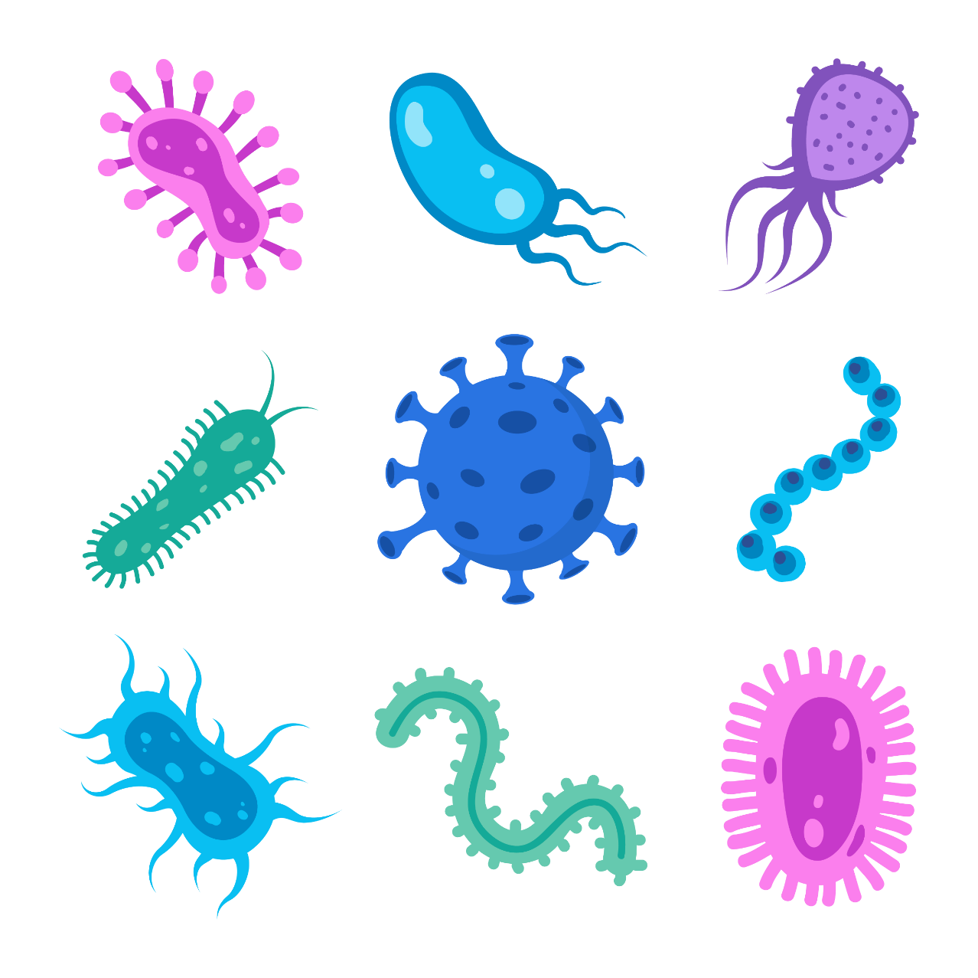
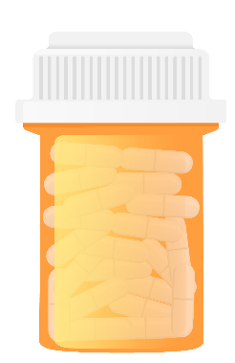
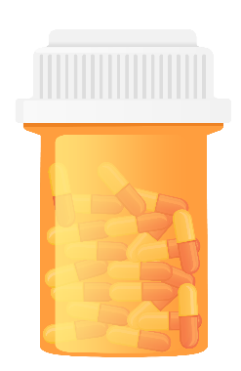

What is a MDRO?
Microorganisms, usually bacteria, that don’t respond to many types of medication
This makes them very hard to treat
Multidrug-resistant organism
Notes:
MDRO stands for multidrug-resistant organism. These microorganisms, usually bacteria, don’t respond to many types of medication, which makes them very hard to treat. We want to prevent MDROs from spreading between residents.

Slide 10

What residents are at risk of being infected with a MDRO?
Residents with wounds
Residents with indwelling medical devices
  Central Venous Catheters (CVC)
  Peripherally Inserted Central Catheters (PICC lines)
  Urinary catheters
  Foley catheters
  Feeding tubes
  Tracheostomy tubes
  Etc.
Catheter
Notes:
Some residents are more at risk of being infected with MDROs than others. This includes residents with wounds and indwelling medical devices. Remember enhanced barrier precautions are specifically for residents known to have a MDRO or at risk of becoming infected with a MDRO.

Slide 11
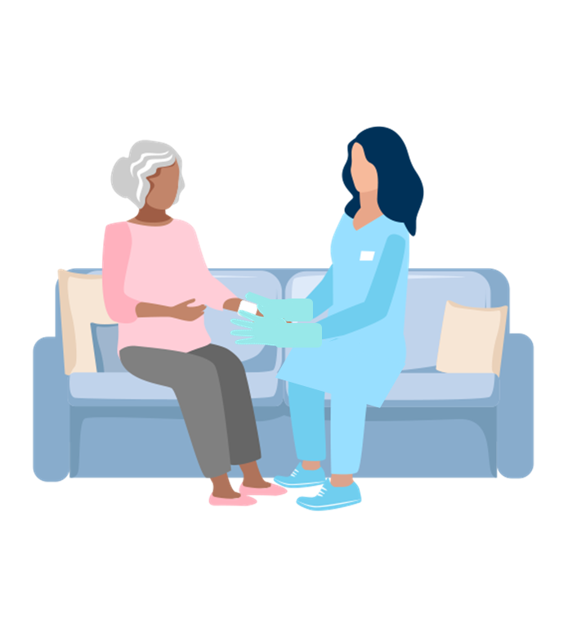
What are high-contact resident care activities?
Dressing
Bathing/showering
Transferring
Changing linens
Providing hygiene
Changing briefs or assisting with toileting
Device care or use:
  Central line, urinary catheter, feeding tube, tracheostomy
Wound care: any skin opening requiring a dressing
Notes:
When a patient is on enhanced barrier precautions, providers are required to wear a gown and gloves during high-contact resident care activities. High-contact resident care activities include dressing, bathinchangingg/showering, transferring, changing linens, providing hygiene, briefs or assisting with toileting, device care or use, and wound care.

Slide 12
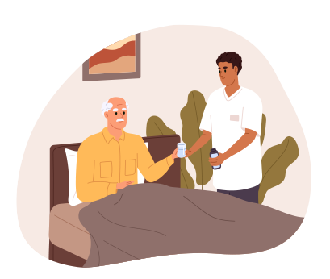
What are not high-contact resident care activities?
Changing the channel on the TV
Delivering a snack
Conversing
Adjusting pillows or moving furniture
Notes:
Many activities do count as high-contact resident care activities. Examples include: changing the channel on a resident’s tv using a remote, bringing a snack, conversing with the patient, adjusting pillows or moving personal items like furniture.

Slide 13

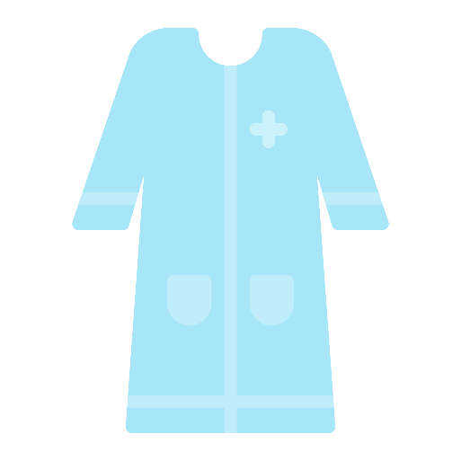
Personal Protective Equipment (PPE)for EBP
Minimum: Gloves and gowns
Additional PPE may be required depending on the resident.
  Example: Face protection is needed for activities where splashes and sprays are likely
Notes:
While gown and gloves are required for patients on enhanced barrier precautions, additional PPE may be necessary depending on the resident. For instance, if splashes and sprays of bodily fluids are likely, face protection is also needed. To care for this resident, you would need gown, gloves, and a face shield.

Slide 14
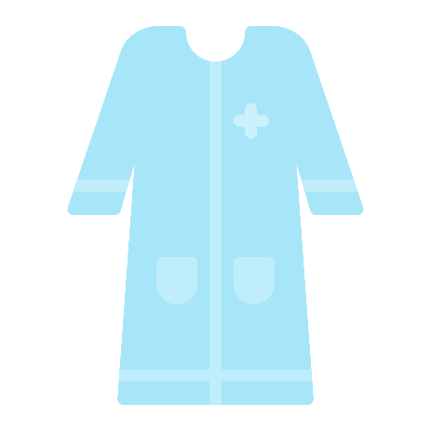

Disposing of PPE
Throw away PPE in resident’s room in appropriate disposal container
Do not wear the same gown and gloves to care of more than one person
Notes:
Once you are done providing care for the resident on enhanced barrier precautions, it is important to dispose of your PPE immediately. Make sure you through away used PPE in the resident’s room in the appropriate disposal container, and do not wear the same gown and gloves to care for more than one person. This is very important to remember.

Slide 15
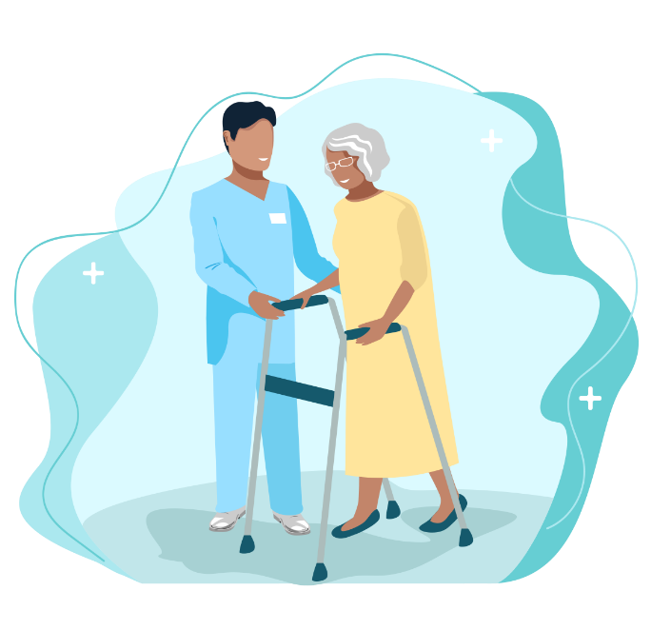

Is Physical or Occupational Therapy a “high-contact” resident care activity?
Therapists should use gowns and gloves with residents on EBP in the therapy gym or in the resident’s room.
Remove gowns and gloves and perform hand hygiene before working with another resident.
Clean and disinfect reusable therapy equipment after each use.
Notes:
Depending on the activity, therapy may be considered "high-contact" resident care. Therapists should use gowns and gloves when working with residents on Enhanced Barrier Precautions in the therapy gym or in the resident's room if they anticipate prolonged, close body contact where transmission of MDROs to the therapist's clothes is possible. As part of Standard Precautions, gowns and gloves should be removed and hand hygiene performed when moving to work with another resident. Therapists should also ensure reusable therapy equipment is cleaned and disinfected after each use and surfaces in the therapy gym receive routine cleaning and disinfection.

Slide 16
PPE in hallways during therapy
If therapy must occur outside of a resident’s room or therapy gym, gown and gloves can be used outside of the room or gym
Notes:
EBP should not limit a resident's ability to continue their medical therapy, so while the use of a gown and gloves is generally discouraged in hallways and other common areas, there may be individual circumstances (e.g., therapy that has to occur outside of the resident's room or therapy gym) that prompt an evaluation for the need to use PPE outside of the room or gym, depending on the degree of assist/close contact.

Slide 17

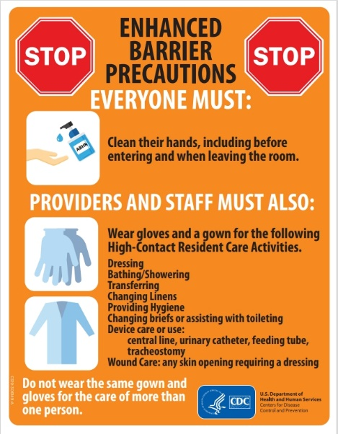
How long should a resident be on Enhanced Barrier Precautions?
Residents on EBP will have a sign hanging outside their room
EBP should be used until leadership at your facility removes the sign
Notes:
Leadership in your facility will decide how long residents should be on enhanced barrier precautions. When a resident is placed on enhanced barrier precautions, a sign will be placed outside of their room. As long as a sign is located outside of a resident’s room, enhanced barrier precautions should be followed.

Slide 18
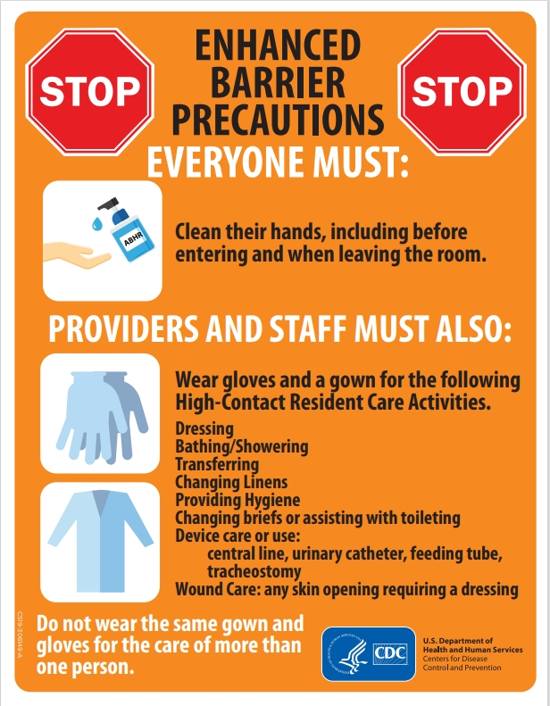
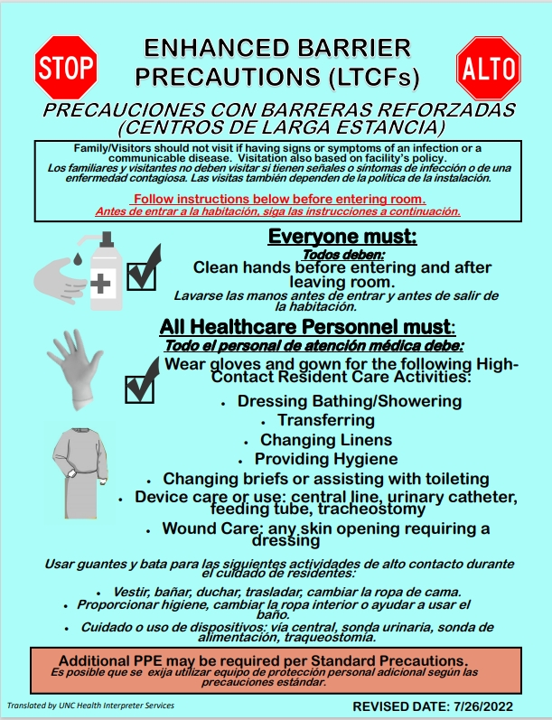
Practicing EBP
Notes:
Here are examples of what an enhanced barrier precaution sign may look like outside of a resident’s room. There are two main signs in NC that facilities use. They could see either of these depending on which one their facility chooses to use (CDC or SPICE)
https://www.cdc.gov/long-term-care-facilities/media/pdfs/enhanced-barrier-precautions-sign-P.pdf
https://spice.unc.edu/wp-content/uploads/2022/07/Enhanced-Barrier-SPICE-FINAL-with-translation-page-print_rev_7_26_22.pdf

Slide 19
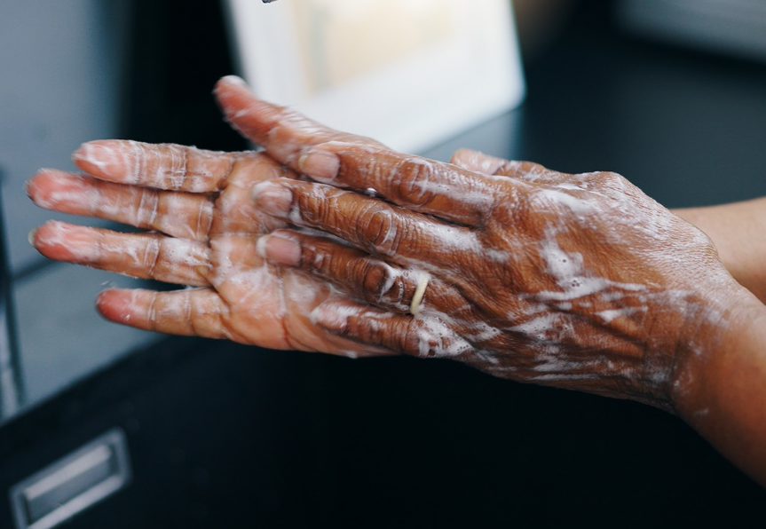
With or without EBP…
Everyone must: Clean their hands before entering and leaving the room
Notes:
As we do with any room, no matter if they are on precautions or not - we always use hand hygiene before entering a resident's room.

Slide 20

With EBP…
Everyone must: Clean their hands before entering and leaving the room
Providers and staff must also: Wear gloves and gown for high-contact care activities
Notes:
With enhanced barrier precautions, providers and staff must also wear gown and gloves for high-contact care activities.

Slide 21
With EBP…
Everyone must: Clean their hands before entering and leaving the room
Providers and staff must also: Wear gloves and gown for high-contact care activities
Do not wear the same PPE to care for more than one resident
Notes:
And remember, do not wear the same PPE to care for more than one resident. Remove the used PPE in the resident’s room after performing high-contact care activates.

Slide 22

Scenarios
Notes:
Now we have finished covering the content of today’s module, let’s get back into our groups to go over some real life scenarios.

Slide 23
Know, Want to Know, Learned (KWL) Chart
Want to Know
Know
Learned
Notes:
Now that we have completed today’s module, we will complete the “Learned” section of the KWL chart. You will have 7 minutes to brainstorm ideas. Please select one representative from your group to share what you all came up with and add your sticky notes to the group chart.

Slide 24
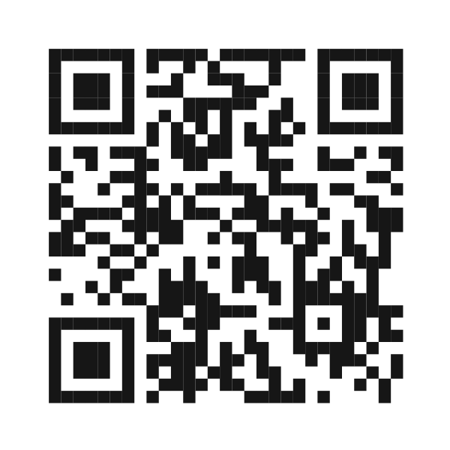
Post-assessment https://forms.office.com/g/VfQ8S5z5vW
Notes:
Please take 5 minutes to complete this post-assessment. All responses will be kept anonymous. https://forms.office.com/Pages/ResponsePage.aspx?id=3IF2etC5mkSFw-zCbNftGZwLhkl927NJtGWhRDsHuapUNVRJTFhWTlZQS0U4RDhKS1BZSlM4TDFKSi4u

Slide 25
Thank you!
infectionprevention@dhhs.nc.gov
Notes:
Thank you for participating in today’s module on Enhanced Barrier Precautions! If you have any additional questions beyond today’s session, please feel free to reach out to our team at infectionprevention@dhhs.nc.gov!

Slide 26
Additional Resources
NCDHHS: Infection Prevention Education | Division of Public Health
CDC: Implementation of Personal Protective Equipment (PPE) Use in Nursing Homes to Prevent Spread of Multidrug-resistant Organisms (MDROs) | LTCFs
Notes:
Here are some links with more information about enhanced barrier precautions. Infection Prevention Education | Division of Public Health

