Slide 1
Training for RN dispensing
Updated June 2024
INSERT TRAINING PHARMCIST INFORMATION HERE

Slide 2
Objectives
Review the NC rules and regulations pertaining to RN dispensing
Review definitions related to dispensing, packaging, labeling and dispensing of medications.
Review legal requirements for prescribing, dispensing, record keeping and permits.
Review the process for RN dispensing and administration of medications.
Discuss the relationship between the pharmacist-manager, the local health department nurses, health department administration, and the North Carolina Board of Pharmacy
Review the process of dispensing/distribution of Epi-pens and naloxone
Overview of 340B program and its requirements

Slide 3
Pharmacy Law
For public health nurse dispensing
1985: G.S. 90-85.34A
Granted registered nurses in local health department clinics limited authority to dispense drugs and devices
1987: NCAC 46.2400
Rules passed to further explain statute provisions
2008
The required language for dispensing a prescription includes referral to FDA
2015: NCAC 46.2401-2403
Allows dispensing of opioid antagonists and epinephrine auto-injectors to health department patients or others.
“Call your doctor for medical advice about side effects. You may report side effects to FDA at 1-800-FDA-1088.”

Slide 4
Manual for “DISPENSING OF DRUGS BY PUBLIC HEALTH REGISTERED NURSES”
This document is meant to serve as guidance and training for public health nurses to understand pharmacy law
The manual contains:
Definitions, review of legislation, requirements for prescription orders, labels, packaging, and records, patient counseling requirements, responsibilities of the pharmacist, etc.
The General Statues, Administrative Code, and NC Board of Pharmacy are the most accurate and up-to-date reflection of pharmacy law
Notes:
https://www.dph.ncdhhs.gov/media/742/download?attachment

Slide 5
Pharmacy Laws
A registered nurse in a local health department clinic may dispense prescription drugs and devices, other than controlled substances as defined in § 90‑85.34A, under the following conditions:
  The registered nurse has acceptable training
  Dispensing occurs only within the local health department clinic
  Only prescription drugs and devices contained in the formulary are allowed to be dispensed
  The local health department has a permitted pharmacy
  Written procedures for storage, packaging, labeling, and delivery of prescription drugs are in place
  The pharmacist-manager reviews dispensing records regularly
§ 90-85.34A Public health pharmacy practice
21 NCAC 46.2402 Training of health department nurses
Notes:
https://www.ncleg.gov/EnactedLegislation/Statutes/PDF/BySection/Chapter_90/GS_90-85.34A.pdf
(6) The pharmacist-manager shall verify the accuracy of the records at least weekly, and where health department personnel dispense to 30 or more patients in a 24-hour period per dispensing site, the pharmacist-manager shall verify the accuracy of the records within 24 hours after dispensing occurs.

Slide 6

Key Points
The general statute pertains to registered nurses only. Dispensing privileges are not granted to LPNs, practical nurses, nursing assistants, nurses’ aides, or medical office assistants.
  This does not impact the practice of nurse practitioners or physician assistants
The person to whom a prescription is dispensed must be a patient of the local health department
  Chart record must exist with medical encounter opened for the date of service
  A provider must be responsible for the patients’ health and/or medical interventions
  EXCEPTIONS → naloxone kits & epinephrine auto-injectors

Slide 7
Drugs and devices to be dispensed
The formulary of drugs and devices that can be dispensed by public health nurses is no longer outlined specifically in the North Carolina General Statutes
For reference, the NC Board of Pharmacy may update the formulary here:
  https://www.ncbop.org/faqs/pharmacist/faq_HDRNDispensing.htm#:~:text=The%20registered%20nurse%20must%20have,be%20dispensed%3B%20the%20local%20health
Notes:
Q: What drugs may registered nurses (RNs) dispense from a health department?
A: Effective October 1, 2022, the following formulary (recommended by NCDHHS and approved by the Board of Pharmacy) governs RN dispensing from a health department:
Anti-tuberculosis drugs, as recommended by the North Carolina Department of Health and Human Services in the North Carolina Tuberculosis Policy Manual (available at www.ncdhhs.gov), when used for the treatment and control of tuberculosis;
Anti-infective agents used in the control of sexually-transmitted diseases as recommended by the United States Centers for Disease Control in the Sexually Transmitted Diseases Treatment Guidelines (available at www.cdc.gov);
Natural or synthetic hormones and contraceptive devices when used for the prevention of pregnancy;
Topical preparations for the treatment of lice, scabies, impetigo, diaper rash, vaginitis, and related skin conditions;
Vitamin and mineral supplements;
Opioid antagonists prescribed pursuant to G.S. 90-12.7;
Epinephrine auto-injectors prescribed pursuant to G.S. 115C-375.2A;
Over-the-counter nicotine replacement therapies;
Folic acid for prevention of neural tube defects and other related conditions;
Low-dose aspirin for prevention or delayed onset of preeclampsia in pregnant individuals with increased risk of pre-eclampsia as defined by the American College of Obstetricians and Gynecologists and the Society for Maternal-Fetal Medicine (criteria available at ACOG Practice Advisory)
NO controlled substances can be dispensed by registered nurses
This has been repealed from the administrative code

Slide 8
Definitions
Healthcare Provider | Any licensed health care professional; any agent or employee of any health care institution, health care insurer, health care professional school; or a member of any allied health profession. [§ G.S. 90-85.3i]
Prescriber | Anyone authorized to prescribe drugs pursuant to the laws of this State. [§ G. S. 90-85.27(5)]
Permit | A permit to operate a pharmacy, deliver medical equipment, or dispense devices, including a renewal license issued by the Board. [§ G.S. 90-85.3m]
Pharmacy | Any place where prescription drugs are dispensed or compounded. [§ G.S. 90-85.3q] 'Pharmacy personnel' means pharmacists and pharmacy technicians. [§ G.S. 90-85.3(q1)] 'Pharmacy technician' means an unlicensed person who, under the supervision of a pharmacist, perform technical functions to assist the pharmacist in preparing and dispensing prescription medications and is subject to the registration requirements under G.S. 90-85.15A. [§ G.S. 90-85.3(q2)]

Slide 9
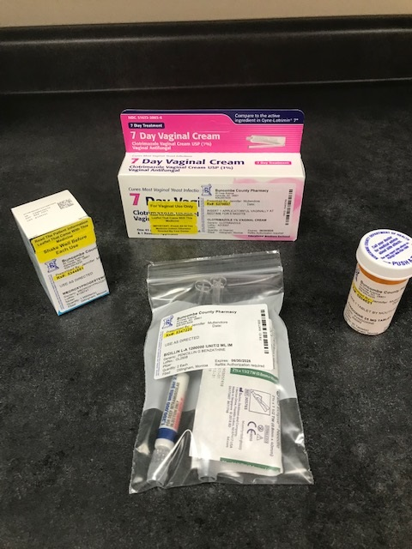
Definitions
"Label"
"Labeling"
“Prescription order”
“Prescription” or “Legend” drug
Written or verbal order for a prescription drug, prescription device, or pharmaceutical service from a person authorized by law to prescribe such drug, device, or service. A prescription order includes an order entered in a chart or other medical record of a patient. [§ G.S. 90-85.3t]
Display of written, printed or graphic matter upon the immediate or outside container of any drug. [§ G.S. 90-85.3j]
Preparing and affixing a label to any drug container, exclusive of labeling by a manufacturer, packer or distributor of a nonprescription drug or a commercially packaged prescription drug or device. [§ G.S. 90-85.3k]
Defined as one that bears the statement “CAUTION: Federal Law prohibits dispensing without prescription” on the label of the manufacturer’s original package.
This includes a standing order

Slide 10
Definitions
Administer | The direct application of a drug to the body of a patient by injection, inhalation, ingestion or other means. [§ G.S. 90-85.3(a)]
Dispense | Preparing and packaging a prescription drug or device in a container and labeling the container with information required by State and federal law. Filling or refilling drug containers with prescription drugs for subsequent use by a patient is "dispensing." Providing quantities of unit dose prescription drugs for subsequent administration is “dispensing.”
Distribution | The delivery of a drug or device other than by administering or dispensing (ie. Naloxone) as described in the STOP Act
Misbranding | Any labeling that is false, misleading, inaccurate, incomplete, or otherwise does not comply with the requirements outlined in NC G.S.§ 106-134.
Notes:
https://www.ncleg.gov/EnactedLegislation/Statutes/PDF/BySection/Chapter_106/GS_106-134.pdf

Slide 11
Prescription Requirements
Prescription Order
Prescription Label
Prescription Records
Name and address of the dispensing pharmacy.
Serial number of the prescription.
Date of the prescription.
Name of the prescriber.
Name of the patient.
Name and strength of the drug.
The generic name of the drug.
Quantity dispensed if quantity of refill is different than quantity of original.
Directions for use.
Appropriate cautionary statements.
“Filled by” or “dispensed by” with the name of the dispensing pharmacist.
A discard date, which shall be the earlier of one year from the date dispensed or the manufacturer’s expiration date, whichever is earlier. The label must not obscure the expiration date and storage statement when the product is dispensed in the manufacturer's original container.
Date of dispensing.
Serial number (or equivalent in an institution).
The identification of the pharmacist responsible for dispensing.
Records of refills to date.
Documentation of satisfaction of state requirements for drug selection. (This refers to manufacturer of brand or generic drug)
Records in institutional pharmacies may be made and kept as part of the patient's medical record. [21 NCAC 46.2302]
Date of issuance.
Name and address of patient.*
Name, address and telephone number of prescriber.*
Drug Enforcement Agency (DEA) number of prescribers in the case of controlled substances.*
Name, strength, dosage form and quantity of drug prescribed.
Refills if authorized or, in institutions, the stop date.*
Route of administration of drug prescribed*
*May be stored in a readily retrievable data file specifically compiled for use in the pharmacy, which is not a commercial publication
Directions for use.

Slide 12
Prescription order requirements
Prescription orders shall include, but not be limited to:
(1) date of issuance;
(2) name and address of patient
(3) name, address and telephone number of prescriber
(4) Drug Enforcement Agency (DEA) number of prescriber in the case of controlled substances
(5) name, strength, dosage form and quantity of drug prescribed
(6) refills if authorized or, in institutions, the stop date
Refills noted as “PRN” or “as needed” can be refilled for up to 1 year from order date
(7) route of administration of drug prescribed
(8) directions for use
21 NCAC 46.2301 Prescription: Drug Order Requirements
Notes:
The statute prohibits the dispensing of controlled substances of any kind by registered nurses. Controlled substances are those licit and illicit drugs listed in the federal controlled substance schedules I through V, and/or the state controlled substances schedules I through VI. Among the most common licit drugs included in the controlled substance schedules are narcotics, amphetamines, barbiturates, certain sedatives and tranquilizers, and codeine-containing cough preparations.

Slide 13
Prescription dispensing requirements
Prescription drugs may be dispensed only:
  Upon written/electronic prescription by a licensed practitioner
  Upon verbal order given by a licensed practitioner which is reduced promptly to written/electronic order
  By refilling any written/electronic or verbal order if refills were authorized in the original order
  A standing order is also a valid form of a prescription order and allows for dispensing of prescription drugs as above

Slide 14
PLACEHOLDER SLIDE
Include LHD Pharmacy labels here as an example

Slide 15
Prescription label requirements
The most up-to-date list of requirements is found on the NC BOP website under FAQs:
“Q: What information is required to be on the prescription label?”
(https://www.ncbop.org/faqs/Pharmacist/faq_Prescriptions.html#Labeling)
Notes:
The discard date must be added when the medication is dispensed in a container other than the original manufacturer container.
- The discard date shall be:
One year from the date of dispensing OR
the manufacturer’s expiration date
Whichever is earlier
- If using the original manufacturer container, the label cannot obscure the printed expiration date and storage information on the original bottle
This applies also to all nonprescription drugs ONLY if they are removed from the manufacturer’s original container and dispensed to a patient (e.g., multivitamins are not subject to these rules)
Looking at this label, what is missing of the required elements?
A: The following information must be on every prescription label:
1. Name and address of the dispensing pharmacy.
2. Serial number of the prescription.
3. Date of the prescription.
4. Name of the prescriber.
5. Name of the patient.
6. Name and strength of the drug.
7. The generic name of the drug, even if the generic drug is unavailable to dispense or even if the substitution of a generic drug is not authorized.
8. Directions for use.
9. Appropriate cautionary statements.
10. “Filled by” or “dispensed by” with the name of the dispensing pharmacist. The name must include, at a minimum, the first initial and full last name of the dispensing pharmacist.
11. If the dispensed drug is a “tranquilizer or sedative,” it should bear the warning “The consumption of alcoholic beverages while on this medication can be harmful to your health” if the prescriber so directs on the prescription.
12. If the prescription is dispensed in a container other than the manufacturer’s original container, a discard date, which shall be the earlier of one year from the date dispensed or the manufacturer’s expiration date, whichever is earlier.
13. If the prescription is dispensed in the manufacturer’s original container, the label must not obscure the expiration date and storage statement when the product is dispensed in the manufacturer's original container.
21 U.S.C. § 353(b)(2);GS § 90-85.29, GS § 106-134.1(b), 21 NCAC 46.1818.
These requirements do not prohibit pharmacists from including additional information on the label. For example, no federal or North Carolina statute requires that the label indicate the number of refills remaining. But such information is, for obvious reasons, typically included on the prescription label.

Slide 16
PLACEHOLDER SLIDE
Include LHD Pharmacy labels here as an example

Slide 17
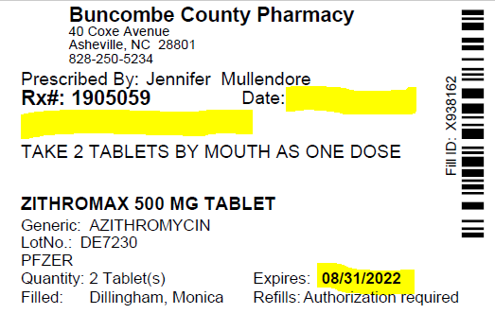
Prescription label requirements
RN must modify the following:
  Patient’s name must be written on the label underneath the RX #
  Date of dispensing must be entered as the date of service
  Expiration must be changed to 1 year from the date of dispensing, unless expiring earlier, then leave as is.
  RN must initial
9/1/2021
County Resident
ABC

Slide 18
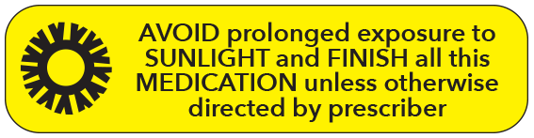



Prescription packaging requirements
Auxiliary labeling and cautionary statements must be attached
Poison prevention packaging (safety lock closures) must be used, unless otherwise requested by the patient
  Safety cap closures on prescription bottles cannot be opened by 80% of children under the age of five but can be opened by 90% of adults.
  Patients may designate all their prescriptions to use non-safety packaging if
  needed

Slide 19
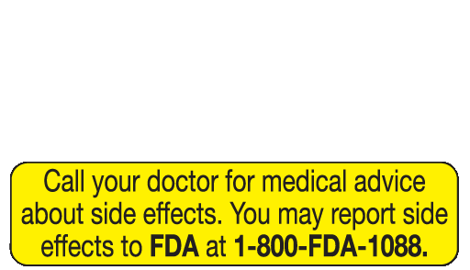
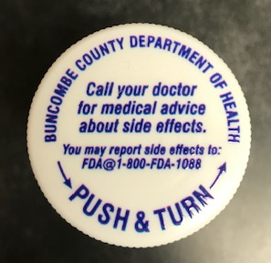
Prescription packaging requirements
The following statement must be included on the packaging:
Prescriptions packaged without the proper poison prevention closures, warning labels, or appropriate storage conditions are considered “misbranded”

Slide 20
Other requirements
Prescription records must be maintained for a minimum of 5 years
Patient counseling must be offered
    (1) name, description, and purpose of the medication
    (2) route, dosage, administration, and continuity of therapy
    (3) special directions for use by the patient
    (4) common severe side or adverse effects or interactions and therapeutic contraindications that may be encountered, including their avoidance, and the action required if they occur
    (5) techniques for self-monitoring drug therapy
    (6) proper storage
    (7) prescription refill information (if applicable)
    (8) action to be taken in the event of a missed dose.
Notes:
An offer to counsel shall be made on new or transfer prescriptions at the time the prescription is dispensed or delivered to the patient or representative. Ancillary personnel may make the offer to counsel, but the pharmacist must personally conduct counseling if the offer is accepted.
Professional judgment shall be exercised in determining whether or not to offer counseling for prescription refills. An offer to counsel shall be communicated in a positive manner to encourage acceptance

Slide 21
Electronic Records
Unless otherwise specified in the rules in this Section or other applicable law, any documentation required by the rules in this Section may be electronically created and maintained, provided that the system that creates and maintains the electronic record:
(1) is capable of printing the documentation so that the pharmacist-manager can provide it to the Board within 48 hours of a request;
(2) contains security features to prevent unauthorized access to the records; and
(3) contains daily back-up functionality to protect against record loss.
(21 N.C. Admin. Code 46 .2508)

Slide 22





Medical histories
Obtain medical history to obtain the following:
Age and social history to identify contraindications
Current disease states to identify contraindications to therapy
Updated medication list to identify potential drug-drug interactions
Updated allergy list to identify drug-allergy interactions
Notes:
Age and social history to identify contraindications
Ex. Advanced age and smoking history in patient who is requesting oral contraceptives
Current disease states in order to identify contraindications to therapy
Ex. Hypertension, migraine with aura or history of blood clots in patients who are being prescribed contraceptives
Updated medication list to identify potential drug-drug interactions
Ex. Current use of oral contraceptives with administration of emergency contraception
Updated allergy list to identify drug-allergy interactions

Slide 23
Responsibilities of Pharmacist Manager
Update pharmacy permits on a yearly basis
Maintain the security and proper storage of all medications within the pharmacy
Review chart records/RN dispensing regularly (weekly unless > 30 scripts per day then reviews must be done daily)
Remove expired drugs from inventory and identify any medications that are expiring within 6 months
Document dispensing errors and implement quality assurance plans

Slide 24
Responsibilities (cont’d)
Prepare a plan to safeguard medications in the event of a natural disaster and report to the board if any emergency or natural disaster affects the strength, purity or labeling of drugs or devices in the pharmacy
Properly dispose of medications that are damaged, expired, adulterated or wasted medications.
Provide training to RN’s and other health department staff regarding dispensing of medications

Slide 25
Violations
Failure to comply with the laws and regulations of pharmacy dispensing may cause the pharmacy permit to be suspended or revoked.
Disciplinary action may also be taken by the board to reprimand or to suspend, revoke, or refuse to grant or renew individual licensure.

Slide 26
2015 Update to 21 NCAC 46
.2401 MEDICATIONS IN HEALTH DEPARTMENTS
A registered nurse employed by a local health department may dispense prescription drugs or devices under the following conditions:
Drugs or devices may be dispensed only to health department patients, with the exception of:
  Opioid antagonists, which may be dispensed either to health department patients or to others as permitted by G.S. 90-106.2; and
  Epinephrine auto-injectors, which may be dispensed either to health department patients or to school personnel as permitted by G.S. 115C-375.2A

Slide 27
Naloxone general statute
Naloxone is an opioid antagonist approved for treatment of opioid overdose.
Naloxone can be prescribed directly or by standing order to:
  a person at risk of experiencing an opiate-related overdose or
  a family member, friend, or other person in a position to assist a person at risk of experiencing an opiate-related overdose.
Immunity prevents any civil or criminal liability for a practitioner who prescribes an opioid antagonist or a person who administers an opioid antagonist
Notes:
This includes everyone

Slide 28
Naloxone general statute
More than 2,000 North Carolinians died of an opioid overdose in 2017 – a 32% increase over the previous year. This number has surpassed the number of deaths from motor vehicle crashes.
The North Carolina Board of Pharmacy agreed…..to allow registered nurses to begin dispensing naloxone kits in a manner consistent with G.S. 96-106.2 (the “Good Samaritan/Naloxone” statute)(Appendix I & II) and a standing order submitted to, and reviewed by, the Board at its January 2014 meeting. (Appendix III)
Opioids can be prescription medications, such as codeine, morphine, hydromorphone, methadone, oxycodone, hydrocodone, meperidine, propoxyphene and fentanyl; or illicit drugs, such as heroin.

Slide 29
What is Naloxone?
Naloxone works by binding to opioid receptors in the brain and blocking the effects of the opioid drug for 30-90 minutes, reversing the respiratory depression that occurs as a result of overdose.
Naloxone will only work if an opioid is present in the body. It will not reverse the effects of other drugs such as benzodiazepines, cocaine, alcohol or amphetamines
It is safe to use, non addictive, and has minimal side effects or contraindications
IV, IM, and intranasal formulations

Slide 30
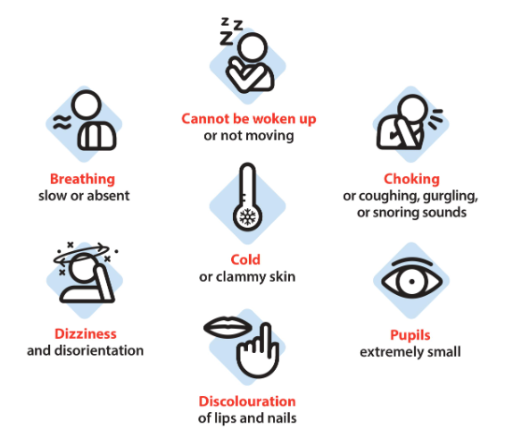
Signs of an Overdose
*FraserHealth.ca*
Notes:
Presentation of symptoms will depend on amount of substance taken and duration since administration -> pupils, dizziness, slowed breathing can be early symptoms. Non response to physical stimuli, discoloration, absent breathing further progressed symptoms
Gagging, gurgling, choking sounds
Not breathing, or very shallow, slow breathing
Blue or grey lips, fingertips (cyanosis)
Unconscious
No response to sternum or upper lip rub

Slide 31
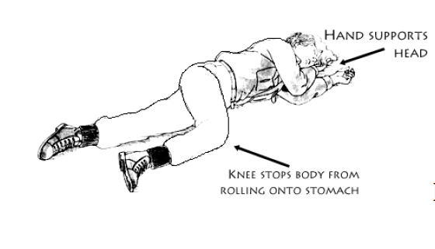
Responding to an opioid overdose
Try to stimulate the person by yelling their name or by rubbing knuckles over the upper lip or sternum
If person remains unresponsive, call 911
Provide rescue breathing to provide oxygen if patient is not breathing
Administer Naloxone
Put patient in recovery position
Stay with the person until help arrives

Slide 32
Dispensing vs. distribution of naloxone
Dispensing | Distribution
Requires an individual patient prescription or meeting the criteria of the statewide standing order or a local standing order | No specific patient order is required, although the organization needs a distribution standing order
Is performed by a licensed healthcare professional (as listed in chart) | Is performed by an agent of the organization covered under the distribution order, who need not be a licensed healthcare professional
Generally involves payment via insurance, insurance co-pay or cash, but not required | Generally involves no payment
Public health nurses are typically dispensing naloxone
More info: https://www.dph.ncdhhs.gov/media/740/open

Slide 33
School supply of epinephrine injectors
A local board of education shall provide for a supply of emergency epinephrine autoinjectors on school property for use by trained school personnel to provide emergency medical aid to persons suffering from an anaphylactic reaction during the school day and at school-sponsored events on school property.
The health department may dispense epinephrine auto-injectors to school personnel
  This does not require that the personnel be patients of the health department
  More information from the NC Board of Pharmacy is found here: https://www.ncbop.org/downloads/GuidanceEpinephrineAutoInjectorStatuteDec2014.pdf

Slide 34
340B overview
340B is a special pricing program that allows covered entities (ie safety net providers) to access discounted drugs in order to “stretch scarce federal resources as far as possible, reaching more eligible patients and providing more comprehensive services”
  Basically, this is deeply discounted prices for medications
Local Health Departments qualify for this special pricing because they provide family planning, STD, and TB services that they receive specific grant resources to support

Slide 35
340B, continued
Patients who receive 340B medications must have a patient-provider relationship established (ie, must have chart encounter and receive services from our clinic)
Certification for 340B status must be renewed yearly
HRSA may audit our 340B program at any time
Internal audits are performed quarterly to maintain compliance
Billing of prescriptions and devices to patients with Medicaid require the use of UD modifiers to ensure that only the acquisition costs are charged

Slide 36
Is my patient eligible?
Three Criteria on the date the prescription is ordered:
The individual must be a patient of the covered entity
The individual must receive health care services from a health care provider who is employed or contracted by the covered entity
The individual must receive health care services that are consistent with the scope of the grant funding that has been provided to the entity.

Slide 37
Scope of service
Family Planning | STI | Tuberculosis
Pregnancy prevention and birth spacing, Pregnancy testing and counseling, Assistance to achieve pregnancy, Basic infertility services, and Other preconception health services. | STI screening services Onsight diagnosis and treatment of STIs DTI patient counseling STI partner notification and treatment | TB case finding and reporting Provision of TB treatment Testing and counseling of TB infection or outbreak

Slide 38
Questions?

